Slide 1
Chapter 13
Head, Face, and Neck, including Regional Lymphatics

Slide 2
Structure and Function: Head
Skull is rigid box that protects brain and is supported by cervical vertebra
Cranial bones
Frontal
Parietal
Occipital
Temporal
Facial expressions formed by facial muscles, which are mediated by cranial nerve VII, the facial nerve

Slide 3
Structure and Function: Head (Cont.)
Two pairs of salivary glands are accessible to examination on the face
Parotid glands are in cheeks over mandible, anterior to and below ear; the largest of salivary glands, they are not normally palpable
Submandibular glands beneath mandible at angle of jaw
Third pair, sublingual glands, lie in floor of mouth
Temporal artery lies superior to temporalis muscle, and pulsation is palpable anterior to ear

Slide 4
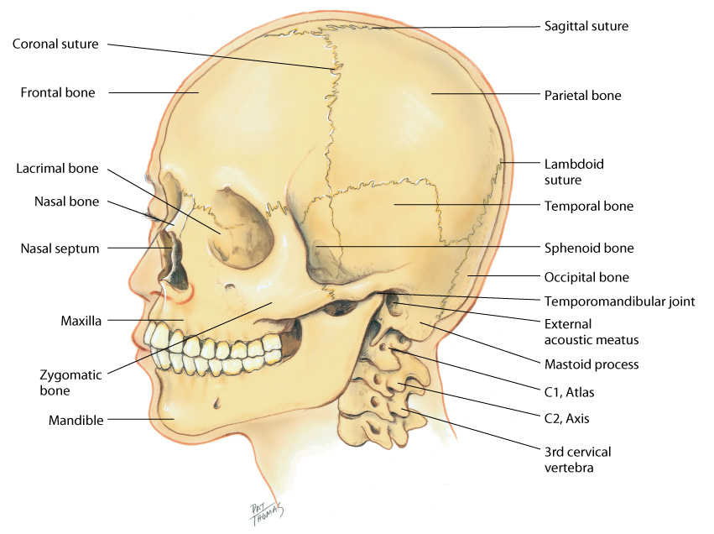
Structure: Head
Cranial bones
Sutures
Facial bones
Facial muscles
Salivary glands

Slide 5
Structure and Function: Neck
Neck delimited by base of skull and inferior border of mandible above, and by manubrium sterni, clavicle, first rib, and first thoracic vertebra below
Think of neck as conduit of many structures
Vessels, muscles, nerves, lymphatics, and viscera of respiratory and digestive systems
Internal carotid branches off common carotid and runs inward and upward to supply brain
External carotid supplies face, salivary glands, and superficial temporal area

Slide 6
Structure and Function: Neck Muscles
Major neck muscles sternomastoid and trapezius are innervated by cranial nerve XI
Sternomastoid enables head rotation and flexion and divides each side of neck into two triangles: anterior and posterior triangles
Two trapezius muscles move shoulders and extend and turn head

Slide 7
Structure and Function: Thyroid
Thyroid gland: an important endocrine gland straddles trachea in middle of the neck
Synthesizes and secretes thyroxine (T4) and triiodothyronine (T3), which are hormones that stimulate rate of cellular metabolism
The gland has two lobes, connected in middle by a thin isthmus and above that by the cricoid cartilage or upper tracheal ring
Thyroid cartilage above that, with small palpable notch in upper edge, the “Adam’s apple” in males

Slide 8
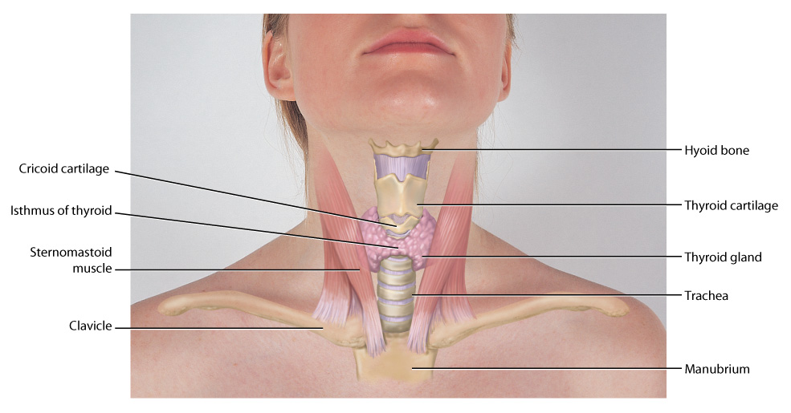
Structures of Neck
Copyright © 2016 by Elsevier, Inc. All rights reserved.
Copyright © 2012, 2008, 2004, 2000, 1996, 1993 by Saunders, an affiliate of Elsevier Inc.

Slide 9
Structure and Function: Lymphatic System
Lymphatic system: an extensive vessel system, is major part of immune system, which detects and eliminates foreign substances from body
Vessels allow flow of clear, watery fluid from tissue spaces into circulation
Nodes are small, oval clusters of lymphatic tissue that filter lymph and engulf pathogens, preventing potentially harmful substances from entering the circulation
Greatest supply is in head and neck
You should be familiar with direction of drainage patterns of lymph nodes

Slide 10
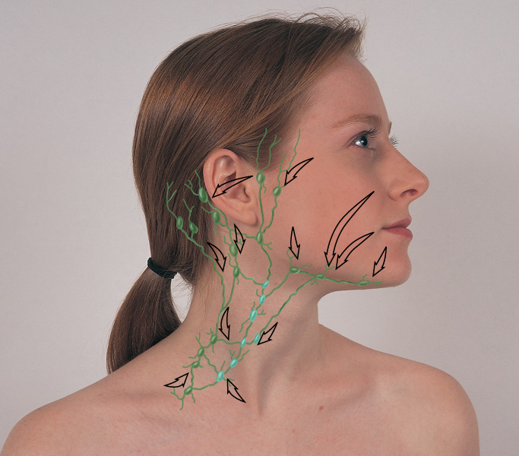
Drainage Patterns of Lymph Nodes
Copyright © 2016 by Elsevier, Inc. All rights reserved.
Copyright © 2012, 2008, 2004, 2000, 1996, 1993 by Saunders, an affiliate of Elsevier Inc.

Slide 11
Structure and Function: Lymph Nodes
Preauricular, in front of ear
Posterior auricular (mastoid), superficial to mastoid process
Occipital, at base of skull
Submental, midline, behind tip of mandible
Submandibular, halfway between angle and tip of mandible

Slide 12
Structure and Function: Lymph Nodes (Cont.)
Jugulodigastric, under angle of mandible
Superficial cervical, overlying sternomastoid muscle
Deep cervical, deep under sternomastoid muscle
Posterior cervical, in posterior triangle along edge of trapezius muscle
Supraclavicular, just above and behind clavicle, at sternomastoid muscle

Slide 13
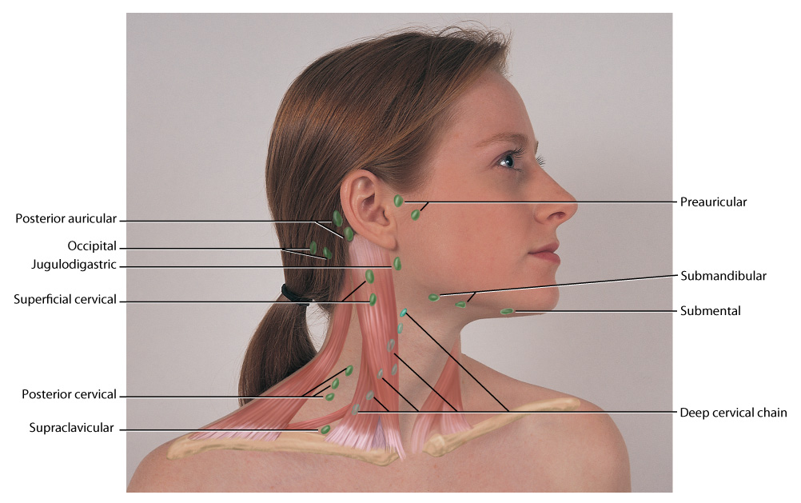
Locations of Lymph Nodes
Copyright © 2016 by Elsevier, Inc. All rights reserved.
Copyright © 2012, 2008, 2004, 2000, 1996, 1993 by Saunders, an affiliate of Elsevier Inc.

Slide 14
Developmental Competence: Infants and Children
Bones of neonatal skull are separated by sutures and fontanels, spaces where the sutures intersect
These membrane-covered “soft spots” allow growth of brain during first year; gradually ossify
Triangle-shaped posterior fontanel closes by 1 to 2 months, and diamond-shaped anterior fontanel closes between 9 months and 2 years
During fetal period, head growth predominates; head size is greater than chest circumference at birth and reaches 90% of final size at 6 years old

Slide 15
Developmental Competence: Infants and Children (Cont.)
During infancy, trunk growth predominates so that head size changes in proportion to body height
Facial bones grow at varying rates; in toddler, mandible and maxilla are small and nasal bridge is low
Lymphoid tissue is well developed at birth and grows to adult size when the child is 6 years old
Facial hair also appears on boys at this time: first on upper lip, then on cheeks and lower lip, and last on the chin; noticeable enlargement of the thyroid cartilage occurs, and with it, the voice deepens

Slide 16
Developmental Competence
Pregnant female
Thyroid gland enlarges slightly during pregnancy as a result of hyperplasia of tissue and increased vascularity
Aging adult
Facial bones and orbits appear more prominent, facial skin sags resulting from decreased elasticity, decreased subcutaneous fat, and decreased moisture in skin
Lower face may look smaller if teeth have been lost

Slide 17
Health History Questions: Headaches
Onset: When did this kind of headache start?
Gradual, over hours, or a day?
Suddenly over minutes, or less than 1 hour
Ever had this kind of headache before?
Location: Where do you feel it: frontal, temporal, behind your eyes, in sinus area, or in occipital area?
Is pain localized on one side or all over?
Character: throbbing, aching, mild, moderate, or severe?
Notes:
Headache: Unusually frequent, severe? Onset? Had this type before? Location? Character? Mild, moderate, severe? Course and duration? Precipitating factors? Associated factors? Other illnesses? Taking meds? What makes it worse? Treatment? Coping strategies?
Head injury: Onset? Setting? How were you just before injury? History of illness (heart trouble, diabetes, epilepsy)? Location? Duration? Associated symptoms? Pattern? Effort to treat?
Dizziness: Determine what patient means by dizziness. Onset? Associated factors?
Neck pain: Onset? Location? Associated symptoms? Precipitating factors? Related to stress? Coping strategies?
Lumps or swelling: Recent infection, tenderness? Duration? Change in size? History of irradiation of head, neck, upper chest? Difficulty swallowing? Do you smoke? Do you drink alcohol? Thyroid problems?
History of head or neck surgery: Ever had surgery of head or neck? Why? When? How do you feel about the results?

Slide 18
Health History Questions: Headaches (Cont.)
Course and duration: When do headaches occur? Do they awaken you from sleep?
How long do they last? Hours or days?
Precipitating factors: What brings it on: activity, exercise, work environment, emotional upset, anxiety, alcohol? Note signs of depression
Associated factors: any relation to other symptoms
Nausea, vomiting, vision changes, pain with bright lights, neck pain or stiffness, fever, weakness, moodiness, stomach problems?
Notes:
Headache: Unusually frequent, severe? Onset? Had this type before? Location? Character? Mild, moderate, severe? Course and duration? Precipitating factors? Associated factors? Other illnesses? Taking meds? What makes it worse? Treatment? Coping strategies?
Head injury: Onset? Setting? How were you just before injury? History of illness (heart trouble, diabetes, epilepsy)? Location? Duration? Associated symptoms? Pattern? Effort to treat?
Dizziness: Determine what patient means by dizziness. Onset? Associated factors?
Neck pain: Onset? Location? Associated symptoms? Precipitating factors? Related to stress? Coping strategies?
Lumps or swelling: Recent infection, tenderness? Duration? Change in size? History of irradiation of head, neck, upper chest? Difficulty swallowing? Do you smoke? Do you drink alcohol? Thyroid problems?
History of head or neck surgery: Ever had surgery of head or neck? Why? When? How do you feel about the results?

Slide 19
Health History Questions: Headaches (Cont.)
Do you have other illness or take any medications?
Pattern: Any family history of headache?
Frequency: Once a week?
For females: When do they occur in relation to your menstrual periods?
What seems to help: sleep, medications?
Coping strategies: How have headaches affected self-care, ability to work, home, and social ability?
Notes:
Headache: Unusually frequent, severe? Onset? Had this type before? Location? Character? Mild, moderate, severe? Course and duration? Precipitating factors? Associated factors? Other illnesses? Taking meds? What makes it worse? Treatment? Coping strategies?
Head injury: Onset? Setting? How were you just before injury? History of illness (heart trouble, diabetes, epilepsy)? Location? Duration? Associated symptoms? Pattern? Effort to treat?
Dizziness: Determine what patient means by dizziness. Onset? Associated factors?
Neck pain: Onset? Location? Associated symptoms? Precipitating factors? Related to stress? Coping strategies?
Lumps or swelling: Recent infection, tenderness? Duration? Change in size? History of irradiation of head, neck, upper chest? Difficulty swallowing? Do you smoke? Do you drink alcohol? Thyroid problems?
History of head or neck surgery: Ever had surgery of head or neck? Why? When? How do you feel about the results?

Slide 20
Health History Questions: Headaches (Cont.)
Head injury or blow to your head?
Dizziness?
Neck pain or limitation of neck motion?
Lumps or swelling?
History of head or neck surgery?
Notes:
Headache: Unusually frequent, severe? Onset? Had this type before? Location? Character? Mild, moderate, severe? Course and duration? Precipitating factors? Associated factors? Other illnesses? Taking meds? What makes it worse? Treatment? Coping strategies?
Head injury: Onset? Setting? How were you just before injury? History of illness (heart trouble, diabetes, epilepsy)? Location? Duration? Associated symptoms? Pattern? Effort to treat?
Dizziness: Determine what patient means by dizziness. Onset? Associated factors?
Neck pain: Onset? Location? Associated symptoms? Precipitating factors? Related to stress? Coping strategies?
Lumps or swelling: Recent infection, tenderness? Duration? Change in size? History of irradiation of head, neck, upper chest? Difficulty swallowing? Do you smoke? Do you drink alcohol? Thyroid problems?
History of head or neck surgery: Ever had surgery of head or neck? Why? When? How do you feel about the results?

Slide 21
Additional Health History Questions
For infants and children
Maternal alcohol or drug use?
Type of delivery? Vaginal or by cesarean section? Any difficulty? Use of forceps?
Growth pattern? Was it on schedule?
For aging adults
Dizziness? How does it affect your daily activities?
Neck pain? How does it affect your daily activities? Are you able to drive, perform at work, do housework, sleep, and look down when using stairs?
Notes:
Infants and children: Maternal use of alcohol or drugs during pregnancy? Type of delivery? Was baby’s growth normal?
Aging adult: Dizziness affect daily activities? Neck pain affect daily activities?

Slide 22
Inspection and Palpation of the Skull
Note general size and shape
Assess shape: place fingers in person’s hair and palpate scalp
Skull normally feels symmetric and smooth
Cranial bones that have normal protrusions are forehead, lateral edge of parietal bones, occipital bone, and mastoid process behind each ear

Slide 23
Inspection and Palpation of the Skull (Cont.)
There is no tenderness to palpation
Palpate temporal artery above zygomatic (cheek) bone between eye and top of ear
Palpate temporomandibular joint as the person opens the mouth, and note normally smooth movement with no limitation or tenderness

Slide 24
Inspection of the Face
Note facial expression and appropriateness to behavior or reported mood
Facial structures always should be symmetric
Note symmetry of eyebrows, palpebral fissures, nasolabial folds, and sides of mouth
Note any abnormal facial structures (coarse facial features, exophthalmos, changes in skin color or pigmentation), or abnormal swellings
Note any involuntary movements (tics) in facial muscles; normally none occur

Slide 25
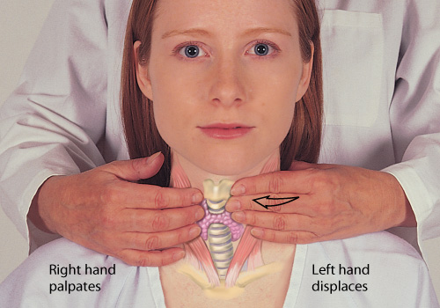
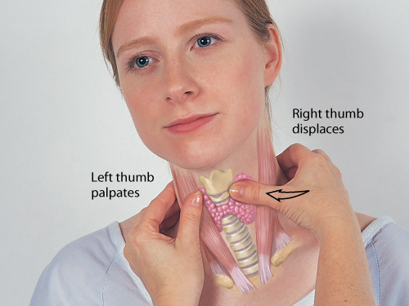
Inspection and Palpation of the Neck
Symmetry
Range of motion
Lymph nodes
Trachea
Thyroid gland
Posterior approach
Anterior approach
Auscultate thyroid for bruit, if enlarged

Slide 26
Head and Neck Symmetry
Symmetry
Head position is centered in midline, and accessory neck muscles should be symmetrical
Head should be held erect and still

Slide 27
Range of Motion (ROM)
Note any limitation of movement during active motion
When neck is supple, motion is smooth and controlled
Test muscle strength and status of cranial nerve XI by trying to resist person’s movements with your hands as person shrugs shoulders and turns head to each side
Look for swelling below angle of jaw; note thyroid gland enlargement though normally none is present
Note any obvious pulsations; carotid artery creates brisk localized pulsation just below angle of the jaw
Normally, there are no other pulsations while person is in sitting position

Slide 28
Lymph Nodes
Normal nodes feel movable, discrete, soft, and nontender
If any nodes are palpable, note location, size, shape, delimitation (discrete or matted together), mobility, consistency, and tenderness
If nodes enlarged or tender, check area they drain for source of the problem; they often relate to inflammation or neoplasm in head and neck
Follow up on or refer your findings; an enlarged lymph node, particularly when you cannot find the source of problem, deserves prompt attention

Slide 29
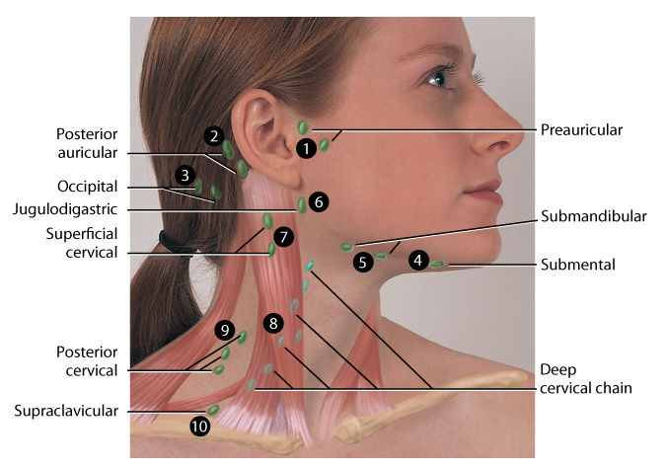
Examining Lymph Nodes
Using a gentle circular motion of finger pads, palpate lymph nodes
Beginning with preauricular lymph nodes in front of ear, palpate the 10 groups of lymph nodes in routine order
Many nodes are closely packed, so you must be systematic and thorough in your examination
Do not vary sequence or you may miss some small nodes

Slide 30
Trachea and Thyroid Gland
Trachea
Normally, trachea is midline; palpate for any tracheal shift
Space should be symmetric on both sides
Note any deviation from midline
Thyroid gland
Difficult to palpate; check for enlargement, consistency, symmetry, and presence of nodules
If enlarged, auscultate thyroid for presence of bruit, which occurs with accelerated or turbulent blood flow, indicating hyperplasia of thyroid (e.g., hyperthyroidism)

Slide 31
Physical Examination: Infants and Children
Skull
Measure infant’s head at each visit up to age 2 years and yearly up to age 6 years
Note infant’s head posture and head control; infant can turn head side to side by 2 weeks
Shows tonic neck reflex when supine and head turned to one side (extension of same arm and leg, flexion of opposite arm and leg); reflex disappears at 3 to 4 months

Slide 32
Physical Examination: Infants and Children (Cont.)
Skull (Cont.)
Two common variations in newborn cause shape of skull to look markedly asymmetric:
Caput succedaneum: edematous swelling and ecchymosis of presenting part of head caused by birth trauma; gradually resolves during first few days of life and needs no treatment
Cephalhematoma: subperiosteal hemorrhage, a result of birth trauma, appears several hours after birth and gradually increases in size; will be reabsorbed during first few weeks of life without treatment

Slide 33
Physical Examination: Infants and Children (Cont.)
Skull (Cont.)
Note infant’s head posture and head control; infant can turn the head side to side by 2 weeks; shows tonic neck reflex when head is turned to one side (extension of same arm and leg, flexion of opposite arm and leg); reflex disappears between 3 and 4 months, and then head is maintained midline
Head control achieved by 4 months, when baby can hold head erect and steady

Slide 34
Physical Examination: Infants and Children: Face
Check facial features for symmetry, appearance, and swelling
Note symmetry of wrinkling when infant cries or smiles (e.g., both sides of lips rise and both sides of forehead wrinkle)
Normally, no swelling is evident
Parotid gland enlargement best seen when child looks up; swelling appears below angle of jaw

Slide 35
Physical Examination: Infants and Children: Neck
An infant’s neck looks short; it lengthens during the first 3 to 4 years
Assess muscle development with gentle passive ROM
Cradle infant’s head with your hands and turn it side to side and test forward flexion, extension, and rotation
Note resistance to movement, especially flexion
During infancy, cervical lymph nodes are not palpable normally, but child’s lymph nodes are palpable
Palpable nodes less than 3 mm are normal
Children have a higher incidence of infection, so you will expect a greater incidence of inflammatory adenopathy; no other mass should occur in neck

Slide 36
Infants and Children: Special Procedures
Palpation
Craniotabes is softening of skull’s outer layer
In newborn pressure along suture of parietal and occipital bones above ear produces snapping sensation because of pliable skull bone
Do not attempt palpation unless craniotabes is suspected because of other abnormal findings; even then avoid excessive pressure
Craniotabes may be normal, especially with premature infants

Slide 37
Infants and Children: Special Procedures (Cont.)
Percussion
With an infant, you may directly percuss with your plexor finger against head surface; this yields a resonant or “cracked pot” sound, which is normal before closure of fontanels
Auscultation
Bruits are common in skull of children under 4 or 5 years of age or children with anemia
Systolic or continuous; heard over temporal area

Slide 38
Infants and Children: Special Procedures (Cont.)
Transillumination
Use if you suspect an abnormal head size or intracranial lesion
Hold a rubber-collared flashlight firmly against infant’s skull
Explore all regions of head: frontal, both sides, occiput
A small ring of light around flashlight is normal
Should not see larger halo around rubber collar

Slide 39
Physical Examination: Pregnant Female
During second trimester, chloasma may show on face; a blotchy, hyperpigmented area over cheeks and forehead that fades after delivery
Thyroid gland may be palpable normally during pregnancy

Slide 40
Physical Examination: Aging Adult
Temporal arteries may look twisted and prominent
In some aging adults, a mild rhythmic tremor of head may be normal
Senile tremors are benign and include head nodding and tongue protrusion
If some teeth have been lost, lower face looks unusually small, with mouth sunken in

Slide 41
Physical Examination: Aging Adult (Cont.)
Neck may show concave curve when head and jaw are extended forward to compensate for kyphosis of spine
During examination, direct aging person to perform ROM slowly; he or she may experience dizziness with side movements
Aging person may have prolapse of submandibular glands, which may be mistaken for a tumor; but drooping submandibular glands will feel soft and be present bilaterally

Slide 42
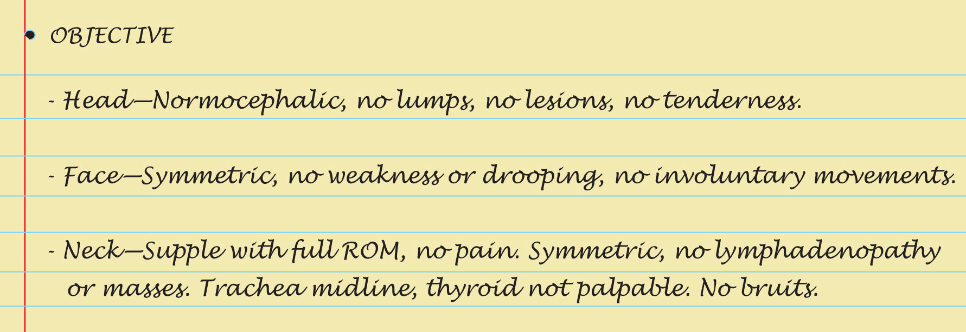
Copyright © 2016 by Elsevier, Inc. All rights reserved.
Copyright © 2012, 2008, 2004, 2000, 1996, 1993 by Saunders, an affiliate of Elsevier Inc.

Slide 43
Summary Checklist: Head, Face, and Neck, including Regional Lymphatics Examination
Inspect and palpate the skin
General size and contour
Note any deformities
Palpate temporal artery and temporomandibular join (TMJ) joint
Inspect and palpate the face
Observe facial expression
Cranial nerve VII: symmetry of movement
Observe for any abnormal movements
Inspect and palpate the neck
Active ROM, potential enlargement and position of trachea
Auscultate thyroid (if enlarged) for bruit

Slide 44
Abnormal Findings: Head Size and Contour
Hydrocephalus
Obstruction of drainage of cerebrospinal fluid results in excessive accumulation, increasing intracranial pressure, and enlargement of the head
Increasing pressure also produces dilated scalp veins, frontal bossing, and downcast or “setting sun” eyes (sclera visible above iris)
Cranial bones thin, sutures separate, and percussion yields a “cracked pot” sound

Slide 45
Abnormal Findings: Head Size and Contour (Cont.)
Paget disease of bone (osteitis deformans)
Localized bone disease of unknown etiology that softens, thickens, and deforms bone
Affects 3% of adults over age 40 years and 10% over age 80 years and occurs more often in males
Acromegaly
Excessive secretion of growth hormone from pituitary after puberty creates an enlarged skull and thickened cranial bones
Note elongated head, massive face, prominent nose and lower jaw, heavy eyebrow ridge, and coarse facial features

Slide 46
Abnormal Findings: Swellings of Head and Neck
Torticollis (wryneck)
Hematoma in one sternomastoid muscle, probably injured by intrauterine malposition, results in head tilt to one side and limited neck ROM to opposite side
Thyroid, multiple nodules
Multiple nodules usually indicate inflammation or multinodular goiter rather than a neoplasm; however, suspect any rapidly enlarging or firm nodule

Slide 47
Abnormal Findings: Swelling of Head and Neck (Cont.)
Thyroid, single nodule
Most solitary nodules are benign; solitary nodule poses a greater risk of malignancy
Suspect any painless, rapidly growing nodule, especially the appearance of a single nodule in a young person
Cancerous nodules tend to be hard and are fixed to surrounding structures
Pilar cyst (wen)
Smooth, firm, fluctuant swelling on scalp; pressure of contents causes overlying skin to be shiny and taut
Benign growth

Slide 48
Abnormal Findings: Swellings of Head and Neck (Cont.)
Parotid gland enlargement
Rapid painful inflammation of parotid occurs with mumps
Parotid swelling also occurs with blockage of duct, abscess, or tumor; note swelling anterior to lower ear lobe
Stensen duct obstruction can occur in aging adults dehydrated from diuretics or anticholinergics

Slide 49
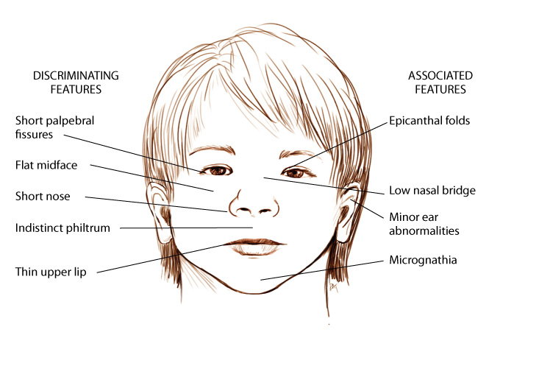
Pediatric Facial Abnormalities
Fetal alcohol syndrome
Congenital hypothyroidism
Down syndrome
Atopic (allergic) facies
Allergic salute and crease

Slide 50
Abnormal Facial Appearances
Associated with Chronic Illnesses
Parkinson syndrome
Cushing syndrome
Graves’ disease
Hyperthyroidism
Myxedema (hypothyroidism)
Bell’s palsy
Brain attack or cerebrovascular accident
Cachectic appearance
Scleroderma

Slide 51
Question
The nurse suspects that a patient has hyperthyroidism. Which of the following findings would the nurse most likely find on examination?
Increased heart rate, weight loss
Decreased heart rate, weight gain
Increased heart rate, weight gain
Decreased heart rate, weight loss
Notes:
The correct answer is 1. An increased heart rate and weight loss are findings consistent with hyperthyroidism.
Answer 2 is incorrect because these findings would be consistent with hypothyroidism.
Answers 3 and 4 are incorrect because these findings are not associated with thyroid disease and would require further investigation to determine the cause.

