Slide 1
Chapter 1

Slide 2
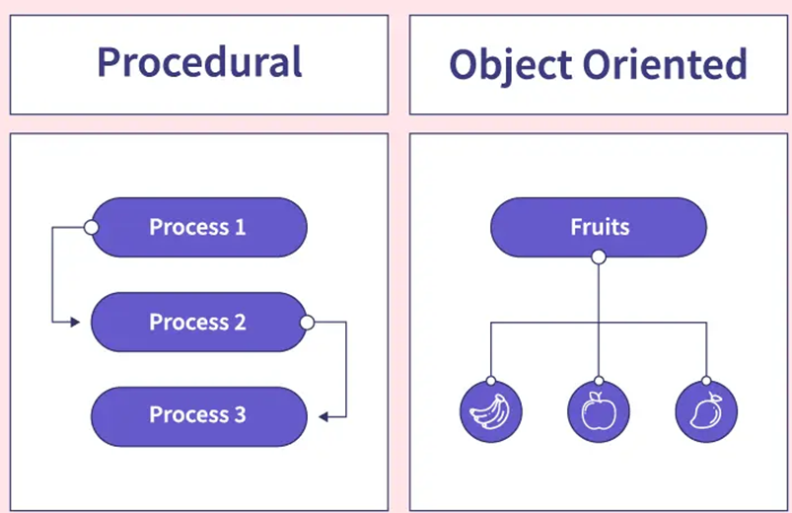
Introduction
What is OOP?
  A programming paradigm where a software system is represented as a collection of objects that interact with each other to solve the overall task.
OOP vs Structured (procedural) Programming ?

Slide 3
OOP is based on the following concepts
  object/class: An object is an entity that combines data with behavior that acts on that data. A class is a type or category of objects.
  information hiding (encapsulation): The ability to protect some components of the object from external entities ("private").
  inheritance: The ability for a class ("subclass") to extend or override functionality of another class ("superclass").
  polymorphism: The ability to replace an object with its sub-objects to achieve different behavior from the same piece of code.
  interface: A specification of method signatures without supplying implementations, as a mechanism for enabling polymorphism.

Slide 4
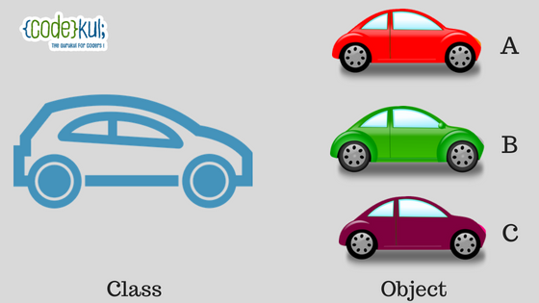
Classes and Objects
A Class is a template (blueprint) for creating a set of similar objects.
An Object is an instance of a class.
You send messages to an object by making method calls.

Slide 5
An Example

Slide 6
Instance Variables
Attribute: A variable inside an object that is part of its state.
  Each object has its own copy of each field.
Attributes are specified by the class’s instance variables.

Slide 7
An Example

Slide 8
Methods
A method defines the behavior of objects that are created from the class.
Two well-known types of methods:
  Accessor (getter): A method that lets clients examine an object’s state.
  Examples: getDistance, distanceFromOrigin
  often has a non-void return type
  Mutator (setter): A method that modifies an object's state.
  Examples: setLocation, updateLanguage
Methods declaration begin usually with public access modifier to indicate that the method can be called from outside the class declaration’s body.

Slide 9
An Example

Slide 10
Instantiating an Object of a Class

Slide 11
Main method
Any class that contains a Main method can be used to execute an application.
A static method can be called without creating an object of the class.

Slide 12
Constructors
Each class can provide a constructor to initialize an object of a class when the object is created.
The new operator calls the class’s constructor to perform the initialization.
The compiler provides a public default constructor with no parameters, so every class has a constructor.
A constructor must have the same name as its class.
Like a method, a constructor has a parameter list.

Slide 13
An Example

Slide 14

Value Types vs. Reference Types
A variable of a value type (such as int) simply contains a value of that type.

Slide 15
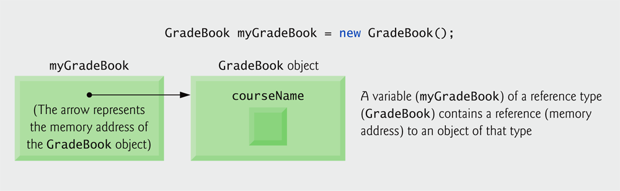
Value Types vs. Reference Types
A variable of a reference type contains the address of a location in memory where its data is stored.
Reference-type instance variables are initialized by default to the value null.
A variable that refers to an object is used to invoke (i.e., call) the object’s methods and access the object’s properties.

Slide 16
Example: Reading inputs from the user input from the user

Slide 17

UML class diagram
The Figure below presents a UML class diagram for class GradeBook.
Classes are modeled as a rectangle with three compartments.
  The top compartment contains the name of the class.
  The middle compartment contains the class’s attributes.
  The bottom compartment contains the class’s operations.
The plus sign (+) indicates that DisplayMessage is a public operation.

Slide 18

UML class Diagram: Declaring a Method with a Parameter
The UML class diagram of Fig. the figure below models class GradeBook.
The UML models DisplayMessage’s parameter by listing the parameter name and type.

Slide 19

UML Class Diagram with a Property
The figure below contains an updated UML class diagram for the version of class GradeBook.
We model properties in the UML as attributes preceded by the word “property” in guillemets (« and »).
To indicate that an attribute is private, a class diagram would list the private visibility symbol—a minus sign (–)—before the attribute’s name.

Slide 20
A full code example:
Create a Java class named Car
The class has the following attributes: model (String): represents the model of the car, year (int): represents the manufacturing year of the car, mileage (double): represents the mileage of the car in miles.
A Constructor: Implement a constructor that takes parameters for model, year, and mileage to initialize the attributes of the car.
Methods: Implement Getter and Setter Methods for each attribute
Implement a method named displayInfo that prints out the details of the car, including model, year, and mileage.

