Slide 1
Experiment two The identification and the assay of Ammonium Chloride
Chemical structure | NH₄Cl
Molecular formula | 53.49 g/mole

Slide 2
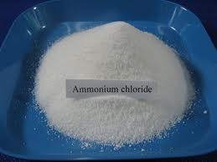
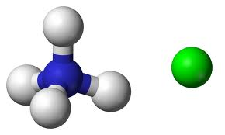
Introduction:
Ammonium chloride (NH₄Cl) is a weak inorganic acid, exists as a white crystalline powder or fine crystals. As most inorganic salts, ammonium chloride is freely soluble in water.

Slide 3
synthesis
NH₃ + HCl → NH₄Cl

Slide 4

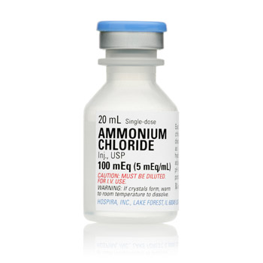
Uses:
As nitrogen source, added to fertilizers and animal nutrients.
Pharmacological uses:
As expectorant in cough preparations.
As acidifying agent to correct metabolic alkalosis.

Slide 5
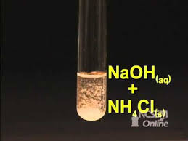
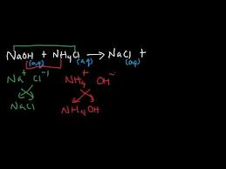
Reactivity
As a weak acid, it can react with strong base such as sodium hydroxide to give ammonia gas, sodium chloride and water.

Slide 6
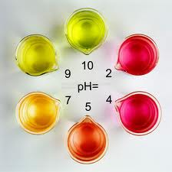
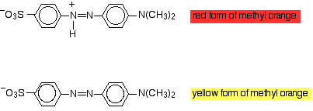
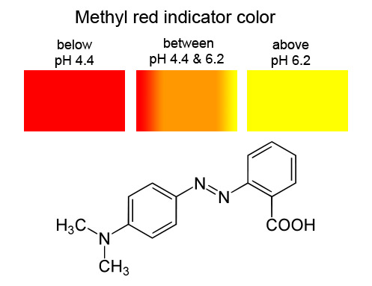
Identification test:
Acidity testing
Color of methyl red indicator according to change of pH
Dissolve 1.0 g of ammonium chloride in 10 ml distilled water.
Add few drops from methyl red indicator.
Observe the color change.

Slide 7
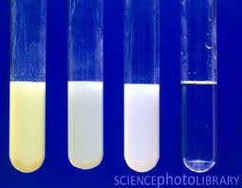
Identification test:
Chemical identification testing:
Make a solution of 0.1 g of ammonium chloride in water (2 ml) in a test tube.
Acidify with few drops 2M nitric acid.
Add 0.4 ml silver nitrate (AgNO₃) solution and shake very well.
Observe the color.
what is the chemical structure of this precipitate?

Slide 8
Informations about today titration
Titrant : 1M NaOH
Titrand: ammonium chloride
Indicator: phenolphthalein
Type : acid base titration
Note to have good titration:
The rate of reaction is rapid ,the reaction is complete & can be expressed by chemical equation in addition to using a standard solution which is sufficiently stable & react rapidly & completely with analyte &undergo a selective reaction with the analyte that can be described by a balanced equation.

Slide 9
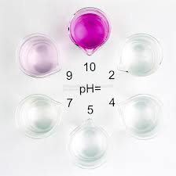
Phenolphthalein indicator color changed according to pH

Slide 10
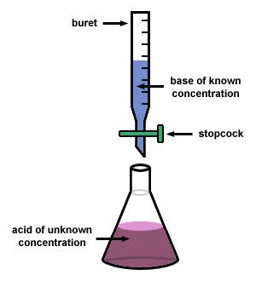
Assay test:
Dissolve 1.0 g of ammonium chloride in 20 ml of distilled water.
Add a mixture of 5 ml formaldehyde solution which is previously neutralize with 0.1 M NaOH (why?) and 20 ml distilled water.
Leave it for 2 minutes, and then titrate slowly with 1M sodium hydroxide using Phenolphthalein as indicator.

Slide 11
Formaldehyde was added.
Why? Suggest one reason.
Neutralization of formaldehyde is done
Why? Suggest one reason.
How ?

Slide 12
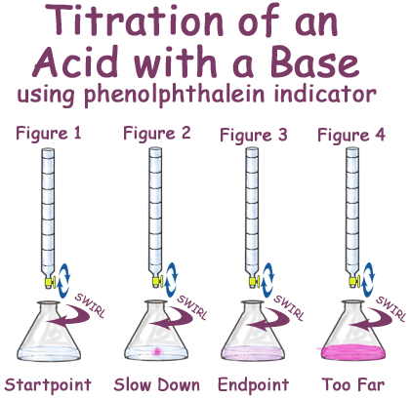

Slide 13
Calculations:
Note: each 1 ml of 1M sodium hydroxide is equivalent to 53.49 mg of NH4Cl.
Note: according to British Pharmacopeia, ammonium chloride sample should contain not less than 99% and not more than 100.5% of pure, dry NH₄Cl (compare your result with this accepted range)

Slide 14
Sources of errors
Using dirty glass.
Rinsing burette or pipette with wrong solution.
Not filling burette properly.
Not transferring all solid /liquid.
Transferring excess volume of liquid.
Using wrong reagent.
Leaking titrant from burette.
Note : NaOH may adsorb atmospheric CO2
thiosulfate may decompose slowly

Slide 15


think
What is the difference between qualitative test & quantitative test?
Which point is happened first the end point or equivalence test?

Slide 16
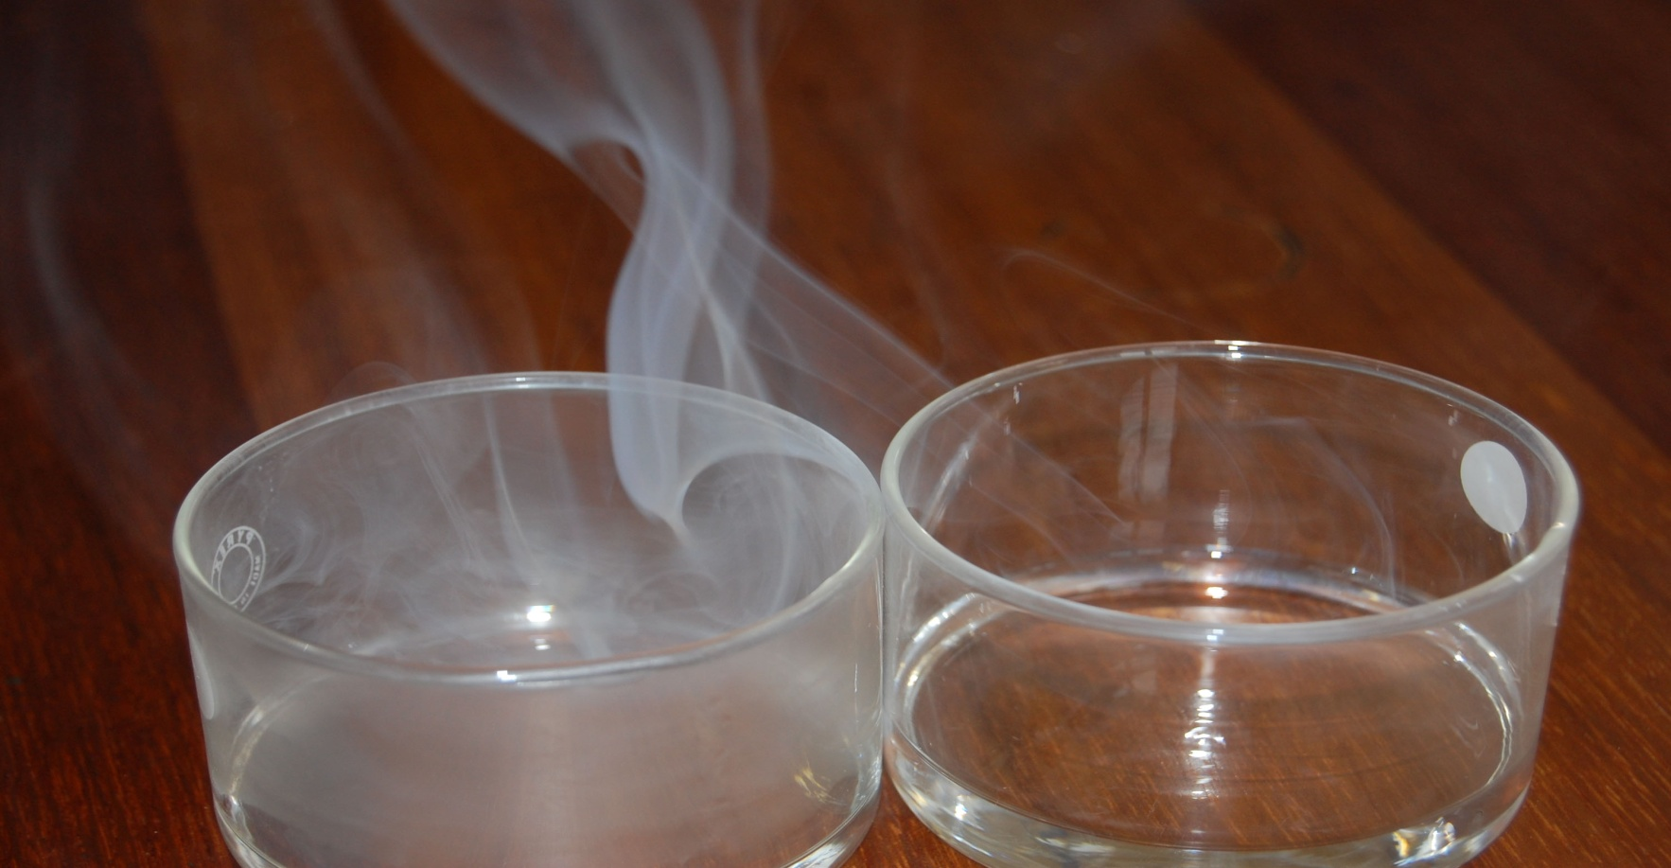
Thanks for listening
Any questions?

