Slide 1


Slide 2
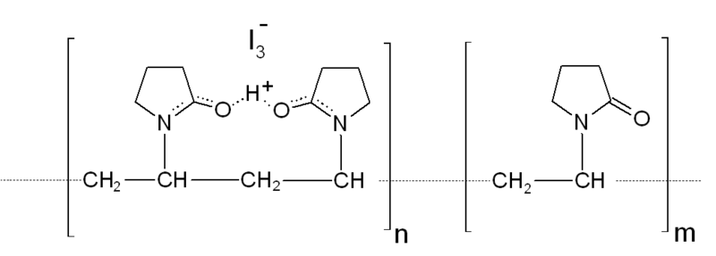
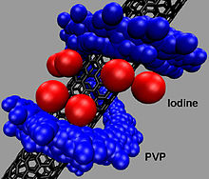
Experiment three
Assay test of Povidone Iodine solution

Slide 3
Introduction:
Molecular formula of iodine | I₂
Molecular weight | 253.8 g/mole
Povidone-iodine (PVP-I) is a stable chemical complex of polyvinylpyrrolidone (povidone, PVP) and elemental iodine. It contains from 9.0% to 12.0% available iodine, calculated on a dry basis.^{[1]}

Slide 4
Is a loose complex of elemental iodine with neutral, amphipathic organic compound Polyvinyl pyrolidone which serves as a sustaned release reservoir of iodine.
Note: amphipathic is a molecule containing both polar hyrdophoilic (water soluble) & non polar not water soluble hydrophobic.

Slide 5
Physicochemical properties:
PVP-I is completely soluble in cold and mild-warm water, ethyl alcohol, isopropyl alcohol, polyethylene glycol, and glycerol. Its stability in solution is much greater than that of tincture of iodine or Lugol's solution
Iodine (I₂):
  Bluish-black crystals.
  Easily sublimating at normal temperature to give violet-pink gas which is irritating to eye.
  Sparingly soluble in water…solubility can be improved by the addition of KI.

Slide 6
Povidone iodine is soluble in water, even more soluble than I₂ itself (Why?).

Slide 7

Synthesis
An Iodophor is a preparation containing iodine complexed with a solubilizing agent, such as a surfactant or povidone (forming povidone-iodine). The result is a water-soluble material that releases free iodine when in solution. Iodophors are prepared by mixing iodine with the solubilizing agent; heat can be used to speed up the reaction.

Slide 8
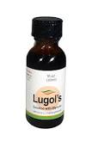
Lugol's iodine solution
Ingredients 1. Potassium iodide: 10 g 2. Distilled water: 100 ml 3. Iodine crystals: 5 g Preparation A. Dissolve 10 g potassium iodide in 100 ml of distilled water. B. Slowly add 5 g iodine crystals, while shaking. C. Filter and store in a tightly stoppered brown bottle. Storage 1 month Label Lugol's iodine solution; Use by (date

Slide 9
Identification:
Description Povidone-Iodine occurs as a dark red-brown
powder. It has a faint, characteristic odor.
It is freely soluble in water and in ethanol (99.5).
The pH of a solution obtained by dissolving 1.0 g of
Povidone-Iodine in 100 mL of water is between 1.5 and 3.5(1) To 10mL of diluted starch TS (1 in 10)
Add 1 drop of a solution of Povidone-Iodine (1 in 10): a deep
blue color develops.
To 1 mL of a solution of Povidone-Iodine (1 in 100) add 1 mL of sodium thiosulfate TS, and add 1 mL of ammonium, thiocyanate-cobaltous nitrate TS and 2 drops of 1 mol W,L hydrochloric acid TS: a blue color develops, and a blue precipitate is gradually formed.
.

Slide 10
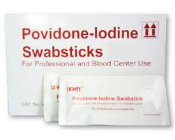
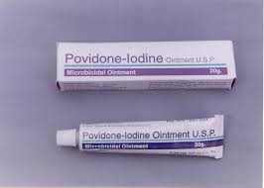
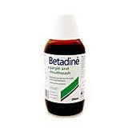
Pharmacological uses:
Has an antimicrobial action against bacteria, viruses, fungi and protozoa.
A key component of thyroid hormones.
Plays an important role in mental development.
Disinfectant.
Use as oxidizing agent...for example to measure ascorbic acid concentration in unknown sample.

Slide 11
Mechanism of action
The disinfecting characteristics of iodine arise from its ability to substitute for covalently bound hydrogens in compounds containing -OH, -NH, -SH, or CH functional groups.
PVP-I being a polymeric iodophor, reacts with oxygen containing functional groups. The difference between a conventional iodine solution and an iodophor is that the latter carries practically all the iodine in a complexes form, so that the concentration of the free iodine in the solution is always very low. This property has the effect of reducing the drawbacks associated with the presence of elemental iodine i.e. high toxicity, high level of irritation and staining power. ³
Biocidal action: PVP-Iodine is used in both human and veterinary medicine to kill on contact a wide variety of bacteria, viruses, fungi, protozoa and yeasts. The determining factor of the bactericidal action of PVP-I remains the concentration of free iodine.³
Notes:
In pharmaceutical formulations that contain both iodine and iodide, the bactericidal effect can almost entirely be attributed to free molecular iodine.³ The microbiocidal action of PVP-Iodine, as discussed earlier, is related to the non-complexed, freely mobile elemental iodine, I2, the active form of which is polarized by water and hence can be considered to be H2OI+ in its final state. This activated iodine reacts in electrophilic reactions with enzymes of the respiratory chain as well as with amino acids from the cell membrane proteins both located in the cell wall. As a result, the well-balanced tertiary structure necessary for maintaining the respiratory chain is destroyed and the microorganism irreversibly damaged. Consequently, PVP-Iodine has a nonspecific mode of action. PVP-I at concentrations more than 0.5% has shown to be rapidly virucidal. Studies have shown that PVP-I 0.25% surgical scrub and solution inactivated HIV within seconds in-vitro, and if used in clinically achievable concentrations could serve as a surface disinfectant in hospital settings where HIV may be present. PVP-I was the most effective when compared with benzalkonium chloride and chlorhexidine digluconate, since it also yielded negative results in the HIV-specific plaque forming assay.⁴

Slide 12
Free iodine, slowly liberated from the poviodine-iodine (PVP-I) complex in solution, kills eukaryotic or prokaryotic cells through iodination of lipids and oxidation of cytoplasmic and membrane compounds. This agent exhibits a broad range of microbicidal activity against bacteria, fungi, protozoa, and viruses. Slow release of iodine from the PVPI complex in solution minimizes iodine toxicity towards mammalian cells.

Slide 13
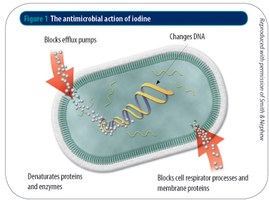

Slide 14
Assay Test (using Iodometric titration):
Iodometric titration is an oxidation-reduction titration which involves Iodine as an oxidizing agent...the poor water solubility and the high volatility of iodine is the main issue in the iodometric titration.

Slide 15
The procedure will be as follows:
In a conical flask, add 5 ml of 1% Povidone-Iodine solution and 5 ml of 0.1 M HCl, then sufficient water to produce 75 ml solution.
Titrate with 0.02 M sodium thiosulfate using 2 ml of starch as the indicator
Note: Iodine can be used as self indicator, since there will be a clear change in colour from the dark orange of I₂ to colourless I⁻ . To better observe the end point, starch will be added... Starch will form a dark-blue to black complex with triiodide ion (not with either I₂ or I⁻).
Notes:
In the PVP-Iodine complex, the iodine does not exist as a single species, and infact several forms of iodine have been characterized:
• Available iodine: Contains all the iodine species which can be titrated with sodium thiosulfate
• Iodide: Negatively charged ion; necessary for the complexation of iodine
• Total iodine: Given by the sum of available iodine and iodide.
• Free Iodine: The type of iodine which can be extracted from aqueous PVP-Iodine solution

Slide 16
Important notes:
Because the presence of water , hydration of sodium thiosulphate can not be used as primary standard.
Reaction is taken place in acidic condition in presence of excess iodide
IO₃⁻ + 5I⁻ + 6 H ⁺ 3 I₂ + 3 H₂O
Iodate iodide iodine
starch solution have to be freshly prepared because it deteriorates quickly on standing.
Starch make complex with tri-iodide ion.

Slide 17
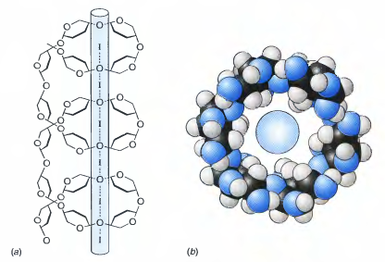
Starch should be added after adding few drops of thiosulfate from the burette (WHY?).
If it is added earlier, then some of the iodine tends to remain bound to the starch particles, even after the equivalence point is reached, thus introducing an unwanted error.

Slide 18
Redox titration
Oxidation-reduction reactions or Redox reactions involves oxidation and reduction reaction. In other words; it involves the transfer of electrons between two chemical species.
One compound in reaction loses an electron, this compound is said to be oxidized and at the same time another compound gains an electron and is said to be reduced.
There are specific terms used to describe these chemical species. The compound that is oxidized is called as a reducing agent, while another compound that is reduced is called as the oxidizing agent

Slide 19
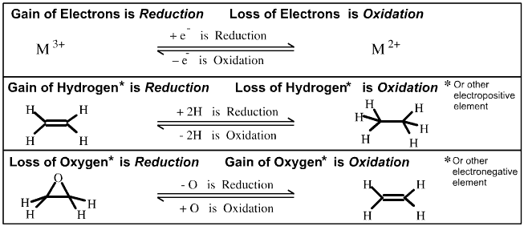
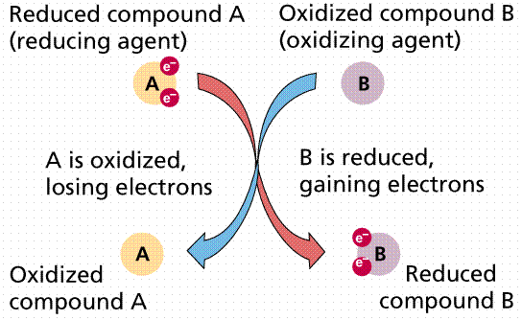
It follows that Redox Chemistry can proceed by three types of redox reaction:

Slide 20
Some Redox titration involves iodine as an oxidizing agent. If standard iodine is used for the oxidation of a reducing agent (analyte), the method is termed as iodimetry. On the other hand, the indirect presence of iodine in titration in a Redox reaction is called iodometry.
Iodine formed a complex ion (triiodide ion) with iodide ion solution.
I₂ + I⁻ = I₃⁻
Here this tri-iodide ion acts as an oxidizing agent and involved in both type of redox titration

Slide 21
Reducing Agents Used in Titrations Involving Iodine
Usually Sodium thiosulfate (Na₂S₂O₃) is used as a reducing agent in redox titration involving iodine.
The reaction between iodine and thiosulfate is as follows;
I₂ + 2 S₂O₃²⁻ 2 I⁻ + S₄O₆²⁻
Iodine+thiosulphate iodide+tetra-thionate
Since I₂ is present as the tri-iodide in aqueous solutions containing iodide , hence reaction can be written as ;
I₃⁻ + 2 S₂O₃²⁻ 3 I⁻ + S₄O₆²⁻
tri-iodide+ thiosulphate tri-iodide + tetra-thionate

Slide 22
Calculations
Each ml of 0.02M thiosulfate equivalent to 2.538 mg I₂
Note: Povidone-Iodine should contain not less than 9% and not more than 12% of available iodine.

