Slide 1
Chapter 1
Evidence-Based Assessment

Slide 2
Assessment: Point of Entry in an Ongoing Process
Subjective data
  What patient says about himself or herself during history taking
Objective data
  Observed when inspecting, percussing, palpating, and auscultating patient during physical examination
Database
  Formed from these elements, plus patient’s record and laboratory studies

Slide 3
Diagnostic Reasoning
Hypodeductive model that contains four major components:
    Attend to initially available cues
    Formulate diagnostic hypotheses
    Gather data relative to hypotheses
    Evaluate each hypothesis with new data collected to arrive at final diagnosis
Tentative explanation for cues used as a basis for further investigation
A piece of information, sign, symptom, or piece of laboratory data

Slide 4
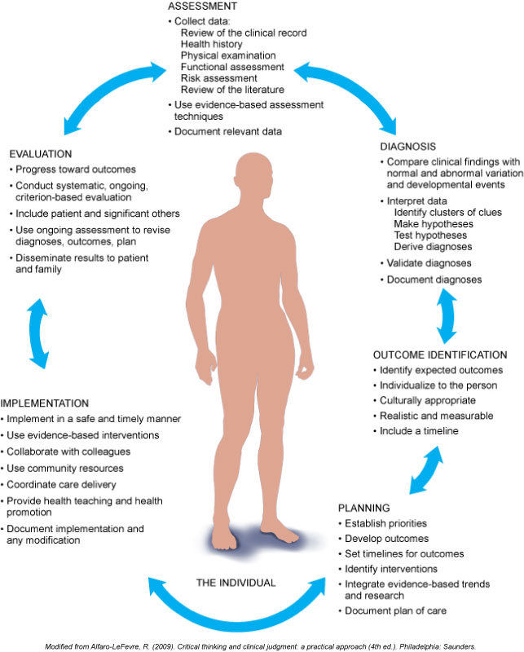
Steps of the Nursing Process
Assessment
Diagnosis
Outcome identification
Planning
Implementation
Evaluation

Slide 5
Nursing Process: Assessment
Collection of data from multiple sources
  Review of clinical record
  Interview
  Health history
  Physical examination
  Functional assessment
  Cultural and spiritual assessment
  Consultation
  Review of the literature

Slide 6
Nursing Process: Diagnosis
Interpretation of data by identifying clusters of cues so as to make inferences
Compare clusters of cues with definitions and defining characteristics
Validation of inferences based on findings
Identify related factors
Document the diagnosis

Slide 7
Nursing Process: Outcome Identification
Identify expected outcomes related to patient individualization
Ensure outcomes are realistic and measurable
Specify short-term and long-term goal measurement criteria

Slide 8
Nursing Process: Planning
Establish priorities based on meeting identified patient care goals
Develop outcomes and set time frames for meeting proposed outcomes
Identify relevant interventions and utilize interdisciplinary health care team members in the care planning process for the patient
Document plan of care

Slide 9
Question
The nurse has a “hunch” that the patient’s elevated blood pressure is due to pain level; however, the patient received blood pressure and pain medication 45 minutes ago. What should the nurse consider in regards to this hunch?
Research supports that the pain and blood pressure medications will take 30 minutes to become effective. The nurse should wait until the next prescribed time and reevaluate pain level.
The nurse should consider consulting with the pain management team to evaluate the effectiveness of the pain medication regimen.
The nurse should disregard the hunch because hunches are not effective at incorporating evidence-based practices.
The nurse should administer pain medication based on the hunch.
Notes:
The correct answer is 2. The nurse should trust the hunch; however, having another member of the team substantiate the hunch would be a collaborative approach and would provide additional reinforcement for the hunch.
Answer 1 is incorrect because a patient’s clinical status is unique and may not fit a textbook definition.
Answer 3 is incorrect because to disregard a hunch would be to disregard an important component of critical thinking and an opportunity to add to evidence-based practice.
Answer 4 is incorrect because the hunch is not enough to act on, and no information regarding the next appropriate time is given in this scenario.

Slide 10
Nursing Process: Implementation
Determine patient readiness and involve patient(s) in health care process
Review planned interventions with interdisciplinary health care team members to facilitate collaborative effort
Utilize principles of delegation, being mindful of supervision and evaluation
Counsel person and significant others
Refer for continuing care
Document care provided

Slide 11
Nursing Process: Evaluation
Refer to established outcomes
Evaluate individual’s condition and compare actual outcomes with expected outcomes
Summarize results of evaluation
Identify reasons for failure to achieve expected outcomes
Take corrective action to modify plan of care
Document evaluation in plan of care

Slide 12
Critical Thinking Principles
Proceed through sequential steps from novice to expert
  Incorporation of experience provides foundation for development of clinical practice
Utilize a multidimensional thinking approach to interpret data
  Use an organized, systematic assessment format
Validate and confirm findings based on nonjudgmental interpretation of data
  Check and corroborate accuracy and reliability of data
Cluster data information to support evidence as well as rule out inconsistent clinical findings in terms of differential diagnosis
  Distinguish relevant signs and symptoms

Slide 13
Priority Problems Level
First-level priority
  Emergent, life threatening, and immediate
Second-level priority
  Next in urgency, requiring attention so as to avoid further deterioration
Third-level priority
  Important to patient’s health but can be addressed after more urgent problems are addressed
Collaborative problems
  Approach to treatment involves multiple disciplines

Slide 14
Problems and Outcomes
Identify patient outcomes and delineate measurable goals
  Qualify short-term and long-term goals that are realistic and patient centered
Include evaluation methods that will allow for validation of results or adjustments to care planning
  Incorporation of planning methods is a critical element in the delivery of care
Continuously evaluate the plan of care
  Analyze and implement changes as needed in order to maintain pathway toward goal achievement

Slide 15
Comprehensive Plan of Care
Evaluate and update plan
Record revised plan and keep it up-to-date
Communicate revised plans to multidisciplinary team
Be aware that this is a legal document, and accurate recording is important for evaluation, insurance reimbursement, and research

Slide 16
Evidence-Based Assessment
Current and best clinical practice based on research standards focused on systematic reviews of randomized clinical trials (RCTs)
Utilizing evidenced-based practice (EBP) in conjunction with provider experience will lead to better health outcomes for patients
Fostering a “culture of EBP” at both the undergraduate and graduate levels will assist health educators to make EBP the “gold standard” of practice

Slide 17
Question
What is the best electronic resource for incorporating evidence-based practice into health assessment?
Wikipedia.org
Nursingworld.org
Mayoclinic.com
WebMD.com
Notes:
The correct answer is 2. Discerning credible sources to incorporate into practice is important to providing evidence-based assessment. It is vital that learners be able to discern information in the electronic format. Nursingworld.org is the American Nursing Association’s website. This site is updated continuously and has scholarly, peer-reviewed research for nurses.
Answer 1 is incorrect because Wikipedia.org is an editable source that can be changed by anyone.
Answer 3 is incorrect because Mayoclinic.com, although a credible consumer website, is not a site used for nursing research.
Answer 4 is incorrect because WebMD is a consumer website for general information.

Slide 18
Collecting Four Types of Data
Complete total health database
  Includes complete health history and full physical examination
  Describes current and past health state and forms baseline to measure all future changes
  Yields first diagnoses
Episodic or problem-centered database
  For limited or short-term problems
  Collect “mini” database, smaller scope and more focused than complete database
  Concerns mainly one problem, one cue complex, or one body system
  History and examination follow direction of presenting concern

Slide 19
Collecting Four Types of Data (Cont.)
Follow-up database
  Status of all identified problems should be evaluated at regular and appropriate intervals
  Note changes that have occurred
  Evaluate whether problem is getting better or worse
  Identify coping strategies being used
Emergency database
  Rapid collection of data, often compiled concurrently with lifesaving measures
  Diagnosis must be rapid and comprehensive in nature

Slide 20
Expanding the Concept of Health
Assessment: collection of data about an individual’s health state
A clear idea of health is important because it determines assessment data to be collected

Slide 21
Holistic Model of Health
Mind, body and spirit are interdependent and function as a whole
Multifaceted basis of disease
Individual and human environment are open systems
Expanded assessment factors such as lifestyle behaviors, culture and values, family and social roles, self-care behaviors, job-related stress, developmental tasks, failures and frustrations of life
Health promotion and disease prevention form the core of nursing

Slide 22
Frequency of Assessment
Interval of assessment varies with illness and wellness needs
  Ill people seek care because of pain or abnormal signs and symptoms
  This prompts an assessment: gathering a complete, episodic, or emergency database
    Screening history for dietary intake, physical activity, tobacco/alcohol/drug use, and sexual practices
    Counseling for injury prevention, substance use, sexual behavior, diet and exercise, and dental health

Slide 23
Frequency of Assessment (Cont.)
Routine periodic examination might include the following services for preventive health care:
  Screening history for dietary intake, physical activity, tobacco/alcohol/drug use, and sexual practices
  Counseling for injury prevention, substance use, sexual behavior, diet and exercise, and dental health
  Immunizations
  Chemoprophylaxis for multivitamin with folic acid for females capable of or planning pregnancy

Slide 24
Frequency of Assessment (Cont.)
For well persons, opinions are changing about assessment intervals
  Annual checkup is vague: What does it constitute? Is it necessary? Does it sometimes give an implicit promise of health and thus provide false security?
  Timing of formerly accepted procedures is now variable: for example, annual Pap tests
  Same annual routine physical examination cannot be recommended for all persons because health priorities vary among individuals, age groups, and risk categories

Slide 25
Assessment through the Life Cycle
Age-specific charts for periodic health examinations are a positive approach to health assessment
  Define lifetime schedule of health care, organized into packages for four specific age groups
  Each chart lists a frequency schedule for periodic health visits and preventive services for age group
    These services include screening factors to gather during the history, and age-specific items for physical examination and laboratory procedures, counseling topics, and immunizations

Slide 26
Assessment through the Life Cycle (Cont.)
Age-specific charts focus on major risk factors specific for each age group based on lifestyle, health needs, and problems
  Shift emphasis from an annual physical examination toward rational and varying periodicity
  Incorporate health promotion and disease prevention at every health visit, not just at one annual physical examination
  Health education and counseling are highlighted as means to promote health

Slide 27
Cross-Cultural Care Concepts
A holistic model of health care assessment must include culture
Inclusion of heritage assessment is of paramount importance to gather meaningful data and intervene with culturally sensitive and appropriate care
  With the rapid increases in numbers of individuals from diverse cultural backgrounds in the United States, a concern for the cultural beliefs and practices of people is increasingly important in health care

Slide 28
Cross-Cultural Care Principles
A serious conceptual problem arises as nurses and physicians are expected to know, understand, and meet health needs of people from culturally diverse backgrounds without formal preparation for doing so
International interchanges are increasing among nurses and physicians, making attention to cultural aspects of health and illness an even greater priority

Slide 29
High-Level Assessment Skills
Attention to life cycle, holism, and culture must not detract from the importance of assessment skills themselves
Assessment skills require hands-on expertise refined to a high level
  The nurse is the first and often only health professional to see an individual in many communities
  The nurse is the only health professional continually present at bedside in hospitals

Slide 30
Cost Containment Principles
Efforts at cost containment result in hospital populations composed of people with increased acuity, shorter stays, and earlier discharges than in the past
  Nurses must make faster, more efficient assessments
  Nurses required to go people’s homes for follow-up assessment and diagnosis
  First-rate assessment skills grounded in holistic approach and knowledge of age-specific problems are required

Slide 31
Case Study
A nurse working in the emergency department triage wants to apply principles of priority setting with regard to an organizational framework for delivery of care.
Based on your understanding of the principles of priority setting, what categories would be included in the framework?
Notes:
Based on your understanding of the principles of priority setting, what categories would be included in the framework?
See Chapter 1, Table 1-1, Identifying Immediate Priorities
Setting priorities is a dynamic, changing process. The categories are as follows:
First level priority—immediate airway issues—ABCs plus V
Second level priority—next in urgency requiring an intervention to prevent further deteriorations
Third level priority—those issues that must be addressed but may be done so at a later time, indicating that they are not considered to be urgent but rather long-term problems

Slide 32
Case Study (Cont.)
Using this priority principle framework, how would the nurse categorize the patients who arrived at the emergency department for treatment?
A 48-year-old male presenting with chest pain
A 19-year-old female who has frequent headaches with stable vital signs
A 68-year-old male who had a ground-level fall (GLF)
Notes:
See Chapter 1, Table 1-1
Using the priority principle framework, the nurse would categorize these patients as follows:
#1: The 48-year-old male should be categorized as a level 1 priority – so as to rule out a cardiac event.
#2: The 68-year-old who had a GLF should be categorized as a level 2 priority with the potential to emerge also as a level 1 priority. Level 2 in that the patient should be evaluated for mental status changes and level 1 if there are circulation/vascular problems associated with the injury.
#3: The 5-year-old should be categorized as a level 2 priority because the child is not exhibiting any significant distress at this time and is playing with a toy; the foreign body (toy truck) must be removed before it causes any damage, so the child should be seen promptly.
#4: The 19-year-old female should be categorized as a level 2, as the nature of her complaint, frequent headaches, should be assessed but it is not a priority concern at this time; however, the prudent nurse must still determine the etiology or risk factors for “frequent headaches.”

Slide 33
Case Study (Cont.)
A 5-year-old male who has a toy truck sticking out of his left ear and is playing with a toy
The nurse has used clinical decision making to make her priority category assessments for the four patients who have arrived for treatment.
Which priority information should the nurse obtain for the 48-year-old male who has chest pain?
Notes:
See sections in Chapter 1: Evidenced-Based Assessment: Critical Thinking & The Diagnostic Process
The nurse would obtain assessment data relevant to the patient’s vital signs, pulse oximetry, airway status, EKG tracing, pain assessment scale, allergy status, last time that the patient had something to eat, presence of associated symptoms such as nausea, vomiting, or headache. The nurse should obtain a past medical/surgical history indicating whether the patient has any comorbidities or other variables that may affect therapeutic treatment. The nurse should also obtain family medical as well as social history (smoking, alcohol or drug use). Specific information relative to pain parameters such as quality, duration, intensity, time of onset and precipitating or alleviating factors should be recorded.
The nurse would anticipate that the physician would order STAT testing related to cardiac enzymes, chemistry/coagulation/complete blood count labs, ABGs, and additional cardiac/hemodynamic monitoring as needed. Based on the patient’s presentation status, the nurse would assume that the patient would be kept NPO and an intravenous line accessed with fluids in order to maintain hydration and allow for medication to be administered.

Slide 34
Case Study (Cont.)
What physician orders would the nurse anticipate based on the clinical presentation for this patient?
The nurse is verifying physician’s orders for the 48-year-old male patient with chest pain when she is advised by the charge nurse that the 19-year-old female patient with complaints of frequent headaches has had a seizure. What would the nurse’s initial action be?
Notes:
See sections in Chapter 1: Evidenced-Based Assessment: Critical Thinking & the Diagnostic Process, Table 1-1
The 19-year-old female patient is now categorized as a Priority Level 1 problem due to the emergent change in her medical condition. At the time of initial triage, the patient presented with stable vital signs and as such was not considered to be a high-level priority patient. This finding provides evidence that patient status can change rapidly, thus the nurse must use clinical decision making to ensure that care is delivered as needed based on patient category needs.
Table 1-1 in textbook provides the following information:
Setting priorities is a dynamic, changing process; at times the order of priority changes, depending on the seriousness and relationship of the problems.

