Slide 1
Chapter 4
The Complete Health History

Slide 2
The Health History Sequence
Biographical data
Source of history
Reason for seeking care
Present health or history of present illness
Past health
Family history
Review of systems
Functional assessment including activities of daily living (ADLs)

Slide 3
Biographical Data
Name
Address and phone number
Age and birth date
Birthplace
Sex
Marital status
Race
Ethnic origin
Occupation: usual and present
Notes:
Source of Information (edition change): The 5th edition includes reference to new TJC standards that require documentation of the patient’s primary language and authorized representative, if one is present.

Slide 4
Source of History
Record who furnishes information, usually the person, although source may be relative or friend
Judge reliability of informant and how willing he or she is to communicate
A reliable person always gives same answers when questions are rephrased or are repeated later in interview
Note any special circumstances, such as use of interpreter
Notes:
Source of Information (edition change): The 5th edition includes reference to new TJC standards that require documentation of the patient’s primary language and authorized representative, if one is present.

Slide 5
Reason for Seeking Care
Brief spontaneous statement in person’s own words describing reason for visit
Symptom: subjective sensation person feels from disorder
What person says is reason for seeking care is recorded and enclosed in quotation marks to indicate person’s exact words
Sign: objective abnormality that can be detected on physical examination or in laboratory reports
Notes:
Source of Information (edition change): The 5th edition includes reference to new TJC standards that require documentation of the patient’s primary language and authorized representative, if one is present.

Slide 6
Present Health or History of Present Illness (HPI)
Location
Character or quality
Quantity or severity
Timing
Setting
Aggravating or relieving factors
Associated factors
Patient’s perception

Slide 7
PQRSTU Mnemonic
P = Provocative or palliative
Q = Quality or quantity
R = Region or radiation
S = Severity scale: 1 to 10
T = Timing or onset
U = Understand patient’s perception of problem

Slide 8
Question
Which of the following is a good example of a well-written chief complaint?
Patient complaining of chest pain for about 3 days that is worse with activity and relieved with rest.
Pain is a 10/10.
Patient complaining of chest pain. R/O MI.
Patient states “I don’t know what this pain is. This is the worst I have ever felt.”
Notes:
The correct answer is 1. The other three choices do not include precipitating or alleviating factors.

Slide 9
Past Medical History
Childhood illnesses
Accidents or injuries
Serious or chronic illnesses
Hospitalizations
Operations
Obstetric history
Immunizations
Last examination date
Allergies
Current medications

Slide 10
Family History
Age and health or cause of death of relatives
Health of close family members
Family history of various conditions such as heart disease, high blood pressure, stroke, diabetes, blood disorders, cancer, sickle-cell anemia, arthritis, allergies, obesity, alcoholism, mental illness, seizure disorder, kidney disease, and tuberculosis
Family tree (genogram) to show this information clearly and concisely

Slide 11
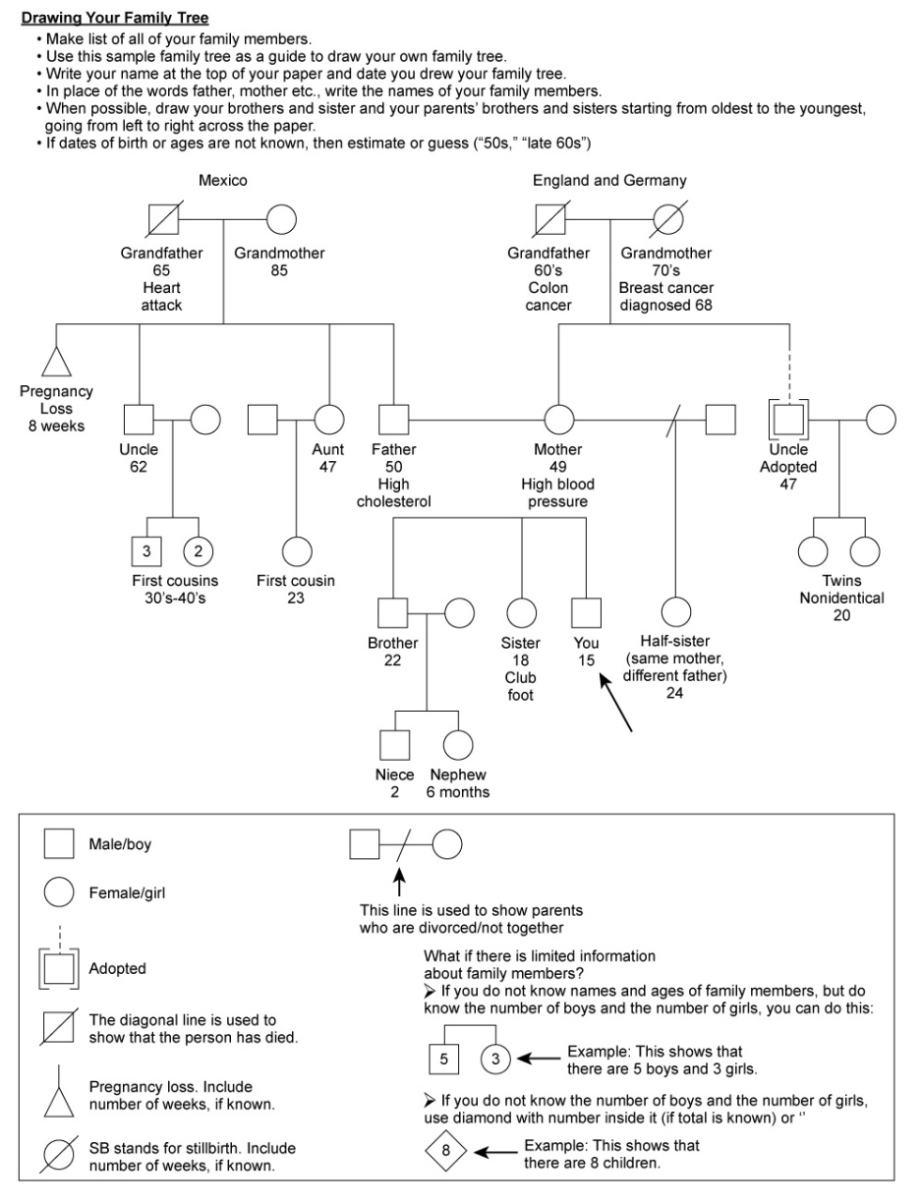
Genogram or Family Tree

Slide 12
Cross-Cultural Care Implications
Additional questions for new immigrants
Biographical data
Spiritual resource and religion: assess if certain procedures cannot be done
Past health: what immunizations, if any
Health perception
How does person describe health and illness
How does person see problems he or she is now experiencing
Nutrition: taboo foods or food combinations

Slide 13
Review of Systems
General overall health state
Skin
Hair
Head
Eyes
Ears
Nose and sinuses
Mouth and throat
Neck
Breast
Axilla
Respiratory system
Cardiovascular
Peripheral vascular
Gastrointestinal
Urinary system
Male genital system
Female genital system
Sexual health
Musculoskeletal system
Neurologic system
Hematologic system
Endocrine system

Slide 14
Functional Assessment: ADLs
Self-esteem, self-concept
Activity and exercise
Sleep and rest
Nutrition and elimination
Interpersonal relationships and resources
Spiritual resources
Coping and stress management
Personal habits
Illicit or street drugs
Environment and work hazards
Intimate partner violence
Occupational health

Slide 15
CAGE Test
Have you ever thought you should Cut down your drinking?
Have you ever been Annoyed by criticism of your drinking?
Have you ever felt Guilty about your drinking?
Do you drink in the morning, an Eye opener?

Slide 16
Perception of Health
Ask questions such as the following:
How do you define health?
How do you view your situation now?
What are your concerns?
What do you think will happen in the future?
What are your health goals?
What do you expect from us as nurses, physicians, or other health care providers?

Slide 17
Question
Which of the following statements by the patient would indicate a substance abuse problem?
“I have a glass of wine each day with dinner.”
“My wife keeps nagging me to cut down on drinking.”
“I love to have a few drinks around the holidays.”
“I have a few drinks on the weekend when my friends get together.”
Notes:
The correct answer is 2. This statement requires further investigation; see CAGE assessment.
Answer 1 is incorrect because one glass of wine a day does not indicate a problem and may be beneficial.
Answer 3 is incorrect because this patient probably does not have an abuse problem if he or she can go all year without a drink.
Answer 4 is incorrect because this patient probably does not have an abuse problem if he or she can go all week without a drink, although further assessment of how many a “few” is would be required to ensure patient is not binge drinking, which could indicate a problem.

Slide 18
Developmental Competence Child
Health history adapted to include information specific for age and developmental stage of child
Biographic data
Source of history
Person providing information and relation to child
Your impression of reliability of information
Any special circumstances (e.g., use of an interpreter)
Reason for seeking care

Slide 19
Developmental Competence: Child (Cont.)
History of present Illness
Severity of pain: note effect on usual behavior (e.g., does it stop child from playing?)
Associated factors, such as relation to activity, eating, and body position
Parent’s intuitive sense of problem often accurate; even if proven otherwise, this gives an idea of parent’s area of concern
Parent’s coping ability and reaction of other family members to child’s symptoms or illness

Slide 20
Past Health History: Child
Prenatal status
Labor and delivery
Postnatal status
Childhood illnesses
Serious accidents or injuries
Serious or chronic illnesses
Operations or hospitalizations
Immunizations and allergies
Medications

Slide 21
Past Health History: Child (Cont.)
Developmental history
Growth
Milestones
Current development for children 1 month through preschool age
School-age child
Nutritional history
Family history

Slide 22
Review of Systems: Child
General overall health state
Skin
Hair
Head
Eyes
Ears
Nose and sinuses
Mouth and throat
Neck
Breast
Axilla
Respiratory system
Cardiovascular
Peripheral vascular
Gastrointestinal
Urinary system
Male genital system
Female genital system
Sexual health
Musculoskeletal system
Neurologic system
Hematologic system
Endocrine system

Slide 23
Functional Assessment: Child
Including ADLs
Interpersonal relationships
Activity and rest
Economic status
Home environment
Environmental hazards
Coping and stress management
Habits
Health promotion

Slide 24
Adolescent: HEEADSSS
Psychosocial Interview
Method of interviewing focuses on assessment of Home environment, Education and employment, Eating, peer-related Activities, Drugs, Sexuality, Suicide and depression, and Safety from injury and violence
Home
Education and employment
Eating
Activities
Drugs
Sexuality
Suicide and depression
Safety

Slide 25
The Older Adult: Assessment Questions
Includes same format described for younger adult, plus additional questions
These questions address ways in which ADLs are affected by normal aging processes or by effects of chronic illness or disability
No specific age at which to ask these additional questions; use them when it seems appropriate
Important to recognize positive health measures: what they are doing to help themselves stay well

Slide 26
The Older Adult: Assessment
Older people have spent a lifetime with traditional health care that searches only for pathology and what is wrong with their health
May be pleasant surprise to have a health professional affirm things they are doing right and note health strengths

Slide 27
The Older Adult: Reason for Seeking Care
May take time to figure out why older person has come for an examination
Aging person may shrug off symptoms as evidence of growing old and be unsure whether it is worth mentioning
Some older people have a conservative philosophy toward their health status and come for care only when something is seriously wrong
Older person may have many chronic problems, such as diabetes, hypertension, or constipation
Final statement should be person’s reason for seeking care, not your assumption of problem

Slide 28
The Older Adult: Past Health History
General health in past 5 years
Accidents or injuries, serious or chronic illnesses, hospitalizations, operations
Last examination
Obstetric status

Slide 29
The Older Adult: Medication Profile
Current medications
Also consider following issues:
Some older persons take large number of drugs prescribed by different physicians
Person may not know drug name or purpose
Ask person to bring in drug to be identified
When person is unable to afford drug, he or she may decrease dosage or not refill immediately
Travel to pharmacy may present a problem
May use over-the-counter medications for self-treatment
Some share medications with neighbors or friends

Slide 30
The Older Adult: Family History
Not as useful in predicting which familial diseases person may contract, because most of those will have occurred at an earlier age
Useful to assess which diseases or causes of death of relatives person has experienced
Also describes person’s existing social network

Slide 31
The Older Adult: Review of Systems
General
Skin
Eyes
Ears
Mouth
Respiratory system
Cardiovascular system
Peripheral vascular system
Urinary system
Sexual health
Musculoskeletal system
Neurologic system

Slide 32
The Older Adult: Functional Assessment
Including ADLs
Self-concept, self-esteem
Occupation
Activity and exercise
Sleep and rest
Nutrition and elimination
Interpersonal relationships and resources
Coping and stress management
Environment and home safety hazards

