Slide 1
Chapter 7
Domestic and Family Violence Assessments

Slide 2
Intimate Partner Violence Defined
Intimate partner violence defined by the Centers for Disease Control and Prevention (CDC)
  Physical or sexual violence, use of physical force, or threat of such violence
  Psychological or emotional abuse or coercive tactics after prior physical violence between persons who are spouses or nonmarital partners or former spouses or nonmarital partners

Slide 3
Child Abuse and Neglect Defined
Child abuse and neglect defined at both federal and state level
The Child Abuse and Prevention Treatment Act (CAPTA) dictates minimum standards that must be incorporated into state statutes
Most state statutes incorporate the following definitions:
  Neglect
  Physical abuse
  Sexual abuse
  Emotional abuse

Slide 4
Child Abuse State
Statutes Defined
Neglect: failure to provide for a child’s basic physical, educational, medical, and emotional needs
Physical abuse: physical injury due to punching, beating, kicking, biting, burning, shaking, or otherwise harming a child; even if parent or caretaker did not intend harm, such acts are considered abuse when done purposefully
Sexual abuse: includes fondling child’s genitals, incest, penetration, rape, sodomy, indecent exposure, and exploitation through prostitution or production of pornographic materials
Emotional abuse: any pattern of behavior that harms child’s emotional development or sense of self-worth; includes frequent belittling, rejection, threats, and withholding of love and support

Slide 5
Adolescent Violence Defined
CDC definition for adolescent dating violence
  Physical, sexual, or psychological/emotional violence within a dating relationship that includes stalking
  Abuse may occur in person or electronically
  May occur with present or former partner

Slide 6
Elder Abuse and Neglect Defined
Almost every state has some form of mandatory reporting of abused elderly and other vulnerable patients
  As mandatory reporters of abuse, you need only have suspicion that elder abuse or neglect may have occurred in order to call authorities
  Many nurses, physicians, and social workers are erroneously under the assumption that they must have proof of abuse before calling authorities

Slide 7
American Medical Association (AMA) Definitions of Elder Abuse and Neglect
Physical abuse: violent acts that result or could result in injury, pain, impairment, or disease
Physical neglect: failure of family or caregiver to provide basic goods and services such as food, shelter, health care, and medications
Psychological abuse: behaviors that result in mental anguish
Psychological neglect: failure to provide basic social stimulation
Financial abuse: intentional misuse of elderly person’s financial and material resources
Financial neglect: failure to use elderly person’s assets to provide needed services

Slide 8
Health Effects of Violence: Women
Violent experiences have significant effects on women’s health
  Injury serious enough to require medical attention
  Abused women have significantly more chronic health problems: neurologic, gastrointestinal, gynecologic, and chronic pain
  Forced sex that accompanies physical abuse contributes to a host of reproductive health problems including chronic pelvic pain, unintended pregnancy, sexually transmitted infections (STIs) including HIV, and urinary tract infections

Slide 9
Health Effects of Violence: Women (Cont.)
Health care system can be an extremely important early point of contact
  Abused women have significantly more depression, suicidality, posttraumatic stress disorder (PTSD) symptoms, and problems with substance abuse
  Abuse during pregnancy has serious results for both the pregnant mother and the infant, including low birth weight and increased risk of child abuse
  By uncovering abuse in early stages, it is hoped the pattern of violence can be stopped and long-term health problems can be avoided or minimized

Slide 10
Health Effects of Violence:
Elder Abuse
Health effects of elder abuse
  Complications from injuries or bleeding from trauma can cause changes in circulatory homeostasis and fluctuations in blood pressure and pulse, shock, and death
  Infections can progress to generalized sepsis, then death in immunocompromised aging patients
  Assault, or stress leading up to or following assault, can contribute to cardiac complications
  STIs and related complications for younger women are present in older sexually assaulted women

Slide 11
Health Effects of Violence:
Elder Abuse (Cont.)
Abuse of the elderly often is coupled with neglect
Family or others working with aging persons may be responsible for actions of neglect either intentionally or unintentionally
This type of neglect is often, by definition, criminal in nature
Family members or others caring for elderly persons may struggle with their own severe physical and cognitive health challenges leading to caregiver role strain
Self-neglect raises often unanswerable questions about one’s right to live autonomously
  Suspected self-neglect is also a mandatory reportable activity to adult protective services

Slide 12
Health Effects of Violence:
Child Abuse
There are many long-term physical and psychological effects of child maltreatment
  Immediate consequences include a spectrum of injuries such as bruises, fractures, and lacerations and can involve more severe injury such as shaken baby syndrome
  More severe forms of maltreatment can lead to death or long-term disability such as mental retardation, blindness, and physical disability

Slide 13
Health Effects of Violence:
Child Abuse (Cont.)
Child maltreatment can have long-term effects on child’s development and adult life
  Interrupts bond between child and caregiver
  Ongoing maltreatment can lead to changes in brain structure and chemistry and may lead to long-term physical, psychological, emotional, social, and cognitive dysfunction in adulthood
  Research indicates that abused children will likely abuse their own children
  Research indicates that adults in drug treatment programs reported abuse as children

Slide 14
Health Effects of Violence:
Child Abuse (Cont.)
Risk factors that may contribute to child maltreatment
  Disabilities or mental retardation in children that may increase caregiver burden
  Social isolation of families
  Parents’ lack of understanding of children’s needs and child development
  Parents’ history of domestic abuse
  Poverty and other socioeconomic disadvantages, such as unemployment

Slide 15
Health Effects of Violence:
Child Abuse (Cont.)
Risk factors that may contribute to child maltreatment
  Family disorganization, dissolution, and violence,
  Substance abuse in family
  Young, single, nonbiological parents
  Parental thoughts and emotions supporting maltreatment behaviors
  Parental stress and distress, including depression or other mental health conditions
  Community violence

Slide 16
Routine Screening for Intimate Partner Violence (IPV)
Routine, universal screening for IPV means the following:
  Asking every woman at every health care encounter if she has been abused by a husband, boyfriend, or other intimate partner or ex-partner
Required by most nursing professional organizations
U.S. Preventative Task Force has issued a policy statement supporting the positive benefits of routine screening for IPV
Notes:
“Because domestic violence has such serious health care consequences, we are asking all of our female patients the questions that follow.”

Slide 17
How to Assess for Intimate
Partner Violence
How to assess
  Many precede questions with an introduction, such as “Because domestic violence is so common in our society, we are asking all women the following questions.”
  Or “Because domestic violence has such serious health care consequences, we are asking all of our female patients the questions that follow.”
  Alerts women that questions about domestic violence are coming and makes sure they know they are not being singled out for these questions
Notes:
“Because domestic violence has such serious health care consequences, we are asking all of our female patients the questions that follow.”

Slide 18
Assessment for Intimate
Partner Violence
Questions
  If a woman answers yes to any of the Abuse Assessment Screen (AAS) questions, then ask questions to assess how recent and how serious the abuse was
  Even if the woman only says yes to the first question and calls abuse “only emotional” or “not that bad,” more abuse may be uncovered by gently continuing the assessment
  This is not “denial,” but normal minimization that often accompanies trauma from violence
Notes:
“Because domestic violence has such serious health care consequences, we are asking all of our female patients the questions that follow.”

Slide 19
Assessing for Intimate Partner Violence (Cont.)
Procedure
  It is appropriate to show concern and distress about degree of violence
  One message that needs to be conveyed is that abuse is not the woman’s fault; this can be said several times
  Also express concern and reassure patient that help is possible
  Furthermore, inform patient that several health problems can occur because of domestic violence and that is why it is necessary to conduct a thorough assessment
Notes:
“Because domestic violence has such serious health care consequences, we are asking all of our female patients the questions that follow.”

Slide 20
Assessing for Adolescent Relationship Violence
No validated screening tool
Observe for risk factors and be aware that it occurs in both genders
  Alcohol or substance abuse
  Early onset of sexual activity or risk behaviors
  Signs of mental illness or poor performance at school
Ask pertinent questions relative to assessing risk
  Have you felt unsafe in relationships?
  Is a partner from a previous relationship making you feel unsafe now?
  Have you been physically assaulted or otherwise hurt by your boyfriend or dating partner when he/she has been angry?
  Have you ever been hurt by a dating partner to the point where it left a mark or bruise?

Slide 21
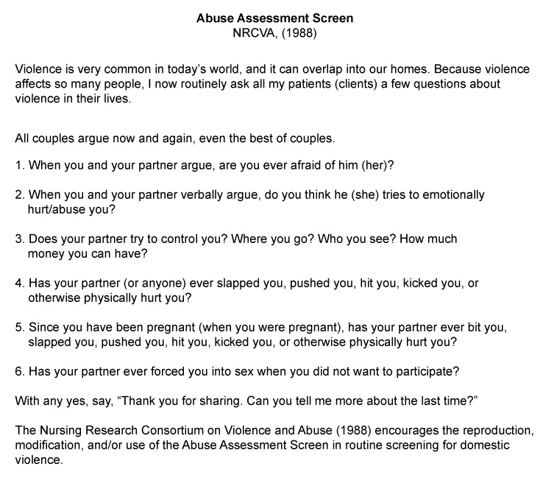
Abuse Assessment Screen
From Nursing Research Consortium on Violence and Abuse (NRCVA), 1988.

Slide 22
Assessment of Elder/Vulnerable Person Abuse and Neglect
Assessment of abuse or neglect in cognitively challenged persons is complicated
Physical findings inconsistent with history provided by patient, family, or caregiver are red flags of possible abuse and neglect
Problems can exist at multiple levels, both physically and cognitively
Notes:
“Because domestic violence has such serious health care consequences, we are asking all of our female patients the questions that follow.”

Slide 23
Question
The nurse is assessing a patient who admits to being physically abused by her spouse. The patient says, “I wish I would have agreed with my husband, because then I wouldn’t have been hit.” What is the nurse’s best response?
“Changing your reaction to your spouse will likely change his actions against you.”
“Try not to blame yourself. You will know better for next time.”
“Your husband has to want to change. Let’s focus on you for now.”
“It is not your fault that your husband lost control. Changing your actions will not prevent him from abusing you again.”
Notes:
The correct answer is 4. It is important for the nurse to reassure the patient that it was not his or her fault. Abuser have problems with self control that cause them to strike their victims.
Answer 1 is incorrect because this answer implies that it is the victim’s fault.
Answer 2 is incorrect because this option implies that the victim is at fault.
Answer 3 is correct; however, this is not the best option because this option offers little reassurance to the patient.

Slide 24
Elder Abuse Screen
Has anyone done the following:
  Ever touched you inappropriately?
  Made you do things you didn’t want to do?
  Taken things that were yours without asking?
  Physically hurt, scolded, or threatened you?
  Failed to help you take care of yourself?
Have you signed documents you didn’t understand?
Are you afraid of anyone at home?
Are you alone a lot?

Slide 25
History of Traumatic Injuries
May have an impact on current health condition
  Assess and document prior abuse: IPV, childhood abuse, and prior rapes
  Mental status examination important in cases of IPV or elder abuse, for potential head trauma or neurologic symptoms
  All survivors of violence should be given a mental status examination, with attention to mental health problems associated with violence: depression, suicidality, PTSD, substance abuse, and anxiety

Slide 26
Screening for Child Abuse and Neglect
Medical history important part of evaluation
  Previous hospitalizations, injuries, or does he/she suffer from any chronic medical conditions?
  Take medications that may cause easy bruising?
  History of repeated visits to hospital?
  Delays seeking care for other than minor injury?
If child is verbal, history should be obtained away from caretakers through open-ended questions or spontaneous statements

Slide 27
Screening for Child Abuse and Neglect (Cont.)
Documentation
  When documenting history and physical findings of child abuse and neglect, use words child has used to describe how his or her injury occurred
  Remember the possibility that the abuser may be accompanying the child
  If child is nonverbal, use reports of caregivers
  Know your institutional protocol for obtaining history in cases of suspected child maltreatment
  Some protocols may delay a full interview until it can be done by a forensically trained interviewer

Slide 28
Physical Examination: IPV or
Elder Abuse
Important components of physical examination of known survivor of IPV or elder abuse include the following:
  Complete head-to-toe visual examination, especially if patient is receiving health services for reported abuse
  Health evaluations for known or suspected elder abuse and neglect should include baseline laboratory tests, including a complete blood count with platelet level, basic blood chemistries, serum liver function tests, a coagulation panel, and urinalysis
Notes:
Ecchymoses are not directly related to blunt force trauma that results in bruising, and not all open wounds should be called lacerations (only those related to splitting of tissue from blunt force impact or tearing of tissue should be).

Slide 29
Physical Examination: Children
Visual inspection of child from head to toe is important in any physical examination
  Significant injuries can be hidden under clothing, diapers, socks, and long hair
  Bruising in “atypical” places such as buttocks, hands, feet, and abdomen is exceedingly rare and should arouse concern
  Any bruise in shape of an object should be considered highly specific for abuse
  Bruising found in nonmobile children should raise concern for further injury, including fractures and intracranial injury

Slide 30
Documentation Requirements
Documentation of IPV, child abuse, and elder abuse must include the following:
  Detailed, nonbiased progress notes
  Use of injury maps
  Photographic documentation in health record
  Other aspects of abuse history, including reports of past abusive incidents, can be paraphrased with use of partial direct quotations
  Written documentation of histories of IPV and elder abuse needs to be verbatim but within reason
  Critical to document exceptionally poignant statements made by victim that identify perpetrator and severe threats of harm made by perpetrator

Slide 31
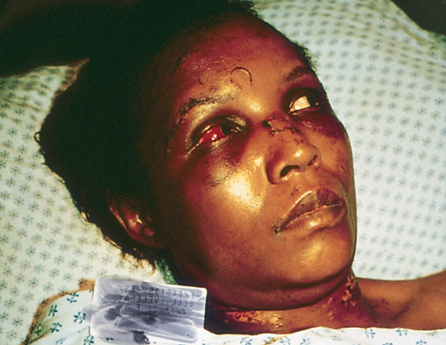
Photographic Documentation
Patterned, punch-like abrasion to the mid-forehead from an assailant wearing a ring with a stone; sutured laceration to the left eyebrow; sutured partial-avulsion injury to the nose, punch-like contusion to the left eye involving the sclera, and manual strangulation-related abrasion to the neck
Courtesy Daniel J. Sheridan, PhD, RN, CNS, Hanover, MD.
Notes:
(Photo courtesy Daniel Sheridan.)
Speaker’s notes:
Patterned, punch-like abrasion to the mid-forehead from an assailant wearing a ring with a stone.
Sutured laceration to the left eyebrow.
Sutured partial-avulsion injury to the nose.
Punch-like contusion to the left eye involving the sclera.
Manual strangulation-related abrasion to the neck.

Slide 32
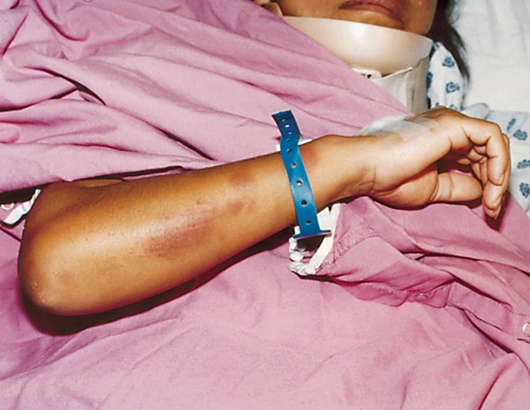
Photographic Documentation (Cont.)
Patterned, defensive posture-like bruises to the right forearm
Courtesy Daniel J. Sheridan, PhD, RN, CNS, Hanover, MD.
Notes:
(Photo courtesy Daniel Sheridan.)

Slide 33
Assessing for Risk of Homicide
Danger assessment (DA)
  This 19-item yes/no instrument is used extensively by nurses in the health care system
  It starts with a calendar so women can more accurately see how frequent and severe violence has become over the past year
  This is also an excellent assessment of frequency and severity of violence for health care providers
  The more yes answers, the more serious the danger of the woman’s situation

Slide 34
When She* Says No but There Are Other IPV Indicators
Suspect IPV when she says no to AAS, but there are other indicators associated with IPV
In addition, providers need to be alert for conditions associated with IPV including the following:
  Gynecologic problems, especially STIs, pelvic pain, and complaints of sexual dysfunction
  Chronic irritable bowel syndrome, back pain, depression, symptoms of PTSD, problems sleeping, panic attacks, or nerves
* Can occur in both genders

Slide 35
When There Are Other
IPV Indicators
When these problems occur, and especially when they persist, a thorough and repeated assessment for domestic violence is needed.
In this case, an instrument such as the WEB scale might be used in addition to the AAS or gentle indirect queries
  “I am concerned about your health conditions. Is there any chance that stress at home is contributing to these problems?”

Slide 36
Culture and Genetics
Domestic violence (DV) occurs cross-culturally
  It may be more difficult to determine in many cultural groups
  Lifetime prevalence of DV occurs significantly higher among racial and ethnic minorities
  Highest rates of IPV is found in multiracial women (54%)
  Death rates are higher among refugee and immigrant women

Slide 37
IVP Factors among Ethnic and
Racial Minorities
Societal stressors
  Poverty, fear of seeking help due to racism and discrimination or lack of knowledge
Legal regulations
  Legal status may be complicated by immigrant status
  Fear of legal action being taken
Lack of access
  Inability to access health/medical services due to knowledge or fear
  Limited amount of mental health resources available
Cultural values and gender roles
  Privacy or shame associated with IVP

Slide 38
Question
Which tool will assist the nurse in assessing a patient's risk for homicide?
Harassment in Abusive Relationships: A Self-Report Scale (HARASS)
Danger Assessment (DA)
The Abuse Assessment Screen (AAS)
Intimate Partner Violence (IPV) screening tool
Notes:
The correct Answer is 2. The DA is designed to assess risk of homicide.
Answer 1 is incorrect because HARASS is a screening and self-assessment tool.
Answer 3 is incorrect because the AAS is an appropriate tool for initial assessment of domestic abuse.
Answer 4 is incorrect because the IPV is an initial assessment tool.

