Slide 1
Chapter 10
Pain Assessment: The Fifth Vital Sign

Slide 2
Pain: Fifth Vital Sign Definition
Pain is a highly complex and subjective experience that originates from the central nervous system (CNS), the peripheral nervous system (PNS), or both

Slide 3
Structure and Function
Nociceptors: specialized nerve endings designed to detect painful sensations
Transmit sensations to central nervous system
Located within skin; connective tissue; muscle; and thoracic, abdominal, and pelvic viscera
These nociceptors can be stimulated directly by trauma or injury or secondarily by chemical mediators released from site of tissue damage
Nociceptors carry pain signal to central nervous system by two primary sensory (afferent) fibers: Aδ and C fibers

Slide 4
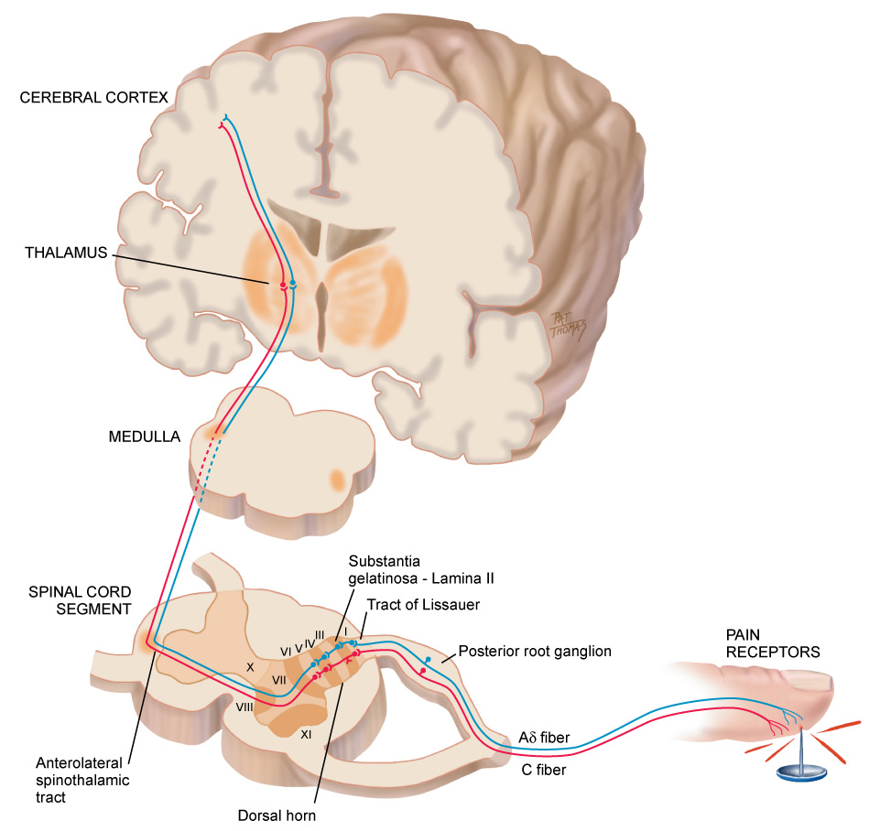
Neuroanatomic Pathways

Slide 5
Nociceptors Fibers
Aδ fibers are myelinated and larger in diameter, and they transmit pain signal rapidly to CNS; localized, short-term, and sharp sensations result from Aδ fiber stimulation
In contrast, C fibers are unmyelinated and smaller, and transmit signal more slowly; sensations are diffuse and aching, and they persist after initial injury
Peripheral sensory Aδ and C fibers enter spinal cord by posterior nerve roots within dorsal horn by tract of Lissauer
Fibers synapse with interneurons located within a specified area of cord called substantia gelatinosa

Slide 6
Nociceptors Fibers (Cont.)
A cross section shows that gray matter of the spinal cord is divided into a series of consecutively numbered laminae (layers of nerve cells)
Substantia gelatinosa is lamina II, which receives sensory input from various areas of body
Pain signals then cross over to other side of spinal cord and ascend to brain by anterolateral spinothalamic tract

Slide 7
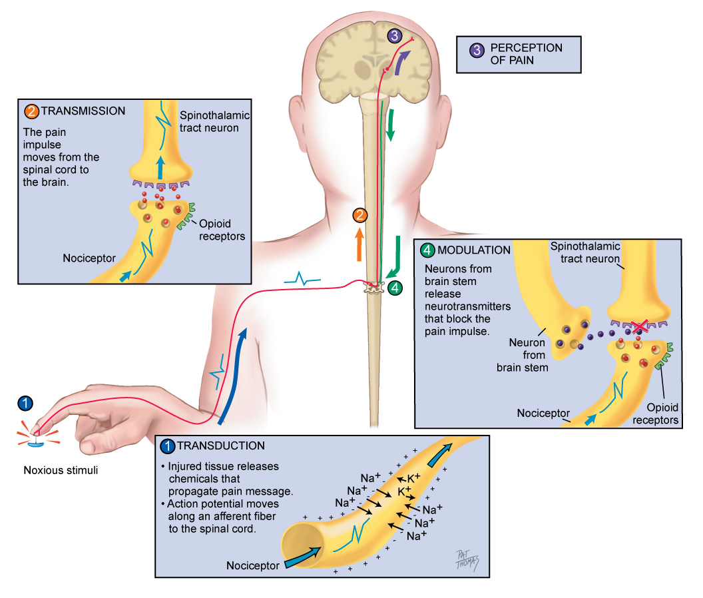
Nociception

Slide 8
Nociception Process
Important to understand pain occurs on a cellular level
Only then can you appreciate patient’s report of painful sensations that develop after initial site of injury heals
Nociception is the term used to describe how noxious stimuli are perceived as pain
Nociception can be divided into four phases
Transduction
Transmission
Perception
Modulation

Slide 9
Nociception Phases I and II
Initially, first phase of transduction occurs when a noxious stimulus in form of traumatic or chemical injury, burn, incision, or tumor takes place in periphery
Injured tissues then release a variety of chemicals, including substance P, histamine, prostaglandins, serotonin, and bradykinin
These are neurotransmitters that propagate pain message, or action potential, along sensory afferent nerve fibers to spinal cord
These fibers terminate in dorsal horn of spinal cord
In second phase, known as transmission, pain impulse moves from level of spinal cord to brain

Slide 10
Nociception Phase III
At synaptic cleft are opioid receptors that can block this pain signaling with endogenous or exogenous opioids
However, if uninterrupted, pain impulse moves to brain via various ascending fibers within spinothalamic tract to brainstem and thalamus
Once pain impulse moves through thalamus, the message is dispersed to higher cortical areas via mechanisms that are not clearly understood at this time
In third phase, perception indicates conscious awareness of painful sensation
Cortical structures such as limbic system account for emotional response to pain

Slide 11
Nociception Phase IV
Only when noxious stimuli are interpreted in these higher cortical structures can this sensation be identified as pain
Lastly, pain message is inhibited through phase of modulation
Descending pathways from brainstem to spinal cord produce third set of neurotransmitters that slow down or impede pain impulse, producing an analgesic effect
These neurotransmitters include serotonin; norepinephrine; neurotensin; γ-aminobutyric acid (GABA); and our own endogenous opioids, β-endorphins, enkephalins, and dynorphins

Slide 12
Neuropathic Pain
Indicates type of pain that does not adhere to typical phases inherent in nociceptive pain
Neuropathic pain implies an abnormal processing of pain message
This type of pain is most difficult to assess and treat
Often perceived long after site of injury heals
Sustained on a neurochemical level that cannot be identified by x-ray, computerized axial tomography (CAT) scan, or magnetic resonance imaging (MRI)
Electromyography and nerve-conduction studies are needed

Slide 13
Neuropathic Pain (Cont.)
The abnormal processing of neuropathic pain impulse can be continued by peripheral or central nervous system
Exact mechanisms are unclear
A proposed mechanism is that injury to peripheral neurons can result in spontaneous and repetitive firing of nerve fibers, almost seizure like in activity
Neuropathic pain may be sustained centrally in a phenomenon known as neuronal “wind-up”
Within dorsal horn of spinal cord, neurons are thought to be transformed into a hyperexcitable state and a minimal stimulus can ultimately spiral into much larger painful effect

Slide 14
Sources of Pain: Visceral
Pain sources based on their origin
Visceral pain originates from larger interior organs (i.e., kidney, stomach, intestine, gallbladder, pancreas)
Pain can stem from direct injury to organ or from stretching of organ from tumor, ischemia, distention, or severe contraction
Examples of visceral pain include ureteral colic, acute appendicitis, ulcer pain, and cholecystitis
Pain impulse transmitted by ascending nerve fibers along with nerve fibers of autonomic nervous system
That is why visceral pain often presents with autonomic responses such as vomiting, nausea, pallor, and diaphoresis

Slide 15
Sources of Pain
Pain sources based on their origin
Deep somatic pain comes from sources such as blood vessels, joints, tendons, muscles, and bone
Injury may result from pressure, trauma, or ischemia
Cutaneous pain derived from skin surface and subcutaneous tissues; injury is superficial, with a sharp, burning sensation
Linking pain to a mental disorder (psychogenic pain) negates person’s pain report
A clinician’s lack of awareness and understanding of neuropathic pain may contribute to this mislabeling

Slide 16
Sources of Pain (Cont.)
Pain sources based on their origin
Pain that is felt at a particular site but originates from another location is termed referred pain
Both sites are innervated by same spinal nerve, and it is difficult for brain to differentiate point of origin
Referred pain may originate from visceral or somatic structures
Various structures maintain their same embryonic innervation
It is useful to have knowledge of areas of referred pain for diagnostic purposes
For example, an inflamed appendix in right lower quadrant of abdomen may have referred pain in periumbilical area

Slide 17
Types of Pain: Duration
Pain can be classified by its duration
Duration can provide information on possible underlying mechanisms and treatment decisions

Slide 18
Types of Pain: Categories
Pain is divided into acute or chronic categories
Acute pain is short term and self-limiting, often follows a predictable trajectory, and dissipates after an injury heals
Examples of acute pain include surgery, trauma, and kidney stones
Acute pain serves a self-protective purpose; acute pain warns individual of actual or potential tissue damage
In contrast, chronic (or persistent) pain is diagnosed when pain continues for 6 months or longer
It can last 5, 15, or 20 years and beyond

Slide 19
Types of Pain: Chronic
Chronic pain can be further divided into malignant (cancer related) and nonmalignant
Malignant pain often parallels pathology created by tumor cells
Pain induced by tissue necrosis or stretching of an organ by growing tumor
The pain fluctuates within the course of the disease
Chronic nonmalignant pain is often associated with musculoskeletal conditions, such as arthritis, low back pain, or fibromyalgia

Slide 20
Types of Pain: Chronic (Cont.)
Chronic pain can be further divided into malignant (cancer related) and nonmalignant
Chronic pain does not stop when the injury heals
It persists after the predicted trajectory
Chronic pain outlasts its protective purpose, and the level of pain intensity does not correspond with the physical findings
Unfortunately, many patients with chronic pain are not believed and often labeled as malingers, attention seekers, drug seekers, and so forth

Slide 21
Types of Pain: Chronic (Cont.)
Chronic pain can be further divided into malignant (cancer related) and nonmalignant
Chronic pain originates from abnormal processing of pain fibers from peripheral or central sites
Because pain is transmitted on a cellular level, our current technology cannot reliably detect this process
Therefore, most important and reliable indicator for pain is patient’s self-report

Slide 22
Question
A patient is crying and says, “Please get me something to relieve this pain.” What should the nurse do next?
Verify that the patient has an order for pain medications and administer order as directed.
Assess the level of pain and ask patient what usually works for his or her pain, administer pain medication as needed, then reassess pain level.
Assess the level of pain and give medications according to pain level, and then reassess pain.
Reposition the patient, then reassess the pain after intervention.
Notes:
The correct answer is 2.
Answers 1, 3, and 4 are incorrect because pain management should be collaborative, and the patient is not part of the decision making process in these answers.

Slide 23
Developmental Competence: Infants
Infants have same capacity for pain as adults
By 20 weeks of gestation, ascending fibers, neurotransmitters, and cerebral cortex are developed and functioning to extent that fetus is capable of feeling pain
However, inhibitory neurotransmitters are in insufficient supply until birth at full term
Therefore, preterm infant rendered more sensitive to painful stimuli

Slide 24
Developmental Competence: Infants (Cont.)
Infants have same capacity for pain as adults
Preverbal infants are at high risk for undertreatment of pain because of persistent myths and beliefs that infants do not remember pain
New research indicates that repetitive and poorly controlled pain in infants (daily heel sticks, venipunctures) can result in lifelong adverse consequences such as neurodevelopmental problems, poor weight gain, learning disabilities, psychiatric disorders, and alcoholism

Slide 25
Developmental Competence: The Aging Adult
No evidence exists to suggest that older individuals perceive pain to a lesser degree or that sensitivity is diminished
Although pain is common experience among individuals 65 years of age and older, it is not normal process of aging; it indicates pathology or injury
Pain should never be considered something to tolerate or accept in one’s later years
Unfortunately, many clinicians and older adults wrongfully assume pain should be expected in aging, which leads to less aggressive treatment

Slide 26
Developmental Competence: The Aging Adult (Cont.)
Older adults have additional fears about becoming dependent, undergoing invasive procedures, taking pain medications, and having a financial burden
Most common pain-producing conditions for aging adults include pathologies such as arthritis, osteoarthritis, osteoporosis, peripheral vascular disease, cancer, peripheral neuropathies, angina, and chronic constipation
Somatosensory cortex is generally unaffected by dementia of Alzheimer type

Slide 27
Developmental Competence: The Aging Adult (Cont.)
Sensory discrimination is preserved in cognitively intact and impaired adults
Because limbic system is affected by Alzheimer disease, current research focuses on how person interprets and reports these pain messages

Slide 28
Gender Differences
Gender differences are influenced by societal expectations, hormones, and genetic makeup
Traditionally, men have been raised to be more stoic about pain, and more affective or emotional displays of pain are accepted for women
Hormonal changes are found to have strong influences on pain sensitivity for women
Women are two to three times more likely to experience migraines during childbearing years, are more sensitive to pain during premenstrual period, and are six times more likely to have fibromyalgia

Slide 29
Gender Differences (Cont.)
With recent findings from Human Genome Project, genetic differences between both sexes may account for differences in pain perception
A pain gene exists, which helps to explain why some people feel more or less pain even with same stimulus
Efforts are being made to tailor pharmacologic agents to improve pain treatment based on genetic sequencing

Slide 30
Cultural Differences in Pain
Most research conducted on racial differences and pain has focused on disparity in management of pain for various races
Comparing pain treatment for individuals of color (e.g., African Americans, Hispanics) with standard treatment for White individuals with similar injuries or diseases
Various studies describe how African American and Hispanic patients are often prescribed and administered less analgesic therapy than White patients, although most of these differences are small

Slide 31
Subjective Data: Pain
Defined as an unpleasant sensory and emotional experience
Associated with actual or potential tissue damage or described in terms of such damage
Pain is always subjective
Pain is whatever the experiencing person says it is, existing whenever he or she says it does
Subjective report is most reliable indicator of pain
Because pain occurs on a neurochemical level, clinician cannot base diagnosis of pain exclusively on physical examination findings, although these findings can lend support

Slide 32
Initial Pain Assessment Questions
Where is your pain?
When did your pain start?
What does your pain feel like?
Burning, stabbing, aching
Throbbing, fire like, squeezing
Cramping, sharp, itching, tingling
Shooting, crushing, sharp, dull
How much pain do you have now?

Slide 33
Initial Pain Assessment Questions (Cont.)
What makes your pain better or worse? Include behavioral, pharmacologic, nonpharmacologic interventions
How does pain limit your function or activities?
How do you usually behave when you are in pain? How would others know you are in pain?
What does this pain mean to you? Why do you think you are having pain?

Slide 34
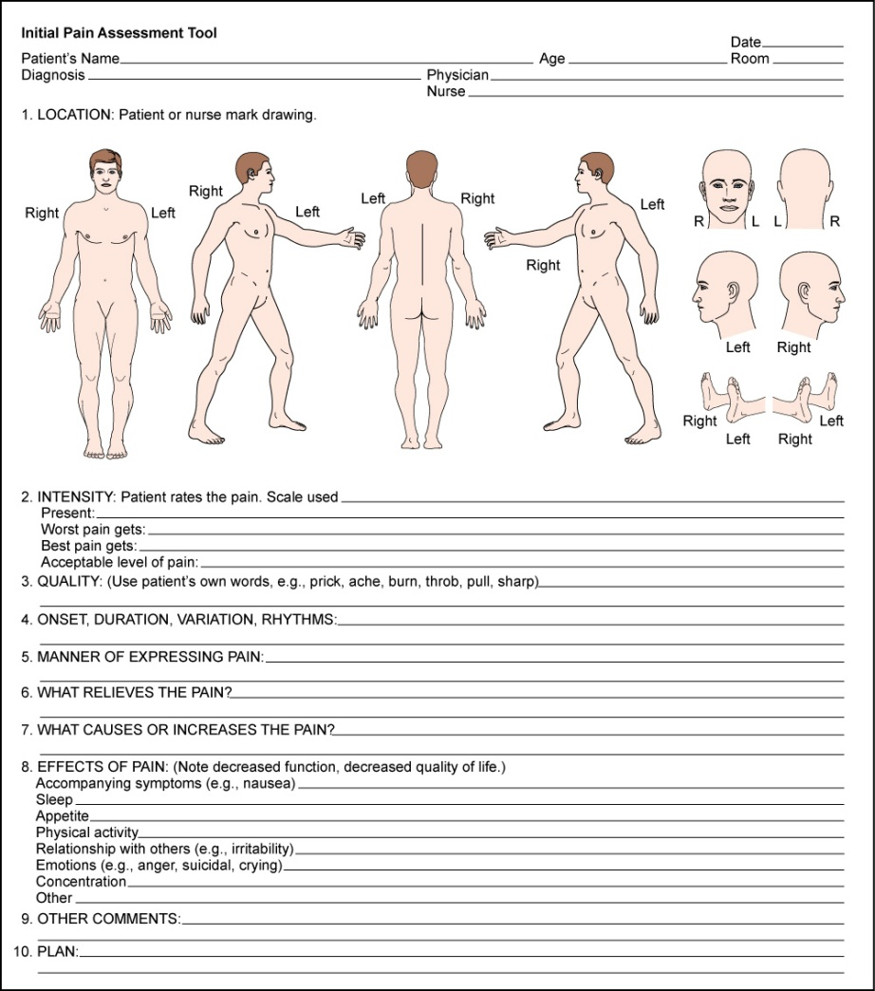
Initial Pain Assessment

Slide 35
Pain Assessment Tools
Various tools have been developed to capture one-dimensional aspects (i.e., intensity) or multidimensional components
Pain is multidimensional in scope, encompassing physical, affective, and functional domains
Select pain assessment tool based on its purpose, time involved in administration, and patient’s ability to comprehend and complete tool
First, teach patients how to use each tool, with practice sessions to strengthen validity and reliability of response
Enlarge print when appropriate for individuals with impaired vision

Slide 36
Pain Assessment Tools (Cont.)
Printed language should be translated to native language of patient
Standardized overall pain assessment tools are more useful for chronic pain conditions or particularly problematic acute pain problems
A few examples include the following:
Initial Pain Assessment
Brief Pain Inventory
McGill Questionnaire

Slide 37
Pain Assessment Tools (Cont.)
Initial pain assessment
Clinician asks patient to answer eight questions concerning location, duration, quality, intensity, and aggravating/relieving factors
Furthermore, clinician adds questions about manner of expressing pain and effects of pain that impairs one’s quality of life
Brief pain inventory
Asks patient to rate pain within past 24 hours on graduated scales (0 to 10) with respect to its impact on areas such as mood, walking ability, and sleep

Slide 38
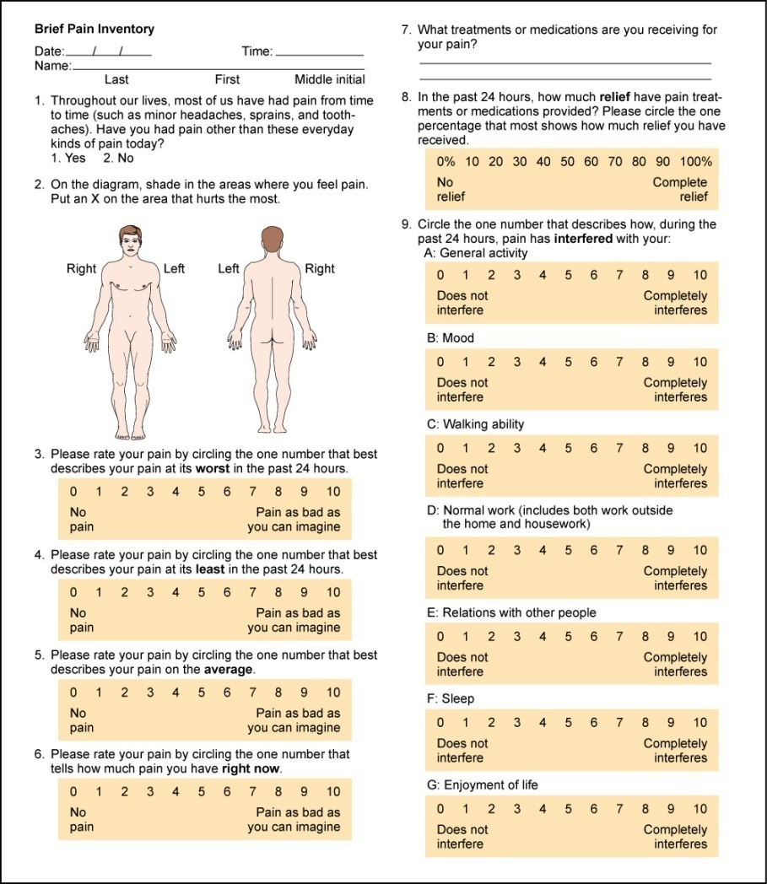
Brief Pain Inventory
From McCaffery M, Pasero C: Pain: clinical manual, ed. 2, St. Louis, 1999, Mosby.

Slide 39
Pain Assessment Tools (Cont.)
Short-form McGill Pain Questionnaire
Asks patient to rank list of descriptors in terms of their intensity and to give an overall intensity rating to his or her pain
Pain rating scales are one-dimensional and are intended to reflect pain intensity
Pain rating scales can indicate a baseline intensity, track changes, and give some degree of evaluation to a treatment modality

Slide 40
Pain Assessment Tools (Cont.)
Numeric rating scales ask patient to choose a number that rates level of pain, with 0 being no pain and highest anchor 10 indicating worst pain
It can be administered verbally or visually along a vertical or horizontal line
Verbal descriptor scales have the patient use words to describe pain
Visual analog scales have the patient mark the intensity of the pain on a horizontal line from “no pain” to “worst pain”
Older adults may prefer the descriptor scale that asks patients to indicate their pain by using selected pain term words

Slide 41
Pain Assessment: Infants and Children
Because infants are preverbal and incapable of self-report, pain assessment is dependent on behavioral and physiologic cues
It is important to underscore understanding that infants do feel pain
Children 2 years of age can report pain and point to its location
They cannot rate pain intensity at this developmental level
It is helpful to ask parent or caregiver what words the child uses to report pain

Slide 42
Pain Assessment: Infants and Children (Cont.)
Rating scales can be introduced at 4 or 5 years
Wong-Baker Scale is one example; child is asked to choose face that shows “How much hurt do you have now?”
Oucher Scale has six photographs of young boys’ faces with different expressions of pain, ranked on a 0 to 5 scale of increasing intensity
Child is asked to point to face that best matches the hurt or pain
Has variations for girls and ethnic groups

Slide 43
Objective Data Preparation
Physical examination process can help you understand the nature of the pain
Consider whether this is an acute or chronic condition
Recall that physical findings may not always support patient’s pain complaints, particularly for chronic pain syndromes
Pain should not be discounted when objective, physical evidence is not found
Based on the patient’s pain report, make every effort to reduce or eliminate pain with appropriate analgesic and nonpharmacologic intervention

Slide 44
American Pain Society
In cases in which cause of acute pain is uncertain, establishing a diagnosis is a priority, but symptomatic treatment of pain should be given while investigation is proceeding
With occasional exceptions (e.g., initial examination of patient with an acute condition of abdomen), it is rarely justified to defer analgesia until a diagnosis is made
In fact, a comfortable patient is better able to cooperate with diagnostic procedures

Slide 45
Question
The nurse is reassessing a patient’s pain level after pain medication administration following a pain level of 9/10. The patient states that his pain level is now a 3/10. What should the nurse do next?
Verify orders for medications and offer more pain medication, if appropriate.
Continue to assess patient’s pain level.
Document the pain level in the chart.
There is no need for action, because the patient’s pain is manageable.
Notes:
The correct answer is 1. Patients have the right to be pain free, and a level of 3/10 would indicate that the patient is still in pain.
Answer 2 is incorrect because this patient needs intervention.
Answer 3 is incorrect because although the patient’s pain level should be documented, this is not the main priority and offers no resolution for the patient’s pain.
Answer 4 is incorrect because a pain level of 3/10 indicates that the pain is not manageable.

Slide 46
Objective Data: Joints
Note size and contour of joint
Measure circumference of involved joint for comparison with baseline
Check active or passive range of motion
Joint motion normally causes no tenderness, pain, or crepitation

Slide 47
Objective Data: Muscles and Skin
Inspect skin and tissues for color, swelling, and any masses or deformity
To assess for changes in sensation, ask person to close his or her eyes
Test person’s ability to perceive sensation by breaking a tongue blade in two lengthwise
Lightly press sharp and blunted ends on skin in a random fashion and ask to identify it as sharp or dull
This test will help you identify location and extent of altered sensation

Slide 48
Objective Data: Abdomen
Observe for contour and symmetry
Palpate for muscle guarding and organ size
Note any areas of referred pain

Slide 49
Nonverbal Behaviors of Pain
When individual cannot verbally communicate pain, you can (to a limited extent) identify pain using behavioral cues
Recall that individuals react to painful stimuli with a wide variety of behaviors
Behaviors are influenced by a wide variety of factors, including nature of pain (acute versus chronic), age, and cultural and gender expectations

Slide 50
Nonverbal Behaviors of Pain (Cont.)
Acute pain behaviors
Because acute pain involves autonomic responses and has protective purpose, individuals experiencing moderate to intense levels of pain may exhibit the following behaviors:
Guarding, grimacing, vocalizations such as moaning, agitation, restlessness, stillness, diaphoresis, or change in vital signs
This list of behaviors is not exhaustive because the behaviors should not be used exclusively to deny or confirm presence of pain

Slide 51
Nonverbal Behaviors of Pain (Cont.)
Chronic pain behaviors
Persons with chronic pain often live with experience for months and years
One cannot function physiologically and go on with life in a repetitive state of grimacing, diaphoresis, guarding, and the like
Person adapts over time, and clinicians cannot look for or anticipate the same acute pain behaviors to exist in order to confirm a pain diagnosis
Chronic pain behaviors have even more variability than acute pain behaviors

Slide 52
Nonverbal Behaviors of Pain (Cont.)
Chronic pain behaviors
Persons with chronic pain typically try to give little indication they are in pain and therefore are at higher risk for underdetection
Behaviors that have been associated with chronic pain include bracing, rubbing, diminished activity, sighing, and change in appetite
Whenever possible it is best to ask the person how he or she acts or behaves when in pain

Slide 53
Nonverbal Behaviors of Pain (Cont.)
Chronic pain behaviors
Chronic pain behaviors—such as being with other people, movement, exercise, prayer, sleeping, or inactivity—underscore more subtle, less anticipated ways in which persons behave when they are experiencing chronic pain
Sleeping is one way persons behave in response to chronic pain in order to self-distract
Unfortunately, clinical staff may inadvertently interpret this behavior as “comfort” and do not follow up with an appropriate pharmacologic intervention

Slide 54
Developmental Competence: Infants
Most pain research on infants has focused on acute, procedural pain
We have a limited understanding of how to assess chronic pain in infants
There is no one assessment tool that adequately identifies pain in infants
Using a multidimensional approach for whole infant is encouraged
Changes in facial activity and body movements may help assess pain

Slide 55
Developmental Competence: Infants (Cont.)
Much effort and time are spent on decoding facial expressions (e.g., taut tongue, bulging brow, closing of eye fissures), which may be difficult for general practitioner to carry out in a busy clinical setting
One tool that has been developed for postoperative pain in preterm and term neonates is CRIES
It measures physiologic and behavioral indicators on a 3-point scale
Because sympathetic nervous system is engaged particularly in acute episodes of pain, physiologic changes take place that may indicate the presence of pain

Slide 56
Developmental Competence: Infants (Cont.)
These include sweating, increases in blood pressure and heart rate, vomiting, nausea, and changes in oxygen saturation
However, like adults, these physiologic changes cannot be used exclusively to confirm or deny pain because of other factors such as stress, medications, and fluid changes
Note that these measures target acute pain
No biological markers have been identified for long-term chronic pain in infants or children
Therefore, evaluate whole individual

Slide 57
Developmental Competence: Infants (Cont.)
Look for changes in temperament, expression, and activity
If a procedure or disease process is known to induce pain in adults (e.g., circumcision, surgery, sickle cell disease, cancer), it will induce pain in an infant or child

Slide 58
Developmental Competence: The Aging Adult
Although pain should not be considered a “normal” part of aging, it is prevalent
When older adult reports a history of conditions such as osteoarthritis, peripheral vascular disease, cancer, osteoporosis, angina, or chronic constipation, be alert and anticipate a pain problem
Older adults often deny having pain for fear of dependency, further testing or invasive procedures, cost, and fear of taking painkillers or becoming a drug addict
During interview, you must establish an empathic and caring rapport to gain trust

Slide 59
Developmental Competence: The Aging Adult (Cont.)
When you look for behavioral cues, look at changes in functional status
Observe for changes in dressing, walking, toileting, or involvement in activities
Slowness and rigidity may develop, and fatigue may occur
Look for sudden onset of acute confusion, which may indicate poorly controlled pain
However, you will need to rule out other competing explanations such as infection or adverse reaction from medications

Slide 60
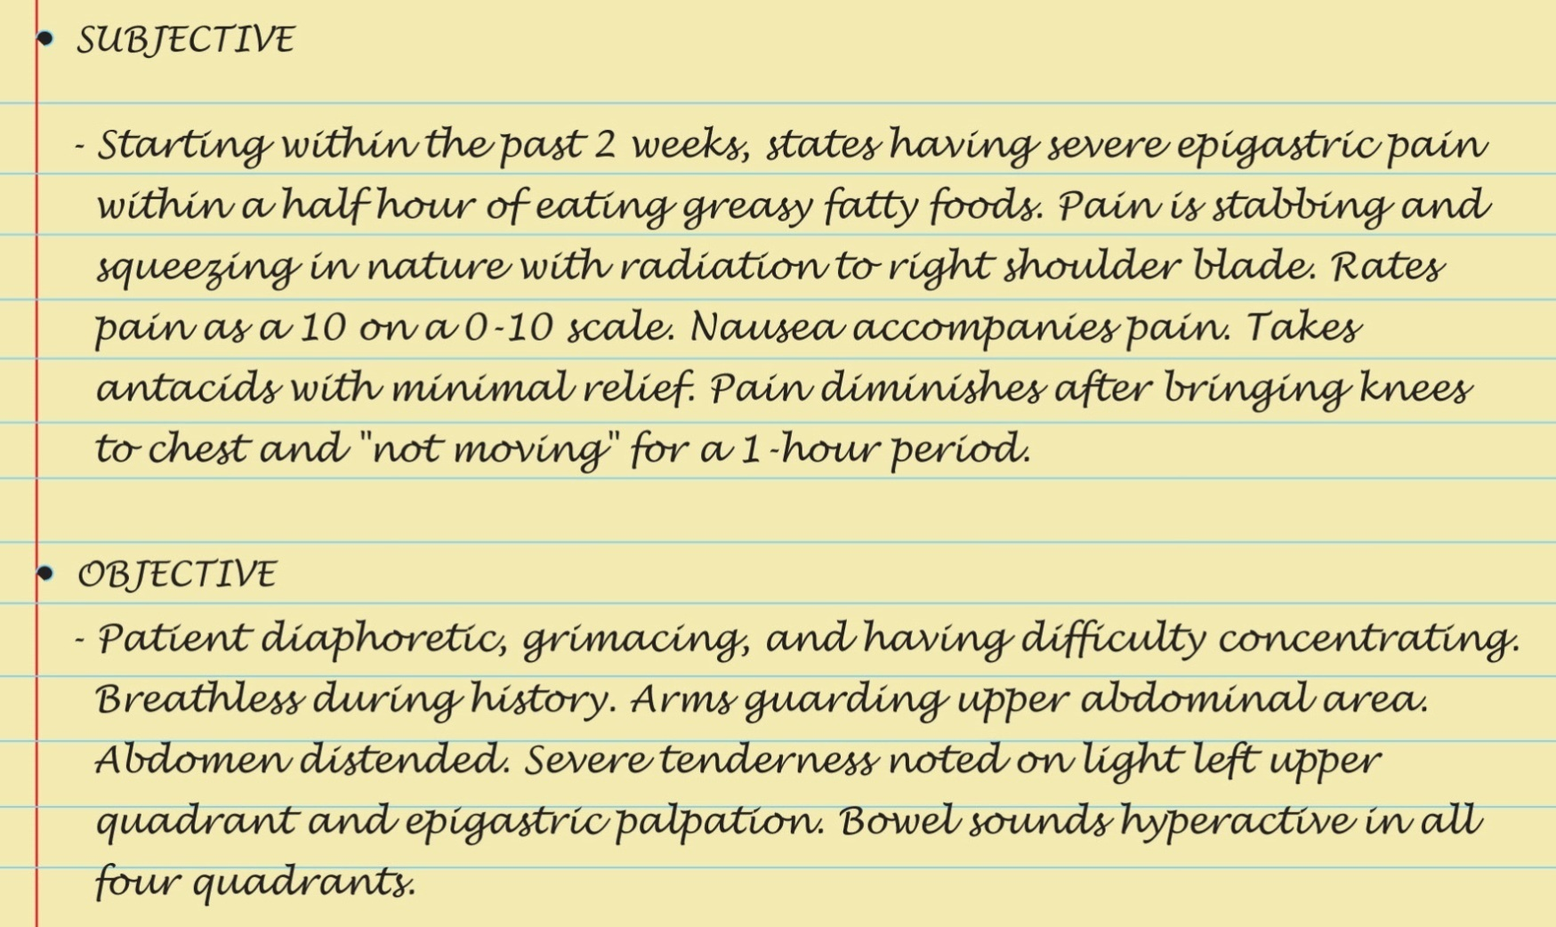
Sample Charting

Slide 61
Case Study
A 52-year-old female presents with complaints of continuing pain across her lower back. Denies any injury or traumatic event but states that the pain is a 10 on a scale of 1 to 10 and that no one believes that she is really in “pain.” Pain has been present for several months.
Notes:
What information would you as the nurse obtain in order to validate the patient’s complaints?
See Chapter 10, Review information relative to Subjective and Objective Data
From Textbook:
Subjective Data:
Ask the patient about her pain using basic-level questions to determine an initial baseline:
1. Do you have pain? Discomfort or soreness? Ouch?
2. Where is your pain? Tell me about all of the places that have pain.
3. When did your pain start?
4. What does your pain feel like?
Burning, stabbing, aching
Throbbing, fire like, squeezing
Cramping, sharp, itching, tingling
Shooting, crushing, sharp, dull
5. How much pain do you have now?
6. What makes your pain better or worse? (Include behavioral, pharmacologic, and nonpharmacologic interventions)
7. How does pain limit your function or activities? What does pain prevent you from doing?
8. How do you usually react when you are in pain? How would others know that you are in pain?
9. What does this pain mean to you? Why do you think you are having pain?
Alternatively you can collect a complete pain health history using the PQRST mnemonic described in Table 10-1.
Objective Data:
Inspect the skin and tissues for color, swelling, and any masses or deformity.
To assess for changes in sensation, ask the person to close his or her eyes. Test the person’s ability to perceive sensation by breaking a tongue blade in two lengthwise. Lightly press the sharp and blunted ends on the skin in a random fashion and ask to identify it as sharp or dull.

Slide 62
Case Study (Cont.)
What information would you as the nurse obtain in order to validate the patient’s complaints?
The patient is still complaining of pain after having been medicated with morphine 1 mg given via intravenous route as an IVP. When you attempt to reposition the patient, she complains even more that just a “mere touch” causes her severe discomfort. How would the nurse interpret this finding?
Notes:
See Chapter 10: Pain Assessment: The Fifth Vital Sign
The detection of pain etiology is a difficult process, especially when the patient presents with what appears to be a chronic pain presentation. Additional information relative to the patient’s complaint would focus on her past medical/surgical history and her current status relative to medications, both prescription and over-the-counter remedies. The nurse must be careful not to pass judgment based on one patient encounter, and even though the patient has voiced that “no one believes her,” the nurse at this point cannot make a valid assessment that the patient is not feeling pain or demonstrating drug-seeking behavior. Additional investigation must be performed in conjunction with the patient’s complaint in order for the nurse to make an accurate determination. Severe pain upon touch indicates both an increased pain response (hyperalgesia) and allodynia (pain sensation evoked in response to a normal stimuli), which pose considerable concern about the patient’s health status.

Slide 63
Case Study (Cont.)
In reviewing the patient’s health record, the nurse notes that there have been multiple admissions for the same “pain complaint” and that the patient had been treated with a variety of pain medications ranging from nonsteroidal anti-inflammatory drugs (NSAIDs) to narcotics with little success. What recommendations might the nurse consider for this patient in order to manage her pain more effectively?
Notes:
See sections in Chapter 10: Pain Assessment: The Fifth Vital Sign
As the patient’s history provides evidence of multiple admissions for the same “pain complaint,” the nurse may want to consider implementing an interdisciplinary health care team to help manage the patient’s pain. Inclusion of a pain management specialist would be beneficial so as to look at alternative methods of pain control. Pharmacologic as well as nonpharmacologic measures might prove to be effective. Additionally, collaborative care with physical therapy and occupational therapy might help the patient become more in “control of her pain.”
The nurse should also review the patient’s records for potential comorbidities such as diabetes or shingles that might be a possible etiology to neuropathic pain. As the pain pattern has persisted, the patient must be assessed for complex regional pain syndrome (CRPS) or reflexive sympathetic dystrophy (RSD).

Slide 64
Case Study (Cont.)
What clinical data, if observed in this patient, would lead the nurse to believe that the patient is experiencing complex regional pain syndrome (CRP)?
Notes:
See sections in Chapter 10: Pain Assessment: The Fifth Vital Sign—Table 10-5
From Textbook:
RSD/CRPS is a chronic progressive nerve condition, characterized by burning pain, swelling, stiffness, and discoloration of the affected extremity. It affects both men and women, usually around 40 to 60 years old, and occurs weeks to months after a nerve injury (e.g., carpal tunnel syndrome, broken leg, cerebral lesions). Pathophysiology involves a complex interaction of sensory, motor, and autonomic nerves and the immune system. The nerve injury may modify the usual pain pathway, causing a neuropathic “wind-up” or “short-circuit” mechanism.
A key feature is that a typically innocuous stimulus (e.g., a light brush of a cotton ball or clothing) can create a severe, intense painful response. Other subjective data include burning pain often disproportionate to the degree of injury and joint pain during movement. Objective data include swelling, disappearance of skin wrinkles, cool skin temperature, discoloration, brittle nails, and finally atrophic changes (pale, dry, shiny skin and muscle atrophy). Treatment includes high doses of drugs (e.g., prednisone, amitriptyline, pregabalin, clonidine) to decrease symptoms and physical therapy to regain limb function.

