Slide 1
Chapter 14
Eyes

Slide 2
External Anatomy
Bony orbital cavity surrounded by cushion of fat protects eye
Eyelids are like two movable shades that further protect eye from injury, strong light, and dust
Upper eyelid larger and more mobile
Eyelashes are short hairs in double or triple rows that curve outward from lid margins, filtering out dust and dirt
Palpebral fissure: elliptical open space between eyelids
When closed, lid margins approximate completely
When open, upper lid covers part of iris
Lower lid margin, at limbus, borders between cornea and sclera
Canthus: corner of eye, angle where lids meet
Inner canthus: caruncle is small fleshy mass containing sebaceous glands

Slide 3
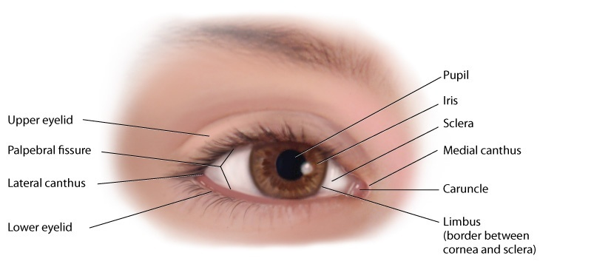
External Anatomy of the Eye

Slide 4
Tarsal Plates
Within upper lid, they are strips of connective tissue that give it shape
Contain meibomian glands, which are modified sebaceous glands that secrete an oily lubricating material onto lids
This stops the tears from overflowing and helps to form an airtight seal when lids are closed

Slide 5
Conjunctiva and Cornea
Conjunctiva: transparent protective covering of exposed part of eye
Palpebral conjunctiva: lines lids, is clear, with many small blood vessels
Bulbar conjunctiva: overlies eyeball, with white sclera showing through
At limbus, conjunctivae merge with cornea
Cornea: covers and protects iris and pupil

Slide 6
Lacrimal Gland
Lacrimal gland, in upper outer corner over eye, secretes tears
Tears wash across eye and drawn up evenly as lid blinks
Drain into puncta, on upper and lower lids at inner canthus
Then drain into nasolacrimal sac, through ½-inch-long nasolacrimal duct, and empty into inferior meatus inside nose

Slide 7
Extraocular Muscles
Six muscles attach eyeball to its orbit and direct eye to points of person’s interest
Give eye both straight and rotary movement
Four straight, or rectus, muscles are superior, inferior, lateral, and medial rectus muscles
Two slanting, or oblique, muscles are superior and inferior muscles
Each muscle is coordinated, or yoked, with one in other eye ensuring that when two eyes move, their axes always remain parallel, called conjugate movement

Slide 8
Extraocular Muscles (Cont.)
Parallel axes are important because human brain has a binocular, single-image visual system
Movement of the extraocular muscles stimulated by three cranial nerves
Cranial nerve VI: abducens nerve, innervates lateral rectus muscle, which abducts eye
Cranial nerve IV: trochlear nerve, innervates superior oblique muscle
Cranial nerve III: oculomotor nerve, innervates all the rest: the superior, inferior, and medial rectus and the inferior oblique muscles

Slide 9
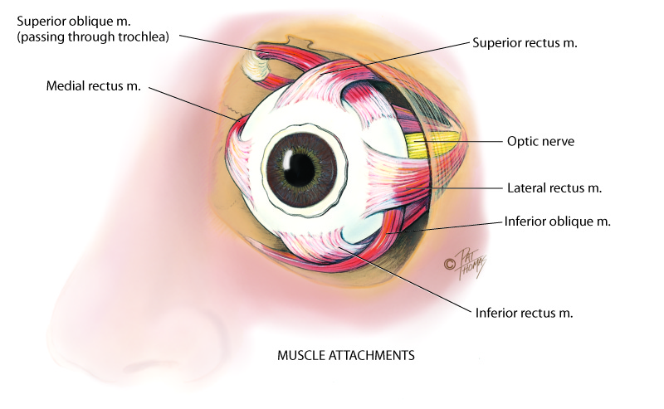
Muscle Attachments
© Pat Thomas, 2006.

Slide 10
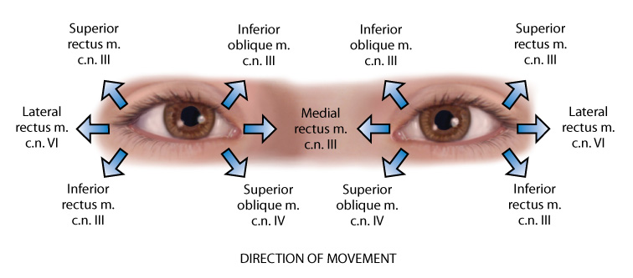
Direction of Movement
© Pat Thomas, 2006.

Slide 11
Internal Anatomy
Eye: a sphere of three concentric coats
Outer fibrous sclera
Middle vascular choroid
Inner nervous retina
Inside retina is transparent vitreous body
Only parts accessible to examination are sclera anteriorly and retina through ophthalmoscope

Slide 12
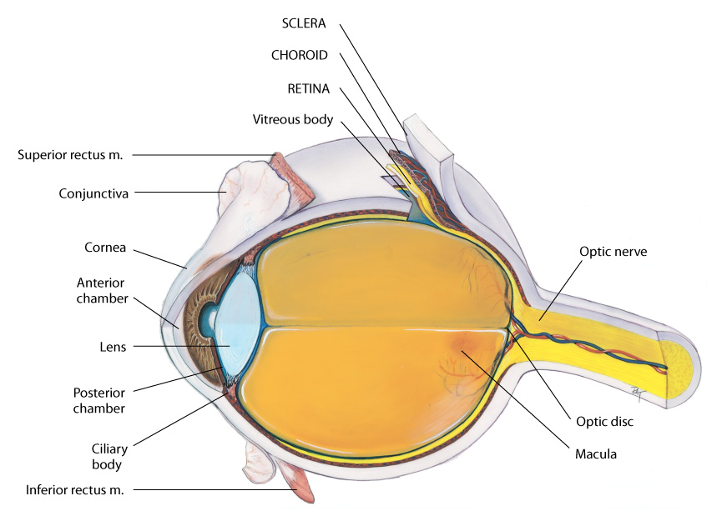
Three Concentric Coats

Slide 13
Internal Anatomy: Outer Layer
Sclera: tough, protective, white covering
Continuous anteriorly with smooth, transparent cornea, which covers iris and pupil
Cornea: part of refracting media of eye, bending incoming light rays so that they will be focused on inner retina
Very sensitive to touch; contact with a wisp of cotton stimulates a blink in both eyes, called corneal reflex
Trigeminal nerve, cranial nerve V, carries afferent sensation into brain, and facial nerve, cranial nerve VII, carries efferent message that stimulates blink

Slide 14
Internal Anatomy: Middle Layer
Choroid: has dark pigmentation to prevent light from reflecting internally and is heavily vascularized to deliver blood to retina
Anteriorly is continuous with ciliary body and iris
Muscles of ciliary body control thickness of lens
Iris: functions as a diaphragm, varying opening at its center, the pupil
Controls amount of light admitted into retina
Muscle fibers of iris contract pupil in bright light and to accommodate for near vision, and dilate pupil when light is dim and for far vision

Slide 15
Internal Anatomy: Middle Layer (Cont.)
Pupil: round and regular; size determined by balance between parasympathetic and sympathetic chains of autonomic nervous system
Stimulation of parasympathetic branch, through cranial nerve III, causes constriction of pupil
Stimulation of sympathetic branch dilates pupil and elevates eyelid
Pupil size also reacts to amount of ambient light and to accommodation, or focusing an object on retina

Slide 16
Internal Anatomy: Middle Layer (Cont.)
Lens: biconvex disc located just posterior to pupil
Transparent, it serves as a refracting medium, keeping a viewed object in focus on retina
Thickness controlled by ciliary body; lens bulges focusing on near objects; flattens for far objects
Anterior and posterior chambers contain clear, watery aqueous humor produced continually by ciliary body
Continuous flow of fluid serves to deliver nutrients to surrounding tissues and to drain metabolic wastes
Intraocular pressure determined by balance between amount of aqueous produced and resistance to outflow

Slide 17
Internal Anatomy: Inner Layer
Retina: the visual receptive layer of eye where light waves change into nerve impulses
Retinal structures viewed through ophthalmoscope are optic disc, retinal vessels, general background, and macula
Optic disc: area in which fibers from retina converge to form optic nerve
Located toward nasal side of retina, it has these characteristics: a color that varies from creamy yellow-orange to pink; a round or oval shape; margins that are distinct and sharply demarcated, especially on temporal side; and a physiologic cup, the smaller circular area inside disc where blood vessels exit and enter

Slide 18
Internal Anatomy: Inner Layer (Cont.)
Retinal vessels: normally include a paired artery and vein extending to each quadrant
Macula: located on temporal side of fundus
Slightly darker pigmented region surrounding fovea centralis, area of sharpest and keenest vision
Receives and transduces light from center of visual field

Slide 19
Visual Pathways and Visual Fields
Light rays are refracted through transparent media, the cornea, aqueous humor, lens, and vitreous body, striking the retina
Retina transforms light stimulus into nerve impulses conducted to visual cortex
Image formed on retina is upside down and reversed
All retinal fibers collect to form optic nerve, but maintain same spatial arrangement
At optic chiasm, fibers from both visual fields cross over
Left optic tract now has fibers from left half of each retina, and right optic tract contains fibers only from right; thus, right side of brain looks at left side of the world

Slide 20
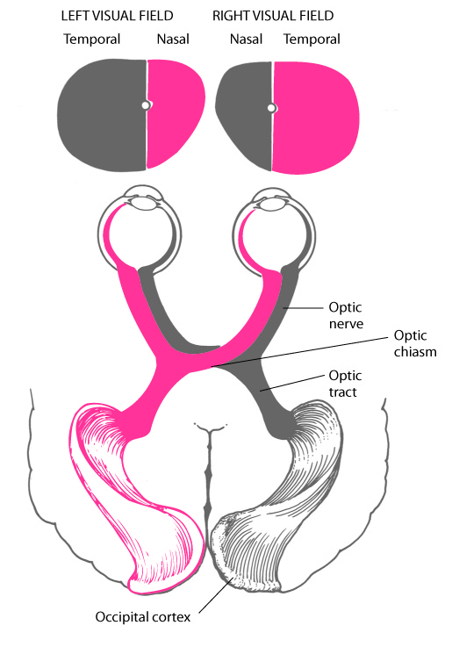
Visual Pathways

Slide 21
Visual Reflexes
Pupillary light reflex: normal constriction of pupils when bright light shines on retina
Subcortical reflex arc, person has no conscious control over it
Sensory afferent link is cranial nerve II, optic nerve
Motor efferent path is cranial III, oculomotor nerve
When one eye exposed to bright light, a direct light reflex occurs, constriction of that pupil; and a consensual light reflex, simultaneous constriction of other pupil
Because the optic nerve carries the sensory afferent message in and then synapses with both sides of brain

Slide 22
Visual Reflexes (Cont.)
Fixation: a reflex direction of eye toward an object attracting person’s attention
Image fixed in center of visual field, the fovea centralis
Consists of rapid ocular movements to put target back on the fovea, and somewhat slower movements to track target and keep its image on fovea
These ocular movements are impaired by drugs, alcohol, fatigue, and inattention

Slide 23
Visual Reflexes (Cont.)
Accommodation: adaptation of eye for near vision
Accomplished by increasing curvature of lens through movement of ciliary muscles
Although lens cannot be observed directly, the following components of accommodation can be observed:
Convergence (motion toward) of the axes of the eyeballs
Pupillary constriction

Slide 24
Developmental Competence: Infants and Children
Peripheral vision is intact in newborn infant
Macula, area of keenest vision, is absent at birth but mature by 8 months
By 3 to 4 months of age, infant establishes binocularity and can fixate on a single image with both eyes simultaneously
Lens is nearly spherical at birth, growing flatter throughout life
Consistency changes from that of soft plastic at birth to rigid glass in old age

Slide 25
Developmental Competence: Aging Adults
Pupil size decreases
Lens loses elasticity, becoming hard and glasslike, which decreases ability to change shape to accommodate for near vision; this condition is termed presbyopia
By age 70, normally transparent fibers of lens begin to thicken and yellow, the beginning of cataracts
Visual acuity may diminish gradually after age 50, and more so after age 70

Slide 26
Developmental Competence: Aging Adults (Cont.)
Most common causes of decreased visual functioning in older adults are the following:
Cataract formation, or lens opacity, resulting from a clumping of proteins in lens
Glaucoma, or increased intraocular pressure; chronic open-angle glaucoma is most common type
Macular degeneration, or breakdown of cells in macula of retina
Loss of central vision is most common cause of blindness; person is unable to read fine print, sew, or do fine work; loss of central vision may cause great distress

Slide 27
Cultural Competence
Racial differences evident in palpebral fissures
Persons of Asian origin often identified by eyes, whereas presence of narrowed palpebral fissures in non-Asian individuals may be diagnostic of congenital anomaly, Down syndrome
Culturally based variability exists in color of iris and retinal pigmentation, with darker irides having darker retinas behind them

Slide 28
Cultural Competence (Cont.)
Racial variations in disease
Primary open-angle glaucoma affects African Americans three to six times more often than Whites and is six times more likely to cause blindness than in Whites; reasons are not known
Prevalence rates are 50% higher for those living below the poverty level than among other adults
Age-related macular degeneration (AMD) is more prevalent among Whites, especially those over the age of 75, and is the leading form of blindness in Whites

Slide 29
Subjective Data
Vision difficulty: decreased acuity, blurring, blind spots
Pain
Strabismus, diplopia
Redness, swelling
Watering, discharge
History of ocular problems
Glaucoma
Use of glasses or contact lenses
Self-care behaviors

Slide 30
Vision Difficulty Questions
Any difficulty seeing or any blurring? Blind spots? Come on suddenly or slowly? One eye or both?
Constant, or does it come and go?
Do objects appear out of focus or clouding of objects?
Do spots move in front of your eyes? One or many? In one or both eyes?
Any halos, rainbows, rings around objects?
Any blind spot? Does it move as you shift your gaze? Any loss of peripheral vision?
Any night blindness?

Slide 31
Question
The nurse is obtaining a focused review of a patient’s eye function. Which statement by the patient would require emergent medical attention?
“I see flashing lights and spots.”
“My eyes feel tired all the time.”
“My eyes get watery when I am gardening.”
“I’m having trouble seeing when I drive at night.”
Notes:
The correct answer is 1. Seeing spots or floaters and flashing lights could be a sign of retinal detachment, which is a medical emergency.
Answer 2 is incorrect because this could be either a normal finding or an indication to renew/change glasses.
Answer 3 is incorrect because watery eyes in this case are most likely environmental allergies.
Answer 4 is incorrect because having trouble seeing at night may be a sign of cataracts or vitamin A deficiency and is not considered an medical emergency.

Slide 32
Pain Questions
Any eye pain? Please describe
Come on suddenly?
Quality: burning or itching? Or sharp, stabbing pain; pain with bright light?
A foreign body sensation? Or deep aching? Or headache in brow area?

Slide 33
Strabismus, Diplopia, Redness and Swelling
Strabismus, diplopia: Any history of crossed eyes? Now or in the past? Does this occur with eye fatigue?
Ever see double? Constant, or does it come and go? In one eye or both?
Redness, swelling
Any redness or swelling in eyes?
Any infections? Now or in past? When do these occur? In a particular time of year?

Slide 34
Discharge and Past History
Watering, discharge
Any watering or excessive tearing?
Any discharge? Any matter in the eyes? Is it hard to open your eyes in the morning? What color is the discharge?
How do you remove matter from eyes?
Past history of ocular problems
Any history of injury or surgery to eye? Any history of allergies?

Slide 35
Glaucoma, Eyeglasses, and Contact Lenses
Glaucoma
Have you ever been tested for glaucoma? What were the results?
Do you have any family history of glaucoma?
Use of glasses or contact lenses
Do you wear glasses or contact lenses? How do they work for you?
Last time your prescription was checked? Was it changed?
If you wear contact lenses, are there any problems such as pain, photophobia, watering, or swelling?

Slide 36
Self-Care Behaviors
How do you care for contacts? How long do you wear them? How do you clean them? Do you remove them for certain activities?
Last vision test? Ever tested for color?
Any environmental conditions at home or at work that may affect your eyes? If so, do you wear goggles to protect your eyes?
What medications are you taking? Systemic or topical? Any specifically for eyes?
If you have experienced a vision loss, how do you cope? Do you have books with large print, books on audio tape, braille?
Do you maintain living environment the same?
Do you sometimes fear complete loss of vision?

Slide 37
Additional History for Infants and Children
Any vaginal infections in mother at delivery?
Considering age of child, which developmental milestones of vision have you (parent) noted?
Does child have routine vision testing at school?
Are you (parent) aware of safety measures to protect child’s eyes from trauma? Do you inspect toys?
Have you taught child safe care of sharp objects and how to carry and how to use them?

Slide 38
Additional History for Aging Adults
Have you noticed any visual difficulty with climbing stairs or driving? Any problem with night vision?
When was last time tested for glaucoma?
Any aching pain around eyes? Any loss of peripheral vision?
If you have glaucoma, how do you manage your eyedrops?
Is there history of cataracts? Any loss or progressive blurring of vision?
Do your eyes ever feel dry or burning? What do you do for this?
Any decrease in usual activities, such as reading or sewing?

Slide 39
Objective Data
Preparation
Position person standing for vision screening; then sitting up with head at your eye level
Equipment needed
Snellen eye chart
Handheld visual screener
Opaque card or occluder
Penlight

Slide 40
Test Central Visual Acuity
Snellen alphabet chart is most commonly used and accurate measure of visual acuity
It has lines of letters arranged in decreasing size
Place chart in a well-lit spot at eye level; position person exactly 20 feet from chart; hand person an opaque card with which to shield one eye at a time during test
If person wears glasses or contact lenses, leave them on; remove only reading glasses
Ask person to read through chart to smallest line of letters possible; encourage trying next smallest line also

Slide 41
Test Central Visual Acuity (Cont.)
If person unable to see even largest letters, shorten distance to chart until the person sees it, and record that distance (e.g., 10/20)
If visual acuity even lower, assess whether person can count your fingers when they are spread in front of eyes or distinguish light perception from your penlight

Slide 42
Test Near Vision
For those who report increasing difficulty reading
Test near vision with handheld vision screener with various sizes of print (e.g., a Jaeger card)
Hold card in good light about 35 cm (14 inches) from the eye; this distance equals print size on 20-foot chart
Test each eye separately, with glasses on
Normal result is “14/14” in each eye, read without hesitancy and without moving card closer or farther away
When no vision screening card is available, ask person to read from a magazine or newspaper

Slide 43
Confrontation Test
Gross measure of peripheral vision; compares person’s peripheral vision with yours
Position yourself at eye level with person about 2 feet away
Direct person to cover one eye with an opaque card and with other eye to look straight at you
Cover your own eye opposite to person’s covered one; you are testing uncovered eye
Hold pencil or your finger as target midline between you and person, and slowly advance it in from periphery in several directions

Slide 44
Confrontation Test (Cont.)
Ask person to say “now” as target is first seen; this should be just as you see the object also
Estimate angle between anteroposterior axis of eye and peripheral axis where object is first seen
Normal results are about 50 degrees upward, 90 degrees temporal, 70 degrees down, and 60 degrees nasal

Slide 45
Corneal Light Reflex
Also known as the Hirschberg test
Assess parallel alignment of eye axes by shining a light toward person’s eyes
Direct person to stare straight ahead as you hold the light about 30 cm (12 inches) away
Note reflection of light on corneas; should be in exactly same spot on each eye

Slide 46
Cover Test
This test detects small degrees of deviated alignment by interrupting fusion reflex that normally keeps two eyes parallel
Ask the person to stare straight ahead at your nose, even though gaze may be interrupted
With an opaque card, cover one eye; note uncovered eye; normal response is a steady fixed gaze
Meanwhile, macular image has been suppressed on covered eye

Slide 47
Cover Test (Cont.)
If muscle weakness exists, covered eye will drift into a relaxed position
Now uncover eye and observe it for movement
It should stare straight ahead
If it jumps to reestablish fixation, eye muscle weakness exists
Repeat with other eye

Slide 48
Diagnostic Positions Test
Leading eyes through six cardinal positions of gaze will elicit any muscle weakness during movement
Ask person to hold head steady and follow movement of your finger, pen, or penlight only with his or her eyes
Hold target back about 12 inches so person can focus comfortably, and move it to each of six positions; hold momentarily, then back to center
Progress clockwise; normal response is parallel tracking of object with both eyes

Slide 49
Diagnostic Positions Test (Cont.)

Slide 50
Diagnostic Positions Test (Cont.)
In addition to parallel movement, note any nystagmus, a fine oscillating movement best seen around iris
Mild nystagmus at extreme lateral gaze is normal; nystagmus at any other position is not
Finally, note that upper eyelid continues to overlap superior part of iris, even during downward movement
You should not see white rim of sclera between lid and iris
If noted, this is termed lid lag

Slide 51
General Inspection and Eyebrows
General: begin with external points, work inward
Already you will have noted person’s ability to move around room, with vision functioning well enough to avoid obstacles and to respond to your directions
Also note facial expression; relaxed expression accompanies adequate vision
Eyebrows
Look for symmetry between the two eyes
Normally eyebrows are present bilaterally, move symmetrically as expression changes, and have no scaling or lesions

Slide 52
Eyelids, Lashes, and Eyeballs
Eyelids and lashes
Upper lids normally overlap superior part of iris, and approximate completely with lower lids when closed
Palpebral fissures horizontal in non-Asians; Asians normally have an upward slant
Note that eyelashes are evenly distributed along lid margins and curve outward
Eyeballs
Eyeballs aligned normally in their sockets with no protrusion or sunken appearance
African Americans normally may have slight protrusion of eyeball beyond supraorbital ridge

Slide 53
Conjunctiva and Sclera
Ask person to look up; using thumbs, slide lower lids down along orbital rim, being careful not to push against eyeball
Inspect exposed area; eyeball should look moist and glossy
Numerous small blood vessels normally show through transparent conjunctiva
Otherwise, conjunctivae clear and show normal color of structure below; pink over lower lids and white over sclera
Note any color change, swelling, or lesions

Slide 54
Conjunctiva and Sclera (Cont.)
Sclera is china white, although African Americans occasionally have gray-blue or “muddy” color to sclera
Also in dark-skinned people, you normally may see small brown macules (like freckles) on sclera, which should not be confused with foreign bodies or petechiae
Last, African Americans may have yellowish fatty deposits beneath lids away from cornea
Do not confuse these yellow spots with overall scleral yellowing that accompanies jaundice

Slide 55
Lacrimal Apparatus
Ask person to look down; with thumbs, slide outer part of upper lid up along bony orbit to expose under lid; inspect for any redness or swelling
Normally puncta drain tears into lacrimal sac
Presence of excessive tearing may indicate blockage of nasolacrimal duct
Check by pressing index finger against sac, just inside lower orbital rim, not against side of the nose
Pressure will slightly evert lower lid, but there should be no other response to pressure

Slide 56
Cornea and Lens
Shine light from side across cornea, and check for smoothness and clarity
Oblique view highlights any abnormal irregularities in corneal surface
There should be no opacities (cloudiness) in cornea, anterior chamber, or lens behind the pupil
Do not confuse an arcus senilis with an opacity; arcus senilis is normal finding in aging persons

Slide 57
Iris and Pupil
Iris normally appears flat, with round regular shape and even coloration
Note size, shape, and equality of pupils; normally pupils appear round, regular, and of equal size in both eyes
To test pupillary light reflex, darken room and ask person to gaze into distance; this dilates pupils; advance a light in from side and note response
Normally you will see constriction of same-sided pupil (a direct light reflex) and simultaneous constriction of other pupil (a consensual light reflex)

Slide 58
Iris and Pupil (Cont.)
Test for accommodation by asking person to focus on a distant object
This dilates pupils; then have person shift gaze to near object, such as your finger held about 7 to 8 cm (3 inches) from nose
Normal response includes
Pupillary constriction
Convergence of axes of eyes
Record normal response to all these maneuvers as PERRLA, or Pupils Equal, Round, React to Light, and Accommodation

Slide 59
Question
The nurse is assessing the pupils of a patient with a pen light. Which finding would be considered normal?
Both eyes cross when exposed to the light.
The patient’s pupils are fixed and dilated in response to light.
Both pupils dilate in response to light.
Both pupils constrict in response to light.
Notes:
The correct answer is 4.The pupils should constrict in response to light.
Answer 1 is incorrect because this would be assessing ocular movements.
Answer 2 is incorrect because this finding is consistent with brain damage.
Answer 3 is incorrect because this finding may indicate narcotic use.

Slide 60
Inspection of Ocular Fundus
Ophthalmoscope enlarges your view of eye so that you can inspect media (anterior chamber, lens, vitreous) and the ocular fundus (internal surface of retina)
Recall that ophthalmoscope contains set of lenses that control focus
Unit of strength of each lens is diopter
Black numbers indicate positive diopter; they focus on nearer objects
Red numbers show negative diopter and focus on objects farther away

Slide 61
Ocular Fundus Examination
To examine person
Darken room to help dilate pupils; dilating eyedrops are not needed during a screening examination
Select large round aperture with white light for routine examination
If pupils are small, use smaller white light
Ask person to please keep looking at mark on wall across room
Staring at distant fixed object helps to dilate pupils and to hold retinal structures still

Slide 62
Ocular Fundus Examination (Cont.)
To examine person (Cont.)
Begin about 25 cm (10 inches) away from person at angle of 15 degrees to person’s line of vision
Note red glow filling person’s pupil; this is red reflex, caused by reflection of ophthalmoscope light off inner retina
Keep sight of red reflex, and steadily move closer to eye
If you lose red reflex, adjust angle to find it again
As you advance, adjust lens to #6 and note any opacities in media; these appear as dark shadows or black dots interrupting red reflex; normally, none is present

Slide 63
Ocular Fundus Examination (Cont.)
To examine person (Cont.)
Progress toward person until foreheads almost touch
Adjust diopter to bring ocular fundus into sharp focus; if you and person have normal vision, this should be at 0
Moving diopters compensates for near- or farsightedness
Use red lenses for nearsighted eyes
Use black lenses for farsighted eyes
Moving in on 15-degree lateral line should bring your view just to optic disc
If disc is not in sight, track a blood vessel as it grows larger and it will lead to disc

Slide 64
Ocular Fundus Examination (Cont.)
To examine person (Cont.)
Systematically inspect structures in ocular fundus
Optic disc
Retinal vessels
General background
Macula

Slide 65
Inspection of Optic Disc
Most prominent landmark is optic disc, located on nasal side of retina; explore these characteristics:
Color: creamy yellow-orange to pink
Shape: round or oval
Margins: distinct and sharply demarcated, although nasal edge may be slightly fuzzy
Cup-disc ratio: distinctness varies; when visible, physiologic cup is brighter yellow-white than rest of disc; width not more than one half disc diameter

Slide 66
Inspection of Optic Disc (Cont.)
Two normal variations may ring disc margins
Scleral crescent: gray-white new moon shape occurs when pigment absent in choroid layer looking directly at sclera
Pigment crescent: black due to accumulation of pigment in choroid
Diameter of disc, or DD, is standard measure for other fundus structures
To describe finding, note its clock-face position and relationship to disc in size and distance (e.g., at 5:00, 3 DD from disc)

Slide 67
Retinal Vessels
Only place in body where you can view blood vessels directly
Many systemic diseases that affect vascular system show signs in retinal vessels
Follow a paired artery and vein out to periphery in four quadrants, noting these points:
Number: paired artery and vein pass to each quadrant; vessels look straighter at nasal side
Color: arteries brighter red than veins; also have arterial light reflex, with thin stripe of light down middle
A:V ratio: ratio comparing artery-to-vein width is 2:3 or 4:5
Caliber: arteries and veins show a regular decrease in caliber as they extend to periphery

Slide 68
Retinal Vessels (Cont.)
A-V, arteriovenous crossing: artery and vein may cross paths; not significant if within 2 DD of disc and if no sign of interruption in blood flow is seen; should be no indenting or displacing of vessel
Tortuosity: mild vessel twisting when present in both eyes is usually congenital and not significant
Pulsations: present in veins near disc as their drainage meets intermittent pressure of arterial systole; often hard to see

Slide 69
Fundus and Macula
General background of fundus
Color normally varies from light red to dark brown-red; view of fundus should be clear; no lesions should obstruct retinal structures
Macula
1 DD in size, located 2 DD temporal to disc
Inspect last in funduscopic examination; bright light causes some watering, discomfort, and pupillary constriction
Normal color somewhat darker than rest of fundus but even and homogeneous
Clumped pigment may occur with aging

Slide 70
Developmental Competence
Infants and children
Eye examination often deferred at birth because of transient edema of lids from birth trauma or from the instillation of silver nitrate at birth; eyes should be examined within a few days and at every well child visit thereafter

Slide 71
Infants and Children: Visual Acuity
Child’s age determines screening measures used
In newborn, test visual reflexes and attending behaviors
Test light perception using blink reflex; neonate blinks in response to bright light
Also, pupillary light reflex shows that pupils constrict in response to light
These reflexes indicate that the lower portion of the visual apparatus is intact
But cannot infer that infant can see; that requires later observation to show that brain has received images and can interpret them

Slide 72
Infants and Children: Visual Acuity (Cont.)
As you introduce an object to infant’s line of vision, note these attending behaviors:
Birth to 2 weeks: refusal to reopen eyes after exposure to bright light; increasing alertness to object; infant may fixate on an object
By 2 to 4 weeks: infant can fixate on an object
By 1 month: infant can fixate and follow light or bright toy
By 3 to 4 months: infant can fixate, follow, and reach for toy
By 6 to 10 months: infant can fixate and follow toy in all directions

Slide 73
Visual Acuity Testing and Visual Fields
Infants and children
Visual acuity testing
Allen test, picture cards, screens children from 2½ years to 2 years, 11 months, and is even reliable with cooperative toddlers as young as 2
Use picture chart or Snellen E chart for preschooler from age 3 to 6; normally a child achieves 20/20 acuity by age 6 to 7
Visual fields
Assess peripheral vision with confrontation test in children older than 3 years

Slide 74
Color Vision and Extraocular Muscle Function (EOM)
Infants and children
Color vision
Color blindness an inherited recessive X-linked trait affecting about 8% of White males and 4% of African American males; rare in females
Test only boys for color vision, once between ages of 4 and 8; use Ishihara test
Extraocular muscle function
Testing for strabismus (squint, crossed eye) is important screening measure during early childhood
Test malalignment by corneal light reflex and cover test
Check corneal light reflex

Slide 75
External Eye Structures
Infants and children
External eye structures
Inspect ocular structures as described in earlier section
A neonate usually holds the eyes tightly shut; do not attempt to pry them open; that just increases contraction of the orbicularis oculi muscle

Slide 76
Eyelids and Lashes
Infants and children
Eyelids and lashes
In newborns, setting-sun sign common; eyes appear to deviate down with white rim of sclera visible over iris
Many infants have an epicanthal fold, an excess skinfold extending over inner corner of eye, partly or totally overlapping inner canthus
It occurs frequently in Asian children and in 20% of Whites
In non-Asians usually disappears by 10 years of age
While present, epicanthal folds give false appearance of malalignment, termed pseudostrabismus; yet corneal light reflex is normal

Slide 77
Eye Structures
Infants and children
Conjunctiva and sclera
Newborn may have transient chemical conjunctivitis from instillation of silver nitrate; appears within 1 hour and lasts not more than 24 hours after birth
Sclera should be white and clear, although it may have a blue tint as a result of thinness at birth; lacrimal glands are not functional at birth
Iris and pupils
Iris normally blue or slate gray in light-skinned newborns and brown in dark-skinned infants; by 6 to 9 months, permanent color differentiated

Slide 78
Ocular Fundus
Infants and children
Ocular fundus
The amount of data gathered during funduscopic examination depends on child’s ability to hold eyes still and on your ability to glean as much as possible in brief period
A complete funduscopic examination is difficult to perform on an infant; at least check red reflex and note any interruption
Perform funduscopic examination on infants between 2 and 6 months
Position infant (up to 18 months) lying on table

Slide 79
Ocular Fundus (Cont.)
Infants and children
Ocular fundus
Fundus appears pale, and vessels are not fully developed; no foveal light reflection because macula area will not be mature until 1 year of age
Inspect fundus of young and school-age child as described in preceding section on adult
Allow child to handle equipment; explain why you are darkening room and that you will leave a small light on
Assure child that procedure will not hurt; direct child to look at an appealing picture, perhaps a toy or an animal, during examination

Slide 80
Developmental Competence
Aging adult
Visual acuity
Perform same examination as described in adult section
Central acuity may decrease, particularly after 70 years of age; peripheral vision may be diminished
Ocular structures
Eyebrows may show loss of outer one third to one half of hair because of decrease in hair follicles; remaining brow hair is coarse
As result of atrophy of elastic tissues, skin around eyes may show wrinkles or crow’s feet; upper lid may be so elongated as to rest on lashes, resulting in pseudoptosis

Slide 81
Developmental Competence (Cont.)
Aging adult
Ocular structures
Eyes may appear sunken from atrophy of orbital fat; orbital fat may herniate, causing bulging at lower lids and inner third of upper lids
Lacrimal apparatus may decrease tear production, causing eyes to look dry and lusterless and person to report a burning sensation
Pingueculae commonly show on sclera
These yellowish elevated nodules are due to thickening of bulbar conjunctiva from prolonged exposure to sun, wind, and dust; they appear at 3 and 9 o’clock positions

Slide 82
Developmental Competence (Cont.)
Aging adult
Ocular structures
Cornea may look cloudy with age
Arcus senilis commonly seen around cornea
Gray-white arc or circle around limbus due to deposition of lipid material
As more lipid accumulates, cornea may look thickened and raised, but arcus has no effect on vision
Xanthelasma: soft, raised yellow plaques occurring on lids at inner canthus
They commonly occur around fifth decade of life and more frequently in women, occur with both high and normal levels of cholesterol, and have no pathologic significance

Slide 83
Developmental Competence (Cont.)
Aging adult
Ocular structures
Pupils small in old age; pupillary light reflex may be slowed
Lens loses transparency and looks opaque
Ocular fundus
Retinal structures generally have less shine; blood vessels look paler, narrower, and attenuated; arterioles appear paler and straighter, with a narrower light reflex
Drusen, or benign degenerative hyaline deposits, are normal development on retinal surface
Often symmetrically placed in eyes with no effect on vision

Slide 84
Sample Charting: Subjective

Slide 85
Sample Charting: Objective

Slide 86
Sample Charting: Assessment

Slide 87
Summary Checklist: Eye Examination
Test visual acuity
Snellen eye chart
Test visual fields
Confrontation test
Inspect EOM function
Corneal light reflex, cover test, diagnostic positions test
Inspect external eye structures
Inspect anterior eyeball structures
Inspect ocular fundus
Optic disc, retinal vessels, general background, and macula

Slide 88
Abnormal Findings: Extraocular Muscle Dysfunction
Strabismus
Esotropia
Exotropia
Paralysis

Slide 89
Abnormal Findings: Abnormalities in the Eyelids
Periorbital edema
Exophthalmos, protruding eyes
Enophthalmos, sunken eyes
Ptosis, drooping upper lid
Upward palpebral slant
Ectropion
Entropion

Slide 90
Abnormal Findings: Lesions on the Eyelids
Blepharitis, inflammation of eyelids
Chalazion
Hordeolum, stye
Dacryocystitis, inflammation of lacrimal sac
Basal cell carcinoma

Slide 91
Abnormalities in the Pupil
Unequal pupil size, anisocoria
Monocular blindness
Constricted and fixed pupils, miosis
Dilated and fixed pupils, mydriasis
Argyll Robertson pupil
Tonic pupil, Adie’s pupil
Cranial nerve III damage
Horner’s syndrome

Slide 92
Abnormal Findings: Visual Field Loss
Retinal damage
Lesion in globe or optic nerve
Lesion at optic chiasm
Lesion of outer uncrossed fibers at optic chiasm
Lesion R optic tract or R optic radiation

Slide 93
Abnormal Findings: Vascular Disorders of External Eye
Conjunctivitis
Subconjunctival hemorrhage
Iritis, circumcorneal redness
Acute glaucoma

Slide 94
Abnormal Findings: Cornea and Iris
Pterygium
Corneal abrasion
Hyphema
Hypopyon

Slide 95
Abnormal Findings: Opacities in the Lens
Central gray opacity, nuclear cataract
Star-shaped opacity, cortical cataract

Slide 96
Abnormal Findings: Abnormalities in the Optic Disc
Optic atrophy, disc pallor
Papilledema, choked disc
Excessive cup-disc ratio

Slide 97
Abnormal Findings: Retinal Vessels and Background
Arteriovenous crossing, nicking
Narrowed, attenuated, arteries
Diabetic retinopathy
Microaneurysms
Intraretinal hemorrhages
Exudates

