Slide 1
Chapter 15
Ears

Slide 2
Structure and Function: External Ear
Called the auricle or pinna
Consists of movable cartilage and skin
Characteristic shape serves to funnel sound waves into its opening, which is called the external auditory canal
Auditory canal
A cul-de-sac 2.5 to 3 cm long in adults that terminates at eardrum, or tympanic membrane
Lined with glands that secrete cerumen, a yellow waxy material that lubricates and protects ear
Forms sticky barrier to keep foreign bodies from entering and reaching sensitive tympanic membrane

Slide 3
Structure and Function: External Ear (Cont.)
Outer one third of canal is cartilage
Inner two thirds consists of bone covered by thin sensitive skin
Canal has a slight S-curve in adult
Lymphatic drainage of external ear flows to parotid, mastoid, and superficial cervical nodes

Slide 4
Tympanic Membrane (TM)
Also called the eardrum, separates external and middle ear
Translucent membrane with a pearly gray color
Oval and slightly concave, pulled in at its center by one of middle ear ossicles, the malleus
Parts of malleus show through translucent drum: umbo, manubrium (handle), and the short process
Pars flaccida: small, slack, superior section of TM
Pars tensa: remainder of TM, thicker and more taut
Annulus: outer fibrous rim of the TM

Slide 5
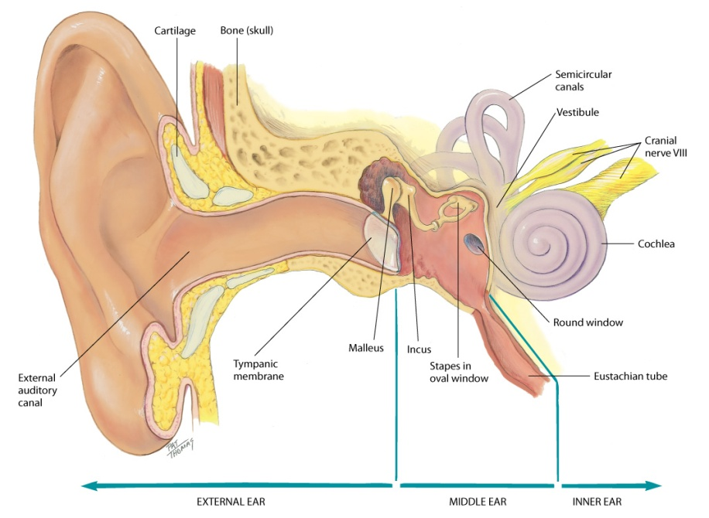
External Ear

Slide 6
Structure and Function: Middle Ear
Tiny air-filled cavity inside temporal bone
Contains tiny ear bones, or auditory ossicles: the malleus, incus, and stapes
Several openings are present
Opening to the outer ear is covered by the TM
Openings to inner ear are oval window at the end of the stapes and the round window
Eustachian tube: opening that connects middle ear with nasopharynx and allows passage of air
Normally closed, but opens with swallowing or yawning

Slide 7
Structure and Function: Middle Ear (Cont.)
Has three functions
Conducts sound vibrations from outer ear to central hearing apparatus in inner ear
Protects inner ear by reducing amplitude of loud sounds
Eustachian tube allows equalization of air pressure on each side of TM so that it does not rupture

Slide 8
Structure and Function: Inner Ear
Contains the bony labyrinth, which holds sensory organs for equilibrium and hearing
Vestibule and semicircular canals within bony labyrinth compose the vestibular apparatus
Cochlea contains central hearing apparatus
Although the inner ear is not accessible to direct examination, its functions can be assessed

Slide 9
Structure and Function: Hearing
Hearing
Auditory system can be divided into three levels:
Peripheral, brainstem, and cerebral cortex
At peripheral level, ear transmits sound and converts its vibrations into electrical impulses, which can be analyzed by brain
Amplitude: loudness
Frequency: pitch or number of cycles per second

Slide 10
Structure and Function: Hearing (Cont.)
Sound waves produce vibrations on TM
Carried by middle ear ossicles to oval window
Through cochlea, and dissipated against round window
Along the way, the basilar membrane vibrates at a point specific to frequency of sound
Numerous fibers along basilar membrane are receptor hair cells of organ of Corti, the sensory organ of hearing
As hair cells bend, they mediate vibrations into electric impulses, which are conducted by auditory portion of cranial nerve VIII to brainstem

Slide 11
Structure and Function: Hearing (Cont.)
Function at brainstem level is binaural interaction
Locates direction of a sound in space, as well as identifying the sound
How does this work?
Each ear is actually one half of total sensory organ
Cranial nerve VIII from each ear sends signals to both sides of brainstem, which are sensitive to differences in intensity and timing of messages from two ears, depending on way head is turned
Finally, the function of the cortex is to interpret meaning of the sound and begin appropriate response; all this happens in the split second it takes to react to a sound

Slide 12
Structure and Function: Hearing (Cont.)
Pathways of hearing
Normal pathway of hearing is air conduction (AC) described previously; it is the most efficient
Alternate route is by bone conduction (BC)
Bones of the skull vibrate and are transmitted directly to inner ear and to cranial nerve VIII

Slide 13
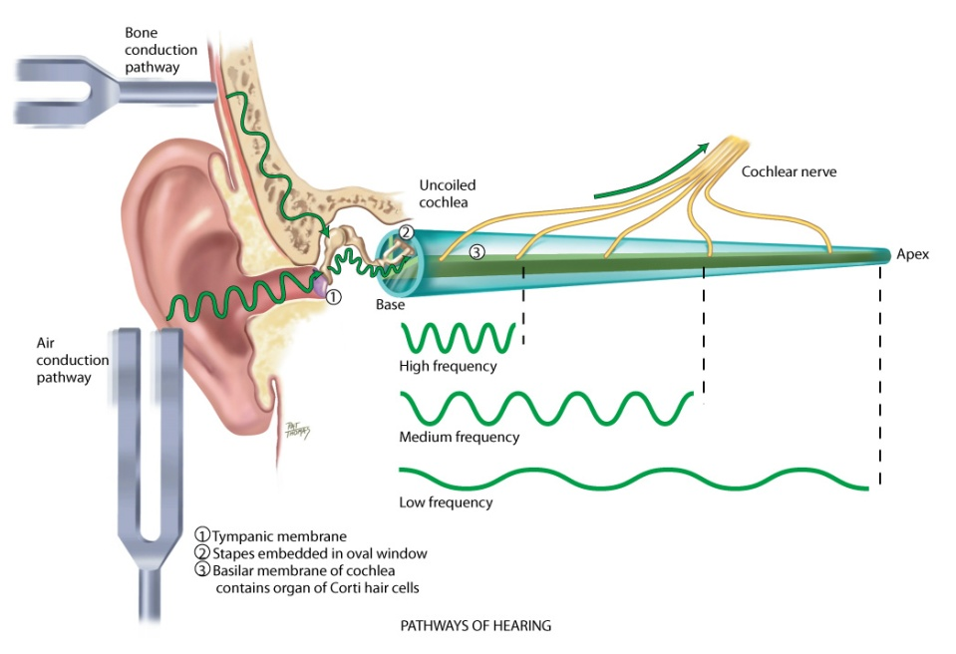
Pathways of Hearing

Slide 14
Structure and Function: Hearing Loss
Hearing loss
Anything obstructing transmission of sound impairs hearing
Conductive hearing loss involves a mechanical dysfunction of external or middle ear
Partial loss because person is able to hear if sound amplitude is increased enough to reach normal nerve elements in inner ear
May be caused by impacted cerumen, foreign bodies, a perforated TM, pus or serum in middle ear, and otosclerosis, which is a decrease in mobility of ossicles

Slide 15
Structure and Function: Hearing Loss (Cont.)
Sensorineural (or perceptive) hearing loss signifies pathology of inner ear, cranial nerve VIII, or auditory areas of cerebral cortex
Increase in amplitude may not enable person to understand words
May be caused by presbycusis, which is a gradual nerve degeneration that occurs with aging, and by ototoxic drugs, which affect hair cells in cochlea
Mixed hearing loss is combination of conductive and sensorineural types in same ear

Slide 16
Equilibrium
Labyrinth in inner ear constantly feeds information to brain about body’s position in space
Works like a plumb line to determine verticality or depth
Ear’s plumb lines register angle of your head in relation to gravity
If labyrinth ever becomes inflamed, it feeds wrong information to brain, creating a staggering gait and a strong spinning, whirling sensation called vertigo

Slide 17
Developmental Competence: Infants and Children
Inner ear starts to develop early in fifth week of gestation
In early development ear is posteriorly rotated and low set; later ascends to its normal placement around eye level
If maternal rubella infection occurs during first trimester, it can damage organ of Corti and impair hearing
Infant’s eustachian tube is relatively shorter and wider and more horizontal than adult’s, so it is easier for pathogens from nasopharynx to migrate through to middle ear

Slide 18
Developmental Competence: Infants and Children (Cont.)
Lumen surrounded by lymphoid tissue, which increases during childhood and is easily occluded
These factors place infants at greater risk for middle ear infections than adults
Infant’s and young child’s external auditory canal is shorter and has a slope opposite to that of adult’s

Slide 19
Developmental Competence: Adults
Otosclerosis
Common cause of conductive hearing loss in young adults between ages of 20 and 40 years
Gradual hardening that causes foot plate of stapes to become fixed in oval window, impeding transmission of sound and causing progressive deafness

Slide 20
Developmental Competence: Aging Adults
In aging persons, cilia lining ear canal become coarse and stiff
May cause cerumen to accumulate and oxidize, which greatly reduces hearing
Cerumen is drier with aging because of atrophy of apocrine glands
Impacted cerumen is a common but reversible cause of hearing loss in older people

Slide 21
Developmental Competence: Aging Adults (Cont.)
Presbycusis: type of hearing loss that occurs with aging, even in people living in quiet environment
Gradual sensorineural loss caused by nerve degeneration in inner ear or auditory nerve
Onset usually occurs in 50s and slowly progresses
First notice a high-frequency tone loss
Ability to localize sound is impaired also
Accentuated when unfavorable background noise is present

Slide 22
Culture and Genetics: Otitis Media
Obstruction of eustachian tube or passage of nasopharyngeal secretions into middle ear
One of most common illnesses in children
Incidence and severity increased in indigenous children of North America, New Zealand, and northern Europe
Most important cause is environmental: children in high-risk groups have multiple pathogens and total bacterial load is high

Slide 23
Culture and Genetics: Otitis Media (Cont.)
In the supine position effects of gravity and sucking tend to draw nasopharyngeal contents directly into middle ear
Urge parents to hold baby partly upright while feeding
Do not prop bottle or let baby take a bottle to bed
Encouraging breastfeeding helps prevent this problem
Most important side effect of otitis media is persistence of fluid in middle ear after treatment; this middle ear effusion can impair hearing, placing child at risk for delayed cognitive development

Slide 24
Culture and Genetics: Cerumen
Cerumen: genetically determined and comes in two major types:
Dry cerumen: gray, flaky, and frequently forms thin mass in ear canal
Wet cerumen: honey brown to dark brown and moist
Wet cerumen phenotype (chromosome 16) occurs more often in Caucasians and African Americans whereas the dry type occurs more often in Asians and American Indians
Presence and composition of cerumen are not related to poor hygiene; take caution to avoid mistaking flaky, dry cerumen for eczematous lesions

Slide 25
Subjective Questions
Any earache or other pain in ears?
Location: Does it feel close to surface or deep in head? Does it hurt when you push on ear?
Character: Is it dull, aching or sharp, stabbing? Is it constant or does it come and go? Is it affected by changing position of head?
Any accompanying cold symptoms or sore throat? Any problems with sinuses or teeth?
Ever been hit on ear or on side of head or had any sport injury? Ever had any trauma from a foreign body?
What have you tried to relieve pain?

Slide 26
Subjective Questions (Cont.)
Infections
Any ear infections? As an adult or in childhood?
How frequent were they? How were they treated?
Discharge
Any discharge from your ears?
Does it look like pus, or is it bloody?
Any odor to the discharge?
Any relationship between discharge and ear pain?

Slide 27
Hearing Loss Questions
Ever had any trouble hearing?
Onset: Did loss come on slowly or all at once?
Character: Has all your hearing decreased or just on hearing certain sounds?
In what situations do you notice loss: conversations, using telephone, listening to TV, at a party?
Do people seem to shout at you?
Do ordinary sounds seem hollow, as if you are hearing in a barrel or under water?
Have you recently traveled by airplane?
Do you have a family history of hearing loss?

Slide 28
Hearing Loss Questions (Cont.)
Efforts to treat: Do you have any hearing aid or other device? Anything that helps hearing?
Coping strategies: How does loss affect your daily life? Any job problems? Feelings of embarrassment or frustration? How do your family and friends react?

Slide 29
Note to Examiner
During history, notice clues from normal conversation indicating possible hearing loss
Lip reading or watching your face and lips rather than your eyes
Frowning or straining forward to hear
Posturing of head to catch sounds with better ear
Misunderstands questions; frequently asks you to repeat
Irritable or shows startle reflex when you raise your voice
Person’s speech sounds garbled, vowel sounds distorted
Inappropriately loud voice
Flat, monotonous tone of voice

Slide 30
Environmental Noise Questions
Any loud noises at home or on the job? For example, do you live in a noise-polluted area, near an airport or busy traffic area? Now or in the past?
Are you near other noises such as heavy machinery, loud persistent music, gunshots while hunting?
Coping strategies: Do you take any steps to protect your ears, such as headphones or ear plugs?

Slide 31
Tinnitus and Vertigo Questions
Tinnitus
Ever felt ringing, crackling, or buzzing in your ears? When did this occur?
Does it seem louder at night?
Are you taking any medications?
Vertigo
Ever felt vertigo, that the room is spinning around or feel that you are spinning?
Ever felt dizzy, like you are not quite steady, or falling or losing your balance? Giddy, lightheaded?

Slide 32
Self-Care Behavior Questions
How do you clean your ears?
Last time you had your hearing checked?
If hearing loss was noted, did you obtain a hearing aid? How long have you had it? Do you wear it? How does it work? Any trouble with upkeep, cleaning, changing batteries?

Slide 33
Additional History for Infants and Children
Ear infections
At what age was child’s first episode? How many ear infections in past 6 months? How many total? How were these treated?
Has child had any surgery, such as insertion of ear tubes or removal of tonsils?
Are infections increasing in frequency, in severity, or staying same?
Does anyone in the home smoke cigarettes?
Does child receive care outside your home? In daycare center or someone else’s home? How many children in group care?

Slide 34
Additional History for Infants and Children (Cont.)
Does child seem to be hearing well?
Have you noticed that infant startles with loud noise? Did infant babble around 6 months? Does he or she talk? At what age did talking start? Was speech intelligible?
Ever had child’s hearing tested? If there was a hearing loss, did it follow any diseases in child or in mother during pregnancy?
Does child tend to put objects in ears? Is older child or adolescent active in contact sports?
Note: It is important to catch any problem early, because a child with hearing loss is at risk for delayed speech and social development and learning deficit

Slide 35
Objective Data Preparation
Position sitting up straight with head at eye level
Occasionally ear canal partially filled with cerumen, which obstructs view of TM
If TM intact and no current infection present, a method of cleaning canal is to soften cerumen with a warmed solution of mineral oil and hydrogen peroxide
Then, canal irrigated with warm water with a bulb syringe or a low-pulsatile dental irrigator or WaterPik
Direct fluid to posterior wall; leave space around irrigator tip for water to escape
Do not irrigate if history or examination suggests perforation or infection

Slide 36
Objective Data Equipment
Equipment needed
Otoscope with bright light, fresh batteries give off white, not yellow light
Pneumatic bulb attachment, sometimes used with infant or young child
Tuning forks in 512 and 1024 Hz

Slide 37
Inspection and Palpation
Inspect and palpate external ear
Size and shape
Ears are of equal size bilaterally with no swelling or thickening
Ears of unusual size and shape may be a normal familial trait with no clinical significance
Skin condition
Skin color consistent with person’s facial skin color
Skin intact, with no lumps or lesions
On some people you may note Darwin’s tubercle, a small painless nodule at the helix; this is a congenital variation and not significant

Slide 38
Inspection and Palpation (Cont.)
Inspect and palpate external ear
Tenderness
Move pinna and push on tragus; they should feel firm, and movement should produce no pain
Palpating mastoid process should also produce no pain
External auditory meatus
Note size of opening to direct choice of speculum for otoscope; no swelling, redness, or discharge should be present
Some cerumen usually present; color varies from gray-yellow to light brown and black, and texture varies from moist and waxy to dry and desiccated

Slide 39
Inspect with Otoscope
As you inspect external ear, note size of auditory meatus
Choose largest speculum that will fit comfortably in ear canal; tilt person’s head slightly away from you to bring obliquely sloping eardrum into better view
Pull pinna up and back on an adult or older child to straighten S-shape of canal
Pull pinna down on an infant and a child under 3
Hold pinna gently but firmly; do not release traction on ear until you have finished examination and removed otoscope

Slide 40
Inspect with Otoscope (Cont.)
Insert speculum slowly and carefully along axis of canal
Avoid touching inner “bony” section of canal wall covered by a thin epithelial layer because it is sensitive to pain
Once in place, you may need to rotate otoscope slightly to visualize all the TM; do this gently
Last, perform otoscopic examination before you test hearing
Canals with impacted cerumen give the erroneous impression of pathologic hearing loss

Slide 41
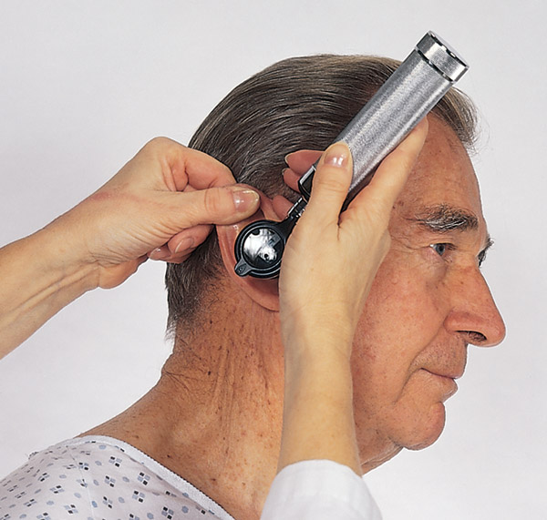
Otoscopic Examination

Slide 42
Question
The nurse is assessing the ear of an adult. How should the nurse perform the examination?
Pull the pinna down and insert scope.
Insert the scope straight into the ear.
Pull the pinna up and insert the scope.
Tilt the scope to the angle of the ear.
Notes:
The correct answer is 3. The proper procedure to examine the ear of an adult is to pull the pinna up and insert the scope.
Answer 1 is incorrect because this is the correct procedure to examine the ear of a child.
Answers 2 and 4 are incorrect because the anatomy of the ear would not accommodate the scope at these angles.

Slide 43
External Canal
Note any redness and swelling, lesions, foreign bodies, or discharge
If any discharge is present, note color and odor
Also, clean any discharge from speculum before examining other ear to avoid contamination with possibly infectious material
For person with hearing aid, note any irritation on canal wall from poorly fitting ear molds

Slide 44
Tympanic Membrane
Color and characteristics
Systematically explore landmarks
Normal TM shiny and translucent, with a pearl-gray color
Cone-shaped light reflex prominent in anteroinferior quadrant, a reflection of the otoscope light
Sections of malleus are visible through translucent drum: the umbo, manubrium, and short process
At periphery annulus looks whiter and dense

Slide 45
Tympanic Membrane (Cont.)
Position
TM is flat, slightly pulled in at center, and flutters when person performs Valsalva maneuver or holds nose and swallows (insufflation)
You may elicit these maneuvers to assess drum mobility
Avoid them with an aging person because they may disrupt equilibrium
Avoid middle ear insufflation in person with upper respiratory infection because it could propel infectious matter into middle ear

Slide 46
Tympanic Membrane (Cont.)
Integrity of membrane
Inspect TM and entire circumference of annulus for perforations
Normal TM is intact
Some adults may show scarring, which is a dense white patch on TM, a sequela of repeated ear infections

Slide 47
Test for Hearing Acuity
Screening for hearing deficit begins during history; how well does person hear conversational speech?
Ask the person directly if there is a hearing difficulty
If answer is yes, perform audiometric testing or refer for audiometric testing
If the answer is no, screen using the whispered voice test
Useful to document presence of hearing loss
Refer any abnormal findings for more accurate measures with pure tone audiometry

Slide 48
Whispered Voice Test
Test one ear at a time while masking hearing in other ear by placing one finger on tragus and rapidly pushing it in and out of auditory meatus
Shield your lips so the person cannot compensate for a hearing loss (consciously or unconsciously) by lip reading or using the “good” ear
With your head 30 to 60 cm (1 to 2 ft) from person’s ear, exhale and whisper slowly some two-syllable words
Normally, person repeats each word correctly after you say it

Slide 49
Tuning Fork Tests
Measure hearing air conduction (AC) or by bone conduction (BC), in which sound vibrates through cranial bones to the inner ear
AC route through ear canal and middle ear usually the more sensitive route
To activate tuning fork, hold it by stem and strike tines softly on back of your hand
A hard strike makes tone too loud, and it takes a long time to fade out

Slide 50
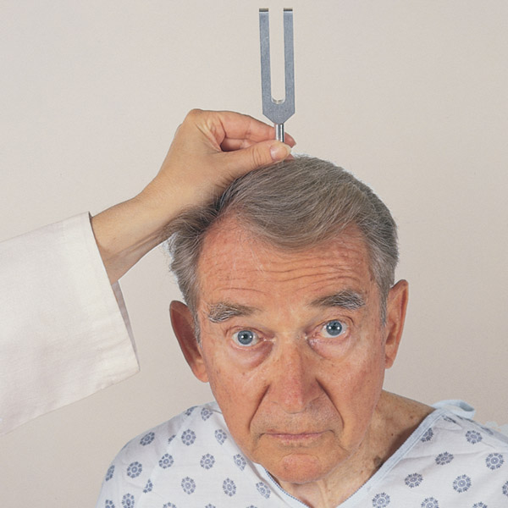
Test Hearing

Slide 51
Vestibular Apparatus
Romberg test: assesses ability of vestibular apparatus in inner ear to help maintain standing balance
Also assesses intactness of cerebellum and proprioception as it is part of the neurologic system

Slide 52
Developmental Competence
Infants and young children
Examination of external ear is similar to that described for adult, with addition of examination of position and alignment on head
Note ear position
Top of pinna should match an imaginary line extending from corner of eye to the occiput
Also, ear should be positioned within 10 degrees of vertical

Slide 53
Infants and Young Children
Otoscopic examination
In addition to its place in complete examination, TM assessment is mandatory for any infant or child requiring care for illness or fever
For the infant or young child, timing of otoscopic examination best toward end of complete examination
Many young children protest vigorously during this procedure no matter how well you prepare, and it is difficult to reestablish cooperation afterward
Save otoscopic examination until last; then parent can hold and comfort child

Slide 54
Infants and Young Children (Cont.)
Otoscopic examination
Positioning child is important
Need clear view of canal; avoid harsh restraint, but you must protect TM from injury in case of sudden head movement
Enlist aid of a cooperative parent; child’s head must be stabilized to avoid movement against otoscope
Remember to pull pinna straight down on an infant or a child younger than 3 years old; this will match slope of ear canal

Slide 55
Infants and Young Children (Cont.)
Otoscopic examination
Otoscopic examination is not performed at birth because canal is filled with amniotic fluid and vernix caseosa; after a few days the TM is examined
During first few days, TM often looks thickened and opaque; may look “injected” and have mild redness from increased vascularity
TM also looks injected in infants after crying
Position of eardrum is more horizontal in neonate, making it more difficult to see completely and harder to differentiate from canal wall

Slide 56
Infants and Young Children (Cont.)
Otoscopic examination
By 1 month, drum is in the same oblique (more vertical) position as in older child, and examination is a bit easier
Pneumatic bulb attachment enables you to direct light puff of air toward TM to assess vibratility
Rubber tip on end of speculum gives a better seal
Give a small pump to bulb (positive pressure), and then release bulb (negative pressure)
Normally TM moves inward with a slight puff and outward with a slight release
Normally TM is intact

Slide 57
Infants and Young Children (Cont.)
Otoscopic examination
In a child being treated for chronic otitis media, you may note presence of a tympanostomy tube in central part of eardrum
This is inserted surgically to equalize pressure and drain secretions
Finally, although condition is not normal, it is not uncommon to note a foreign body in a child’s canal, such as a small stone or a bead

Slide 58
Testing Hearing Acuity
Infants and young children
Room should be silent and baby contented; make a loud sudden noise; you should note these responses:
Newborn: startle (Moro) reflex, acoustic blink reflex
3 to 4 months: acoustic blink reflex, infant stops movement and appears to listen, halts sucking, quiets if crying, cries if quiet
6 to 8 months: infant turns head to localize sound; responds to own name
Preschool and school-age child: child must be screened with audiometry

Slide 59
Testing Hearing Acuity (Cont.)
Infants and young children
Note behavioral manifestations of hearing loss:
Child is inattentive in casual conversation
Reacts more to movement and facial expression than to sound
Facial expression strained or puzzled
Frequently asks to have statements repeated
Confuses words that sound alike
Has accompanying speech problem
Appears shy and withdrawn and “lives in a world of his or her own”
Frequently complains of earaches
Hears better at times when environment more conducive

Slide 60
Aging Adult
May have pendulous earlobes with linear wrinkling because of loss of elasticity of pinna
Coarse, wiry hairs may be present at opening of canal
Eardrum normally may be whiter in color and more opaque, duller and thicker than in younger adult
High-tone frequency loss apparent for those affected with presbycusis, hearing loss that occurs with aging
Revealed in difficulty hearing whispered words in voice test and in difficulty hearing consonants during conversation
Aging adult feels that “people are mumbling” and feels isolated in family or friendship groups

Slide 61
Question
The nurse is assessing a patient who has a hearing impairment. How should the nurse communicate with this patient?
Use a low tone voice and speak slowly.
Use a normal tone of voice and speak slowly.
Speak loudly with normal rate.
Face the patient and speak slowly.
Notes:
The correct answer is 4. Speaking slowly and directly to the patient allows time and a visual for the patient to interpret lip movement.
Answer 1 is incorrect because low tones usually are not audible by patients with a hearing impairment.
Answer 2 is incorrect because normal tones are subjective and vary according to the speaker’s hearing level.
Answer 3 is incorrect because speaking loudly with a normal rate may not allow the patient to discern words and speech.

Slide 62
Sample Charting: Subjective

Slide 63
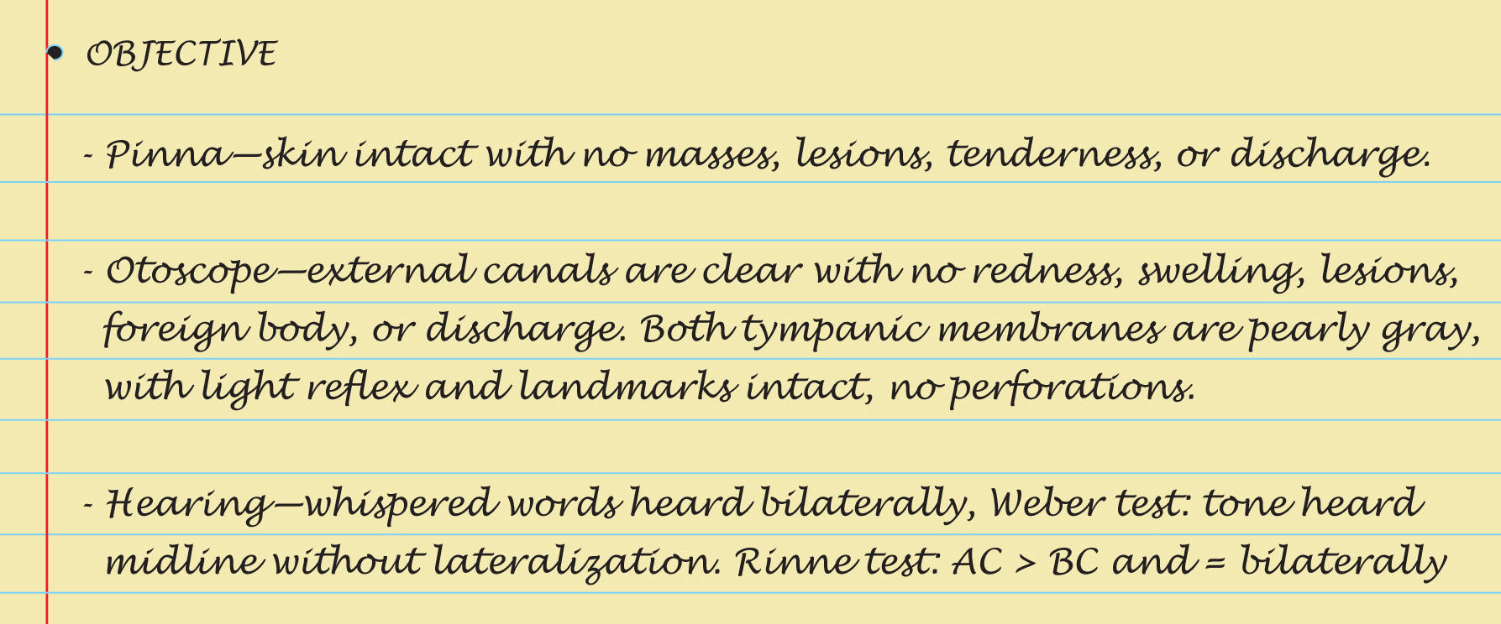
Sample Charting: Objective

Slide 64
Sample Charting: Assessment

Slide 65
Summary Checklist: Ear Examination
Inspect external ear
Size and shape of auricle, position and alignment on head
Note skin condition
Check auricle and tragus for tenderness
Evaluate external auditory meatus
Otoscopic examination
External canal – redness or swelling
Cerumen discharge, foreign bodies or lesions
Inspect tympanic membrane
Color, characteristics, position, and integrity
Test hearing acuity

Slide 66
Abnormal Findings: Abnormalities of External Ear
Frostbite
Otitis externa, “swimmer’s ear”
Brachial remnant and ear deformity

Slide 67
Abnormal Findings: Lumps and Lesions on External Ear
Sebaceous cyst
Tophi
Chondrodermatitis nodularis helicis
Keloid
Carcinoma

Slide 68
Abnormal Findings: Abnormalities in Ear Canal
Excessive cerumen
Otitis externa
Osteoma
Foreign body
Exostosis
Furuncle
Polyp

Slide 69
Abnormal Findings: Abnormalities of Tympanic Membrane
Retracted drum
Otitis media with effusion (OME)
Acute (purulent) otitis media
Perforation
Insertion of tympanostomy tubes
Cholesteatoma

Slide 70
Abnormal Findings: Abnormalities of Tympanic Membrane
Scarred drum
Blue drum (hemotympanum)
Bullous myringitis
Fungal infection (otomycosis)

