Slide 1
Chapter 16
Nose, Mouth, and Throat

Slide 2
Structure and Function: Nose I
  First segment of respiratory system
    Warms, moistens, and filters inhaled air, and is sensory organ for smell
    External nose shaped like triangle attached to face
      Bridge is superior part and free corner is tip.
    Nares: oval openings at base
    Each naris widens into the vestibule.
    Columella: divides two nares and continuous inside with nasal septum
    Ala: lateral outside wing of nose on either side
  Upper third made up of bone; rest is cartilage

Slide 3
Structure and Function: Nose II
  Nasal cavity much larger than external nose would indicate
    Extends back over roof of mouth
    Nasal hairs or vibrissae line anterior edge of cavity
    Rest of cavity lined with blanket of ciliated mucous membrane
    Nasal hairs filter coarsest matter from inhaled air
    Mucous blanket filters out dust and bacteria
    Nasal mucosa appears redder than oral mucosa because of rich blood supply present to warm inhaled air

Slide 4
Structure and Function: Nose III
  Nasal cavity divided medially by septum into two slit-like air passages
    Anterior part of septum holds a rich vascular network, Kiesselbach’s plexus, most common site of nosebleeds.
    Lateral walls of each nasal cavity contain three parallel bony projections: superior, middle, and inferior turbinates.
    Underlying each turbinate is a cleft, the meatus, which is named for turbinate above.
    Sinuses drain into middle meatus, and tears from nasolacrimal duct drain into inferior meatus.

Slide 5
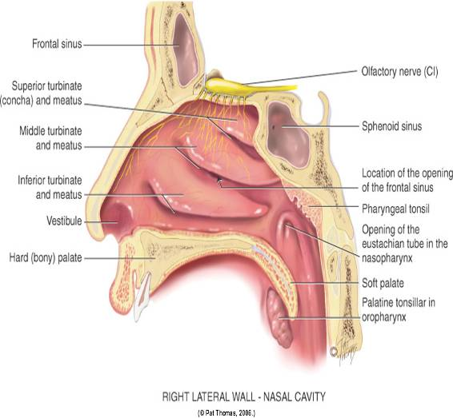
Nasal Cavity

Slide 6
Structure and Function: Nose IV
  Olfactory receptors, hair cells, lie at roof of nasal cavity and upper third of septum.
    These receptors for smell merge into olfactory nerve, cranial nerve I, which transmits to temporal lobe of brain.
    Although not necessary for human survival, the sense of smell adds to nutrition by enhancing pleasure and taste of food.

Slide 7
Structure and Function: Nose V
  Paranasal sinuses: air-filled pockets within the cranium
    Communicate with nasal cavity and are lined with same type of ciliated mucous membrane
    Lighten weight of skull bones, serve as resonators for sound production, and provide mucus, which drains into nasal cavity
    Sinus openings are narrow and easily occluded, which may cause inflammation or sinusitis.

Slide 8
Structure and Function: Nose VI
  Two pairs of sinuses are accessible to examine.
    Frontal sinuses in frontal bone above and medial to orbits
    Maxillary sinuses in maxilla (cheekbone) along side walls of nasal cavity
    Other two sets are smaller and deeper.
      Ethmoid sinuses between the orbits
      Sphenoid sinuses deep within skull in the sphenoid bone

Slide 9
Structure and Function: Nose VII
  Only maxillary and ethmoid sinuses are present at birth.
    Maxillary sinuses reach full size after all permanent teeth have erupted.
    Ethmoid sinuses grow rapidly between 6 and 8 years of age and after puberty.
    Frontal sinuses are absent at birth, fairly well developed between ages 7 and 8, and reach full size after puberty.
    Sphenoid sinuses are minute at birth and develop after puberty.

Slide 10
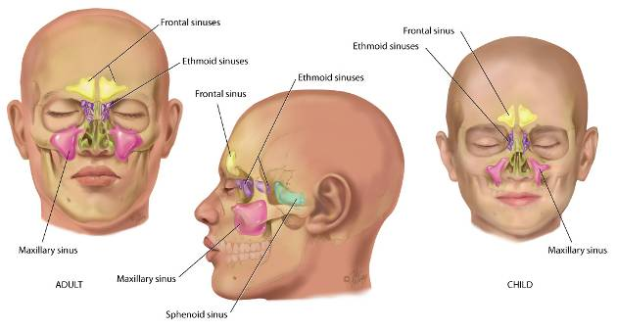
Sinuses

Slide 11
Structure and Function: Mouth I
  First segment of digestive system and an airway for the respiratory system
  Oral cavity: short passage bordered by lips, palate, cheeks, and tongue
  Lips: anterior border of oral cavity, transition zone from outer skin to inner mucous membrane lining the oral cavity
    Palate: arching roof of mouth divided into two parts
    Hard palate: anterior part made up of bone
    Soft palate: posterior part, an arch of muscle that is mobile
    Uvula: free projection hanging down from middle of soft palate
    Cheeks are the side walls of oral cavity.

Slide 12
Structure and Function: Mouth II
  Floor of mouth consists of the horseshoe-shaped mandible bone, tongue, and underlying muscles.
    Tongue: striated muscle arranged in a crosswise pattern so that it can change shape and position
      Papillae: rough, bumpy elevations on its dorsal surface
      Ventral surface: smooth, shiny and has prominent veins
      Frenulum: midline fold of tissue connecting tongue to floor of mouth
    Tongue’s ability to change shape and position enhances its functions in mastication, swallowing, cleansing teeth, and the formation of speech.
    Functions in taste sensation

Slide 13
Structure and Function: Mouth III
  Mouth contains three pairs of salivary glands.
    Parotid gland lies within cheeks in front of ear.
      Stensen’s duct runs forward to open on buccal mucosa opposite second molar.
    Submandibular gland lies beneath mandible at angle of jaw.
    Wharton’s duct runs up and forward to the floor of mouth and opens at either side of frenulum.
    Sublingual gland, the smallest, almond-shaped, lies within floor of mouth under tongue and has many small openings along sublingual fold under tongue.

Slide 14
Structure and Function: Mouth IV
  Glands secrete saliva, the clear fluid that moistens and lubricates the food bolus, starts digestion, and cleans and protects the mucosa.
  Adults have 32 permanent teeth; 16 in each arch
    Each tooth has three parts: crown, neck, and root.
  Gums (gingivae) collar the teeth
    Thick fibrous tissues covered with mucous membrane
    Different from rest of oral mucosa because of their pale pink color and stippled surface

Slide 15
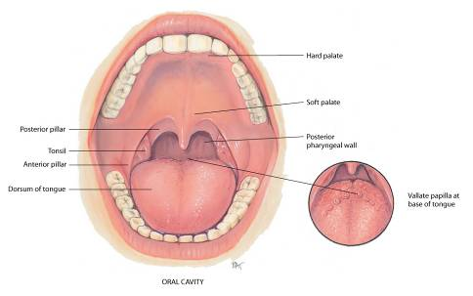
Mouth

Slide 16
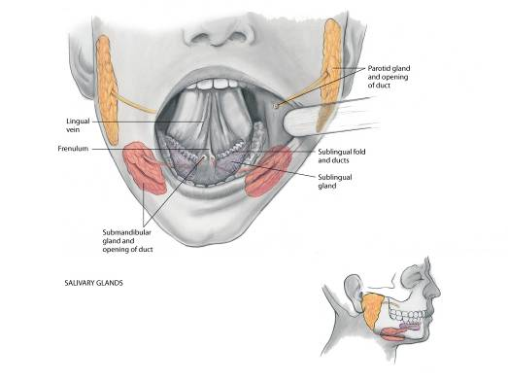
Salivary Glands

Slide 17
Structure and Function: Throat or Pharynx
  Area behind mouth and nose
    Oropharynx: separated from mouth by a fold of tissue on each side, the anterior tonsillar pillar
    Tonsils: behind folds, each is a mass of lymphoid tissue look more granular, and surface shows deep crypts
    Tonsillar tissue enlarges during childhood until puberty
    Posterior pharyngeal wall is seen behind these structures
    Nasopharynx: continuous with oropharynx above oropharynx and behind nasal cavity
    Pharyngeal tonsils (adenoids) and eustachian tube openings are located here.

Slide 18
Developmental Competence: Infants and Children
    Salivation starts at 3 months; baby will drool periodically for a few months before learning to swallow saliva.
    Teeth, both sets, begin development in utero
    Children have 20 deciduous, or temporary teeth, that erupt between 6 months and 24 months of age; all 20 should appear by 2½ years.
    Deciduous teeth lost beginning at age 6 through 12; replaced by permanent, starting with central incisors
    Nose develops during adolescence, along with other secondary sex characteristics.
      This growth starts at age 12 or 13, reaching full growth at age 16 in females and age 18 in males.

Slide 19
Developmental Competence: Pregnant Woman
  Nasal stuffiness and epistaxis may occur during pregnancy as a result of increased vascularity in the upper respiratory tract.
  Gums may be hyperemic and softened and may bleed with normal toothbrushing.

Slide 20
Developmental Competence: Aging Adult
  Gradual loss of subcutaneous fat starts during later middle adult years, making the nose appear more prominent in some people.
  Atrophic tissues ulcerate easily, increasing risk for older people for infections, such as oral moniliasis and malignant lesions.
  Natural tooth loss exacerbated by inadequate dental care, poor oral hygiene, and tobacco use
  Diminished sense of taste and smell decreases aging person’s interest in food and may contribute to malnutrition.
  Trouble with mastication can lead to dietary pattern changes which may place the older adult at risk for nutritional deficits (protein, vitamins, and minerals).

Slide 21
Culture and Genetics I
  Bifid uvula: a condition in which uvula is split either completely or partially; occurs in 10% of some American Indian groups
  Cleft lip and cleft palate: most common in Asians, intermediate in Whites, and least common in Blacks.
  Torus palatinus: a bony ridge running in middle of hard palate is seen in 20% to 35% of the U.S. population.
  Leukoedema: a benign lesion occurring on buccal mucosa, is seen more often in Blacks.

Slide 22
Culture and Genetics II
  NHANES data reports a decrease in dental caries in permanent teeth, with non-Hispanic white subjects having lower prevalence and severity than non-Hispanic Black and Mexican American participants.
  Prevalence of edentulism has dropped to 8% of adults over 20 years of age, based on water fluoridation, dental sealants, and use of fluoride toothpaste.
  Incidence and mortality rates have decreased for oral and pharyngeal cancers among black and white men and women since the 1900s.

Slide 23
Subjective Data: Nose
  Discharge
  Frequent colds, upper respiratory infections
  Sinus pain
  Trauma
  Epistaxis, nosebleeds
  Allergies
  Altered smell

Slide 24
Subjective Data Questions: Nose I
  Discharge
    Any nasal discharge or runny nose? Continuous?
    Is discharge watery, purulent, mucoid, bloody?
  Frequent colds
    Any unusually frequent or severe colds (upper respiratory infections)? How often do these occur?
  Sinus pain
    Any sinus pain or sinusitis? How is this treated?
    Do you have chronic postnasal drip?

Slide 25
Subjective Data Questions: Nose II
  Trauma
    Ever had any trauma or a blow to the nose?
    Do you breathe through your nose?
  Epistaxis, nosebleeds
    Any nosebleeds? How often?
    How much bleeding, a teaspoonful or does it pour out?
    Color of the blood, red or brown? Clots?
    From one nostril or both?
    Aggravated by nose-picking or scratching?
    How do you treat nosebleeds? Are they difficult to stop?

Slide 26
Subjective Data Questions: Nose III
  Allergies
    Any allergies or hay fever? To what are you allergic, for example, pollen, dust, or pets?
    How was this determined?
    What type of environment makes it worse? Can you avoid exposure?
    Do you use inhalers, nasal spray, or nose drops? How often? Which type?
    How long have you used this?
  Altered smell
    Experienced any change in sense of smell?

Slide 27
Subjective Data: Mouth and Throat
  Sores or lesions
  Sore throat
  Bleeding gums
  Toothache
  Hoarseness
  Dysphagia
  Altered taste
  Smoking, alcohol consumption
  Self-care behaviors
  Dental care pattern
  Dentures or appliances

Slide 28
Subjective Data Questions:
Mouth and Throat I
  Sores or lesions
    Have you noticed any sores or lesions in the mouth, tongue, or gums?
    How long have you had it? Ever had this lesion before? Is it single or multiple?
    Does it seem associated with stress, season change, or food?
    How have you treated sore? Have you applied any local medication?

Slide 29
Subjective Data Questions:
Mouth and Throat II
  Sore throat
    How frequently do you get them? Do you have a sore throat now? When did it start?
    Is it associated with cough, fever, fatigue, decreased appetite, headache, postnasal drip, or hoarseness?
    Is it worse when arising? What is humidity level in room where you sleep? Any dust or smoke inhaled at work?
    Do you usually get a throat culture for the sore throats? Were any documented as streptococcal?
    How have you treated this sore throat: medication, gargling? How effective are these? Have your tonsils or adenoids been taken out?

Slide 30
Subjective Data Questions:
Mouth and Throat III
  Bleeding gums
    Any bleeding gums? How long have you had this?
  Toothache
    Any toothache? Do your teeth seem sensitive to hot, cold? Have you lost any teeth?
  Hoarseness
    Any hoarseness, voice change? For how long?
    Feel like having to clear your throat? Or, like a “lump in your throat?” Use your voice a lot at work, recreation?
    Does hoarseness seem associated with a cold or sore throat?

Slide 31
Subjective Data Questions:
Mouth and Throat IV
  Dysphagia
    Any difficulty swallowing? How long have you had it?
    Do you feel as if food gets stopped at a certain point?
    Any pain with this?
  Altered taste or any change in sense of taste?
  Smoking, alcohol consumption
    Do you smoke? Pipe or cigarettes? Smokeless tobacco? How many packs per day? For how many years?
    When was your last alcohol drink? How much alcohol did you drink that time? How much alcohol do you usually drink?

Slide 32
Subjective Data Questions:
Mouth and Throat V
  Self-care behaviors
    How often do you use a toothbrush and floss?
    Last dental examination? Do dental problems affect which foods you eat?
    Do you have a dental appliance: braces, bridge, headgear?
    Do you wear dentures? All of the time? How long have you had this set? How do they fit?
    Any sores or irritation on the palate or gums?
    Any problems with talking; do dentures whistle or drop? Can you chew all foods? How do you clean them?

Slide 33
Additional History for Infants and Children
  Does child have any mouth infections or sores, such as thrush or canker sores? How frequently?
    Does child have frequent sore throat or tonsillitis? How often? How are these treated? Have they ever been documented as streptococcal infections?
  Did child’s teeth erupt on time?
    Do teeth seem straight to you?
    Is child using a bottle? Does child sleep with a bottle?
    Noticed any thumb sucking after child’s secondary teeth came in?
    Have you noticed child grinding his or her teeth?
  Self-care behaviors
    How are child’s dental habits? Use a toothbrush regularly? How often does child see a dentist?
    Do you use fluoridated water or fluoride supplement?

Slide 34
Additional History for Aging Adult
  Any dryness in the mouth? Are you taking any medications? (Note prescribed and over-the-counter medications.)
  Have you had any loss of teeth? Can you chew all types of food?
  Are you able to care for your own teeth or dentures?
  Have you noticed a change in your sense of taste or smell?

Slide 35
Objective Data
Preparation
  Position person sitting up straight with his or her head at your eye level.
  If person wears dentures, offer a paper towel and ask person to remove them.
Equipment
    Otoscope with short, wide-tipped nasal speculum
    Penlight
    Two tongue blades
    Cotton gauze pad, 4 × 4 inches
    Gloves

Slide 36
Inspection and Palpation: Nose I
  External nose
    Normally nose is symmetric, in midline, and in proportion to other facial features.
    Inspect for any deformity, asymmetry, inflammation, or skin lesions; if an injury is reported or suspected, palpate gently for any pain or break in contour.
    Test patency of nostrils by pushing each nasal wing shut with your finger while asking person to sniff inward through other naris; this reveals any obstruction, to be explored using the nasal speculum.
    Sense of smell, mediated by cranial nerve I, is usually not tested in a routine examination.

Slide 37
Inspection and Palpation: Nose II
  Nasal cavity
    Attach short wide-tipped speculum to otoscope head and insert apparatus into nasal vestibule, avoiding pressure on nasal septum; gently lift up tip of nose with your finger before inserting.
    View each nasal cavity with person’s head erect and then with head tilted back.
      Inspect nasal mucosa, noting its normal red color and smooth moist surface.
      Note any swelling, discharge, bleeding, or foreign body.

Slide 38
Inspection and Palpation: Nose III
  Nasal septum
    Observe nasal septum for deviation; deviated septum is common and is not significant unless air flow is obstructed.
      If present in hospitalized patient, document deviated septum in event that person needs nasal suctioning or a nasogastric tube
    Note any perforation or bleeding in septum.

Slide 39
Inspection and Palpation: Nose IV
  Nasal turbinates
    Inspect turbinates, the bony ridges curving down from lateral walls.
    Superior turbinate may not be in view.
    Middle and inferior turbinates appear the same light red color as nasal mucosa; note any swelling but do not try to push speculum past it.
    Turbinates are quite vascular and tender if touched.
    Note any polyps, benign growths that accompany chronic allergy, and distinguish them from normal turbinates.

Slide 40
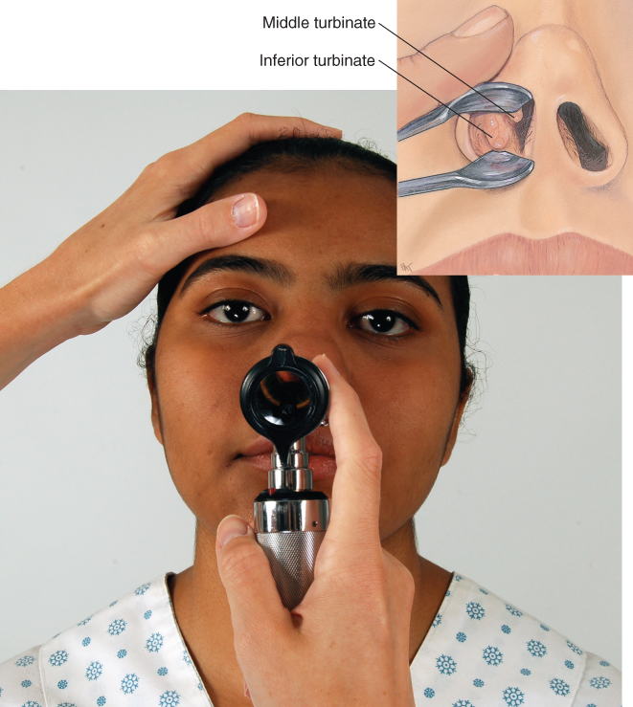
Inspection of Nose

Slide 41
Palpation of Sinus Areas I
  Using thumbs, press frontal sinuses by pressing up and under the eyebrows and over maxillary sinuses below cheekbones.
  Transillumination
    You may use this technique when you suspect sinus inflammation, although it is of limited usefulness.
    Darken room; affix strong narrow light to end of otoscope and hold it deep under superior orbital ridge against location of frontal sinus area; cover with your hand.
    A diffuse red glow is a normal response; comes from light shining through air in the healthy sinus.

Slide 42
Palpation of Sinus Areas II
  Transillumination
    May use same technique with maxillary sinuses, providing person has no upper denture that would impede light
    Ask person to tilt head back and open mouth; shine light on each cheek just under inner corner of eye; note a dull glow inside the mouth on hard palate as light transmits through sinuses.
    Healthy sinuses contain air and may light up symmetrically; be aware that asymmetry is not a reliable sign of sinus inflammation because many healthy sinuses normally will not transilluminate.

Slide 43
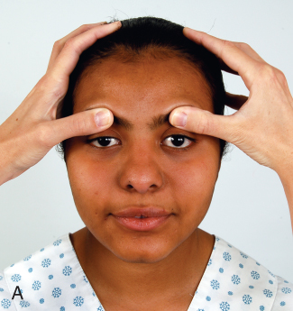
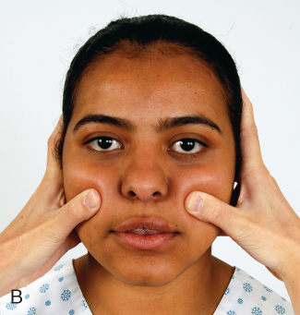
Inspection of Sinus Area

Slide 44
Question
The nurse is assessing a patient for sinus tenderness. How should the nurse perform the examination?
Palpate behind the ears and along side of the throat and clavicles, noting edema.
Press firmly around the orbit of the eyes and palpate the nose, noting pain.
Tap the above the eyes and nose, noting tenderness or pain.
Auscultate the neck bilaterally with the bell of the stethoscope.
Notes:
The correct answer is 3. The underlying sinuses are best assessed above the eyes and nose.
Answer 1 is incorrect because this is a lymph node examination.
Answer 2 is incorrect because pressing is improper technique and could illicit pain in the patient.
Answer 4 is incorrect because this is carotid arterial circulation assessment.

Slide 45
Inspection of the Mouth
  Begin with anterior structures and move posteriorly; use tongue blade to retract structures and bright light for optimal visualization.
  Inspect lips for color, moisture, cracking, or lesions; retract lips and note inner surface.
    African Americans normally may have bluish lips and a dark line on gingival margin.

Slide 46
Inspection of Teeth and Gums I
    Condition of teeth is an index of person’s general health.
    Note any diseased, absent, loose, or abnormally positioned teeth; teeth normally look white, straight, and evenly spaced, and clean and free of debris or decay.
    Compare number of teeth with number expected for person’s age; ask person to bite as if chewing something, and note alignment of upper and lower jaw.
    Normal occlusion in back is upper teeth rest directly on lowers; in front, upper incisors slightly override lower incisors.

Slide 47
Inspection of Teeth and Gums II
  Normally gums look pink or coral with a stippled (dotted) surface.
  Gum margins tight and well defined; check for swelling; retraction of gingival margins; and spongy, bleeding, or discolored gums.
  African Americans normally have a dark melanotic line along gingival margin.

Slide 48
Inspection of Tongue I
  Check tongue for color, surface characteristics, and moisture.
  Ask person to touch tongue to roof of mouth; its ventral surface looks smooth, glistening, and shows veins.
  With a glove, hold tongue with a cotton gauze pad for traction and swing tongue out and to each side; inspect for any white patches or lesions; normally none are present.
  If any occur, palpate these lesions for induration.
    Always wear gloves to examine mucous membranes; this follows standard precautions to prevent spread of possible communicable disease.

Slide 49
Inspection of Tongue II
  Inspect carefully entire U-shaped area under tongue behind teeth; oral malignancies are most likely here.
  Note any white patches, nodules, or ulcerations.
  If lesions are present, or with any person over 50 years old or with a positive history of smoking or alcohol use, use your gloved hand to palpate area.
  Place your other hand under jaw to stabilize tissue and to “capture” any abnormality; note any induration.

Slide 50
Inspection of Buccal Mucosa I
  Hold cheek open with a wooden tongue blade, and check buccal mucosa for color, nodules, or lesions; looks pink, smooth, and moist, although patchy hyperpigmentation is common in dark-skinned people.
  Stensen’s duct: opening of parotid salivary gland is an expected finding; looks like a small dimple opposite upper second molar.
  May also see a raised occlusion line on buccal mucosa parallel where teeth meet caused by teeth closing against cheek.

Slide 51
Inspection of Buccal Mucosa II
  Larger patch also may be present along buccal mucosa.
    Leukoedema: a benign grayish opaque area, more common in African Americans and East Indians.
    Severity of condition increases with age, looking grayish white and thickened; cause of condition is unknown.
    Do not mistake leukoedema for oral infections, such as candidiasis, thrush.
  Fordyce’s granules: small, isolated white or yellow papules on mucosa of cheek, tongue, and lips
    These little sebaceous cysts are painless and not significant.

Slide 52
Inspection of Palate
Anterior hard palate white with irregular transverse rugae
Posterior soft palate is pinker, smooth, and upwardly movable
  Torus palatinus: normal variation, is a nodular bony ridge down middle of hard palate; benign growth arises after puberty and is more common finding in American Indians, Inuits, and Asians
Observe uvula; normally looks like fleshy pendant hanging in midline; ask person to say “ahhh” and note soft palte and uvula rise in midline; this tests one function of cranial nerve X, the vagus nerve.

Slide 53
Inspection of Throat I
Observe oval, rough-surfaced tonsils.
  Color is same pink as oral mucosa, and their surface peppered with indentations, or crypts; there should be no exudate on tonsils.
  Tonsils graded in size as follows:
    1+ Visible
    2+ Halfway between tonsillar pillars and uvula
    3+ Touching uvula
    4+ Touching each other
  You may normally see 1+ or 2+ tonsils in healthy people, especially in children, because lymphoid tissue is proportionately enlarged until puberty.

Slide 54
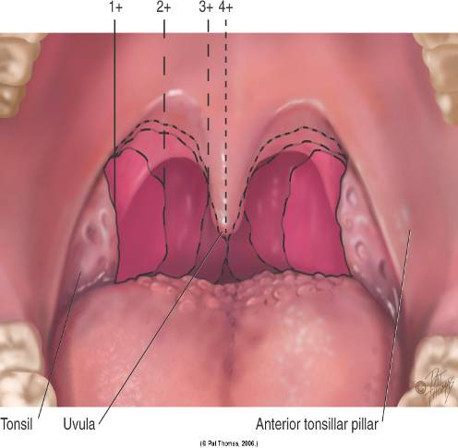
Inspection of Throat

Slide 55
Inspection of Throat II
Enlarge your view of posterior pharyngeal wall by depressing tongue with tongue blade.
  Scan posterior wall for color, exudate, or lesions.
    Touching posterior wall with tongue blade elicits gag reflex; this tests cranial nerves IX and X, the glossopharyngeal and vagus.
  Test cranial nerve XII, hypoglossal nerve, by asking person to stick out tongue; should protrude in midline; note any tremor, loss of movement, or deviation to side.
  Notice any breath odor, halitosis.
    Usually due to local cause; poor oral hygiene, consumption of odoriferous foods, alcohol, smoking, or dental infection.

Slide 56
Developmental Competence: Infants and Children I
Because oral examination is intrusive for infant or young child, timing is best toward end with ear examination
  If crying episodes occur earlier, seize opportunity to examine open mouth and oropharynx.
  Let parent help position child; place infant supine on examining table, with arms restrained; older infant and toddler may be held on parent’s lap.
  Be discriminating in use of tongue blade; it may be necessary for a full view of oral structures, but it produces a strong gag reflex in infant; may avoid tongue blade completely with cooperative preschooler and school-age child.

Slide 57
Developmental Competence: Infants and Children II
Essential to determine patency of nares in immediate newborn period
  Most newborns are obligate nose breathers; nares blocked with amniotic fluid are suctioned gently with a bulb syringe; if obstruction suspected, a small-lumen catheter is passed down each naris to confirm patency.
  Avoid nasal speculum when examining infant and young child; instead, gently push up the tip of the nose with your thumb while using your other hand to shine light into naris.
  With a toddler, be alert for possible foreign body lodged in nasal cavity.

Slide 58
Developmental Competence: Infants and Children III
Mouth and throat
  Normal finding in infants is sucking tubercle, a small pad in middle of upper lip from friction of breastfeeding or bottle-feeding.
  Note number of teeth and, if appropriate, for child’s age.
  Note pattern of eruption, position, condition, and hygiene.
  Child’s age in months minus number 6 should equal expected number of deciduous teeth.
  Normally all 20 deciduous teeth are in by 2½ years.
  Saliva present after 3 months of age and shows in excess with teething children.

Slide 59
Developmental Competence: Infants and Children IV
Mouth and throat
  Mobility should allow tongue to extend at least as far as alveolar ridge.
  Note any bruising or laceration on buccal mucosa or gums of infant or young child.
  Epstein pearls on palate are normal finding in newborns and infants.
    Small, whitish, glistening, pearly papules along median raphe of hard palate and on gums, where they look like teeth
    Small retention cysts that disappear in first few weeks

Slide 60
Developmental Competence: Infants and Children V
Bednar aphthae are traumatic areas or ulcers on posterior hard palate on either side of midline; result from abrasions while sucking
  Tonsils are not visible in newborn; gradually enlarge during childhood, remaining proportionately larger until puberty
  Tonsils appear still larger if infant is crying or gagging.
  Insert gloved finger into baby’s mouth and palpate hard and soft palate as baby sucks; the sucking reflex can be elicited in infants up to 12 months old.

Slide 61
Developmental Competence: Pregnant Woman
  Gum hypertrophy (surface looks smooth, and stippling disappears) may occur normally at puberty or during pregnancy (pregnancy gingivitis)

Slide 62
Developmental Competence:
Aging Adult I
  Nose may appear more prominent on face from a loss of subcutaneous fat.
  In edentulous person, mouth and lips fold in, giving a “purse-string” appearance.
  Teeth may look slightly yellowed, but color is uniform; yellowing results from dentin visible through worn enamel.
  Surface of incisors may show vertical cracks from a lifetime of exposure to extreme temperatures.

Slide 63
Developmental Competence:
Aging Adult II
  Teeth may look longer as gum margins recede.
    Surface of teeth look worn down or abraded; old dental work deteriorates, especially at gum margins; teeth loosen with bone resorption and may move with palpation.
    Tongue looks smoother as a result of papillary atrophy.
    Aging adult’s buccal mucosa is thinned and may look shinier, as though it were “varnished.”

Slide 64
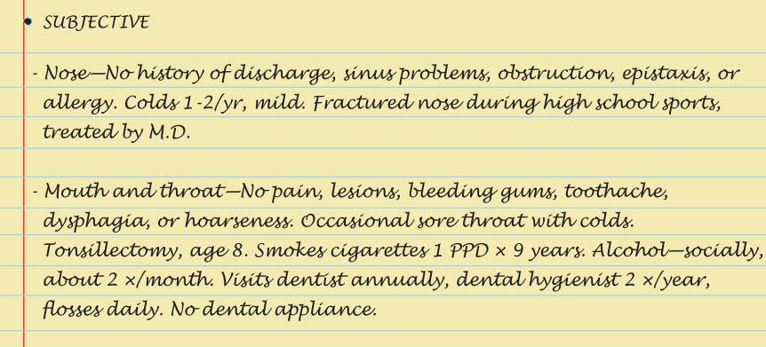
Sample Charting Subjective

Slide 65
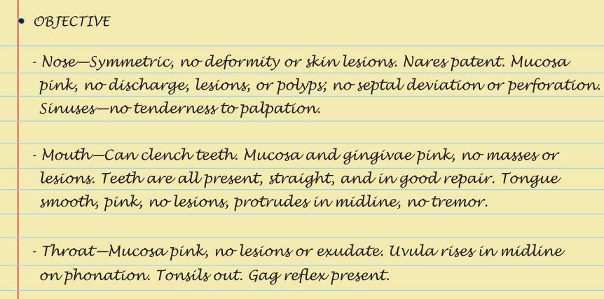
Sample Charting Objective

Slide 66

Sample charting Assessment

Slide 67
Summary Checklist: Nose, Mouth, and Throat Examination
Nose
  Inspect external nose for symmetry, any deformity, or lesions.
  Palpation: test patency of each nostril
  Inspect with nasal speculum nasal mucosa, septum, and turbinates.
  Palpate the sinus area.
Mouth and throat
  Inspect with penlight: mouth, teeth and gums, buccal mucosa, palate and tonsils, and pharyngeal wall.
  Palpate when indicated.

Slide 68
Abnormalities of the Nose
Choanal atresia
Epistaxis
Foreign body
Perforated septum
Furuncle
Acute rhinitis
Allergic rhinitis
Sinusitis
Nasal polyps
Carcinoma

Slide 69
Abnormalities of the Lips
Cleft lip
Herpes simplex I
Angular cheilitis (stomatitis, perlèche)
Carcinoma
Retention “cyst” (mucocele)

Slide 70
Abnormalities of Teeth and Gums
Baby bottle tooth decay
Malocclusion
Dental caries
Epulis
Gingival hyperplasia
Gingivitis
Meth mouth

Slide 71
Abnormalities of Buccal Mucosa
Aphthous ulcers
Koplik’s spots
Leukoplakia
Candidiasis or monilial infection

Slide 72
Abnormalities of the Tongue
Ankyloglossia
Fissured or scrotal tongue
Geographic tongue (migratory glossitis)
Smooth, glossy tongue (atrophic glossitis)
Black hairy tongue
Enlarged tongue (macroglossia)
Carcinoma

Slide 73
Abnormalities of the Oropharynx
Cleft palate
Bifid uvula
Oral Kaposi’s sarcoma
Acute tonsillitis and pharyngitis

