Slide 1
Chapter 17
Breasts and Regional Lymphatics

Slide 2
Surface Anatomy I
  Breasts lie anterior to pectoralis major and serratus anterior muscles.
    Located between second and sixth ribs, extending from side of sternum to midaxillary line
    Superior lateral corner of breast tissue, called axillary tail of Spence, projects up and laterally into axilla.
    Nipple is just below the center of the breast.

Slide 3
Surface Anatomy II
  Areola surrounds nipples; contains small elevated sebaceous glands, called Montgomery’s glands.
    Montgomery’s glands secrete protective lipid material during lactation.
    Areola has smooth muscle fibers that cause nipple erection when stimulated.
    Both nipple and areola are more darkly pigmented than rest of breast surface; color varies from pink to brown, depending on person’s skin color and parity.

Slide 4
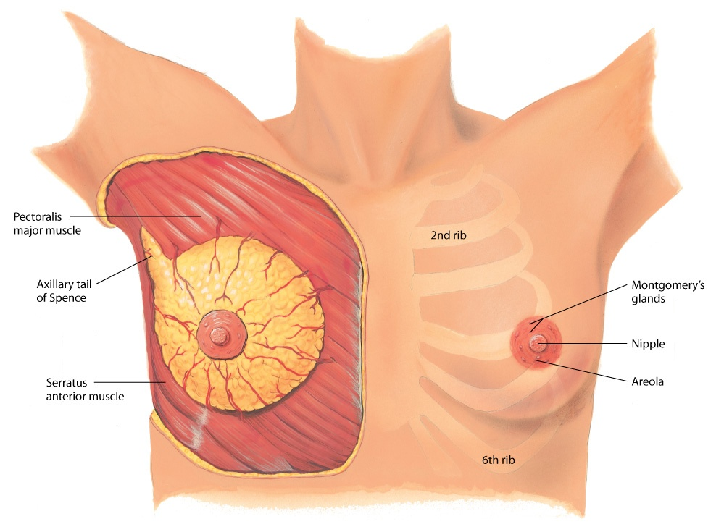
Breast Surface Anatomy

Slide 5
Internal Anatomy I
  Breast is composed of
    Glandular tissue
    Fibrous tissue, including suspensory ligaments
    Adipose tissue
  Glandular tissue contains 15 to 20 lobes radiating from nipple, and these are composed of lobules.
    Within lobules are clusters of alveoli that produce milk.
    Each lobe empties into lactiferous duct; lactiferous ducts form collecting duct system converging toward nipple.
    There, ducts form ampullae, or lactiferous sinuses, behind nipple, which are reservoirs for storing milk.

Slide 6
Internal Anatomy II
  Suspensory ligaments, or Cooper’s ligaments, are fibrous bands extending vertically from surface to attach on chest wall muscles.
    These support breast tissue; they become contracted in cancer of breast, producing dimples in overlying skin.
  Lobes are embedded in adipose tissue.
    These layers of subcutaneous and retromammary fat actually provide most of bulk of breast.
    The relative proportion of glandular, fibrous, and fatty tissue varies depending on age, cycle, pregnancy, lactation, and general nutritional state.

Slide 7
Internal Anatomy III
  Breast may be divided into four quadrants by imaginary horizontal and vertical lines intersecting at nipple.
    This makes a convenient map to describe clinical findings.
    Upper outer quadrant is axillary tail of Spence, cone-shaped breast tissue that projects up into axilla, close to pectoral group of axillary lymph nodes.
    Upper outer quadrant is site of most breast tumors.

Slide 8
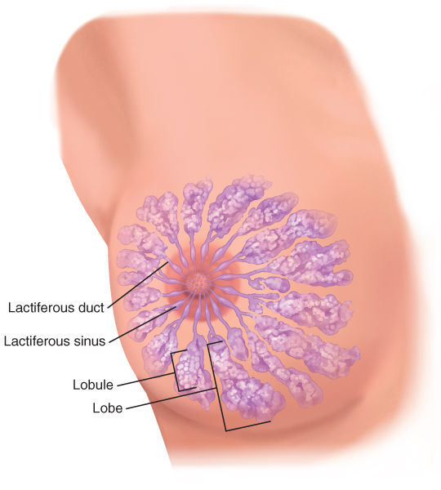
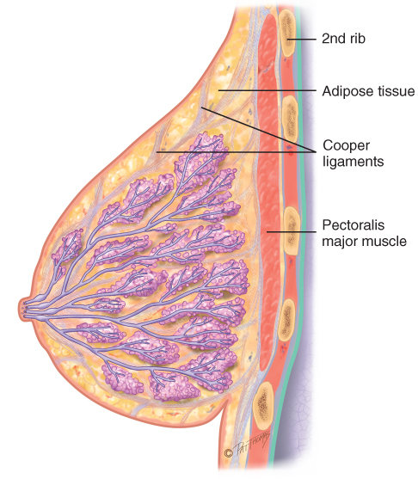
Breast Internal Anatomy
Copyright Pat Thomas, 2010.
Copyright Pat Thomas, 2010.

Slide 9
Lymphatics
  Breast has extensive lymphatic drainage.
  Four groups of axillary nodes are present
    Central axillary nodes
    Pectoral (anterior)
    Subscapular (posterior)
    Lateral
  From the central axillary nodes, drainage flows up to infraclavicular and supraclavicular nodes.

Slide 10
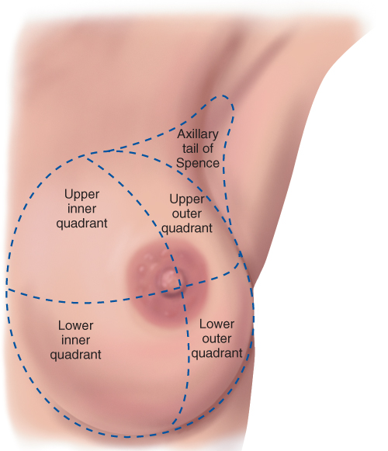
Regional Lymphatics

Slide 11
Developmental Competence
During embryonic life, ventral epidermal ridges, or “milk lines,” are present and curve down from axilla to groin bilaterally.
  Breast develops along ridge over thorax, and rest of the ridge usually atrophies.
  Occasionally a supernumerary nipple (i.e., an extra nipple) persists and is visible along track of mammary ridge.
  At birth, the only breast structures present are lactiferous ducts within nipple; no alveoli have developed; little change occurs until puberty.

Slide 12
Developmental Competence: Adolescent
  At puberty, estrogen stimulates breast changes.
  Occasionally one breast may grow faster than other, producing a temporary asymmetry.
  Five stages of breast development are correlated with Tanner Staging.
  Beginning of breast development precedes menarche by about 2 years.

Slide 13
Developmental Competence: Pregnant Woman
  Breast changes start during the second month of pregnancy and are an early sign for most women.
  Colostrum may be expressed after fourth month.
    This thick yellow fluid is precursor for milk, containing same amount of protein and lactose, but practically no fat.
    Breasts produce colostrum for first few days after delivery.
    It is rich with antibodies that protect newborn against infection, so breastfeeding is important.
  Lactation, milk production, begins 1 to 3 days postpartum; whitish color is from emulsified fat and calcium caseinate.

Slide 14
Question
A pregnant woman who has breast implants asks the nurse if she can still breastfeed. What is the nurse’s best response?
“You should not have any problems breast feeding because your implants do not affect milk production.”
“When the breast implants are inserted they usually affect the milk glands, and breastfeeding is not possible.”
“This would depend on which type of implants were placed and which procedure was used by the surgeon. Check with your surgeon to see if your milk production will be affected.”
Notes:
The correct answer is 3. Milk production may vary depending on the procedure. Many women can still breastfeed after breast augmentation. The surgeon would be able to determine this ability.
Answers 1 and 2 are incorrect because they may not be true. Only the surgeon can determine if milk production will be affected.

Slide 15
Developmental Competence: Aging Woman
  After menopause, ovarian secretion of estrogen and progesterone decreases, causing breast glandular tissue to atrophy.
  Decreased breast size makes inner structures more prominent.
  A breast lump may have been present for years but is suddenly palpable.
  Around nipple, the lactiferous ducts are more palpable and feel firm and stringy because of fibrosis and calcification.
  Axillary hair decreases.

Slide 16
Male Breast
  Rudimentary structure consisting of a thin disk of undeveloped tissue underlying nipple.
  Gynecomastia: during adolescence, it is common for breast tissue to temporarily enlarge.
    Condition is usually unilateral and temporary.
    Reassurance is necessary for adolescent male, whose attention is riveted on his body image.
    Gynecomastia may reappear in aging male and may be due to testosterone deficiency.

Slide 17
Cultural Competence
  Timing of puberty is influenced by genetic and environmental factors.
  Research data indicate age differences in onset of puberty according to different ethnic groups.
  Obesity contributes to the early onset of puberty.
  Menses began at an average age of 12.16 years for black girls and age 13 for white girls.

Slide 18
Cultural Competence: Breast Cancer I
  Incidence of breast cancer varies in cultural groups.
  Women who inherit mutations of BRCA1 and BRACA2 on one or both sides are at an increased risk for developing breast or ovarian cancer.
  Different risks are linked to breast cancer related to age and ethnicity variables.
  Women’s Health Initiative (WHI) study looked at increased risk linkage with use of combined hormone replacement therapy (HRT) and development of breast cancer.
  Screening mammography annual screening is recommended starting at age 40.

Slide 19
Cultural Competence: Breast Cancer II
  Lifestyle risk factors relate to risk.
    Alcohol has dose-dependent effect.
    Continuation of physical exercise during aging helps reduce risk.
    Postmenopausal weight gain negates effects of physical exercise.
  Factors contributing to breast health care access include low income, lack of health insurance, geographic, cultural and language barriers, and racial bias.

Slide 20
Cultural Competence: Breast Cancer III
  “Alcohol/Western” dietary pattern linked to increased risk of breast cancer, especially with estrogen or progesterone + tumors
  “Mediterranean” dietary pattern linked to a modest protective effect against breast cancer

Slide 21
Subjective Data
Breast
  Pain
  Lump
  Discharge
  Rash
  Swelling
  Trauma
  History of breast disease
  Surgery
  Self-care behaviors
  Perform breast self-examination
  Last mammogram
Axilla
  Tenderness, lump, or swelling
  Rash

Slide 22
Breast Cancer: Culture and Women
In Western culture, female breasts signify more than their primary purpose of lactation.
  Matters pertaining to breasts affect woman’s body image and generate emotional responses.
A woman who has found a breast lump may come to you with fear, anxiety, and panic.
  Although many breast lumps are benign, women initially assume worst possible outcome, including cancer, disfigurement, and death.
  While you are collecting subjective data, tune in to cues for these behaviors that call for a reasoned and straightforward attitude.

Slide 23
Subjective Data Questions: Pain
    Any pain or tenderness in breasts? When did you first notice it?
    Where is pain? Localized or all over?
    Is painful spot sore to touch? Do you feel a burning or pulling sensation?
    Is pain cyclic? Any relation to your menstrual period?
    Is pain brought on by strenuous activity, especially involving one arm; a change in activity; manipulation during sex; part of underwire bra; exercise?

Slide 24
Subjective Data Questions I
  Lump
    Ever noticed lump or thickening in breast? Where?
    When did you first notice it? Changed at all since then?
    Does lump have any relation to your menstrual period?
    Noticed any change in overlying skin: redness, warmth, dimpling, swelling?
  Discharge
    Any discharge from nipple? When did you first notice this?
    What color is discharge?
    Is consistency thick or runny? Odor?

Slide 25
Subjective Data Questions II
  Rash
    Any rash on breast?
    When did you first notice this?
    Where did it start? On the nipple, areola, or surrounding skin?
  Swelling
    Any swelling in breasts? In one spot or all over?
    Related to your menstrual period, pregnancy, or breastfeeding?
    Any change in bra size?

Slide 26
Subjective Data Questions III
  Trauma
    Any trauma or injury to the breasts?
    Did it result in any swelling, lump, or break in skin?
  History of breast disease
    Any history of breast disease yourself?
    What type? How was this diagnosed?
    When did this occur? How is it being treated?
    Any breast cancer in your family? Who? Sister, mother, maternal grandmother, maternal aunts, daughter?
    At what age did this relative have breast cancer?

Slide 27
Subjective Data Questions IV
  Surgery or radiation
    Ever had surgery on the breasts? Was this a biopsy? What were the biopsy results?
    Mastectomy? Mammoplasty, augmentation, or reduction?
    Ever had mammography, a screening x-ray examination of breasts? When was last x-ray?
  Medications
    Have you taken oral contraceptives? How long?
    Have you been on HRT? How long?
    Types of medications

Slide 28
Subjective Data Questions V
  Self-care behaviors
    Have you ever been taught breast self-examination?
      (If the answer is yes) How often do you perform it? What helps you remember? It is an excellent way to be in charge of your own health; I would like you to show me your technique after we do your examination.
      (If the answer is no) This will be an excellent way that you can take charge of your own health; you can make breast self-examination a very routine health habit, just like brushing your teeth; I will teach you the technique after we do your examination.

Slide 29
Subjective Data Questions VI
Axilla
  Tenderness, lump, or swelling
    Any tenderness or lump in the underarm area?
    Where? When did you first notice this?
  Rash
    Any axillary rash? Please describe it.
    Does it seem to be a reaction to deodorant?

Slide 30
Additional History for Preadolescent Girl
  Have you noticed your breasts changing?
    How long has this been happening?
  Many girls notice other changes in their bodies, too, that come with growing up.
    What have you noticed?
    What do you think about all this?

Slide 31
Additional History for Pregnant Woman
  Have you noticed any enlargement or fullness in the breasts?
    Is there any tenderness or tingling?
    Do you have a history of inverted nipples?
  Are you planning to breastfeed your baby?

Slide 32
Additional History for Menopausal Woman
  Have you noticed any change in breast contour, size, or firmness?
    Change may not be as apparent to obese woman or to woman whose earlier pregnancies have already produced breast changes.

Slide 33
Risk Profile for Breast Cancer
  Breast cancer is second major cause of death from cancer in women.
  However, early detection and improved treatment have increased survival rates.
    The 5-year survival rate for localized breast cancer has increased from 78% in 1940s to 98% today.
    If cancer has spread regionally, survival rate is 84%.

Slide 34
Objective Data
Preparation
  Woman sitting up facing examiner
    An alternative draping method is to use a short gown, open at back, and lift it up to woman’s shoulders during inspection.
  During palpation when woman is supine, cover one breast with gown while examining other.
    Be aware that many women are embarrassed to have their breasts examined; use a sensitive but matter-of-fact approach.
  After examination, be prepared to teach woman breast self-examination.
Equipment
  Small pillow
  Ruler marked in centimeters
  Pamphlet or teaching aid for breast self-examination (BSE)

Slide 35
Inspection of the Breast I
  General appearance
    Note symmetry of size and shape; common to have a slight asymmetry in size; often left breast is slightly larger than right.
  Skin
    Normally smooth and of even color
    Note any localized areas of redness, bulging, or dimpling; also any skin lesions or focal vascular pattern.
    Fine blue vascular network visible during pregnancy; pale linear striae, or stretch marks, follow pregnancy.
    Normally no edema is present.

Slide 36

General Appearance of Breasts

Slide 37
Inspection of the Breast II
  Lymphatic drainage areas
    Observe axillary and supraclavicular regions; note any bulging, discoloration, or edema.
  Nipple
    Should be symmetric on same plane on both breasts
    Nipples usually protrude, although some are flat and some are inverted.
    Normal nipple inversion may be unilateral or bilateral and usually can be pulled out.
    Note any dry scaling, any fissure or ulceration, and bleeding or other discharge.

Slide 38
Inspection of the Breast III
  Supernumerary nipple is normal variation.
    An extra nipple along embryonic “milk line” on thorax or abdomen is congenital finding.
    Usually below breast near midline and has no associated glandular tissue; looks like a mole, although a close look reveals a tiny nipple and areola.

Slide 39
Maneuvers to Screen for Retraction
    Direct woman to change position to check breasts for skin retraction signs; first ask her to lift arms slowly over head; both breasts should move up symmetrically.
    Next ask her to push her hands onto her hips and then to push her two palms together; these maneuvers contract pectoralis major muscle; slight lifting of both breasts will occur.
    Ask woman with large pendulous breasts to lean forward while you support her forearms; note symmetric free-forward movement of both breasts.

Slide 40
Inspection and Palpation of the Axillae
Examine axillae while woman is sitting.
  Inspect skin, noting any rash or infection; lift woman’s arm and support it, so that her muscles are loose and relaxed; use right hand to palpate left axilla.
  Reach fingers high into axilla; move them firmly down in four directions.
  Move woman’s arm through range-of-motion to increase surface area you can reach.
  Usually nodes are not palpable, although you may feel a small, soft, nontender node in central group.
  Note any enlarged and tender lymph nodes.

Slide 41
Palpation of the Breasts I
  Help woman to a supine position
    Tuck a small pad under side to be palpated and raise her arm over her head to flatten breast tissue and displace it medially; any significant lumps will then feel more distinct.
    Use pads of your first three fingers and make a gentle rotary motion on breast; vary pressure palpating light, medium, and deep tissue in each location.
    Vertical strip pattern currently recommended to detect a breast mass, but two other patterns are in common use:
      From the nipple palpating out to periphery as if following spokes on a wheel
      Palpating in concentric circles out to periphery

Slide 42
Palpation of the Breasts II
  In nulliparous women, normal breast tissue feels firm, smooth, and elastic.
  After pregnancy, tissue feels softer and looser.
  Premenstrual engorgement is normal from increasing progesterone.
    Consists of slight enlargement, tenderness to palpation, and generalized nodularity; lobes feel prominent and their margins more distinct.

Slide 43
Palpation of the Breasts III
  Normally you may feel a firm transverse ridge of compressed tissue in lower quadrants.
  After palpating over four breast quadrants, palpate nipple; note any induration or subareolar mass.
  With your thumb and forefinger, gently depress nipple tissue into well behind areola; tissue should move inward easily.
  If woman reports spontaneous nipple discharge, press areola inward with your index finger; repeat from a few different directions; note color and consistency of any discharge.
  If woman mentions a breast lump that she has discovered herself, examine unaffected breast first to learn a baseline of normal consistency for this woman.

Slide 44
Characteristics of Lump or Mass I
  Location: as with clock face, describe distance in centimeters from nipple; or diagram breast in woman’s record and mark in location of lump.
  Size: judge in centimeters in three dimensions: width, length, and thickness.
  Shape: state whether lump is oval, round, lobulated, or indistinct.
  Consistency: state whether lump is soft, firm, or hard.
  Movability: is lump freely movable or fixed when you try to slide it over chest wall?

Slide 45
Characteristics of Lump or Mass II
  Distinctness: is lump solitary or multiple?
  Nipple: is it displaced or retracted?
  Note skin over lump: is it erythematous, dimpled, or retracted?
  Tenderness: is lump tender to palpation?
  Lymphadenopathy: are any regional lymph nodes palpable?

Slide 46
Palpation: Breast
  Premenopausal women mid-cycle have tissue edema and mastalgia (pain) that make it hard to detect lesions.
  If your findings are in question, consider asking woman to return for follow-up examination first week after menses when hormone levels are lower and edema is not present.

Slide 47
Teach Breast Self-Examination (BSE)
  Help each woman establish regular schedule of self-care.
    The best time to conduct BSE is right after menstrual period, when breasts are smallest and least congested.
    Advise pregnant or menopausal woman not having menstrual periods to select a familiar date to examine her breasts each month.
    Stress that self-examination will familiarize woman with her own breasts and their normal variation; emphasize absence of lumps (not the presence of them).
    Encourage her to report any unusual finding promptly.

Slide 48
Positive Aspects of BSE
  Avoid citing frightening mortality statistics about breast cancer and generating excessive fear and denial that actually obstructs a woman’s self-care action.
    Majority of women will never get breast cancer.
    Great majority of breast lumps are benign.
    Early detection of breast cancer is important; if cancer is not invasive, survival rate is close to 98%.

Slide 49
BSE: Keep Teaching Simple
  The simpler the plan, the more likely person is to comply.
  Describe correct technique and rationale and expected findings to note as woman inspects her own breasts.
  Teach woman to do this in front of a mirror while she is disrobed to waist.
  At home, she can start palpation in shower, where soap and water assist palpation.
  Then palpation should be performed while lying supine.
  Encourage woman to palpate her own breasts while you monitor her technique.

Slide 50
BSE: Teaching Methods
  Many examiners use a simulated breast model so that woman can palpate a “lump.”
  Pamphlets are helpful reinforcers; give woman two pamphlets to take home and encourage her to give one to a relative or friend; this may promote discussion, which is reinforcing.

Slide 51
Question
The nurse is teaching a woman how to perform breast self-examination (BSE). Which statement by the patient would indicate a need for further teaching?
“The best time to check my breasts is a week before my cycle.”
“I will check my breasts in the shower one week after my cycle.”
“I will exam my breast in a clock-like sequence so that I don’t miss any surface area.”
“I will be sure to check my arm pits.”
Notes:
The correct answer is 1. The week before a woman’s cycle is not the best time to check for lumps because the breasts become sore and tender and may also be “lumpy” a week prior to the cycle.
Answer 2 is incorrect because the week after a woman’s cycle is the best time to do the examination, and the shower allows for ease of palpation.
Answer 3 in incorrect because a clock-like sequence is the proper way to perform a BSE.
Answer 4 is incorrect because under the arms houses lymph nodes and the axillary tail of Spence, which is a common site for breast cancer.

Slide 52
Male Breast I
  Examination of male breast can be abbreviated, but do not omit it.
    Combine breast exam with that of anterior thorax.
    Inspect chest wall, noting skin surface and any lumps or swelling.
    Palpate nipple area for any lump or tissue enlargement; it should feel even, with no nodules.
    Palpate axillary lymph nodes.

Slide 53
Male Breast II
  Normal male breast has flat disk of undeveloped breast tissue beneath nipple.
    Gynecomastia is a benign growth of this breast tissue, making it distinguishable from other tissues in chest wall.
    Feels like a smooth, firm, movable disk
    Occurs normally during puberty and is temporary
    The adolescent is acutely aware of his body image.
    Reassure him that this change is normal, common, and temporary.

Slide 54
Developmental Competence I
Infants and children
  In neonate, breasts may be enlarged and visible due to maternal estrogen crossing placenta.
    May secrete a clear or white fluid, called “witch’s milk”
    This is not significant and is resolved within a few days to a few weeks.
  Note position of nipples on prepubertal child.
    Should be symmetric, just lateral to midclavicular line, between fourth and fifth ribs
    Nipple is flat, and areola is darker pigmented.

Slide 55
Developmental Competence II
Adolescent girl
  Breast development usually begins on an average between 8 and 10 years.
    Expect some asymmetry during growth; record stage of development using Tanner staging.
    Use chart to teach adolescent normal developmental stages and to assure her of her own normal progress.
    With maturing adolescents, palpate breasts as you would with adult; note any mass.
    Teach BSE now, so that technique will become a natural, comfortable habit by time girl becomes an adult.

Slide 56
Developmental Competence III
Pregnant woman
  Breasts increase in size, as do nipples.
    Delicate blue vascular pattern is visible over the breasts.
    Jagged linear stretch marks, or striae, may develop if breasts have large increase.
    Nipples become darker and more erectile.
    Areolae widen; grow darker; and contain small, scattered, elevated Montgomery’s glands.
    On palpation, breasts feel more nodular, and thick yellow colostrum can be expressed after first trimester.

Slide 57
Developmental Competence IV
Lactating woman
  Colostrum changes to milk production around the third postpartum day.
    Breasts may become engorged, appearing enlarged, reddened, and shiny and feeling warm and hard.
    Frequent nursing helps drain ducts and sinuses and stimulate milk production.
    Nipple soreness is normal, appearing around twentieth nursing, lasting 24 to 48 hours, then disappearing.
    Nipples may look red and irritated; may even crack but will heal rapidly if kept dry and exposed to air; frequent nursing is best treatment for nipple soreness.

Slide 58
Developmental Competence V
Aging woman
  On inspection, breasts look pendulous, flat, and sagging.
    Nipples may be retracted but can be pulled outward.
    On palpation, breasts feel more granular; terminal ducts around nipple feel more prominent and stringy.
    Thickening of inframammary ridge at lower breast is normal and feels more prominent with age.
    Reinforce value of BSE.
    Women over 50 years old have increased risk of breast cancer.

Slide 59
Developmental Competence VI
Aging woman
  Older women may have problems with arthritis, limited range of motion, or decreased vision that may inhibit self-care.
  Suggest aids to self-examination; for example, talcum powder helps fingers glide over skin.

Slide 60

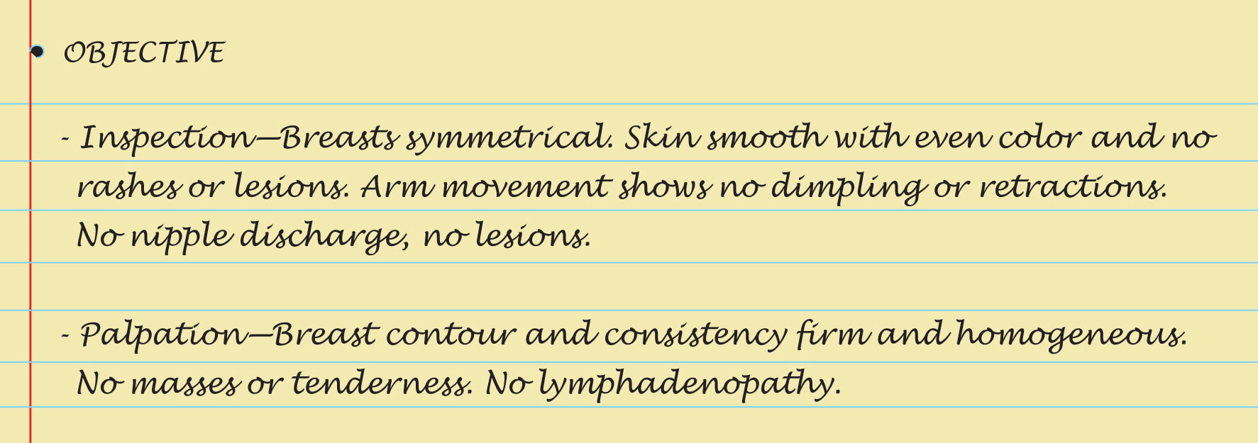
Sample Charting

Slide 61

Sample Charting Assessment

Slide 62
Summary Checklist: Breasts and Regional Lymphatics
Inspect breasts as woman sits, raises arms overhead, pushes hands on hips and leans forward.
Inspect the supraclavicular and infraclavicular areas.
Palpate the axilla and regional lymph nodes.
With woman supine, palpate the breast tissue, including tail of Spence, the nipples, and areolae.
Teach BSE.

Slide 63
Abnormal Findings:
Retraction and Inflammation
Dimpling
Nipple retraction
Fixation
Edema (peau d’orange)
Deviation in nipple pointing

Slide 64
Abnormal Findings:
Breast Lump
Benign breast disease (formerly fibrocystic breast disease)
Cancer
Fibroadenoma

Slide 65
Abnormal Findings:
Abnormal Nipple Discharge
Mammary duct ectasia
Carcinoma
Intraductal papilloma
Paget disease (intraductal carcinoma)

Slide 66
Abnormal Findings:
Disorders During Lactation
Plugged duct
Breast abscess
Mastitis

Slide 67
Abnormal Findings:
Male Breast
Gynecomastia
Male breast cancer

