Slide 1
Chapter 18
Thorax and Lungs

Slide 2
Structure and Function
Position and surface landmarks
  Thoracic cage is a bony structure with a conical shape, which is narrower at top.
    Defined by sternum, 12 pairs of ribs, and 12 thoracic vertebrae
    Floor is the diaphragm, a musculotendinous septum that separates thoracic cavity from abdomen.
    First seven ribs attach to sternum by costal cartilages.
    Ribs 8, 9, and 10 attach to costal cartilage above.
    Ribs 11 and 12 are “floating,” with free palpable tips.
    Costochondral junctions are points at which ribs join their cartilages; they are not palpable.

Slide 3
Anterior Thoracic Landmarks I
  Surface landmarks on thorax are sign posts for underlying respiratory structures.
  Knowledge of landmarks will help you localize a finding and will facilitate communication of your findings.
    Suprasternal notch: feel this hollow U-shaped depression just above sternum between clavicles.
    Sternum: “breastbone” has three parts; manubrium, body, and xiphoid process.
  Walk fingers down manubrium a few centimeters until you feel distinct bony ridge, the manubriosternal angle.

Slide 4
Anterior Thoracic Landmarks II
  Manubriosternal angle: “Angle of Louis,” at articulation of manubrium and sternum, and continuous with second rib
  Identify Angle of Louis, palpate lightly to second rib, and slide down to second intercostal space.
  Each intercostal space is numbered by rib above it.
  Continue counting ribs in middle of hemithorax, not close to sternum because costal cartilages lie too close to count.
  You can palpate easily down to the tenth rib.

Slide 5
Anterior Thoracic Landmarks III
  Angle of Louis also marks site of tracheal bifurcation into right and left main bronchi; corresponds with upper border of atria of the heart, and it lies above fourth thoracic vertebra on back.
  Costal angle: the right and left costal margins form an angle where they meet at xiphoid process.
  Usually 90 degrees or less, this angle increases when rib cage is chronically overinflated, as in emphysema.

Slide 6
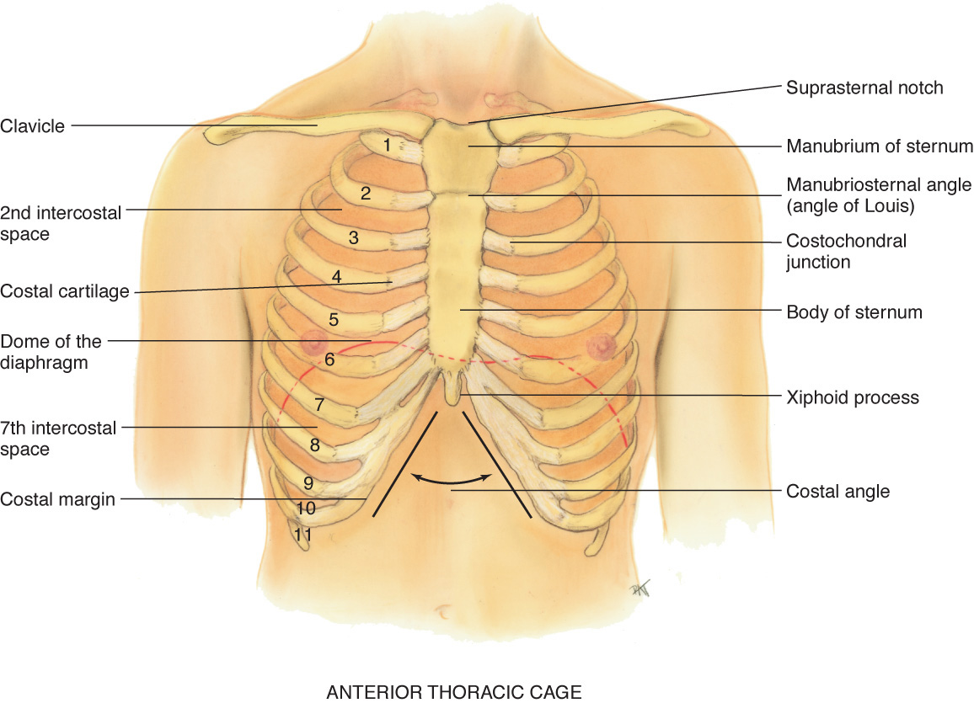
Anterior Thoracic Cage

Slide 7
Posterior Thoracic Landmarks I
    Counting ribs and intercostal spaces on back is harder due to muscles and soft tissue surrounding ribs and spinal column.
    Vertebra prominens: start here; flex your head and feel for most prominent bony spur protruding at base of neck.
    This is spinous process of C7; if two bumps seem equally prominent, upper one is C7 and lower one is T1.
    Spinous processes: count down these knobs on vertebrae, which stack together to form spinal column.

Slide 8
Posterior Thoracic Landmarks II
    Note that spinous processes align with their same numbered ribs only down to T4.
    After T4, spinous processes angle downward from their vertebral body and overlie vertebral body and rib below.
    Inferior border of scapula: scapulae are located symmetrically in each hemithorax.
    Lower tip is usually at seventh or eighth rib.
    Twelfth rib: palpate midway between spine and person’s side to identify its free tip.

Slide 9
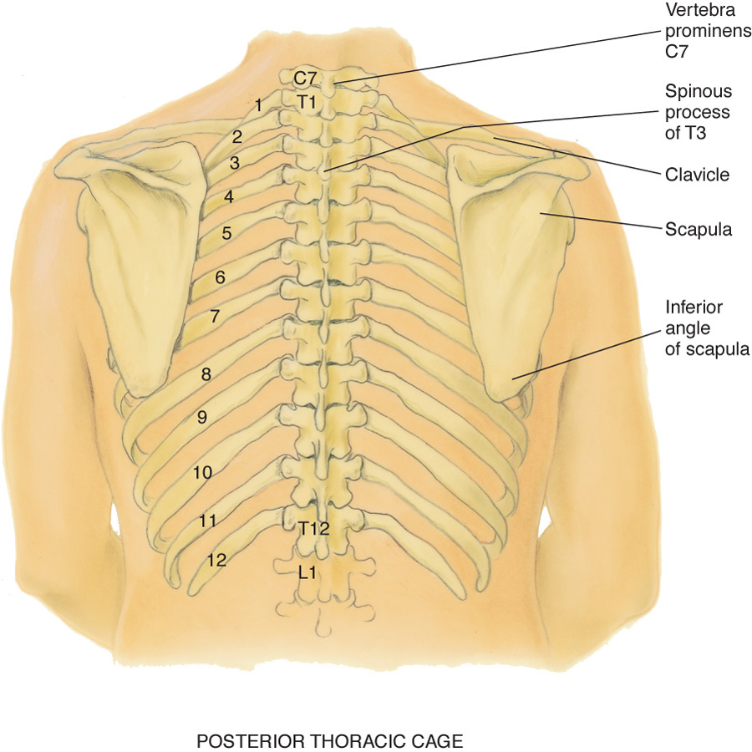
Posterior Thoracic Cage

Slide 10
Reference Lines I
  Use reference lines to pinpoint finding vertically on chest.
  On anterior chest, note midsternal line and midclavicular line.
  Midclavicular line bisects center of each clavicle at a point halfway between palpated sternoclavicular and acromioclavicular joints.
  Posterior chest wall has vertebral (or midspinal) line and scapular line, which extends through inferior angle of scapula when arms are at sides of body.

Slide 11
Reference Lines II
  Lift up the person’s arm 90 degrees, and divide lateral chest by three lines:
    Anterior axillary line: extends down from anterior axillary fold where pectoralis major muscle inserts
    Posterior axillary line: continues down from posterior axillary fold where latissimus dorsi muscle inserts
    Midaxillary line: runs down from apex of axilla and lies between and parallel to other two

Slide 12
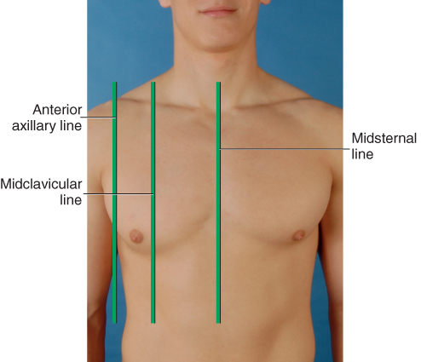
Anterior Reference Lines

Slide 13
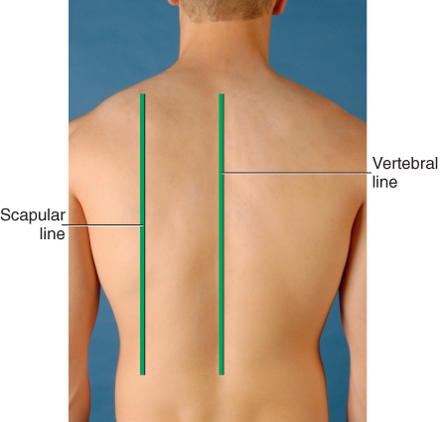
Posterior Reference Lines

Slide 14
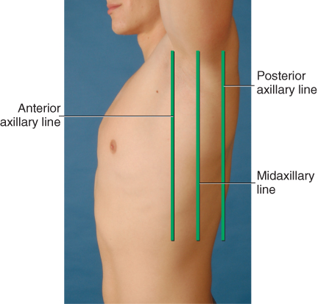
Lateral Reference Lines

Slide 15
Thoracic Cavity I
  Mediastinum: middle section of thoracic cavity containing esophagus, trachea, heart, and great vessels
    Right and left pleural cavities, on either side of mediastinum, contain lungs.
    Lung borders: In anterior chest, apex of lung tissue is 3 or 4 cm above inner third of clavicles.
    Base rests on diaphragm at about sixth rib in midclavicular line.
    Laterally, lung tissue extends from apex of axilla down to seventh or eighth rib.

Slide 16
Thoracic Cavity II
  Posteriorly, the location of C7 marks apex of lung tissue, and T10 usually corresponds to base.
    Deep inspiration expands lungs, and their lower border drops to level of T12.
  Lobes of the lung
    Lungs are paired but not precisely symmetric structures.
    Right lung shorter than left because of underlying liver
    Left lung narrower than right because heart bulges to left.
    Right lung has three lobes, and left lung has two lobes.

Slide 17
Lobes of the Lung Anterior Chest
Lobes not arranged in horizontal bands; they stack in diagonal sloping segments and are separated by fissures that run obliquely through chest
Anterior chest
  On anterior chest, oblique fissure crosses fifth rib in midaxillary line and terminates at sixth rib in midclavicular line.
  Right lung also contains horizontal (minor) fissure, which divides right upper and middle lobes.
  This fissure extends from fifth rib in right midaxillary line to third intercostal space or fourth rib at right sternal border.

Slide 18
Lobes of the Lung Posterior Chest
  Posterior chest
    Most remarkable point about posterior chest is that it is almost all lower lobe.
    Upper lobes occupy a smaller band of tissue from their apices at T1 down to T3 or T4.
    At this level, lower lobes begin, and their inferior border reaches down to level of T10 on expiration and to T12 on inspiration.
    Right middle lobe does not project onto posterior chest at all.

Slide 19
Lobes of the Lung Lateral Chest
  Lateral chest
    Lung tissue extends from apex of axilla down to seventh or eighth rib.
    Right upper lobe extends from apex of axilla down to horizontal fissure at fifth rib.
    Right middle lobe extends from horizontal fissure down and forward to sixth rib at midclavicular line.
    Right lower lobe continues from fifth rib to eighth rib in midaxillary line.

Slide 20
Lobes of the Lung Left
  Left lung contains only two lobes, upper and lower.
  These are seen laterally as two triangular areas separated by oblique fissure.
  Left upper lobe extends from apex of axilla down to fifth rib at midaxillary line.
  Left lower lobe continues down to eighth rib in midaxillary line.
  Using these landmarks, take a marker and try tracing outline of each lobe on a willing partner.
  Take special note of three points that commonly confuse beginning examiners.
    Left lung has no middle lobe.
    Anterior chest contains mostly upper and middle lobe with very little lower lobe.
    Posterior chest contains almost all lower lobe.

Slide 21
Pleurae I
  The thin, slippery pleurae form an envelope between lungs and chest wall.
  Visceral pleura lines outside of lungs, dipping down into fissures.
  It is continuous with parietal pleura lining inside of chest wall and diaphragm.
  Pleural cavity is potential space filled only with few milliliters of lubricating fluid.

Slide 22
Pleurae II
  Pleural cavity normally has a vacuum, or negative pressure, which holds lungs tightly against chest wall.
    Pleurae extend about 3 cm below level of lungs, forming the costodiaphragmatic recess.
  Lungs slide smoothly and noiselessly up and down during respiration, lubricated by a few milliliters of fluid.
  Similar to two glass slides with a drop of water between them; although it is difficult to separate slides, they slide smoothly back and forth.
  This is a potential space; when it abnormally fills with air or fluid, it compromises lung expansion.

Slide 23
Trachea and Bronchial Tree I
  Trachea lies anterior to esophagus and is 10 to 11 cm long in the adult.
  Begins at level of cricoid cartilage in neck and bifurcates just below sternal angle into right and left main bronchi.
  Posteriorly, tracheal bifurcation is at level of T4 or T5.
  Right main bronchus is shorter, wider, and more vertical than the left main bronchus.

Slide 24
Trachea and Bronchial Tree II
  Trachea and bronchi transport gases between the environment and lung parenchyma.
  Constitute dead space, or space that is filled with air but is not available for gaseous exchange.
  This is about 150 mL in adult.
  Bronchial tree also protects alveoli from small particulate matter in inhaled air.
  Bronchi are lined with goblet cells, which secrete mucus that entraps particles; bronchi are lined with cilia, which sweep particles upward where they can be swallowed or expelled.

Slide 25
Trachea and Bronchial Tree III
  Acinus is a functional respiratory unit that consists of bronchioles, alveolar ducts, alveolar sacs, and the alveoli.
  Gaseous exchange occurs across respiratory membrane in alveolar duct and in millions of alveoli.
  Alveoli are clustered like grapes around each alveolar duct.
  This creates millions of interalveolar septa (walls) that increase tremendously the working space available for gas exchange.
  This bunched arrangement creates surface area for gas exchange that is as large as a tennis court.

Slide 26
Mechanics of Respiration I
Four major functions of respiratory system
  Supplying oxygen to the body for energy production
  Removing carbon dioxide as a waste product of energy reactions
  Maintaining homeostasis (acid-base balance) of arterial blood
    By supplying oxygen to blood and eliminating excess carbon dioxide, respiration maintains pH or acid-base balance of blood.
  Maintaining heat exchange (less important in humans)

Slide 27
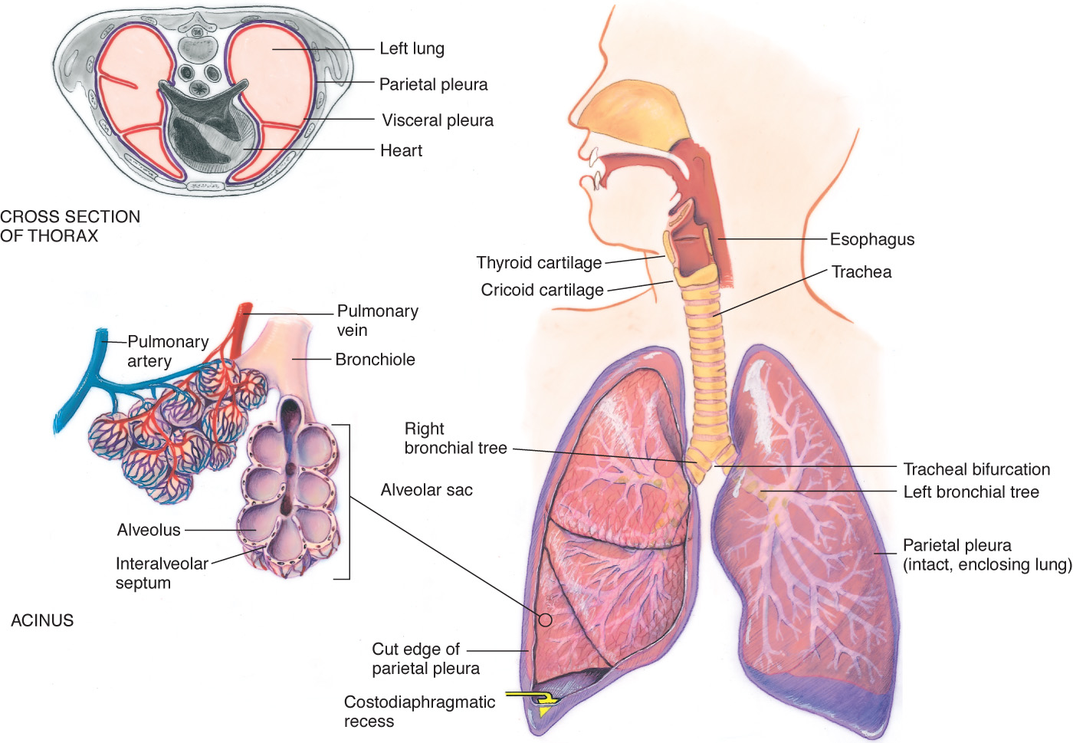
Structures of Respiratory System

Slide 28
Mechanics of Respiration II
  Body tissues are bathed by blood that normally has a narrow acceptable range of pH.
    Although a number of compensatory mechanisms regulate pH, lungs help maintain balance by adjusting level of carbon dioxide through respiration.
    Hypoventilation (slow, shallow breathing) causes carbon dioxide to build up in blood, and hyperventilation (rapid, deep breathing) causes carbon dioxide to be blown off.

Slide 29
Mechanics of Respiration III
  Control of respirations
    Normally our breathing pattern changes without our awareness in response to cellular demands.
    Major feedback loop is humoral regulation, or change in carbon dioxide and oxygen levels in blood, and, less important, hydrogen ion level.
    Normal stimulus to breathe for most of us is an increase of carbon dioxide in blood, or hypercapnia.
    Decrease of oxygen in blood (hypoxemia) also increases respirations but is less effective than hypercapnia.

Slide 30
Mechanics of Respiration IV
  Changing chest size
    Respiration is the physical act of breathing; air rushes into the lungs as chest size increases (inspiration) and is expelled from lungs as chest recoils (expiration).
    Mechanical expansion and contraction of chest cavity alters size of thoracic container in two dimensions.
      Vertical diameter lengthens or shortens, which is accomplished by downward or upward movement of diaphragm.
      Anteroposterior diameter increases or decreases, which is accomplished by elevation or depression of ribs.

Slide 31
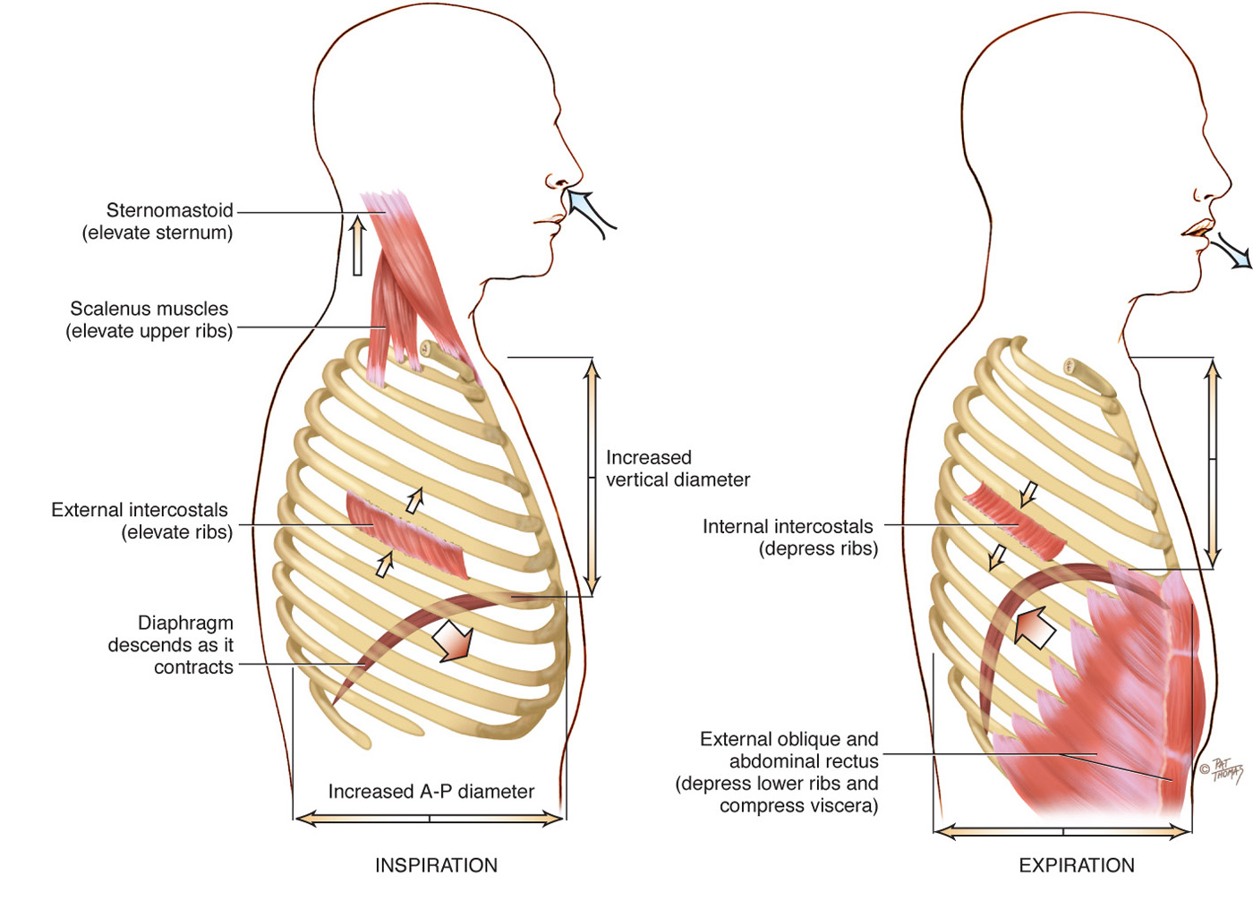
Mechanics of Respiration

Slide 32
Developmental Competence I
Infants and children
  During first 5 weeks of fetal life, primitive lung bud emerges.
  Infant’s body systems all develop in utero, but the respiratory system alone does not function until birth; birth demands its instant performance.
  Respiratory development continues throughout childhood.
  Other conditions associated with environmental tobacco smoke (ETS) exposure include sudden infant death syndrome, negative behavioral and cognitive functioning, and increased rates of adolescent smoking.

Slide 33
Developmental Competence II
Pregnant woman
  Enlarging uterus elevates diaphragm 4 cm during pregnancy.
    This decreases vertical diameter of thoracic cage, but this decrease is compensated for by an increase in horizontal diameter.
    Increase in estrogen level relaxes chest cage ligaments.
  Although diaphragm is elevated, it is not fixed.
    It moves with breathing even more during pregnancy, which results in an increase in tidal volume.
    Growing fetus increases oxygen demand on mother’s body.

Slide 34
Developmental Competence III
Aging adult
  Costal cartilages become calcified, which produces a less mobile thorax.
  Aging lung is more rigid structure that is harder to inflate.
  These changes result in an increase in small airway closure.
  With aging, histologic changes (i.e., a gradual loss of intra-alveolar septa and a decreased number of alveoli) also occur, so less surface area is available for gas exchange.
  Lung bases become less ventilated as a result of closing off of a number of airways.
  Histologic changes also increase the older person’s risk of postoperative pulmonary complications.

Slide 35
Culture and Genetics: Tuberculosis (TB)
  Incidence of tuberculosis (TB) has declined in the U.S.; however, persons who are foreign-born and of racial or ethnic minorities have a disproportionately large burden of TB disease.
  In 2012 the TB rates were
    11.5 times higher in foreign-born than in U.S.-born
    8.7 million new cases of TB worldwide
    Incidence of multi-resistant TB is increasing

Slide 36
Culture and Genetics: Asthma
  Prevalence rate of asthma in the U.S. in 2011 was 8.4%.
    Most common chronic disease in childhood with a prevalence rate of 9.5% in children ages 0 to 17 years.
    Blacks, Hispanics, and American Indians experience more asthma-related problems and medical care than do Whites or Asians.

Slide 37
Subjective Data
Cough
Shortness of breath
Chest pain with breathing
History of respiratory infections
Smoking history
Environmental exposure
Self-care behaviors

Slide 38
Subjective Data: Cough I
  Do you have a cough? When did it start? Gradual or sudden?
    How long have you had it?
    How often do you cough? At any special time of day or just on arising? Cough wake you up at night?
    Do you cough up any phlegm or sputum? How much? What color is it?
    Cough up any blood? Does this look like streaks or frank blood? Does the sputum have a foul odor?
    How would you describe your cough: hacking, dry, barking, hoarse, congested, bubbling?

Slide 39
Subjective Data: Cough II
  Cough seems to come with anything: activity, position (lying), fever, congestion, talking, anxiety
    Activity make it better or worse?
    What treatment have you tried? Prescription or over-the-counter medications, vaporizer, rest, position change?
    Does the cough bring on anything such as chest pain or ear pain? Is it tiring? Are you concerned about it?

Slide 40
Subjective Data: Shortness of Breath (SOB) I
  Ever had any shortness of breath or hard- breathing spells?
    What brings it on? How severe is it? How long does it last?
    Is it affected by position, such as lying down?
    Occur at any specific time of day or night?
    Shortness of breath episodes associated with night sweats?
    Or cough, chest pain, or bluish color around lips or nails? Wheezing sound?

Slide 41
Subjective Data: Shortness of Breath (SOB) II
  Do episodes seem to be related to food, pollen, dust, animals, season, or emotion?
    What do you do in a hard-breathing attack? Take a special position, or use pursed-lip breathing? Do you use any oxygen, inhalers, or medications?
    How does the shortness of breath affect your work or home activities? Is it getting better or worse or staying about the same?

Slide 42
Subjective Data: Chest Pain with Breathing
  Any chest pain with breathing? Please point to exact location.
    When did it start? Is it constant or does it come and go?
    Describe the pain: burning, stabbing?
    Is it brought on by respiratory infection, coughing, or trauma? Is it associated with fever, deep breathing, unequal chest inflation?
    What have you done to treat it? Have you tried medication or heat application?

Slide 43
History of Respiratory Infections
  Any past history of breathing trouble or lung diseases, such as bronchitis, emphysema, asthma, or pneumonia?
    Any unusually frequent or unusually severe colds?
    Any family history of allergies, tuberculosis, or asthma?
  Smoking history
    Do you smoke cigarettes or cigars? At what age did you start? How many packs per day do you smoke now? For how long? Do you live with someone who smokes?
    Have you ever tried to quit? Why do you think it did not work? What activities do you associate with smoking?

Slide 44
Environmental Exposure
  Are there any environmental conditions that may affect your breathing?
    Where do you work? At a factory, chemical plant, coal mine, farming, outdoors in a heavy traffic area?
    Do you do anything to protect your lungs, such as wear a mask or have ventilatory system checked at work?
    Do you do anything to monitor your exposure? Do you have periodic examinations, pulmonary function tests, or x-ray examinations?
    Do you know what specific symptoms to note that may signal breathing problems?

Slide 45
Patient-Centered Care
Self-care behaviors
  When was the last time you had the following?
    TB skin test
    Chest x-ray study
    Pneumonia or influenza immunization

Slide 46
Additional History for Infants and Children
  Has the child had any frequent or very severe colds?
  Is there any history of allergy in family?
    (For child under 2 years of age): At what age were new foods introduced? Was child breastfed or bottle-fed?
  Does child have a cough or seem congested? Does child have noisy breathing or wheezing?
  What measures have you taken to child-proof your home and yard? Is there any possibility of child inhaling or swallowing toxic substances?
  Has anyone taught you emergency care measures in case of accidental choking or a hard-breathing spell?
  Are any smokers in home or in car with child?

Slide 47
Additional History for Aging Adult
  Have you noticed any shortness of breath or fatigue with your daily activities?
    Tell me about your usual amount of physical activity.
    (For those with a history of chronic obstructive pulmonary disease, lung cancer, or tuberculosis): How are you getting along each day? Any weight change in last 3 months? How much?
    How is your energy level? Do you tire more easily? How does your illness affect you at home and at work?
    Do you have any chest pain with breathing?
    Do you have any chest pain after a bout of coughing or after a fall?

Slide 48
Objective Data: Preparation
  Provide respect and comfort while allowing for access of examination techniques.
    A warm room, a warm diaphragm endpiece, and a private examination time with no interruptions
    For smooth choreography in a complete examination, begin the respiratory examination just after palpating thyroid gland when you are standing behind person.
    Perform inspection, palpation, percussion, and auscultation on posterior and lateral thorax.
    Then move to face person and repeat four maneuvers on anterior chest.
    Clean stethoscope endpiece with an alcohol wipe.

Slide 49
Objective Data: Equipment
  Stethoscope
  Small ruler, marked in centimeters
  Marking pen
  Alcohol wipe

Slide 50
Inspect the Posterior Chest I
  Thoracic cage
    Note shape and configuration of chest wall.
    Spinous processes should appear in a straight line; thorax is symmetric, in an elliptical shape, with downward sloping ribs, about 45 degrees relative to spine; scapulae are placed symmetrically in each hemithorax.
    Anteroposterior diameter should be less than transverse diameter.
    The neck muscles and trapezius muscles should be developed normally for age and occupation.

Slide 51
Inspect the Posterior Chest II
    Note position person takes to breathe.
    Include relaxed posture and ability to support one’s own weight with arms comfortable at sides or in lap.
    Assess skin color and condition.
    Color should be consistent with person’s genetic background, with allowance for sun-exposed areas on chest and back.
    No cyanosis or pallor should be present.
    Note any lesions; inquire about any change in nevus on back.

Slide 52
Symmetric Expansion
  Confirm symmetric chest expansion by placing your warmed hands on posterolateral chest wall with thumbs at level of T9 or T10.
  Slide your hands medially to pinch up a small fold of skin between your thumbs; ask person to take a deep breath.
  Your hands serve as mechanical amplifiers; as person inhales deeply, your thumbs should move apart symmetrically; note any lag in expansion.

Slide 53
Tactile Fremitus I
  Fremitus is a palpable vibration.
  Sounds generated from larynx are transmitted through patent bronchi and through lung parenchyma to chest wall, where you feel them as vibrations.
  Use either palmar base (ball) of fingers or ulnar edge of one hand, and touch person’s chest while he or she repeats words, “ninety-nine” or “blue moon.”
  These are resonant phrases that generate strong vibrations.

Slide 54
Tactile Fremitus II
  Start over lung apices and palpate from one side to another.
  Fremitus varies among persons, but symmetry is most important; vibrations should feel same in corresponding area on each side.
  However, just between scapulae, fremitus may feel stronger on right side than on left side because the right is closer to bronchial bifurcation; avoid palpating over scapulae because bone damps out sound transmission.

Slide 55
Tactile Fremitus III
  Factors affecting normal intensity of tactile fremitus
    Relative location of bronchi to chest wall; normally most prominent between scapulae and around sternum, sites where major bronchi are closest to chest wall
    Decreases as you progress down because more and more tissue impedes sound transmission
    Thickness of chest wall
    Feels greater over thin wall than over an obese or heavily muscular one where thick tissue dampens vibration
    Pitch and intensity; loud, low-pitched voice generates more fremitus than soft, high-pitched one.

Slide 56
Tactile Fremitus IV
  Note any areas of abnormal fremitus.
  Conditions that increase density of lung tissue make a better conducting medium for sound vibrations and increase tactile fremitus.
  Using fingers, gently palpate entire chest wall.
  Enables noting any areas of tenderness, skin temperature and moisture, detecting any superficial lumps or masses, and exploring any skin lesions noted on inspection

Slide 57
Percussion Posterior Chest I
  Lung fields
    Determine predominant note over lung fields; start at apices and percuss band of normally resonant tissue across tops of both shoulders.
    Then, percussing in interspaces, make side-to-side comparison all the way down lung region.
    Percuss at 5-cm intervals; avoid damping effect of scapulae and ribs.
    Resonance is low-pitched, clear, hollow sound that predominates in healthy lung tissue in adult.

Slide 58
Percussion Posterior Chest II
  Lung fields
    However, resonance is a relative term and has no constant standard.
    Resonant note may be modified somewhat in athlete with heavily muscular chest wall and in heavily obese adult in whom subcutaneous fat produces scattered dullness.
    Percussion sets into motion only outer 5 to 7 cm of tissue; will not penetrate to reveal any change in density deeper than that.
    Abnormal findings must be 2 to 3 cm wide to yield an abnormal percussion note; lesions smaller than that are not detectable by percussion.

Slide 59
Diaphragmatic Excursion I
  Percuss to map out lower lung border, both in expiration and in inspiration.
  First, ask the person to “exhale and hold it” briefly while you percuss down scapular line until sound changes from resonant to dull on each side.
  This estimates level of diaphragm separating lungs from abdominal viscera; it may be somewhat higher on right side because of presence of liver.
  Mark the spot.

Slide 60
Diaphragmatic Excursion II
  Now ask person to “take a deep breath and hold it.”
  Continue percussing down from your first mark and mark level where sound changes to dull on deep inspiration.
  Measure the difference; this diaphragmatic excursion should be equal bilaterally and measure about 3 to 5 cm in adults, although it may be up to 7 to 8 cm in well-conditioned people.

Slide 61
Auscultate the Posterior Chest
  Passage of air through tracheobronchial tree creates a characteristic set of noises that are audible through chest wall.
  These noises also may be modified by obstruction within respiratory passageways or by changes in lung parenchyma, the pleura, or chest wall.

Slide 62
Breath Sounds I
  Evaluate presence and quality of normal breath sounds.
  Instruct person to breathe through mouth, a little bit deeper than usual.
  Use flat diaphragm endpiece of stethoscope and hold it firmly on person’s chest wall; listen to at least one full respiration in each location.
  Side-to-side comparison is most important.
  Do not confuse background noise with lung sounds.

Slide 63
Breath Sounds II
  Become familiar with these extraneous noises that may be confused with lung pathology if not recognized.
    Examiner’s breathing on stethoscope tubing
    Stethoscope tubing bumping together
    Patient shivering
    Patient’s hairy chest; movement of hairs under stethoscope sounds like crackles (rales); minimize this by pressing harder or by wetting the hair with damp cloth.
    Rustling of paper gown or paper drapes

Slide 64
Breath Sounds III
  While standing behind person, listen to following lung areas:
    Posterior from apices at C7 to bases around T10
    Laterally from axilla down to seventh or eighth rib
  Continue to visualize approximate locations of lobes of each lung so that you correlate your findings to anatomic areas.
  As you listen, think
    What am I hearing over this spot?
    What should I expect to be hearing?

Slide 65
Types of Breath Sounds
  You should expect to hear three types of normal breath sounds in adult and older child.
    Bronchial, sometimes called tracheal or tubular
    Bronchovesicular
    Vesicular
  Study description of characteristics of these normal breath sounds.
  Note normal location of three types of breath sounds on the chest wall of adult and older child.

Slide 66
Adventitious Sounds I
    Added sounds that are not normally heard in lungs
    If present, are heard as superimposed on breath sounds
    Caused by moving air colliding with secretions in tracheobronchial passageways or by popping open of previously deflated airways
    Sources differ as to the classification and nomenclature of these sounds, but crackles (or rales) and wheeze (or rhonchi) are terms commonly used by most examiners.

Slide 67
Adventitious Sounds II
    Atelectatic crackles: a type of adventitious sound, is not pathologic; short, popping, crackling sounds that sound like fine crackles but do not last beyond a few breaths
    When sections of alveoli are not fully aerated (as in people who are asleep, or in older adult), they deflate slightly and accumulate secretions.
      Crackles are heard when these sections are expanded by a few deep breaths.
    Atelectatic crackles are heard in the periphery only, and disappear after first few breaths or after a cough.

Slide 68
Voice Sounds I
  Determine quality of voice sounds or vocal resonance.
  Voice can be auscultated over chest wall.
  Ask person to repeat a phrase, such as “ninety-nine” while you listen over chest wall.
  Normal voice transmission is soft, muffled, and indistinct; you can hear sound through stethoscope but cannot distinguish exactly what is being said.

Slide 69
Voice Sounds II
  Pathology that increases lung density enhances transmission of voice sounds.
  Eliciting voice sounds usually not done in routine examination.
  Rather, these are supplemental maneuvers that are performed if you suspect lung pathology on basis of earlier data.
  When they are performed, you are testing for possible presence of bronchophony, egophony, and whispered pectoriloquy.

Slide 70
Inspection of the Anterior Chest I
  Note shape and configuration of chest wall.
    Ribs are sloping downward with symmetric interspaces.
    Costal angle is within 90 degrees; development of abdominal muscles as expected for person’s age, weight, and athletic condition.
    Note person’s facial expression; facial expression should be relaxed, indicating unconscious effort of breathing.
    Assess the level of consciousness; level of consciousness should be alert and cooperative.
    Note skin color and condition; lips and nail beds are free of cyanosis; nails are of normal configuration.

Slide 71
Inspection of Anterior Chest II
  Assess quality of respirations.
    Normal relaxed breathing is automatic and effortless, regular and even, and produces no noise.
    Chest expands symmetrically with each inspiration; note any localized lag on inspiration.
    No retraction or bulging of interspaces with inspiration
    Normally accessory muscles are not used to augment respiratory effort.
    Respiratory rate is within normal limits for person’s age, and pattern of breathing is regular.
    Occasional sighs normally punctuate breathing.

Slide 72
Palpation of Anterior Chest I
  Palpate symmetric chest expansion.
    Place your hands on anterolateral wall with thumbs along costal margins and pointing toward xiphoid process.
    Ask person to take a deep breath; watch thumbs move apart symmetrically, and note smooth chest expansion with fingers.
    Any limitation in thoracic expansion is easier to detect on anterior chest because greater range of motion exists here with breathing.

Slide 73
Palpation of Anterior Chest II
  Assess tactile (vocal) fremitus.
    Begin palpating over lung apices in supraclavicular areas.
    Compare vibrations from one side to other as person repeats “ninety-nine.”
    Avoid palpating over female breast tissue because breast tissue normally damps sound.
  Palpate anterior chest wall.
    Note any tenderness; normally none is present.
    Detect any superficial lumps or masses, again, normally none is present.
    Note skin mobility, turgor, temperature, and moisture.

Slide 74
Percussion of Anterior Chest I
  Begin percussing apices in supraclavicular areas.
    Then, percussing interspaces and comparing one side to other, move down anterior chest.
    Interspaces are easier to palpate on anterior chest than on back.
    Do not percuss directly over female breast tissue because this would produce a dull note; shift breast tissue over slightly using edge of your stationary hand.
    In females with large breasts, percussion may yield little useful data.

Slide 75
Percussion of Anterior Chest II
  Note borders of cardiac dullness normally found on anterior chest.
    Do not confuse these with suspected lung pathology.
    In right hemithorax, upper border of liver dullness is located in fifth intercostal space in right midclavicular line.
    On left, tympany is evident over gastric space.

Slide 76
Auscultate Breath Sounds
  Auscultate lung fields over anterior chest from apices in supraclavicular areas down to sixth rib.
  Progress from side to side as you move downward, and listen to one full respiration in each location.
  Use sequence indicated for percussion; do not place stethoscope directly over female breast; displace breast and listen directly over chest wall.
  Evaluate normal breath sounds, noting any abnormal breath sounds and any adventitious sounds.
  If situation warrants, assess voice sounds.

Slide 77
Question
The nurse knows that the proper technique for assessing lungs in an adult patient is that auscultation is performed:
from right to left using a “z” pattern.
from top to bottom using landmarks for accuracy.
using the bell of the stethoscope to hear vascular sounds.
to the anterior chest wall and abdomen to determine diaphragm function.
Notes:
The correct answer is 1. This technique is preferred to ensure a more accurate comparison of lung lobes.
Answer 2 is incorrect because the up and down technique may cause inaccurate comparisons.
Answer 3 is incorrect because the bell would not be used.
Answer 4 is incorrect because assessment of the diaphragm is not performed in the abdominal quadrants.

Slide 78
Measurement of Pulmonary Function Status I
  Forced expiratory time is number of seconds it takes to exhale from total lung capacity to residual volume.
  It is a screening measure of air flow obstruction.
  Although test is usually not performed in respiratory assessment, it is useful to screen for pulmonary function.
  Ask person to inhale deepest breath possible and then blow it all out hard, as quickly as possible, with mouth open.
  Listen with your stethoscope over sternum; normal time for full expiration is 4 seconds or less.

Slide 79
Measurement of Pulmonary Function Status II
  Pulse oximeter is noninvasive method to assess arterial oxygen saturation (SpO₂).
  A healthy person with no lung disease and no anemia normally has an SpO₂ of 97% to 98%.
  However, every SpO₂ result must be evaluated in context of person’s hemoglobin level, acid-base balance, and ventilatory status.
  The 6-minute walk test (6 MWT) is a safer, simple, inexpensive, clinical measure of functional status in aging adults.

Slide 80
Infants and Children: Inspection I
  Infant has a rounded thorax with an equal anteroposterior-to-transverse chest diameter.
  By age 6 years, thorax reaches adult ratio of 1:2.
  Newborn’s chest circumference is 30 to 36 cm and is 2 cm smaller than head circumference until 2 years of age.
  Chest wall is thin with little musculature.
  Newborn’s first respiratory assessment is part of Apgar scoring system to measure successful transition to extrauterine life.
  Infant breathes through nose rather than mouth and is an obligate nose breather until 3 months.

Slide 81
Infants and Children: Inspection II
  Diaphragm is newborn’s major respiratory muscle.
  Count respiratory rate for 1 full minute; normal rates for newborn are 30 to 40 breaths per minute but may spike up to 60 breaths per minute.
  Obtain the most accurate respiratory rate by counting when the infant is asleep because infants reach rapid rates with very little excitation when awake.
  Respiratory pattern may be irregular when extremes in room temperature occur or with feeding or sleeping.
  Brief periods of apnea less than 10 or 15 seconds are common; this periodic breathing is more common in premature infants.

Slide 82
Infants and Children: Palpation and Percussion
  Palpation
    Palpate symmetric chest expansion by encircling infant’s thorax with both hands.
    Further palpation should yield no lumps, masses, or crepitus, although you may feel costochondral junctions in some normal infants.
  Percussion
    Percussion is of limited usefulness in a newborn, especially in a premature newborn, because the adult’s fingers are too large in relation to the tiny chest.

Slide 83
Infants and Children: Percussion
    Percussion note of hyperresonance occurs normally in infant and young child because of relatively thin chest wall.
    Anything less than hyperresonance would have same clinical significance as dullness in adult.
    If measured, diaphragmatic excursion measures about one to two rib interspaces in children.

Slide 84
Infants and Children: Auscultation I
    Auscultation normally yields bronchovesicular breath sounds in peripheral lung fields of infant and young child up to ages 5 to 6 years.
    Relatively thin chest walls with underdeveloped musculature do not damp off sound as do thicker walls of adults, so breath sounds are louder and harsher.
    Fine crackles are adventitious sounds commonly heard in immediate newborn period from opening of airways and clearing of fluid.

Slide 85
Infants and Children: Auscultation II
  Because newborn’s chest wall is so thin, transmission of sounds is enhanced and sound is heard easily all over chest, making localization of breath sounds a problem.
  Even bowel sounds are easily heard in chest.
  Try using smaller pediatric diaphragm endpiece, or place bell over infant’s interspaces and not over ribs.
  Use pediatric diaphragm on an older infant or toddler.

Slide 86
Developmental Competence
Pregnant woman
  Thoracic cage may appear wider.
  Deeper respirations and an increase in tidal volume by 40%
Aging adult
  Chest cage commonly shows an increased anteroposterior diameter, giving a round barrel shape, and kyphosis or an outward curvature of thoracic spine.
  Chest expansion may be somewhat decreased, although still symmetric.
  Tend to tire easily during auscultation when deep mouth breathing is required

Slide 87
Developmental Competence: Acutely Ill Patient
  Use of a second examiner to assist the patient in terms of positional changes
  If no one is available, examiner may roll patient from side to side to facilitate change of position.
  If rolling technique is used, this may interfere with bilateral assessments of inspection and percussion.

Slide 88
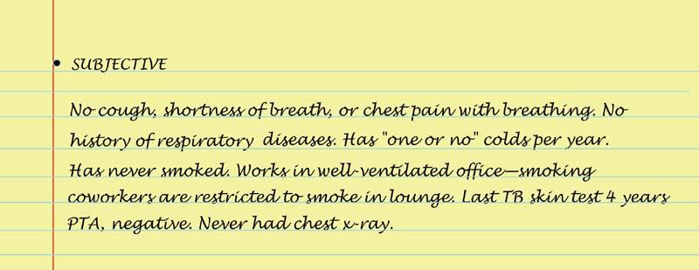
Sample Charting Subjective

Slide 89
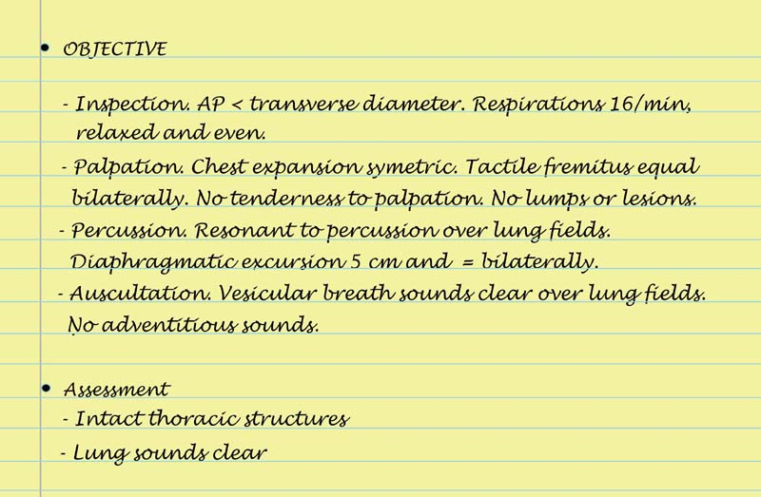
Sample Charting Objective & Assessment

Slide 90
Summary Checklist: Thorax and Lungs Examination
Inspection
  Thoracic cage, respirations, skin color, and condition
  Person’s facial expression, and LOC
Palpation
  Confirm symmetric expansion and tactile fremitus.
  Detection of any lumps, masses, or tenderness
Percussion
  Lung fields and estimate diaphragmatic excursion
Auscultation
  Assess breath sounds, and note any abnormal/adventitious breath sounds.
  Perform bronchophony, whispered pectoriloquy, or egophony as needed.

Slide 91
Abnormal Findings:
Configurations of the Thorax
Barrel chest
Pectus excavatum
Pectus carinatum
Scoliosis
Kyphosis

Slide 92
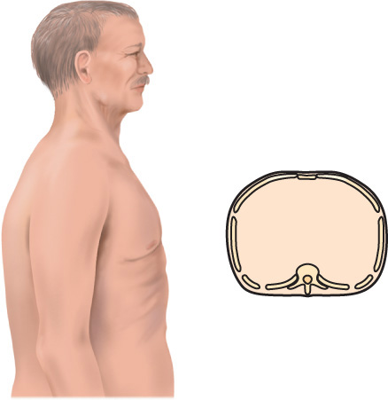
Barrel Chest

Slide 93
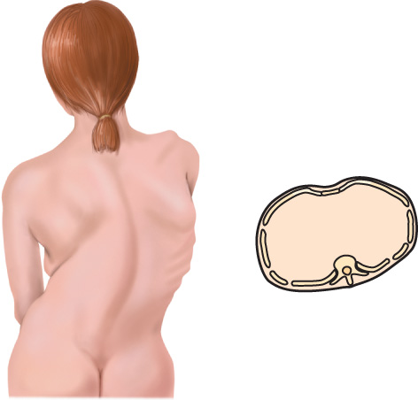
Scoliosis

Slide 94
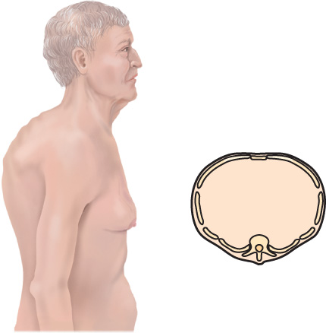
Kyphosis

Slide 95
Abnormal Findings:
Respiration Patterns
Sigh
Tachypnea
Bradypnea
Hyperventilation
Hypoventilation
Cheyne-Stokes respiration
Biot’s respiration
Chronic obstructive breathing

Slide 96
Abnormal Findings:
Abnormal Tactile Fremitus
Increased tactile fremitus
Decreased tactile fremitus
Rhonchial fremitus
Pleural friction fremitus

Slide 97
Question
The nurse is assessing a patient with tactile fremitus. The nurse should suspect that the patient has a(n):
blocked bronchus.
mild case of pneumonia.
advanced case of pneumonia.
pleural effusion.
Notes:
The correct answer is 3.Consolidation must reach to the lung border/chest wall in order to carry the vibration to the examiner’s hands.
Answers 1, 2, and 4 are incorrect because a blocked bronchus or a pleural effusion will decrease tactile fremitus, whereas early pneumonia that has created a small area of consolidation is not likely to change the finding at all.

Slide 98
Abnormal Findings:
Adventitious Lung Sounds
Discontinuous sounds
  Crackles—fine
  Crackles—course
  Atelectatic crackles
  Pleural friction rub
Continuous sounds
  Wheeze—sibilant
  Wheeze—sonorous rhonchi
  Stridor

Slide 99
Abnormal Findings:
Common Respiratory Conditions
Atelectasis
Lobar pneumonia
Bronchitis
Emphysema
Asthma (reactive
airway disease)
Pleural effusion thickening
Pneumothorax
Congestive heart failure
Pneumocystis carinii pneumonia
Tuberculosis
Pulmonary embolism
Acute respiratory distress syndrome

