Slide 1
Chapter 19
Heart and Neck Vessels

Slide 2
Position and Surface Landmarks
Precordium: area on anterior chest overlying heart and great vessels
During contraction, apex beats against chest wall, producing an apical impulse
Heart has four chambers: atria and ventricles
Great vessels lie bunched above base of heart
Pulmonary veins return freshly oxygenated blood to left side of heart, and aorta carries it out to body

Slide 3
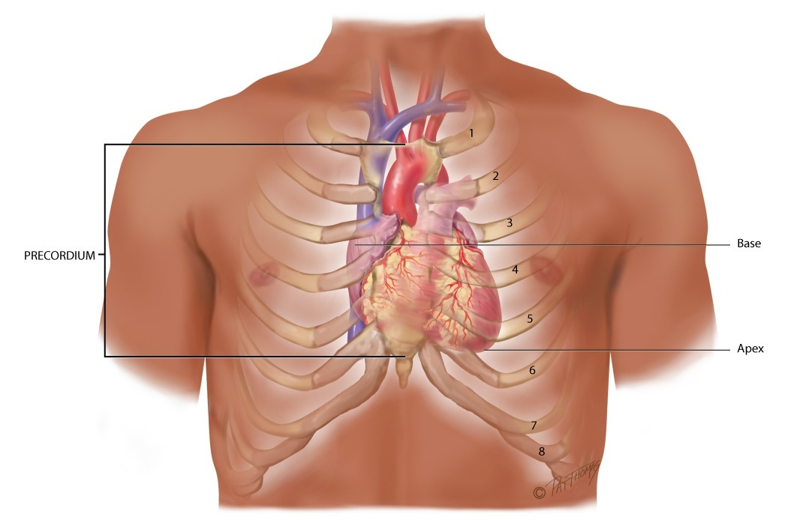
Precordium, Apex, and Base

Slide 4
Heart Wall, Chambers, and Valves
Heart wall has numerous layers
Pericardium: tough, fibrous, double-walled sac that surrounds and protects heart
Myocardium: muscular wall of heart; it does pumping
Endocardium: thin layer of endothelial tissue that lines inner surface of heart chambers and valves
Heart has two pump systems
Each side of the heart has an atrium and ventricle
Atrium: thin-walled reservoir for holding blood
Ventricle: thick-walled, muscular pumping chamber

Slide 5
Heart Chambers and Valves
Four chambers separated by valves, whose main purpose is to prevent backflow of blood
Valves are unidirectional: can only open one way
Valves open and close passively in response to pressure gradients in moving blood
Four valves in heart
Two atrioventricular (AV) valves
Two semilunar (SL) valves

Slide 6
AV Valves
Two AV valves separate atria and ventricles
Tricuspid valve: right AV valve
Bicuspid, or mitral valve: left AV valve
Valves’ thin leaflets are anchored by collagenous fibers (chordae tendineae) to papillary muscles embedded in ventricle floor
AV valves open during heart’s filling phase, or diastole, to allow ventricles to fill with blood
During pumping phase, or systole, AV valves close to prevent regurgitation of blood back up into atria

Slide 7
SL Valves
SL valves are set between ventricles and arteries
Each valve has three cusps that look like half moons
Pulmonic valve: SL valve in right side of heart
Aortic valve: SL valve in left side of heart
Open during pumping, or systole, to allow blood to be ejected from heart
No valves are present between vena cava and right atrium, or between pulmonary veins and left atrium, for this reason
Abnormally high pressure in left side of heart gives a person symptoms of pulmonary congestion
Abnormally high pressure in right side of heart shows in neck veins and abdomen

Slide 8
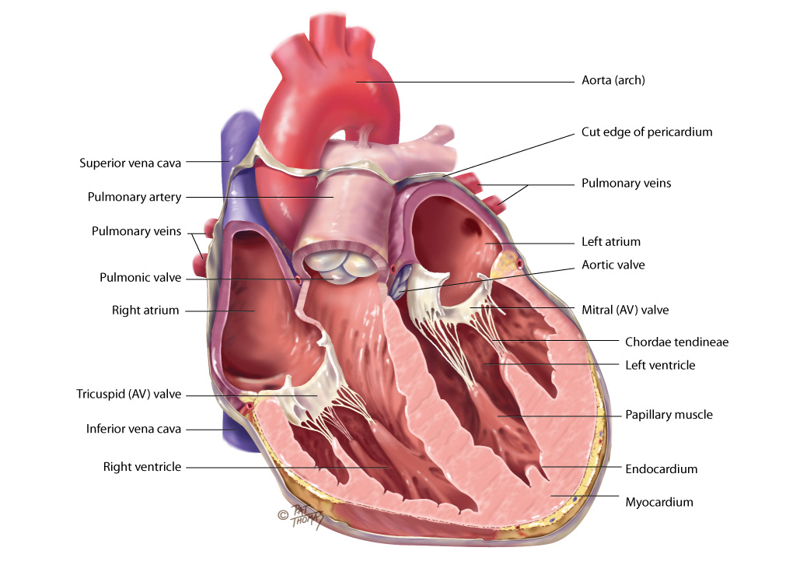
Chambers and Valves

Slide 9
Direction of Blood Flow I
Unoxygenated red blood drains into vena cava, follows route of venous blood
From liver to right atrium (RA) through inferior vena cava
Superior vena cava drains venous blood from the head and upper extremities
From RA, venous blood travels through tricuspid valve to right ventricle (RV)
From RV, venous blood flows through pulmonic valve to pulmonary artery
Pulmonary artery delivers unoxygenated blood to lungs

Slide 10
Direction of Blood Flow II
Lungs oxygenate blood
Pulmonary veins return fresh blood to LA
From LA, arterial blood travels through mitral valve to LV
LV ejects blood through aortic valve into aorta
Aorta delivers oxygenated blood to body
Circulation is continuous loop; blood is kept moving by continually shifting pressure gradients
Blood flows from area of higher pressure to area of lower pressure

Slide 11
Cardiac Cycle
Rhythmic flow of blood through heart is cardiac cycle
Has two phases, diastole and systole
Diastole: ventricles relax and fill with blood; this takes up two thirds of cardiac cycle
Systole: heart’s contraction, blood pumped from ventricles fills pulmonary and systemic arteries; this is one third of cardiac cycle

Slide 12
Cardiac Cycle: Diastole
Ventricles relaxed, and AV valves, tricuspid and mitral, are open; opening of normal valve is silent
Pressure in atria higher than that in ventricles, so blood pours rapidly into ventricles
This first passive filling phase called protodiastolic filling
Toward end of diastole, atria contract and push last amount of blood into ventricles
This active filling phase called presystole, or atrial systole
Note that atrial systole occurs during ventricular diastole, a confusing but important point

Slide 13
Cardiac Cycle: Systole
Ventricular pressure becomes higher than that in atria, so mitral and tricuspid valves close
Closure of AV valves contributes to first heart sound (S1) and signals beginning of systole
AV valves close to prevent any regurgitation of blood back up into atria during contraction
For a very brief moment, all four valves are closed and ventricular walls contract
Isometric contraction: this contraction against closed system works to build high level pressure in ventricles

Slide 14
Events in Right and Left Side of Heart I
Systole
Consider left side of heart
When pressure in ventricle finally exceeds pressure in aorta, aortic valve opens and blood is ejected rapidly
After ventricle’s contents are ejected, its pressure falls
When pressure falls below pressure in aorta, some blood flows backward toward ventricle, causing aortic valve to close
This closure of semilunar valves causes second heart sound (S2) and signals end of systole

Slide 15
Events in Right and Left Side of Heart II
Diastole again
Now all four valves are closed and ventricles relax
Isometric or isovolumic relaxation
Atria have been filling with blood delivered from lungs
Atrial pressure now higher than relaxed ventricular pressure
Mitral valve opens and diastolic filling begins again

Slide 16
Events in Right and Left Side of Heart III
Same events happening in right side of heart
But pressures in right side of heart are much lower than those of left side because less energy needed to pump blood to its destination, pulmonary circulation
Events occur just slightly later in right side of heart because of route of myocardial depolarization
Results in two components to each of the heart sounds
In first heart sound, mitral component (M1) closes just before tricuspid component (T1)
With S2, aortic closure (A2) occurs slightly before pulmonic closure (P2)

Slide 17
Heart Sounds
Events in cardiac cycle generate sounds that can be heard through a stethoscope over chest wall
These include normal heart sounds and, occasionally, extra heart sounds and murmurs

Slide 18
First Heart Sound (S1)
Occurs with closure of AV valves and thus signals beginning of systole
Mitral component of first sound (M1) slightly precedes tricuspid component (T1)
Usually hear these two components fused as one sound
Can hear S1 over all precordium, but loudest at apex

Slide 19
Second Heart Sound (S2)
Occurs with closure of semilunar valves and signals end of systole
Aortic component of second sound (A2) slightly precedes pulmonic component (P2)
Although heard over all precordium, S2 loudest at base

Slide 20
Effect of Respiration I
Volume of right and left ventricular systole is just about equal but can be affected by respiration
To learn this, consider the phrase: More to the right heart, less to the left
That means that during inspiration, intrathoracic pressure is decreased
This pushes more blood into vena cava, increasing venous return to right side of heart, which increases right ventricular stroke volume
Increased volume prolongs right ventricular systole and delays pulmonic valve closure

Slide 21
Effect of Respiration II
Meanwhile, on left side, greater amount of blood sequestered in lungs during inspiration
This momentarily decreases amount returned to left side of heart, decreasing left ventricular stroke volume
Decreased volume shortens left ventricular systole and allows aortic valve to close a bit earlier
When aortic valve closes significantly earlier than pulmonic valve, you can hear two components separately; this is a split S2

Slide 22
Extra Heart Sounds (S3)
Third heart sound (S3)
Normally diastole is silent event
However, in some conditions, ventricular filling creates vibrations that can be heard over chest
S3 occurs when ventricles resistant to filling during early rapid filling phase (protodiastole)
Occurs immediately after S2, when AV valves open and atrial blood first pours into ventricles

Slide 23
Question
The school nurse hears an extra heart sound on a 16-year-old male athlete. The nurse believes this is because:
an extra heart sound in a child or young adult is usually considered a physiological S₃ and is considered normal.
this patient may have a heart murmur and will need to be checked by a cardiologist.
the nurse should assess if the patient has been running because an extra heart sound may be the heart’s reaction to increased activity.
the nurse should determine if heart disease runs in the patient’s family and refer him to his primary care physician.
Notes:
The correct answer is 1. An S3 is common in young children, pregnant women, and young adults.
Answer 2 is incorrect due to patient’s age, if the patient were over the age of 25, then the patient would need to be referred to a cardiologist for further investigation.
Answer 3 is incorrect because although running may affect the heart rate, but it should not affect the heart sounds.
Answer 4 is incorrect because an S3 in an otherwise healthy teenage male is considered normal.

Slide 24
Extra Heart Sounds (S4)
Fourth heart sound (S4)
Occurs at end of diastole, at presystole, when ventricle resistant to filling
Atria contract and push blood into noncompliant ventricle
This creates vibrations that are heard as S4
S4 occurs just before S1

Slide 25
Extra Heart Sounds: Murmurs
Blood circulating through normal cardiac chambers and valves usually makes no noise
However, some conditions create turbulent blood flow and collision currents
These result in a murmur, much like a pile of stones or a sharp turn in a stream creates a noisy water flow
A murmur is a gentle, blowing, swooshing sound that can be heard on chest wall

Slide 26
Conditions Resulting in Murmur
Velocity of blood increases (flow murmur), for example, in exercise, thyrotoxicosis
Viscosity of blood decreases, for example, in anemia
Structural defects in valves, narrowed valve, incompetent valve
Unusual openings occur in chambers, dilated chamber, wall defect

Slide 27
Characteristics of Sound
All heart sounds are described by
Frequency or pitch: described as high pitched or low pitched
Although these terms are relative because all are low-frequency sounds and need good stethoscope to hear them
Intensity or loudness: loud or soft
Duration: very short for heart sounds; silent periods are longer
Timing: systole or diastole

Slide 28
Conduction I
Heart has unique ability: automaticity
Can contract by itself, independent of any signals or stimulation from body
Contracts in response to an electrical current conveyed by a conduction system
Specialized cells in sinoatrial (SA) node, near superior vena cava initiate an electric impulse
Because SA node has intrinsic rhythm, it is called the pacemaker

Slide 29
Conduction II
Current flows in orderly sequence, first across atria to AV node low in atrial septum
There, it is delayed slightly so that atria have time to contract before ventricles are stimulated
Then, impulse travels to bundle of His, right and left bundle branches, and then through ventricles
Electric impulse stimulates heart to do its work, which is to contract
Small amount of electricity spreads to body surface and can be measured and recorded on electrocardiograph (ECG)

Slide 30
Electrocardiograph (ECG)
ECG waves arbitrarily labeled PQRST, which stand for
P wave: depolarization of atria
P-R interval: from beginning of P wave to beginning of
QRS complex (time necessary for atrial depolarization plus time for impulse to travel through AV node to ventricles)
QRS complex: depolarization of ventricles
T wave: repolarization of ventricles
Electrical events slightly precede mechanical events in heart

Slide 31
Pumping Ability
In resting adult, heart normally pumps between 4 and 6 L of blood per minute throughout body
This cardiac output equals volume of blood in each systole (called stroke volume) times number of beats per minute (rate)
Heart can alter its cardiac output to adapt to metabolic needs of body
Preload and afterload affect heart’s ability to increase cardiac output

Slide 32
Preload
Preload: venous return that builds during diastole
Length to which ventricular muscle stretched at end of diastole just before contraction
When volume of blood returned to ventricles increased
Muscle bundles stretched beyond normal resting state
Force of this switch is preload
According to Frank-Starling law, greater the stretch, the stronger the heart’s contraction
This increased contractility results in an increased volume of blood ejected, increased stroke volume

Slide 33
Afterload
Afterload: opposing pressure ventricle must generate to open aortic valve against higher aortic pressure
Resistance against which ventricle must pump its blood
Once ventricle is filled with blood, ventricular end diastolic pressure is 5 to 10 mm Hg, whereas that in aorta is 70 to 80 mm Hg.
To overcome this difference, ventricular muscle tenses, isovolumic contraction
After aortic valve opens, rapid ejection occurs

Slide 34
Neck Vessels: Carotid Artery Pulse
Carotid artery is a central artery
Close to heart; timing closely coincides with ventricular systole
Located in groove between trachea and sternomastoid muscle, medial to and along-side that muscle
Note characteristics of its waveform
Smooth rapid upstroke
Summit rounded and smooth
Downstroke more gradual and has a dicrotic notch caused by closure of aortic valve

Slide 35
Neck Vessels: Jugular Venous Pulse and Pressure I
Jugular veins empty unoxygenated blood directly into superior vena cava
Because no cardiac valve exists to separate superior vena cava from right atrium, jugular veins give information about activity on right side of heart
Specifically reflect filling pressure and volume changes
Jugular veins expose this because volume and pressure increase when right side of heart fails to pump efficiently

Slide 36
Neck Vessels: Jugular Venous Pulse and Pressure II
Two jugular veins present in each side of neck
Larger internal jugular lies deep and medial to sternomastoid muscle
Usually not visible, although diffuse pulsations may be seen in sternal notch when person is supine
External jugular vein is more superficial; lies lateral to sternomastoid muscle, above clavicle

Slide 37
Jugular Pulse: 5 Components
The A wave reflects atrial contraction because some blood flows backward to vena cava during right atrial contraction
The C wave, or ventricular contraction, is backflow from bulging upward of tricuspid valve when it closes at beginning of ventricular systole
The X wave descent shows atrial relaxation when right ventricle contracts during systole and pulls bottom of atria downward
The V wave occurs with passive atrial filling because of increasing volume in right atria and increased pressure
Finally, the Y descent reflects passive ventricular filling when tricuspid valve opens and blood flows from RA to RV

Slide 38
Developmental Competence: Infants and Children
Fetal heart begins to beat after 3 weeks’ gestation
Right and left ventricles equal in weight and muscle wall thickness and both pumping into systemic circulation
Inflation and aeration of lungs at birth produces circulatory changes
Now blood is oxygenated through lungs rather than through placenta
Now left ventricle has greater workload of pumping into systemic circulation

Slide 39
Developmental Competence: Pregnant Woman
Blood volume increases by 30% to 40% during pregnancy
Most rapid expansion occurs during second trimester
Creates an increase in stroke volume and cardiac output and an increased pulse rate of 10 to 15 beats per minute
Despite increased cardiac output, arterial blood pressure decreases in pregnancy as a result of peripheral vasodilation
Blood pressure drops to lowest point during second trimester, then rises after that
Blood pressure varies with person’s position

Slide 40
Developmental Competence: Aging Adult
It is difficult to isolate “aging process” of cardiovascular system, per se, because it is so closely interrelated with lifestyle, habits, and diseases
Lifestyle, smoking, diet, alcohol use, exercise patterns, and stress have an influence on coronary artery disease
Lifestyle also affects aging process; cardiac changes once thought to be due to aging are partially due to sedentary lifestyle accompanying aging
What is left to be attributed to aging process alone?

Slide 41
Hemodynamic Changes with Aging
With aging, there is an increase in systolic BP due to thickening and stiffening of the arteries
Left ventricular wall becomes thicker but the overall size of the heart does not change
Pulse pressure increases
No change in resting heart rate or cardiac output at rest
Ability of heart to augment cardiac output with exercise is decreased

Slide 42
Arrhythmias
Presence of supraventricular and ventricular arrhythmias increases with age
Ectopic beats common in aging people; usually asymptomatic in healthy older people, may compromise cardiac output and blood pressure when disease present
Tachyarrhythmias may not be tolerated as well in older people
Myocardium thicker and less compliant, and early diastolic filling impaired at rest
Thus, may not tolerate a tachycardia as well because of shortened diastole

Slide 43
Age-Related Changes in ECG
Occur as result of histologic changes in conduction system; these changes include
Prolonged P-R interval (first-degree AV block) and prolonged Q-T interval, but the QRS interval is unchanged
Left axis deviation from age-related mild LV hypertrophy and fibrosis in left bundle branch
Increased incidence of bundle branch block
Although hemodynamic changes associated with aging alone do not seem severe or portentous, incidence of cardiovascular disease increases with age

Slide 44
Cardiac Disease and Aging Adult
Incidence of coronary artery disease increases sharply with advancing age and accounts for about half of deaths of older people
Hypertension and heart failure also increase with age
Lifestyle habits play a significant role in the acquisition of heart disease
Also, increasing physical activity of older adults associated with a reduced risk of death from cardiovascular diseases and respiratory illnesses
Both points underscore need for health teaching as an important treatment parameter

Slide 45
Culture and Genetics I
Prevalence is an estimate of how many people in a stated geographic location have a disease at a given time
In the U.S., more than 1 in 3 have one or more forms of cardiovascular heart disease (CVD)
Annual rates of first CVD event increase with age
For women, comparable rates occur 10 years later in life than for men, but this gap narrows with advancing age
Causes of CVD: interaction of genetic, environmental, and lifestyle factors
Evidence shows potentially modifiable risk factors contribute to overwhelming majority of cardiac risk

Slide 46
Culture and Genetics II
Although all adults have some potential CVD risk, some groups, defined by race, ethnicity, gender, socioeconomic status, and educational level carry an excess burden of CVD
Higher percent of men than women have hypertension until 45 years, after which the percentages are similar
After 64 years, women have much higher percentage than men
Hypertension is 2 to 3 times more common among women taking oral contraceptives, especially obese and older women
Hypertension in Blacks is among highest in world and is rising

Slide 47
Culture and Genetics: Hypertension
Prevalence of hypertension is 41.4% Blacks
25.8% for American Indians or Alaska Natives
28.1% for Whites
22.2% for Hispanics and 18.7% for Asians
Compared with Whites, Blacks develop hypertension earlier in life, and their average BP is much higher
Thus, Blacks have greater rate of stroke, death due from heart disease and end-stage kidney disease

Slide 48
Culture and Genetics: Smoking
In the 45+ years from 1965 to 2010, U.S. smoking rates declined by 54% among adults over 18
In 2010, 21.2% of men and 17.5% of women were smokers
Nicotine increases risk of myocardial infarction (MI) and stroke by causing
Increase in oxygen demand with a concomitant decrease in oxygen supply
Activation of platelets, activation of fibrinogen; and an adverse change in lipid profile

Slide 49
Culture and Genetics: Serum Cholesterol
High levels of low density lipoprotein gradually add to lipid core of thrombus formation in arteries, which results in MI and stroke
Age-adjusted prevalence of LDL cholesterol levels over 130 mg/dL include
39.9% of Mexican American men and 30.4% of Mexican American women
30.1% of white men and 29.3% of white women
33.1% of black men and 31.2% of black women

Slide 50
Culture and Genetics: Obesity
Epidemic of obesity in U.S. is well known
Among Americans age 20 or older, prevalence of overweight or obesity
Overall 68% are overweight or obese
Of which 73% are men and 64% are women
Obesity increases the risk of comorbid conditions, such as but not limited to HTN, hyperlipidemia, type II diabetes

Slide 51
Culture and Genetics: Type II Diabetes Mellitus (DM)
Risk of CVD is twofold greater among persons with DM
Increased prevalence of DM in U.S. is being followed by an increasing prevalence of CVD morbidity and mortality
Diabetes causes damage to large blood vessels that nourish brain, heart and extremities; this results in stroke, coronary artery disease, and peripheral vascular disease
About 12.6% of Blacks over age 20 have DM
11.8% of Hispanic Americans have DM, compared to 7.1% of Whites

Slide 52
Culture and Genetics: Sex Differences
Regardless of ethnicity, CVD is the leading cause of death in women
Within the first year following an MI, women age 45 and older are 26% more likely to die than their male counterparts (19%)
Women may report different symptoms than the typical “chest pain” experienced by men, thus clinical diagnosis may be delayed

Slide 53
Subjective Data
Chest pain
Dyspnea
Orthopnea
Cough
Fatigue
Cyanosis or pallor
Edema
Nocturia
Past cardiac history
Family cardiac history
Personal habits (cardiac risk factors)

Slide 54
Chest Pain Questions I
Any chest pain or tightness?
Onset: When did it start? How long have you had it this time? Had this type of pain before? How often?
Location: Where did the pain start? Does the pain radiate to any other spot?
Character: How would you describe it? Is it crushing, stabbing, burning, or viselike? (Allow the person to offer adjectives before you suggest them.) (Note if uses clenched fist to describe pain.)
Is pain brought on by activity (what type), rest, emotional upset, eating, sexual intercourse, or cold weather?

Slide 55
Chest Pain Questions II
Any associated symptoms, such as sweating, ashen gray or pale skin, heart skipping a beat, shortness of breath, nausea or vomiting, or racing of heart?
Is the pain made worse by moving the arms or neck, breathing, or lying flat?
Is the pain relieved by rest or nitroglycerin? How many tablets?

Slide 56
Dyspnea Questions
Any shortness of breath?
What type of activity, and how much brings on shortness of breath? How much activity brought it on 6 months ago?
Onset: Does the shortness of breath come on unexpectedly?
Duration: Is it constant or does it come and go?
Does it seem to be affected by position, such as lying down?
Does it awaken you from sleep at night?
Does the shortness of breath interfere with activities of daily living?

Slide 57
Cough Questions
Do you have a cough?
Duration: How long have you had it?
Frequency: Is it related to time of day?
Type: Is it dry, hacking, barky, hoarse, or congested?
Do you cough up mucus? What color is it? Does it have any odor? Is it blood-tinged?
Associated with activity, position (lying down), anxiety, or talking?
Does activity make it better or worse (sit, walk, exercise)?
Is it relieved by rest or medication?

Slide 58
Fatigue Questions
Do you seem to tire easily? Able to keep up with your family or co-workers?
Onset: When did it start? Sudden or gradual? Any recent change in energy level?
Fatigue related to time of day? All day? Morning, evening?

Slide 59
Assorted Subjective History Questions
Orthopnea
How many pillows do you use when sleeping or lying down?
Cyanosis or pallor
Have you ever noticed your facial skin turn blue or ashen?
Nocturia
Do you awaken at night with an urgent need to void? How long has this been occurring?

Slide 60
Edema Questions
Do you have any swelling of your feet and legs?
Onset: When did you first notice this? Any recent change?
What time of day does the swelling occur? Do your shoes feel tight at the end of day?
How much swelling would you say there is? Are both legs equally swollen?
Does swelling go away with rest, elevation, or after a night’s sleep?
Do you have any associated symptoms, such as shortness of breath? If so, does shortness of breath occur before leg swelling or after?

Slide 61
Cardiac History Questions
Do you have a history of hypertension, elevated cholesterol or triglycerides, heart murmur, congenital heart disease, rheumatic fever or unexplained joint pains as child or youth, recurrent tonsillitis, or anemia?
Have you ever had heart disease? When was this? Was it treated by medication or heart surgery?
When was your last ECG, stress ECG, serum cholesterol measurement, or other heart tests?
Any family history of hypertension, obesity, diabetes, coronary artery disease (CAD), sudden death at younger age?

Slide 62
Personal Habits (Cardiac Risk Factors) I
Nutrition
Please describe your usual daily diet (Note if this diet is representative of the basic food groups, the amount of calories, cholesterol, and any additives such as salt)
What is your usual weight? Has there been any recent change?
Smoking
Do you smoke cigarettes or use other tobacco products? At what age did you start? How many packs per day? For how many years have you smoked this amount? Have you ever tried quitting? If so, how did this go?

Slide 63
Personal Habits (Cardiac Risk Factors) II
Alcohol
How much alcohol do you usually drink each day or week? When was your last drink? What was the number of drinks that episode? Have you ever been told you had a drinking problem?
Exercise
What is your usual amount of exercise each day or week? What type of exercise (state type or sport)? If a sport, what is your usual activity level (light, moderate, heavy)?
Drugs
Do you take any antihypertensives, beta-blockers, calcium channel blockers, digoxin, diuretics, aspirin/anticoagulants, over-the-counter, or street drugs?

Slide 64
Additional History for Infants
How was mother’s health during pregnancy? Was there any unexplained fever, rubella during first trimester, other infection, hypertension, or drugs taken?
Have you noted any cyanosis while nursing or crying? Is baby able to eat, nurse, or finish bottle without tiring?
Growth: Has this baby grown as expected by growth charts and about same as siblings or peers?
Activity: Were this baby’s motor milestones achieved as expected? Is baby able to play without tiring? How many naps does baby take each day? How long does a nap last?

Slide 65
Additional History for Children
Growth: Has this child grown as expected by growth charts?
Activity: Is this child able to keep up with siblings or age mates?
Has the child had any unexplained joint pains or unexplained fever?
Does the child have frequent headaches or nosebleeds?
Does the child have frequent respiratory infections? How many per year? How are they treated? Have any of these been streptococcal infections?
Does child have a sibling with heart defect? Is anyone in child’s family known to have chromosomal abnormalities, such as Down syndrome?

Slide 66
Additional History for Pregnant Woman
Have you had any high blood pressure during this or earlier pregnancies?
What was your usual blood pressure level before pregnancy? How has your blood pressure been monitored during the pregnancy?
If high blood pressure, what treatment has been started?
Do you have any associated symptoms, such as weight gain, protein in urine, or swelling in feet, legs, or face?
Have you had any faintness or dizziness with this pregnancy?

Slide 67
Additional History for Aging Adult
Do you have any known heart or lung disease, such as hypertension, CAD, chronic emphysema, or bronchitis?
Do you take any medications for your illness, such as digitalis? Are you aware of side effects? Have you recently stopped taking your medication? Why?
Environment
Does your home have any stairs? How often do you need to climb them? Does this have any effect on activities of daily living?

Slide 68
Preparation and Equipment
Preparation
To evaluate carotid arteries, person can be sitting
To assess jugular veins and precordium, person should be supine with head and chest slightly elevated
Ensure woman’s privacy by keeping her breasts draped
Equipment
Marking pen
Small centimeter ruler
Stethoscope with diaphragm and bell endpieces
Alcohol wipe to clean endpiece

Slide 69
Neck Vessels: Palpation
Palpate carotid artery
Yields important information on cardiac function
Palpate each carotid artery medial to sternomastoid muscle in neck; palpate gently
Palpate only one carotid artery at a time to avoid compromising arterial blood to brain
Feel contour and amplitude of pulse
Normally contour is smooth with a rapid upstroke and slower downstroke, and the normal strength is 2+ or moderate
Findings should be same bilaterally

Slide 70
Neck Vessels: Auscultation I
Auscultate carotid artery
For persons middle-aged or older, or who show symptoms or signs of cardiovascular disease, auscultate each carotid artery for presence of a bruit
This is a blowing, swishing sound indicating blood flow turbulence; normally none is present
Lightly apply bell of stethoscope over carotid artery at three levels:
Angle of jaw
Midcervical area
Base of neck

Slide 71
Neck Vessels: Auscultation II
Auscultate carotid artery
Avoid compressing artery because this could create an artificial bruit and could compromise circulation if carotid artery is already narrowed by atherosclerosis
Ask person to take a breath, exhale, and hold it briefly while you listen so that tracheal breath sounds do not mask or mimic a carotid artery bruit
Holding breath on inhalation will also tense levator scapulae muscles, which makes it hard to hear carotids
Sometimes you can hear normal heart sounds transmitted to neck; do not confuse these with a bruit

Slide 72
Question
The nurse knows that the proper technique for assessing a patient’s carotid arteries is to:
palpate on the side of the neck using the diaphragm of the stethoscope.
auscultate with the bell of the stethoscope at the top of the femur and palpate for bruits.
auscultate with the bell of the stethoscope on the side of the neck, listen for bruits, and palpate for thrills.
auscultate with the diaphragm of the stethoscope just above the pelvic region.
Notes:
The correct answer is 3. Auscultating with the bell of the stethoscope on the side of the neck, listening for bruits, and palpating for thrills is the proper technique.
Answer 1 is incorrect because the diaphragm is not used and palpation is also necessary.
Answers 2 and 4 are incorrect because the carotid arteries are not located in these regions.

Slide 73
Neck Vessels: Inspection I
Inspect jugular venous pulse
From jugular veins you can assess central venous pressure (CVP) and judge heart’s efficiency as a pump
Although external jugular vein is easier to see, internal (especially the right) jugular vein is attached more directly to superior vena cava and more reliable for assessment
You cannot see internal jugular vein itself, but you can see its pulsation
Position person supine anywhere from a 30- to a 45-degree angle, wherever you can best see pulsations
In general, the higher the venous pressure, the higher the position you need

Slide 74
Neck Vessels: Inspection II
Inspect jugular venous pulse
Look for pulsations of internal jugular veins in area of suprasternal notch or around origin of sternomastoid muscle around clavicle
You must be able to distinguish internal jugular vein pulsation from that of carotid artery
It is easy to confuse them because they lie close together

Slide 75
Jugular Venous Pressure I
Estimate jugular venous pressure
Use angle of Louis as arbitrary reference point, and compare it with highest level of venous pulsation
Hold a vertical ruler on sternal angle
Align a straight edge on ruler like a T-square, and adjust level of horizontal straight edge to level of pulsation
Read level of intersection on vertical ruler; normal jugular venous pulsation is 2 cm or less above sternal angle
State person’s position, for example, “internal jugular vein pulsations 3 cm above sternal angle when elevated 30 degrees”

Slide 76
Jugular Venous Pressure II
Estimate jugular venous pressure
If you cannot find internal jugular veins, use external jugular veins and note point where they look collapsed
If venous pressure is elevated, or if you suspect heart failure, perform hepatojugular reflux
Position person comfortably supine and instruct him or her to breathe quietly through open mouth
Hold your right hand on right upper quadrant of person’s abdomen just below rib cage
Watch level of jugular pulsation as you push in with your hand

Slide 77
Jugular Venous Pressure III
Estimate jugular venous pressure
Exert firm sustained pressure for 30 seconds
This empties venous blood out of liver sinusoids and adds its volume to venous system
If heart is able to pump this additional volume (i.e., if no elevated CVP is present), jugular veins will rise for a few seconds, then recede back to previous level

Slide 78
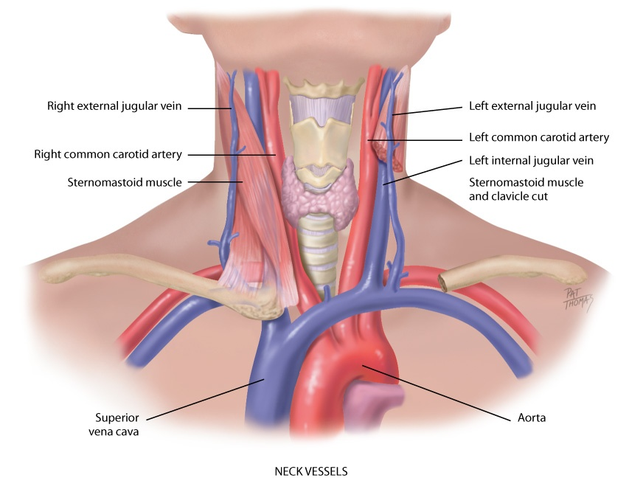
Neck Vessels

Slide 79
Precordium I
Inspect anterior chest
Arrange tangential lighting to accentuate any flicker of movement
Pulsations: you may or may not see apical impulse, pulsation created as left ventricle rotates against chest wall during systole
When visible, it occupies the fourth or fifth intercostal space, at or inside midclavicular line
Easier to see in children and in those with thinner chest walls

Slide 80
Precordium II
Palpate apical impulse
Localize apical impulse precisely by using one finger pad
Asking person to “exhale and then hold it” aids examiner in locating pulsation; may need to roll person midway to left to find it; note that this also displaces apical impulse farther to left
Palpable in about half of adults; is not palpable in obese persons or in persons with thick chest walls
With high cardiac output states (anxiety, fever, hyperthyroidism, anemia), apical impulse increases in amplitude and duration

Slide 81
Precordium III
Palpate across precordium
Using palmar aspects of your four fingers, gently palpate apex, left sternal border, and base, searching for any other pulsations
Normally none occur
If any are present, note timing
Use carotid artery pulsation as a guide, or auscultate as you palpate

Slide 82
Precordium Percussion I
Used to outline heart’s borders, but its use has often been displaced by chest x-ray or echocardiogram
Much more accurate in detecting heart enlargement
When right ventricle enlarges, it does so in anteroposterior diameter, which is better seen on x-ray film
Also, percussion is of limited usefulness with female breast tissue or in an obese person or a person with a muscular chest wall

Slide 83
Precordium Percussion II
There are times when your percussing hands are only tools you have with you
When you need to search for cardiac enlargement, place your stationary finger in person’s fifth intercostal space over on left side of chest near anterior axillary line
Slide your stationary hand toward yourself, percussing as you go, and note change of sound from resonance over lung to dull over heart

Slide 84
Precordium Percussion III
Normally left border of cardiac dullness at midclavicular line in fifth interspace and slopes in toward sternum as you progress upward, so that by second interspace border of dullness coincides with the left sternal border
Right border of dullness normally matches sternal border

Slide 85
Precordium Auscultation I
Auscultation
Identify auscultatory areas where you will listen; these include four traditional valve “areas”
Valve areas are not over actual anatomic locations of valves but sites on chest wall where sounds produced by valves are best heard
Sound radiates with blood flow direction; valve areas are
Second right interspace: aortic valve area
Second left interspace: pulmonic valve area
Left lower sternal border: tricuspid valve area
Fifth interspace at around left midclavicular line: mitral valve area

Slide 86
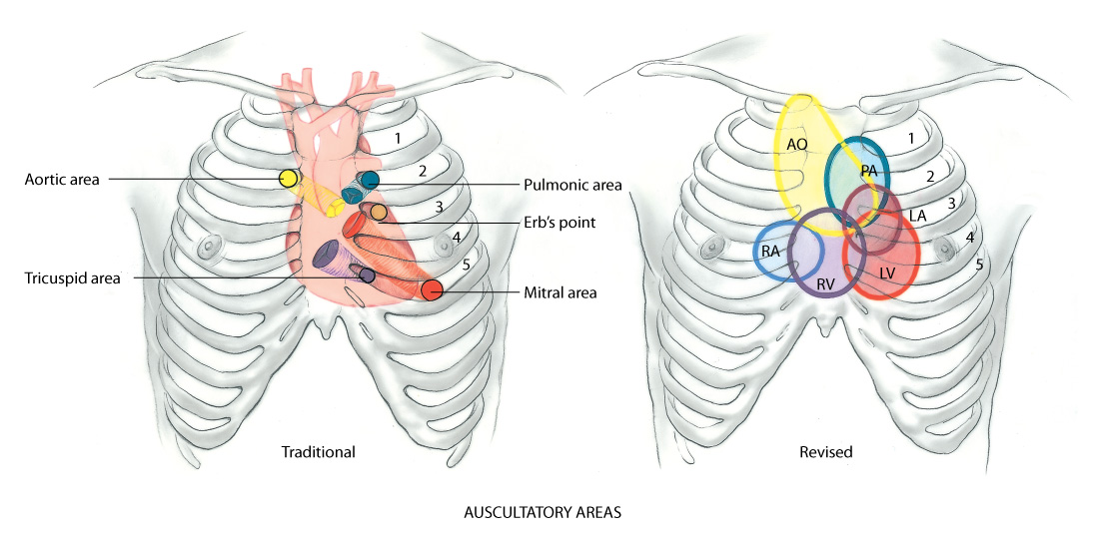
Auscultatory Areas

Slide 87
Precordium Auscultation II
Auscultation
Do not limit your auscultation to only four locations
Sounds produced by valves may be heard all over precordium
Thus, learn to inch your stethoscope in a rough Z pattern, from base of heart across and down, then over to apex; or start at apex and work your way up
Although all heart sounds are low frequency, diaphragm is for relatively higher pitched sounds, and bell is for relatively lower pitched ones

Slide 88
Precordium Auscultation III
Auscultation
Before you begin, alert person that you always listen to heart in a number of places on chest, and just because you are listening a long time does not necessarily mean that something is wrong
After you place stethoscope, try closing your eyes briefly to tune out any distractions

Slide 89
Precordium Auscultation IV
Auscultation
Concentrate, and listen selectively to one sound at a time
Consider that at least two, and perhaps three or four sounds may be happening in less than 1 second
You cannot process everything at once
Begin with diaphragm endpiece and use following routine
Note rate and rhythm
Identify S1 and S2
Assess S1 and S2 separately
Listen for extra heart sounds
Listen for murmurs

Slide 90
Developmental Competence: Infants
Transition from fetal to pulmonic circulation occurs in immediate newborn period
Normally the liver is not enlarged, and respirations are not labored
Heart rate may range from 100 to 180 beats per minute (bpm) immediately after birth
Rapid rates make it more challenging to evaluate heart sounds

Slide 91
Developmental Competence: Infant Murmurs
These murmurs are usually grade I or II
They are systolic and accompany no other signs of cardiac disease, and they disappear in 2 to 3 days
Murmur of patent ductus arteriosis is continuous machinery murmur, which disappears by 2 to 3 days
On other hand, absence of a murmur in immediate newborn period does not ensure a perfect heart
Congenital defects can be present that are not signaled by an early murmur
Best to listen frequently and to note and describe any murmur according to characteristics

Slide 92
Developmental Competence: Children I
Note any extracardiac or cardiac signs that may indicate heart disease
Poor weight gain, developmental delay, persistent tachycardia, tachypnea, dyspnea on exertion, cyanosis, and clubbing
Note that clubbing of fingers and toes usually does not appear until late in first year, even with severe cyanotic defects
Apical impulse sometimes visible in children with thin chest walls
Note any obvious bulge or any heave; these are not normal

Slide 93
Developmental Competence: Children II
Palpate apical impulse
Up to age 4: in fourth intercostal space to left of midclavicular line
Age 4 to 6: at fourth interspace at midclavicular line
Age 7: in fifth interspace to right of midclavicular line
Average heart rate slows as child grows older, although it is still variable with rest or activity
Rhythm remains characterized by sinus arrhythmia
Physiologic S3 is common in children
Occurs in early diastole, just after S2, and is a dull soft sound that is best heard at apex

Slide 94
Developmental Competence: Children III
Palpate apical impulse
Venous hum, due to turbulence of blood flow in jugular venous system, common in healthy children and has no pathologic significance
Continuous, low-pitched, soft hum heard throughout cycle, although loudest in diastole
Listen with bell over the supraclavicular fossa at medial third of clavicle, especially on right, or over upper anterior chest
Venous hum is usually not affected by respiration, may sound louder when the child stands, and is easily obliterated by occluding jugular veins in neck with fingers

Slide 95
Developmental Competence: Children IV
Palpate apical impulse
Heart murmurs that are innocent (or functional) in origin are very common through childhood
Some say they have 30% occurrence, and some say nearly all children may demonstrate murmur
Most innocent murmurs have these characteristics
Soft, relatively short systolic ejection murmur
Medium pitch; vibratory
Best heard at left lower sternal or midsternal border, with no radiation to apex, base, or back

Slide 96
Developmental Competence: Children V
Palpate apical impulse
For child whose murmur has been shown to be innocent, it is very important that parents understand completely
They need to believe that this murmur is just a “noise” and has no pathologic significance
Otherwise, parents may become overprotective and limit activity for child, which may result in child developing a negative self-concept

Slide 97
Developmental Competence: Pregnant Woman
Vital signs usually yield an increase in resting pulse rate of 10 to 15 bpm and drop in BP from normal prepregnancy level
Palpation of apical impulse is higher and lateral compared with normal position
Heart sounds
Exaggerated splitting of S1 and increased loudness of S1
A loud, easily heard S3

Slide 98
Developmental Competence: Aging Adult
Gradual rise in systolic blood pressure common with aging
Overall size of the heart does not change but left ventricular wall thickness increases
Presence of supraventricular and ventricular dysrhythmias increases with age
Age-related ECG changes occur as a result of histologic changes in the conduction system
Incidence of CVD increases with age

Slide 99
Culture and Genetics
Causes of CVD include an interaction of genetic, environmental, and lifestyle factors
Increased risk factors for CVD attributed to hypertension in terms of certain ethnic, racial, gender groups
Even though smoking has declined, it is still the leading cause of preventable disease, disability, and death in the U.S.
High levels of LDL lead to an increased risk of CVD and are associated with certain ethnic groups
Obesity is also an associated risk factor for CVD as well as other comorbidities
CVD risk is increased twofold greater in those patients who have diabetes
Sex differences still place women with CVD with the highest death rate

Slide 100
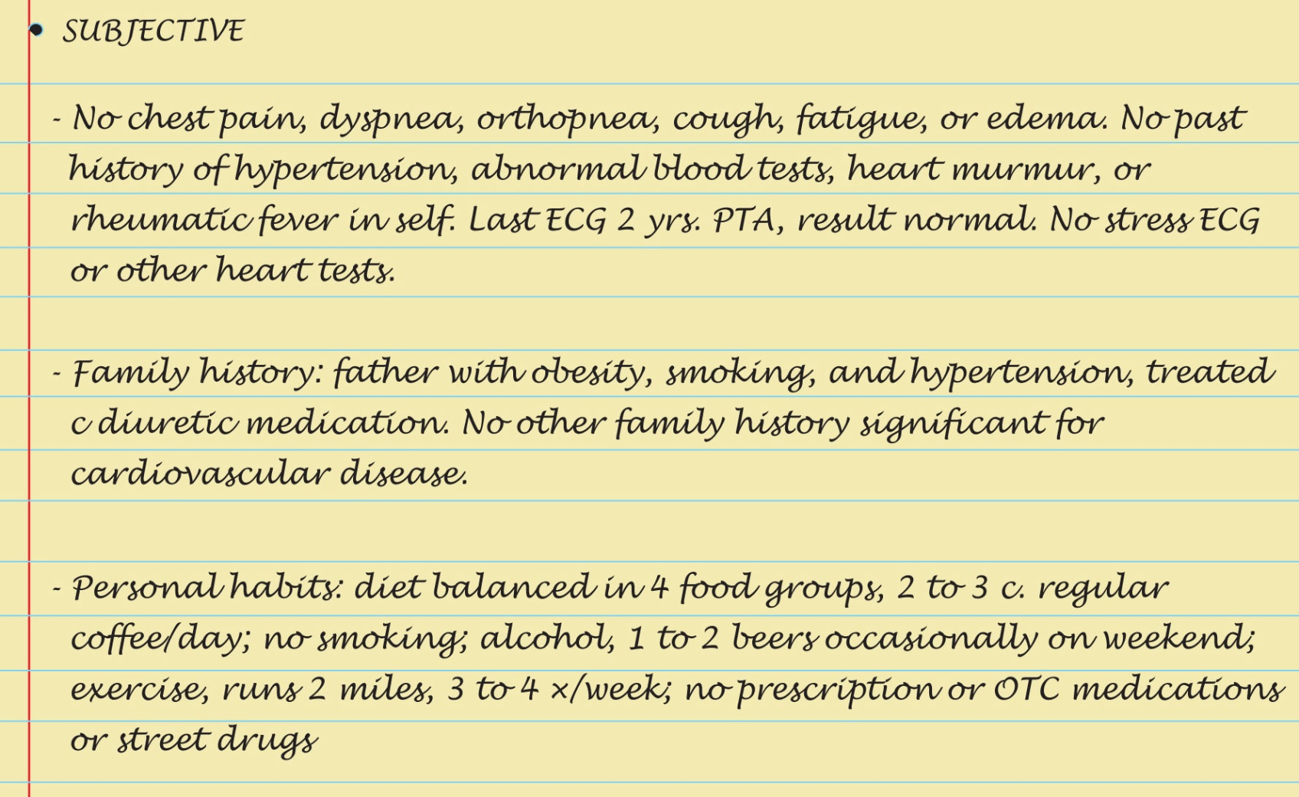
Sample Charting: Subjective

Slide 101
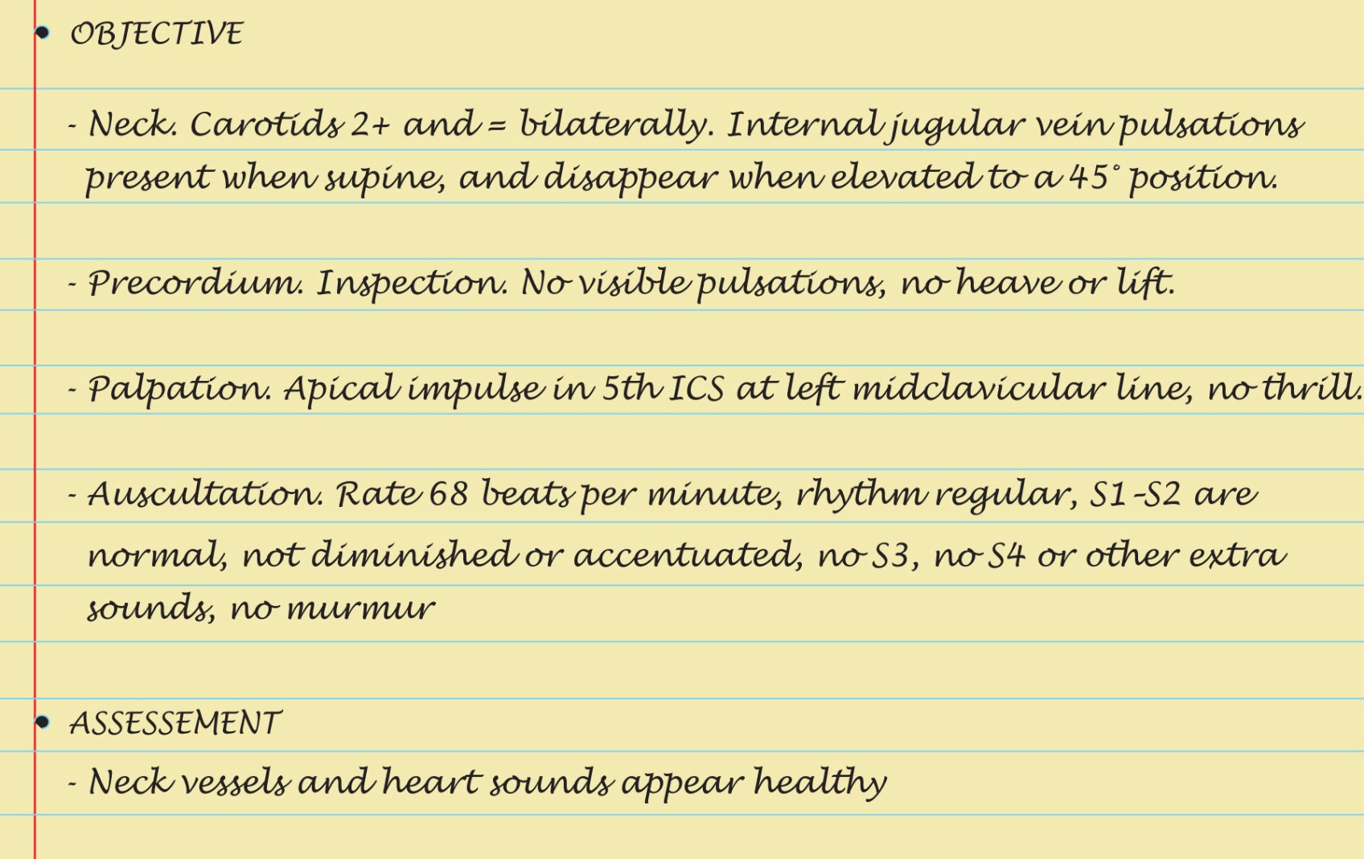
Sample Charting: Objective and Assessment

Slide 102
Abnormal Findings: Systolic Extra Sounds
Ejection click
Aortic prosthetic valve sounds
Midsystolic click

Slide 103
Abnormal Findings: Diastolic Extra Sounds
Opening snap
Mitral prosthetic valve sound
Third heart sound
Fourth heart sound
Summation sound
Pericardial friction rub

Slide 104
Abnormal Findings: Abnormal Pulsations: Precordium
Thrill at the base
Lift (heave) at the sternal border
Volume overload at the apex
Pressure overload at the apex

Slide 105
Abnormal Findings: Congenital Heart Defects
Patent ductus arteriosus
Atrial septal defect
Ventricular septal defect
Tetralogy of Fallot
Coarctation of the aorta

Slide 106
Abnormal Findings: Murmurs Due to Valvular Defects
Midsystolic ejection murmurs
Aortic stenosis
Pulmonic stenosis
Pansystolic regurgitant murmurs
Mitral regurgitation
Tricuspid regurgitation

Slide 107
Abnormal Findings: Murmurs Due to Valvular Defects
Diastolic rumbles of atrioventricular valves
Mitral stenosis
Tricuspid stenosis
Early diastolic murmurs
Aortic regurgitation
Pulmonic regurgitation

Slide 108
Summary Checklist: Heart and Neck Vessels Examination
Neck
Carotid pulse – observe and palpate
Observe jugular venous pulse
Estimate jugular venous pressure
Precordium
Inspection and palpation
Describe location of apical pulse
Note any heave (lift) or thrill
Auscultation
Identify anatomic areas noting rate and rhythm
Listen in systole and diastole for murmurs
Repeat with bell
Listen at apex and base

