Slide 1
Chapter 21
Abdomen

Slide 2
Abdomen Surface Landmarks
Abdomen is a large oval cavity extending from diaphragm down to brim of pelvis
  It is bordered in back by vertebral column and paravertebral muscles and at sides and front by lower rib cage and abdominal muscles
  Four layers of large, flat muscles form ventral abdominal wall
  These are joined at midline by a tendinous seam, the linea alba
  One set, rectus abdominis, forms a strip extending length of midline, and its edge is often palpable

Slide 3
Internal Anatomy I
  Inside abdominal cavity, all internal organs are called viscera
  Lower edge of liver and right kidney may normally be palpable
  Note that small intestine is located in all four quadrants
  Spleen is a soft mass of lymphatic tissue on posterolateral wall of abdominal cavity, immediately under diaphragm
  Aorta is just to the left of midline in upper part of abdomen

Slide 4
Internal Anatomy II
  Pancreas is a soft, lobulated gland located behind stomach
  Bean-shaped kidneys are retroperitoneal, or posterior to abdominal contents
  Because of placement of liver, right kidney rests
  1 to 2 cm lower than left kidney
  For convenience in description, abdominal wall is divided into four quadrants by a vertical and a horizontal line bisecting umbilicus

Slide 5
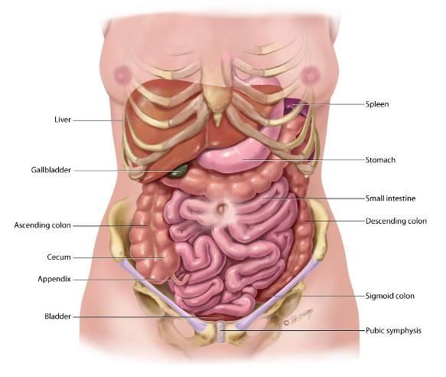
Internal Anatomy

Slide 6
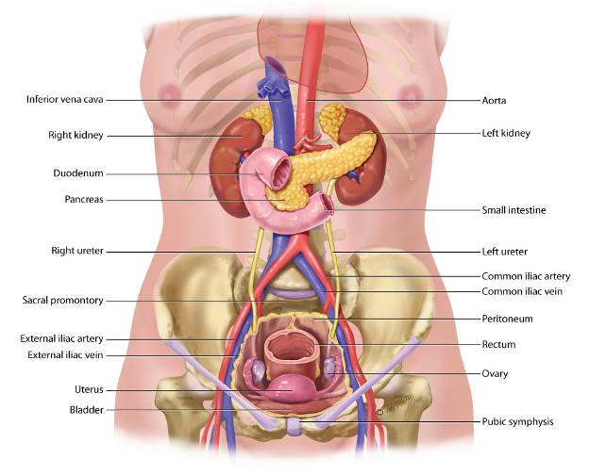
Deep Internal Anatomy

Slide 7
Anatomic Locations of four Upper Quadrants
Right Upper Quadrant
(RUQ)
  Liver
  Gallbladder
  Duodenum
  Head of pancreas
  Right kidney and adrenal gland
  Hepatic flexure of colon
  Part of ascending and transverse colon
Left Upper Quadrant
(LUQ)
  Stomach
  Spleen
  Left lobe of liver
  Body of pancreas
  Left kidney and adrenal gland
  Splenic flexure of colon
  Part of transverse and descending colon

Slide 8
Anatomic Locations of four Lower Quadrants
Right lower quadrant
(RLQ)
  Cecum
  Appendix
  Right ovary and tube
  Right ureter
  Right spermatic cord
Left lower quadrant
(LLQ)
  Part of descending colon
  Sigmoid colon
  Left ovary and tube
  Left ureter
  Left spermatic cord

Slide 9
Midline Organs
  Aorta
  Uterus, if enlarged
  Bladder, if distended

Slide 10
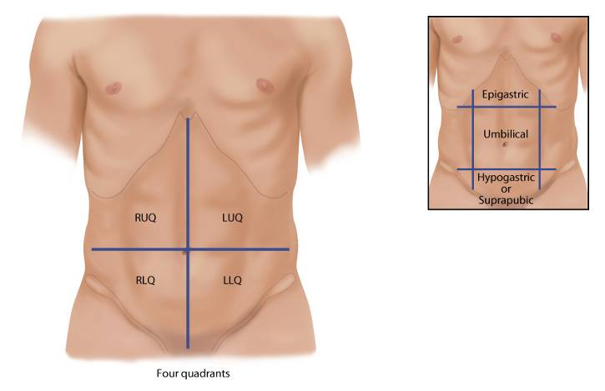
Quadrants

Slide 11
Developmental Competence: Infants and Children
  In newborn, umbilical cord shows prominently on abdomen
    Contains two arteries and one vein
    Liver takes up proportionately more space in abdomen at birth than in later life
    In healthy term neonates, lower edge may be palpated 0.5 to 2.5 cm below right costal margin
    Urinary bladder located higher in abdomen than in adult
    Lies between symphysis and umbilicus
    During early childhood, abdominal wall is less muscular, so organs may be easier to palpate

Slide 12
Developmental Competence: Pregnant Woman I
  Nausea and vomiting, or “morning sickness,” is an early sign of pregnancy for most pregnant women, starting between first and second missed periods
    Cause unknown; may be due to hormone changes, such as production of human chorionic gonadotropin (hCG)
    Another symptom is “acid indigestion” or heartburn (pyrosis) caused by esophageal reflux
    Gastrointestinal motility decreases, which prolongs gastric emptying time
    Decreased motility causes more water to be reabsorbed from colon, which leads to constipation

Slide 13
Developmental Competence: Pregnant Woman II
  Constipation and increased venous pressure in lower pelvis may lead to hemorrhoids
    Enlarging uterus displaces intestines upward and posteriorly
    Bowel sounds are diminished
    Appendix displaced upward and to the right
    Skin changes on abdomen include striae and linea nigra

Slide 14
Developmental Competence:
Aging Adult
  Aging alters appearance of abdominal wall
  Changes of the GI system occur with aging, but most do not significantly affect function as long as no disease is present
  Salivation decreases, leading to a dry mouth and decreased sense of taste
  Esophageal emptying and gastric acid secretion are delayed
  Incidence of gallstones increases with age
  Although liver size decreases, most liver functions remain normal; however, drug metabolism is impaired
  Aging adults frequently report constipation

Slide 15
Common Causes of Constipation
  Found in the older adult
    Decreased physical activity
    Inadequate intake of water
    Low-fiber diet
    Side effects of medications
    Irritable bowel syndrome
    Bowel obstruction
    Hypothyroidism
    Inadequate toilet facilities, that is, difficulty ambulating to toilet may cause person to deliberately retain stool until it becomes hard and difficult to pass

Slide 16
Culture and Genetics I
  Lactase is digestive enzyme necessary for absorption of carbohydrate lactose (milk sugar)
    In some racial groups, lactase activity is high at birth but declines to low levels by adulthood
      These people are lactose intolerant and have abdominal pain, bloating, and flatulence when milk products are consumed
    Estimated incidence of lactose intolerance is
      15% of Whites, 50% of Mexican Americans, and 80% of Blacks

Slide 17
Culture and Genetics II
Obesity is caused by a complex interaction of genetics, dietary consumption, physical activity leading to an obesogenic environment
Globally and within the U.S., the incidence of obesity has increased significantly
NHANES data show significant differences in obesity among racial groups
Obesity presentation across the life cycle leads to development of significant comorbidities
Recommendations: healthy food patterns, decreased consumption of sweetened/processed foods, and increased physical activity

Slide 18
Subjective Data
Appetite
Dysphagia
Food intolerance
Abdominal pain
Nausea and vomiting
Bowel habits
Past abdominal history
Medications
Nutritional assessment

Slide 19
Subjective Data Questions I
Appetite
  Any change in appetite? Is this a loss of appetite?
  Any change in weight? How much weight gained or lost? Over what time period? Is the weight loss due to diet?
Dysphagia
  Any difficulty swallowing? When did you first notice this?
Food intolerance
  Are there any foods you cannot eat? What happens if you do eat them: allergic reaction, heartburn, belching, bloating, or indigestion?
  Do you use antacids? How often?

Slide 20
Abdominal Pain Questions I
  Any abdominal pain? Please point to it.
    Is pain in one spot or does it move around?
    How did it start? How long have you had it?
    Is it constant, or does it come and go? Does it occur before or after meals? Does it peak? When?
    How would you describe the character of the pain: cramping (colic type), burning in pit of stomach, dull, stabbing, or aching?
    Is pain relieved by food, or worse after eating?

Slide 21
Abdominal Pain Questions II
  Is pain associated with menstrual period or irregularities, stress, dietary indiscretion, fatigue, nausea and vomiting, gas, fever, rectal bleeding, frequent urination, or vaginal or penile discharge?
    What makes the pain worse: food, position, stress, medication, or activity?
    What have you tried to relieve pain: resting, using a heating pad, changing position, or taking medication?

Slide 22
Nausea and Vomiting Questions
  Any nausea or vomiting?
    How often? How much comes up? What is the color? Is there an odor?
    Is it bloody?
    Is nausea and vomiting associated with colicky pain, diarrhea, fever, or chills?
    What foods did you eat in last 24 hours? Where did you eat? At home, school, restaurant? Is there anyone else in the family with the same symptoms in the last 24 hours?

Slide 23
Subjective Data Questions II
Bowel habits
  How often do you have a bowel movement?
    What is the color and consistency?
    Any diarrhea or constipation? How long?
    Any recent change in bowel habits?
    Use laxatives? Which ones? How often do you use them?
Abdominal history
  Any history of gastrointestinal problems, such as ulcer, gallbladder disease, hepatitis/jaundice, appendicitis, colitis, or hernia?
    Ever had any operations in abdomen? Please describe.
    Any problems after surgery?
    Any abdominal x-ray studies? What were results?

Slide 24
Subjective Data Questions III
Medications
  What medications are you currently taking?
  How much alcohol do you drink each day? Each week? When was your last alcoholic drink?
  Do you smoke? How many packs per day? For how long?
Nutritional assessment
  Now I would like to ask you about your diet
    Please tell me all food you ate yesterday, starting with breakfast
    Which fresh markets are located in your neighborhood?

Slide 25
Additional History for Infants and Children I
  Are you breastfeeding or bottle-feeding your infant? If bottle-feeding, how does infant tolerate formula?
  How does infant tolerate new foods?
  How often does your toddler/child eat? Does he or she eat regular meals? How do you feel about your child’s eating problems?
    Please describe all that your child had to eat yesterday, starting with breakfast; what foods does child eat for snacks?
    Does toddler/child ever eat non-foods, such as grass, dirt, or paint chips?

Slide 26
Additional History for Infants and Children II
  Does your child have constipation? If so, for how long?
  What are number of stools per day? Stools per week?
  How much water and juice is in child’s diet?
  Does the constipation seem to be associated with toilet training?
  What have you tried to treat constipation?
  Does child have abdominal pain? Please describe what you have noticed and when it started.

Slide 27
Additional History for Infants and Children III
  For overweight child: How long has weight been a problem?
    At what age did child first seem overweight? Did any change in diet pattern occur then?
    Describe diet pattern now.
    Do any others in family have similar problem?
    How does child feel about his or her weight?

Slide 28
Additional History for Adolescents
  What do you eat at regular meals? Do you eat breakfast? What do you eat for snacks?
    How many calories do you consume?
    What is your exercise pattern?
    If weight is less than body requirements: How much have you lost? By diet, exercise, or other means?
      How do you feel? Tired? Hungry? How do you think your body looks?
      What is your activity pattern?
      Is weight loss associated with any other body change, such as menstrual irregularity?
      What do your parents and friends say about your eating?

Slide 29
Additional History for Aging Adults
  How do you acquire your groceries and prepare your meals?
    Do you eat alone or do you share meals with others?
  Please tell me all that you had to eat yesterday, starting with breakfast.
    Do you have any trouble swallowing these foods?
    What do you do right after eating, such as walking or taking a nap?
  How often do your bowels move?
    If person reports constipation: What do you mean by constipation? How much liquid is in your diet? How much bulk or fiber?
    Do you take anything for constipation, such as laxatives? Which ones? How often?
    What medications do you take?

Slide 30
Preparation
  Lighting should include a strong overhead light and a secondary stand light
  Expose abdomen so that it is fully visible; drape genitalia and female breasts
  Position for comfort to enhance abdominal wall relaxation
  Empty bladder prior to examination with specimen saved if needed
  Warm stethoscope and examine areas identified as painful last so as to prevent guarding
  Auscultate prior to palpation and percussion
  Use distraction to keep patient relaxed and facilitate muscle relaxation

Slide 31
Equipment
  Stethoscope
  Small centimeter ruler
  Skin-marking pen
  Alcohol wipe to clean endpiece

Slide 32
Inspection of the Abdomen I
  Contour
    Stand on person’s right side and look down on abdomen
    Then stoop or sit to gaze across abdomen
    Your head should be slightly higher than abdomen
    Determine profile from rib margin to pubic bone; contour describes nutritional state and normally ranges from flat to rounded
  Symmetry
    Shine a light across abdomen toward you, or shine it lengthwise across the person
    Abdomen should be symmetric bilaterally

Slide 33
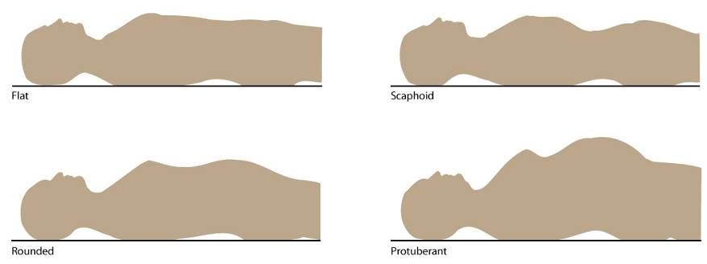
Contour

Slide 34
Inspection of the Abdomen II
  Umbilicus
    Normally it is midline and inverted, with no sign of discoloration, inflammation, or hernia
    Becomes everted and pushed upward with pregnancy
    Umbilicus is common site for piercings in young women; site should not be red or crusted
  Skin
    Surface smooth and even, with homogeneous color; good area to judge pigment because often protected from sun
    Fine venous network may be visible in thin persons
    Good skin turgor reflects healthy nutrition; gently pinch up a fold of skin; then release to note skin’s immediate return to original position

Slide 35
Inspection of the Abdomen III
  Skin
    One common pigment change is striae, silvery white, linear, jagged marks about 1 to 6 cm long
    Occur when elastic fibers in reticular layer of skin are broken after rapid or prolonged stretching, as in pregnancy or excessive weight gain; recent striae are pink or blue, then they turn silvery white
    Pigmented nevi (moles), circumscribed brown macular or papular areas, common on abdomen
    Normally no lesions are present, although you may note well-healed surgical scars

Slide 36
Abdominal Scars
  If a scar is present, draw its location in person’s record, indicating length in centimeters.
  Occasionally, a person forgets about an operation while providing the history; if you note a scar now, ask about it.
  Surgical scar alerts you to possible presence of underlying adhesions and excess fibrous tissue.

Slide 37
Inspection of the Abdomen IV
  Pulsation or movement
    Normally you may see pulsations from aorta beneath skin in epigastric area, particularly in thin persons with good muscle wall relaxation
  Hair distribution
    Pattern of pubic hair growth normally has diamond shape in adult males and an inverted triangle shape in adult females
  Demeanor
    Comfortable person is relaxed quietly on examining table and has a benign facial expression and slow, even respirations

Slide 38
Auscultation of Bowel and Vascular Sounds
  This is done because percussion and palpation can increase peristalsis, which would give a false interpretation of bowel sounds.
    Use diaphragm endpiece because bowel sounds are relatively high pitched.
    Hold stethoscope lightly against skin; pushing too hard may stimulate more bowel sounds.
    Begin in RLQ at ileocecal valve area because bowel sounds are normally always present here.

Slide 39
Bowel Sounds
  Note character and frequency of bowel sounds
  Bowel sounds originate from movement of air and fluid through small intestine
  Depending on time elapsed since eating, a wide range of normal sounds can occur
  Bowel sounds are high pitched, gurgling, cascading sounds, occurring irregularly anywhere from 5 to 30 times per minute; do not bother to count them
  Judge if they are normal, hypoactive, or hyperactive
  Borborygmus is the sound of hyper peristalsis
  Perfectly “silent abdomen” is uncommon; you must listen for 5 minutes by your watch before deciding bowel sounds are completely absent

Slide 40
Vascular Sounds
  As you listen to abdomen, note presence of any vascular sounds or bruits.
  Using firmer pressure, check over aorta, renal arteries, iliac, and femoral arteries, especially in people with hypertension.
  Usually no such sound is present.

Slide 41
Percussion and Tympany
Percuss general tympany, liver, and splenic dullness
  Percuss to assess relative density of abdominal contents, to locate organs, and to screen for abnormal fluid or masses
  General tympany
    First, percuss lightly in all four quadrants to determine prevailing amount of tympany and dullness
    Move clockwise; tympany should predominate because air in intestines rises to surface when person is supine

Slide 42
Liver Span Assessment I
  Percuss to map out boundaries of certain organs
  Measure height of liver in right midclavicular line
  For consistent placement of midclavicular line landmark, remember to palpate acromioclavicular and sternoclavicular joints, and judge line at point midway between two marks
  Begin in area of lung resonance, and percuss down interspaces until sound changes to a dull quality

Slide 43
Liver Span Assessment II
  Mark spot, usually in fifth intercostal space
  Find abdominal tympany, and percuss up in midclavicular line
  Mark where sound changes from tympany to a dull sound, normally at right costal margin
  Measure distance between two marks; normal liver span in adult ranges from 6 to 12 cm
  Height of liver span correlates with height of person; taller people have longer livers

Slide 44
Liver Span Assessment III
  Also, males have larger liver span than females of the same height
  Overall, mean liver span is 10.5 cm for males and 7 cm for females
  One variation occurs in people with chronic emphysema, in which liver displaced downward by hyperinflated lungs
  Although you hear a dull percussion note well below right costal margin, overall span is still within normal limits
  Clinical estimation of liver span important to screen for hepatomegaly and to monitor changes in liver size
  However, this measurement is a gross estimate; liver span may be underestimated because of inaccurate detection of upper border

Slide 45
Liver Span—Scratch Test
  Scratch test: one final technique is scratch test, which may help define liver border when abdomen distended or abdominal muscles are tense
  Place your stethoscope over liver
  With one fingernail, scratch short strokes over abdomen, starting in RLQ and moving progressively up toward liver
  When scratching sound in your stethoscope becomes magnified, you will have crossed border from over a hollow organ to a solid one

Slide 46
Splenic Dullness
Often spleen obscured by stomach contents, but you may locate it by percussing for a dull note from 9th to 11th intercostal space just behind left midaxillary line
Area of splenic dullness normally is not wider than 7 cm in adult and should not encroach on normal tympany over gastric air bubble
Percuss in lowest interspace in left anterior axillary line
Tympany should result; ask person to take a deep breath; normally tympany remains through full inspiration

Slide 47
Costovertebral Angle Tenderness
  Indirect fist percussion causes tissues to vibrate instead of producing a sound
  To assess kidney, place one hand over 12th rib at costovertebral angle on back
  Thump that hand with ulnar edge of your other fist
  Person normally feels thud but no pain
    Its usual sequence in complete examination is with thoracic assessment, when person is sitting up and you are standing behind

Slide 48
Special Procedures
  At times, you may suspect that a person has ascites (free fluid in the peritoneal cavity) because of distended abdomen, bulging flanks, and an umbilicus that is protruding and displaced downward
  You can differentiate ascites from gaseous distention by performing two percussion tests
    Fluid wave test
    Shifting dullness test

Slide 49
Palpate Surface and Deep Areas
  Perform palpation
    Judge size, location, and consistency of certain organs and screen for an abnormal mass or tenderness
    Because most people are naturally inclined to protect abdomen, you need to use additional measures to enhance complete muscle relaxation

Slide 50
Light Palpation I
  Begin with light palpation
  With first four fingers close together, depress skin about 1 cm
  Make gentle rotary motion, sliding fingers and skin together
  Then lift fingers (do not drag them) and move clockwise to next location around abdomen
  Objective is not to search for organs but to form an overall impression of skin surface and superficial musculature

Slide 51
Light Palpation II
  Save examination of any identified tender areas until last
  This method avoids pain and resulting muscle rigidity that would obscure deep palpation later in examination
  As you circle abdomen, discriminate between voluntary muscle guarding and involuntary rigidity
  Voluntary guarding occurs when person is cold, tense, or ticklish; it is bilateral, and you will feel muscles relax slightly during exhalation; use relaxation measures to try to eliminate this type of guarding
  If rigidity persists, it is probably involuntary

Slide 52
Deep Palpation I
  Now perform deep palpation using same technique described earlier, but push down about 5 to 8 cm (2 to 3 inches)
  Moving clockwise, explore entire abdomen
  To overcome resistance of a very large or obese abdomen, use a bimanual technique
    Place your two hands on top of each other
    Top hand does pushing; bottom hand relaxed and can concentrate on sense of palpation

Slide 53
Light and Deep Palpation I
  With either technique, note location, size, consistency, and mobility of any palpable organs and presence of any abnormal enlargement, tenderness, or masses
  Making sense of what you are feeling is more difficult than it looks
  Inexperienced examiners complain that abdomen “all feels same,” as if they are pushing their hand into a soft sofa cushion
  Helps to memorize anatomy and visualize what is under each quadrant as you palpate

Slide 54
Light and Deep Palpation II
  Also remember that some structures are normally palpable
  Mild tenderness normally present when palpating sigmoid colon
  Any other tenderness should be investigated
  If you identify a mass, first distinguish it from a normally palpable structure or an enlarged organ

Slide 55
Light and Deep Palpation IV
  If you identify a mass, then note the following:
    Location
    Size
    Shape
    Consistency: soft, firm, hard
    Surface: smooth, nodular
    Mobility, including movement with respirations
    Pulsatility
    Tenderness

Slide 56
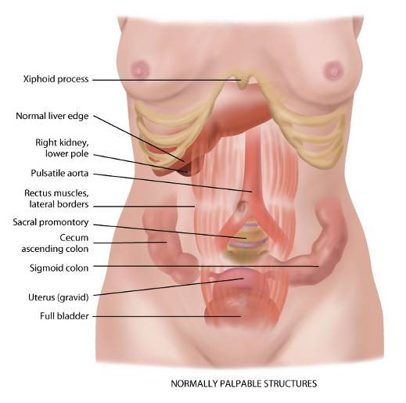
Normally Palpable Structures

Slide 57
Palpation of Liver
Place your left hand under person’s back parallel to 11th and 12th ribs and lift up to support abdominal contents
Place your right hand on RUQ, with fingers parallel to midline
Push deeply down and under right costal margin
Ask person to take a deep breath; it is normal to feel edge of liver bump your fingertips as diaphragm pushes it down during inhalation
It feels like a firm regular ridge; often liver is not palpable

Slide 58
Hooking Technique
An alternative method of palpating liver is to stand up at person’s shoulder and swivel your body to right so that you face person’s feet
Hook your fingers over costal margin from above
Ask person to take a deep breath
Try to feel liver edge bump your fingertips

Slide 59
Palpation of Spleen I
  Normally spleen is not palpable and must be enlarged three times its normal size to be felt
  To search for it, reach your left hand over abdomen and behind left side at the 11th and 12th ribs
  Lift up for support; place your right hand obliquely on LUQ with fingers pointing toward left axilla and just inferior to rib margin
  Push your hand deeply down and under left costal margin, and ask person to take deep breath
  You should feel nothing firm

Slide 60
Palpation of Spleen II
    When enlarged, spleen slides out and bumps your fingertips
    It can grow so large that it extends into lower quadrants
    When this condition is suspected, start low so you will not miss it
    An alternative position is to roll person onto his or her right side to displace spleen more forward and downward
    Then palpate as described earlier

Slide 61
Palpation of Right Kidney
  Search for right kidney by placing your hands together in a “duck-bill” position at person’s right flank
  Press your two hands together firmly (you need deeper palpation than that used with the liver or spleen), and ask person to take deep breath
  In most people, you will feel no change
  Occasionally, you may feel lower pole of right kidney as a round, smooth mass slide between your fingers
  Either condition is normal

Slide 62
Palpation of Left Kidney
  Left kidney sits 1 cm higher than right kidney and is not palpable normally
  Search for it by reaching your left hand across abdomen and behind left flank for support
  Push your right hand deep into abdomen, and ask person to breathe deeply
  You should feel no change with inhalation

Slide 63
Palpation of the Aorta
  Using your opposing thumb and fingers, palpate aortic pulsation in upper abdomen slightly to left of midline
  Normally it is 2.5 to 4 cm wide in adult and pulsates in an anterior direction

Slide 64
Special Procedures for Advanced Practice
  Rebound tenderness (Blumberg’s sign)
  Inspiratory arrest (Murphy’s sign)
  Iliopsoas muscle test
  Obturator test
  The Alvarado score (MANTRELS score) evaluation of RLQ pain

Slide 65
Developmental Competence:
Infant I
  Inspection
    Contour of abdomen is protuberant because of immature abdominal musculature
    Skin contains a fine, superficial venous pattern; this may be visible in lightly pigmented children up to puberty
    Inspect umbilical cord throughout neonatal period
    At birth, it is white and contains two umbilical arteries and one vein surrounded by mucoid connective tissue, called Wharton jelly
    Umbilical stump dries within a week, hardens, and falls off by 10 to 14 days; skin covers area by 3 to 4 weeks

Slide 66
Developmental Competence:
Infant II
Inspection
  Abdomen should be symmetric, although two bulges common
  May note an umbilical hernia; appears at 2 to 3 weeks and especially prominent when infant cries
    Reaches maximum size at 1 month (up to 2.5 cm or 1 in.) and usually disappears by 1 year
  Another common variation is diastasis recti, a separation of rectus muscles with a visible bulge along midline
  Condition more common with black infants, and it usually disappears by early childhood

Slide 67
Developmental Competence:
Infant III
Inspection
  Abdomen shows respiratory movement
  Only other abdominal movement you should note is occasional peristalsis, which may be visible because of thin musculature
Auscultation
  Auscultation yields only bowel sounds, metallic tinkling of peristalsis
  No vascular sounds should be heard

Slide 68
Developmental Competence:
Infant IV
  Percussion
    Percussion finds tympany over stomach (the infant swallows some air with feeding) and dullness over liver
    Percussing the spleen is not done
    Abdomen sounds tympanitic, although it is normal to percuss dullness over bladder; dullness may extend up to umbilicus
  Palpation
    Aid palpation by flexing baby’s knees with one hand while palpating with other

Slide 69
Developmental Competence:
Infant V
  Palpation
    Alternatively, you may hold upper back and flex neck slightly with one hand; offer pacifier to a crying infant
    Liver fills RUQ; normal to feel liver edge at right costal margin or 1 to 2 cm below
    Normally you may palpate spleen tip and both kidneys and bladder
    Also easily palpated are cecum in RLQ, and sigmoid colon, which feels like a sausage in left inguinal area
    Make note of newborn’s first stool, a sticky, greenish-black meconium stool within 24 hours of birth

Slide 70
Developmental Competence:
Child I
  Under age 4 years, abdomen looks protuberant when child is both supine and standing
  After age 4 years, potbelly remains when standing because of lumbar lordosis, but abdomen looks flat when supine
    Normal movement on abdomen includes respirations, which remain abdominal until 7 years
    To palpate abdomen, position young child on parent’s lap as you sit knee-to-knee with parent
    Flex knees up, and elevate head slightly

Slide 71
Developmental Competence:
Child II
  Child can “pant like a dog” to further relax abdominal muscles
    Hold your entire palm flat on abdominal surface for a moment before starting palpation
    This accustoms child to being touched
    If the child is very ticklish, hold his or her hand under your own as you palpate; or apply stethoscope and palpate around it
  Liver
    Remains easily palpable 1 to 2 cm below right costal margin; edge is soft and sharp and moves easily

Slide 72
Developmental Competence:
Child III
  Easily palpable, on the left, the spleen also is easily palpable with a soft, sharp, movable edge
  Usually you can feel 1 to 2 cm of right kidney and tip of left kidney
  Percussion of liver span measures about 3.5 cm at age 2 years, 5 cm at age 6 years, and 6 to 7 cm during adolescence
  In assessing abdominal tenderness, remember that young child often answers this question affirmatively no matter how abdomen actually feels

Slide 73
Developmental Competence:
Child IV
  Use objective signs to aid assessment, such as a cry changing in pitch as you palpate, facial grimacing, moving away from you, and guarding
  School-age child has a slim abdominal shape as he or she loses potbelly
  This slimming trend continues into adolescence
  Adolescent easily embarrassed with exposure of abdomen, and adequate draping is necessary
  Physical findings are same as those listed for adult

Slide 74
Developmental Competence:
Aging Adult
  On inspection, you may note increased deposits of subcutaneous fat on abdomen and hips because it is redistributed away from extremities
  Abdominal musculature is thinner and has less tone than that of younger adult, so in absence of obesity you may note peristalsis
  Because of thinner, softer abdominal wall, organs may be easier to palpate, in the absence of obesity
  Liver is easier to palpate; normally you will feel liver edge at or just below costal margin
  With distended lungs and depressed diaphragm, liver can be palpated lower, descending 1 to 2 cm below costal margin with inhalation
  Kidneys are easier to palpate

Slide 75
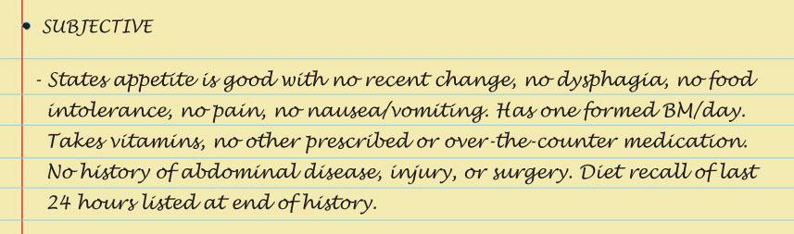
Sample Charting: Subjective

Slide 76
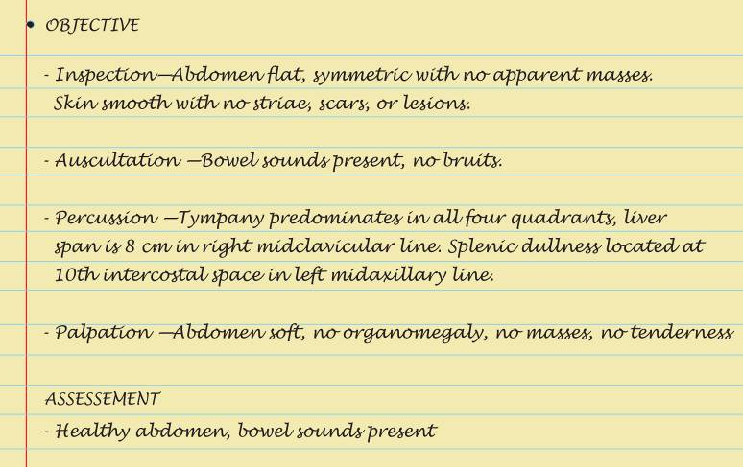
Sample Charting: Objective and Assessment

Slide 77
Abnormal Findings:
Abdominal Distention
Obesity
Air or gas
Ascites
Ovarian cyst
Pregnancy
Feces
Tumor

Slide 78
Abnormal Findings:
Abnormalities on Inspection
Umbilical hernia
Epigastric hernia
Incisional hernia
Diastasis recti

Slide 79
Abnormal Findings:
Abnormal Bowel Sounds
Succussion splash
Hypoactive bowel sounds
Hyperactive bowel sounds

Slide 80
Abnormal Findings:
Friction Rubs and Vascular Sounds
Peritoneal friction rub
Arterial bruit
Venous hum

Slide 81
Abnormal Findings:
On Palpation of Enlarged Organs
Enlarged liver
Enlarged nodular liver
Enlarged gallbladder
Enlarged spleen
Enlarged kidney
Aortic aneurysm

Slide 82
Summary Checklist: Abdomen Examination
Inspection
  Contour, symmetry, umbilicus, skin, pulsation or movement, hair distribution, and demeanor
Auscultation
  Bowel sounds; note any vascular sounds
Percussion
  All four quadrants and borders of liver and spleen
Palpation
  Light and deep palpation in all four quadrants, and palpate for liver and spleen

Slide 83
Question
The nurse suspects appendicitis. How should the nurse proceed with the assessment of the patient’s abdomen?
The nurse should ask the patient to point to where the pain is located and palpate that region first.
The nurse should not palpate the patient’s abdomen because this will illicit pain.
The nurse should listen for a bruit at McBurney’s point.
The nurse should palpate last and note rebound tenderness at McBurney’s point.
Notes:
The correct answer is 4. Rebound tenderness in the right lower quadrant at McBurney’s point is a common finding for appendicitis. Palpation should be done last.
Answer 1 is incorrect because palpation should be done last so as not to illicit pain and abdominal rigidity.
Answer 2 is incorrect because palpation is a necessary assessment.
Answer 3 is incorrect because a bruit in the abdominal region would be indicative of an abdominal aortic aneurysm.

Slide 84
Question
The nurse is assessing a patient’s abdomen and notices a thrill in the right upper quadrant. The nurse should suspect which of the following?
This is a normal finding and should be documented as such.
Possible abdominal aortic aneurysm
Possible appendicitis
Possible gallstones
Notes:
The correct answer is 2. This may be an abdominal aortic aneurysm and requires emergency intervention and attention.
Answer 1 is incorrect because thrills and bruits are not considered to be normal findings.
Answer 3 is incorrect because appendicitis would present with rebound tenderness in the right lower quadrant; no thrill would be present.
Answer 4 is incorrect because gallstones present with pain and no thrill.

