Slide 1
Musculoskeletal System
Chapter 22

Slide 2
Structure and Function
Skeleton is bony framework of body
Bone and cartilage are specialized forms of connective tissue
Bone is hard, rigid, and very dense
Joints, or articulations, are places of union of two or more bones

Slide 3
Musculoskeletal Components
Nonsynovial or synovial joints
Muscles
Temporomandibular joint
Spine
Shoulder
Elbow
Wrist and carpals
Hip
Knee
Ankle and foot

Slide 4
Nonsynovial Joints
Nonsynovial joints: bones united by fibrous tissue or cartilage are
Immovable, for example, sutures in skull
Slightly movable, for example, vertebrae

Slide 5
Synovial Joints I
Move freely because bones separated and enclosed in joint cavity
Cavity filled with lubricant, or synovial fluid; synovial fluid allows sliding which permits movement
Layer of resilient cartilage covers surface of opposing bones; receives nourishment from synovial fluid
Cartilage cushions bones and gives smooth surface to facilitate movement
Has tough, firm consistency, yet is flexible

Slide 6
Synovial Joints II
Joint surrounded by fibrous capsule and supported by ligaments
Ligaments are fibrous bands running directly from one bone to another; strengthen joint and help prevent movement in undesirable directions
Bursa: enclosed sac filled with synovial fluid
Help muscles and tendons glide smoothly over bone
Located in areas of potential friction, for example, subacromial bursa of shoulder, prepatellar bursa of knee

Slide 7
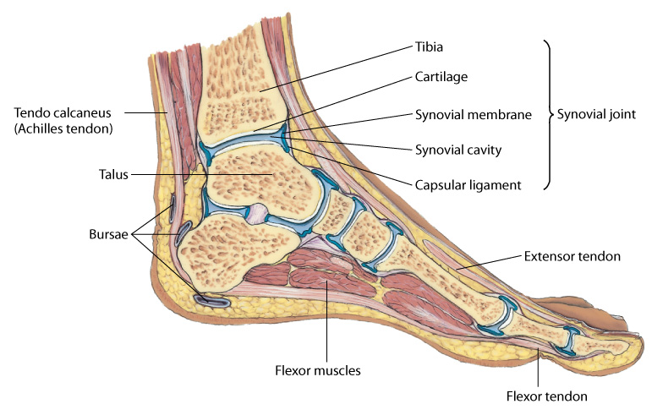
Synovial Joint

Slide 8
Muscles I
Muscles account for 40% to 50% of body’s weight
When they contract, they produce movement
Muscles are of three types: skeletal, smooth, and cardiac
Skeletal or voluntary muscles are under conscious control
Each skeletal muscle is composed of bundles of muscle fibers, or fasciculi
Skeletal muscle is attached to bone by tendon, a strong fibrous cord

Slide 9
Skeletal Muscles I
Skeletal muscles produce following movements:
Flexion: bending limb at joint
Extension: straightening limb at joint
Abduction: moving limb away from midline of body
Adduction: moving limb toward midline of body
Pronation: turning forearm so that palm is down
Supination: turning forearm so that palm is up
Circumduction: moving arm in circle around shoulder

Slide 10
Skeletal Muscles II
Skeletal muscles produce following movements:
Inversion: moving sole of foot inward at ankle
Eversion: moving sole of foot outward at ankle
Rotation: moving head around central axis
Protraction: moving body part forward, parallel to ground
Retraction: moving body part backward, parallel to ground
Elevation: raising a body part
Depression: lowering a body part

Slide 11
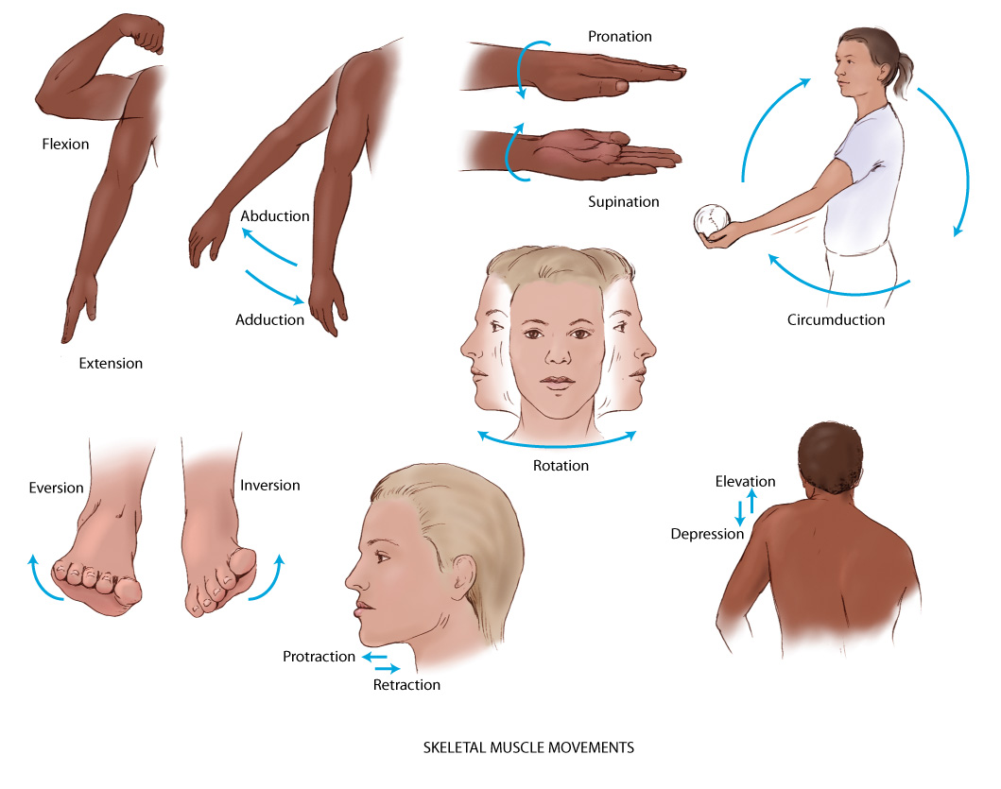
Skeletal Muscle Movements

Slide 12
Temporomandibular Joint (TMJ)
Articulation of mandible and temporal bone
Can feel it in depression anterior to tragus of ear
TMJ permits jaw function of speaking and chewing
Allows three motions:
Hinge action to open and close jaws
Gliding action for protrusion and retraction
Gliding for side-to-side movement of lower jaw

Slide 13
Spine and Vertebrae
Vertebrae are 33 connecting bones stacked in vertical column
Can feel spinous processes in furrow down midline of back
Vertebrae in humans
7 cervical
12 thoracic
5 lumbar
5 sacral
3 to 4 coccygeal

Slide 14
Spine Landmarks
Surface landmarks orient you to their levels
Spinous processes of C7 and T1 prominent at base of neck
Inferior angle of scapula normally at level of interspace between T7 and T8
Imaginary line connecting highest point on each iliac crest crosses L4
Imaginary line joining two symmetric dimples that overlie posterior superior iliac spines crosses sacrum

Slide 15
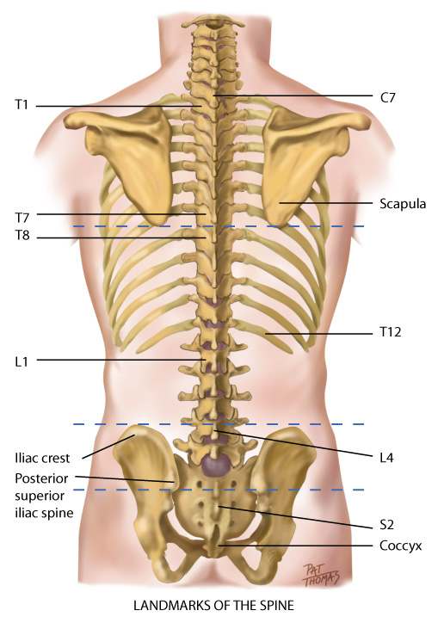
Surface Landmarks of Spine

Slide 16
Spine I
Lateral view shows vertebral column has four curves, a double-S shape
Cervical and lumbar curves are concave (inward or anterior)
Thoracic and sacrococcygeal curves are convex
Balanced or compensatory nature of curves, together with intervertebral disks, allow spine to absorb shock
Intervertebral disks are elastic fibrocartilaginous plates that constitute one fourth the length of column

Slide 17
Spine II
Each disk center has nucleus pulposus, made of soft, semifluid, mucoid material
Disks cushion spine like shock absorber and help it move
As spine moves, elasticity of disks allows compression on one side, with compensatory expansion on other
Motions of vertebral column are flexion (bending forward), extension (bending back), abduction (to either side), and rotation

Slide 18
Shoulder
Glenohumeral joint: articulation of humerus with glenoid fossa of scapula
Ball-and-socket action allows mobility of arm on many axes
Rotator cuff: group of four muscles and tendons support and stabilize shoulder
Palpable landmarks to guide your examination
Scapula and clavicle form shoulder girdle
Can feel the bump of the scapula’s acromion process at very top of shoulder

Slide 19
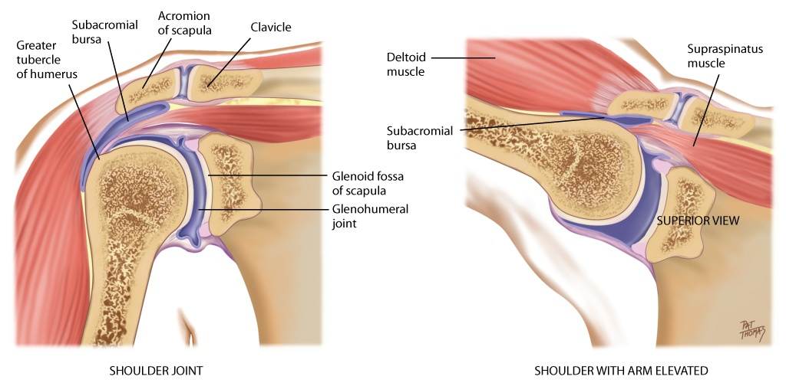
Shoulder

Slide 20
Elbow
Elbow joint contains three bony articulations: humerus, radius, and ulna of forearm
Hinge action moves forearm (radius and ulna) on one plane, allowing flexion and extension
Palpable landmarks are medial and lateral epicondyles of humerus and large olecranon process of ulna between them
Radius and ulna articulate with each other at two radioulnar joints, one at elbow and one at wrist
Permit pronation and supination of hand and forearm

Slide 21
Wrists and Carpals
Wrist, or radiocarpal joint: articulation of radius on thumb side and row of carpal bones
Condyloid action permits movement in two planes at right angles: flexion and extension, and side-to-side deviation
Midcarpal joint: articulation allows flexion, extension, and some rotation
Metacarpophalangeal and interphalangeal joints permit finger flexion and extension
Flexor tendons of wrist and hand enclosed in synovial sheaths

Slide 22
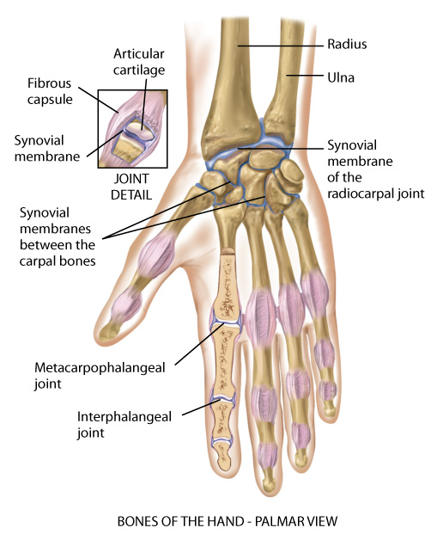
Bones of Hand

Slide 23
Hip I
Hip: articulation between acetabulum and head of the femur
Ball-and-socket action permits wide range of motion on many axes
Less range of motion (ROM) than shoulder, but more stability for weight-bearing function
Hip stability is due to powerful muscles that spread over joint, strong fibrous articular capsule, and deep insertion of head of femur
Three bursae facilitate movement

Slide 24
Hip II
Palpation of bony landmarks will guide examination
Can feel entire iliac crest, from anterior superior iliac spine to posterior
Ischial tuberosity lies under gluteus maximus muscle and palpable when hip flexed
Greater trochanter of femur below iliac crest and between anterior superior iliac spine and ischial tuberosity
Felt best when person standing in flat depression on upper lateral side of thigh

Slide 25
Knee I
Knee joint: articulation of three bones—the femur, tibia, and patella (kneecap)—in common articular cavity
Largest joint in body; hinge joint, permitting flexion and extension of lower leg on single plane
Synovial membrane is largest in body; forms sac at superior border of patella, suprapatellar pouch
Two wedge-shaped cartilages, called medial and lateral menisci, cushion tibia and femur

Slide 26
Knee II
Knee stabilized by two sets of ligaments
Cruciate give anterior and posterior stability and help control rotation
Collateral ligaments give medial and lateral stability and prevent dislocation
Landmarks of knee joint
Quadriceps muscle, felt on anterior and lateral thigh
Muscle’s heads merge into common tendon to enclose round bony patella; then inserts down tibial tuberosity and felt as bony prominence in midline
Note lateral and medial condyles of tibia
Medial and lateral epicondyles of femur are on either side of patella

Slide 27
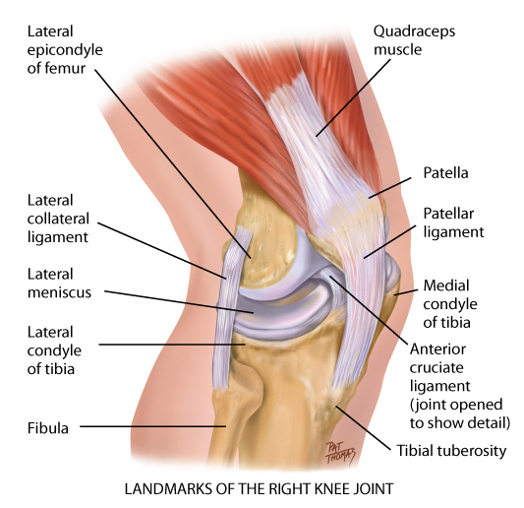
Landmarks of Knee

Slide 28
Ankle and Foot
Ankle or tibiotalar joint: articulation of tibia, fibula, and talus
Hinge joint: limited to flexion (dorsiflexion) and extension (plantar flexion) in one plane
Landmarks are two bony prominences on either side
Medial malleolus and the lateral malleolus
Strong, tight medial and lateral ligaments extend from each malleolus onto foot to help lateral stability of ankle
May be torn in eversion or inversion sprains of ankle
Joints distal to ankle give additional mobility to foot
Subtalar joint permits inversion and eversion of foot
Foot has longitudinal arch, with weight-bearing distributed between parts that touch ground, the heads of metatarsals and calcaneus (heel)

Slide 29
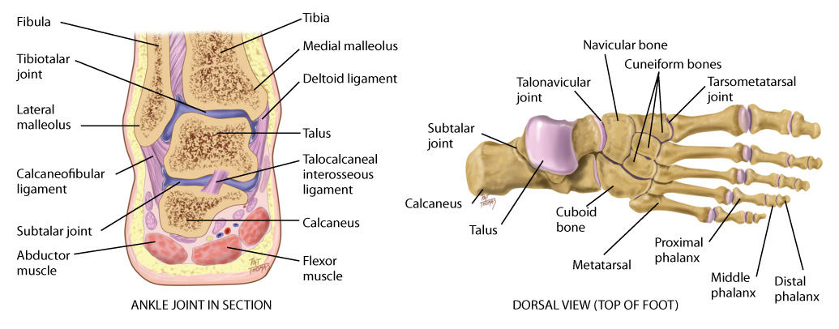
Ankle and Foot

Slide 30
Developmental Competence: Infants and Children
By 3 months, fetus has formed skeleton of cartilage
Bone growth continues rapidly during infancy and steadily in childhood, until adolescent growth spurt
Longitudinal growth continues until closure of epiphyses; last closure occurs about age 20
Although skeleton contributes to linear growth, muscles and fat are significant for weight increase
Muscles vary in size and strength in different people due to genetics, nutrition, and exercise
All through life, muscles increase with use and atrophy with disuse

Slide 31
Developmental Competence: Pregnant Woman I
Increased levels of circulating hormones (estrogen, relaxin from corpus luteum, and corticosteroids) cause increased mobility in joints
Increased mobility in sacroiliac, sacrococcygeal, and symphysis pubis joints in pelvis contributes to noticeable changes in maternal posture
Most characteristic change is progressive lordosis, which compensates for enlarging fetus by shifting weight farther back on lower extremities

Slide 32
Developmental Competence: Pregnant Woman II
Shift in turn creates strain on low back muscles, felt as low back pain during late pregnancy
Anterior flexion of neck and slumping of shoulder girdle are other postural changes that compensate for lordosis
These upper back changes may put pressure on ulnar and median nerves during third trimester

Slide 33
Developmental Competence: Aging Adult I
Bone remodeling is cyclic process of resorption and deposition; after age 40, resorption occurs more rapidly than deposition
Postural changes are evident with aging, and decreased height is most noticeable
Other postural changes are kyphosis, backward head tilt to compensate for kyphosis, and slight flexion of hips and knees
Distribution of subcutaneous fat changes through life; contour different, even if weight is same as when younger

Slide 34
Developmental Competence: Aging Adult II
In eighties and nineties, fat further decreases in periphery, especially noticeable in forearms and apparent over abdomen and hips
Loss of subcutaneous fat leaves bony prominences more marked
Absolute loss in muscle mass occurs; some decrease in size, and some atrophy, producing weakness
Contour of muscles becomes more prominent, and muscles and tendons feel more distinct
Lifestyle affects musculoskeletal changes

Slide 35
Health History Questions: Joints I
Do you have any pain in or problems with your joints?
Location: Which joints? On one or both sides?
Quality: What does pain feel like? Is it aching, stiff, sharp or dull, or shooting? Severity: How strong is the pain?
Onset: When did pain start?
Timing: What time of day does pain occur? How long does it last? How often does it occur?
Notes:
Joints:
• Any problems with your joints? Any pain?
• Location: Which joints? On one side or both sides?
• Quality: What does the pain feel like: aching, stiff, sharp or dull, shooting? Severity: How strong is the pain?
• Onset: When did this pain start?
• Timing: What time of day does the pain occur? How long does it last? How often does it occur?
• Is the pain aggravated by movement, rest, position, weather? Is the pain relieved by rest, medications, application of heat or ice?
• Is the pain associated with chills, fever, recent sore throat, trauma, repetitive activity?
• Any stiffness in your joints?
• Any swelling, heat, redness in the joints?
• Any limitation of movement in any joint? Which joint?
• Which activities give you problems?

Slide 36
Health History Questions: Joints II
Is pain aggravated by movement, rest, position, or weather; is it relieved by rest, medications, or application of heat or ice?
Is pain associated with chills, fever, recent sore throat, trauma, or repetitive activity?
Do you have any stiffness in your joints?
Do you have any swelling, heat, or redness in the joints?
Do you have any limitation of movement in joint? Which joint?
Which activities give you problems?
Notes:
Joints:
• Any problems with your joints? Any pain?
• Location: Which joints? On one side or both sides?
• Quality: What does the pain feel like: aching, stiff, sharp or dull, shooting? Severity: How strong is the pain?
• Onset: When did this pain start?
• Timing: What time of day does the pain occur? How long does it last? How often does it occur?
• Is the pain aggravated by movement, rest, position, weather? Is the pain relieved by rest, medications, application of heat or ice?
• Is the pain associated with chills, fever, recent sore throat, trauma, repetitive activity?
• Any stiffness in your joints?
• Any swelling, heat, redness in the joints?
• Any limitation of movement in any joint? Which joint?
• Which activities give you problems?

Slide 37
Health History Questions: Muscles
Any problems in muscles, such as any pain or cramping? Which muscles?
If in calf muscles: Is pain with walking? Does it go away with rest?
Are your muscle aches associated with fever, chills, or flu?
Do you have any weakness in your muscles?
Location: Where is the weakness? How long have you noticed the weakness?
Notes:
Joints:
• Any problems with your joints? Any pain?
• Location: Which joints? On one side or both sides?
• Quality: What does the pain feel like: aching, stiff, sharp or dull, shooting? Severity: How strong is the pain?
• Onset: When did this pain start?
• Timing: What time of day does the pain occur? How long does it last? How often does it occur?
• Is the pain aggravated by movement, rest, position, weather? Is the pain relieved by rest, medications, application of heat or ice?
• Is the pain associated with chills, fever, recent sore throat, trauma, repetitive activity?
• Any stiffness in your joints?
• Any swelling, heat, redness in the joints?
• Any limitation of movement in any joint? Which joint?
• Which activities give you problems?

Slide 38
Health History Questions: Bones
Do you have any bone pain? Is pain affected by movement?
Do you have any deformity of bones or joint? Is it due to injury or trauma? Does it affect ROM?
Have any accidents or trauma ever affected your bones or joints: fractures, joint strain, sprain, or dislocation? Which ones?
When did it occur? What treatment was given? Any problems or limitations as a result?
Do you have any back pain? In which part of your back? Is pain felt anywhere else, like shooting down leg?
Do you have any numbness and tingling? Any limping?
Notes:
Joints:
• Any problems with your joints? Any pain?
• Location: Which joints? On one side or both sides?
• Quality: What does the pain feel like: aching, stiff, sharp or dull, shooting? Severity: How strong is the pain?
• Onset: When did this pain start?
• Timing: What time of day does the pain occur? How long does it last? How often does it occur?
• Is the pain aggravated by movement, rest, position, weather? Is the pain relieved by rest, medications, application of heat or ice?
• Is the pain associated with chills, fever, recent sore throat, trauma, repetitive activity?
• Any stiffness in your joints?
• Any swelling, heat, redness in the joints?
• Any limitation of movement in any joint? Which joint?
• Which activities give you problems?

Slide 39
Functional Assessment of ADLs I
Do joint (muscle, bone) problems create any limits on your usual ADLs? Which ones?
Bathing: Do you have trouble getting in and out of tub or using faucets?
Toileting: Do you have trouble urinating or moving bowels? Are you able to get on and off toilet and to wipe yourself?
Dressing: Can you do buttons, zippers, fastening behind neck, pulling dress or sweater over head, pulling up pants, tying shoes, and can you get shoes that fit?
Notes:
Functional assessment (activities of daily living): Do your joint (muscle, bone) problems create any limits on your usual activities of daily living (ADLs)? Which ones? (Note: Ask about each category; if the person answers "yes," ask specifically about each activity in category.)
Bathing—getting in and out of the tub, turning faucets?
Toileting—urinating, moving bowels, able to get self on/off toilet, wipe self?
Dressing—doing buttons, zipper, fasten opening behind neck, pulling dress or sweater over head, pulling up pants, tying shoes, getting shoes that fit?
Grooming—shaving, brushing teeth, brushing or fixing hair, applying makeup?
Eating—preparing meals, pouring liquids, cutting up foods, bringing food to mouth, drinking?
Mobility—walking, walking up or down stairs, getting in/out of bed, getting out of house?
Communicating—talking, using phone, writing?
Self-care behaviors: Any occupational hazards that could affect the muscles and joints? Does your work involve heavy lifting? Or any repetitive motion or chronic stress to joints? Any efforts to alleviate these?
Tell me about your exercise program. Describe the type of exercise, frequency, the warm-up program.
Any pain during exercise? How do you treat it?
Have you had any recent weight gain? Please describe your usual daily diet. (Note the person's usual caloric intake, all four food groups, daily amount of protein, calcium.)
Are you taking any medications for musculoskeletal system: aspirin, antiinflammatory, muscle relaxant, pain reliever?
If person has chronic disability or crippling illness: How has your illness affected your interaction with family? Your interaction with friends? The way you view yourself?

Slide 40
Functional Assessment of ADLs II
Grooming: Can you shave, brush teeth, brush or fix hair, and apply makeup?
Eating: Can you prepare meals, pour liquids, cut up foods, bring food to mouth, and drink?
Mobility: Can you walk, walk up or down stairs, get in and out of bed, get out of house?
Communicating: Can you talk, use the telephone, and write?
Notes:
Functional assessment (activities of daily living): Do your joint (muscle, bone) problems create any limits on your usual activities of daily living (ADLs)? Which ones? (Note: Ask about each category; if the person answers "yes," ask specifically about each activity in category.)
Bathing—getting in and out of the tub, turning faucets?
Toileting—urinating, moving bowels, able to get self on/off toilet, wipe self?
Dressing—doing buttons, zipper, fasten opening behind neck, pulling dress or sweater over head, pulling up pants, tying shoes, getting shoes that fit?
Grooming—shaving, brushing teeth, brushing or fixing hair, applying makeup?
Eating—preparing meals, pouring liquids, cutting up foods, bringing food to mouth, drinking?
Mobility—walking, walking up or down stairs, getting in/out of bed, getting out of house?
Communicating—talking, using phone, writing?
Self-care behaviors: Any occupational hazards that could affect the muscles and joints? Does your work involve heavy lifting? Or any repetitive motion or chronic stress to joints? Any efforts to alleviate these?
Tell me about your exercise program. Describe the type of exercise, frequency, the warm-up program.
Any pain during exercise? How do you treat it?
Have you had any recent weight gain? Please describe your usual daily diet. (Note the person's usual caloric intake, all four food groups, daily amount of protein, calcium.)
Are you taking any medications for musculoskeletal system: aspirin, antiinflammatory, muscle relaxant, pain reliever?
If person has chronic disability or crippling illness: How has your illness affected your interaction with family? Your interaction with friends? The way you view yourself?

Slide 41
Self-Care Behaviors
Are there any occupational hazards that could affect muscles and joints? Do they involve heavy lifting? Are there any repetitive motions or chronic stress to joints? Have you made any efforts to alleviate these?
Tell me about your exercise program: describe type of exercise, frequency, warm-up program
Have you had any recent weight gain? Please describe your usual daily diet.
Are you taking any medications such as aspirin, antiinflammatories, muscle relaxants, or pain relievers?
If person has chronic disability or crippling illness:
How has your illness affected your interaction with family, friends, and the way that you view yourself ?
Notes:
Functional assessment (activities of daily living): Do your joint (muscle, bone) problems create any limits on your usual activities of daily living (ADLs)? Which ones? (Note: Ask about each category; if the person answers "yes," ask specifically about each activity in category.)
Bathing—getting in and out of the tub, turning faucets?
Toileting—urinating, moving bowels, able to get self on/off toilet, wipe self?
Dressing—doing buttons, zipper, fasten opening behind neck, pulling dress or sweater over head, pulling up pants, tying shoes, getting shoes that fit?
Grooming—shaving, brushing teeth, brushing or fixing hair, applying makeup?
Eating—preparing meals, pouring liquids, cutting up foods, bringing food to mouth, drinking?
Mobility—walking, walking up or down stairs, getting in/out of bed, getting out of house?
Communicating—talking, using phone, writing?
Self-care behaviors: Any occupational hazards that could affect the muscles and joints? Does your work involve heavy lifting? Or any repetitive motion or chronic stress to joints? Any efforts to alleviate these?
Tell me about your exercise program. Describe the type of exercise, frequency, the warm-up program.
Any pain during exercise? How do you treat it?
Have you had any recent weight gain? Please describe your usual daily diet. (Note the person's usual caloric intake, all four food groups, daily amount of protein, calcium.)
Are you taking any medications for musculoskeletal system: aspirin, antiinflammatory, muscle relaxant, pain reliever?
If person has chronic disability or crippling illness: How has your illness affected your interaction with family? Your interaction with friends? The way you view yourself?

Slide 42
Additional History Questions I
Infants and children
Was there any trauma to infant during labor and delivery? Did infant come head first? Was there any need for forceps?
Did infant need resuscitation?
Were infant’s motor milestones achieved at about same time as siblings or age-mates?
Has child ever broken any bones? Had dislocations? How were these treated?
Have you noticed any bone deformity? Spinal curvature? Unusual shape of toes or feet?

Slide 43
Additional History Questions II
Adolescents
Are you involved in any sports at school or after school? How frequently?
Do you use any special equipment? Does any training program exist for your sport?
What is the nature of your daily warm-up?
What do you do if you get hurt?
How does your sport fit in with other school demands and other activities?

Slide 44
Additional History Questions III
Aging adult
Use functional assessment history questions to elicit any loss of function, self-care deficit, or safety risk
Have you had any change in weakness over past months?
Have you had any increase in falls or stumbling in past months?
Do you use any mobility aids to help you get around such as a cane or walker?

Slide 45
Physical Examination Preparation I
Purpose of musculoskeletal examination is to assess function for ADLs and to screen for abnormalities
You already will have considerable data regarding ADLs through history
Note additional ADL data as person goes through motions necessary for examination: gait, posture, how person sits in chair, raises from chair, takes off jacket, manipulates small object such as a pen, raises from supine position
Screening musculoskeletal examination suffices for most people
Age-specific screening measures, such as Ortolani’s sign for infants or scoliosis screening for adolescents

Slide 46
Physical Examination Preparation II
Complete musculoskeletal exam is appropriate for persons with articular disease, history of musculoskeletal symptoms, or any problems with ADLs
Make person comfortable before and throughout exam; drape for full visualization of body part you are examining without needlessly exposing person
Take an orderly approach: head to toe, proximal to distal, and from midline outward

Slide 47
Physical Examination Preparation III
Complete musculoskeletal exam is appropriate for persons with support each joint at rest; muscles must be soft and relaxed to assess joints accurately
Take care when examining any inflamed area where rough manipulation could cause pain and muscle spasm
Compare corresponding paired joints; expect symmetry of structure and function and normal parameters for each joint

Slide 48
Order of Examination
Inspection
Note size and contour of joint; inspect skin and tissues over joints for color, swelling, and any masses or deformity
Presence of swelling signals joint irritation
Palpation
Palpate each joint, including skin for temperature, muscles, bony articulations, and area of joint capsule; notice any heat, tenderness, swelling, or masses which signal inflammation
Joints normally not tender to palpation
If tenderness occurs, localize to specific anatomic structures, for example, skin, muscles, bursae, ligaments, tendons, fat pads, or joint capsule

Slide 49
Range of Motion (ROM)
Ask for active voluntary ROM while stabilizing the body area proximal to that being moved
Familiarize yourself with the type of each joint and its normal ROM so that you can recognize limitations
For limitations, gently attempt passive motion; anchor joint with one hand while other hand slowly moves it to its limit; normal ranges of active and passive motion should be same
Joint motion normally causes no tenderness, pain, or crepitation
Do not confuse crepitation with normal discrete “crack” heard as tendon or ligament slips over bone during motion

Slide 50
Muscle Testing
Test strength of prime mover muscle groups for each joint; repeat motions for active ROM
Ask person to flex and hold as you apply opposing force
Muscle strength should be equal bilaterally and should fully resist opposing force

Slide 51
TMJ
With person seated, inspect area just anterior to ear
Place tips of first two fingers in front of each ear and ask person to open and close mouth
Drop fingers into depressed area over joint, and note smooth motion of mandible
Audible and palpable snap or click occurs in many healthy people as mouth opens
Palpate contracted temporalis and masseter muscles as person clenches teeth
Compare right and left sides for size, firmness, and strength
Ask person to move jaw forward and laterally against your resistance, and to open mouth against your resistance
This tests integrity of cranial nerve V (trigeminal nerve)

Slide 52
Cervical Spine
Inspect alignment of head and neck
Spine should be straight and head erect
Palpate spinous processes and sternomastoid, trapezius, and paravertebral muscles
They should feel firm, with no muscle spasm or tenderness
Repeat motions while applying opposing force
Person normally can maintain flexion against full resistance
This tests integrity of cranial nerve XI (spinal nerve)

Slide 53
Shoulder I
Inspect and compare both shoulders posteriorly and anteriorly
Check size and contour of joint and compare shoulders for equality of bony landmarks
Normally no redness, muscular atrophy, deformity, or swelling is present
Check anterior aspect of joint capsule and subacromial bursa for abnormal swelling
Do not attempt if you suspect neck trauma

Slide 54
Shoulder II
If person reports shoulder pain, ask him or her to point to spot with hand of unaffected side
Shoulder pain may be from local causes or may be referred pain from a hiatal hernia or cardiac or pleural condition, which could be potentially serious
Pain from a local cause is reproducible during the examination by palpation or motion
While standing in front of person, palpate both shoulders, noting any muscular spasm or atrophy, swelling, heat, or tenderness

Slide 55
Shoulder III
Start at clavicle and methodically explore acromioclavicular joint, scapula, greater tubercle of humerus, area of subacromial bursa, biceps groove, and anterior aspect of glenohumeral joint
Palpate pyramid-shaped axilla; no adenopathy or masses should be present
Test ROM by asking person to perform four motions
Cup one hand over shoulder during ROM to note any crepitation; normally none is present
Test strength of shoulder muscles by asking person to shrug shoulders, flex forward and up, and abduct against your resistance
Shoulder shrug also tests integrity of cranial nerve XI, spinal accessory nerve

Slide 56
Elbow I
Inspect size and contour of elbow in both flexed and extended positions
Look for deformity, redness, or swelling
Check olecranon bursa and the normally present hollows on either side of the olecranon process for abnormal swelling
Palpate elbow flexed about 70 degrees and relaxed
Using left hand to support person’s left forearm and palpate extensor surface of elbow (olecranon process, and medial and lateral epicondyles of humerus) with right thumb and fingers

Slide 57
Elbow II
Palpate either side of olecranon process using varying pressure, with thumb in lateral groove and your index and middle fingers in medial groove
Normally tissues and fat pads feel fairly solid
Check for synovial thickening, swelling, nodules, or tenderness
Palpate the area of the olecranon bursa for heat, swelling, tenderness, consistency, or nodules
Test ROM
While testing muscle strength, stabilize person’s arm with one hand
Have person flex elbow against your resistance applied just proximal to wrist
Then ask person to extend elbow against your resistance

Slide 58
Wrist and Hand I
Inspect hands and wrists on dorsal and palmar sides
Note position, contour, and shape; normally no swelling or redness, deformity, or nodules are present
Skin looks smooth with knuckle wrinkles present and no swelling or lesions; muscles appear full
Palpate each joint in wrist and hands
Facing person, support hand with your fingers under it and palpate wrist with both your thumbs on its dorsum
Normally joint surfaces feel smooth, with no swelling, bogginess, nodules, or tenderness

Slide 59
Wrist and Hand II
Palpate metacarpophalangeal joints with your thumbs, just distal to and on either side of knuckle
Use thumb and index finger in pinching motion to palpate sides of interphalangeal joints
Normally no synovial thickening, tenderness, warmth, or nodules are present
For muscle testing, position person’s forearm palm up and resting on a table; stabilize by holding your hand at person’s midforearm; ask person to flex wrist against your resistance at palm

Slide 60
Carpal Tunnel Testing
Phalen’s test
Ask person to hold both hands back to back while flexing wrists 90 degrees
Acute flexion of wrist for 60 seconds produces no symptoms in the normal hand
Test reproduces numbness and burning in person with carpal tunnel syndrome
Tinel’s Sign
Direct percussion of location of median nerve at wrist produces no symptoms in normal hand
Percussion of median nerve produces burning and tingling along its distribution, which is a positive Tinel’s sign for carpal tunnel syndrome

Slide 61
Hip
Inspect hip joint together with spine later in examination as person stands; note symmetric levels of iliac crests, gluteal folds, and equally sized buttocks
Smooth, even gait reflects equal leg lengths and functional hip motion
Help person into supine position and palpate hip joints; joints should feel stable and symmetric, with no tenderness or crepitation
Assess ROM
Limitation of abduction of hip while supine is most common motion dysfunction found in hip disease

Slide 62
Knee I
Person should remain supine with legs extended
Inspect lower leg alignment; should extend in same axis as thigh
Inspect knee’s shape and contour; normally distinct hollows present on either side of patella; check for any sign of fullness or swelling; note other locations for any abnormal swelling
Check quadriceps muscle in anterior thigh for any atrophy; because it is a prime mover of the knee, it is important for joint stability during weight-bearing

Slide 63
Knee II
Enhance palpation with knee in supine position; start high on anterior thigh above patella
Palpate with left thumb and fingers in grasping fashion; proceed toward knee, exploring region of suprapatellar pouch; note consistency of tissues.
Muscles and soft tissues should feel solid, and joint should feel smooth, with no warmth, tenderness, thickening, or nodularity.
When swelling occurs, need to distinguish if due to soft tissue swelling or increased fluid in joint; tests for bulge sign and ballottement of patella aid this assessment.

Slide 64
Knee: Bulge Sign
For swelling in suprapatellar pouch, bulge sign confirms presence of fluid as you try to move fluid from one side of joint to other.
Firmly stroke up on medial aspect of knee two or three times to displace any fluid; tap lateral aspect and watch medial side in hollow for distinct bulge from a fluid wave; normally none is present.

Slide 65
Knee: Ballottement of Patella
Test reliability when larger amounts of fluid are present
Use left hand to compress suprapatellar pouch to move any fluid into knee joint
With right hand, push patella sharply against femur; if no fluid is present, patella is already snug against femur
Palpate infrapatellar fat pad and patella; check for crepitus by holding hand on patella as knee is flexed and extended; some crepitus in knee is not uncommon
Check ROM
Check muscle strength by asking person to maintain knee flexion while you oppose by trying to pull the leg forward

Slide 66
McMurray’s Test
Special test for meniscal tears
Perform test when person has history of trauma followed by locking, giving way, or local pain in knee
Position person supine as you stand on affected side
Hold heel and flex knee and hip; place your other hand on knee with fingers on medial side
Rotate leg in and out to loosen joint
Externally rotate leg and push a valgus (inward) stress on knee; then slowly extend knee; normally leg extends smoothly with no pain

Slide 67
Ankle and Foot I
Inspect while person is sitting and when standing and walking
Compare both feet, noting contour of joints; foot should align with long axis of lower leg
Weight-bearing should fall on middle of foot; most feet have a longitudinal arch, but this can vary normally from “flat feet” to high instep
Toes point straight forward and lie flat; note locations of calluses or bursal reactions as they reveal areas of abnormal friction
Examining well-worn shoes helps assess areas of wear and accommodation

Slide 68
Ankle and Foot II
Support ankle by grasping heel with your fingers while palpating with your thumbs; joint spaces should feel smooth, with no swelling or tenderness
Palpate metatarsophalangeal joints between your thumb on dorsum and fingers on plantar surface
Test ROM
Assess muscle strength by asking person to maintain dorsiflexion and plantar flexion against your resistance

Slide 69
Spine I
Person should be standing, draped in gown open at back
Place yourself far enough back so that you can see entire back
Inspect and note if spine is straight by following imaginary vertical line from head through spinous processes to gluteal cleft, and noting equal horizontal positions for shoulders, scapulae, iliac crests, and gluteal folds
Knees and feet should be aligned with trunk and should be pointing forward

Slide 70
Spine II
From side, note normal convex thoracic curve and concave lumbar curve
Enhanced thoracic curve, or kyphosis, in aging people
Pronounced lumbar curve, or lordosis, in obese people
Palpate spinous processes; normally straight and not tender
Palpate paravertebral muscles; should feel firm with no tenderness or spasm

Slide 71
Spine III
Check ROM of spine by asking person to touch toes; look for flexion of 75 to 90 degrees, and smoothness and symmetry of movement
Concave lumbar curve should disappear with this motion; back should have single convex C-shaped curve
If you suspect spinal curvature during inspection, this may be more clearly seen when person touches toes
While person is bending over, mark a dot on each spinous process; when person resumes standing, dots should form a straight vertical line

Slide 72
Spine IV
Stabilize pelvis with your hands; check ROM
Bend sideways: lateral bending of 35 degrees
Bend backward: hyperextension of 30 degrees
Twist shoulders to one side, then the other: rotation of 30 degrees, bilaterally
These maneuvers reveal gross restrictions only; movement is still possible even if some spinal fusion has occurred
Finally, ask person to walk on his or her toes for a few steps, then return walking on heels

Slide 73
Straight Leg Raising or Lasègue’s Test
These maneuvers reproduce back and leg pain and may confirm presence of herniated nucleus pulposus
Straight leg raising while keeping the knee extended normally produces no pain
Raise affected leg just short of point where it produces pain; then dorsiflex foot
Test positive if it reproduces sciatic pain; if lifting affected leg reproduces sciatic pain, it confirms presence of herniated nucleus pulposus
Raise unaffected leg leaving other leg flat; inquire about involved side

Slide 74
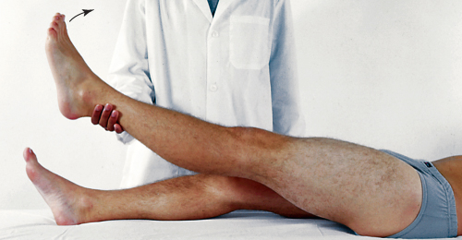
Straight Leg Raising or Lasègue's Test

Slide 75
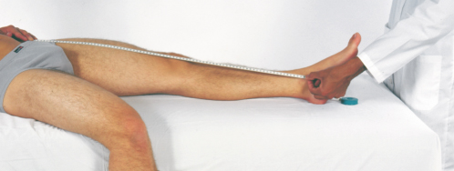
Measure Leg Length Discrepancy
Perform this measurement if you need to determine whether one leg is shorter than other
For true leg length, measure between fixed points, from anterior iliac spine to medial malleolus, crossing medial side of knee
Normally these measurements are equal or within 1 cm, indicating no true bone discrepancy

Slide 76
Developmental Competence
Review developmental milestones
Keep handy a concise chart of usual sequence of motor development to refer to expected findings for age of each child you examine
Use Denver II test to screen fine and gross motor skills for child’s age

Slide 77
Developmental Competence: Infants I
Examine infant fully undressed and lying on back; take care to place newborns on warming table to maintain body temperature
Feet and Legs
Note any positional deformities, a residual of fetal positioning
Note relationship of forefoot to hindfoot
Check for tibial torsion, a twisting of the tibia

Slide 78
Developmental Competence: Infants II
Hips
Check hips for congenital dislocation; most reliable is Ortolani’s maneuver, which should be done at every visit until infant is 1 year old
Allis test is also used to check for hip dislocation
Hands and arms
Inspect hands, noting shape, number, and position of fingers and palmar creases
Palpate length of clavicles; the bone most frequently is fractured during birth

Slide 79
Developmental Competence: Infants III
Back
Lift infant and examine back; note normal single C-curve of newborn’s spine
Inspect length of spine for any tuft of hair, dimple in midline, cyst, or mass; normally none is present
Observe ROM through spontaneous movement
Test muscle strength by lifting up the infant with your hands under the axillae; baby with normal muscle strength wedges securely between your hands

Slide 80
Developmental Competence: Preschool and School-Age Children
Back: note posture; you should note a “plumb line” from back of head, along spine, to middle of sacrum
Shoulders: level within 1 cm; scapulae symmetric; lordosis common throughout childhood
Observe legs and feet for various deformities, such as
Bowleg, knock knees, flatfoot, pigeon toes
Check Trendelenburg’s sign progressively for subluxation of hip
Particularly, check arm for full ROM and presence of pain
Look for subluxation of elbow (head of radius)
Palpate bones, joints, and muscles of extremities as in adult examination

Slide 81
Developmental Competence: Adolescents
Proceed with same musculoskeletal examination as for adult; pay special note to spinal posture
Kyphosis common during adolescence because of chronic poor posture
Screen for scoliosis with forward bend test
From behind standing child, ask child to stand with feet shoulder width apart and bend forward slowly to touch the toes
Expect straight vertical spine while standing and also while bending forward; posterior ribs should be symmetric, with equal elevation of shoulders, scapulae, and iliac crests

Slide 82
Developmental Competence: Pregnant Woman
Proceed through same examination as for adult
Expected postural changes in pregnancy include
Progressive lordosis
Toward third trimester, anterior cervical flexion
Kyphosis and slumped shoulders
When pregnancy at term, protuberant abdomen and relaxed mobility in joints create characteristic “waddling” gait

Slide 83
Developmental Competence: Aging Adult
Postural changes include decrease in height, more apparent in eighth and ninth decades
Kyphosis common, with backward head tilt to compensate
Contour changes include a decrease of fat in body periphery; fat deposition over abdomen and hips
Bony prominences become more marked
ROM testing proceeds as described earlier
ROM and muscle strength are much like younger adult, provided no musculoskeletal illnesses or arthritic changes are present

Slide 84
Functional Assessment
For those with advanced aging changes, arthritic changes, or musculoskeletal disability, perform functional assessment for ADLs
Apply ROM and muscle strength assessments to accomplishment of specific activities
Goal is to determine adequate and safe performance of functions essential for independent home life

Slide 85
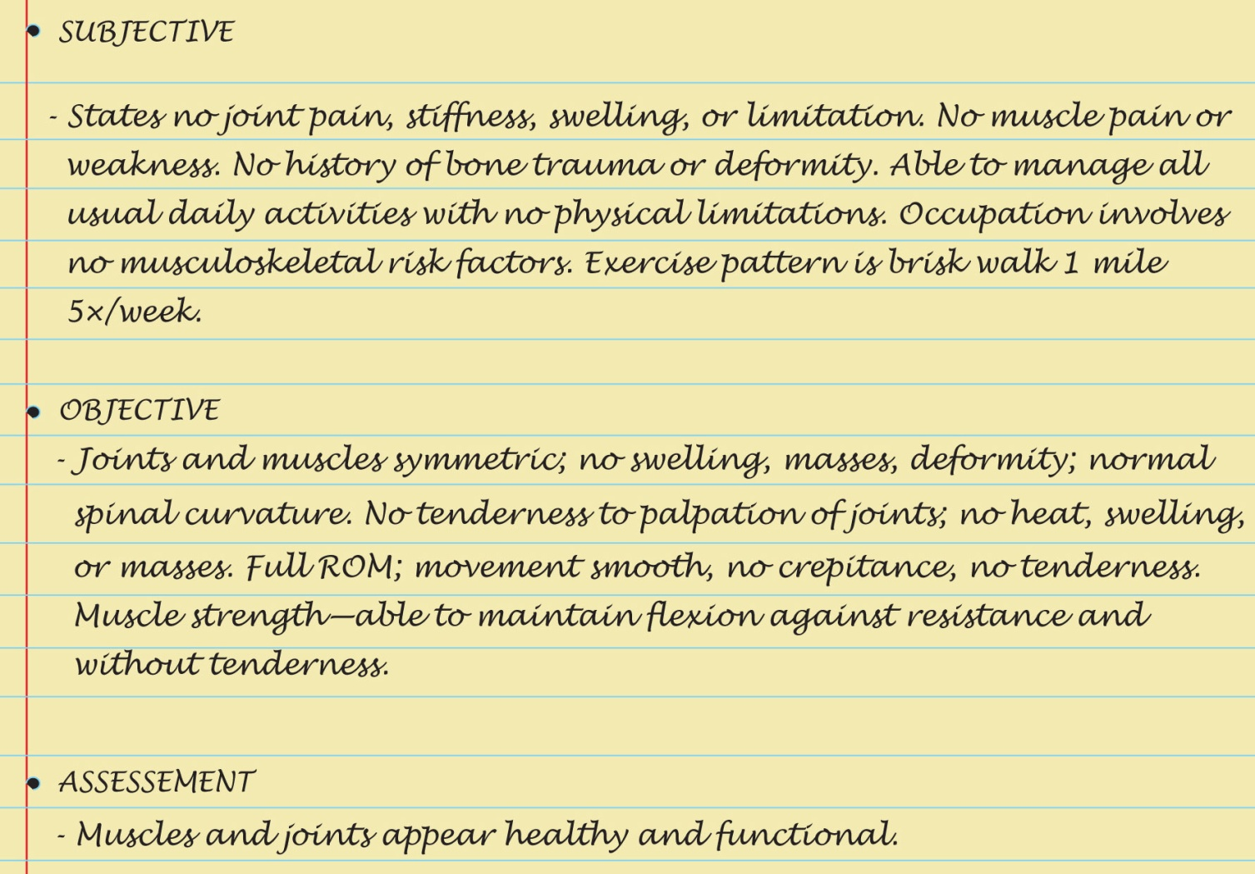
Sample Charting

Slide 86
Abnormalities Affecting Multiple Joints
Inflammatory conditions
Rheumatoid arthritis
Ankylosing spondylitis
Degenerative conditions
Osteoarthritis (degenerative joint disease)
Osteoporosis

Slide 87
Question
The nurse is assessing a patient’s risk of developing osteoporosis. Which patient is considered at high risk for osteoporosis?
A 65-year-old man being treated for hypertension
A 55-year-old woman who has had right knee replacement surgery
A 30-year-old woman who smokes and is taking oral contraceptives
A 25-year-old man who plays numerous college sports
Notes:
The correct answer is 2. A postmenopausal woman who has had joint replacement surgery is at a higher risk for osteoporosis than all those in options 1, 3, and 4.
Answer 1 is incorrect because hypertension and being male does not increase the risk of osteoporosis.
Answer 3 is incorrect because smoking and taking oral contraception places this patient at risk for cerebrovascular accident and does not increase risk of osteoporosis.
Answer 4 is incorrect because this patient is decreasing his risk of getting osteoporosis by playing sports.

Slide 88
Question
A patient tells the nurse that she has rheumatoid arthritis (RA). The symptoms this patient is likely to exhibit are pain and stiffness in the:
joints that increases with activity.
joints that is relieved with rest.
right elbow and left knee relieved with medication.
joints that is worse in the morning and improves with activity.
Notes:
The correct answer is 4. RA is worse in the morning and improves with activity.
Answer 1 is incorrect because activity helps symptoms of RA.
Answer 2 is incorrect because rest will increase stiffness associated with RA.
Answer 3 is incorrect because unilateral joint involvement is a symptom of osteoarthritis (OA).

Slide 89
Abnormalities of Shoulder
Atrophy
Dislocated shoulder
Joint effusion
Tear of the rotator cuff
Frozen shoulder, adhesive capsulitis
Subacromial bursitis

Slide 90
Abnormalities of Elbow
Olecranon bursitis
Gouty arthritis
Subcutaneous nodules
Epicondylitis, tennis elbow

Slide 91
Abnormalities of Wrist and Hand I
Ganglion cyst
Colles’ fracture
Carpal tunnel syndrome
Ankylosis
Dupuytren’s contracture

Slide 92
Abnormalities of Wrist and Hand II
Conditions caused by chronic rheumatoid arthritis
Swan-neck and boutonniere deformities
Ulnar deviation or drift
Degenerative joint disease or osteoarthritis
Acute rheumatoid arthritis
Syndactyly
Polydactyly

Slide 93
Abnormalities of Knee
Mild synovitis
Prepatellar bursitis
Swelling of menisci
Post polio
Osgood-Schlatter disease
Chondromalacia patellae

Slide 94
Abnormalities of Ankle and Foot
Achilles tenosynovitis
Chronic/acute gout
Hallux vagus with bunion and hammer toes
Callus
Plantar wart
Ingrown toenail

Slide 95
Abnormalities of Spine
Scoliosis
Herniated nucleus pulposus
Notes:
Edition change: note that routine screening for scoliosis is no longer recommended.

Slide 96
Pediatric Abnormalities
Common congenital or pediatric abnormalities
Congenital dislocated hip
Talipes equinovarus (clubfoot)
Spina bifida
Coxa plana (Legg-Calvé-Perthes syndrome)

Slide 97
Summary Checklist: Musculoskeletal Examination
Inspection
Size and contour of joint
Skin color and characteristics
Palpation of joint area
Skin, muscles, bony articulations, and joint capsules
ROM
Active
Passive (If limitation noted in active ROM is present)
Measure with goniometer (if abnormality in ROM is present)
Muscle testing

