Slide 1
Chapter 23
Neurologic System

Slide 2
Structure and Function
Nervous system divided into two parts:
Central nervous system (CNS), which includes brain and spinal cord
Peripheral nervous system (PNS), which includes all nerve fibers outside brain and spinal cord
Includes 12 pairs of cranial nerves, 31 pairs of spinal nerves, and all their branches
Carries sensory (afferent) messages to CNS from sensory receptors
Motor (efferent) messages from CNS to muscles and glands, as well as autonomic messages that govern internal organs and blood vessels

Slide 3
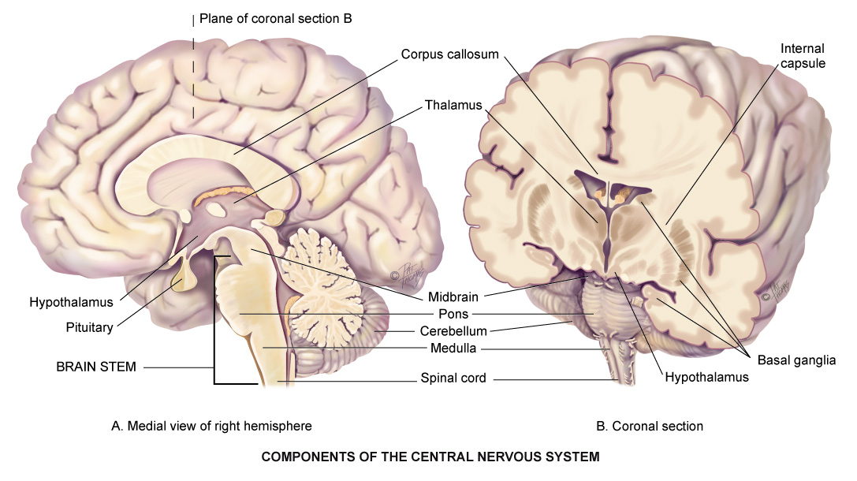
Central Nervous System
© Pat Thomas, 2006.

Slide 4
Cerebral Cortex
Cerebral cortex is cerebrum’s outer layer of nerve cells
Cerebral cortex is center of functions governing thought, memory, reasoning, sensation, and voluntary movement
Each half of cerebrum is hemisphere
Each hemisphere divided into four lobes: frontal, parietal, temporal, and occipital

Slide 5
Lobes of the Cerebral Cortex I
Lobes have areas that mediate specific functions:
Frontal lobe concerned with personality, behavior, emotions, and intellectual function
Precentral gyrus of frontal lobe initiates voluntary movement
Parietal lobe’s postcentral gyrus is primary center for sensation
Occipital lobe is primary visual receptor center
Temporal lobe behind ear, has primary auditory reception center, taste, and smell

Slide 6
Lobes of the Cerebral Cortex II
Wernicke’s area in temporal lobe associated with language comprehension
When damaged in the person’s dominant hemisphere, receptive aphasia results; person hears sound, but it has no meaning, like hearing a foreign language
Broca’s area in frontal lobe mediates motor speech
When injured in dominant hemisphere, expressive aphasia results; person cannot talk; person can understand language and knows what they want to say, but can produce only garbled sound

Slide 7
Damage to Cerebral Cortex
Damage to specific cortical areas produces a corresponding loss of function:
Motor weakness
Paralysis
Loss of sensation
Impaired ability to understand and process language
Damage occurs when highly specialized neurologic cells are deprived of blood supply, such as when a cerebral artery becomes occluded

Slide 8
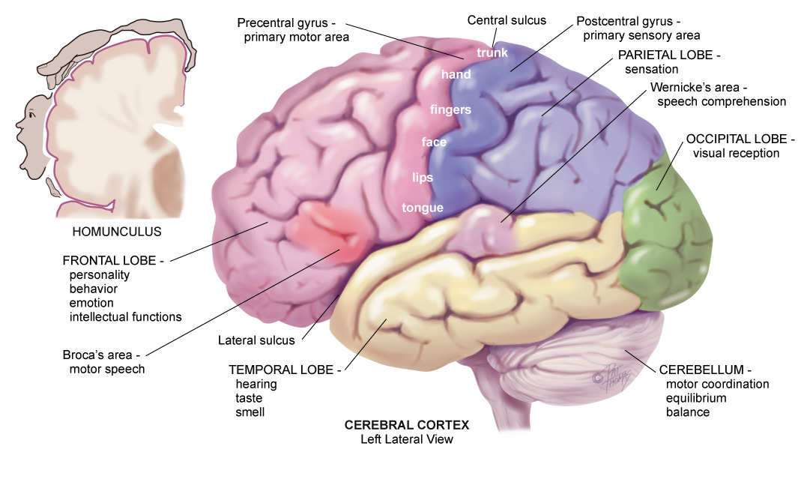
Cerebral Cortex

Slide 9
Central Nervous System Components
Basal ganglia
Large bands of gray matter in two cerebral hemispheres that form subcortical associated motor system (extrapyramidal system)
Initiate and coordinate movement and control automatic associated movements of body
Thalamus
Main relay station where sensory pathways of spinal cord, cerebellum, and brain stem form synapses

Slide 10
Hypothalamus
Major respiratory center with many basic functions, such as appetite, sex drive, temperature, heart rate, blood pressure, sleep, anterior and posterior pituitary gland regulation, and coordination of autonomic nervous system, stress response, and emotional status

Slide 11
Cerebellum
Coiled structure located under occipital lobe concerned with coordination of voluntary movements, equilibrium, and muscle tone
Does not initiate, but coordinates and smoothes movements
Coordinates many different muscles needed in playing piano, swimming, or juggling
Adjusts and corrects voluntary movements, but operates entirely below conscious level

Slide 12
Brainstem
Central core of brain consists of nerve fibers:
Cranial nerve (CN) III through XII originate from nuclei in brain stem
Midbrain: most anterior part of brain stem with tubular structure of spinal cord; merges into thalamus and hypothalamus; contains many motor neurons and tracts
Pons: enlarged area containing ascending sensory and descending motor tracts
Medulla: continuation of spinal cord in brain; contains all fiber tracts connecting brain and spinal cord

Slide 13
Spinal Cord
Long cylindrical structure of nervous tissue that occupies upper two thirds of vertebral canal from medulla to lumbar vertebrae L1 to L2
Main highway for ascending and descending fiber tracts that connect the brain to spinal nerves, and it mediates reflexes
Nerve cell bodies, or gray matter, arranged in butterfly shape with anterior and posterior “horns”

Slide 14
Pathways of CNS
Crossed representation is notable feature of nerve tracts
Left cerebral cortex receives sensory information from and controls motor function to right side of the body
Right cerebral cortex likewise interacts with left side of body
Knowledge of where fibers cross midline will help interpret clinical findings

Slide 15
Sensory Pathways I
Millions of sensory receptors are embroidered into skin, mucous membranes, muscles, tendons, and viscera
Monitor conscious sensation, internal organ functions, body position, and reflexes
Sensation travels in afferent fibers in peripheral nerve, through posterior (dorsal) root, and into spinal cord
There, may take one of two routes: spinothalamic tract or posterior (dorsal) columns

Slide 16
Sensory Pathway Routes
Spinothalamic tract
Contains sensory fibers that transmit sensations of pain, temperature, and crude or light touch
Fibers enter dorsal root of spinal cord and synapse with a second sensory neuron
At thalamus, fibers synapse with third sensory neuron, carrying message to sensory cortex for full interpretation
Posterior (dorsal) columns
These fibers conduct sensations of position, vibration, and finely localized touch

Slide 17
Sensory Pathways II
Sensory cortex arranged in corresponding “map” of body; pain in right hand perceived at specific spot on left cortex map
Some organs absent from brain map, such as heart, liver, or spleen; you know you have one, but have no “felt image” of it
Pain originating in these organs is referred, e.g., pain in heart referred to chest, shoulder, and left arm, neighbors in fetal development; pain originating in spleen felt on left shoulder

Slide 18
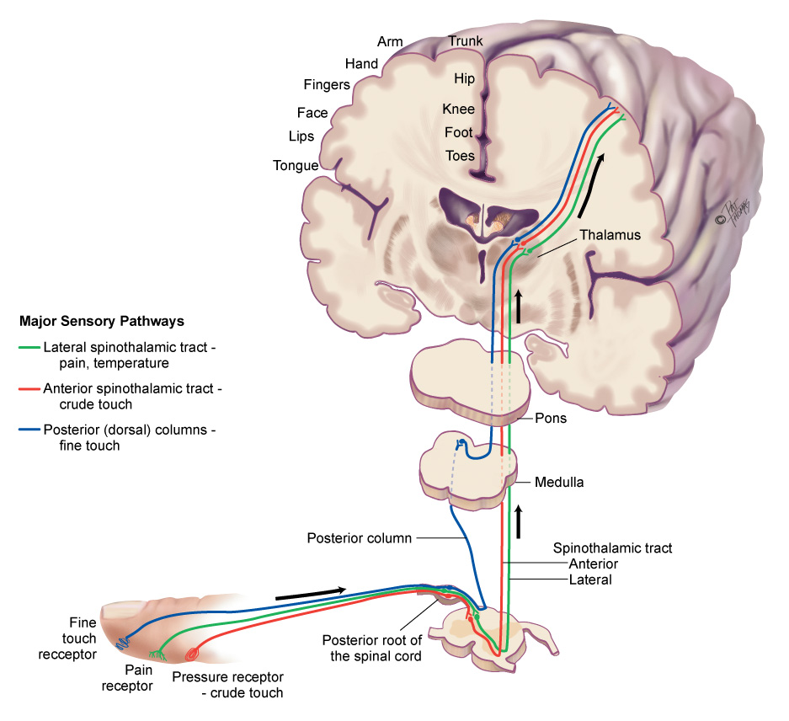
Sensory Pathways

Slide 19
Motor Pathways I
Corticospinal or pyramidal tract fibers mediate voluntary movement, particularly very skilled, discrete, purposeful movements, such as writing
Motor nerve fibers travel to brain stem crossing to opposite, contralateral side, (pyramidal decussation) and then pass down in lateral column of spinal cord
Permits very skilled and purposeful movements
Arranged in pattern called somatotopic organization
Parts whose movements are relatively more important occupy proportionally more space on this brain map

Slide 20
Motor Pathways II
Extrapyramidal tracts include motor nerve fibers originating in motor cortex, basal ganglia, brain stem, and spinal cord outside pyramidal tract
Subcortical motor fibers maintain muscle tone and control body movements, especially gross automatic movements, such as walking
Cerebellar system coordinates movement, maintains equilibrium and posture; receives information on position of muscles and joints, body’s equilibrium, and kind of motor messages sent from cortex to muscles

Slide 21
Upper Motor Neurons
Complex of descending motor fibers that can influence or modify lower motor neurons
Located completely within CNS; convey impulses from motor areas of cerebral cortex to lower motor neurons
Examples of upper motor neuron diseases are cerebrovascular accident, cerebral palsy, and multiple sclerosis

Slide 22
Lower Motor Neurons
Final common pathway, providing final contact with muscle
Located in anterior gray column of spinal cord, but nerve fibers extend to muscle
Movement must be translated into action by lower motor neuron fibers
Examples of lower motor neurons are cranial nerves and spinal nerves of peripheral nervous system
Examples of lower motor neuron diseases are spinal cord lesions, poliomyelitis, and amyotrophic lateral sclerosis

Slide 23
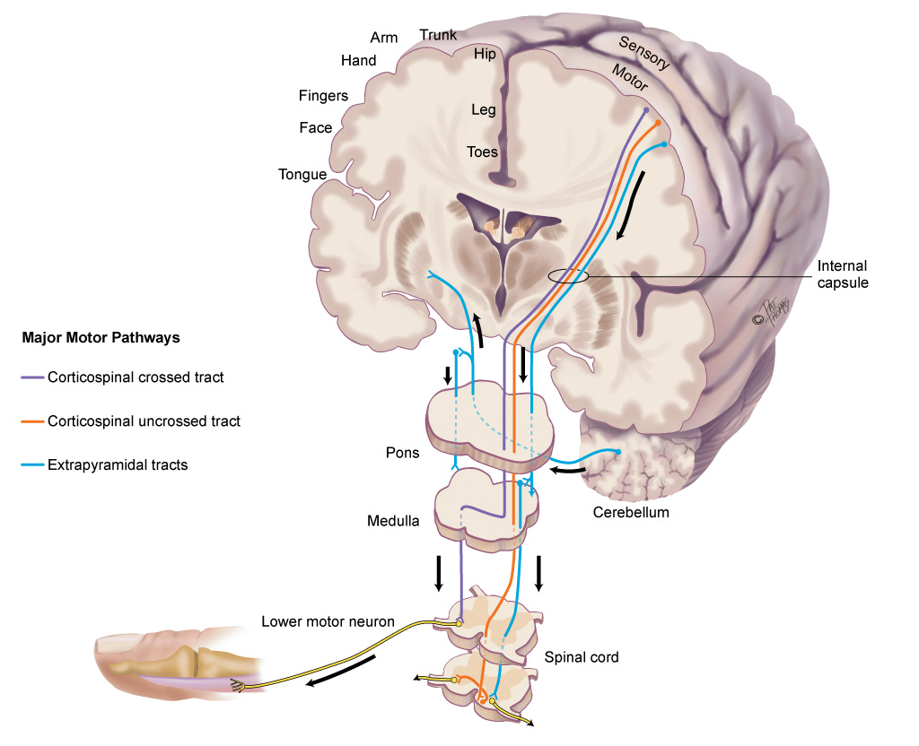
Motor Pathways

Slide 24
Reflexes
Reflexes: basic defense mechanisms of nervous system
Involuntary; below level of conscious control permitting quick reaction to potentially painful or damaging situations
Four types of reflexes:
Deep tendon reflexes (myotatic), e.g., knee jerk
Superficial, e.g., corneal reflex, abdominal reflex
Visceral, e.g., pupillary response to light
Pathologic (abnormal), e.g., Babinski’s reflex or extensor plantar reflex

Slide 25
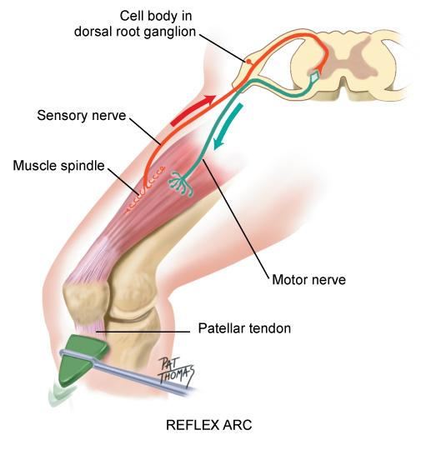
Reflex Arc

Slide 26
Cranial Nerves
Enter and exit brain rather than spinal cord
CN I and II extend from cerebrum; cranial nerves III to XII extend from lower diencephalon and brain stem
12 pairs of cranial nerves supply primarily head and neck, except vagus nerve, which travels to heart, respiratory muscles, stomach, and gallbladder

Slide 27
Spinal Nerves
31 pairs of spinal nerves arise from length of spinal cord and supply rest of body
Named for region of spine from which they exit: 8 cervical, 12 thoracic, 5 lumbar, 5 sacral, and 1 coccygeal
“Mixed” nerves, they contain both sensory and motor fibers
Each innervates particular segment of body
Dermal segmentation is cutaneous distribution of various spinal nerves

Slide 28
Dermatomes
Dermatome
Circumscribed skin area supplied mainly from one spinal cord segment through particular nerve
Dermatomes overlap; if one nerve is severed, most of sensations are transmitted by one above and one below
Useful landmark dermatomes
Thumb, middle finger, fifth finger are C6, C7, and C8; Axilla at T1; Nipple at T4; Umbilicus at T10; Groin in region of L1; Knee at L4

Slide 29
Autonomic Nervous System
Peripheral nervous system composed of cranial nerves and spinal nerves
Carry fibers divided functionally into two parts:
Somatic fibers innervate skeletal (voluntary) muscles
Autonomic fibers innervate smooth (involuntary) muscles, cardiac muscle, and glands
Autonomic system mediates unconscious activity

Slide 30
Developmental Competence: Infants
Neurologic system not completely developed at birth
Movement directed primarily by primitive reflexes
Persistence of primitive reflexes is an indication of CNS dysfunction
Sensory and motor development proceed with gradual acquisition of myelin needed to conduct most impulses
As myelinization develops, infant able to localize stimulus more precisely and make more accurate motor response

Slide 31
Developmental Competence: Aging Adult I
Atrophy with steady loss of neuron structure in brain and spinal cord
Causes loss of weight and volume with thinning of cerebral cortex, reduced subcortical brain structures, and expansion of the ventricles
People over 65 show signs that, in younger adult, would be considered abnormal such as general loss of muscle bulk, loss of muscle tone in face, neck, and around spine, decreased muscle strength, impaired fine coordination and agility, loss of vibratory sense at ankle, decreased or absent Achilles reflex, pupillary miosis, irregular pupil shape, and decreased pupillary reflexes

Slide 32
Developmental Competence: Aging Adult II
Velocity of nerve conduction decreases making reaction time slower in some older persons
Increased delay at synapse results in diminished sensation of touch, pain, taste, and smell
Motor system may show general slowing down of movement; muscle strength and agility decrease
Progressive decrease in cerebral blood flow and oxygen consumption may cause dizziness and loss of balance

Slide 33
Culture and Genetics
Racial/Ethnic Disparity noted relative to strokes
4% of African Americans have had a stroke
6% of American Indians/Alaska Natives have had a stroke
2.5% of Hispanics have had a stroke
Geographic Disparity noted relative to strokes
Existence of “Stroke Belt” – 8 states with increased stroke mortality
Nationwide Burden of Stroke
Higher for African Americans and Hispanic populations

Slide 34
Subjective Data Questions
Headache
Have you had any unusually frequent or severe headaches? When did this start? How often does it occur?
Where do you feel headaches? Do headaches seem to be associated with anything?
Head injury
Have you ever had any head injury? What part of head was injured? Describe.
Did you have loss of consciousness? For how long?
Notes:
Headache: Any unusually frequent or severe headaches?
Head injury: Ever had any head injury? Please describe.
Dizziness/vertigo: Ever feel lightheaded, a swimming sensation, like feeling faint?
Seizures: Ever had any convulsions? When did they start? How often do they occur?
Tremors: Any shakes or tremors in the hands or face? When did these start?
Weakness: Any weakness or problem moving any body part? Is this generalized or local? Does it occur with anything?

Slide 35
Dizziness/Vertigo
Do you ever feel a lightheaded, swimming sensation, like feeling faint? When have you noticed this? How often does it occur? Does it occur with activity or a change in position?
Do you ever feel a sensation called vertigo, a rotational spinning sensation? Do you feel as if the room spins, or do you feel you are spinning? Does it come on suddenly or gradually?
Notes:
Headache: Any unusually frequent or severe headaches?
Head injury: Ever had any head injury? Please describe.
Dizziness/vertigo: Ever feel lightheaded, a swimming sensation, like feeling faint?
Seizures: Ever had any convulsions? When did they start? How often do they occur?
Tremors: Any shakes or tremors in the hands or face? When did these start?
Weakness: Any weakness or problem moving any body part? Is this generalized or local? Does it occur with anything?

Slide 36
Seizures
Ever had any convulsions? When did they start? How often do they occur?
When seizure starts, do you have warning sign?
Motor activity: Where in your body do seizures begin? Do seizures travel through your body? Do they occur on one side or both?
Do you have any associated signs, such as color change in face or lips, loss of consciousness, or incontinence?
Are there any precipitating factors? Does anything seem to bring on seizures, such as activity, discontinuing medication, fatigue, stress?
Notes:
Headache: Any unusually frequent or severe headaches?
Head injury: Ever had any head injury? Please describe.
Dizziness/vertigo: Ever feel lightheaded, a swimming sensation, like feeling faint?
Seizures: Ever had any convulsions? When did they start? How often do they occur?
Tremors: Any shakes or tremors in the hands or face? When did these start?
Weakness: Any weakness or problem moving any body part? Is this generalized or local? Does it occur with anything?

Slide 37
Seizures and Tremors
Seizures
Postictal phase: After having a seizure, do you sleep? Do you have confusion, weakness, headache, or muscle ache? Are you on any medication?
Coping strategies: How have seizures affected daily life and your occupation?
Tremors
Any shakes or tremors in hands or face? When did these start?
Do they seem to grow worse with anxiety, intention, or rest? Do they affect daily activities?
Notes:
Headache: Any unusually frequent or severe headaches?
Head injury: Ever had any head injury? Please describe.
Dizziness/vertigo: Ever feel lightheaded, a swimming sensation, like feeling faint?
Seizures: Ever had any convulsions? When did they start? How often do they occur?
Tremors: Any shakes or tremors in the hands or face? When did these start?
Weakness: Any weakness or problem moving any body part? Is this generalized or local? Does it occur with anything?

Slide 38
Subjective Data Questions II
Weakness
Is this generalized or local?
Does weakness occur with particular movement?
Is it hard to get up out of a chair or reach for an object?
With distal or small muscle weakness, it is hard to open a jar, write, use scissors, or walk without tripping?
Incoordination
Do you have any problem with balance when walking? Any falling? Which way? Do your legs seem to give way? Any clumsy movement?
Numbness or tingling
Does it ever feel like pins and needles? When did this start? Where do you feel it? Does it occur with activity?
Notes:
Headache: Any unusually frequent or severe headaches?
Head injury: Ever had any head injury? Please describe.
Dizziness/vertigo: Ever feel lightheaded, a swimming sensation, like feeling faint?
Seizures: Ever had any convulsions? When did they start? How often do they occur?
Tremors: Any shakes or tremors in the hands or face? When did these start?
Weakness: Any weakness or problem moving any body part? Is this generalized or local? Does it occur with anything?

Slide 39
Subjective Data Questions III
Difficulty swallowing
Do you have difficulty swallowing solids or liquids?
Have you experienced excessive saliva or drooling?
Difficulty speaking
Do you have difficultly forming words or saying what you intend? When did you first notice this? How long did it last?
Significant history
Do you have a history of stroke (cerebrovascular accident), spinal cord injury, meningitis or encephalitis, congenital defect, or alcoholism?
Notes:
Headache: Any unusually frequent or severe headaches?
Head injury: Ever had any head injury? Please describe.
Dizziness/vertigo: Ever feel lightheaded, a swimming sensation, like feeling faint?
Seizures: Ever had any convulsions? When did they start? How often do they occur?
Tremors: Any shakes or tremors in the hands or face? When did these start?
Weakness: Any weakness or problem moving any body part? Is this generalized or local? Does it occur with anything?

Slide 40
Subjective Data Questions IV
Environmental and occupational hazards
Are you exposed to insecticides, organic solvents, or lead?
Are you taking any medications now?
How much alcohol do you drink? Each week? Each day?
How about mood-altering drugs, such as marijuana, cocaine, barbiturates, and tranquilizers?
Notes:
Headache: Any unusually frequent or severe headaches?
Head injury: Ever had any head injury? Please describe.
Dizziness/vertigo: Ever feel lightheaded, a swimming sensation, like feeling faint?
Seizures: Ever had any convulsions? When did they start? How often do they occur?
Tremors: Any shakes or tremors in the hands or face? When did these start?
Weakness: Any weakness or problem moving any body part? Is this generalized or local? Does it occur with anything?

Slide 41
Additional History: Infants and Children I
Did mother have any health problems during pregnancy, such as infections or illnesses, medications taken, toxemia, hypertension, alcohol or drug use, or diabetes?
Was infant premature or full term? What was the infant’s birth weight?
Was there any birth trauma? Did infant breathe immediately?
Were you told infant’s Apgar scores?
Were there any congenital defects?
Notes:
Headache: Any unusually frequent or severe headaches?
Head injury: Ever had any head injury? Please describe.
Dizziness/vertigo: Ever feel lightheaded, a swimming sensation, like feeling faint?
Seizures: Ever had any convulsions? When did they start? How often do they occur?
Tremors: Any shakes or tremors in the hands or face? When did these start?
Weakness: Any weakness or problem moving any body part? Is this generalized or local? Does it occur with anything?

Slide 42
Additional History: Infants and Children II
Reflexes: What have you noticed about infant’s behavior? Do infant’s sucking and swallowing seem coordinated? Does infant turn head toward touch? Does infant startle with a loud noise? Does infant grasp your finger?
Does child seem to have problem with balance? Has there been any unexplained falling clumsy or unsteady gait, progressive muscular weakness, or problems going up or down stairs or getting up from lying position?
Notes:
Headache: Any unusually frequent or severe headaches?
Head injury: Ever had any head injury? Please describe.
Dizziness/vertigo: Ever feel lightheaded, a swimming sensation, like feeling faint?
Seizures: Ever had any convulsions? When did they start? How often do they occur?
Tremors: Any shakes or tremors in the hands or face? When did these start?
Weakness: Any weakness or problem moving any body part? Is this generalized or local? Does it occur with anything?

Slide 43
Additional History: Infants and Children III
Has child had any seizures? Did it occur with high fever? Was there any loss of consciousness? How long?
Did motor or developmental milestones come at about right age? Does child seem to be growing normally? How does development compare to that of siblings or age-mates?
Has child had any environmental exposure to lead?
Is there any family history of seizure disorder, cerebral palsy, or muscular dystrophy?
Notes:
Headache: Any unusually frequent or severe headaches?
Head injury: Ever had any head injury? Please describe.
Dizziness/vertigo: Ever feel lightheaded, a swimming sensation, like feeling faint?
Seizures: Ever had any convulsions? When did they start? How often do they occur?
Tremors: Any shakes or tremors in the hands or face? When did these start?
Weakness: Any weakness or problem moving any body part? Is this generalized or local? Does it occur with anything?

Slide 44
Additional History: Aging Adult I
Any problem with dizziness?
Does it occur when you first sit or stand up, when you move your head, get up and walk, or after eating? Does it occur with any medications?
(For men) Do you ever get up at night and feel faint while standing to urinate?
How does dizziness affect your daily activities? Are you able to drive safely and maneuver within your house safely?
What safety modifications have you applied at home?
Notes:
Headache: Any unusually frequent or severe headaches?
Head injury: Ever had any head injury? Please describe.
Dizziness/vertigo: Ever feel lightheaded, a swimming sensation, like feeling faint?
Seizures: Ever had any convulsions? When did they start? How often do they occur?
Tremors: Any shakes or tremors in the hands or face? When did these start?
Weakness: Any weakness or problem moving any body part? Is this generalized or local? Does it occur with anything?

Slide 45
Additional History: Aging Adult II
Have you noticed a decrease in memory or a change in mental function? Have you felt any confusion? Does it come on suddenly or gradually?
Have you noticed any tremor in hands or face? Is it worse with anxiety, activity, or rest? Does it seem to be relieved with alcohol, activity, or rest? Does it interfere with daily or social activities?
Have you had any sudden vision change or fleeting blindness? Did this occur along with weakness? Did you have any loss of consciousness?
Notes:
Headache: Any unusually frequent or severe headaches?
Head injury: Ever had any head injury? Please describe.
Dizziness/vertigo: Ever feel lightheaded, a swimming sensation, like feeling faint?
Seizures: Ever had any convulsions? When did they start? How often do they occur?
Tremors: Any shakes or tremors in the hands or face? When did these start?
Weakness: Any weakness or problem moving any body part? Is this generalized or local? Does it occur with anything?

Slide 46
Objective Data: Preparation I
Perform screening neurologic examination on well persons with no significant findings from history
Perform complete neurologic examination on persons with neurologic concerns, e.g., headache, weakness, loss of coordination, or who have shown signs of neurologic dysfunction
Perform neurologic recheck examination on persons with demonstrated neurologic deficits who require periodic assessments, e.g., hospitalized persons or those in extended care

Slide 47
Objective Data: Preparation II
Integrate steps of neurologic examination with examination of particular part of body
Test cranial nerves while assessing head and neck; test superficial abdominal reflexes while assessing abdomen
Record all neurologic data together as a functional unit
Use following sequence for complete neurologic examination
Mental status
Cranial nerves
Motor system
Sensory system
Reflexes

Slide 48
Objective Data: Equipment
Penlight
Tongue blade
Cotton swab
Cotton ball
Tuning fork: 128 Hz or 256 Hz
Percussion hammer

Slide 49
Cranial Nerve I
Cranial nerve I: olfactory nerve (not tested routinely)
Test sense of smell in those who report loss of smell, head trauma, and abnormal mental status, and when presence of intracranial lesion suspected
With person’s eyes closed, occlude one nostril and present familiar aromatic substance, e.g., coffee, orange, vanilla, soap, or peppermint
Normally person can identify an odor on each side of nose; normally decreased with aging; any asymmetry in sense of smell is important

Slide 50
Cranial Nerves II, III, IV, and VI
Cranial nerve II: optic nerve
Test visual acuity and visual fields by confrontation
Using ophthalmoscope, examine ocular fundus to determine color, size, and shape of optic disc
Cranial Nerves III, IV, and VI: oculomotor, trochlear, and abducens nerves
Palpebral fissures usually equal in width
Check pupils for size, regularity, equality, direct and consensual light reaction, and accommodation
Assess extraocular movements by cardinal positions of gaze
Nystagmus is back-and-forth oscillation of eyes

Slide 51
Nystagmus
Assess nystagmus carefully, noting
Presence of nystagmus in one or both eyes
Pendular movement (oscillations move equally left to right); or jerk (a quick phase in one direction, then a slow phase in other)
Amplitude: degree of movement: fine, medium, or coarse
Frequency: constant, or fades after a few beats
Plane of movement: horizontal, vertical, rotary, or combination

Slide 52
Cranial Nerve V
Cranial nerve V: trigeminal nerve
Motor function: assess muscles of mastication by palpating temporal and masseter muscles as person clenches teeth
Muscles should feel equally strong on both sides; try to separate jaws by pushing down on chin; normally you cannot
Sensory function: with person’s eyes closed, test light touch sensation by touching a cotton wisp to designated areas on person’s face: forehead, cheeks, and chin
Tests all three divisions of CN V: ophthalmic, maxillary, and mandibular

Slide 53
Corneal Reflex
Corneal reflex: omit test, unless person has abnormal facial sensation or abnormalities of facial movement
Remove any contact lenses; with person looking forward, bring wisp of cotton in from side (to minimize defensive blinking) and lightly touch cornea, not conjunctiva
Normally person will blink bilaterally
Corneal reflex may be decreased or absent in those who have worn contact lenses
This procedure tests sensory afferent in cranial nerve V and motor efferent in cranial nerve VII (muscles that close eye)

Slide 54
Cranial Nerve VII
Cranial nerve VII: facial nerve
Motor function:
Note mobility and facial symmetry as person responds to requests to smile, frown, close eyes tightly (against your attempt to open them), lift eyebrows, show teeth
Have person puff cheeks, then press puffed cheeks in, to see that air escapes equally from both sides
Sensory function: (not tested routinely)
Test only when you suspect facial nerve injury
When indicated, test sense of taste by applying cotton applicator covered with solution of sugar, salt, or lemon juice to tongue and ask person to identify taste

Slide 55
Cranial Nerve VIII
Cranial nerve VIII: acoustic nerve (Vestibulocochlear)
Test hearing acuity by ability to hear normal conversation and by whispered voice test

Slide 56
Cranial Nerves IX and X
Cranial nerves IX and X: glossopharyngeal and vagus nerves
Motor function
Depress tongue with tongue blade, and note pharyngeal movement as person says “ahhh” or yawns; uvula and soft palate should rise in midline, and tonsillar pillars should move medially
Touch posterior pharyngeal wall with tongue blade, and note gag reflex; voice should sound smooth, not strained
Sensory function
Cranial nerve IX does mediate taste on posterior one third of tongue, but technically too difficult to test

Slide 57
Cranial Nerve XI
Cranial nerve XI: spinal accessory nerve
Examine sternomastoid and trapezius muscles for equal size
Check equal strength by asking person to rotate head against resistance applied to side of chin
Ask person to shrug shoulders against resistance
These movements should feel equally strong on both sides

Slide 58
Cranial Nerve XII
Cranial nerve XII: hypoglossal nerve
Inspect tongue; no wasting or tremors should be present
Note forward thrust in midline as person protrudes tongue
Ask person to say “light, tight, dynamite,” and note that lingual speech (sounds of letters l, t, d, n) is clear and distinct

Slide 59
Inspect and Palpate Motor System: Muscles I
Size: inspect all muscle groups for size
Compare right side with left; muscle groups should be within normal size limits for age and should be symmetric bilaterally
If muscles in extremities are asymmetric, measure in centimeters and record difference; difference of 1 cm or less is not significant
Note that it is difficult to assess muscle mass in very obese people

Slide 60
Inspect and Palpate Motor System: Muscles II
Strength: test muscle groups of extremities, neck, and trunk
Tone: normal tension in relaxed muscles
Persuade person to relax completely, and move each extremity smoothly through a full range of motion; normally note mild, even resistance to movement
Involuntary movements
Normally none occur; if present, note location, frequency, rate, and amplitude; note if movements can be controlled at will

Slide 61
Cerebellar Function Tests I
Balance Tests
Gait: observe as person walks 10 to 20 feet, turns, and returns to starting point; normally person moves with a sense of freedom; gait is smooth, rhythmic, and effortless; opposing arm swing is coordinated; person turns smooth; step length about 15 inches from heel to heel
Ask person to walk straight line in heel-to-toe fashion; this decreases base of support and accentuates any problem with coordination; normally person can walk straight and stay balanced
You may also test for balance by asking person to walk on toes, then on heels for a few steps

Slide 62
Cerebellar Function Tests II
Romberg test:
Ask person to stand up with feet together and arms at sides; when in stable position, ask person to close eyes and to hold position for about 20 seconds
Normally person can maintain posture and balance even with visual orienting information blocked
Ask person to perform shallow knee bend or hop in place, first on one leg, then other
Demonstrates normal position sense, muscle strength, and cerebellar function
Some individuals cannot hop because of aging or obesity

Slide 63
Coordination and Skilled Movements I
Rapid Alternating Movements (RAM)
Ask person to pat knees with both hands, lift up, turn hands over, and pat knees with backs of hands; then ask person to do this faster
Normally done with equal turning and quick rhythmic pace
Alternatively, ask person to touch thumb to each finger on same hand, starting with the index finger, then reverse direction

Slide 64
Coordination and Skilled Movements II
Rapid Alternating Movements (RAM)
Finger-to-finger test: with eyes open, ask person to use index finger to touch your finger, then their own nose; then move your finger to continue test
Person’s movement should be smooth and accurate
Finger-to-nose test: with eyes closed and stretch out arms and touch tip of their nose with each index finger, alternating hands and increasing speed
Normally this is done with accurate and smooth movement
Heel-to-shin test: ask person in supine position to place heel on opposite knee and run it down shin to ankle
Normally person moves heel in straight line down shin

Slide 65
Question
The nurse observes that a patient’s gait is unsteady and assesses a positive Romberg sign. Which area of the brain is most likely affected?
Hypothalamus
Medulla oblongata
Cerebellum
Left hemisphere
Notes:
The correct answer is 3. The cerebellum’s main function to ensure balance and movement.
Answer 1 is incorrect because the hypothalamus plays a role in temperature regulation.
Answer 2 is incorrect because the medulla oblongata plays a role in breathing and heart rate regulation.
Answer 4 is incorrect because the left hemisphere plays a role in controlling the right side of the body.

Slide 66
Assess Sensory System I
Ask person to identify various sensory stimuli in order to test intactness of peripheral nerve fibers, sensory tracts, and higher cortical discrimination
Routine screening procedures include testing superficial pain, light touch, and vibration in few distal locations, and testing stereognosis
Complete testing of sensory system warranted in those with neurologic symptoms (e.g., localized pain, numbness, and tingling) or if you discover abnormalities

Slide 67
Assess Sensory System II
Compare sensations on symmetric parts of body
When you find definite decrease in sensation, map it by systematic testing in that area
Proceed from point of decreased sensation toward sensitive area; ask person to tell you where sensation changes; you can map exact borders of deficient area; draw results on diagram
Person’s eyes should be closed during tests
Take time to explain what will be happening and exactly how you expect person to respond

Slide 68
Spinothalamic Tract
Pain: tested by person’s ability to perceive pinprick
Temperature: test temperature sensation only when pain sensation is abnormal; otherwise, you may omit it because the fiber tracts are much the same.
Light touch: apply wisp of cotton to skin in random order of sites and at irregular intervals; include arms, forearms, hands, chest, thighs, and legs; ask person to say “now” or “yes” when touch is felt
Compare symmetric points

Slide 69
Posterior Column Tract I
Vibration: test person’s ability to feel vibrations of tuning fork over bony prominences
Compare right side with left side; if you find a deficit, note whether gradual or abrupt
Position (kinesthesia): test person’s ability to perceive passive movements of extremities

Slide 70
Posterior Column Tract II
Tactile discrimination (fine touch): tests also measure discrimination ability of sensory cortex
Stereognosis: test person’s ability to recognize objects by feeling their forms, sizes, and weights
Graphesthesia: ability to “read” a number by having it traced on skin
Two-point discrimination: test ability to distinguish separation of two simultaneous pin points on skin
Extinction: simultaneously touch both sides of body at same point; normally both sensations are felt
Point location: touch skin and withdraw stimulus promptly; ask person to put finger where you touched

Slide 71
Deep Tendon Reflexes (DTRs)
Measurement of stretch reflexes reveals intactness of reflex arc at specific spinal levels and normal override on reflex of higher cortical levels
Limb should be relaxed and muscle partially stretched
Stimulate reflex by directing short, snappy blow of reflex hammer onto muscle’s insertion tendon
Compare right and left sides: responses should be equal

Slide 72
DTRs 4-Point Scale
Reflex response graded on 4-point scale
4 = very brisk, hyperactive with clonus, indicative of disease
3 = brisker than average, may indicate disease
2 = Average, normal
1 = diminished, low normal, or occurs with reinforcement
0 = no response
Subjective scale requires clinical practice; scale not completely reliable; a wide range of normal exists in reflex responses

Slide 73
Testing Reflexes I
Biceps reflex, C5 to C6
Support the person’s forearm on yours; place your thumb on biceps tendon and strike a blow on your thumb
Normal response is contraction of biceps muscle and flexion of forearm
Triceps reflex, C7 to C8
Tell person to let arm “just go dead” as you strike triceps tendon directly just above the elbow
Normal response is extension of forearm

Slide 74
Testing Reflexes II
Brachioradialis reflex, C5 to C6
Hold person’s thumbs to suspend forearms in relaxation and strike forearm directly, about 2 to 3 cm above radial styloid process
Normal response is flexion and supination of forearm
Quadriceps reflex, L2 to L4 (“knee jerk”)
Let lower legs dangle freely to flex knee and stretch tendons; strike tendon directly just below patella
Normal response is extension of lower leg
Achilles reflex, L5 to S2 (“ankle jerk”)
Position person with knee flexed; hold foot in dorsiflexion and strike Achilles tendon directly
Normal response is foot plantar flexes against your hand

Slide 75
Clonus
Clonus: test when reflexes hyperactive
Support lower leg in one hand and with other hand, move foot up and down to relax muscle; then stretch muscle by briskly dorsiflexing foot; hold the stretch
Normal response: you feel no further movement
When clonus present, you will note rapid rhythmic contractions of calf muscle and movement of foot

Slide 76
Superficial Reflexes I
Superficial (cutaneous) reflexes
Sensory receptors in skin rather than in muscles; motor response is localized muscle contraction
Abdominal reflexes: upper: T8 to T10; lower: T10 to T12
Person in supine position, knees slightly bent; use handle end of reflex hammer to stroke skin
Move from each corner toward midline at both upper and lower abdominal levels
Normal response is ipsilateral contraction of abdominal muscle with observed deviation of umbilicus toward stroke

Slide 77
Superficial Reflexes II
Cremasteric reflex, L1 to L2 (not routinely done)
On male, lightly stroke inner aspect of thigh with reflex hammer or tongue blade
Note elevation of ipsilateral testicle
Plantar reflex, L4 to S2
Position thigh with slight external rotation
With reflex hammer, draw a light stroke up lateral side of sole of foot and inward across ball of foot, like an upside-down “J”
Normal response is plantar flexion of toes and inversion and flexion of forefoot

Slide 78
Developmental Competence: Infants I
Note if milestones normally expected for each month achieved, and more primitive reflexes eliminated from baby’s repertory when expected
Observations of infant’s spontaneous waking activity, responses to environmental stimuli, and social interaction with parents and others

Slide 79
Developmental Competence: Infants II
Motor system
Observe spontaneous motor activity for smoothness and symmetry; smoothness of movement suggests proper cerebellar function, as does coordination involved in sucking and swallowing
Screen gross and fine motor coordination using Denver II test with its age-specific developmental milestones
Assess muscle tone by first observing resting posture
Head control is an important milestone in development

Slide 80
Developmental Competence: Infants III
Sensory system
You will perform very little sensory testing with infants and toddlers
Newborn normally has hypoesthesia and requires strong stimulus to elicit a response
Baby responds to pain by crying and a general reflex withdrawal of all limbs
By 7 to 9 months, infant can localize stimulus and shows more specific signs of withdrawal
Reflexes
Infantile automatisms: reflexes that have predictable timetable of appearance and departure
For screening examination, check rooting, grasp, tonic neck, and Moro reflexes

Slide 81
Infant Reflexes I
Rooting reflex: brush the infant’s cheek near mouth; note whether infant turns head toward that side and opens mouth
Appears at birth; disappears at 3 to 4 months
Palmar grasp: place baby’s head midline to ensure symmetric response; offer finger from baby’s ulnar side, away from thumb; note tight grasp of all baby’s fingers
Present at birth; strongest at 1 to 2 months; disappears at 3 to 4 months
Plantar grasp: touch your thumb at ball of baby’s foot; note that toes curl down tightly
Reflex present at birth; disappears at 8 to 10 months

Slide 82
Infant Reflexes II
Tonic neck reflex: with baby supine, turn head to one side with chin over shoulder; note ipsilateral extension of arm and leg, and flexion of opposite arm and leg; the “fencing” position; turning head to opposite side, positions will reverse
Appears by 2 to 3 months; decreases at 3 to 4 months; disappears by 4 to 6 months
Moro reflex: startle infant by jarring crib, making a loud noise, or supporting head and back in semi-sitting position and quickly lowering infant to 30 degrees
Baby looks as if he or she is hugging a tree; symmetric abduction and extension of arms and legs, fanning fingers, and curling of index finger and thumb to C position; infant then brings in both arms and legs
Present at birth; disappears at 1 to 4 months

Slide 83
Developmental Competence: Preschool and School-Age Children I
Assess the child’s general behavior during play activities, reaction to parent, and cooperation with parent and with you
Much of motor assessment can be derived from watching child undress and dress and manipulate buttons; indicates muscle strength, symmetry, joint range of motion, and fine motor skills
Use Denver II to screen gross and fine motor skills appropriate for child’s age
Note child’s gait both walking and running; allow for normal wide-based gate of toddler and normal knock-kneed walk of preschooler

Slide 84
Developmental Competence: Preschool and School-Age Children II
Observe child as rising from supine position to sitting position, then to a stand; note muscles of neck, arms, legs, and abdomen
Normally child curls up midline to sit up, then pushes off with both hands against floor to stand
Assess fine coordination using finger-to-nose test
Demonstrate procedure first, then ask child to do test with the eyes open, then with eyes closed
Fine coordination not fully developed until child is 4 to 6 years; consider it normal if younger child can bring finger to within 2 to 5 cm of nose
Testing sensation very unreliable in toddlers and preschoolers
May test light touch by asking child to close eyes and point to spot where you touch

Slide 85
Developmental Competence: Preschool and School-Age Children III
When you need to test DTRs in young child, use your finger to percuss tendon
Use reflex hammer only with an older child; coax child to relax, or distract and percuss discreetly when child not paying attention
Knee jerk present at birth; then ankle jerk and brachial reflex appear; and triceps reflex present by 6 months

Slide 86
Developmental Competence: Aging Adult I
Use same examination as with younger adults
Cranial nerves mediating taste and smell not usually tested, may show some decline in function
Decrease in muscle bulk most apparent in hand; dorsal hand muscles often look wasted, even with no apparent arthropathy; grip strength remains relatively good
Senile tremors occasionally occur; these benign tremors include an intention tremor of hands, head nodding, and tongue protrusion

Slide 87
Developmental Competence: Aging Adult II
Dyskinesias: repetitive stereotyped movements in jaw, lips, or tongue may accompany senile tremors; no associated rigidity present
Gait may be slower and more deliberate than in younger person; may deviate from midline path
Rapid alternating movements, e.g., pronating and supinating hands on thigh, may be difficult to perform
After 65 years of age, loss of sensation of vibration at ankle malleolus common; loss of ankle jerk; tactile sensation may be impaired; may need stronger stimuli for light touch; and especially for pain

Slide 88
Developmental Competence: Aging Adult III
DTRs less brisk; those in upper extremities usually present, but ankle jerk commonly lost; knee jerks may be lost; because aging people find it difficult to relax limbs, always use reinforcement when eliciting DTRs
Plantar reflex may be absent or difficult to interpret; often, you will not see a definite normal flexor response; still should consider definite extensor response abnormal
Superficial abdominal reflexes may be absent, probably because of stretching of musculature through pregnancy or obesity

Slide 89
Neurologic Recheck I
Some hospitalized persons have head trauma or a neurologic deficit due to systemic disease process
Must be monitored closely for any improvement or deterioration in neurologic status and for any indication of increasing intracranial pressure
Signs of increasing intracranial pressure signal impending cerebral disaster and death and require early and prompt intervention
Use abbreviation of neurologic examination in following sequence:
Level of consciousness
Motor function
Pupillary response
Vital signs

Slide 90
Neurologic Recheck II
Level of Consciousness(LOC)
A change in LOC is the single most important factor in this examination
Motor Function
Check voluntary responses by giving simple commands as this will also help to validate LOC
Pupillary Response
Note size and symmetry of both pupils
Vital Signs
Monitor vital signs to establish baseline
Glasgow Coma Scale
Accurate and reliable quantitative tool to assess LOC

Slide 91
Sample Charting: Subjective

Slide 92
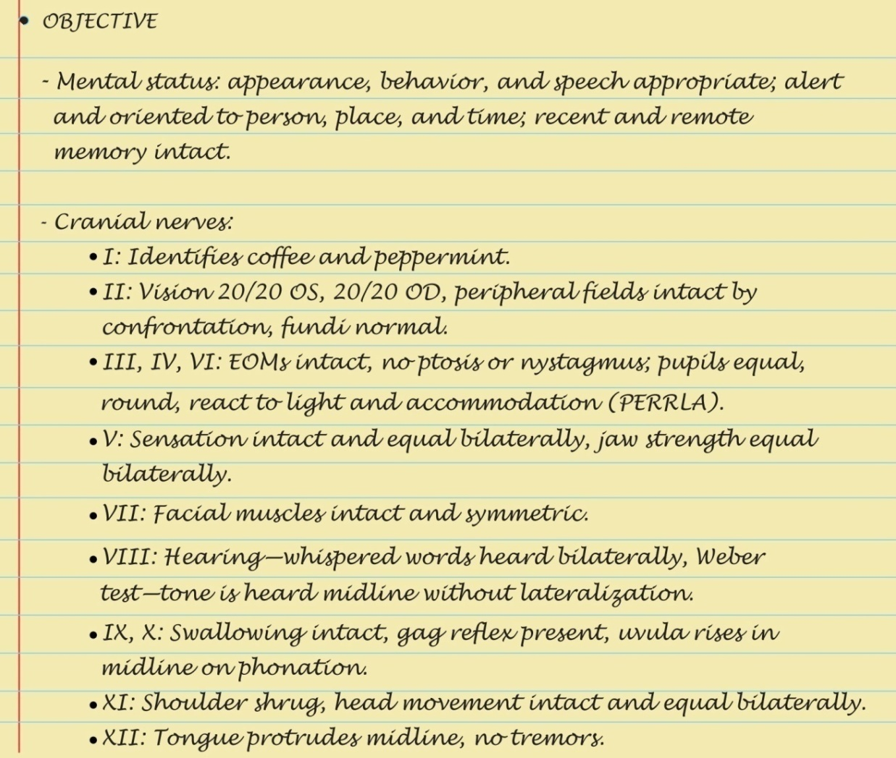
Sample Charting: Objective I

Slide 93
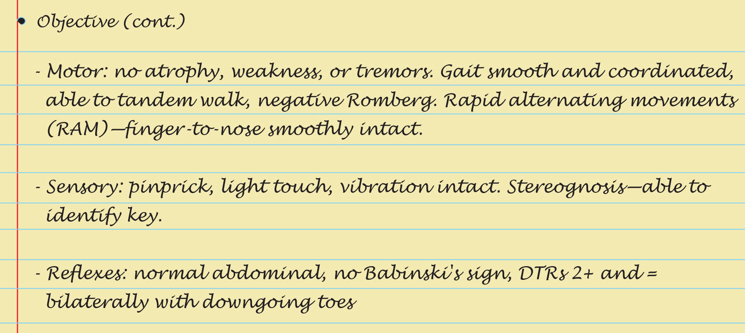
Sample Charting: Objective II

Slide 94
Question
The nurse is assessing a patient’s neurologic status and finds that the patient is aware of his name but does not know what the date or time of the day. How would the nurse best document this finding?
Awake, alert, and oriented times three
Awake, alert, and oriented times two
Awake, alert, and oriented times one
Awake, alert, and oriented times one, to person only
Notes:
The correct answer is 4. This answer is the best answer because it denotes which specific orientation.
Answer 1 is incorrect because the patient is not oriented times three.
Answer 2 is incorrect because the patient is not oriented times two.
Answer 3 is a correct statement; however, this is not the best way to document this patient’s orientation because the specific orientation is not noted. For example, the patient could be oriented to place or time.

Slide 95
Abnormalities in Cranial Nerves I
CN I, olfactory nerve
Anosmia
CN II, optic nerve
Defect or absent central vision
Defect in peripheral vision, hemianopsia
Absent light reflex
Papilledema
Optic atrophy
Retinal lesions

Slide 96
Abnormalities in Cranial Nerves II
CN III, oculomotor nerve
Dilated pupil, ptosis, eye turns out and slightly down
Failure to move eye up, in, down
Absent light reflex
CN IV, trochlear nerve
Failure to turn eye down or out
CN V, trigeminal nerve
Absent touch and pain, paresthesias
No blink
Weakness of masseter or temporalis muscles

Slide 97
Abnormalities in Cranial Nerves III
CN VI, abducens nerve
Failure to move laterally, diplopia on lateral gaze
CN VII, facial nerve
Absent or asymmetric facial movement
Loss of taste
CN VIII, acoustic nerve
Decrease or loss of hearing
CN IX, glossopharyngeal nerve
No Gag Reflex

Slide 98
Abnormalities in Cranial Nerves IV
CN X, vagus nerve
Uvula deviates to side
No gag reflex
Voice quality:
Hoarse or brassy, nasal twang or husky
Dysphagia, fluids regurgitate through nose
CN XI, spinal accessory nerve
Absent movement of sternomastoid or trapezius muscles
CN XII, hypoglossal nerve
Tongue deviates to side
Slowed rate of tongue movement

Slide 99
Abnormalities in Muscle Tone
Flaccidity
Spasticity
Rigidity
Cogwheel rigidity

Slide 100
Abnormalities in Muscle Movement
Paralysis
Fasciculations
Tic
Myoclonus
Seizure disorder
Tremor
Rest tremor
Intention tremor
Chorea
Athetosis

Slide 101
Abnormal Gaits
Spastic hemiparesis
Cerebellar ataxia
Parkinsonian (festinating)
Scissors
Steppage or footdrop
Waddling
Short leg

Slide 102
Common Patterns of Motor System Dysfunction
Cerebral palsy
Muscular dystrophy
Hemiplegia
Parkinsonism
Cerebellar
Paraplegia
Multiple sclerosis

Slide 103
Common Patterns of Sensory Loss I
Peripheral neuropathy
Loss of sensation involves all modalities; loss most severe distally at feet and hands
Individual nerves or roots
Decrease or loss of all sensory modalities; corresponds to distribution of involved nerve
Spinal cord hemisection (Brown-Séquard syndrome)
Loss of pain and temperature, contralateral side, loss of vibration and position discrimination on ipsilateral side

Slide 104
Common Patterns of Sensory Loss II
Complete transection of spinal cord
Complete loss of all sensory modalities below level of lesion; associated with motor paralysis and loss of sphincter control
Thalamus
Loss of all sensory modalities on face, arm, and leg; contralateral to lesion
Cortex
Loss of discrimination on contralateral side; loss of graphesthesia, stereognosis, recognition of shapes and weights, finger finding

Slide 105
Abnormal Postures I
Decorticate rigidity
Upper extremities
Flexion of arm, wrist, and fingers
Adduction of arm: tight against thorax
Lower extremities
Extension, internal rotation, plantar flexion; indicates hemispheric lesion of cerebral cortex
Decerebrate rigidity
Upper extremities: stiffly extended, adducted, internal rotation, palms pronated
Lower extremities: stiffly extended, plantar flexion; teeth clenched; hyperextended back
More ominous than decorticate rigidity; indicates lesion in brain stem at midbrain or upper pons

Slide 106
Abnormal Postures II
Flaccid quadriplegia
Complete loss of muscle tone and paralysis of all four extremities, indicating nonfunctional brain stem
Opisthotonos
Prolonged arching of back, with head and heels bent backward; indicates meningeal irritation

Slide 107
Summary Checklist: Neurologic Examination
Screening and Complete
Mental status
Cranial nerves
Motor function
Sensory function
Reflexes

