Slide 1
Male Genitourinary System
Chapter 24
Notes:
Edition Change: The title of this chapter has been changed from “Male Genitalia”

Slide 2
Male Genitourinary System
Male genital structures include:
  External
    Penis and scrotum
  Internal
    Testis, epididymis, and vas deferens
  Glandular structures accessory to genital organs:
    Prostate, seminal vesicles, and bulbourethral glands

Slide 3
Penis
Composed of three cylindrical columns of erectile tissue:
  Two corpora cavernosa on dorsal side
  Corpus spongiosum ventrally
Glans: at distal end of shaft corpus spongiosum expands into cone of erectile tissue
  Corona: shoulder where glans joins shaft
Urethra transverses corpus spongiosum, and its meatus forms slit at tip of glans
Foreskin or prepuce forms hood or flap over glans
  Often removed shortly after birth by circumcision
Frenulum: fold of foreskin extending from urethral meatus ventrally

Slide 4
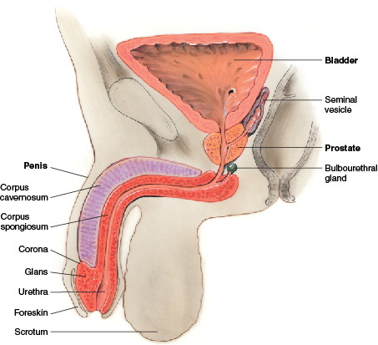
Penis

Slide 5
Scrotum
Loose protective sac; continuation of abdominal wall
After adolescence, scrotal skin deeply pigmented and has large sebaceous follicles
Scrotal wall consists of thin skin lying in folds, or rugae, and underlying cremaster muscle
Cremaster muscle controls size of scrotum by responding to ambient temperature
Septum inside separates sac into halves; in each is a testis, which produces sperm

Slide 6
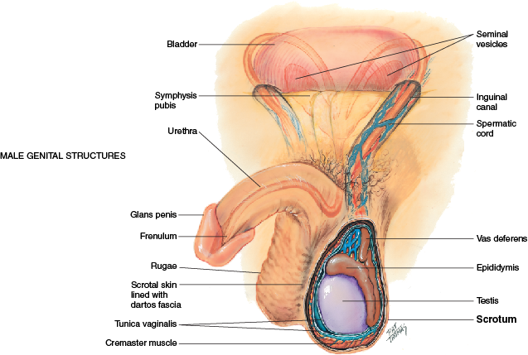
Scrotum

Slide 7
Testes
Have a solid oval shape, suspended vertically by spermatic cord
Left testis is lower because left spermatic cord is longer
Tunica vaginalis: double-layered membrane covers each testis and separates it from scrotal wall
  Layers are lubricated by fluid so that testis can slide within scrotum which helps prevent injury

Slide 8
Sperm & Spermatic Cord
Sperm
  Transported along series of ducts
  Epididymis: markedly coiled duct system and main storage site of sperm; comma-shaped structure, curved over top and posterior surface of testis
  Vas deferens: a muscular duct continuous with lower part of epididymis and with other vessels (arteries and veins, lymphatics, nerves) that forms spermatic cord
Spermatic cord
  Ascends along posterior border of testis and runs through tunnel of inguinal canal into abdomen
  Here, vas deferens continues back and down behind bladder, where it joins duct of seminal vesicle to form ejaculatory duct, which empties into urethra

Slide 9
Lymphatics
Lymphatics of penis and scrotal surface drain into inguinal lymph nodes
Lymphatics of testes drain into abdomen
  Abdominal lymph nodes are not accessible to clinical examination

Slide 10
Inguinal Area or Groin I
  Juncture of lower abdominal wall and thigh
    Knowledge of these anatomic areas is useful because they are potential sites for a hernia, which is a loop of bowel protruding through a weak spot in musculature
  Borders are the anterior superior iliac spine and symphysis pubis
  Between these landmarks lies inguinal ligament
  Inguinal canal lies superior to ligament formed by narrow tunnel passing obliquely between layers of abdominal muscle

Slide 11
Inguinal Area or Groin II
  Inguinal canal is 4 to 6 cm long in adult
  Openings are:
    Internal ring: 1 to 2 cm above midpoint of inguinal ligament
    External ring: above and lateral to pubis
  Femoral canal is inferior to inguinal ligament
    Potential space located 3 cm medial to and parallel with femoral artery
    You can use artery as landmark to find this space

Slide 12
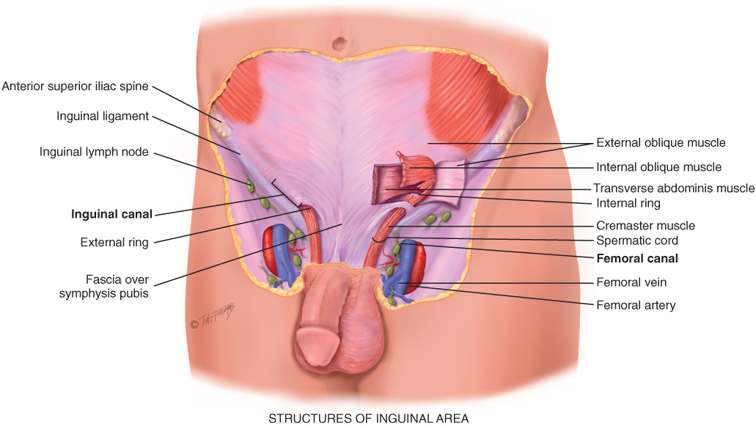
Inguinal Area
Copyright Pat Thomas, 2010.

Slide 13
Developmental Competence: Infants
  Prenatally, testes develop in abdominal cavity near kidneys
    During later months of gestation testes migrate, pushing abdominal wall in front of them and dragging the vas deferens, blood vessels, and nerves behind
    Descend along inguinal canal into scrotum before birth
  At birth, testis measure 1.5 to 2 cm long and 1 cm wide
  Only a slight increase in size occurs during prepubertal years

Slide 14
Developmental Competence: Adolescents
  Signs of puberty are appearing earlier in boys according to research studies at an average age of 9 years in African Americans & age 10 for Caucasians & Hispanics
    First sign is enlargement of testes
    Next, pubic hair appears, then penis size increases
    Stages of development are documented in Tanner’s sexual maturity ratings

Slide 15
Developmental Competence: Adults & Aging Adults
  Male does not experience a definite end to fertility as female does
  Around age 40 years, production of sperm begins to decrease, although it continues into 80s and 90s
  Testosterone production declines after age 30 but continues very gradually so resulting physical changes are not evident until later in life
    Pubic hair decreases and penis size decreases
    Due to decreased tone of dartos muscle, scrotal contents hang lower, rugae decrease, and scrotum becomes pendulous
    Testes decrease in size and are less firm to palpation
    Increased connective tissue is present in tubules, so these become thickened and produce less sperm

Slide 16
Sexual Expression in Later Life I
  Chronologic age by itself should not mean a halt in sexual activity; physical changes need not interfere with libido and sexual pleasure
  Older male is capable of sexual function as long as he is in reasonably good health and has an interested, willing partner
  Danger is in male misinterpreting normal age changes as a sexual failure; once this idea occurs, it may demoralize man and place undue emphasis on performance rather than on pleasure

Slide 17
Sexual Expression Later in Life II
  In the absence of disease, withdrawal from sexual activity may be due to:
    Loss of spouse
    Depression
    Preoccupation with work
    Marital or family conflict
    Side effects of medications
    Heavy use of alcohol
    Lack of privacy, living with adult children or in a nursing home
    Economic or emotional stress
    Poor nutrition or fatigue

Slide 18
Culture & Genetics: Circumcision
  During pregnancy or immediate neonatal period, parents may ask whether or not to circumcise male infant
  There are religious and cultural indications for circumcision, also prevention of phimosis and inflammation of glans penis and foreskin, decreasing incidence of cancer of penis, and slightly decreasing incidence of urinary tract infections in infancy
  Circumcision lowers risk of certain STIs, specifically syphilis, chancroid, and somewhat reduced risk of genital herpes
  Circumcised men have a significantly lowered risk of acquiring genital HPV infection, and their partners have a lower risk of cervical cancer
  Finally, epidemiological studies now suggest a potential reduction in acquisition of HIV in circumcised men

Slide 19
Culture & Genetics: Kidney Disease
Two main causes of ESRD: hypertension & diabetes
Prevalence of diabetes & hypertension is higher in some racial groups: African Americans, American Indians & Hispanics are more likely to be affected
Contributing factors such as low socioeconomic status lead to poor health outcomes by limiting access to care and/or diagnosis/treatment being delayed

Slide 20
Subjective Data Questions I
Frequency, urgency, and nocturia
  Are you urinating more often than usual?
  Do you feel as if you cannot wait to urinate?
  Do you awaken during the night because you need to urinate? How often? Is this a recent change?
    Nocturia occurs with frequency and urgency in urinary tract disorders; other origins include cardiovascular, habitual, diuretic medication
Dysuria
  Any pain or burning with urinating?
    Burning common with acute cystitis, prostatitis, and urethritis

Slide 21
Subjective Data Questions II
Hesitancy and straining
  Do you have any trouble starting urine stream?
  Do you need to strain to start or maintain stream?
  Has there been any change in force of stream?
  Have you experienced dribbling, so that you must stand closer to toilet?
  Afterward, do you still feel you need to urinate?
  Have you ever had any urinary tract infections?
Urine color
  Is usual urine clear or discolored, cloudy, foul-smelling, or bloody?

Slide 22
Subjective Data Questions III
Genitourinary history
  Have you had any difficulty controlling your urine?
    True incontinence: loss of urine without warning
    Urgency incontinence: sudden loss, as in acute cystitis
  Do you accidentally urinate when you sneeze, laugh, cough, or bear down?
  Do you have any history of kidney disease, kidney stones, flank pain, urinary tract infections, or prostate trouble?

Slide 23
Subjective Data Questions IV
Penis
  Have you had any problem with your penis, such as pain or lesions?
    Any discharge? How much? Increased or decreased since start? Color? Odor? Discharge associated with pain or urination?
Scrotum, self-care behaviors
  Any problem with scrotum or testicles?
    Any lumps or swelling on testes? Change in size of scrotum? History of undescended testicle as infant? Any bulge or swelling in scrotum?
    Have you ever been told you have a hernia? Have you had any dragging, heavy feeling in scrotum?

Slide 24
Subjective Data Questions V
Sexual activity and contraceptive use
  Are you in a relationship involving sexual intercourse?
    Are aspects of sex satisfactory to you and your partner?
    Are you satisfied with the way you and your partner communicate about sex?
    Occasionally a man notices a change in ability to have an erection when aroused. Have you noticed any changes?
    Do you and your partner use a contraceptive? Which method? Is this satisfactory? Do you have any questions about this method?

Slide 25
Subjective Data Questions VI
Sexual activity and contraceptive use
  Are you in a relationship involving sexual intercourse?
    At times, phrase your questions so that all is right for person to acknowledge a problem
    How many sexual partners have you had in the last 6 months?
    What is your sexual preference? Do you prefer a relationship with a woman, a man, or both?

Slide 26
STI Contact Questions
Any sexual contact with a partner having an STI, such as gonorrhea, herpes, AIDS, chlamydia, venereal warts, or syphilis?
  When was this contact? Did you get the disease?
  How was it treated? Were there any complications?
  Do you use condoms to help prevent STIs?
  Do you have any questions or concerns about any of these diseases?

Slide 27
Additional History: Infants & Children I
Does your child have any problem urinating? Does his urine stream look straight?
Any pain with urinating, crying, or holding the genitals?
Any urinary tract infections?
  If child older than 2 to 2½ years of age
Has toilet training started? How is it progressing?
If child is 5 years old or older, does he wet bed at night? Is this a problem for child or for parents? What have you done? How does the child feel about it?

Slide 28
Additional History: Infants & Children II
Any problem with child’s penis or scrotum, such as sores, swelling, or discoloration?
Have you been told if his testes are descended?
Has he ever had a hernia or hydrocele?
Does he have any swelling in his scrotum during crying or coughing?
Ask directly to preschooler or young school-age child: Has anyone ever touched your penis or in between your legs and you did not want them to?
  Tell him that sometimes that happens to children and it’s not okay
  They should remember that they have not been bad
  They should try to tell a big person about it
  Can you tell me three different big people you trust who you could talk to?

Slide 29
Additional History: Preadolescents & Adolescents I
  Use the following questions regarding sexual growth and development and sexual behavior
    First ask questions that seem appropriate for boy’s age, but be aware that norms vary widely
    When you are in doubt, it is better to ask too many questions than to omit something
    Children obtain information, often misinformation, from media, internet, and from peers at surprisingly early ages
    Ask direct, matter-of-fact questions; avoid sounding judgmental

Slide 30
Additional History: Preadolescents & Adolescents II
  Start with a permission statement: “Often boys your age experience . . . ” This conveys that it is normal and all right to think or feel a certain way
    Try the ubiquity approach, “When did you . . . ” rather than “Do you . . . ” This method is less threatening because it implies that topic is normal and unexceptional
    Do not be concerned if a boy will not discuss sexuality with you or respond to offers for information
    You do well to “open the door;” adolescents may come back at a future time

Slide 31
Additional History: Preadolescents & Adolescents III
  Around age 12 to 13, but sometimes earlier, boys start to change and grow around penis and scrotum; what changes have you noticed?
    Have you ever seen charts and pictures of normal growth patterns for boys? Let’s go over these now.
    Who can you talk to about your body changes and about sex information? How do these talks go? What about sex education classes at school? How about your parents? Is there a favorite teacher, nurse, doctor, minister, or counselor to whom you can talk?

Slide 32
Additional History: Preadolescents & Adolescents IV
  Boys around age 12 to 13 have normal experience of fluid coming out of penis at night, called nocturnal emissions, or “wet dreams”
    Have you had this?
    Teenage boys wonder if they are only ones who ever had them, like having an erection at embarrassing times, having sexual fantasies, or masturbating
    Boys might have thoughts about touching another boy’s genitals and wonder if he might be homosexual
    Would you like to talk about any of these things?

Slide 33
Additional History: Preadolescents & Adolescents V
  Often boys your age have questions about sexual activity
    What questions do you have? How about things like birth control, or STIs such as gonorrhea or herpes? Do you have any questions about these?
    Are you dating? Someone steady? Have you had intercourse? Are you using birth control?
    What kind of birth control do you use?
    Has a nurse or doctor ever taught you how to examine your own testicles to make sure they are healthy?

Slide 34
Additional History: Preadolescents & Adolescents VI
  Has anyone ever touched your genitals and you did not want them to?
    Another boy, or an adult, even a relative?
    Sometimes that happens to teenagers
    You should remember it is not your fault and you should tell another adult about it

Slide 35
Question
The nurse is obtaining a sexual history from an adolescent male. Which of the following
would be the best way to begin the sexual history interview?
Often young men your age…
I worry that you might…
Do you…
You don’t…do you?
Notes:
The correct answer is 1.
Answers 2 and 4 are incorrect because they convey a judgmental attitude.
Answer 3 is incorrect because it should be “When you…”

Slide 36
Additional History: Aging Adult
  Any difficulty urinating?
    Have you experienced any hesitancy or straining, a weakened force of stream, dribbling, or incomplete emptying?
  Do you ever leak water or urine when you don’t want to?
    Do you use pads/tissue to catch urine in your underwear?
  Do you need to get up at night to urinate?
    What medications are you taking? What fluids do you drink in the evening?

Slide 37
Objective Data: Preparation I
  Position male standing with underwear down and appropriate draping
    Examiner should be sitting; alternatively, male may be supine for first part of examination and stand for hernia check
    It is normal for a male to feel apprehensive about having his genitalia examined, especially by a female examiner
    Younger adolescents usually have more anxiety than older adolescents
    But any male may have difficulty dissociating a necessary, matter-of-fact step in physical examination from feeling this is an invasion of his privacy

Slide 38
Objective Data: Preparation II
  Concerns are similar to those experienced by female during examination of genitalia
    Modesty, fear of pain, cold hands, negative judgment, or memory of previously uncomfortable examinations
    Additionally, he may fear comparison to others, or fear having an erection during examination that would be misinterpreted by examiner
    Apprehension becomes manifested in different behaviors
      Many act resigned or embarrassed and may avoid eye contact
      Occasional man will laugh and make jokes to cover embarrassment; also man may refuse examination by female and may insist on male examiner

Slide 39
Objective Data: Preparation III
  Take time to consider these feelings, as well as to explore your own
    You may feel embarrassed and apprehensive too
    You may worry about your age, lack of clinical experience, causing pain, or even that your movements might “cause” an erection
    Some examiners feel guilty when this occurs; you need to accept these feelings and work through them so that you can examine the male in a professional way
      Discuss these concerns with an experienced examiner
      Your demeanor is important; your unresolved discomfort magnifies any discomfort the man may have

Slide 40
Objective Data: Preparation IV
  Your demeanor should be confident and relaxed
    Do not discuss genitourinary history or sexual practices while you are performing examination as it may be perceived as judgmental
  Use a firm deliberate touch, not soft, stroking one
    If erection does occur, do not stop the examination or leave the room; this only focuses more attention on the erection and increases embarrassment
    Reassure the male that this is only a normal physiologic response to touch
    Proceed with the rest of examination

Slide 41
Objective Data: Equipment
  Gloves: wear gloves during every male genitalia examination
  Occasionally may require glass slide for urethral specimen
  Materials for cytology
  Flashlight

Slide 42
Inspection & Palpation: Penis I
  Skin normally looks wrinkled, hairless, and without lesions; dorsal vein may be apparent
  Glans looks smooth and without lesions; ask uncircumcised male to retract foreskin, or you retract it; it should move easily
    Some cheesy smegma may have collected under foreskin; after inspection, slide foreskin back to original position
  Urethral meatus positioned just about centrally

Slide 43
Inspection & Palpation: Penis II
  Compress glans anteroposteriorly between your thumb and forefinger; meatus edge should appear pink, smooth, and without discharge
    If you note urethral discharge, collect smear for microscopic examination and culture
    If no discharge shows but person gives history of it, ask him to milk shaft of penis; this should produce a drop of discharge
    Palpate shaft of penis between your thumb and first two fingers
    Normally, penis feels smooth, semifirm, and nontender

Slide 44
Inspection & Palpation: Scrotum I
  Inspect scrotum as male holds penis out of the way; alternatively, you hold penis out of the way with back of your hand
    Scrotal size varies with ambient room temperature; asymmetry is normal, with left scrotal half usually lower than right
    Spread rugae out between your fingers; lift sac to inspect posterior surface; normally, no scrotal lesions are present, except commonly found sebaceous cysts; these are yellowish, 1-cm nodules that are firm, nontender, and often multiple

Slide 45
Inspection & Palpation: Scrotum II
  Palpate gently each scrotal half between your thumb and first two fingers
    Scrotal contents should slide easily; testes normally feel oval, firm and rubbery, smooth, and equal bilaterally, and are freely movable and tender to moderate pressure
    Each epididymis normally feels discrete, softer than testis, smooth, and nontender
  Palpate each spermatic cord between your thumb and forefinger, along its length from epididymis up to external inguinal ring
    You should feel a smooth, nontender cord

Slide 46
Inspection & Palpation: Scrotum III
  Normally, no other scrotal contents are present; if you find a mass, note:
    Is there any tenderness?
    Is the mass distal or proximal to testis?
    Can you place your fingers over it?
    Does it reduce when person lies down?
    Can you auscultate bowel sounds over it?
  Transillumination
    Perform this maneuver only if you note swelling or mass
      Darken room; shine flashlight from behind scrotal contents
      Normal scrotal contents do not transilluminate

Slide 47
Inspection & Palpation: Hernia
  Inspect inguinal region for bulge as person stands and strains down; normally none is present
  Palpate inguinal canal
    For right side, ask male to shift his weight onto left leg
    Place your right index finger low on right scrotal half
    Palpate up length of spermatic cord, invaginating scrotal skin as you go, to the external inguinal ring
      It feels like a triangular slitlike opening, if it will admit your finger, gently insert it into canal and ask person to “bear down;” normally you feel no change
      Repeat procedure on the left side
  Palpate femoral area for a bulge
    Normally you feel none

Slide 48
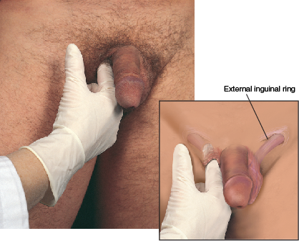
Inspect and palpate for hernia

Slide 49
Palpation of Inguinal Lymph Nodes
  Palpate horizontal chain along groin inferior to inguinal ligament and vertical chain along upper inner thigh
  Normal to palpate an isolated node on occasion; it then feels small, 1 cm, soft, discrete, and movable
    Enlarged, hard, matted, fixed nodes are abnormal findings

Slide 50
Testicular Self-Examination (TSE)
  Encourage self-care by teaching every male from 13 to 14 years old through adulthood how to examine his own testicles
    Overall incidence of testicular cancer is still rare, but testicular cancer most commonly occurs in young men age 15 to 35
  Early detection of cancer enhanced if male is familiar with his normal consistency
  Points to include during health teaching are:
    T - timing, once a month
    S - shower, warm water relaxes scrotal sac
    E - examine, check for and report changes immediately

Slide 51
TSE Teaching Points
  Phrase your teaching something like this:
    A good time to examine testicles is during shower or bath, when your hands are warm and soapy and scrotum is warm; cold hands retract scrotal contents
    Procedure is simple; hold scrotum in palm of your hand and gently feel testicles using thumb and first two fingers
    Testicle is egg-shaped and movable; it feels rubbery with a smooth surface
    Abnormal lumps are very rare and usually not worrisome, but if you ever notice a firm, painless lump, a hard area, or an overall enlarged testicle, call your physician for further check

Slide 52
Question
The nurse is reviewing the importance of testicular self-examination (TSE) with a 17-year-old male. Which statement by the patient confirms the patient’s understanding of TSE?
“I will check my testicles for lumps in the shower.”
“I will bear down and check my groin area while seated.”
“I will check my testicles while lying on my right side.”
“I will have my testicles examined by my health care provider every year.”
Notes:
The correct answer is 1. Examining the testicles for lumps in the shower is the proper technique for TSE.
Answers 2, 3, and 4 are incorrect because they do not assist with detecting testicular cancer.

Slide 53
Assessment of Urinary Function
Observe urine color
Note pH & specific gravity
Serum analysis of kidney function correlates with creatinine level which is relatively stable (end product of muscle metabolism)
BUN measures urea which can vary based on several factors (end product of protein metabolism)

Slide 54
Developmental Competence: Infants & Children I
  Perform this procedure right after abdominal examination
  In preschool-age to young school-age child, 3 to 8 years of age, leave underpants on until just before examination
  In an older school-age child or adolescent, offer an extra drape, as with adult; reassure child and parents of normal findings

Slide 55
Developmental Competence: Infants & Children II
  Inspect penis and scrotum
    Penis size usually small in infants and in young boys until puberty
    In obese boy, penis looks even smaller because of folds of skin covering base
    In circumcised infant, glans looks smooth with meatus centered at tip
    While child wears diapers, meatus may be ulcerated from ammonia irritation; more common in circumcised infants
    If possible, observe newborn’s first voiding to assess strength and direction of stream

Slide 56
Developmental Competence: Infants & Children III
  Inspect penis and scrotum
    If uncircumcised, foreskin normally tight during first 3 months and should not be retracted because of risk of tearing membrane attaching foreskin to shaft
      This leads to scarring and possibly to adhesions later in life
      In infants older than 3 months of age, retract foreskin gently to check glans and meatus; it should return to its original position easily
    Scrotum looks pink in white infants and dark brown in dark-skinned infants
    Rugae well formed in full-term infant

Slide 57
Developmental Competence: Infants & Children IV
  Inspect penis and scrotum
    Scrotum size varies with ambient temperature, but overall, infant’s scrotum looks large in relation to penis
      No bulges, either constant or intermittent, are present
  Palpate scrotum and testes
    Cremasteric reflex is strong in infant, pulling testes up into inguinal canal and abdomen from exposure to cold, touch, exercise, or emotion; take care not to elicit reflex
      Keep your hands warm and palpate from external inguinal ring down
      Block inguinal canals with thumb and forefinger of your other hand to prevent testes from retracting

Slide 58
Developmental Competence: Infants & Children V
  Inspect penis and scrotum
    Normally, testes are descended and are equal in size bilaterally
    Important to document that you have palpated testes
      Once palpated, they are considered descended, even if they have retracted momentarily at next visit
    If scrotal half feels empty, search for testes along inguinal canal and try to milk them down
    Ask toddler or child to squat with knees flexed up; this pressure may force the testes down; or have child sit cross-legged to relax reflex

Slide 59
Developmental Competence: Infants & Children VI
  Inspect penis and scrotum
    Migratory testes, physiologic cryptorchidism, is common because of strength of cremasteric reflex and small mass of prepubertal testes
    Note that affected side has normally developed scrotum; these testes descend at puberty and are normal
      With true cryptorchidism, the scrotum is atrophic
    Palpate epididymis and spermatic cord as described in adult section

Slide 60
Developmental Competence: Infants & Children VII
  Inspect penis and scrotum
    Common scrotal finding in boy under 2 is a hydrocele, or fluid in scrotum; appears as a large scrotum and transilluminates as faint pink glow
    Usually disappears spontaneously
  Inspect inguinal area for a bulge
    If parent gives a positive history of one, try to elicit it by increasing intraabdominal pressure
    Ask boy to hold his breath and strain down or have him blow up a balloon
    If a hernia is suspected, palpate inguinal area
    Use your little finger to reach external inguinal ring

Slide 61
Developmental Competence: Adolescent
  Adolescents show wide variation in normal development of genitals
  Using SMR charts, note:
    Enlargement of testes and scrotum
    Pubic hair growth
    Darkening of scrotal color
    Roughening of scrotal skin
    Increase in penis length and width
    Axillary hair growth
  Be familiar with normal sequence of growth

Slide 62
Developmental Competence: Aging Adult
  In older male, you may note thinner, graying pubic hair and decreased size of penis
  Size of testes may be decreased and may feel less firm
  Scrotal sac pendulous with less rugae
  Scrotal skin may become excoriated if man continually sits on it

Slide 63
Promoting a Healthy Lifestyle: Prostate Cancer
  Discussion of prostate health and examination of prostate gland is a unique aspect of male health assessment
    Gradual enlargement of prostate gland considered to be normal part of aging
    Enlargement termed benign prostatic hypertrophy, or BPH; it does not raise an individual’s risk for prostate cancer, yet symptoms for BPH and prostate cancer can be very similar

Slide 64
Prostate Cancer Testing
  Prostate cancer typically detected by testing blood for prostate-specific antigen (PSA) and/or on digital rectal examination (DRE)
    US Preventative Task Force Recommendation Statement of PSA Screening – May 2012 - shift in paradigm assessing relative benefits versus risks of PSA screening tests
    Men at higher risk for developing prostate cancer, such as African Americans and/or men who have a first-degree relative (father, brother, or son) diagnosed with prostate cancer at an early age (younger than 65) should be offered testing earlier

Slide 65
Prostate Gland
  PSA made by normal prostate gland
    When prostate cancer develops, PSA levels increase
    But, benign or noncancerous enlargement of prostate (BPH), age, and prostatitis can cause PSA to increase
    The DRE involves a gloved, lubricated finger being inserted into rectum

Slide 66
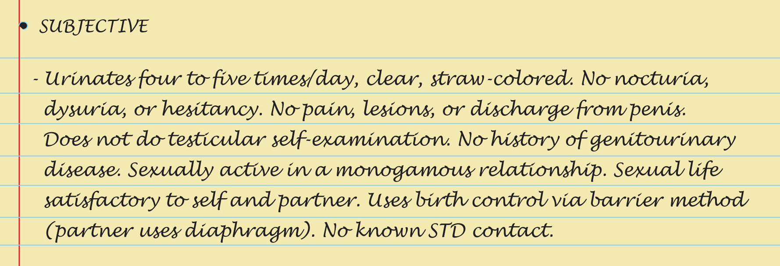

Sample Charting: Subjective & Objective

Slide 67
Abnormal Findings: Male Genital Lesions I
Genital herpes, HSV-2 infection
Syphilitic chancre
Genital warts, human papillomavirus (HPV)
Carcinoma
  Begins as red, raised warty growth or as an ulcer, with watery discharge
  As it grows, may necrose and slough
  Usually painless; almost always on glans or inner lip of foreskin and following chronic inflammation; enlarged lymph nodes are common

Slide 68
Abnormal Findings: Male Genital Lesions II
Urethritis, urethral discharge, and dysuria
  Infection of urethra, painful burning urination
    Meatus edges are reddened, everted, and swollen; purulent urethral discharge is present; urine cloudy with discharge and mucous shreds
  Cause determined by culture
    Gonococcal urethritis has thick, profuse, yellow or gray-brown discharge
    Nonspecific urethritis (NSU) may have similar discharge but often has scanty, mucoid discharge
    About 50% are caused by chlamydia infection
      Important to differentiate as antibiotic treatment differs

Slide 69
Abnormal Findings: Urinary Problems
Renal calculi
Acute urinary retention
Urethral stricture

Slide 70
Abnormal Findings: Abnormalities of the Penis
Phimosis
Paraphimosis
Hypospadias
Epispadias
Peyronie’s disease
Priapism

Slide 71
Abnormal Findings:
Abnormalities in the Scrotum
Absent testis, cryptorchidism
Small testis
Testicular torsion
Epididymitis
Spermatic cord varicocele
Spermatocele
Early testicular tumor
Diffuse tumor
Hydrocele
Scrotal hernia
Orchitis
Scrotal edema

Slide 72
Abnormal Findings:
Inguinal and Femoral Hernias I
Indirect inguinal hernia
  Sac herniates through internal inguinal ring; can remain in canal or pass into scrotum
  Pain with straining; soft swelling that increases with increased intraabdominal pressure; may decrease when lying down
  Most common; 60% of all hernias; more common in infants less than 1 year old and in males 16 to 20 years old
  Congenital or acquired

Slide 73
Abnormal Findings:
Inguinal and Femoral Hernias II
Direct inguinal hernia
  Directly behind and through external inguinal ring, above inguinal ligament; rarely enters scrotum
  Usually painless; round swelling close to pubis in area of internal inguinal ring; easily reduced when supine
  Less common, occurs most often in men over 40 age, rare in women
  Acquired weakness; brought on by heavy lifting, muscle atrophy, obesity, chronic cough, or ascites

Slide 74
Abnormal Findings:
Inguinal and Femoral Hernias III
Femoral hernia
  Through femoral ring and canal, below inguinal ligament, more often on right side
  Pain may be severe, may become strangulated
  Least common, 4% of all hernias; but more common in women
  Acquired; due to increased abdominal pressure, muscle weakness, or frequent stooping

Slide 75
Summary Checklist: Male Genitourinary System
Inspect & palpate the penis
Inspect & palpate the scrotum
If a mass exists, try to transilluminate it
Palpate for an inguinal hernia
Palpate the inguinal lymph nodes

