Slide 1
Chapter 25
Anus, Rectum, and Prostate

Slide 2
Structure and Function: Anal Canal I
Outlet of gastrointestinal tract; lined with modified skin; no hair or sebaceous glands
Contains only autonomic nerves, but numerous somatic sensory nerves present in anal canal and external skin, so one feels sharp pain with trauma to anal area
Surrounded by two concentric layers of muscle, the sphincters
Internal sphincter under involuntary control by autonomic nervous system
External sphincter surrounds internal sphincter but also has small section overriding tip of internal sphincter at opening

Slide 3
Structure and Function: Anal Canal II
Under voluntary control; except for passing feces and gas, sphincters keep anal canal tightly closed
Intersphincteric groove separates internal and external sphincters and is palpable
Anal columns, or columns of Morgagni, are folds of mucosa; extend vertically down from rectum and end in anorectal junction, also called mucocutaneous junction, pectinate, or dentate line; junction is not palpable, but it is visible on proctoscopy; each anal column contains an artery and a vein
Under conditions of chronic increased venous pressure, vein may enlarge, forming a hemorrhoid

Slide 4
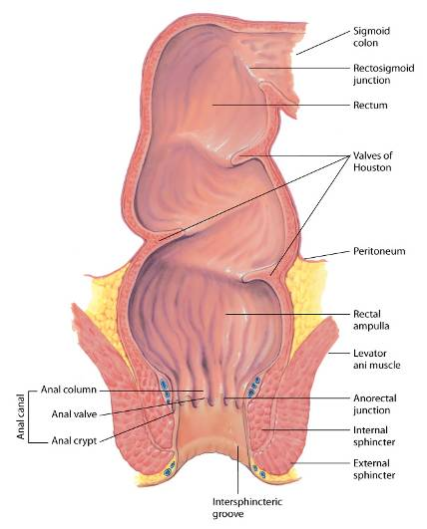
Anus and Rectum

Slide 5
Structure and Function: Rectum
Rectum is distal portion of large intestine
It extends from sigmoid colon, at level of third sacral vertebra, and ends at anal canal
Just above anal canal, rectum dilates and turns posteriorly, forming rectal ampulla
Rectal interior has three semilunar transverse folds, called valves of Houston
These cross one-half circumference of rectal lumen
Lowest within reach of palpation and must not be mistaken for an intrarectal mass

Slide 6
Structure and Function: Peritoneal Reflection
Peritoneum covers only upper two thirds of rectum
In male, anterior part of peritoneum reflects down to anal opening, forming rectovesical pouch and then covers bladder
In female, it is termed the rectouterine pouch

Slide 7
Prostate Gland
Lies in front of anterior wall of rectum and 2 cm behind symphysis pubis
Surrounds bladder neck and urethra and has 15 to 30 ducts that open into urethra
Two seminal vesicles project above prostate
Secrete a fluid rich in fructose, which nourishes sperm, and contains prostaglandins
Two bulbourethral Cowper’s glands located inferior to prostate on either side of urethra secrete a clear, viscid mucus

Slide 8
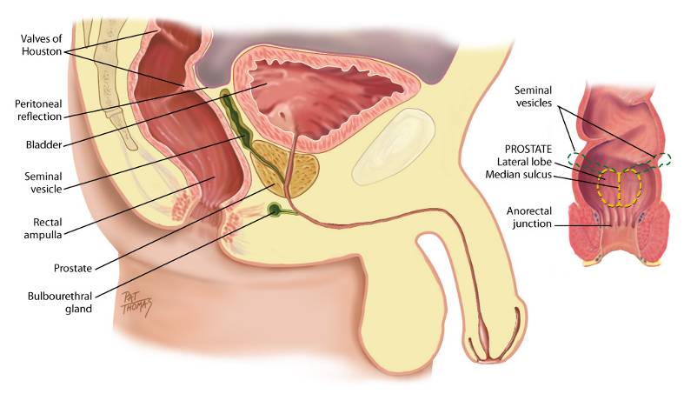
Anatomy of the Prostate Gland and Seminal Vesicles

Slide 9
Regional Structures
Uterine cervix, in females, lies in front of anterior rectal wall and may be palpated through it
Combined length of anal canal and rectum is about 16 cm in adult
Sigmoid colon, S-shaped course in pelvic cavity
Extends from iliac flexure of descending colon and ends at rectum; accessible to examination only with colonoscope
Flexible fiberoptic scope in current use provides view of entire mucosal surface of sigmoid, as well as colon

Slide 10
Developmental Competence
Infants
First stool passed by newborn is dark green meconium; occurs within 24 to 48 hours of birth, indicates anal patency
From then on, infant usually has stool after each feeding
Gastrocolic reflex: wave of peristalsis in response to eating
Infant passes stools by reflex
Children and adults
At male puberty, prostate gland undergoes a very rapid increase to more than twice its prepubertal size; during young adulthood size remains fairly constant
Prostate gland commonly starts to enlarge during middle adult years; increases with age
Thought that hypertrophy caused by hormonal imbalance leading to proliferation of benign adenomas, which gradually impede urine output because they obstruct urethra

Slide 11
Culture and Genetics: Prostate Cancer
More common in North America and northwestern Europe; less common in Central and South Americas, Africa, and Asia
Incidence higher for black men than other racial groups, and more likely to be diagnosed at advanced stage
Mortality rates are two times higher for black men
Diets heavy in red meat or high-fat dairy products may be factor
Some evidence suggests that prostate cancer may increase with obesity

Slide 12
Culture and Genetics: Prostate and Colorectal Cancer
Prostate cancer
Screening recommendations vary for racial groups
Men at high risk, black men, and men with first-degree relative with disease should begin screening at age 45
Colorectal cancer also has racial variation
Incidence in black women and men is almost 20% higher than in white women and men
Mortality is 50% higher in black men and women than in white men and women

Slide 13
Subjective Data Questions
Usual bowel routine
Change in bowel habits
Rectal bleeding, blood in stool
Medications: laxatives, stool softeners, iron
Rectal conditions: pruritus, hemorrhoids, fissure, fistula
Family history
Self-care behaviors: diet of high-fiber foods, most recent examinations
Notes:
Usual bowel routine: Bowels move regularly? How often? Usual color? Hard or soft? Pain while passing a bowel movement?
Change in bowel habits: Any change in usual bowel habits? Loose stools or diarrhea? When did this start? Is the diarrhea associated with nausea and vomiting, abdominal pain, something you ate recently?
Rectal bleeding, blood in the stool: Ever had black or bloody stools? When did you first notice blood in the stools? What is the color, bright red or dark red-black? How much blood: spotting on the toilet paper or outright passing of blood with the stool? Do the bloody stools have a particular smell?
Medications: What medications do you take—prescription and over-the-counter? Laxatives or stool softeners? Which ones? How often? Iron pills? Do you ever use enemas to move your bowels? How often?
Rectal conditions: Any problems in rectal area: itching, pain or burning, hemorrhoids? How do you treat these? Any hemorrhoid preparations? Ever had a fissure, or fistula? How was this treated?
Family history: Any family history of polyps or cancer in colon or rectum, inflammatory bowel disease, prostate cancer?
Self-care behaviors: What is the usual amount of high-fiber foods in your daily diet: cereals, apples or other fruits, vegetables, whole-grain breads? How many glasses of water do you drink each day?

Slide 14
Usual Bowel Routine Questions
Do your bowels move regularly? How often? What is the usual color? Are they hard or soft? Any straining at stool; incomplete evacuation; or urge to go but nothing comes? Any pain with bowel movement?
Has there been any change in bowel habits? Any diarrhea? When did this start? Is it associated with nausea and vomiting, abdominal pain, or something you ate recently?
Have you eaten at a restaurant recently? Did anyone else in your group or family have the same symptoms?
Notes:
Usual bowel routine: Bowels move regularly? How often? Usual color? Hard or soft? Pain while passing a bowel movement?
Change in bowel habits: Any change in usual bowel habits? Loose stools or diarrhea? When did this start? Is the diarrhea associated with nausea and vomiting, abdominal pain, something you ate recently?
Rectal bleeding, blood in the stool: Ever had black or bloody stools? When did you first notice blood in the stools? What is the color, bright red or dark red-black? How much blood: spotting on the toilet paper or outright passing of blood with the stool? Do the bloody stools have a particular smell?
Medications: What medications do you take—prescription and over-the-counter? Laxatives or stool softeners? Which ones? How often? Iron pills? Do you ever use enemas to move your bowels? How often?
Rectal conditions: Any problems in rectal area: itching, pain or burning, hemorrhoids? How do you treat these? Any hemorrhoid preparations? Ever had a fissure, or fistula? How was this treated?
Family history: Any family history of polyps or cancer in colon or rectum, inflammatory bowel disease, prostate cancer?
Self-care behaviors: What is the usual amount of high-fiber foods in your daily diet: cereals, apples or other fruits, vegetables, whole-grain breads? How many glasses of water do you drink each day?

Slide 15
Rectal Bleeding Questions
Is there blood in your stool? Have you ever had black or bloody stools? When did you first notice blood in the stools? Is color bright red or dark red-black? How much blood was there? Was it spotting on toilet paper or outright passing of blood with stool? Do bloody stools have a particular smell?
Have you ever had clay-colored stools?
Have you ever had mucus or pus in stool?
Have you ever had frothy stool?
Do you need to pass gas frequently?
Notes:
Usual bowel routine: Bowels move regularly? How often? Usual color? Hard or soft? Pain while passing a bowel movement?
Change in bowel habits: Any change in usual bowel habits? Loose stools or diarrhea? When did this start? Is the diarrhea associated with nausea and vomiting, abdominal pain, something you ate recently?
Rectal bleeding, blood in the stool: Ever had black or bloody stools? When did you first notice blood in the stools? What is the color, bright red or dark red-black? How much blood: spotting on the toilet paper or outright passing of blood with the stool? Do the bloody stools have a particular smell?
Medications: What medications do you take—prescription and over-the-counter? Laxatives or stool softeners? Which ones? How often? Iron pills? Do you ever use enemas to move your bowels? How often?
Rectal conditions: Any problems in rectal area: itching, pain or burning, hemorrhoids? How do you treat these? Any hemorrhoid preparations? Ever had a fissure, or fistula? How was this treated?
Family history: Any family history of polyps or cancer in colon or rectum, inflammatory bowel disease, prostate cancer?
Self-care behaviors: What is the usual amount of high-fiber foods in your daily diet: cereals, apples or other fruits, vegetables, whole-grain breads? How many glasses of water do you drink each day?

Slide 16
Medication Questions
What medications do you take, including prescriptions and over-the-counter medications? Do you take laxatives or stool softeners? Which ones? How often? Do you take iron pills? Do you ever use enemas to move your bowels? How often?
Notes:
Usual bowel routine: Bowels move regularly? How often? Usual color? Hard or soft? Pain while passing a bowel movement?
Change in bowel habits: Any change in usual bowel habits? Loose stools or diarrhea? When did this start? Is the diarrhea associated with nausea and vomiting, abdominal pain, something you ate recently?
Rectal bleeding, blood in the stool: Ever had black or bloody stools? When did you first notice blood in the stools? What is the color, bright red or dark red-black? How much blood: spotting on the toilet paper or outright passing of blood with the stool? Do the bloody stools have a particular smell?
Medications: What medications do you take—prescription and over-the-counter? Laxatives or stool softeners? Which ones? How often? Iron pills? Do you ever use enemas to move your bowels? How often?
Rectal conditions: Any problems in rectal area: itching, pain or burning, hemorrhoids? How do you treat these? Any hemorrhoid preparations? Ever had a fissure, or fistula? How was this treated?
Family history: Any family history of polyps or cancer in colon or rectum, inflammatory bowel disease, prostate cancer?
Self-care behaviors: What is the usual amount of high-fiber foods in your daily diet: cereals, apples or other fruits, vegetables, whole-grain breads? How many glasses of water do you drink each day?

Slide 17
Rectal Condition Questions
Do you have any problems in rectal area, such as itching, pain or burning, or hemorrhoids? How do you treat these? Do you use any hemorrhoid preparations? Have you ever had a fissure or fistula? How was this treated?
Have you ever had a problem controlling your bowels?

Slide 18
FMH and Self-Care Behaviors
Family history
Do you have a family history of polyps or cancer in colon or rectum, inflammatory boel disease, or prostate cancer?
Self-care behaviors
Usual amount of high-fiber foods in your daily diet, such as cereals, apples or other fruits, vegetables, and whole-grain breads? Glasses of water each day?
What were the dates of last digital rectal examination, stool blood test, and colonoscopy? Men: When was your most recent PSA blood test?
Notes:
Usual bowel routine: Bowels move regularly? How often? Usual color? Hard or soft? Pain while passing a bowel movement?
Change in bowel habits: Any change in usual bowel habits? Loose stools or diarrhea? When did this start? Is the diarrhea associated with nausea and vomiting, abdominal pain, something you ate recently?
Rectal bleeding, blood in the stool: Ever had black or bloody stools? When did you first notice blood in the stools? What is the color, bright red or dark red-black? How much blood: spotting on the toilet paper or outright passing of blood with the stool? Do the bloody stools have a particular smell?
Medications: What medications do you take—prescription and over-the-counter? Laxatives or stool softeners? Which ones? How often? Iron pills? Do you ever use enemas to move your bowels? How often?
Rectal conditions: Any problems in rectal area: itching, pain or burning, hemorrhoids? How do you treat these? Any hemorrhoid preparations? Ever had a fissure, or fistula? How was this treated?
Family history: Any family history of polyps or cancer in colon or rectum, inflammatory bowel disease, prostate cancer?
Self-care behaviors: What is the usual amount of high-fiber foods in your daily diet: cereals, apples or other fruits, vegetables, whole-grain breads? How many glasses of water do you drink each day?

Slide 19
Question
A patient presents to the emergency department nurse with bright red rectal bleeding. The nurse knows that the most common cause for this is:
stomach cancer.
rectal fistula.
urinary tract infection.
hemorrhoids.
Notes:
The correct answer is 4. Hemorrhoids usually present with bright red bleeding.
Answer 1 is incorrect because stomach cancer does not usually present with rectal bleeding.
Answer 2 is incorrect because rectal fistula is not the most common cause of bright red bleeding.
Answer 3 is incorrect because a urinary tract infection does not present with rectal bleeding.

Slide 20
Additional History: Infants and Children
Have you ever noticed any irritation in your child’s anal area, such as redness, raised skin, or frequent itching?
How are your child’s bowel movements? How frequent are they? Are there any problems or pain or straining with bowel movement?
Notes:
Usual bowel routine: Bowels move regularly? How often? Usual color? Hard or soft? Pain while passing a bowel movement?
Change in bowel habits: Any change in usual bowel habits? Loose stools or diarrhea? When did this start? Is the diarrhea associated with nausea and vomiting, abdominal pain, something you ate recently?
Rectal bleeding, blood in the stool: Ever had black or bloody stools? When did you first notice blood in the stools? What is the color, bright red or dark red-black? How much blood: spotting on the toilet paper or outright passing of blood with the stool? Do the bloody stools have a particular smell?
Medications: What medications do you take—prescription and over-the-counter? Laxatives or stool softeners? Which ones? How often? Iron pills? Do you ever use enemas to move your bowels? How often?
Rectal conditions: Any problems in rectal area: itching, pain or burning, hemorrhoids? How do you treat these? Any hemorrhoid preparations? Ever had a fissure, or fistula? How was this treated?
Family history: Any family history of polyps or cancer in colon or rectum, inflammatory bowel disease, prostate cancer?
Self-care behaviors: What is the usual amount of high-fiber foods in your daily diet: cereals, apples or other fruits, vegetables, whole-grain breads? How many glasses of water do you drink each day?

Slide 21
Objective Data: Equipment
Penlight
Lubricating jelly
Glove
Guaiac test container

Slide 22
Objective Data: Preparation
Perform rectal examination on all adults and particularly for those in middle and late years
Help person assume one of following positions:
Examine male in left lateral decubitus or standing position; instruct standing male to point his toes together; this relaxes regional muscles, making it easier to spread buttocks
Place female in lithotomy position if examining genitalia as well
Use left lateral decubitus position for rectal area alone

Slide 23
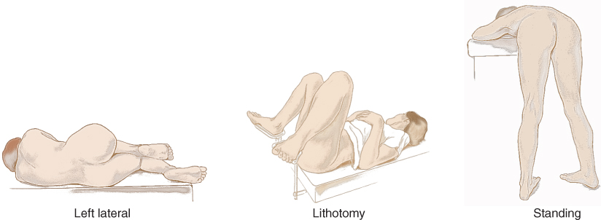
Rectal Examination Positions

Slide 24
Inspect Perianal Area
Spread buttocks wide apart, and inspect perianal region
Anus normally looks moist and hairless, with coarse folded skin more pigmented than perianal skin
Anal opening tightly closed; no lesions present
Inspect sacrococcygeal area; normally appears smooth and even
Instruct person to hold breath and bear down by performing a Valsalva maneuver
No break in skin integrity or protrusion through anal opening should be present
Describe any abnormality in clock-face terms, with 12:00 as the anterior point toward symphysis pubis and 6:00 toward coccyx

Slide 25
Palpate Anus and Rectum I
Instruct person that palpation is not painful but may feel like needing to move bowels
Drop lubricating jelly onto gloved index finger; place pad of index finger gently against anal verge
You will feel sphincter tighten, then relax; as it relaxes, flex tip of your finger and slowly insert it into anal canal toward umbilicus
Never approach anus at right angles with your index finger extended; such jabbing motion does not promote sphincter relaxation and is painful

Slide 26
Palpate Anus and Rectum II
Rotate examination finger to palpate entire muscular ring
Canal should feel smooth and even; note intersphincteric groove circling canal wall
To assess tone, ask person to tighten muscle; sphincter should tighten evenly around with no pain to person
Use a bi-digital palpation with your thumb against perianal tissue; press examining finger toward it; this maneuver highlights swelling or tenderness and helps assess bulbourethral glands

Slide 27
Palpate Anus and Rectum III
Above anal canal, rectum turns posteriorly, following curve of coccyx and sacrum
Insert examination finger farther and explore all around rectal wall; normally feels smooth with no nodularity
Promptly report any mass you discover for further examination

Slide 28
Prostate Gland
On anterior wall in male, note elastic, bulging prostate gland
Palpate entire prostate in a systematic manner; note that only superior and part of lateral surfaces is accessible to examination
Press into gland at each location; when nodule occurs, it will not project into rectal lumen
Surface should feel smooth and muscular; search for any distinct nodule or diffuse firmness

Slide 29
Prostate Gland Characteristics
Note the following characteristics:
Size: 2.5 cm long by 4 cm wide; should not protrude more than 1 cm into rectum
Shape: heart shape, with palpable central groove
Surface: smooth
Consistency: elastic, rubbery
Mobility: slightly movable
Sensitivity: nontender to palpation

Slide 30
Cervical Examination
Palpate cervix in female through anterior rectal wall
Normally feels like small round mass
May palpate retroverted uterus or tampon in vagina
Withdraw examination finger; normally no bright red blood or mucus is on glove
To complete examination, offer person tissues to remove lubricant and help person to comfortable position

Slide 31
Examination of Stool
Inspect any feces remaining on glove
Normally color is brown and consistency is soft
Test any stool on glove for occult blood using specimen container that your agency directs
Negative response is normal
If stool Hematest is positive, it indicates occult blood
Note that false-positive finding may occur if person has ingested red meat within 3 days of test
Enhance self-care by providing the average risk patient an at-home collection kit to screen for asymptomatic colorectal cancer and precancerous lesions

Slide 32
Developmental Competence: Infants and Children I
Newborn
Hold feet with one hand and flex knees up onto abdomen
Note presence of the anus
Confirm a patent rectum and anus by noting first meconium stool passed within 24 to 48 hours of birth
Check anal reflex to assess sphincter tone; gently stroke anal area and note quick contraction of sphincter
For each infant and child, note that buttocks are firm and rounded with no masses or lesions
Recall that Mongolian spot is a common variation of hyperpigmentation in African American, American Indian, Mediterranean, and Asian newborns

Slide 33
Developmental Competence: Infants and Children II
Perianal skin is free of lesions
Diaper rash is common in children younger than 1 year of age and is exhibited as generalized reddened area with papules or vesicles
Omit palpation unless history or symptoms warrant
When internal palpation is needed, position infant or child on back with legs flexed, and gently insert a gloved, well-lubricated finger into rectum
Your fifth finger usually is long enough, and its smaller size is more comfortable for infant or child
On withdrawing finger, scant bleeding or protruding rectal mucosa may occur

Slide 34
Developmental Competence: Aging Adult
As an aging person performs Valsalva maneuver, you may note relaxation of perianal musculature and decreased sphincter control
Otherwise, full examination proceeds as that described for younger adult

Slide 35
Colorectal Cancer (CRC) Screening
Currently second leading cancer killer in the U.S.
However, it should not be; if everyone age 50 or older had regular screening tests, 60% deaths from this cancer could be avoided
Screening identifies precancerous polyps so they can be removed before they become cancer
Screening can also find CRC early, when treatment can be effective
CRC is most often found in people age 50 and older
Older you get the higher your risk; both men and women get CRC

Slide 36
CRC Screening Tests
CRC screening tests include
Fecal occult blood test (FOBT)
Flexible sigmoidoscopy
Combination of FOBT and flexible sigmoidoscopy
Colonoscopy
Double-contrast barium enema

Slide 37
Sample Charting: Subjective and Objective

Slide 38
Abnormal Findings: Anus and Perianal Region
Pilonidal cyst or sinus
Anorectal fistula
Fissure
Hemorrhoids
Rectal prolapse
Pruritus ani

Slide 39
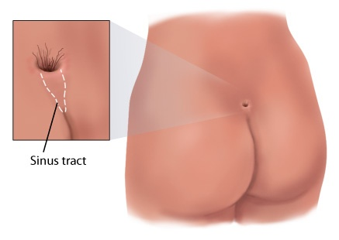
Pilonidal Cyst or Sinus

Slide 40
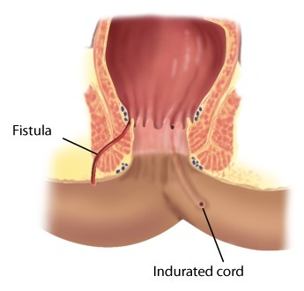
Anorectal Fistula

Slide 41
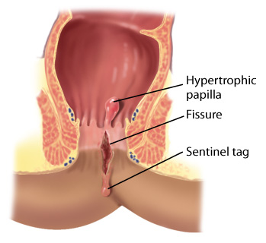
Fissure

Slide 42
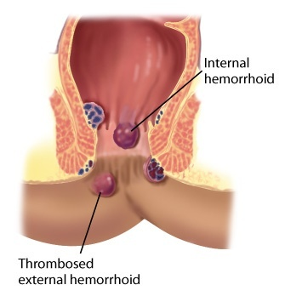
Hemorrhoids

Slide 43
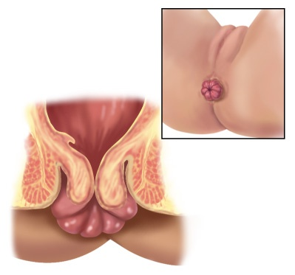
Rectal Prolapse

Slide 44
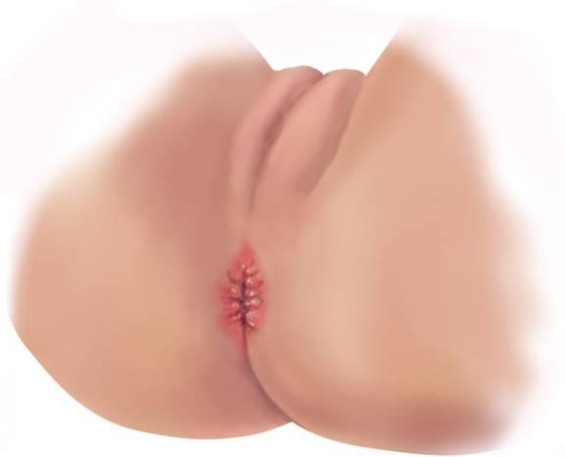
Pruritus Ani

Slide 45
Abnormal Findings: Rectum
Abscess
Rectal polyp
Fecal impaction
Carcinoma

Slide 46
Abnormal Findings: Prostate Gland
Benign prostatic hypertrophy (BPH)
Prostatitis
Carcinoma

Slide 47
Summary Checklist: Anus, Rectum, and Prostate
Inspect anus and perineal area
Inspect during Valsalva maneuver
Palpate anal canal and rectum on all adults
Test stool for occult blood

Slide 48
Question
The nurse is assessing a male patient’s symptoms of benign prostate hypertrophy (BPH). Which questions would be useful to determine BPH?
“How many times do you get up in the middle of the night to urinate?”
“Has your urine stream increased in intensity?”
“Do you experience burning when you urinate?”
“Do you have urinate when you first wake up in the morning?”
Notes:
The correct answer is 1. Men often experience increased urination at night when BPH is present.
Answer 2 is incorrect because the urine stream is usually decreased in BPH.
Answer 3 is incorrect because burning could indicate infection or a sexually transmitted infection.
Answer 4 is incorrect because urinating in the morning is considered normal for both males and females.

