Slide 1
Female Genitourinary System
Chapter 26

Slide 2
Female Genitourinary System
External female genital structures include:
Vulva, or pudendum
Mons pubis
Labia majora
Labia minora
Frenulum or fourchette
Clitoris
Vestibule
Urethral meatus
Skene’s glands
Vaginal orifice
Hymen
Bartholin’s glands

Slide 3
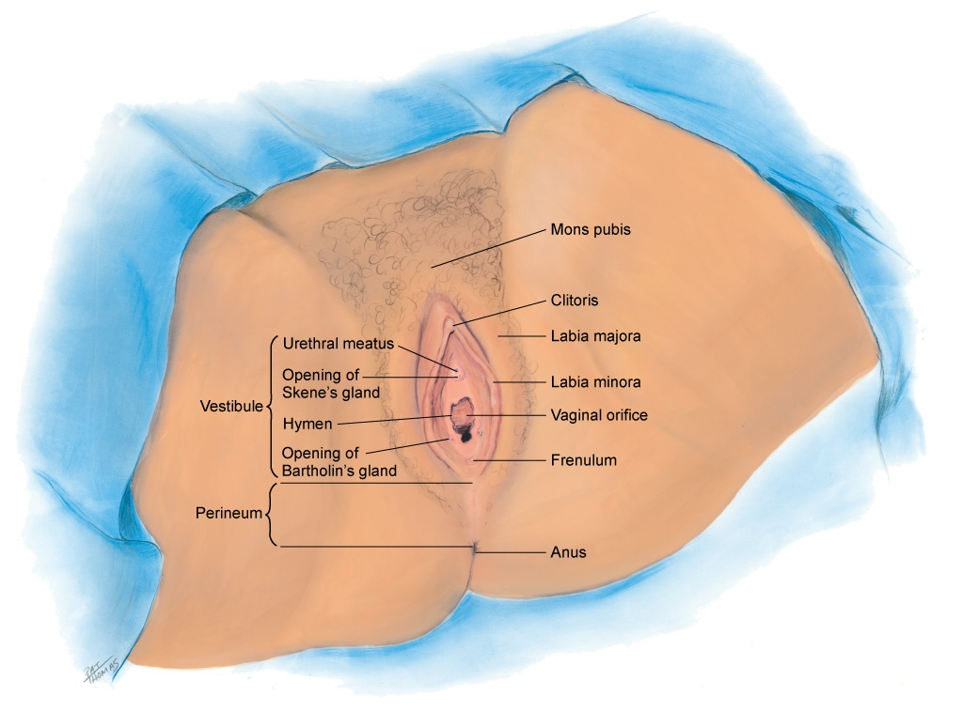
External Female Genitalia

Slide 4
Female Genitourinary System
Internal female genital structures include:
Vagina
Cervix
Squamocolumnar junction
Anterior fornix
Posterior fornix
Rectouterine pouch, or cul-de-sac of Douglas
Uterus
Fallopian tubes

Slide 5
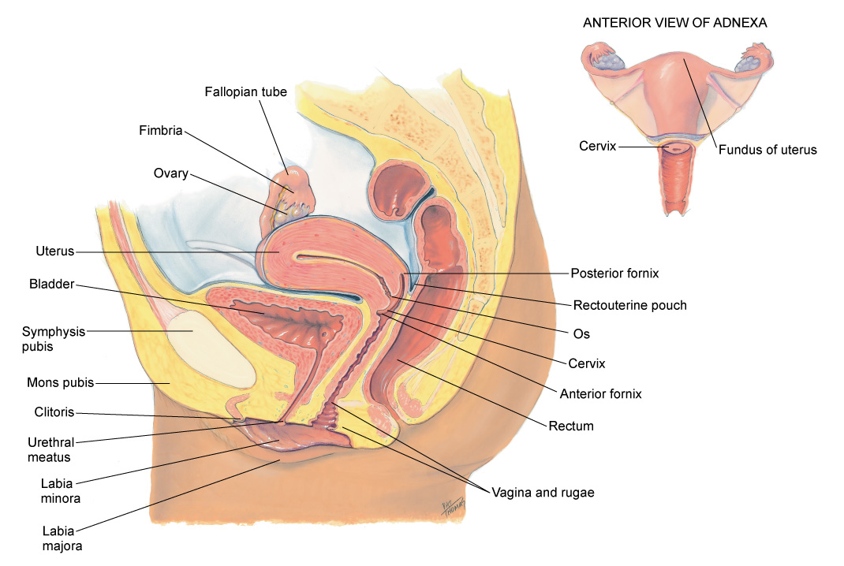
Internal Female Genitalia

Slide 6
External Genitalia I
Called vulva, or pudendum
Mons pubis is a round, firm pad of adipose tissue covering the symphysis pubis
After puberty, it is covered with hair in pattern of an inverted triangle
Labia majora are two rounded folds of adipose tissue extending from mons pubis down and around to perineum
After puberty, hair covers outer surfaces of the labia, whereas inner folds are smooth and moist and contain sebaceous follicles

Slide 7
External Genitalia II
Labia minora: inside labia majora as two smaller, darker folds of skin
Joined anteriorly at clitoris, forming a hood, or prepuce
Labia minora are joined posteriorly by a transverse fold, the frenulum or fourchette
Clitoris: small, pea-shaped erectile body homologous with male penis and highly sensitive to tactile stimulation

Slide 8
External Genitalia III
Vestibule: a boat-shaped space, or cleft encircled by the labial structures
Within it are numerous openings
Urethral meatus appears as dimple just posterior to clitoris
Surrounding the urethral meatus are tiny, multiple paraurethral (Skene’s) glands; their ducts are not visible, but open posterior to urethra
Vaginal orifice: posterior to urethral meatus
Appears either as a thin median slit or as a large opening with irregular edges, depending on presentation of the membranous hymen

Slide 9
External Genitalia IV
Hymen: thin, circular or crescent-shaped fold that may cover part of the vaginal orifice or may be absent completely
Vestibular or Bartholin’s glands: on either side and posterior to vaginal orifice, secrete clear lubricating mucus during intercourse
Their ducts are not visible, but open in groove between labia minora and hymen

Slide 10
Internal Genitalia I
Vagina: flattened, tubular canal extending from the orifice up and backward into the pelvis
9 cm long, it sits between rectum posteriorly and bladder and urethra anteriorly
Its walls are in thick transverse folds, or rugae, enabling the vagina to dilate widely during childbirth
Uterine cervix: at end of the canal, projects into the vagina
In nulliparous female, the cervix appears as a smooth doughnut-shaped area with a small circular hole, or os
After childbirth, os is slightly enlarged and irregular

Slide 11
Internal Genitalia II
Cervical epithelium is of two distinct types
Vagina and cervix covered with smooth, pink, stratified squamous epithelium
Inside os, the endocervical canal lined with columnar epithelium that looks red and rough
Squamocolumnar junction: the point where these two tissues meet and is not visible
Anterior fornix in front and the posterior fornix in back form a continuous recess around cervix
Behind the posterior fornix is another deep recess called the rectouterine pouch, or cul-de-sac of Douglas

Slide 12
Internal Genitalia III
Uterus: pear-shaped, thick-walled, muscular organ, flattened anteroposteriorly, not fixed and freely movable, and usually tilts forward and superior to the bladder
Fallopian tubes: two pliable, trumpet-shaped tubes, 10 cm in length, extending from the uterine fundus laterally to the brim of the pelvis
Ovaries are located one on each side of the uterus at the level of the anterior superior iliac spine

Slide 13
Developmental Competence: Infants & Adolescents I
At birth, external genitalia are engorged because of presence of maternal estrogen
At puberty, estrogens stimulate growth of cells in the reproductive tract and development of secondary sex characteristics
First signs of puberty are breast and pubic hair development, beginning between ages 8 and 10
Menarche occurs during latter half of this sequence, just after peak of growth velocity
Ovaries are now in pelvic cavity

Slide 14
Tanner’s Table
Five stages of pubic hair development, sex maturity rating, SMR, helpful in teaching girls expected sequence of sexual development
Data may not necessarily generalize to all racial groups as research was based on Caucasian girls
Mature Asian women normally have fine sparse pubic hair
African-American and Mexican-American girls had pubic hair and had achieved menarche at younger ages than white girls

Slide 15
Developmental Competence: Pregnant Woman I
Shortly after first missed menstrual period, genitalia show signs of the growing fetus
Cervix softens (Goodell’s sign) at 4 to 6 weeks of gestation, and vaginal mucosa and cervix look cyanotic (Chadwick’s sign) at 8 to 12 weeks of gestation
Changes occur because of increased vascularity and edema of cervix and hypertrophy and hyperplasia of cervical glands
Isthmus of uterus softens (Hegar’s sign) at 6 to 8 weeks of gestation

Slide 16
Developmental Competence: Pregnant Woman II
Greatest change is in uterus
Increases in capacity by 500 to 1000 times its nonpregnant state, first because of hormone stimulation, then because of increasing size of its contents
Early growth encroaches on space occupied by bladder, producing symptom of urinary frequency
By 10 to 12 weeks’ gestation, uterus becomes globular in shape and is too large to stay in pelvis
At 20 to 24 weeks’ gestation, uterus has oval shape; it rises almost to the liver, displacing intestines superiorly and laterally

Slide 17
Developmental Competence: Pregnant Woman III
Clot of thick, tenacious mucus forms in spaces of cervical canal, the mucus plug, which protects fetus from infection
Mucus plug dislodges when labor begins at end of term, producing a sign of labor called “bloody show”
Cervical and vaginal secretions increase
Increased acidity occurs by action of Lactobacillus acidophilus, which changes glycogen into lactic acid
Acidic pH keeps pathogenic bacteria from multiplying in vagina, but increases in glycogen increase risk of candidiasis (yeast infection) during pregnancy

Slide 18
Developmental Competence: Aging Woman I
Female’s hormonal milieu decreases rapidly in contrast with slow decline in aging male
Menopause: cessation of menses
Usually this occurs around 48 to 51, although a wide variation of ages from 35 to 60 years exists
Stage of menopause includes preceding 1 to 2 years of decline in ovarian function, shown by irregular menses that gradually become farther apart and produce lighter flow
Ovaries stop producing progesterone and estrogen
Because cells in the reproductive tract are estrogen dependent, decreased estrogen levels during menopause bring dramatic physical changes

Slide 19
Developmental Competence: Aging Woman II
Uterus shrinks in size because of decreased myometrium
Ovaries atrophy to 1 to 2 cm and are not palpable after menopause
Ovulation still may occur sporadically after menopause
Uterus droops as sacral ligaments relax and pelvic musculature weakens
Sometimes it may protrude, or prolapse, into vagina
Cervix shrinks, looks paler, thick, glistening epithelium

Slide 20
Developmental Competence: Aging Woman III
Vagina becomes shorter, narrower, and less elastic because of increased connective tissue
Without sexual activity, vagina atrophies to one-half its former length and width
Vaginal epithelium atrophies, becoming thinner, drier, and itchy
This results in a fragile mucosal surface that is at risk for bleeding and vaginitis
Decreased vaginal secretions leave vagina dry and at risk for irritation and pain with intercourse, dyspareunia
Vaginal pH becomes more alkaline, and a decreased glycogen content occurs from the decreased estrogen

Slide 21
Developmental Competence: Aging Woman IV
Externally, mons pubis looks smaller because fat pad atrophies
Labia and clitoris gradually decrease in size
Pubic hair becomes thin and sparse
Changes in female sexual response cycle
Declining estrogen levels produce some physiologic changes in the female sexual response cycle
Reduced amount of vaginal secretion and lubrication during excitement
Shorter duration of orgasm; and rapid resolution
However, these changes do not affect sexual pleasure and function
Sexual desire and need for full sexual expression continue

Slide 22
Culture & Genetics
Differences in how ethnic groups perceive the value of Pap Smear testing
Even though overall rates of cervical cancer have decreased in the U.S., the overall incidence of cervical cancer is increased in African American women
Pap test is also better at screening subtype squamous better than subtype adeno
Female circumcision, known as infibulation or female genital mutilation
Invasive surgical procedure (removal partial or total of the clitoris) usually performed on girls before puberty – social custom
Practiced within Aboriginal, Christian, and Muslim families who have emigrated to U.S. from western and southern Asia, Middle East, and large areas of Africa

Slide 23
Subjective Data
Menstrual history
Obstetric history
Menopause
Self-care behaviors
Acute pelvic pain
Urinary symptoms
Vaginal discharge
Past history
Sexual activity
Contraceptive use
Sexually transmitted infection (STI) contact
STI risk reduction

Slide 24
Menstrual History Questions
Tell me about your menstrual periods
Age at first period? Date of your last menstrual period?
How often are your periods?
How many days does your period last?
Is your usual amount of flow light, medium, or heavy? How many pads or tampons do you use each day or hour?
Do you have any clotting?
Do you have any pain or cramps before or during your period? How do you treat them? Do they interfere with daily activities? Are there any other associated symptoms, such as bloating, breast tenderness, or moodiness?
Do you have any spotting between periods?

Slide 25
Obstetric History Questions
Have you ever been pregnant?
How many times?
How many infants have you given birth to?
Have you had any miscarriages or abortions?
For each pregnancy, describe the duration, any complications, labor and delivery, and infant’s gender, birth weight, and condition
Do you think you may be pregnant now? What symptoms have you noticed?

Slide 26
Menopause History Questions
Have your periods slowed down or stopped?
Do you have any associated symptoms of menopause, such as hot flashes, night sweats, numbness and tingling, headache, palpitations, drenching sweats, mood swings, vaginal dryness, or itching? Any treatment?
If you are using hormone replacement, how much? How is it working? Do you have any side effects?
How do you feel about going through menopause?

Slide 27
Self-Care Behaviors Questions
How often do you have a gynecologic checkup?
When was your last Pap smear? What were the results?
Has your mother ever mentioned taking hormones while pregnant with you?

Slide 28
Urinary Symptom History Questions
Any problems with urinating? Frequently and small amounts? Cannot wait to urinate?
Any burning or pain on urinating?
Do you awaken during night to urinate?
Is there blood in your urine?
Is your urine dark, cloudy, or foul smelling?
Do you have any difficulty controlling urine or wetting yourself?
Do you urinate when sneezing, laughing, coughing, or bearing down?

Slide 29
Vaginal Discharge History Questions
Any unusual vaginal discharge? Increased amount? Is it white, yellow-green, gray, curdlike, or foul smelling?
When did this begin?
Is the discharge associated with vaginal itching, rash, or pain with intercourse?
Are you taking any medications?
Do you have a family history of diabetes?
What part of your menstrual cycle are you in now?
Do you use a vaginal douche? How often?
Do you use feminine hygiene spray?
Do you wear nonventilating underpants or pantyhose?
Have you treated the discharge with anything? What was the result?

Slide 30
Past History Questions
Any other problems in genital area? Do you have any sores or lesions, now or in past? How were these treated?
Do you have any abdominal pain?
Have you had any surgery on uterus, ovaries, or vagina?

Slide 31
Sexual Activity History Questions
Often women have a question about their sexual relationship and how it affects their health. Do you?
Are you in a relationship involving sex now?
Are aspects of sex satisfactory to you and your partner?
Satisfied with the way you and partner communicate about sex?
Are you satisfied with your ability to respond sexually?
Do you have more than one sexual partner?
What is your sexual preference: do you prefer a relationship with a man, with a woman, or with both?

Slide 32
Contraceptive Use
Currently planning a pregnancy or avoiding pregnancy?
Do you and your partner use a contraceptive? Which method? Is this satisfactory? Do you have any questions about this or other methods?
Which methods have you used in the past?
Have you and your partner discussed having children?
Have you ever had any problems becoming pregnant?

Slide 33
STI History Questions
Sexually transmitted infection (STI) contact
Any sexual contact with partner having an STI, such as gonorrhea, herpes, HIV, AIDS, chlamydial infection, venereal warts, or syphilis? When? How was this treated? Were there any complications?
STI risk reduction
Do you use any precautions to reduce risk of STIs? Do you use condoms at each episode of sexual intercourse?

Slide 34
Additional History: Infants & Children
Does your child have any problem urinating? Pain with urinating, crying, holding genitals? Urinary tract infection?
If child is older than 2 to 2½, has toilet training started? How is it progressing?
Does the child wet bed at night? Is this a problem for child or you (parents)? What have you (parents) done?
Problem with genital area: itching, rash, vaginal discharge?
To child: Has anyone ever touched you between your legs and you did not want them to?
Sometimes that happens to children; they should remember they have not been bad; they should try to tell a big person about it
Can you tell me three different big people you trust who you could talk to?

Slide 35
Additional History: Preadolescents & Adolescents I
Use following questions to assess sexual growth, development, and sexual behavior
Ask questions that seem appropriate for girl’s age, but norms vary widely
When in doubt ask too many questions rather than omit something
Children obtain information, often misinformation, from media and peers at surprisingly early ages
Ask direct, matter-of-fact questions; avoid sounding judgmental
Start with a permission statement, “Often girls your age experience . . .” This conveys that it is normal to think or feel a certain way
Try open-ended, “When did you . . .” rather than “Do you . . .” This is less threatening because it implies that the topic is normal and unexceptional

Slide 36
Additional History: Preadolescents & Adolescents II
Around age 9 or 10, girls start to develop breasts and pubic hair
Have you ever seen charts and pictures of normal growth patterns for girls? Let us go over these now.
Have your periods started? How did you feel? Were you prepared or surprised?
Who in your family do you talk to about your body changes and about sex information?
Do you think you get enough information?
What about sex education classes at school? Is there a teacher, a nurse, a minister, to whom you can talk?
Often girls your age have questions about sexual activity; Do you have questions? Are you dating?

Slide 37
Additional History: Preadolescents & Adolescents III
Do you and your boyfriend have intercourse? Are you using condoms? What kind of protection did you use the last time you had sex?
Has anyone ever talked to you about sexually transmitted infections, such as chlamydia, herpes, gonorrhea, or AIDS?
Have you and your parents discussed the human papillomavirus vaccine? It is recommended before girls become sexually active.
Sometimes a person touches a girl in a way that she does not want them to
Has that ever happened to you? If that happens, the girl should remember it is not her fault
She should tell another adult about it

Slide 38
Additional History: Aging Woman
After menopause, have you noted any vaginal bleeding?
Any vaginal itching, discharge, or pain with intercourse?
Any pressure in genital area, loss of urine with cough or sneeze, back pain, or constipation?
Are you in a relationship involving sex now? Are aspects of sex satisfactory to you and your partner? Is there adequate privacy for a sexual relationship?

Slide 39
Objective Data: Preparation
Assemble equipment before helping woman into position
Arrange within easy reach
Familiarize yourself with vaginal speculum before examination
Practice opening and closing blades, locking them into position, and releasing them
Try both metal and plastic types
Note that plastic speculum locks and unlocks with a resounding click that can be alarming

Slide 40
Objective Data: Equipment
Gloves
Goose-necked lamp
Vaginal speculum of appropriate size
Graves’ speculum, useful for most adult women, available in varying lengths and widths
Pederson speculum, narrow blades, useful for young or postmenopausal women with narrowed introitus
Large cotton-tipped applicators, rectal swabs
Lubricant
Materials for cytologic study:
Glass slide with frosted end
Sterile Cytobrush or cotton-tipped applicator
Ayre’s spatula
Spray fixative
Specimen container for gonorrhea culture (GC)/chlamydia
Small bottle of normal saline solution, potassium hydroxide (KOH), and acetic acid (white vinegar)

Slide 41
Objective Data: Positioning
Initially, the woman should be sitting up
An equal-status position is important to establish trust and rapport before vaginal examination
For examination, woman should be placed in lithotomy position, with examiner sitting on stool
Help woman into lithotomy position, with body supine, feet in stirrups, knees apart, and buttocks at edge of examining table
Ask woman to lift hips as you guide them to edge of table
Some women prefer to leave their shoes or socks on

Slide 42
Lithotomy Position and Draping

Slide 43
Objective Data: Positioning II
Place arms at her sides or across chest, not over head, because this position only tightens abdominal muscles
Traditional mode is to drape woman fully, covering stomach and legs, exposing only vulva to view
Be sure to push down drape between woman’s legs and elevate her head so that you can see her face
Lithotomy position leaves many women feeling helpless and vulnerable
Indeed, many women tolerate pelvic examination because they consider it basic for health care, yet find it uncomfortable

Slide 44
Objective Data: Positioning III
You can help woman relax, decrease her anxiety, and retain a sense of control by using these measures
Have her empty bladder before examination
Position examination table so that her perineum is not exposed to an inadvertent open door
Ask if she would like a friend, family member, or chaperone present; position this person by woman’s head to maintain privacy
Elevate her head and shoulders to semisitting position to maintain eye contact
Place stirrups so that legs are not abducted too far

Slide 45
Objective Data: Positioning IV
You can help woman relax, decrease her anxiety, and retain a sense of control by using these measures
Explain each step in examination before you do it
Assure woman she can stop examination at any point should she feel any discomfort
Use a gentle, firm touch, and gradual movements
Communicate throughout examination; maintain a dialog to share information
Use techniques of educational or mirror pelvic examination

Slide 46
Educational or Mirror Pelvic Examination
Routine examination with some modifications in attitude, position, and communication
First, woman considered active participant, one who is interested in learning and in sharing decisions about her own health care
Woman props herself up on one elbow, or head of table is raised; her other hand holds a mirror between her legs, above examiner’s hands
Mirror works well for teaching normal anatomy and its relationship to sexual behavior
Woman is more willing to comply with treatment when she shares in decisions

Slide 47
External Genitalia: Inspection I
Skin color is even; labia minora are darker pink
Hair distribution in usual female pattern of inverted triangle, although it normally may trail up abdomen
Labia majora normally are symmetric, plump, and well formed; in nulliparous woman, labia meet in midline; after a vaginal delivery, labia are gaping and slightly shriveled
No lesions should be present, except for occasional sebaceous cysts

Slide 48
External Genitalia: Inspection II
With your gloved hand, separate labia majora to inspect:
Clitoris
Labia minora are dark pink and moist, usually symmetric
Urethral opening appears stellate or slitlike and is midline
Vaginal opening, or introitus, may appear as narrow vertical slit or as larger opening
Perineum is smooth; a well-healed episiotomy scar, midline or mediolateral, may be present after vaginal birth
Anus has coarse skin of increased pigmentation

Slide 49
External Genitalia: Palpation I
Assess urethra and Skene’s glands
Dip gloved finger in bowl of warm water to lubricate
Insert index finger into vagina, and gently milk urethra by applying pressure up and out
Procedure should produce no pain
If any discharge appears, culture it
Assess Bartholin’s glands
Palpate posterior parts of labia majora with index finger in vagina and your thumb outside; normally, labia feel soft and homogeneous

Slide 50
Palpation: Bartholin’s Glands

Slide 51
External Genitalia: Palpation II
Assess support of pelvic musculature by using these maneuvers:
Palpate perineum
Normally, it feels thick, smooth, and muscular in nulliparous woman; thin and rigid in multiparous woman
Ask woman to squeeze vaginal opening around your fingers; it should feel tight in nulliparous woman and have less tone in multiparous woman
Using index and middle fingers, separate vaginal orifice and ask woman to strain down; normally, no bulging of vaginal walls or urinary incontinence occurs

Slide 52
Speculum Examination I
Internal genitalia:
Select proper-sized speculum; warm and lubricate speculum under warm running water
Evidence shows applying a small amount, dime size water soluble gel lubricant on the outer inferior blade increases patient comfort and yields no more unsatisfactory slides than does water only
However, effect of gel lubricant on interference with bacterial or viral cultures has not been tested

Slide 53
Speculum Examination II
Internal genitalia:
Good technique is to dedicate one hand to patient and other to picking up equipment
For example, hold speculum in your left hand with index and middle fingers surrounding blades and thumb under thumbscrew
This prevents blades from opening painfully during insertion; with your right index and middle fingers push introitus down and open to relax pubococcygeal muscle
Tilt width of blades obliquely and insert speculum past your right fingers, applying any pressure downward; this avoids pressure on sensitive urethra above it
Ease insertion by asking woman to bear down

Slide 54
Internal Genitalia I
Internal genitalia: inspect cervix and its os
Color: normally cervical mucosa is pink and even
During second month of pregnancy it looks blue
(Chadwick’s sign); after menopause it is pale
Position: midline, either anterior or posterior; projects 1 to 3 cm into vagina
Size: diameter is 2.5 cm (1 inch)
Os: small and round in nulliparous woman; in parous woman, it is horizontal irregular slit and also may show healed lacerations on sides

Slide 55
Internal Genitalia II
Internal genitalia: inspect cervix
Surface: normally smooth, but cervical eversion, or ectropion, may occur after vaginal deliveries
Endocervical canal everted; looks like red, beefy halo inside pink cervix surrounding os
Difficult to distinguish this normal variation from an abnormal condition and biopsy may be needed
Nabothian cysts are benign growths that commonly appear on cervix after childbirth; they are small, smooth, yellow nodules that may be single or multiple; they are retention cysts caused by obstruction of cervical glands
If secretions are copious, swab area with a thick-tipped rectal swab
This method sponges away secretions, and you have better view of structures

Slide 56
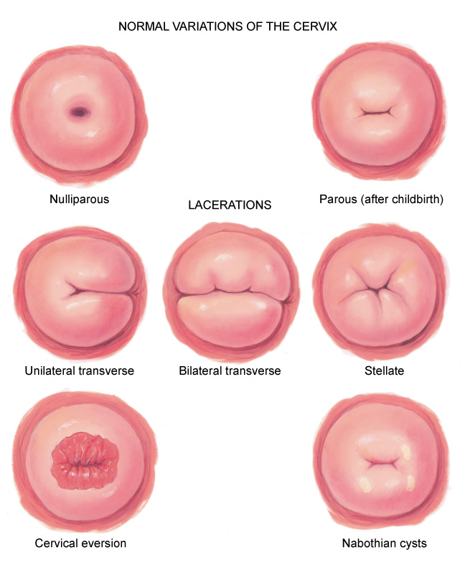
Variations of the Cervix

Slide 57
Papanicolaou
Obtain cervical smears and cultures
Pap smear screens for cervical cancer, but not for endometrial or ovarian cancer
Do not obtain during woman’s menses or if a heavy infectious discharge present
Instruct woman not to douche, have intercourse, or put anything into vagina 24 hours before collecting specimen
Obtain Pap smear before other specimens so you will not disrupt or remove cells

Slide 58
Pap Smear Specimens
Vaginal pool: gently rub blunt end of an Ayre spatula over vaginal wall under and lateral to cervix; wipe specimen on glass slide
Cervical scrape: insert bifid end of Ayre spatula into vagina with the more pointed bump into cervical os; rotate 360 to 720 degrees, using firm pressure; this specimen is important for the adolescent whose endocervical cells have not yet migrated into endocervical canal
Endocervical: insert a Cytobrush into os; Cytobrush gives a higher yield of endocervical cells at squamocolumnar junction, and is safe for use during pregnancy

Slide 59
Pap Smear Specimen Documentation
Send specimens to laboratory with following necessary data:
Date of specimen
Woman’s date of birth
Date of last menstrual period
Any hormone medication
If pregnant, with estimated date of delivery
Known infections
Prior surgery or radiation
Prior abnormal cytology
Abnormal findings on physical examination

Slide 60
Testing for STIs
To screen for STIs, and if you note any abnormal vaginal discharge, obtain gonorrhea (GC)/chlamydia culture
Insert a sterile cotton applicator into os, rotate it 360 degrees, and leave it in place 10 to 20 seconds for complete saturation
Insert into labeled specimen container

Slide 61
Additional Testing Samples
Saline mount, or wet preparation: spread sample of discharge onto a glass slide and add one drop of normal saline solution and a coverslip
KOH preparation: add one drop of potassium hydroxide and a coverslip to a sample of discharge on slide
Anal culture: insert sterile cotton swab into anal canal about 1 cm; rotate and move it side to side
Acetic acid wash: acetic acid (white vinegar) screens for asymptomatic HPV, which causes genital warts

Slide 62
Inspection of Vaginal Wall
Loosen thumbscrew but continue to hold speculum blades open
Slowly withdraw speculum, rotating it as you go, to fully inspect vaginal wall
Normally wall looks pink, deeply rugated, moist and smooth, and free of inflammation or lesions
Normal discharge is thin and clear, or opaque and stringy, but always odorless
When blade ends near vaginal opening, let them close, but be careful not to pinch mucosa or catch any hairs

Slide 63
Bimanual Examination: Vaginal Wall
Rise to a stand, and have woman remain in lithotomy position; drop lubricant onto first two fingers of your gloved intravaginal hand
Assume “obstetric” position with first two fingers extended, last two flexed onto palm, and thumb abducted
Insert fingers into vagina, with any pressure directed posteriorly; wait until vaginal walls relax, then insert your fingers fully
Use both hands to palpate internal genitalia
Assess location, size, and mobility, and screen for any tenderness or mass
One hand is on abdomen while other hand inserts two fingers into vagina
Palpate vaginal wall; normally, it feels smooth and has no area of induration or tenderness

Slide 64
Bimanual Examination: Cervix
Locate cervix in midline, often near anterior vaginal wall
Palpate using palmar surface of fingers; note these characteristics of normal cervix:
Consistency: feels smooth and firm; softens and feels velvety at 5 to 6 weeks of pregnancy (Goodell’s sign)
Contour: evenly rounded
Mobility: with a finger on either side, move cervix gently from side to side; normally, this produces no pain
Palpate all around fornices; the wall should feel smooth
Next, use abdominal hand to push pelvic organs closer for your intravaginal fingers to palpate
Place your hand midway between umbilicus and symphysis; push down slowly
Brace elbow of your pelvic arm against your hip, and keep it horizontal; woman must be relaxed

Slide 65
Bimanual Examination: Uterus
Assess with intravaginal fingers in anterior fornix
Determine position, or version, of uterus
In many women, uterus is anteverted; you palpate it at level of pubis with cervix pointing posteriorly
Two other positions occur normally: midposition and retroverted
Palpate uterine wall with your fingers in fornices
Bounce uterus gently between your abdominal and intravaginal hands
Normally, it feels firm and smooth, with contour of fundus rounded; it softens during pregnancy; it should be freely movable and nontender

Slide 66
Bimanual Examination: Adnexa
Move both hands to right to explore adnexa
Place abdominal hand on lower quadrant inside anterior iliac spine and place intravaginal fingers in lateral fornix
Push abdominal hand in and try to capture ovary
Often you cannot feel ovary; normally feels smooth, firm, almond shaped, and movable, sliding through fingers
Fallopian tube is not palpable normally; no other mass or pulsation should be felt
Move to left to palpate other side
Then, withdraw your hand and check secretions on fingers before discarding the glove
Normal secretions are clear or cloudy and odorless

Slide 67
Bimanual Examination
Note of caution
Normal adnexal structures often are not palpable
Be careful not to mistake an abnormality for a normal structure
To be safe, consider abnormal any mass that you cannot positively identify, and refer woman for further study

Slide 68
Rectovaginal Examination I
Use this technique to assess rectovaginal septum, posterior uterine wall, cul-de-sac, and rectum
Change gloves to avoid spreading any possible infection; lubricate first two fingers
Instruct woman this may feel uncomfortable and will mimic feeling of moving her bowels
Ask her to bear down as you insert your index finger into vagina and your middle finger gently into rectum

Slide 69
Rectovaginal Examination II
While pushing with abdominal hand, repeat steps of bimanual examination
Keep intravaginal finger on cervix so intrarectal finger does not mistake cervix for a mass
Rectovaginal septum should feel smooth, thin, firm, and pliable
Uterine wall and fundus feel firm and smooth
Rotate intrarectal finger to check rectal wall and anal sphincter tone
Check your gloved finger as you withdraw; test any adherent stool for occult blood
Give woman tissues to wipe area; help her to sit up

Slide 70
Developmental Competence: Infants & Children
Preparation
Infant: place on examination table
Toddler/preschooler: place on parent’s lap
Frog-leg position: hips flexed, soles of feet together and up to bottom
Preschool child may want to separate her own labia
No drapes: young girl wants to see what you are doing
School-age child: place on examination table, frog-leg position, no drapes
During childhood routine screening limited to inspection of external genitalia to determine that (1) structures are intact, (2) vagina is present, and (3) hymen is patent

Slide 71
Developmental Competence: Newborn I
Genitalia somewhat engorged
Labia majora swollen, labia minora prominent and protrude beyond labia majora; clitoris looks relatively large, and hymen appears thick
Because of transient engorgement, vaginal opening more difficult to see now than it will be later
Place your thumbs on labia majora; push laterally while pushing perineum down, and try to note vaginal opening above hymenal ring; do not palpate clitoris as it is very sensitive

Slide 72
Developmental Competence: Newborn II
A sanguineous vaginal discharge or leukorrhea (mucoid discharge) normal during first few weeks due to maternal estrogen effect; may also cause transient breast engorgement and secretion
During early weeks, genital engorgement resolves, and labia minora atrophy and remain small until puberty
Between the ages of 2 months and 7 years, labia majora are flat, labia minora thin, clitoris relatively small, and hymen is tissue-paper thin
Normally, no irritation or foul-smelling discharge is present

Slide 73
Question
The parent of a newborn girl is concerned because the baby’s vagina and clitoris appear large and swollen. What is the nurse’s best response?
“This is a normal finding in newborn girls and should resolve within a few weeks.”
“I would make an appointment to see your infant’s pediatrician as soon as you get her home.”
“The infant will need some additional tests to determine the cause of this problem.”
“We will have the doctor examine the infant right away.”
Notes:
The correct answer is 1. This is a normal finding in newborn infants.
Answer 2 is incorrect because there is no need for concern.
Answer 3 is incorrect because no other studies are necessary because this is a normal finding.
Answer 4 is incorrect because this is not an medical emergency.

Slide 74
Developmental Competence: School-Age Girl
Around 7 to 10 years of age, the mons pubis thickens, labia majora thicken, and labia minora become slightly rounded
Pubic hair appears beginning around age 11, although sparse pubic hair may occur as early as age 8
Normally hymen is perforate
Almost always in these age groups, an external examination will suffice
If needed, an internal pelvic examination is best performed by a pediatric gynecologist using specialized instruments

Slide 75
Developmental Competence: Adolescent I
Girl has special needs during genitalia examination
Examine her alone, without mother present
Assure her of privacy and confidentiality
Allow plenty of time for health education and discussion of pubertal progress
Assess her growth velocity and menstrual history, and use SMR charts to teach breast and pubic hair development
Assure her that increased vaginal fluid (physiologic leukorrhea) is normal because of estrogen effect

Slide 76
Developmental Competence: Adolescent II
Perform pelvic examination
When contraception is desired
When girl’s sexual activity includes intercourse
At age 18 in virgins
Start periodic Pap smears when intercourse begins
Although techniques of examination are listed in adult section, you will need to provide additional time and psychologic support for adolescent having her first pelvic examination

Slide 77
Developmental Competence: Adolescent III
First pelvic examination experience determines how adolescent will approach future care
Your accepting attitude and gentle, unhurried approach are important; you have unique teaching opportunity here
Take time to teach, using girl’s own body as illustration
Your frank discussion of anatomy and sexual behavior communicates that these topics are acceptable to discuss and not taboo with health care providers
This affirms girl’s self-concept
During bimanual examination, note that adnexa are not palpable in adolescent

Slide 78
Developmental Competence: Pregnant Woman
Depending on week of gestation of pregnancy, inspection shows enlarging abdomen
Height of fundus ascends gradually as fetus grows
External genitalia show hyperemia of perineum and vulva because of increased vascularity
During bimanual examination, the isthmus of uterus feels softer and is more easily compressed between your two hands (Hegar’s sign)

Slide 79
Developmental Competence: Aging Woman I
To avoid painful examination, take care to lubricate instruments and examining hand adequately
Use Pedersen speculum, rather than Graves, because its narrower, flatter blades are more comfortable in women with vaginal stenosis or dryness
Menopause and resulting decrease in estrogen production cause numerous physical changes
Pubic hair gradually decreases, becoming thin and sparse in later years
Skin is thinner and fat deposits decrease, leaving mons pubis smaller and labia flatter
Clitoris size also decreases after age 60 years

Slide 80
Developmental Competence: Aging Woman II
Internally, rugae of vaginal walls decrease, and walls look pale pink because of thinned epithelium
Cervix shrinks and looks pale and glistening
May retract, appearing to be flush with vaginal wall
Sometimes hard to distinguish cervix from surrounding vaginal mucosa
Alternately, cervix may protrude into vagina, if uterus has prolapsed
With bimanual examination, you may need to insert only one gloved finger if vaginal stenosis exists
Uterus feels smaller and firmer, and ovaries are not palpable normally

Slide 81
Developmental Competence: Aging Woman III
Older women may have special needs and will appreciate following plans of care
For those with arthritis, taking a mild analgesic or anti-inflammatory before appointment may ease joint pain in positioning
Schedule appointment times when joint pain or stiffness is at its least
Allow extra time for positioning and “unpositioning” after examination; be careful to maintain dignity and privacy

Slide 82
HPV Vaccine
Breakthrough in cancer prevention
In June, 2006, the Advisory Committee on Immunization Practices (ACIP) voted to recommend first vaccine developed to prevent cervical cancer
CDC recommendation for girls or boys starting at age 11 or 12 years of age with a series of 3 injections within a 6 month period
One of most important advances in women’s health in recent years
Vaccine targets HPV, responsible for most cases of cervical cancer
It is recommended for girls and women before they become sexually active because it is not effective if individual is already infected with HPV

Slide 83
HPV – Sexually Transmitted Virus
Human papillomavirus, or HPV, is a very common sexually-transmitted virus
Most people who have had sex, both men and women, have been infected at some point in their lives
Most people never even know they have HPV because virus usually does not cause any symptoms and body is able to fight it off
However, sometimes virus lingers in a woman’s cervix and can cause changes that may eventually lead to cervical cancer

Slide 84
HPV Teaching Points
Remind women that obtaining vaccine does not mean they can forget about routine pelvic examinations and Pap tests
Vaccine will protect against major types of HPV that cause cervical cancer, but not all types
Pap tests detect cell changes in cervix before they turn into cancer, at an early, curable stage
Only other way to prevent HPV is to abstain from all sexual activity
Condoms may not protect against HPV because areas not covered by condom can be exposed to virus

Slide 85
Question
The parent of a 10-year-old female asks the nurse if her daughter can receive the human papillomavirus (HPV) vaccine. The nurse’s best response is:
“Your daughter can start the HPV series after her first menstrual cycle.”
“Your daughter can start the HPV series now.”
“Your daughter will need to wait until she is sexually active to start the HPV series.”
“The HPV vaccine is not appropriate for females.”
Notes:
The correct answer is 2. Females ages 9 to 26 are appropriate candidates to start the three-injection series of the HPV vaccine, ideally prior to becoming sexually active.
Answers 1, 3, and 4 are incorrect because they are not true statements.

Slide 86
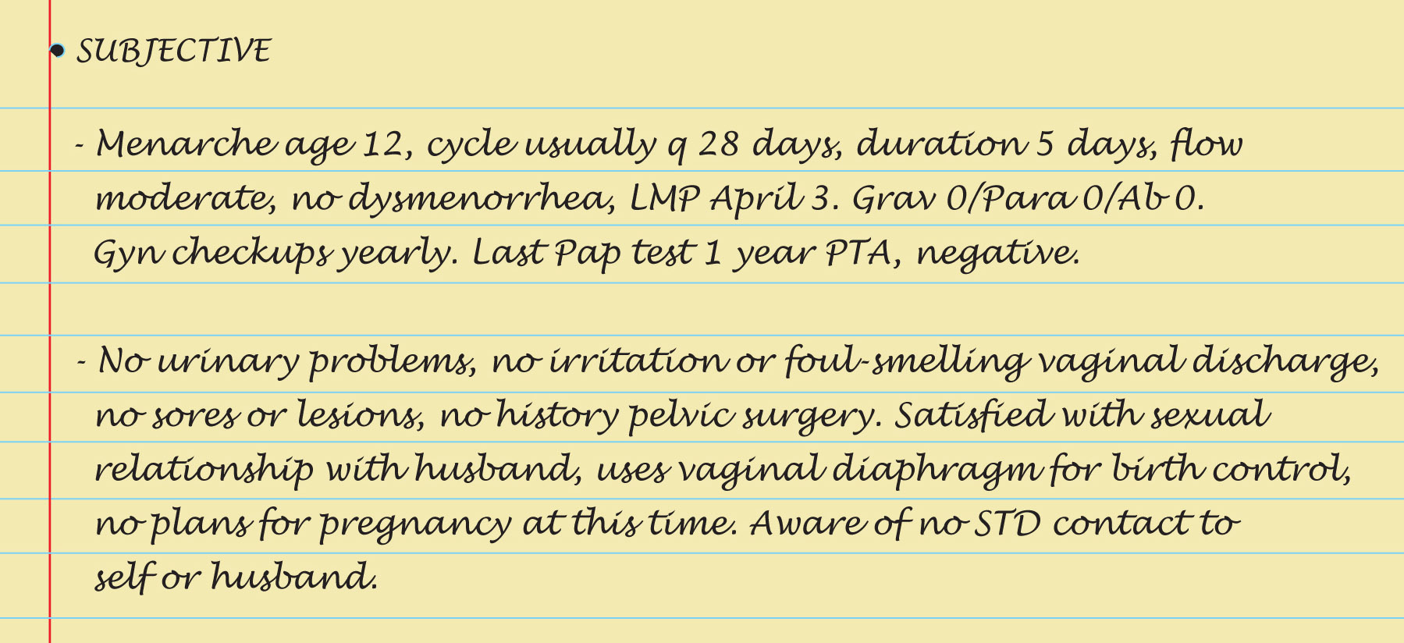
Sample Charting: Subjective

Slide 87
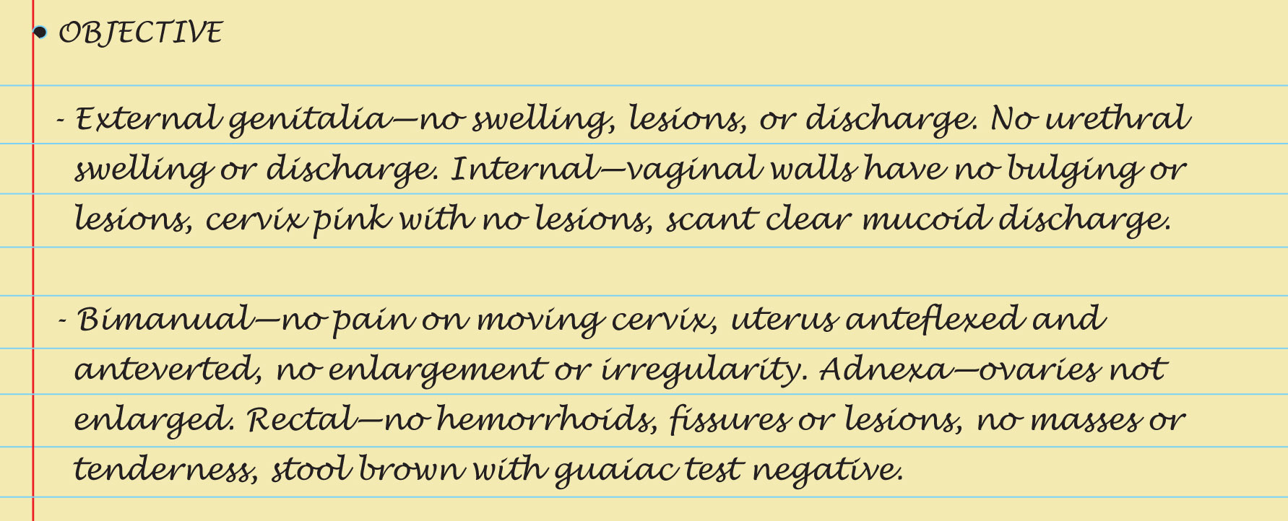
Sample Charting: Objective & Assessment

Slide 88
Abnormalities of External Genitalia
Pediculosis pubis, crab lice
Syphilitic chancre
Herpes simplex virus, type 2 herpes genitalis
Red rash, contact dermatitis
HPV warts
Urethritis
Abscess of Bartholin’s gland
Urethral caruncle

Slide 89
Abnormalities of Pelvic Musculature
Cystocele
Rectocele
Uterine prolapse

Slide 90
Abnormalities of Cervix
Bluish cervix, cyanosis
Erosion
HPV, condylomata
Polyp
Diethylstilbestrol (DES) syndrome erosion
Carcinoma

Slide 91
Vulvovaginal Inflammations
Atrophic vaginitis
Candidiasis (moniliasis)
Trichomoniasis
Bacterial vaginosis
Chlamydia
Gonorrhea

Slide 92
Uterine Enlargement
Pregnancy
Myomas, leiomyomas, uterine fibroids
Carcinoma of the endometrium
Endometriosis

Slide 93
Adnexal Enlargement
Fallopian tube mass, acute salpingitis, pelvic inflammatory disease (PID)
Fallopian tube mass, ectopic pregnancy
Fluctuant ovarian mass, ovarian cyst
Solid ovarian mass, ovarian cancer

Slide 94
Abnormalities in Pediatric Genitalia
Ambiguous genitalia
Vulvovaginitis in child

Slide 95
Summary Checklist: Female Genitourinary System
Inspect external genitalia
Palpate labia, Skene’s & Bartholin’s glands
Using vaginal speculum, inspect cervix & vagina
Obtain specimens for cytologic study
Perform bimanual examination: cervix, uterus & adnexa
Perform rectovaginal examination
Test stool for occult blood

