Slide 1
Chapter 27
The Complete Health
Assessment: Adult

Slide 2
Complete Health Assessment
Adult I
The art of arranging all of the steps you have learned so far
  You may have to pause and think of what comes next rather than just gather data
    Repeated rehearsals will make it smoother
    You will come to the point at which the procedure flows naturally
    Even if you forget a step, you will be able to insert it gracefully into the next logical place
    The following sequence is one suggested route
    It is intended to minimize the number of position changes for the patient and for you

Slide 3
Complete Health Assessment
Adult II
Perform all of the steps listed here for a complete examination
    With experience, you will learn to strike a balance between which steps you must retain to be thorough and which corners you may safely cut when time is pressing
    Have all equipment prepared and accessible before examination

Slide 4
Sequence
Patient walks into room, sits; the examiner sits facing the patient; the patient is in street clothes

Slide 5
The Health History
Collect the history, complete or limited as visit warrants
  While obtaining the history and throughout the examination, note data on person’s general appearance

Slide 6
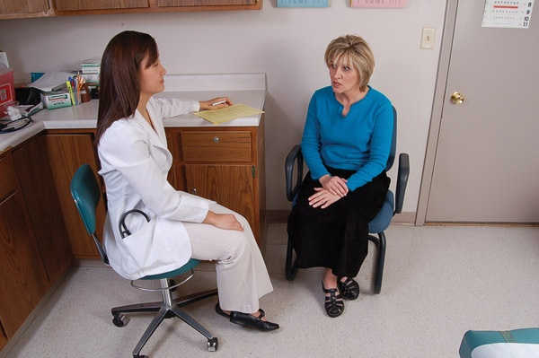
Seated Together
Notes:
The Health History
General Appearance

Slide 7
General Appearance I
  Appears stated age
  Level of consciousness
  Skin color
  Nutritional status
  Posture and position comfortably erect
  Obvious physical deformities

Slide 8
General Appearance II
  Mobility
    Gait
    Use of assistive devices
    Range of motion (ROM) of joints
    No involuntary movement
    Able to rise easily from a seated position
  Facial expression
  Mood and affect
  Speech: articulation, pattern, content appropriate, native language
  Hearing
  Personal hygiene

Slide 9
Measurement
  Weight
  Height
  Compute body mass index
  Vision using Snellen’s eye chart

Slide 10
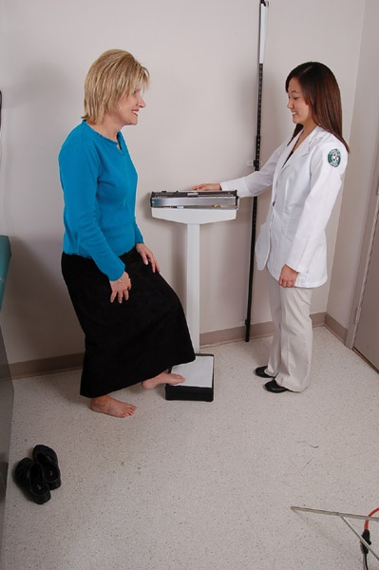
Standing
Notes:
Measurement

Slide 11
Skin
  Examine both hands and inspect nails
  For the rest of the examination, examine skin with corresponding regional examination

Slide 12
Vital Signs and Head and Face
Vital signs
  Radial pulse
  Respirations
  Blood pressure in arms or lower legs, if indicated
  Temperature, if indicated
Head and face
  Inspect and palpate scalp, hair, and cranium
  Inspect face: expression, symmetry, CN VII
  Palpate temporal artery, then temporomandibular joint as person opens and closes mouth
  Palpate maxillary sinuses and frontal sinuses
    If tender, transilluminate the sinuses

Slide 13
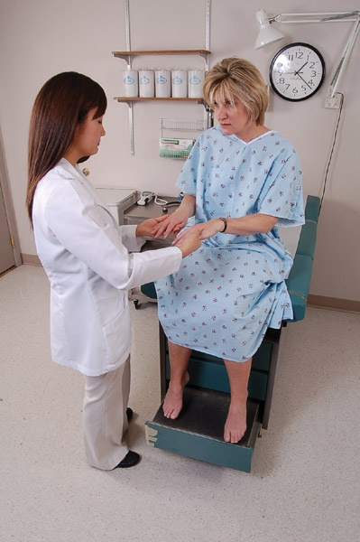
Seated, Changed into Gown
Notes:
Skin (hands)
Vital Signs
Head and Face
Eye
Ear
Nose
Mouth and Throat
Neck
Chest, Posterior and Lateral
Chest, Anterior
Heart
Upper Extremities
Breasts

Slide 14
Eyes
  Test visual fields by confrontation, CN II
  Test extraocular muscles: corneal light reflex, six cardinal positions of gaze, CN III, IV, VI
  Inspect external eye structures
  Inspect conjunctivae, sclerae, corneas, and irides
  Test pupil size for light and accommodation
  Darken room
  Using an ophthalmoscope, inspect ocular fundus, including red reflex, disc, vessels, and retinal background

Slide 15
Ears
  Inspect external ear: position and alignment, skin condition, and auditory meatus
  Move auricle and push tragus for tenderness
  With an otoscope, inspect canal, then tympanic membrane for color, position, landmarks, and integrity
  Test hearing using voice test; tuning fork tests, Weber and Rinne tests

Slide 16
Nose
  Inspect external nose for symmetry and lesions
  Inspect facial symmetry, CN VII
  Test the patency of each nostril
  With a speculum, inspect the nares, including nasal mucosa, septum, and turbinates

Slide 17
Mouth and Throat
  With a penlight, inspect mouth, including buccal mucosa, teeth and gums, tongue, floor of mouth, palate, and uvula
  Grade tonsils, if present
  Note mobility of uvula as person phonates “ahh,” and test gag reflex, CN IX, and CN X
  Ask the person to stick out tongue, check CN XII
  With a gloved hand, bimanually palpate mouth, if indicated

Slide 18
Neck
  Inspect neck for symmetry, lumps, and pulsations
  Palpate cervical lymph nodes
  Inspect and palpate carotid pulse, one side at a time; if indicated, listen for carotid bruits
  Palpate trachea in midline
  Test ROM and muscle strength against your resistance: head forward and back, head turned to each side, and shoulder shrug, CN XI
    Step behind person, taking your stethoscope, ruler, and marking pen with you
  Palpate thyroid gland from posterior approach
  Open person’s gown to expose all of back for examination of thorax, but leave gown on shoulders and anterior chest

Slide 19
Chest: Posterior and Lateral
  Inspect the posterior chest: configuration of thoracic cage, skin characteristics, and symmetry of shoulders and muscles
  Palpate: symmetric expansion; tactile fremitus; lumps or tenderness
  Palpate length of spinous processes
  Percuss over all lung fields, percuss using diaphragmatic excursion
  Percuss costovertebral angle, noting tenderness
  Auscultate breath sounds; note any adventitious sounds
    Move around to face patient; patient remains sitting
    For a female breast examination, ask permission to lift gown to drape on shoulders, exposing anterior chest
    For male, lower gown to the lap

Slide 20
Chest: Anterior
  Inspect respirations and skin characteristics
  Palpate for tactile fremitus, lumps, or tenderness
  Percuss anterior lung fields
  Auscultate breath sounds

Slide 21
Heart and Upper Extremities
Heart
  Ask person to lean forward and exhale briefly; auscultate cardiac base for any murmurs
Upper extremities
  Test ROM and muscle strength of hands, arms, and shoulders
  Palpate epitrochlear nodes

Slide 22
Female Breasts I
  Inspect for symmetry, mobility, and dimpling as woman lifts arms over head, pushes hands on hips, and leans forward
  Inspect supraclavicular and infraclavicular areas
  Help woman to lie supine with head at a flat to 30-degree angle
    Stand at person’s right side
    Drape gown up across shoulders, and place an extra sheet across lower abdomen

Slide 23
Female Breasts II
  Palpate each breast, lifting same side arm up over head
    Include the tail of Spence and areola
  Palpate each nipple for discharge
  Support person’s arm and palpate axilla and regional lymph nodes
  Teach breast self-examination

Slide 24
Male Breasts and Neck Vessels
Male breasts
  Inspect and palpate while palpating anterior chest wall
  Supporting each arm, palpate axilla and regional nodes
Neck vessels
  Inspect each side of neck for a jugular venous pulse, turning person’s head slightly to other side
  Estimate jugular venous pressure, if indicated

Slide 25
Heart
  Inspect precordium for any pulsations or heave (lift)
  Palpate apical impulse and note location
  Palpate precordium for any abnormal thrill
  Auscultate apical rate and rhythm
  Auscultate with the diaphragm of stethoscope to study heart sounds, inching from apex up to base, or vice versa
  Auscultate heart sounds with the bell of stethoscope, again inching through all locations
  Turn person over to left side while again auscultating apex with bell
    Person should be supine, with bed or table flat; arrange drapes to expose abdomen from chest to pubis

Slide 26
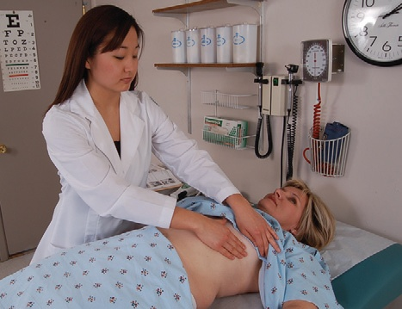
Person Supine

Slide 27
Abdomen
  Inspect for contour, symmetry, skin characteristics, umbilicus, and pulsations
  Auscultate bowel sounds
  Auscultate for vascular sounds over aorta and renal arteries
  Percuss all quadrants
  Percuss height of liver span in right midclavicular line
  Percuss location of spleen
  Palpate using light palpation in all quadrants, then deep palpation in all quadrants
  Palpate for liver, spleen, kidneys, and aorta
  Test abdominal reflexes, if indicated

Slide 28
Inguinal Area, Lower Extremities, and Musculoskeletal
Inguinal area
  Palpate each groin for femoral pulse and inguinal nodes; lift drape to expose legs
  Palpate for temperature and pretibial edema
Lower extremities
  Inspect for symmetry, skin characteristics, and hair distribution
  Palpate pulses, including popliteal, posterior tibial, and dorsalis pedis pulses
  Separate toes and inspect
  Test ROM and muscle strength of hips, knees, ankles, and feet
    Ask person to sit up and to dangle legs off bed or table; keep gown on and drape over lap
Musculoskeletal
  Note muscle strength as person sits up

Slide 29
Neurologic
  Test sensation in selected areas on face, arms, hands, legs, and feet: superficial pain, light touch, and vibration
  Test position sense of finger, one hand
  Test stereognosis
  Test cerebellar function of the upper extremities using finger-to-nose test or rapid-alternating-movements test
  Test cerebellar function of lower extremities by asking person to run each heel down opposite shin
  Elicit deep tendon reflexes: biceps, triceps, brachioradialis, patellar, and Achilles
  Test the Babinski reflex
    Ask person to stand with gown on; stand close to person

Slide 30
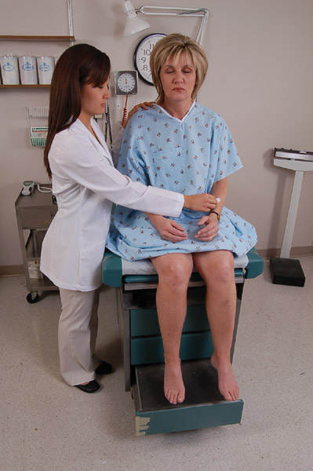
Patient Sits Up and Dangles Legs
Notes:
Musculoskeletal
Neurologic

Slide 31
Lower Extremities and Musculoskeletal
Lower extremities
  Inspect legs for varicose veins
Musculoskeletal
  Ask person to walk across room in his or her regular walk, turn, then walk back toward you, in heel-to-toe fashion
  Ask person to walk on toes for a few steps, then to walk on heels for a few steps
  Stand close and check for Romberg sign
  Ask person to hold edge of bed and to perform a shallow knee bend, one for each leg

Slide 32
Male Genitalia
  Inspect penis and scrotum
  Palpate the scrotal contents; if a mass exists, transilluminate
  Check for inguinal hernia
  Teach testicular self-examination

Slide 33
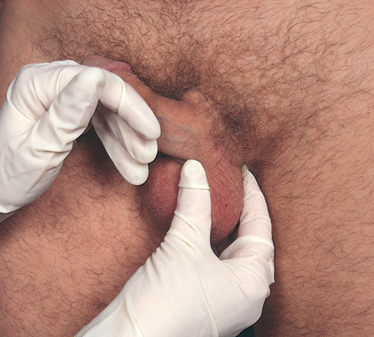
Male Genitalia
Notes:
Male Rectum (standing at table)

Slide 34
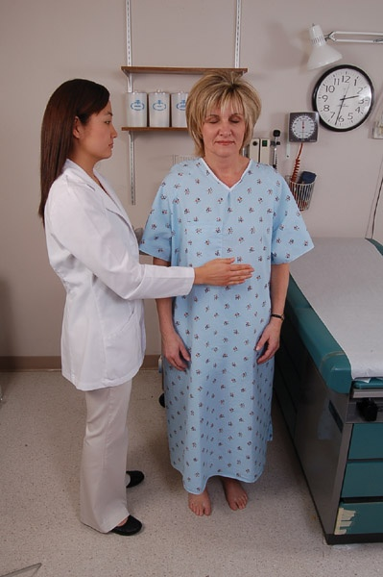
Patient Stands Up
Notes:
Lower Extremities
Musculoskeletal

Slide 35
Musculoskeletal
  Stand behind and check the spine as person touches toes
  Stabilize pelvis and test ROM of spine as person hyperextends, rotates, and laterally bends
  For male patient, sit on a stool in front of him; person stands

Slide 36
Male Rectum
  Inspect the perianal area
  With a gloved lubricated finger, palpate the rectal walls and prostate gland
  Save a stool specimen for an occult blood test

Slide 37
Female Genitalia
  Inspect perineal and perianal areas
  With a vaginal speculum, inspect cervix and vaginal walls
  Procure specimens
  Perform a bimanual examination; check cervix, uterus, and adnexa
  Continue bimanual examining, checking rectum and rectovaginal walls
  Save a stool specimen for an occult blood test
  Provide tissues for female to wipe perineal area, and help her up to a sitting position

Slide 38
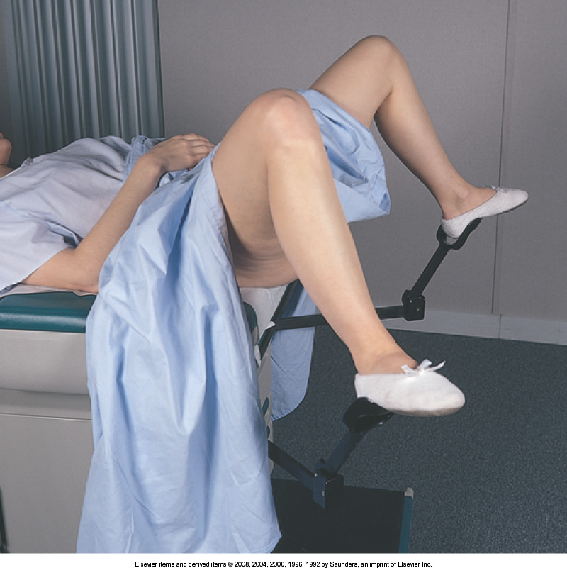
Lithotomy Position, Female Genitalia
Notes:
Breasts, cont
Neck Vessels
Heart
Abdomen
Inguinal Area
Lower Extremities

Slide 39
End of Physical Examination
Tell patient you are finished with examination and that you will leave room as he or she gets dressed
Return to discuss examination and further plans and to answer any questions
Thank person for his or her time
For hospitalized person, return bed and any room equipment to way you found it
Make sure call light and telephone are within easy reach

Slide 40
Documentation and Critical Thinking
Record and document in a timely manner so as to assure accuracy
Note pertinent negative and positive findings
Use short, clear phrases and avoid redundant phrases
Use simple line drawings to identify as well as assist in health teaching

Slide 41
Components of the Health Assessment
Indicate Source of Information
Health history
  Biographic data
  Past health
  Family history
  Review of systems
  Functional assessment
  Perception of health
Physical examination
  Measurement
  Head-to-toe examination
Assessment
  Nursing diagnoses

Slide 42
Question
The nurse is completing a review of systems (ROS) during a health assessment. The nurse knows that the ROS is considered:
factual information that incorporates objective information.
a systematic approach to obtaining objective information.
a systematic approach to obtaining subjective information.
an important component of the social history.
Notes:
The correct answer is 3. The ROS is a systematic approach to obtaining subjective data.
Answer 1 is incorrect because the ROS is in the patient’s words and is considered subjective.
Answer 2 is incorrect because the ROS is considered subjective data.
Answer 4 is incorrect because the ROS is a separate component of the health history and is not included in the social history.

