Slide 1
Chapter 30
The Pregnant Woman

Slide 2
The Endocrine Placenta
Dominant follicle ruptures and ovulation occurs
If ovum meets with sperm, then fertilization occurs
Remaining cells in the follicle form the corpus luteum, which secretes hormones
Fertilized ovum when it enters the uterus and known as blastocyst
Specialized cells in the blastocyst secrete human chorionic gonadotropin (hCG)
Blastocyst implants into the wall of the uterus
Specialized layer of cells becomes the placenta and ultimately takes over hormonal regulation from the corpus luteum to maintain the pregnancy

Slide 3
Pregnancy Structure and Function
Average length of pregnancy
  280 days from the first day of the LMP
  Equal to 40 weeks, 10 lunar months, or 9 calendar months
Trimester division
  1st: 12 weeks
  2nd: 13 to 27 weeks
  3rd: 28 weeks to delivery
Terminology
  Primigravida to primipara after delivery
  Multigravida is a woman who has previously been pregnant and becomes a multipara after delivery
  GTPAL—Gravida, term, preterm, abortion, living

Slide 4
Changes during Pregnancy
Presumptive
  Signs such as amenorrhea, breast tenderness, fatigue, and increased urinary frequency but may be due to other causes than pregnancy
Probable
  Signs detected by the examiner upon inspection of the uterus but again may be due to other causes than pregnancy
Positive
  Signs that indicate direct evidence of the fetus, such as FHTs or positive cardiac activity on ultrasound

Slide 5
First Trimester I
Serum hCG becomes + and cessation of menses occurs
Estrogen, progesterone, and human placental lactogen (HPL) impact breast sensation and development
Increased likelihood of nausea and vomiting due to hormonal changes, low blood sugar, gastric overloading, slowed peristalsis, uterine size increase, and/or emotional factors
Fatigue levels increase possibly due to decrease in metabolic rate early in pregnancy
Vascular changes in the uterus as a result of hormone production

Slide 6
First Trimester II
Decrease in blood pressure due to decrease in systemic vascular resistance
Initial decrease in blood pressure due to decrease in systemic vascular resistance until mid-pregnancy
BP gradually returns to nonpregnant baseline by term
Embryonic period ends at 9 weeks and fetal period begins
FHTs can be heard by Doppler ultrasound between 9 and 12 weeks
Uterus may be enlarged above the symphysis at about 12 weeks

Slide 7
Second Trimester I
After week 12, nausea, vomiting, and urinary frequency improve
Perception of fetal movement (quickening) between 18 and 20 weeks
Breast enlargement and colostrum may be expressed
Hormonal effects lead to darkening of body tissues: areola, nipples, and linea nigra
May see “stretch marks” (striae gravidarum) on breasts, abdomen, and areas of weight gain
Drop in blood pressure noticeable about 20 weeks and may cause orthostatic changes to occur

Slide 8
Second Trimester II
Gastrointestinal changes as a result of displacement by growing uterus leading to heartburn, constipation, and predisposition to gallstone formation
Transient changes in thyroid hormones (TSH) and plasma iodine levels as a result of increased hCG between 8 and 14 weeks
Cutaneous blood flow increased due to decreased vascular resistance allowing for dissipation of heat
Gingivitis or epulis of pregnancy may occur as a result of hypertrophy and fragility of capillaries
FHTs are audible by fetoscope between 17 and 19 weeks
Fetal outline palpable through abdominal wall at 20 weeks

Slide 9
Question
A woman in her eighth week of pregnancy is complaining of morning sickness and wants to know if she has to deal with this the entire pregnancy. The nurse best response is:
“I am sorry you are having difficulty; this may last your entire pregnancy.”
“You should get some relief in your second trimester.”
“You should see improvement by your third trimester.”
“I will ask the doctor to get a HCG level to be sure you are not coming down with a virus.”
Notes:
The correct answer is 2. Most women experience relief in the second trimester.
Answer 1 is incorrect because most women experience relief in the second trimester.
Answer 3 is incorrect because most women experience relief in the second trimester.
Answer 4 is incorrect because HCG level is a hormonal measurement and is not used for virus detection.

Slide 10
Third Trimester I
Blood volume peaks in third trimester
Although erythrocyte mass increases, proportional increase in blood volume leads to hemodilution effect
Uterine enlargement causes the diaphragm to rise and the shape of the rib cage to widen at the base, leading to decreased lung expansion, which can result in SOB
Uterine enlargement also displaces the heart up and to the left leading to increased CO, SV, and force of contraction
Pulse rate rises and functional systolic murmur (grade ii/iv or less) can be heard in >95% of pregnant patients (normal abnormal)
Dependent edema due to growing fetus as well as standing position

Slide 11
Third Trimester II
Increased likelihood for varicosities in legs, vulva, and rectal area
Progressive lordosis noted to compensate for shifting center of balance
Positional changes due to weight of breasts (slumping shoulder and anterior neck flexion) may cause aching as well as numbness/tingling (carpal tunnel nerve compression)
Approximately 2 weeks prior to delivery, engagement and lightening occur
Cervix begins to efface and dilate in preparation for labor
Mucous plug expelled at various times before or during labor
Term is between 37 and 42 weeks; after 42 weeks is considered postterm

Slide 12
Question
The nurse hears a heart murmur when assessing heart sounds on a woman who is at 32 weeks’ gestation. The nurse assumes this is:
because the fetus is lying on the diaphragm, causing the heart to pump harder.
because the woman has a heart murmur and will need to be evaluated by a cardiologist.
a normal finding due to increased circulation in pregnancy.
because the patient has a family history of heart disease.
Notes:
The correct answer is 3. Ninety-five percent of pregnant women have +S3 due to increased circulation.
Answer 1 is incorrect because a woman would most likely be short of breath if the fetus is putting pressure on the diaphragm.
Answer 2 is incorrect because a murmur is common for pregnant women due to increased circulation.
Answer 4 is incorrect because a murmur is common for pregnant women due to increased circulation.

Slide 13
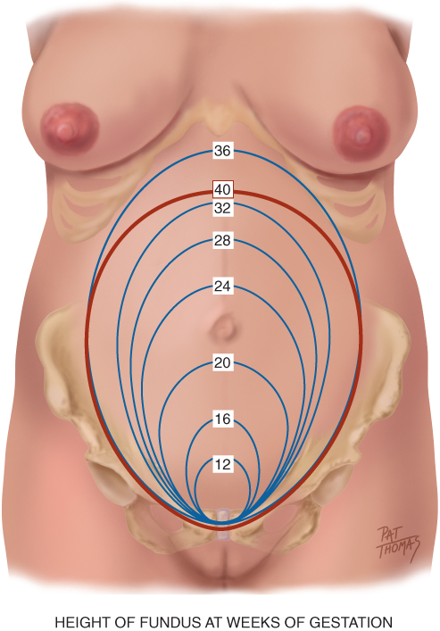
Height of Fundus at Weeks of Gestation

Slide 14
Determining Weeks of Gestation
Expected Date of Delivery (EDD) can be calculated from
  280 days from the LMP
  Calculated using Nägele's rule if menstrual period is regular
    First day of LMP: add 7 days and subtract 3 months
  Determined by pregnancy wheel
  Estimated by physical examination
  Estimated by hCG level
  Ultrasound estimation +/-2 days

Slide 15
Weight Gain in Pregnancy
Weight gain composed of fetus, amniotic fluid, uterus, blood volume, extravascular fluid, maternal fat stores, and breast size
Reflects mother and fetus with approximately 25% of gain attributed to fetus, 11% to placenta and amniotic fluid, and the rest to the mother
IOM recommendations on total weight gain during pregnancy based on initial BMI
  Underweight: 28 to 40 pounds
  Normal: 25 to 35 pounds
  Overweight: 15 to 25 pounds
  Obese: 11 to 20 pounds
  Provides recommendations also for twin gestation, normal weight

Slide 16
Developmental Competence
Associated risks of teen pregnancy compounded by psychosocial and medical complications
Delay in seeking medical care and noncompliance plays a role during prenatal care
Delay in becoming pregnant seen with Generation X-ers and now seeing more first time pregnancies after age 35
Increased likelihood for genetic deformities and complications due to comorbid conditions with “older moms” (diabetes, obesity, and hypertension)

Slide 17
Culture and Genetics
Risk for genetic disorders as a result of increased age of mother
Potential for being a carrier of certain disease states (Tay Sachs or sickle cell, as examples)
Racial disparities result in poor pregnancy outcomes
Differences in outcomes due to race and ethnicity are seen in women who have gestational diabetes
Cultural impact of pregnancy has profound psychological and social meaning for the woman, her family, and community
Be aware of culturally charged issues, and use your skill to understand preferences within a cultural context and accept rather than judge the person

Slide 18
Menstrual History
Use Nägele's rule to calculate EDD
Obtain information about patient’s menstrual cycle pattern and flow
Use a pregnancy wheel to determine current week of gestation

Slide 19
Gynecologic History
Ask patient whether she has had any of the following or specify:
  Surgery related to the cervical area
  History or exposure to genital herpes
  Abnormal Pap test or tested for HPV
  History of STIs (sexually transmitted infections)
  Tested for HIV
  Sexual preference
  Number of sexual partners
  Mammogram or breast surgery

Slide 20
Obstetric History
Ask the patient about
  GTPAL details
  Complications related to prior pregnancies
  Previous pregnancies, labor, and delivery events
  Cesarean as a mode of delivery/VBAC
  History of infertility/use of assisted reproductive technology
  Gestational ages and weights of babies
  Feeding method used with previous babies

Slide 21
Current Pregnancy
Ask the patient about
  Contraceptive used and when it was discontinued
  Planned pregnancy and reaction to pregnancy
  Vaginal bleeding or abdominal pain
  Illnesses since being pregnant
  Edema, urinary frequency or burning, vaginal itching or burning
  Movement of fetus
  Plans for feeding infant: bottle or breast

Slide 22
Medical History
Ask the patient about
  Medications: Rx or OTC or herbal supplements
  Allergies to medications and/or foods and reactions
  History of asthma: being treated with medication
  History/exposure to communicable diseases (rubella/chickenpox)
  Surgical interventions
  Smoking history
  Exercise pattern
  Vitamin D levels checked

Slide 23
Family History
Family history and family tree questions previously addressed in Chapter 4
Also ask patient about
  History of fraternal twins or multiple births
  History of congenital birth defects on your side or father’s side

Slide 24
Review of Systems
Body weight prior to pregnancy: calculate BMI
Last dental appointment
Exposure to TB and/or positive testing
Cardiac valve disease
Anemia: type and treatment
Thrombophlebitis, PE, or DVT
Hypertension or renal disease
Diabetic: type and treatment
History of hepatitis B or C
Thyroid disease
History of seizures and/or treatment
UTIs
Depression or mental illness
Safety in your environment and relationships
Abusive relationships/experiences
Forcing of sexual activity
Copyright © 2016 by Elsevier, Inc. All rights reserved.
Copyright © 2012, 2008, 2004, 2000, 1996, 1993 by Saunders, an affiliate of Elsevier Inc.

Slide 25
Nutritional History
Ask the patient and/or advise the patient about
  Do you follow a special diet?
  Vegetarian and type
  Relevant safety practices related to food (avoid mercury containing seafood and raw food products)
  Food intolerance
  Food craving
  Compliance with prenatal vitamins

Slide 26
Environment/Hazards
Ask the patient and/or advise the patient about
  Occupation and physical work demands
  Exposure to chemicals, odors, radiation, or harmful substances
  Do you consider your housing adequate?
  Seatbelt and car safety
  Any matters of concern

Slide 27
Preparation and Equipment
Verbally prepare woman for exam
Have her empty bladder and obtain specimen as needed
Perform pelvic exam last
Drape for privacy and help maintain comfort level
Check BP while patient is seated to avoid positional compression
Place the patient in lithotomy position
Blood pressure cuff
Centimeter measuring tape
Fetal Doppler and gel
Reflex hammer
Urine specimen container and dipstick
Speculum and other equipment needed for pelvic examination
Copyright © 2016 by Elsevier, Inc. All rights reserved.
Copyright © 2012, 2008, 2004, 2000, 1996, 1993 by Saunders, an affiliate of Elsevier Inc.

Slide 28
General Survey
Normal
Abnormal
Observe normal state of nourishment: correlate with BMI
Note posture, grooming, and mood; assess mental state
Observe maturity and assess readiness level for health promotion
Undernourished or obese
1st trimester weight loss of >5% may indicate hyperemesis gravidarum
Poor grooming or flat affect may refer to depression
Poor grooming may relate to economic factors
Lack of attention may indicate preoccupation
Potential learning disabilities, which may impact care
Copyright © 2016 by Elsevier, Inc. All rights reserved.
Copyright © 2012, 2008, 2004, 2000, 1996, 1993 by Saunders, an affiliate of Elsevier Inc.

Slide 29
Skin
Normal
Abnormal
Note any scars and/or skin changes associated with pregnancy
Inspect for PUPPP: most common pruritic skin rash of pregnancy
Bruises may suggest physical abuse
Facial edema is significant finding suggesting preeclampsia
Track marks and/or nasal stuffiness or recurrent nose bleeds may suggest drug abuse
Note any suspicious nevi or lesion
Copyright © 2016 by Elsevier, Inc. All rights reserved.
Copyright © 2012, 2008, 2004, 2000, 1996, 1993 by Saunders, an affiliate of Elsevier Inc.

Slide 30
Mouth and Neck
Normal
Abnormal
Mouth
  Mucous membranes dark pink and moist
  Gum hypertrophy
  Bleeding gums
Neck
  Thyroid may be palpable and smooth during the normal pregnancy of a euthyroid patient
Mouth
  Pale mucous membranes indicates anemia
  Poor dental hygiene may lead to preterm birth
Neck
  Solitary nodes indicate neoplasm
  Multiple nodes usually indicate inflammation or a multinodular goiter
  Significant diffuse enlargement occurs with thyroiditis
Copyright © 2016 by Elsevier, Inc. All rights reserved.
Copyright © 2012, 2008, 2004, 2000, 1996, 1993 by Saunders, an affiliate of Elsevier Inc.

Slide 31
Breasts
Normal
Abnormal
Enlarged and may be tender
Areolae and nipples darken
Mammary soufflé heard
Montgomery tubercles
Colostrum
Nipple presentation may vary
Breast tissue feels nodular
Teach BSE
Note any abnormal mass and refer for ultrasound
Copyright © 2016 by Elsevier, Inc. All rights reserved.
Copyright © 2012, 2008, 2004, 2000, 1996, 1993 by Saunders, an affiliate of Elsevier Inc.

Slide 32
Heart and Lungs
Normal
Abnormal
Heart
  Late in pregnancy, you can palpate apical impulse left of the midclavicular line and up to the 4th intercostal space
  Functional soft blowing systolic murmur
Lung
  Clear to auscultation
  SOB is common in 3rd trimester
Heart
  Note any abnormal murmur and refer: hemodynamic burden with cardiac disease
  Valvular heart disease may require prophylactic antibiotics at delivery
Lung
  Pregnant woman with asthma may have expiratory and inspiratory wheezes
  Note any signs of respiratory infection: dyspnea, crackles, and congested cough
Copyright © 2016 by Elsevier, Inc. All rights reserved.
Copyright © 2012, 2008, 2004, 2000, 1996, 1993 by Saunders, an affiliate of Elsevier Inc.

Slide 33
Peripheral Vasculature and Neurologic
Normal
Abnormal
Peripheral vasculature
  Legs may show diffuse, symmetric, bilateral pitting edema, especially in the 3rd trimester during exams late in day
  Common varicose veins in 3rd trimester
Neurologic
  Check reflexes (biceps, patellar, and DTRs) using reflex hammer
  Normally 1+ to 2+
Peripheral vasculature
  Assess for triad of preeclampsia: edema, proteinuria, and hypertension
  Edema and calf pain: DVT
  Hot red streak: phlebitis
Neurologic
  Brisk or >2+ and clonus in combination with elevated BP and cerebral edema in the preeclamptic patient
Copyright © 2016 by Elsevier, Inc. All rights reserved.
Copyright © 2012, 2008, 2004, 2000, 1996, 1993 by Saunders, an affiliate of Elsevier Inc.

Slide 34
Inspect and Palpate the Abdomen
Observe the shape and contours of the abdomen; note diastasis recti
Fundus should be palpable from 12 weeks’ gestation
Note fundal location by landmarks and fingerbreadths
After 20 weeks, fundal height should correlate with gestational age
Differences noted in fundal height may indicate problems with gestational age assessment and/or perinatal complications
Palpate for uterine contractions, noting “indentibility.”
Observe for abnormal uterine contraction patterns: hypotonic or hypertonic

Slide 35
Leopold’s Maneuvers I
In third trimester, perform Leopold’s maneuvers to determine fetal lie, presentation, attitude, position, variety, and engagement
Fetal lie: orientation of fetal spine to maternal spine–longitudinal, transverse, or oblique
Presentation: part of the fetus that is entering the pelvis first–vertex, head, or breech
Attitude: position of fetal parts in relationship to each other–flexed, military, or extended
Position: designates the location of a fetal part to the right or left of the maternal pelvis
Variety: location of the fetal back to the anterior, lateral, or posterior part of the maternal pelvis
Engagement: occurs when the widest diameter of the presenting part has descended into the pelvic outlet at the level of the ischial spines

Slide 36
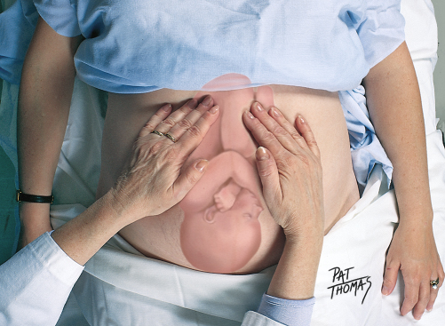
Leopold’s First Maneuver
This picture illustrates how to perform the first step of Leopold’s maneuver
Copyright © 2016 by Elsevier, Inc. All rights reserved.
Copyright © 2012, 2008, 2004, 2000, 1996, 1993 by Saunders, an affiliate of Elsevier Inc.

Slide 37
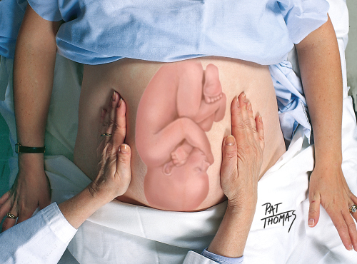
Leopold’s Second Maneuver
This picture illustrates how to perform the second step of Leopold’s maneuver
Copyright © 2016 by Elsevier, Inc. All rights reserved.
Copyright © 2012, 2008, 2004, 2000, 1996, 1993 by Saunders, an affiliate of Elsevier Inc.

Slide 38
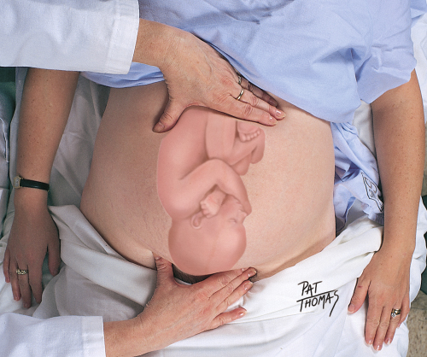
Leopold’s Third Maneuver
This picture illustrates how to perform the third step of Leopold’s maneuver. It is also called Pawlik maneuver.
Copyright © 2016 by Elsevier, Inc. All rights reserved.
Copyright © 2012, 2008, 2004, 2000, 1996, 1993 by Saunders, an affiliate of Elsevier Inc.

Slide 39
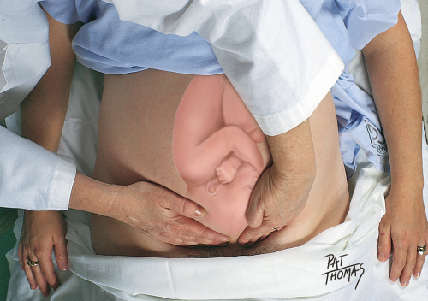
Leopold’s Fourth Maneuver
This picture illustrates how to perform the fourth step of Leopold’s maneuver and is done to determine engagement
Copyright © 2016 by Elsevier, Inc. All rights reserved.
Copyright © 2012, 2008, 2004, 2000, 1996, 1993 by Saunders, an affiliate of Elsevier Inc.

Slide 40
Auscultate FHTs
FHTs are a positive sign of pregnancy
Heard by Doppler ultrasound between 8 and 10 weeks of pregnancy
Auscultated best by locating the back of the fetus
Normal heart rate between 110 and 160 bpm
Spontaneous accelerations indicate fetal well-being
Differentiate FHTs between maternal heart rate and uterine soufflé
Difficulty in obtaining FHTs requires further investigation

Slide 41
Pelvic Examination
Genitalia
Use procedure for pelvic examination outlined in Chapter 26
Enlargement of labial minora is common in multiparous women
Labial varicosities may be present
Inspect perineal area for scarring, lesions, and hemorrhoids
Speculum
Observe for Chadwick’s sign
Note any vaginal discharge
Note appearance of cervical os
Bimanual
Chapter 26 provides detailed description–palpation of the uterus
Note Goodell’s sign
Assess adnexa to rule out the presence of a mass
Assess tone by asking women to squeeze your fingers–opportunity to teach Kegel exercises
Copyright © 2016 by Elsevier, Inc. All rights reserved.
Copyright © 2012, 2008, 2004, 2000, 1996, 1993 by Saunders, an affiliate of Elsevier Inc.

Slide 42
Blood Pressure, Routine Labs, and Radiologic Imaging Studies
Take BP after examination when she is the most relaxed in semi-Fowler’s or upright position
During first routine prenatal visit, obtain panel lab tests pertinent to pregnancy
Subsequently, obtain urine specimen at each interval visit to check for abnormal components, such as proteinuria
Standard of care in U.S. is to have fetal anatomic survey at 18 to 20 weeks with cervical length measurement
Additional optional testing offered: quad screening and fetal nuchal translucency screening
Antepartum fetal testing improves perinatal outcomes: fetal well-being testing, including but not limited to NST, CST, and biophysical profile

Slide 43
Abnormal Findings: Preeclampsia
Classic symptoms: hypertension, proteinuria, and edema
Combination of maternal and fetal factors: placenta implanted with abnormal trophoblastic invasion, immunologic intolerance, cardiovascular or inflammatory changes, and genetic factors
Monitor patient closely for elevated BP changes and/or symptoms, such as headaches and visual changes
Serious variant is called HELLP (hemolysis, elevated liver enzymes, and low platelets)

Slide 44
Abnormal Findings: Fetal Size Inconsistent with Dates
Size small for dates
  Inaccuracy of dates
  Preterm labor
  Intrauterine growth restriction (IUGR) or fetal growth restriction
  Fetal position
Size large for dates
  Hydatiform mole
  Multiple fetuses
  Polyhydramnios
  Oligohydramnios
  Leiomyoma–myoma or fibroids
  Fetal macrosomia
Copyright © 2016 by Elsevier, Inc. All rights reserved.
Copyright © 2012, 2008, 2004, 2000, 1996, 1993 by Saunders, an affiliate of Elsevier Inc.

Slide 45
Abnormal Findings: Malpresentations
Malpresentations may be detected by
  Hands of experienced examiner
  Confirmed by fetal heart tone location
  Confirmed by ultrasound
Alternate delivery method may be warranted, based on malpresentation

Slide 46
Summary Checklist: The Pregnant Woman I
Collect history
Determine EDD and current number of weeks of gestation
Instruct woman to empty her bladder and undress, saving urine specimen for dipstick testing/culture at first visit
Measure weight
Perform a physical examination starting with a general survey
Inspect skin for pigment changes and scars
Check oral mucous membranes

Slide 47
Summary Checklist: The Pregnant Woman II
Palpate thyroid gland
Inspect breast changes and palpate for masses
Auscultate breath sounds, heart sounds, heart rate, and note presence of any murmurs
Check lower extremities for edema, varicosities, and reflexes
Abdomen: check fundal height, perform Leopold’s maneuvers, and auscultate FHTs
Pelvic examination: note signs of pregnancy, condition of cervix, and size/position of uterus
Measure BP
Obtain appropriate lab work

