Slide 1
Essentials of Systems Analysis and Design Fifth Edition Joseph S. Valacich Joey F. George Jeffrey A. Hoffer
Chapter 1
The Systems Development Environment
1.1

Slide 2
Learning Objectives
Define information systems analysis and design
Discuss the modern approach to systems analysis and design that combines both process and data views of systems
Describe the role of the systems analyst in information systems development
1.2

Slide 3
Learning Objectives (continued)
Describe the information systems development life cycle (SDLC)
List alternatives to the systems development life cycle, including a description of the role of computer aided software engineering (CASE) tools in systems development
1.3

Slide 4
Chapter Preview
Systems Analysis is a proven method to help a business utilize information to its fullest capacity
Systems Development Life Cycle (SDLC)
Central to Information Systems Development
1.5

Slide 5
What is Information Systems Analysis and Design?
A method used by companies to create and maintain systems that perform basic business functions
Main goal is to improve employee efficiency by applying software solutions to key business tasks
A structured approach must be used in order to ensure success
1.6

Slide 6
What is Information Systems Analysis and Design? (continued)
Systems Analysts perform analysis and design based upon:
Understanding of organization’s objectives, structure and processes
Knowledge of how to exploit information technology for advantage
Fig 1-1 illustrates the Systems Development Life Cycle, a four-phased approach used throughout this text
1.7

Slide 7
1.7

Slide 8
Systems Analysis and Design: Core Concepts
Major goal: to improve organizational systems by developing or acquiring application software and training employees in its use
Application software, or a system, supports organizational functions or processes
1.8

Slide 9
Systems Analysis and Design: Core Concepts (continued)
System: Turns data into information and includes:
Hardware and system software
Documentation and training materials
Job roles associated with the system
Controls to prevent theft or fraud
The people who use the software to perform their jobs
Figure 1.2 illustrates all the components of a system
1.9

Slide 10
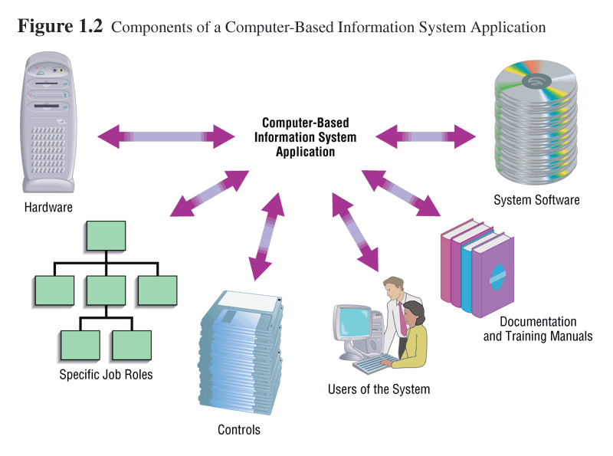
1.10

Slide 11
Software Engineering Process
A process used to create an information system
Consists of:
Methodologies
A sequence of step-by-step approaches that help develop the information system
Techniques
Processes that the analyst follows to ensure thorough, complete, and comprehensive analysis and design
Tools
Computer programs that aid in applying techniques
1.11

Slide 12
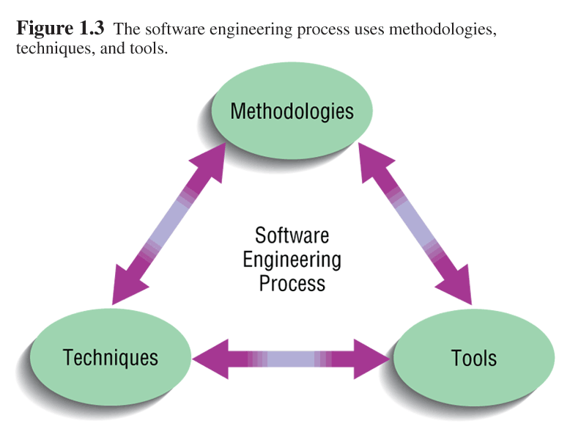
1.12

Slide 13
System
A system is an interrelated set of business procedures used within one business unit working together for a purpose
A system has nine characteristics
A system exists within an environment
A boundary separates a system from its environment
1.13

Slide 14
Characteristics of a System
Components
Interrelated Components
Boundary
Purpose
Environment
Interfaces
Constraints
Input
Output
1.14

Slide 15
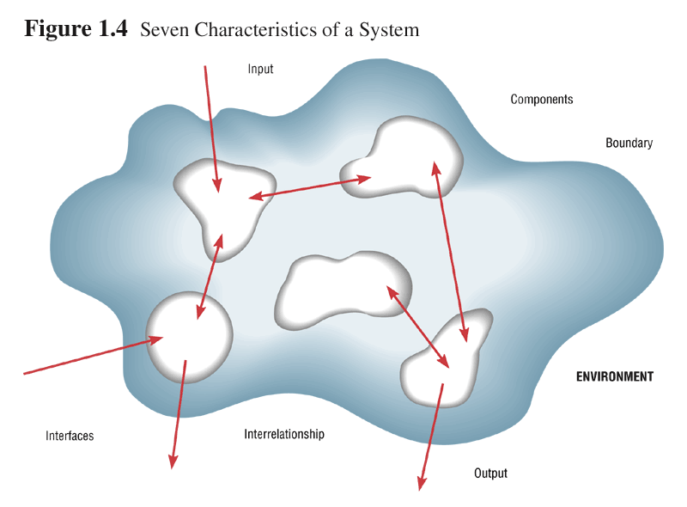
1.15

Slide 16
Important System Concepts
Decomposition
The process of breaking down a system into smaller components
Allows the systems analyst to:
Break a system into small, manageable and understandable subsystems
Focus on one area at a time, without interference from other areas
Concentrate on component pertinent to one group of users without confusing users with unnecessary details
Build different components at independent times and have the help of different analysts
1.16

Slide 17
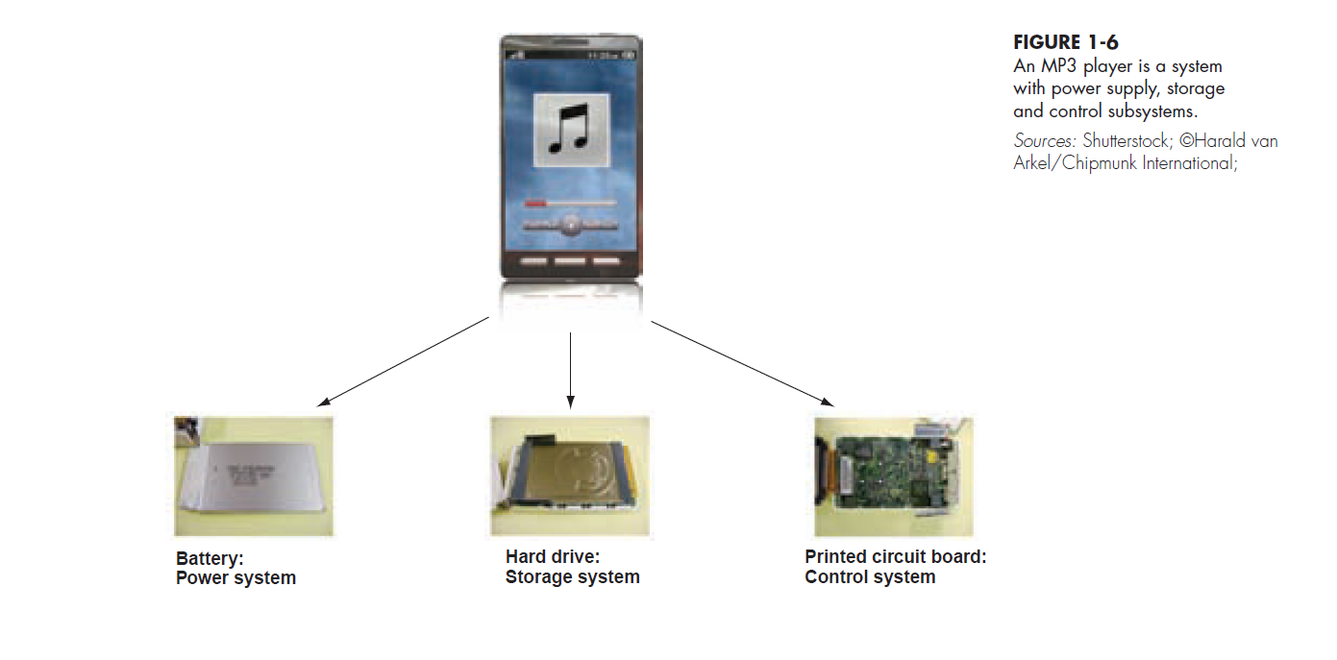
1.17

Slide 18
Important System Concepts (continued)
Modularity
Process of dividing a system into modules of a relatively uniform size
Modules simplify system design
Coupling
Subsystems that are dependent upon each other are coupled
Cohesion
Extent to which a subsystem performs a single function
1.18

Slide 19
A Modern Approach to Systems Analysis and Design
Systems Integration
Allows hardware and software from different vendors to work together
Enables procedural language systems to work with visual programming systems
Visual programming environment uses client/server model
1.19

Slide 20
Your Role in Systems Development
Study problems and needs of an organization
Determine best approach to improving organization through use of:
People
Methods
Information technology
Help system users and managers define their requirements for new or enhanced information systems
1.20

Slide 21
Developing Information Systems and the Systems Development Life Cycle
Systems Development Methodology
A standard process followed in an organization to conduct all the steps necessary to
analyze
design
implement
and maintain information systems.
1.21

Slide 22
Developing Information Systems and the Systems Development Life Cycle (continued)
Systems Development Life Cycle
Series of steps used to manage the phases of development for an information system
Consists of four phases:
Planning and Selection
Analysis
Design
Implementation and Operation
1.22

Slide 23
Developing Information Systems and the Systems Development Life Cycle (continued)
Phases are not necessarily sequential
Each phase has a specific outcome and deliverable
Every company customizes the life-cycle model to its individual needs
1.23

Slide 24
Phases of the Systems Development Life Cycle
1. Systems Planning and Selection
Two Main Activities
Identification of need
Investigation and determination of scope
2. Systems Analysis
Study of current procedures and information systems
Determine requirements
Generate alternative designs
Compare alternatives
Recommend best alternative
1.24

Slide 25
Phases of the Systems Development Life Cycle (continued)
3. System Design
Logical Design
Concentrates on business aspects of the system
Physical Design
Technical specifications
4. System Implementation and Operation
Implementation
Hardware and software installation
Programming
User Training
Documentation
1.25

Slide 26
Phases of the Systems Development Life Cycle (continued)
System Implementation and Operation (continued)
System changed to reflect changing conditions
System obsolescence
1.26

Slide 27
Alternative Approaches to Development
Prototyping
Building a scaled-down working version of the system
Advantages:
Users are involved in design
Captures requirements in concrete form
1.27

Slide 28
Alternative Approaches to Development (continued)
Computer-Assisted Software Engineering (CASE) Tools
Automated software tools used by systems analysts to develop information systems
Can be used throughout SDLC
Product and tool integration is provided through a repository
1.28

Slide 29
Alternative Approaches to Development (continued)
General types of CASE tools
Diagramming tools
Computer display and report generators
Analysis tools
Repository
Documentation generators
Code generators
1.29

Slide 30
Alternative Approaches to Development (continued)
Joint Application Design (JAD)
Users, Managers and Analysts work together for several days
System requirements are reviewed
Structured meetings
Rapid Application Development (RAD)
Utilizes prototyping to delay producing system design until after user requirements are clear
1.30

Slide 31
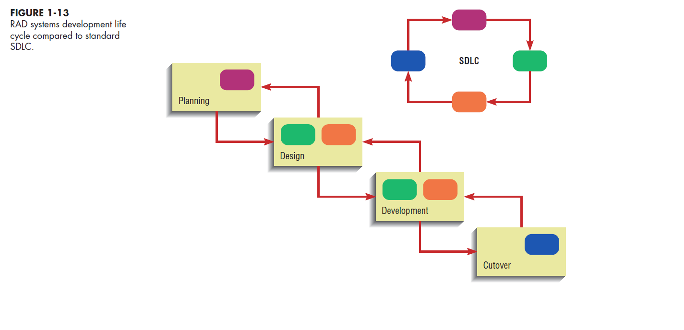
1.31

Slide 32
Approaches to Development (continued)
Participatory Design (PD)
Emphasizes role of the user
Entire user community can be involved in design
Agile Methodologies
Focuses on
Adaptive methodologies
People instead of roles
Self-adaptive development process
1.32

Slide 33
Summary
Information systems analysis and design
Process of developing and maintaining an information system
Modern approach to systems analysis
Process-oriented
Data-oriented
1.33

Slide 34
Summary (continued)
Role of Systems Analyst
Systems Development Life Cycle (SDLC)
Systems Planning and Selection
Systems Analysis
Systems Design
Systems Implementation
1.34

Slide 35
Summary (continued)
Alternatives to Systems Development Life Cycle
Prototyping
Rapid Application Development (RAD)
CASE
Joint Application Design (JAD)
Participatory Design (PD)
Agile Methodologies
1.35

Slide 36
All rights reserved. No part of this publication may be reproduced, stored in a retrieval system, or transmitted, in any form or by any means, electronic, mechanical, photocopying, recording, or otherwise, without the prior written permission of the publisher. Printed in the United States of America.
Copyright © 2021 Pearson Education, Inc.
Publishing as Prentice Hall

