Slide 1
Essentials of
Systems Analysis and Design
Fifth Edition
Joseph S. Valacich
Joey F. George
Jeffrey A. Hoffer
Chapter 4
Systems Planning and Selection
4.1

Slide 2
Learning Objectives
Describe the steps involved when identifying and selecting projects and initiating and planning projects
Discuss the content of and need for a project scope statement and baseline project plan
Describe various methods for accessing project feasibility
4.2

Slide 3
Learning Objectives (continued)
Explain intangible and tangible costs and benefits
Explain recurring and one-time costs
Describe various methods of cost/benefit analysis
Describe a structured walkthrough
4.3

Slide 4
Identifying and Selecting Projects
Sources of Projects
  Managers and business units
    to gain more information or provide new services
  Managers
    to make a system more efficient, less costly, or want a new operating environment
  Formal planning groups
    to improve an existing system in order to help the organization meet its corporate objectives
4.4

Slide 5
Identifying and Selecting Projects (continued)
1. Projects are identified by
    Top management
    Steering committee
    User departments
    Development group or senior IS staff
4.5

Slide 6
Identifying and Selecting Projects (continued)
  Top-Down identification
    Senior management or steering committee
    Focus is on global needs of organization
  Bottom-up identification
    Business unit or IS group
    Don’t reflect overall goals of the organization
4.6

Slide 7
Identifying and Selecting Projects (continued)
2. Classify and rank development projects
3. Select development projects
  Factors:
    Perceived needs of the organization
    Existing systems and ongoing projects
    Resource availability
    Evaluation criteria
    Current business conditions
    Perspectives of the decision makers
4.7

Slide 8
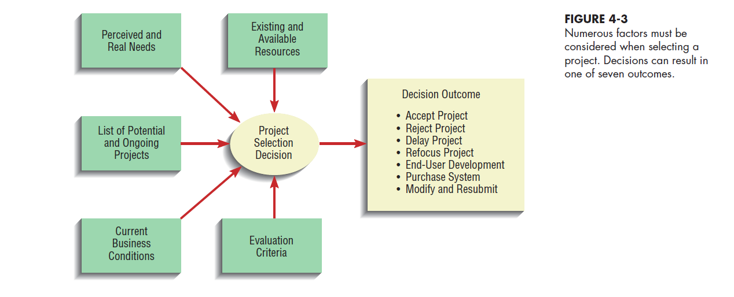
4.8

Slide 9
Identifying and Selecting Projects (continued)
Deliverables and Outcomes
  Primary deliverable of this phase is a schedule of specific IS development projects
  Incremental commitment
    Continuous reassessment of project after each phase
4.9

Slide 10
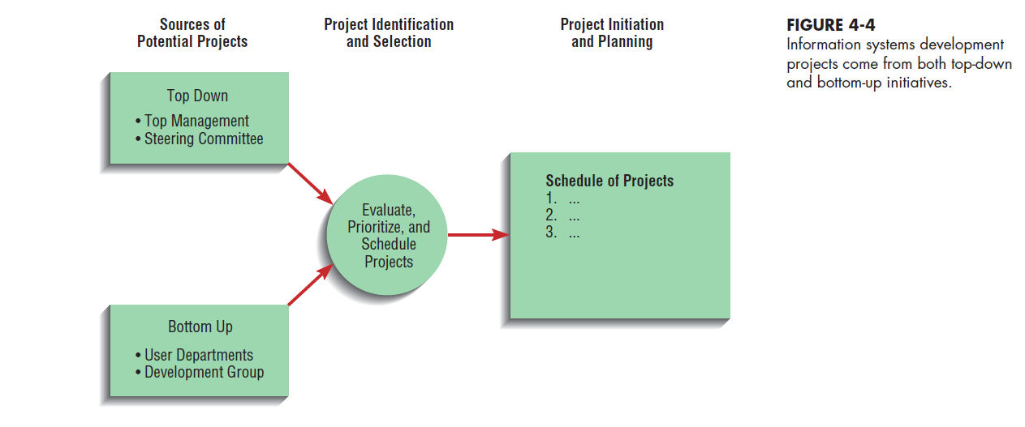
4.10

Slide 11
Initiating and Planning System Development Projects
Objectives
  Baseline Project Plan (BPP)
    Internal document
  Project Scope Statement
    Prepared for external and internal stakeholders
    Provides a high-level overview of the project
4.11

Slide 12
Assessing Project Feasibility
Six Categories
  Economic
  Operational
  Technical
  Schedule
  Legal and contractual
  Political
4.12

Slide 13
Assessing Economic Feasibility
Cost–Benefit Analysis
Determine Benefits
  Tangible benefits
    Can be measured easily
      Examples
        Cost reduction and avoidance
        Error reduction
        Increased flexibility
        Increased speed of activity
        Increased management planning and control
4.13

Slide 14
Assessing Economic Feasibility (continued)
  Intangible Benefits
    Cannot be measured easily
    Examples
      Increased organizational flexibility
      Increased employee morale
      Competitive necessity
      More timely information
      Promotion of organizational learning and understanding
4.14

Slide 15
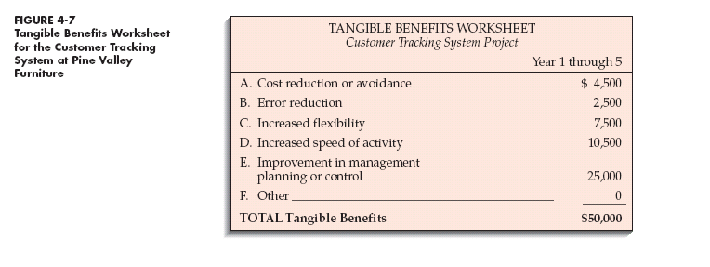
4.15

Slide 16
Assessing Economic Feasibility (continued)
Determine Costs
  Tangible Costs
    Can easily be measured in dollars
      Example: Hardware
  Intangible costs
    Cannot be easily measured in dollars
    Examples:
      Loss of customer goodwill
      Loss of employee morale
4.16

Slide 17
Assessing Economic Feasibility (continued)
  One-Time Costs
    Associated with project start-up, initiation and development
    Includes
      System development
      New hardware and software purchases
      User training
      Site preparation
      Data or system conversion
4.17

Slide 18
Assessing Economic Feasibility (continued)
  Recurring Costs
    Associated with on-going use of the system
    Includes:
      Application software maintenance
      Incremental data storage expense
      Incremental communications
      New software and hardware releases
      Consumable supplies
  Time value of money (TVM)
    The process of comparing present cash outlays to future expected returns

Slide 19
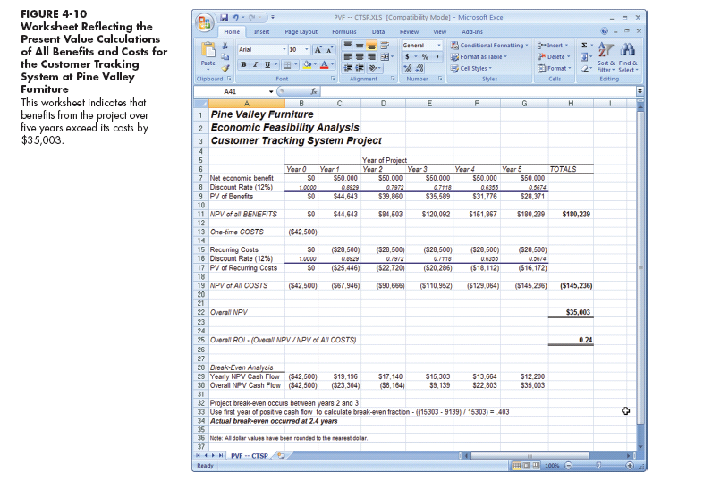
4.19

Slide 20
Assessing Other Feasibility Concerns
Operational Feasibility
  Assessment of how a proposed system solves business problems or takes advantage of opportunities
Technical Feasibility
  Assessment of the development organization’s ability to construct a proposed system
4.20

Slide 21
Assessing Other Feasibility Concerns (continued)
Schedule Feasibility
  Assessment of time-frame and project completion dates with respect to organization constraints for affecting change
Legal and Contractual Feasibility
  Assessment of legal and contractual ramifications of new system
4.21

Slide 22
Assessing Other Feasibility Concerns (continued)
Political Feasibility
  Assessment of key stakeholders’ view in organization toward proposed system
4.22

Slide 23
Building the Baseline
Project Plan
Objectives
  Assures that customer and development group have a complete understanding of the proposed system and requirements
  Provides sponsoring organization with a clear idea of scope, benefits and duration of project
4.23

Slide 24
Building the Baseline
Project Plan (continued)
Four Sections of a Baseline Project Plan:
  Introduction
  System description
  Feasibility assessment
  Management issues
4.24

Slide 25
Building the Baseline
Project Plan (continued)
Introduction
  Brief overview
  Recommended course of action
  Project scope defined
    Units affected
    Interaction with other systems
    Range of system capabilities
4.25

Slide 26
Building the Baseline
Project Plan (continued)
System Description
  Outline of possible alternative solutions
  Narrative format
Feasibility Assessment
  Project costs and benefits
  Technical difficulties
  High-level project schedule
4.26

Slide 27
Building the Baseline
Project Plan (continued)
Management Issues
  Outlines concerns that management may have about the project
  Team composition
  Communication plan
  Project standards and procedures
4.27

Slide 28
4.28

Slide 29
Reviewing the
Baseline Project Plan
Objectives
  Assure conformity to organizational standards
  All parties agree to continue with project
4.29

Slide 30
Reviewing the Baseline Project Plan (continued)
Walkthrough
  Peer group review
  Participants
    Coordinator
    Presenter
    User
    Secretary
    Standard Bearer
    Maintenance Oracle
  Activities
    Walkthrough review form
    Individuals polled
    Walkthrough action list
  Advantages
    Assures that review occurs during project
4.30

Slide 31
4.31

Slide 32
4.32

Slide 33
Electronic Commerce Application
Development process for Internet projects is no different than other projects
Special issues need to be taken into account
4.33

Slide 34
Electronic Commerce Application (continued)
Internet
  Worldwide network comprised of individual networks used for global computing and electronic commerce
Intranet
  Internet-based communication to support business activities within a single organization
Extranet
  Internet-based communication to support business-to-business activities
4.34

Slide 35
Electronic Commerce Application (continued)
Electronic Data Interchange (EDI)
  The use of telecommunications technologies to transfer business documents directly between organizations
Internet vs. Intranet/Extranet Apps
  Intranet/Extranet: Developer knows how application will be run and used
  Internet: Developer faces various unknowns
4.35

Slide 36
Summary
Project Identification and Selection involves:
  Identifying potential projects
  Classifying and ranking of projects
  Selecting projects
Baseline Project Plan (BPP)
  Created during project initiation and planning
4.36

Slide 37
Summary (continued)
  Contains:
    Introduction
    High-level description of system
    Outline of feasibility
    Overview of management issues
Project Scope Statement
  Describes what project will deliver
4.37

Slide 38
Summary (continued)
Feasibility
  Economic
  Operational
  Technical
  Schedule
  Legal
  Contractual
  Political
4.38

Slide 39
Summary (continued)
Benefits
  Tangible vs. Intangible
Costs
  Tangible vs. Intangible
  One-time vs. Recurring
Internet Applications
  Internet
  Intranet
  Extranet
4.39

Slide 40
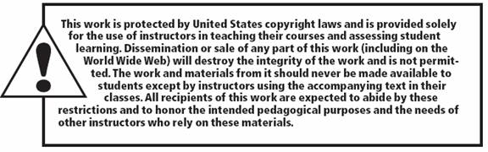
All rights reserved. No part of this publication may be reproduced, stored in a retrieval system, or transmitted, in any form or by any means, electronic, mechanical, photocopying, recording, or otherwise, without the prior written permission of the publisher. Printed in the United States of America.
Copyright © 2021 Pearson Education, Inc.
Publishing as Prentice Hall

