Slide 1
Relational Algebra

Slide 2
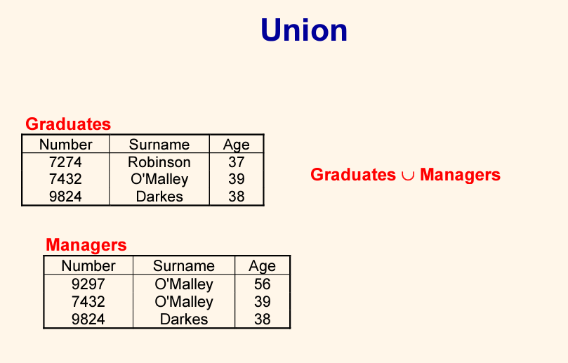
Existed in A AND in B without duplicate

Slide 3
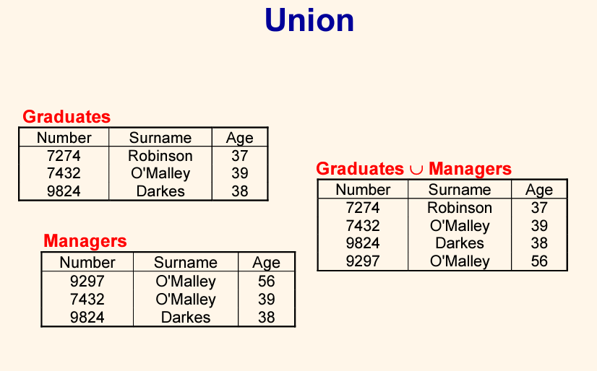
Existed in A AND in B without duplication /// Similar and Not Similar

Slide 4
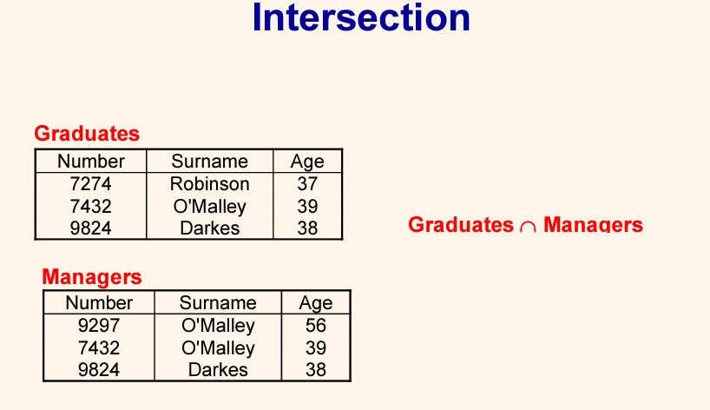


Slide 5
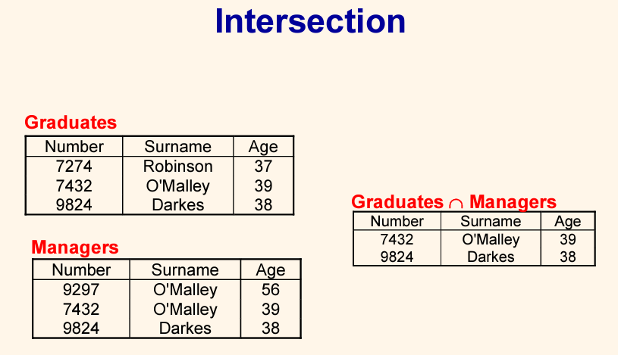
ONLY Similar ones

Slide 6
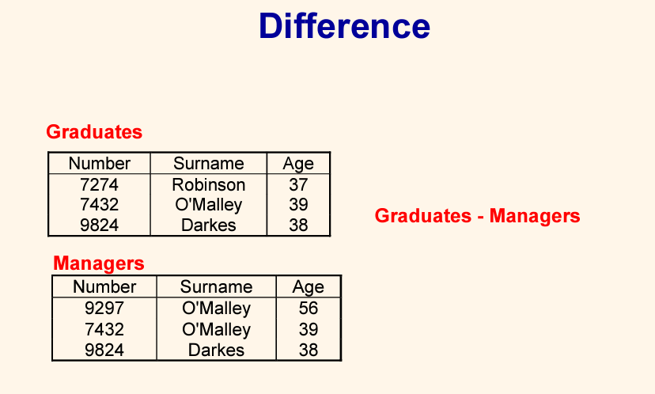
Existed in A and NOT Existed in B

Slide 7
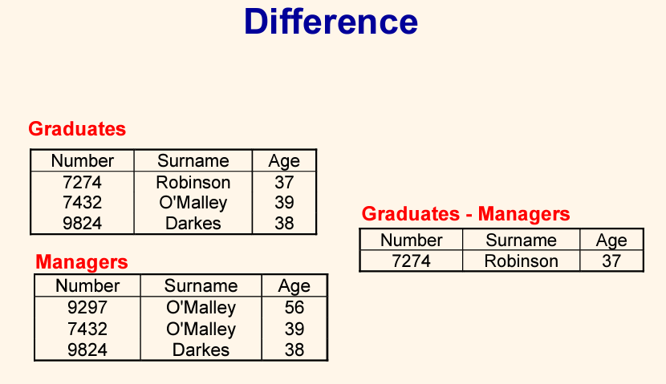
Existed in A and NOT Existed in B

Slide 8
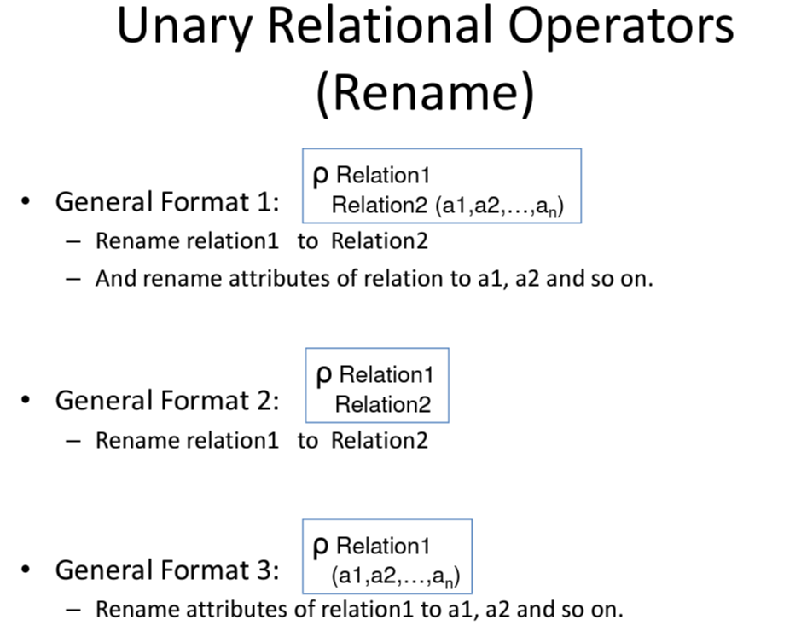

Slide 9
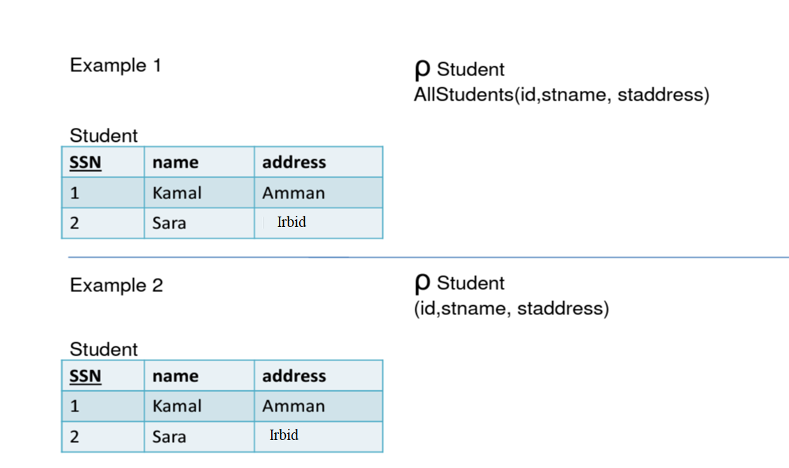

Slide 10
