Slide 1
Greedy Algorithms
Dr. Maram Bani Younes

Slide 2
Contents
Greedy Algorithm
Huffman Coding Tree
Shortest Path problem (Dijkstra algorithm)
Minimum Cost Spanning Tree (Kruskal’s algorithm)

Slide 3
Greedy Algorithm
A greedy algorithm is any algorithm that follows the problem-solving heuristic of making the locally optimal choice at each stage.
In many problems, a greedy strategy does not produce an optimal solution, but a greedy heuristic can yield locally optimal solutions that approximate a globally optimal solution in a reasonable amount of time.

Slide 4
Huffman Coding Tree
The space/time tradeoff suggests that one can often gain an improvement in space requirements in exchange for a penalty in running time. A typical example is storing files on disk.
If the files are not actively used the owner may wish to compress them to save space. And then, they can be uncompressed for use, which costs some time, but only once.

Slide 7
Building Huffman Coding Trees
Huffman coding tree assigns codes to characters such that the length of the code depends on the relative frequency or weight of the corresponding character, (it is variable-length code).
Huffman code for each letter is derived from a full binary tree called Huffman tree. Each leaf corresponds to a letter. The goal is to build a tree with a minimum external path weight.
Weighted path length of a leaf to be its weight times its depth. A letter with high weight should have low depth.

Slide 8
Process of Building the Huffman Tree
First order the letters in a list by ascending weight (frequency).
Remove the first two letters (ones with lowest weight), from the list and assign them to leaves in what will become the Huffman tree.
Assign these leaves as the children of an internal node whose weight is the sum of the weights for the two children.
Put the sum back on the list in correct place necessary to preserve the order of the list.
The process is repeated until only one item remains on the list.

Slide 9
Example
This process will build a full Huffman tree.
Z K F C U D L E
2 7 24 32 37 42 42 120

Slide 10
Note
This is an example of a greedy algorithm, because at each step, the two sub trees with least weight are joined together.

Slide 11
Assigning Huffman Codes
After the Huffman tree is constructed we start assigning codes to individual letters. Start at the ROOT, we assign either a (0), or a (1), to each edge in the tree.
Zero is assigned to edges connecting a node with its left child, and (one) to the right child.
The Huffman code for a letter is simply a binary number determined by the path from the root to the leaf corresponding to that letter.

Slide 12
Letter | Frequency | Code | Bits
C | 32 | 1110 | 4
D | 42 | 101 | 3
E | 120 | 0 | 1
F | 24 | 11111 | 5
K | 7 | 111101 | 6
L | 42 | 110 | 3
U | 37 | 100 | 3
Z | 2 | 111100 | 6

Slide 13
Decoding the message
Decoding the message is done by looking at the bits in the coded string from left to right until a letter is decoded.
This can be done using the Huffman tree in a reverse process from that used to generate the codes.
We start from the root; we take branches depending on the bit value (0 left, 1 right), until reaching a leaf node.
A set of codes is said to meet the prefix property, if no code in the set is the prefix of another. The prefix property guarantees that there will be no ambiguity in how a bit string is decoded. i.e. once we reach the last bit of a code during the decoding process, we know which letter it is the code for.

Slide 16
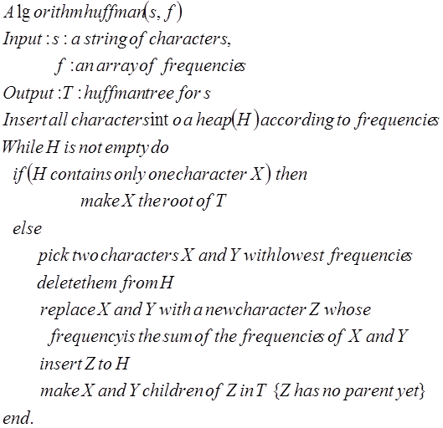

Slide 17
Implementation
The operations required for Huffman’s encoding are
Insertions into a data structure
Deletions of the two characters with minimal frequency from heap
Building the tree
A heap is a good data structure for the 1st two operations, each of which requires O(lgn) steps in the worst case.

Slide 18
Complexity
Building the tree takes constant time per node.
Insertions and deletions take O(lgn) steps each.
Overall, the running time of the algorithm is O(nlgn).

Slide 19
Shortest Path problem (Dijkstra algorithm)
Use an adjacency matrix representation, in which the edge lengths are the cost (distances, times…), associated with the edges. Then we initialize an array called Dist to equal the 1st row of the edge matrix.

Slide 20
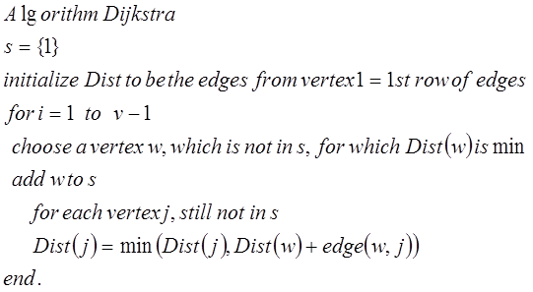

Slide 21
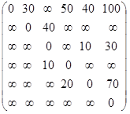
Iter | S | W | Dist(2) | Dist(3) | Dist(4) | Dist(5) | Dist(6)
initial | {1} | - | 30* | ∞ | 50 | 40 | 100
1 | {1,2} | 2 | 30 | 70 | 50 | 40* | 100
2 | {1,2,5} | 5 | 30 | 70 | 50* | 40 | 100
3 | {1,2,5,4} | 4 | 30 | 60* | 50 | 40 | 100
4 | {1,2,5,4,3} | 3 | 30 | 60 | 50 | 40 | 90*
5 | {1,2,5,4,3,6} | 6 | 30 | 60 | 50 | 40 | 90

Slide 22
This algorithm is called a greedy algorithm, because at each stage it simply does what is locally optimal.
If the graph is undirected, we can think of it as a directed graph such that each undirected edge corresponds to two directed edges in opposite directions with the same length.
Computes the cost of the shortest path from V₀ to each vertex requires O(n²) time.

Slide 23
Minimum Cost Spanning Tree (Kruskal’s algorithm)

Slide 26
