Slide 1
Algorithm
Introduction (Ch1)
DR. Maram Bani Younes

Slide 2
Contents
Algorithm Definition
Algorithm Features
Problem Types
Algorithm Design and Analysis
Algorithm Design Strategies
Fundamental Data Structure

Slide 3
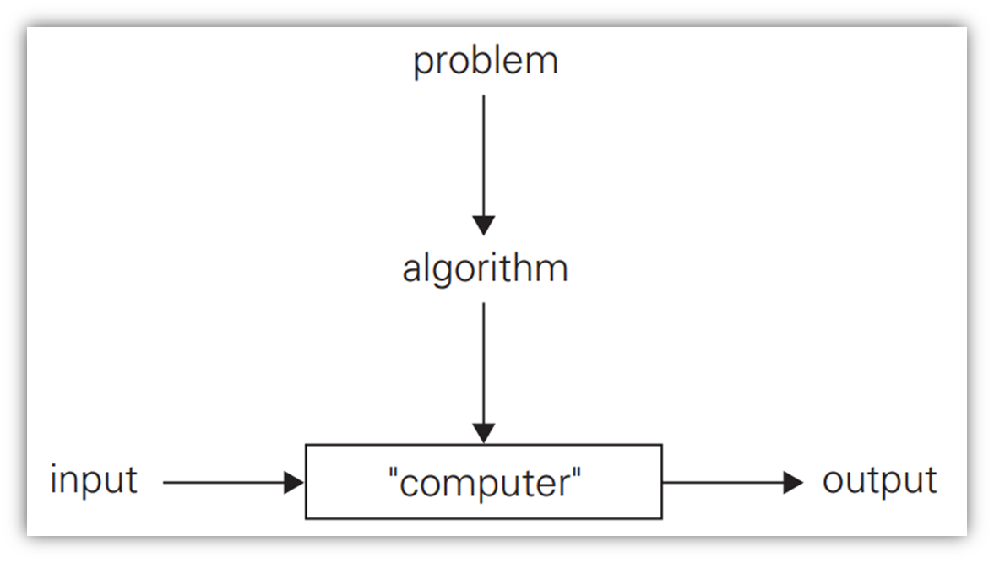
1. Algorithm Definition
A finite set of rules which give a sequence of operations for solving a specific type of problem.

Slide 4
2. Algorithm Features
Finiteness: An algorithm must always terminate after a finite number of steps.
Definiteness: Each step of an algorithm must be precisely defined; the actions to be carried out must be rigorously and unambiguously specified for each case.
Input: An algorithm has zero or more inputs (externally supplied) i.e. quantities which are given to it initially before the algorithm begins.
Output: An algorithm has one or more outputs produced. i.e. quantities which have a specified relation to the inputs.
Effectiveness: An algorithm should consider the time and memory recourses.

Slide 5

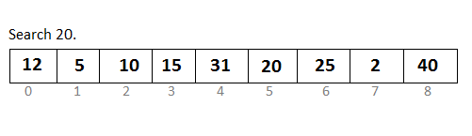
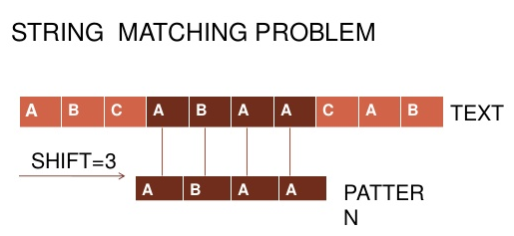
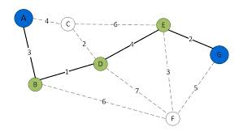
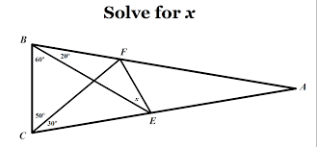
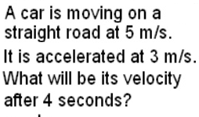
3. problem types
Sorting
Searching
String processing
Graph problems
Geometric problems
Numerical problems

Slide 6
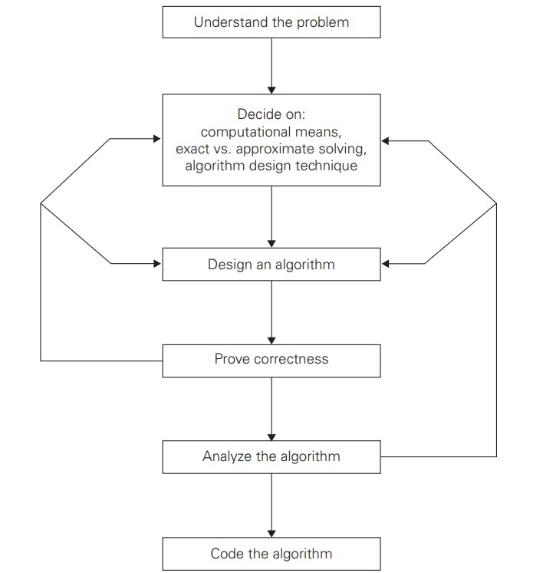
4. Algorithm design and analysis
Understand the problem
Decide on: computational means, exact vs. approximate solving, algorithm design technique
Design an algorithm (Natural language, pseudocode, flowchart)
Prove correctness
Analyse the algorithm and data structure
  Efficiency (time & space)
  Simplicity
  Generality
Code the algorithm

Slide 7
5. Algorithm design strategies
Brute force
    straightforward methods of solving a problem that rely on sheer computing power and trying every possibility rather than advanced techniques to improve efficiency.
Divide and conquer
    recursively breaks down a problem into two or more sub-problems of the same or related type, until these become simple enough to be solved directly. The solutions to the sub-problems are then combined to give a solution to the original problem.

Slide 8
5. Algorithm design strategies
Greedy approach
    an approach for solving a problem by selecting the best option available at the moment.
Dynamic programming
    is an algorithmic technique for solving an optimization problem by breaking it down into simpler subproblems and utilizing the fact that the optimal solution to the overall problem depends upon the optimal solution to its subproblems.

Slide 9
5. Algorithm design strategies
Backtracking
    is used to find all possible solutions available to a problem. When it realizes that it has made a bad choice, it undoes the last choice by backing it up. It searches the state space tree until it has found a solution for the problem.
Branch-and-bound
    is used to solve optimization problems. When it realizes that it already has a better optimal solution that the pre-solution leads to, it abandons that pre-solution. It completely searches the state space tree to get optimal solution.

Slide 10
6. Fundamental Data structures
A data structure can be defined as a particular scheme of organizing related data items.
The nature of the data can range from data types (e.g., integers or characters) to data structures (e.g., one-dimensional array)
Data Structures
  Lists (array, string, linked list, stack, queue)
  Graphs
  Trees
  Sets

Slide 11

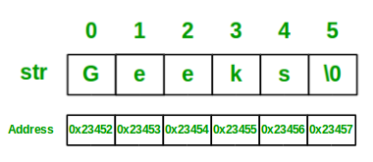


6.1. Linear Data Structures
A linear list or simply a list is a finite sequence of data items, i.e., a collection of data items arranged in a certain linear order
A (one-dimensional) array is a sequence of n items of the same data type that are stored contiguously in computer memory and made accessible by specifying a value of the array’s index
A string is a sequence of characters from an alphabet terminated by a special character indicating the string’s end.
A linked list is a sequence of zero or more elements called nodes, each containing two kinds of information: some data and one or more links called pointers to other nodes of the linked list.
  Singly linked list
  Doubly linked list

Slide 12
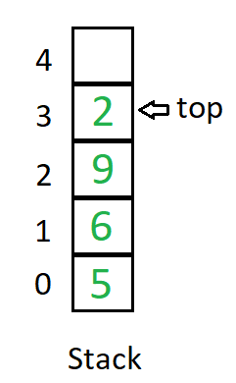
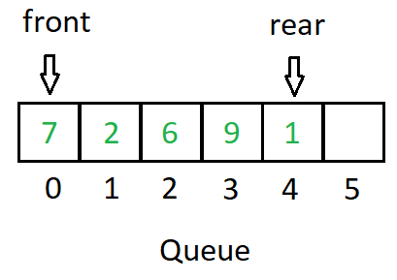
6.1. Linear Data Structures
A linear list or simply a list is a finite sequence of data items, i.e., a collection of data items arranged in a certain linear order
A stack is a list in which insertions and deletions can be done only at the end (top)
  last-in–first-out (LIFO)
A queue is a list from which elements are deleted from one end of the structure, called the front, and new elements are added to the other end (rear)
  first-in–first-out (FIFO)

Slide 13
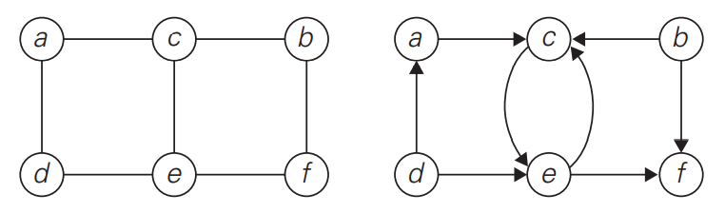
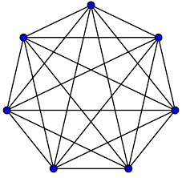
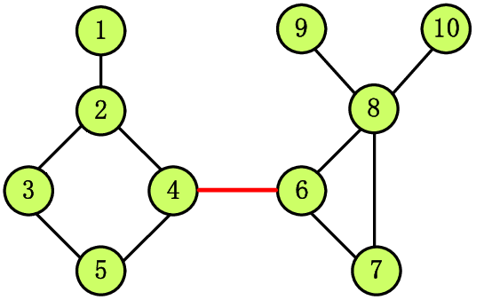
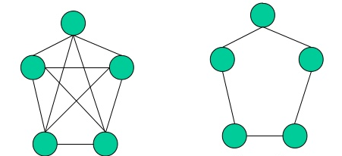
6.2. Graphs
A graph is informally thought of as a collection of points in the plane called “vertices” or “nodes,” some of them connected by line segments called “edges” or “arcs.”
Formally, a graph G = ‹V,E› is defined by a pair of two sets: a finite nonempty set V of items called vertices and a set E of pairs of these items called edges.
Undirected vs directed graphs
Complete graph
Connected graph
Dense vs sparse graphs

Slide 14
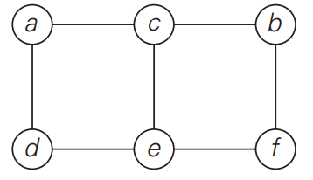
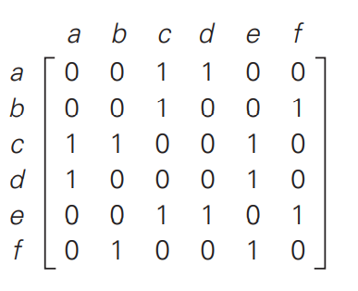
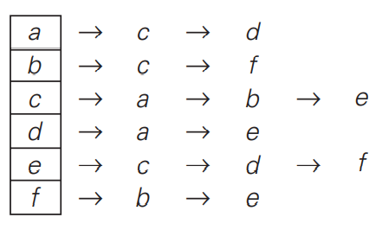
6.2. Graphs Representations
The adjacency matrix of a graph with n vertices is an n × n boolean matrix with one row and one column for each of the graph’s vertices, in which the element in the ith row and the jth column is equal to 1 if there is an edge from the ith vertex to the jth vertex, and equal to 0 if there is no such edge.
The adjacency lists of a graph or a digraph is a collection of linked lists, one for each vertex, that contain all the vertices adjacent to the list’s vertex (i.e., all the vertices connected to it by an edge).

Slide 15
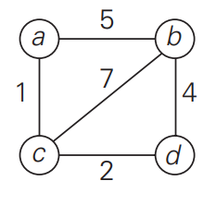
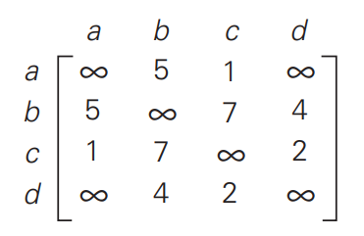
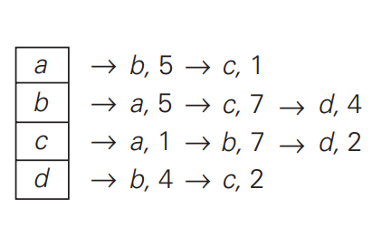
6.2. Graphs
A weighted graph (or weighted digraph) is a graph (or digraph) with numbers assigned to its edges.
These numbers are called weights or costs.
An interest in such graphs is motivated by numerous real-world applications, such as finding the shortest path between two points in a transportation or communication network or the traveling salesman problem.

Slide 16
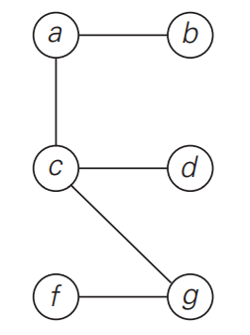
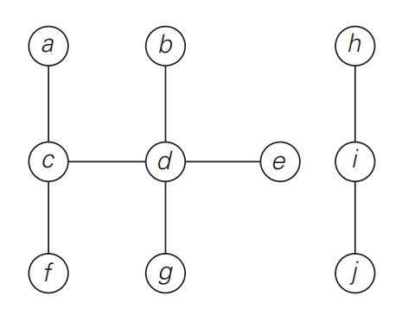
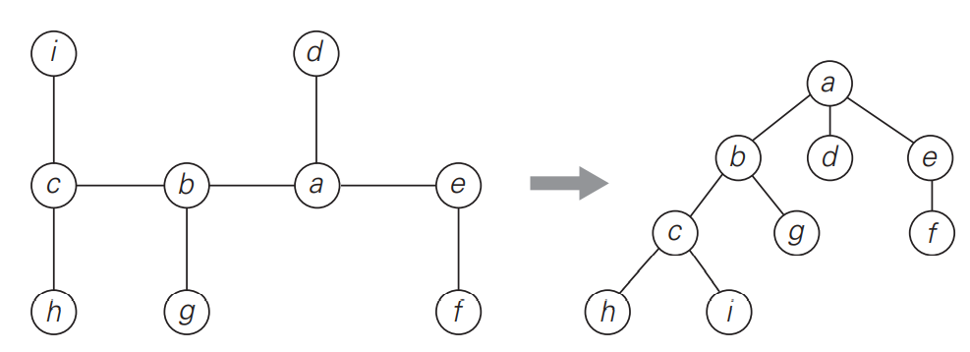
6.3. Trees
A tree (more accurately, a free tree) is a connected acyclic graph
A graph with no cycles is said to be acyclic
A graph that has no cycles but is not necessarily connected is called a forest: each of its connected components is a tree
For every two vertices in a tree, there always exists exactly one simple path from one of these vertices to the other.
Select an arbitrary vertex in a free tree and consider it as the root of the so-called rooted tree.

Slide 17
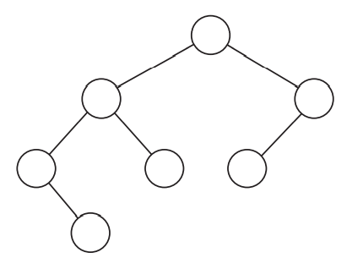
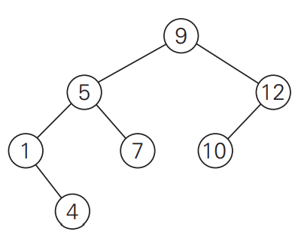
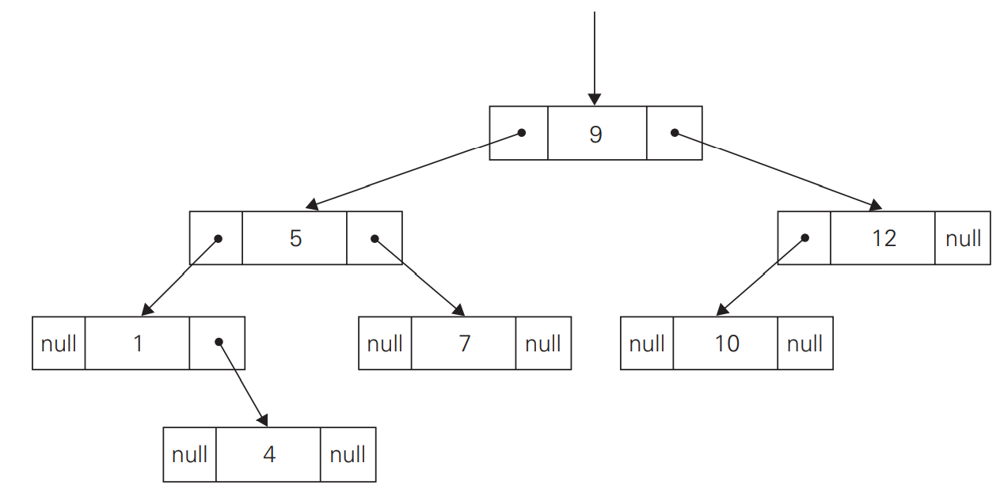
6.4. Trees
Ordered Trees An ordered tree is a rooted tree in which all the children of each vertex are ordered. It is convenient to assume that in a tree’s diagram, all the children are ordered left to right.
A binary tree can be defined as an ordered tree in which every vertex has no more than two children and each child is designated as either a left child or a right child of its parent; a binary tree may also be empty.
A number assigned to each parental vertex is larger than all the numbers in its left subtree and smaller than all the numbers in its right subtree. Such trees are called binary search trees.

Slide 18
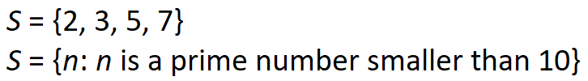
6.5. Sets
In mathematic, a set can be described as an unordered collection (possibly empty) of distinct items called elements of the set.
A set is represented by:
  bit vector (011010100 for
  S = {2, 3, 5, 7} if U= {1, 2, 3, 4, 5, 6, 7, 8, 9}
  and S is a subset of U )
  list

