Slide 1
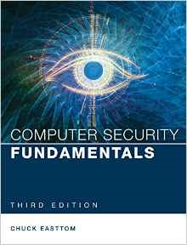
Computer Security Fundamentals
Chuck Easttom
Chapter 1 Introduction to Computer Security

Slide 2
Chapter 1 Objectives
Identify top threats to a computer network
Assess the likelihood of an attack
Define key terms like cracker, sneaker, firewall, and authentication
Compare and contrast perimeter and layered approaches to network security
Use online resources
Notes:
Identify the top threats to a computer network: malware, intrusion, Denial of service attacks
Assess the likelihood of an attack on your personal computer and network
Define key terms such as cracker, sneaker, firewall and authentication
Compare and contrast perimeter and layered approaches to network security
Use online resources to secure your network (find out who the address belongs to)

Slide 3
Introduction
Computer systems and networks are all around us.
  Online banking
  Automated supermarket checkouts
  Online classes
  Online shopping
  Online travel resources
Notes:
Computer systems are everywhere.
Online banking, ATMs, debit cards
E-Bay, Amazon, Half.com for textbooks
Expedia, Travelocity, airplane e-tickets

Slide 4
Introduction (cont.)
How is personal information safeguarded?
What are the vulnerabilities?
What secures these systems?
Notes:
How is my online personal information safeguarded?
Passwords, account numbers, etc.
What are the vulnerabilities to these systems?
Web site security
What steps are taken to ensure that these systems and data are safe?
SSL, Encryption, etc.

Slide 5
How Seriously Should You Take Threats to Network Security?
Which group do you belong to?
  “No one is coming after my computer.”
  “The sky is falling!”
  Middle ground.
Notes:
Which group do you belong to?:
“No one is coming after me/my computer.”
Prove to me that I am at risk
Ostrich Theory
“The sky is falling!!”
Prove to me that I am not at risk
Paranoia
Middle Ground
An educated awareness of true risk

Slide 6
Identifying Types of Threats
Malware: MALicious softWARE
Security Breaches
DoS: Denial of Service attacks
Web Attacks
Session Hijacking
DNS Poisoning
Insider Threats
Notes:
Malware – MALicious softWARE, the most common threat to your system
Intrusions – an attempt to gain unauthorized access to your system
DoS – Denial of Service attacks, attempts to deny authorized users access to the system

Slide 7
Malware
Software with a malicious purpose
  Virus
  Trojan horse
  Spyware
  Logic Bomb
Notes:
Virus – “a small program that replicates itself and hides itself inside other programs, usually without your knowledge” (Symantec, 2003)
Trojan horse - a malicious program disguised as something desirable or harmless
Spyware – the fastest-growing category of malware

Slide 8
Malware (cont.)
Virus
  One of the two most common types
  Usually spreads through e-mail
  Uses system resources, causing slowdown or stoppage
Notes:
One of the two most common types of malware
Usually spreads itself through unsuspecting user’s e-mail
Even without malicious payload, rapid replication uses system resources, causing slow down or stoppage

Slide 9
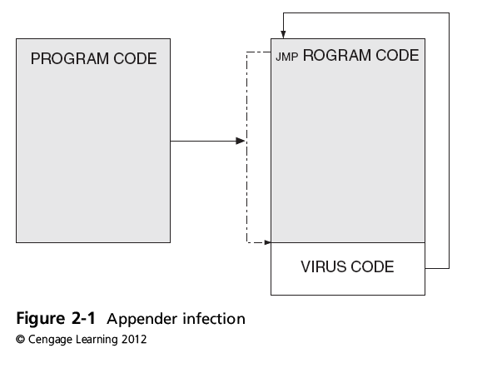
Malware That Spreads (cont’d.)

Slide 10
Malware (cont.)
Trojan Horse
  The other most common kind of malware
  Named after the wooden horse of ancient history
Notes:
The other most common kind of malware
Named after the famous wooden horse of ancient history
It disguises itself as something benign, something you need or want, i.e. a game, screen saver, account logon, etc
It captures your information and returns it to the intruder

Slide 11
Malware (cont.)
Spyware
  The most rapidly growing types of malware
    Cookies
    Key logger
Notes:
Spyware is the most rapidly growing type of malware.
Cookies: initially a good idea to help users surf the Web, now misused to spy on users
Key logger: both in software and hardware, captures all the user’s typing and logs it, capturing passwords, account numbers, credit card numbers, etc.

Slide 12
Malware (cont.)
Logic Bomb
  Lays dormant until some logical condition is met, often a specific date.
Notes:
Spyware is the most rapidly growing type of malware.
Cookies: initially a good idea to help users surf the Web, now misused to spy on users
Key logger: both in software and hardware, captures all the user’s typing and logs it, capturing passwords, account numbers, credit card numbers, etc.

Slide 13

Compromising System Security
Intrusions
  Attacks that break through system resources
    Hackers
    Crackers
    Social engineering
    War-driving
Notes:
Intrusions are attacks that break through your system’s resources without authorization
Hackers – early internet joy riders, by intent not malevolent
Crackers – system intruders, with malevolent intent
Social Engineering – intruding into a system using human nature, not technology
War driving – driving around looking for unprotected wireless networks

Slide 14

Denial of Service Attacks
The attacker does not intrude into the system but just blocks access by authorized users.
Notes:
The attacker does not actually intrude into the system, just blocks access from authorized users
Keeps your customers from purchasing on your Web site, denying you sales
Keeps your employees from purchasing e-tickets to a trade show, making them use a travel agent, which costs more money than you had planned
Keeps you from transferring the money from your business Line of Credit to your business account to pay for the tickets, causing your account to be overdrawn

Slide 15

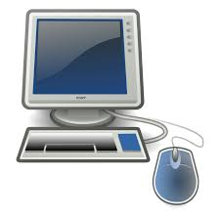
Example 1 DoS
  Ping flood attack : a faster, more powerful computer rapidly sends a large number of ICMP (Internet Control Message Protocol ) echo requests, overwhelming a smaller, slower Web server computer
ICMP ping
Echo request
Slower
Faster
Echo reply

Slide 16
Example 2 DoS
src: victim
dst: broadcast address
From the presentation: Smurf Attack Description & Suppression by Craig A. Huegen (Cisco Systems)

Slide 17
Web Attacks
The attacker attempts to breach a web application. Common attacks of this type are SQL injection and Cross Site Scripting.
Notes:
The attacker does not actually intrude into the system, just blocks access from authorized users
Keeps your customers from purchasing on your Web site, denying you sales
Keeps your employees from purchasing e-tickets to a trade show, making them use a travel agent, which costs more money than you had planned
Keeps you from transferring the money from your business Line of Credit to your business account to pay for the tickets, causing your account to be overdrawn

Slide 18
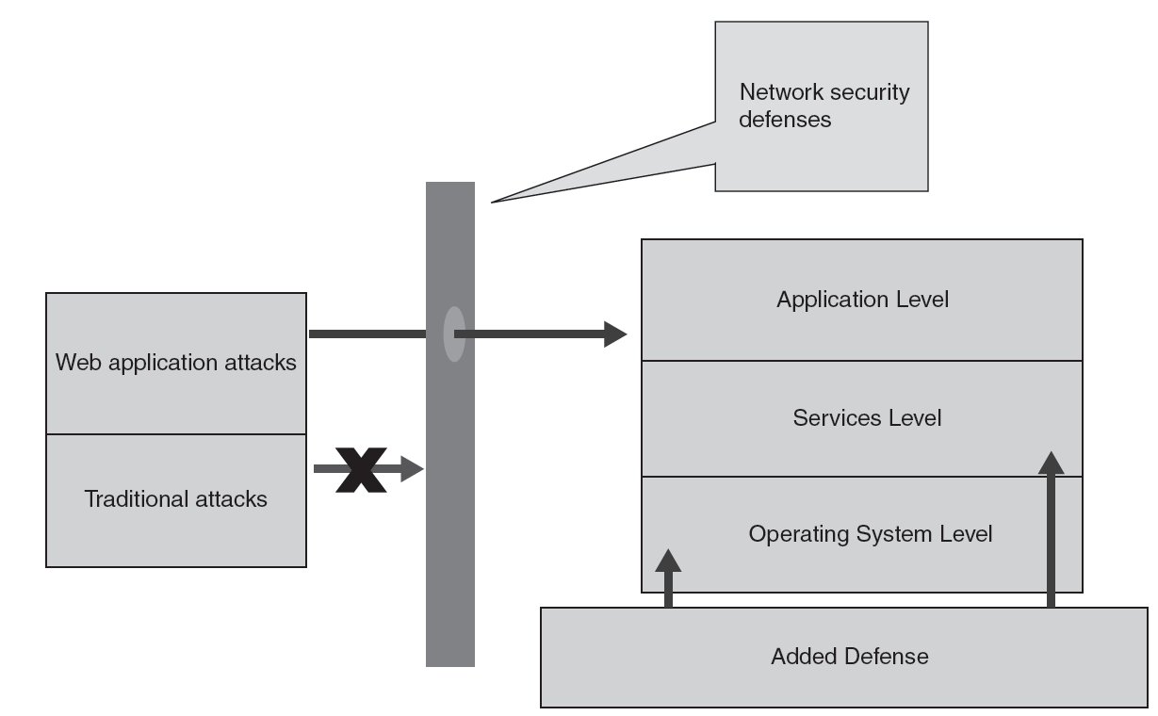
Figure 3-2 Web application security
© Cengage Learning 2012
By design, the user’s input through the Web browser using HTTP must be processed by Web applications at the application level

Slide 19
Session Hijacking
This is a complex attack that involves actually taking over an authenticated session.
Notes:
The attacker does not actually intrude into the system, just blocks access from authorized users
Keeps your customers from purchasing on your Web site, denying you sales
Keeps your employees from purchasing e-tickets to a trade show, making them use a travel agent, which costs more money than you had planned
Keeps you from transferring the money from your business Line of Credit to your business account to pay for the tickets, causing your account to be overdrawn

Slide 20
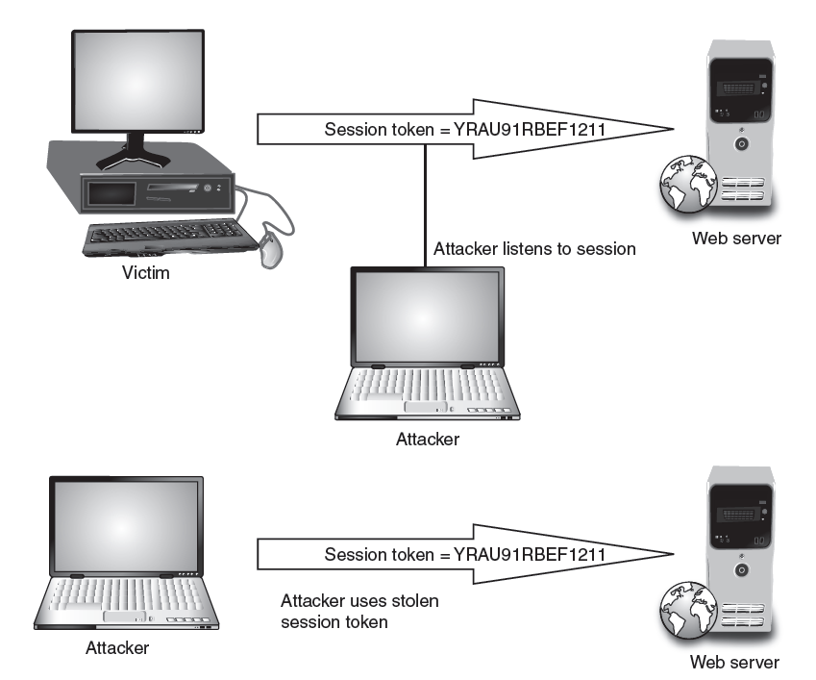
Figure 3-7 Session hijacking
© Cengage Learning 2012

Slide 21
DNS Poisoning
This involves altering DNS records on a DNS server to redirect client traffic to malicious websites, usually for identity theft.
Notes:
The attacker does not actually intrude into the system, just blocks access from authorized users
Keeps your customers from purchasing on your Web site, denying you sales
Keeps your employees from purchasing e-tickets to a trade show, making them use a travel agent, which costs more money than you had planned
Keeps you from transferring the money from your business Line of Credit to your business account to pay for the tickets, causing your account to be overdrawn

Slide 22
Assessing the Likelihood of an Attack on Your Network
Viruses
  Catch up on new and refurbished viruses
Unauthorized use of systems
  DoS attacks
  Intrusions
  Employee misuse
Notes:
Viruses are most common network attacks
Check any AV vendor Web site to catch up on new and refurbished viruses
Unauthorized use of systems is the next most common attack
DoS attacks
Intrusions
Employee misuse, either deliberate or accidental

Slide 23
Basic Security Terminology
People:
  Hackers
    White hats
    Black hats
    Gray hats
  Script kiddies
  Sneakers
  Ethical hackers
Notes:
People
Hackers – anyone who studies a system through analyzing its flaws
White hats – Consider themselves the “good guys”
Black hats – Or “crackers” are definitely the “bad guys”
Gray hats – Not a common term; refers to individuals who operate out side of the law on occasion
Script kiddies – Inexperienced; consider themselves hackers, but only copy the work of others
Ethical hackers – Consultants who are hired to do vulnerability assessments on company systems

Slide 24
Basic Security Terminology (cont.)
Devices
  Firewall
    Filters network traffic
  Proxy server
    Disguises IP address of internal host
  Intrusion Detection System
    Monitors traffic, looking for attempted attacks
Notes:
Firewalls – Found in a router or a server or as a stand-alone device, it filters ingress and egress network traffic.
Proxy server – This sits between a client and an application, acting as the host on your network, disguising the IP address of your internal host.
Intrusion Detection System – IDS monitors traffic, looking for attempted attacks.

Slide 25
Basic Security Terminology (cont.)
Activities
  Authentication
  Auditing
Notes:
Phreaking – A subspecialty of hacking, breaking into telephone systems, it gave Kevin Mitnick his start down the road to prison.
Authentication – Process todetermine if the credentials given by a user are authorized to access system resources.
Auditing – Process of reviewing logs, records, and procedures to ensure established standards are being met; tedious but critical.

Slide 26
Network Security Paradigms
How will you protect your network?
  CIA Triangle (Confidentiality, Integrity, Availability: Cryptography)
  Least Privileges
  Perimeter security approach
  Layered security approach
  Proactive versus reactive
  Hybrid security method
Notes:
How will you protect our network?
Perimeter security approach
Perimeter Defense is the most popular because it used to be clearly defined, but as companies hire mobile workers, home workers, and contract workers, the perimeter is becoming less and less clearly defined.
Layered security approach
Not only the perimeter but separate sections of the network are protected to the security level assigned to them.
Proactive Versus Reactive
Are your security measures active or passive?
Do you have a security plan, or are you part of someone else’s plan to intrude on you?
Hybrid Security Method
Only a thorough and ongoing risk assessment and vulnerability can keep you informed about what combination of postures will benefit your network the most.

Slide 27
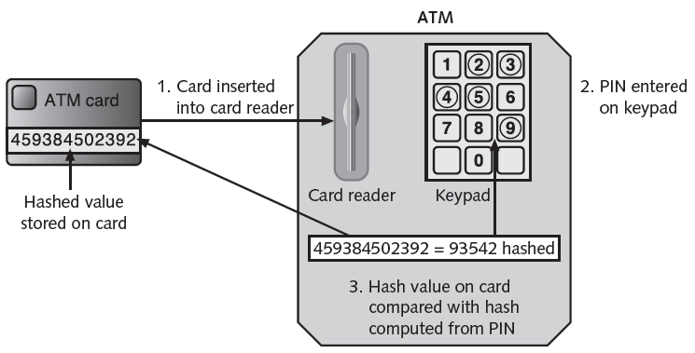
Figure 11-3 Hashing at an ATM
© Cengage Learning 2012

Slide 28
How Do Legal Issues Impact Network Security?
The Computer Security Act of 1987
OMB Circular A-130
See www.alw.nih.gov/Security/FIRST/papers/ legal/statelaw.txt for state computer laws
Health Insurance Portability and Accountability Act of 1996, HIPAA
Notes:
The Computer Security Act of 1987, the first piece of U.S. legislation to affect computer systems
OMB Circular A-130, a more specific federal law that addresses the idea of security standards

Slide 29
Online Security Resources
CERT (Computer Emergency Readiness Team)
  www.cert.org
Microsoft Security Advisor
  www.microsoft.com/security/default.mspx
  F-Secure (Information on virus outbreaks)
  www.f-secure.com
  SANS (Documentation on computer security issues)
  www.sans.org
Notes:
CERT
Computer Emergency Response Team, sponsored by Carnegie-Mellon University, the first computer incident response team
Microsoft Security Advisor
Microsoft security information, tools, and updates
F-Secure
Information on virus outbreaks
SANS
Documentation on computer security issues

Slide 30
Summary
Network security is a constantly changing field.
You need three levels of knowledge.
  Take the courses necessary to learn the basic techniques.
  Learn your enterprise system intimately, with all its strengths and vulnerabilities.
  Keep current in the ever-changing world of threats and exploits.

