Slide 1
Inspecting Application Layer Protocols: DNS

Slide 2
Contents
DNS: Domain Name Sever
Breaking Down DNS Types (RR)
Common DNS RR Types
Examining the RR structure
Reviewing the DNS packet

Slide 3
DNS: Domain Name Sever
The Domain Name System (DNS) converts a human-readable hostname into an Internet Protocol (IP) address.
It is one of the most common application layer protocols in use today and is essential to any network.

Slide 4
Breaking Down DNS Types
Breaking down DNS types Whenever you send a request to a DNS server, the request will include the type of record to return (RR).
Although there are many types of DNS RR, we'll take a look at some common types.
For a comprehensive list of DNS types, visit:
https://phoenixnap.com/kb/dns-record-types

Slide 5
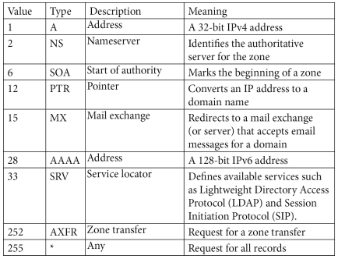
Common DNS RR Types

Slide 6
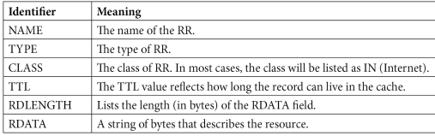
Examining the RR structure
The structure of all RRs contains elements that describe the RR, as shown in the following table:

Slide 7
Example of an RR answer in a DNS response packet
CloudShark (https://www. cloudshark.org/captures/13833cdd14ba).
Download the file, DNS Question & Answer.pcapng, and open it in Wireshark.

Slide 8
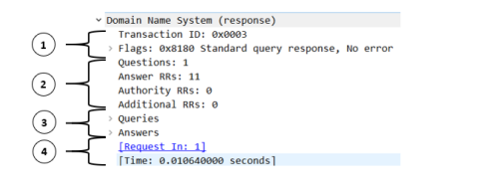
Reviewing the DNS packet
• The first section (1) is the DNS header.
• The second section (2) summarizes the contents.
• The third section (3) is the query section.
• The fourth section (4) are Wireshark-specific references.

Slide 9
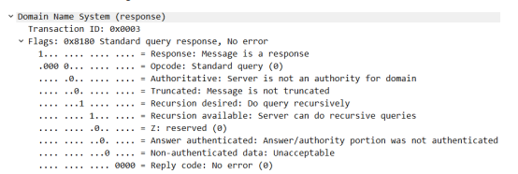
Examining the header
When examining the header fields, you will see two main sections:
  Transaction ID
  Flags

Slide 10
Transaction ID
Transaction ID is an essential element of a DNS packet, as it identifies the specific DNS transaction during the exchange of the query and response packets.
Wireshark keeps track of Transaction ID so that you can easily reference parts of the transaction.

Slide 11
Comparing the Flags
When comparing the flags in a DNS header, you will see a distinct difference between the packet coming from the client and the packet coming from the server.

Slide 12
The Flags From the Client
Response: Set at 0, which indicates that the message is a query.
OpCode: For most requests, the Operation code (OpCode) is 0, which indicates this is a standard query.
Truncated: When set at 0, this means the message is not truncated.
Recursion desired: When set at 1, this will indicate that the client requests recursion.
Z: A deprecated flag that was used in outdated DNS implementations.
Non-authenticated data: Set at 0, as this flag is used only in a response packet.

Slide 13
The Flags From the Server
Response: Set at 1, which indicates that the message is a response.
OpCode: For most responses, the OpCode is 0, which indicates this is a standard query.
Authoritative: Indicates whether the server is an authority for the domain. When set at 0, this indicates the server is not an authority for the domain.
Truncated: When set at 0, this means the message is not truncated.
Recursion desired: When set at 1, this will indicate that the client requests recursion.
Recursion available: When set at 1, this will indicate that the server can do recursive queries.
Z: A deprecated flag that was used in outdated DNS implementations.
Answer authenticated: Will indicate whether the answer/authority portion was authenticated by the server.
Non-authenticated data: Used in a response packet. If the value is set to 1, this will indicate that all data included has been authenticated by the DNS server.
Reply code: 0 will indicate that there is no error.

Slide 14
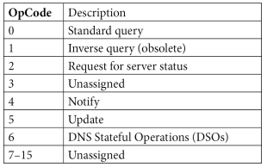
OpCode Flag
The OpCode flag will indicate the type of message that is being sent, as it issues a command to the DNS server to perform some action. Let's take a look.

Slide 15
Requesting Recursion
There are two types of queries in: DNS – recursive and iterative.
Whenever the client submits a DNS query, it's common to see the following flag set – Recursion desired: Do query recursively.
A recursive query is the preferred option, as when available, the DNS server will do the work of obtaining the response.
In contrast, an iterative query is for when the client must do the work of obtaining the response.

Slide 16
Requesting Recursion
When the server responds, it will reply with either of the following:
  Recursion Available where the flag is set at 1, which means the server will complete a recursive query .
  Recursion Not Available where the flag is set at 0, which means the server will not complete a recursive query, as this type of query is not supported.

Slide 17
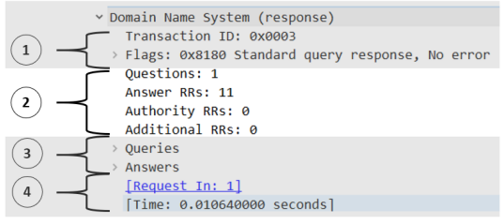
Dissecting the packet structure
The four sections that follow the DNS header, for either a query or response, are as follows:
  Questions: The requested resolution
  Answers RRs: The number of RRs that provide the answer(s)
  Authority RRs: The number of RRs that provide the IP address of an authoritative NS
  Additional RRs: The number of RRs that contain additional information

Slide 18
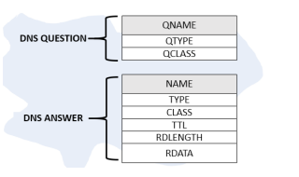
Outlining the Query Section
When looking at DNS header details, the format for the DNS question is different than the DNS answer, as shown here:

Slide 19
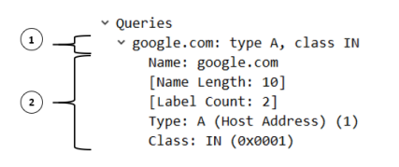
Question
Name: The requested resolution. In this case, the client would like a resolution of Google.com.
Type: The type of RR. In this case, the client is requesting an A type or a Type A (IPv4) address.
Class: The class of RR requested. In this case, the class is listed as IN, which is the most common QClass request.

Slide 20
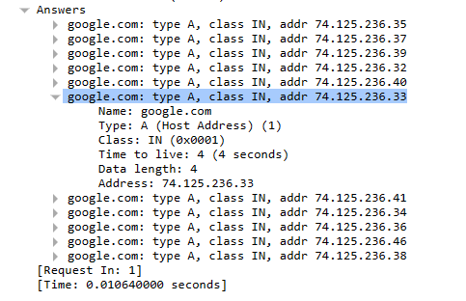
Answers
11 response

Slide 21
Evaluating queries and responses
Caching a response
Within that response is the TTL value, which reflects how long the record can live in the cache before disappearing.
It's common to see a wide range of TTL values for DNS RRs.
To check your own cache on a Windows machine, open a Command Prompt and type ipconfig /displaydns.

Slide 22
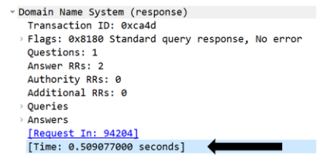
Evaluating queries and responses
Viewing DNS response times

Slide 23
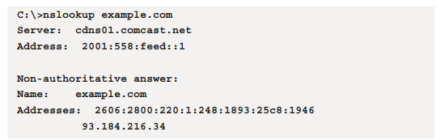
Evaluating queries and responses
Testing using nslookup
Once in the command-line interface, type “nslookup example.com,” and then press Enter. Once run, my output was as follows

Slide 24
Securing DNS
Poisoning the cache:
DNS is essential to any network. When clients request an IP address, they are trusting the server to provide an accurate address. If the address is incorrect, the client might be redirected to a bogus site.
Poisoning DNS server cache
Poisoning the cache of an ISP server

Slide 25
Defending DNS
DNS servers can represent a vulnerable target. To protect the server, the network administrator can employ a few techniques:
  Use cache locking, which controls how and when the cache can be overwritten.
  Restrict zone transfers to only respond to trusted servers.
  Use DNS Security Extensions (DNSSEC), which provide data authentication and integrity.
Additionally, all other standard good practice techniques to secure DNS servers should be used. Techniques include keeping the servers updated and patched and using firewalls that restrict access to only authorized entities

