Slide 1
Database Security

Slide 2
Introduction
Security violations and attacks are increasing globally at an annual average rate of 20%.
You serve as a database administrator to enforce security policies. Responsibilities can be:
  ◦ Design and implement a new DB security policy.
  ◦ Enforce a stringent security policy.
  ◦ Implement functional specification of a module, i.e. encrypt the stored data, replace sensitive data using the data masking pack.

Slide 3
Database Security
Security measures
  ◦ Prevent physical access to the servers where the data resided.
  ◦ Operating systems require authentication of the identity of computer users.
  ◦ Implement security models that enforce security measures.
DBA should manage databases and implement security policies to protect the data (assets)

Slide 4
Security
Database security: degree to which data is fully protected from tampering or unauthorized acts.
Comprises information system and information security concepts

Slide 5
Information Systems
Wise decisions require:
  ◦ Accurate and timely information
  ◦ Information integrity
Information system: comprised of components working together to produce and generate accurate information
Categorized based on usage: low-level, mid-level and high-level

Slide 6
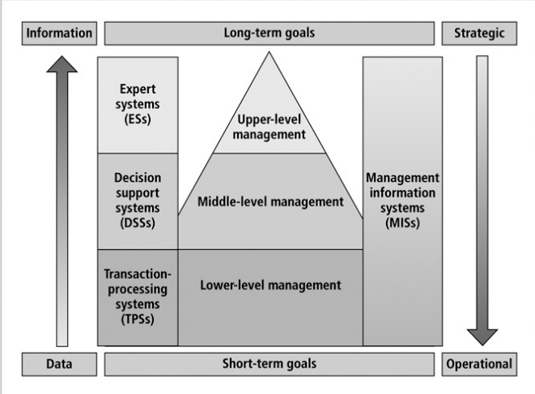
Information System

Slide 7
Information System
Information system components include:
  ◦ Data
  ◦ Procedures
  ◦ Hardware
  ◦ Software
  ◦ Network
  ◦ People

Slide 8
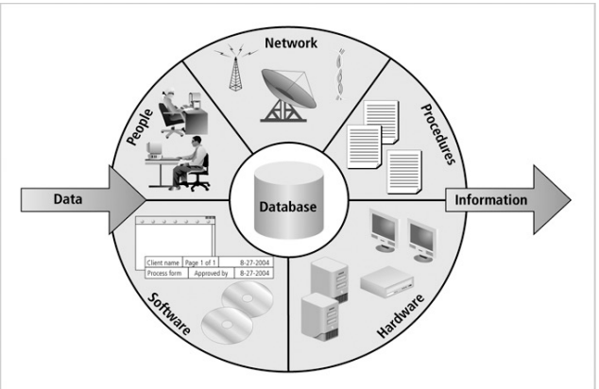
Information System

Slide 9
Information System
Client/server architecture:
  ◦ Based on the business model
  ◦ Can be implemented as one-tier; two-tier; n-tier
  ◦ Composed of three layers
Tier: physical or logical platform
Database management system (DBMS): collection of programs that manage database

Slide 10
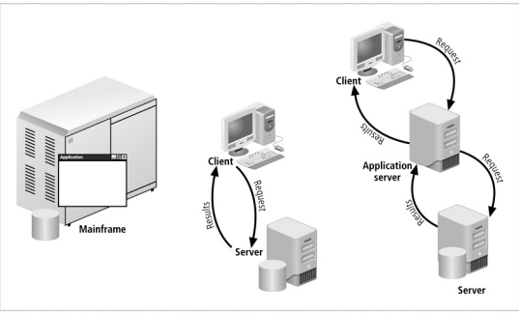
Information System

Slide 11
Database Management
Essential to success of information system
DBMS functionalities:
  ◦ Organize data
  ◦ Store and retrieve data efficiently
  ◦ Manipulate data (update and delete)
  ◦ Enforce referential integrity and consistency
  ◦ Enforce and implement data security policies and procedures
  ◦ Back up, recover, and restore data

Slide 12
Database Management
DBMS components include:
  ◦ Data
  ◦ Hardware
  ◦ Software
  ◦ Networks
  ◦ Procedures
  ◦ Database servers

Slide 13
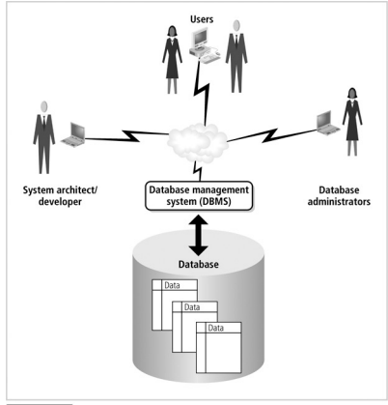
Database Management

Slide 14
Information Security Architecture
Protects data and information produced from the data
Model for protecting logical and physical assets
Is the overall design of a company’s implementation of C.I.A. triangle

Slide 15
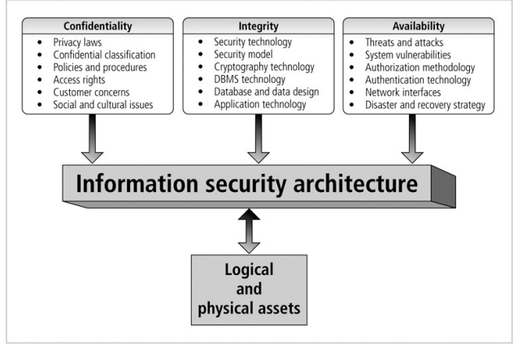
Information Security Architecture

Slide 16
Information Security Architecture
Components include:
  ◦ Policies and procedures
  ◦ Security personnel and administrators
  ◦ Detection equipments
  ◦ Security programs
  ◦ Monitoring equipment
  ◦ Monitoring applications
  ◦ Auditing procedures and tools

Slide 17
Database Security
Enforce security at all database levels
Security access point: place where database security must be protected and applied
Data requires highest level of protection; data access point must be small

Slide 18
Database Security

Slide 19
Database Security
Reducing access point size reduces security risks
Security gaps: points at which security is missing
Vulnerabilities: kinks in the system that can become threats
Threat: security risk that can become a system breach

Slide 20
Database Security

Slide 21
Database Security

Slide 22
Database Security Level
Relational database: collection of related data files
Data file: collection of related tables
Table: collection of related rows (records)
Row: collection of related columns (fields)

Slide 23
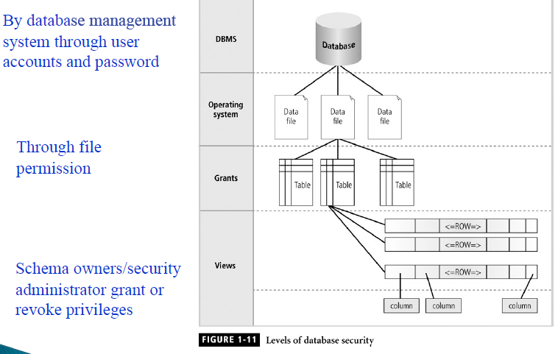
Database Security Level

Slide 24
Menaces to Databases
Security vulnerability: a weakness in any information system component.

Slide 25
Menaces to Databases
Security threat: a security violation or attack that can happen any time because of a security vulnerability.

Slide 26
Menaces to Databases
Security risk: a known security gap left open.

Slide 27
Menaces to Databases

Slide 28
Asset Types and their Value
Security measures are based on the value of each asset
Types of assets include:
  ◦ Physical: tangible assets including buildings, cars, hardware, …
  ◦ Logical: such as business applications, in-house programs, purchased software, databases, …
  ◦ Intangible: business reputation, public confidence,
  …
  ◦ Human: human skills, knowledge, expertise, …

Slide 29
Security Methods

Slide 30
Database Security Methodology

