Slide 1
A Performance Evaluation of an Efficient Traffic Congestion Detection Protocol through VANETs
Maram Bani Younes

Slide 2
Outline
Introduction
Motivation
Related Work
Contributions
  ECODE : Efficient Congestion Detection protocol
  Iterative Execution Schemes: Proactive, Reactive, Hybrid.
  Case Study: Ottawa Downtown
Conclusion && Future Work

Slide 3
Introduction
Vehicular Ad-Hoc Network (VANET), is an application network form of Mobile Ad-Hoc network (MANET).
VANET has two main types of communications:
  Vehicle-to-Vehicle.
  Vehicle-to-Infrastructure.
Many real-time and safety applications were introduced over roads through VANET communication.
3

Slide 4
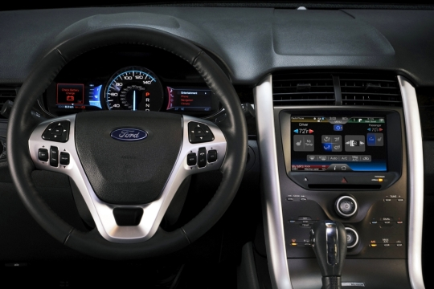
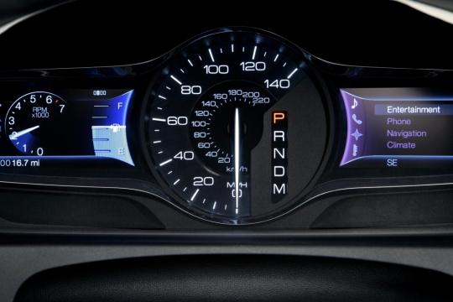
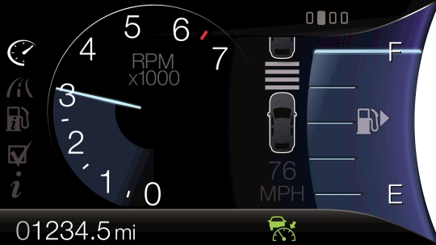
Introduction
Wheel-Mounted Buttons
Voice Interface
Visual Interface
Protect people and vehicles over roads, save lives, avoid and minimize the effect of accidents.
Safety
Efficiency
Infotainment
Increase traffic fluency by decreasing traffic congestion, decreasing fuel consumption and minimizing environmental and economical impact.
Provide entertainment or information to drivers and passengers.

Slide 5
Introduction
Applications
Safety
Efficiency
Infotainment
Road Traffic Congestion decreases traffic fluency, and introduces a suitable areas for accidents.
Downtown areas are typical examples for Traffic Congestions situation; the larger the city and the higher the population are, the more severe the traffic congestion becomes.
5

Slide 6
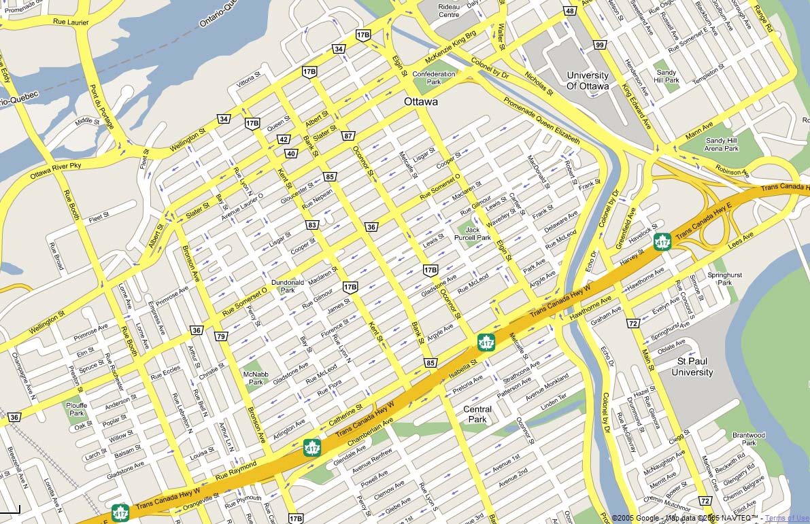
Motivations
Some road segments may suffer high traffic congestions while other have a very light traffic experience.
Some road segments suffer from bad conditions characteristics (i.e., numerous pot-holes, slippery, etc), while others are in good conditions. The road conditions affect the quality and efficiency of driving through the recommended path

Slide 7
Motivations
Evaluate the traffic characteristics and the conditions of each road segment in any grid layout which enables to:
  Recommend drivers to take the Best Path towards their destinations according to their priorities.
  Develop an Intelligent Traffic Light systems.

Slide 8
Challenges
Evaluate the real time traffic characteristics of each road segment (Accuracy)
Disseminate and gather data between traveling vehicles and existed RSUs (Efficiency)

Slide 9
Related Work
Traffic Evaluation
Research | Technique | Advantages | Drawbacks
Sensor Based
Pongpaibool et al., | Using road surveillance cameras, the road traffic evaluation system for image processing using manually tuned fuzzy logic and adaptive neuro-fuzzy techniques. | Achieved a high accuracy and low error margin. | Suffer many usage limitations (i.e., expensive, limited coverage area, the resolution and accuracy could be affected by the weather or the time of the day).
Roy et al., | The system comprises of a wireless sender-receiver pair across each road. | This mechanism is able to address the complex problem of traffic congestion detection in a chaotic road. | This mechanism is limited to the area covered by the equipments. It is also expensive in term of installing and maintaining these equipments.
Vehicle communications Based
Shibata et al., StreetSmart | Cluster-based collected data, each vehicle measures a certain area’s passing time for each entering/exiting pair of roads. | Estimated the needed traveled time per area at a certain time. | limited at the covered area, and does not give an accurate congestion level evaluation.
Chou et al., | Uses virtual data sink to disseminate data over VANETs. | Uses vehicles as mobile traffic detectors, eliminate the cost of using sensors and equipments. | This mechanism may flood the network with redundant data, and cause inaccurate and late evaluation results.
Xu et al., | Restricted 2-Hop Broad- cast and Probabilistic Restricted 2-Hop Broadcast. | Expand the detection range of each RSU and to improve the performance of 2-hop broadcast. | The computed congestion level is not a real time nor an accurate.

Slide 10
Related Work
Disseminating Data
Research Paper | Approach | Technique | Bandwidth consumptions | Broadcast Storm | Restricted Memory | Reliability and hidden nodes
Chou et al., | Broadcast to disseminate data. | Relay Vehicle | √ | √ | X | X
Dornbush et al., | Need to Say principle. | Event-Driven. | √ | √ | √ | X
Zhong et al., | Make a local decision when to disseminate a report, based on the vehicle status. | Data- Prioritization | √ | √ | X | X
Bauza et al., | Send a statistical data related to each Area (Geocast). | Using Statistical Data. | √ | √ | X | X
Korkmaz and Ekici, | The ACK message is sent to announce a correct received report. | ACK Mechanism. | X | X | √ | √

Slide 11
Efficient COngestion Detection (ECODE )
ECODE: Traffic Evaluation
Detecting the Congested road segments Directionally | Disseminating Traffic Data Efficiently
Measuring the road segment direction basic traffic characteristics: traffic density traffic speed traffic volume travel time Evaluate the traffic congestion level using these values | Each vehicle collects the basic data about its surrounding vehicles Select a number of vehicles to forward the traffic data towards the next hops in each road segment Select a certain vehicle to report the congestion level of its road segment This reduces the redundant transmitted data, guarantee the reliability and eliminate the hidden node problem

Slide 12
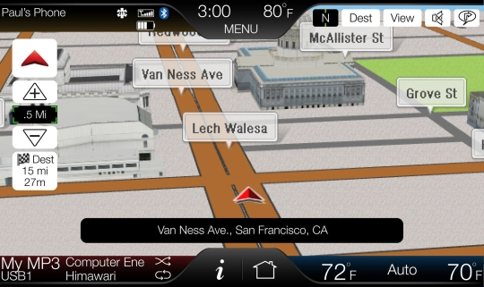
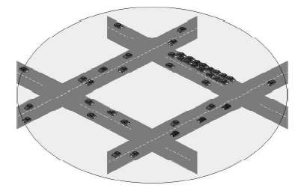
Efficient COngestion Detection (ECODE )
Each Vehicle is equipped by:
  Digital Map
  Wireless transceiver (e.g., IEEE802.11p)
12

Slide 13
ECODE Phases
Data Dissemination
Local Traffic Evaluation
Data Gathering
Expanding
the traffic Evaluation
Road Clustering

Slide 14
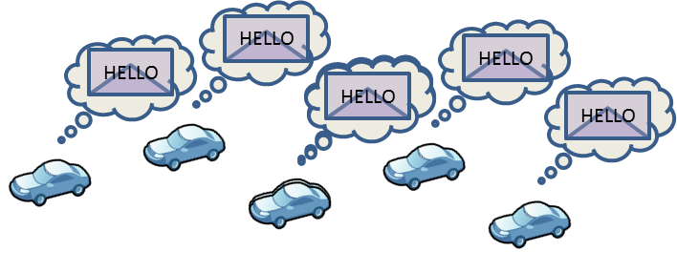
Data Dissemination
Each vehicle broadcasts a “Hello” message to declare its basic traffic data

Slide 15
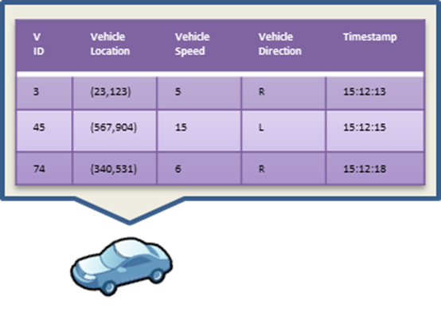
Data Gathering
Each vehicle receives the basic traveling data of its surrounding vehicles in an NR table, including:
  V ID
  V Location
  V Speed
  V Direction
  Timestamp
15

Slide 16
Road Segment Clustering

Slide 17
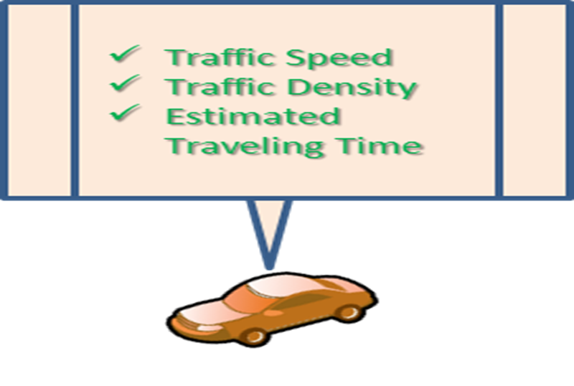
Local Traffic Evaluation
Each vehicle determines which cluster it is located in, and evaluates the traffic situation of that cluster zone based on its knowledge about the surrounding vehicles that are located on the same cluster.

Slide 18
Expanding Traffic Evaluation Area
Selecting Relay Vehicles
Global Traffic Evaluation
The closest vehicle to the center of each reporting area.

Slide 19
Global Traffic Evaluation
Traffic characteristics of each road segment direction
Succession of updating the NR table about the surrounding cluster areas and sending the updated data, enables the Road Sides Units (RSUs) that are installed at the end of such a road segment to gather the traffic evaluation of all clusters in the road segment.

Slide 20
Iterative Execution Scheme
Proactive
Each vehicle broadcasts its basic traveling data, periodically. The length of each time interval could be set externally as a variable in order to guarantee a level of flexibility.
++ Easy to implement.
- - Short intervals obtain a good accuracy but it consumes a high bandwidth.
- - Long intervals obtain a bad accuracy while it consumes a lower bandwidth.

Slide 21
Iterative Execution Scheme
Reactive
vehicles only broadcast the ADV message if they detect a certain changeable traffic situation (e.g., detect a sudden change in their traveling speed, receive a request from the nearest RSU, etc ).
++ It consumes a low bandwidth.
- - It is accuracy is bad for slowly traffic change.

Slide 22
Iterative Execution Scheme
Hybrid
This scheme combines between the proactive and reactive schemes, in order to balance between their advantages and drawbacks.

Slide 23
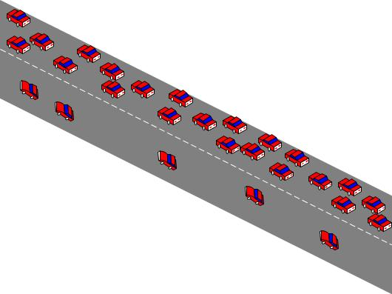
Performance Evaluations
Parameter | Value
Wireless Medium | IEEE802.11
Transmission Range (m) | 250
Vehicle Speed (m\s) | 3 - 17
Simulation Time (Sec) | 500
Simulation Area (mXm) | 20X200 – 20 X1200
Number of RSUs | 2
Number of Vehicles | 20 – 500
Simulation Map | Road Segment in Urban Area

Slide 24
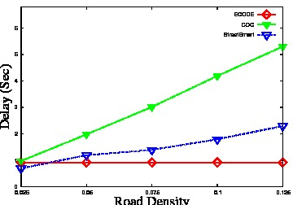
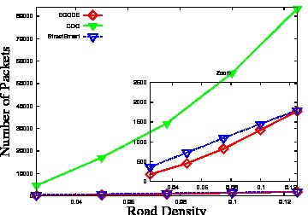
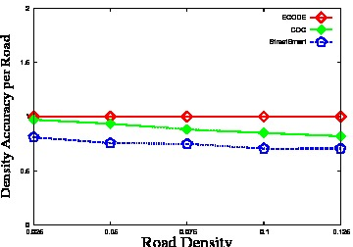
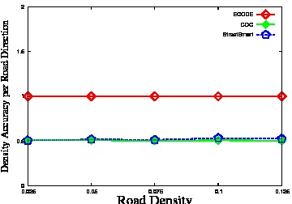
Simulation Results

Slide 25
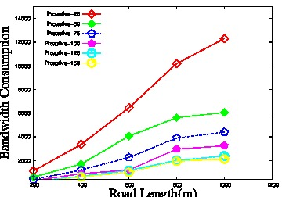
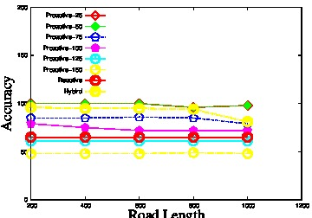
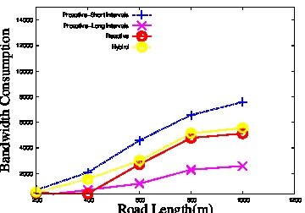
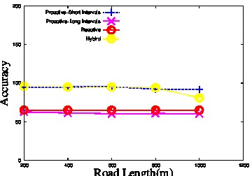
Simulation Evaluation of the
Iterative Execution Schemes

Slide 26
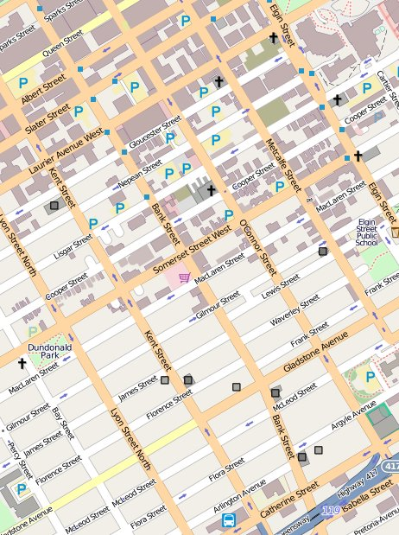
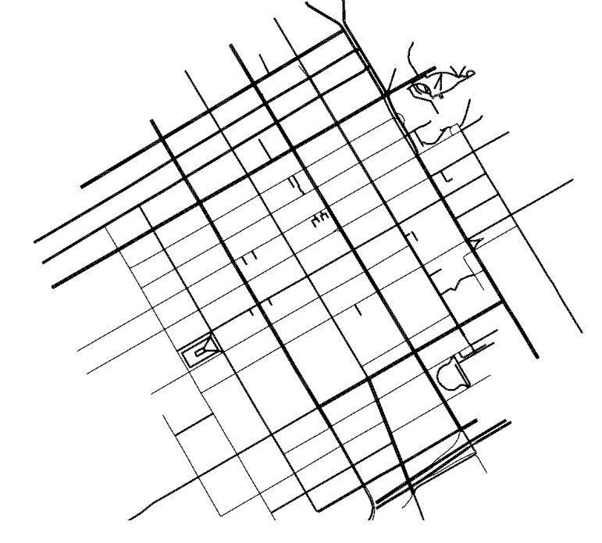
Case Study: Downtown of Ottawa

Slide 27
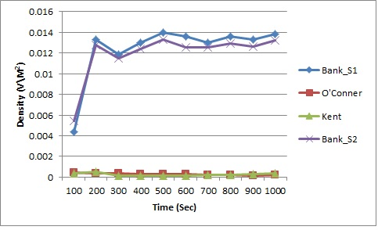
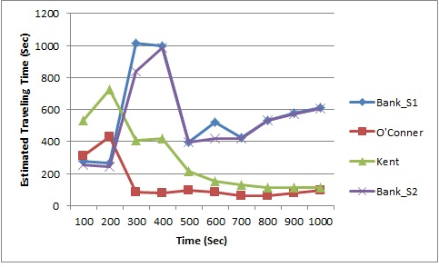
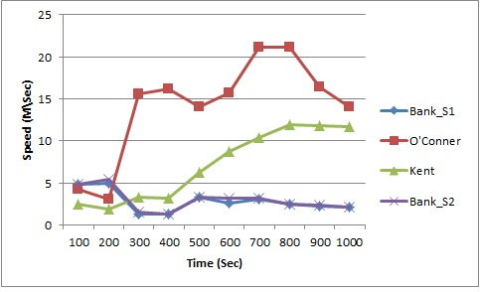
Traffic Evaluation of the Ottawa Downtown

Slide 28
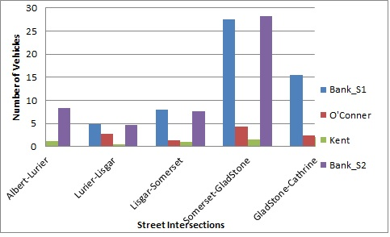
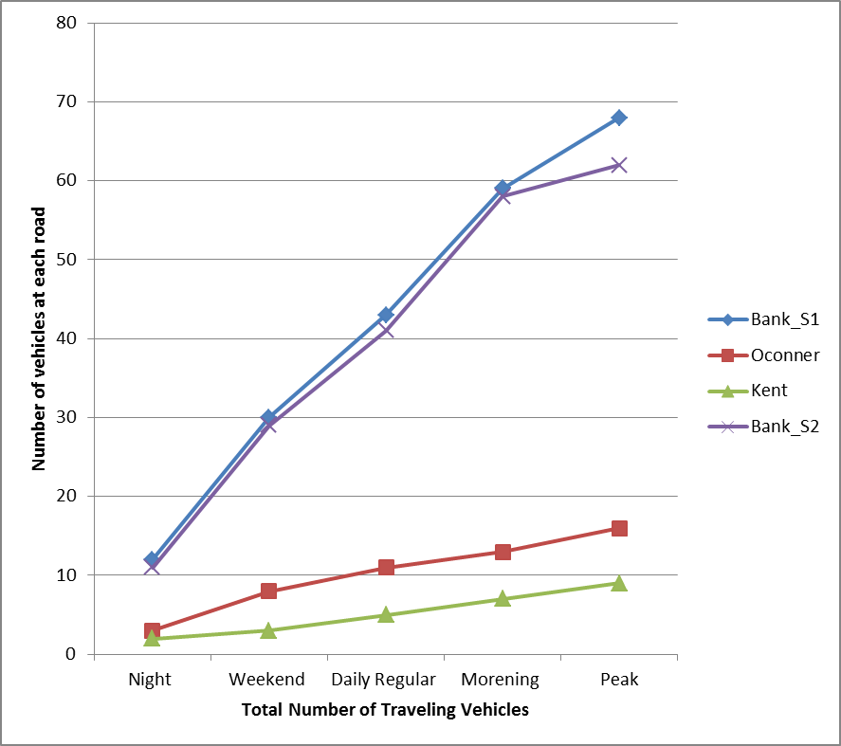
Traffic Evaluation of the Ottawa Downtown

Slide 29
Conclusions
ECODE:
  Detect the traffic congestion level per segment of road based on the road segment Traffic Monitoring Data directionally
  Reduce the bandwidth consumption by electing some relay vehicles
  The hybrid iterative execution schemes achieves a good performance in terms of the traffic evaluation accuracy and the bandwidth consumption considerations.
  In the Downtown of Ottawa, the Bank street witnesses the highest traffic density on its both directions compared to O’Conner and Kent streets.
29

Slide 30
Thank YOU
Questions

