Slide 1
HTTP and FTP

Slide 2
Connects

Slide 3
Describing HTTP
HTTP is an application-layer protocol responsible for exchanging data between a client browser and a web server.
HTTP allows us to gather, distribute, collaborate, and disseminate a wide range of data.
Although a stateless protocol, HTTP has several request methods, error codes, and headers that allow us to access resources from many different types of applications

Slide 4
Dissecting a web page
Using a browser, such as Firefox or Chrome, a client requests a page by clicking on a hyperlink.
The link directs the client to a website, which is a set of linked web pages, and the server sends the requested data to the client.

Slide 5
Dissecting a web page
The first page we hit is called index or default, and that's where most of us start when searching for content.
Once at the website, each page contains objects, such as a HyperText Markup Language (HTML) file, Joint Photographic Experts Group (JPEG) images, text, applications, and/or JavaScript.
Most websites have many linked pages that are hyperlinked to other content within the site, along with a variety of information and objects that can be extracted.

Slide 6
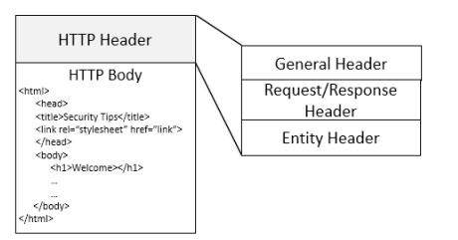
A standard web page

Slide 7
Finding the target
When a client requests a web page, the user will click on a link to request an object using a Uniform Resource Identifier (URI), which is used to identify an object (or resource) on the internet.
Two subsets of a URI are a Uniform Resource Locator (URL) and a Uniform Resource Name (URN).
In some cases, the client will request a specific page from the server.

Slide 8
Finding the target
For example, if requesting
https://www.nist.gov/blogs/cybersecurity-insights,
the URL will break down in the following manner:
• Hostname: The name of the host is www.nist.gov.
• Path: The path to the specific resource is /blogs/cybersecurity-insights.

Slide 9
Making the connection
When a client initiates a connection with a web server, they will use either Transmission Control Protocol (TCP) port 80 or port 443, depending on the type of connection, as described here:
  TCP port 80 is used for a standard, unencrypted connection.
  TCP port 443 is used for a secure, encrypted connection.
  In some cases, the server may be reached using an alternate port, such as http-alt 8080 or http-alt 8008.

Slide 10
Making the connection
Using a secure connection is common today, as most websites use encryption to protect data transactions.
When accessing a secure site, the URL will be identified using the HTTP Secure (HTTPS) preface.
HTTPS uses Transport Layer Security (TLS) to secure all transactions between the client and the server.
Even if someone were able to obtain the data stream, they would not be able to read the contents without the appropriate key to decrypt the data.

Slide 11
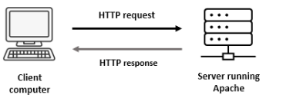
Comparing client and server roles

Slide 12
Comparing client and server roles
A client is a host that initiates each session using a browser to interface with a server and retrieve objects.
A server is an always-on host with a fixed Internet Protocol (IP) address that uses dedicated web server software.

Slide 13
web server applications
Apache is one of the most popular open source web server applications in use today. Apache has a full library of modules that enable a rich set of features that can power even the largest sites.
nginx (or engine X) is the second most popular open source web server application and is robust, scalable, and easy to configure.
Cloudflare is a popular option used to host websites and help prevent malicious attacks such as distributed denial-of-service (DDoS) attacks.

Slide 14
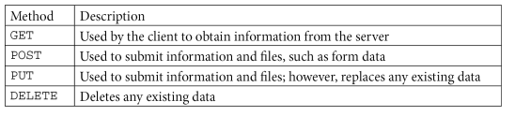
Recognizing HTTP methods

Slide 15
Keeping track of the connection
Every version of HTTP has evolved in methods to transport and process data, with techniques such as using persistent connections with a pipelining goal to optimize the connection.
Because HTTP is a stateless protocol, cookies are used to maintain client information about the connection, such as shopping cart elements and pages the client has visited.

Slide 16
Evaluating connection types
Using a non-persistent connection
Offering a persistent connection (HTTP keep-alive)
Pipelining the data transfer

Slide 17
Maintaining state with cookies
A cookie is a string of characters created by the server that can be placed on a user's system and then managed by the user's browser to interact with the server.
Once the user accepts a cookie, the information contained in the cookie can be used for the following reasons:
  Authentication
  Personalize the user experience (UX)

Slide 18
Link
http:// tcpreplay.appneta.com/wiki/captures.html#bigflows-pcap
bigFlows.pcap
Go to Frame 912 and then expand the HTTP header.

Slide 19
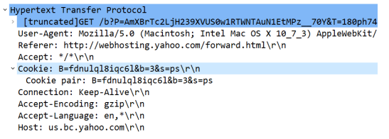
Cookies
Cookies pose a privacy risk as they can gather marketing statistics and personal information.
That is why, in most cases, a user will have the ability to opt out of allowing cookies on their system.
Non-persistent

Slide 20
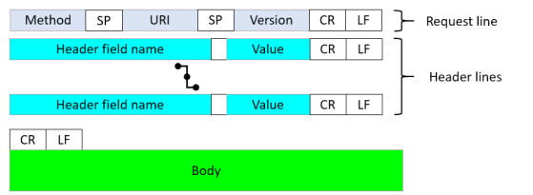
Comparing request and response messages

Slide 21
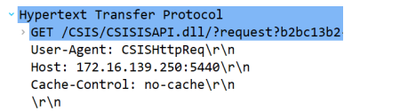
Request Message

Slide 22
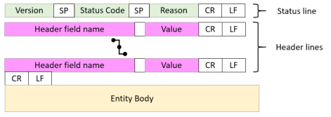
Responding to the client

Slide 23
Understanding status codes
1xx Informational
2xx Success (e.g 200 OK)
3xx Redirection (e.g. 301 Moved )
4xx Client Error (404 notFound)
5xx Server Error

Slide 24
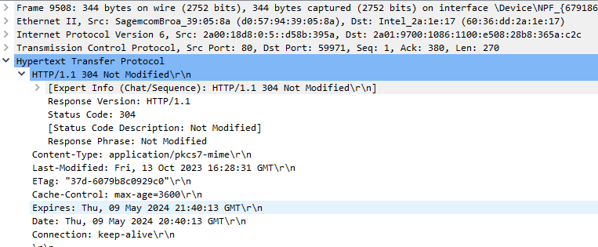

Slide 25
Following an HTTP stream
https://www.cloudshark.org/captures/0012f52602a3
frame 1
Statistics >> Flow Graph >> limit to display filtter
Frame 4 >> tcp stream

Slide 26
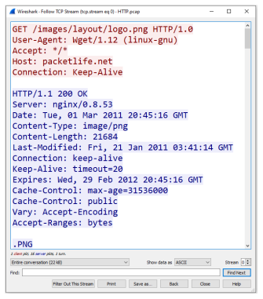

Slide 27
Check SYN and FIN
Frame 1
Frame 2
Frame 36

