Slide 1
Scrum Methodology

Slide 2
Scrum in 100 words
Scrum is an agile process that allows us to focus on delivering the highest business value in the shortest time.
It allows us to rapidly and repeatedly inspect actual working software (every two weeks to one month).
The business sets the priorities. Teams self-organize to determine the best way to deliver the highest priority features.
Every two weeks to a month anyone can see real working software and decide to release it as is or continue to enhance it for another sprint.

Slide 3
Characteristics
Self-organizing teams
Product progresses in a series of month-long “sprints”
Requirements are captured as items in a list of “product backlog”
No specific engineering practices prescribed
Uses generative rules to create an agile environment for delivering projects
One of the “agile processes”

Slide 4
SCRUM has the following ELEMENTS:
A project team called a SCRUM Team
A Product Backlog of all known Requirements
A Sprint Backlog of requirements being worked on
A period of work referred to as a Sprint
Daily Stand-up Meetings with the SCRUM Team
A Burndown Chart to track progress of the Sprint
An Incremental Delivery at the end of each sprint

Slide 5





Scrum
24 hours
Sprint
2-4 weeks
Sprint goal
Return
Sprint backlog
Potentially shippable
product increment
Return
Cancel
Gift wrap
Coupons
Gift wrap
Cancel
Coupons
Product
backlog

Slide 6
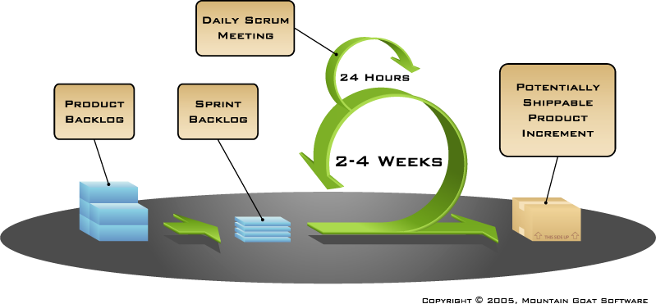
Putting it all together
Image available at www.mountaingoatsoftware.com/scrum

Slide 7
Sprints
Scrum projects make progress in a series of “sprints”
  Analogous to Extreme Programming iterations
Typical duration is 2–4 weeks or a calendar month at most
A constant duration leads to a better rhythm
Product is designed, coded, and tested during the sprint

Slide 8
The SCRUM Team
Is all the people who will COMMITTED to the delivery of the backlogs
One role is ‘SCRUM Master’ who is in practice the PM
Is staffed by PMs, BAs, Developers, Testers, Support – i.e. ALL the typical project staff

Slide 9
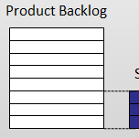
Product Backlog
Contains all the currently known requirements for a product
Is managed by the Product Owner and can change as needed

Slide 10

Sprint Backlog
Contains the set of prioritised Product Backlog items that are currently being worked on
Are not to be changed during the Sprint

Slide 11
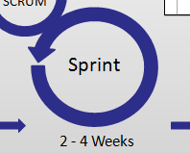
Sprint
Is a fixed period of development and testing
Results in an incremental delivery of usable product
Usually lasts 2 to 4 weeks

Slide 12

Daily SCRUM Meeting
Brief ‘Stand-up’ meeting each morning with SCRUM Team only
What value did you add yesterday?
What value will you add today?
What will stop you making progress?

Slide 13
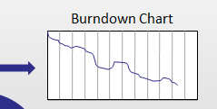
Burndown Chart
Charts delivery of the Sprint Backlog against Sprint Duration.
Simple, at-a-glance view of progress showing velocity and traction
Easy to keep updated

Slide 14

Incremental Delivery
Output of the Sprint
Working functionality that can be deployed
Delivered every 2 to 4 weeks, tested and working

Slide 15
Quick Overview I
Product Owner
Product
Backlog
Sprint Planning Meeting
Sprint
Backlog
Scrum Team
Scrum Master
Sprint
Executable Product Increment

Slide 16

Scrum framework
Roles
Product owner
ScrumMaster
Team
Ceremonies
Sprint planning
Sprint review
Sprint retrospective
Daily scrum meeting
Artifacts
Product backlog
Sprint backlog
Burndown charts

Slide 17
Scrum framework
Roles
Product owner
ScrumMaster
Team
Ceremonies
Sprint planning
Sprint review
Sprint retrospective
Daily scrum meeting
Artifacts
Product backlog
Sprint backlog
Burndown charts

Slide 18

Scrum Roles: Product Owner
Represents the interests of all stakeholders in the project and resulting system
Tasks/Responsibilities:
  is the only person in charge of the Product Backlog
    maintains and sustains content
    prioritizes Product Backlog items
    estimates Product Backlog effort
  is responsible for initial and ongoing funding

Slide 19

Scrum Roles: Scrum Master
Represents management and team to each other
Tasks/Responsibilities:
  ensures that Scrum values, practices and rules are enacted and enforced
  plans and initiates Sprints together with the team
  conducts Daily Scrums and ensures that impediments are promptly removed
  controls progress and takes appropriate measures

Slide 20





Scrum Roles: Scrum Team
Tasks/Responsibilities:
  formulates a Sprint Goal at the Sprint Planning Meeting
  commits to turn a set of Product Backlog into a working product
  self-organizes (assigns, works on, modifies and
  (re-)estimates tasks)
  → responsible for doing all analysis, design, coding, testing and user documentation
  → has full authority to do whatever is necessary to meet the Sprint Goal
Team size: seven people, plus or minus two
Team composition: cross-functional → analysts, designers, coding engineers

Slide 21
Scrum framework
Roles
Product owner
ScrumMaster
Team
Ceremonies
Sprint planning
Sprint review
Sprint retrospective
Daily scrum meeting
Artifacts
Product backlog
Sprint backlog
Burndown charts

Slide 22



Team capacity
Sprint planning meeting
Sprint prioritization
Product backlog
Sprint
goal
Analyze and evaluate product backlog
Select sprint goal
Business conditions
Sprint planning
Decide how to achieve sprint goal (design)
Create sprint backlog (tasks) from product backlog items (user stories / features)
Estimate sprint backlog in hours
Current product
Sprint
backlog
Technology

Slide 23

Sprint planning
Team selects items from the product backlog they can commit to completing
Sprint backlog is created
  Tasks are identified and each is estimated (1-16 hours)
  Collaboratively, not done alone by the ScrumMaster
High-level design is considered
As a vacation planner, I want to see photos of the hotels.
Code the middle tier (8 hours)
Code the user interface (4)
Write test fixtures (4)
Code the foo class (6)
Update performance tests (4)

Slide 24
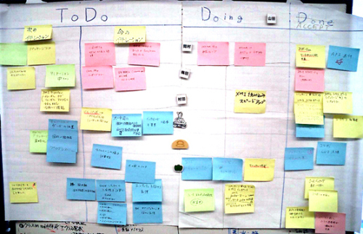
The daily scrum
Parameters
  Daily
  15-minutes
  Stand-up
Not for problem solving
  Whole world is invited
  Only team members, ScrumMaster, product owner, can talk
Helps avoid other unnecessary meetings

Slide 25

Everyone answers 3 questions
1
What did you do yesterday?
2
What will you do today?
3
Is anything in your way?
These are not status for the ScrumMaster
  They are commitments in front of peers

Slide 26
The sprint review
Team presents what it accomplished during the sprint
Typically takes the form of a demo of new features or underlying architecture
Informal
  2-hour prep time rule
  No slides
Whole team participates
Invite the world

Slide 27
Sprint retrospective
Periodically take a look at what is and is not working
Typically 15–30 minutes
Done after every sprint
Whole team participates
  ScrumMaster
  Product owner
  Team
  Possibly customers and others

Slide 28

Start / Stop / Continue
Whole team gathers and discusses what they’d like to:
Start doing
Stop doing
This is just one of many ways to do a sprint retrospective.
Continue doing

Slide 29
Scrum framework
Roles
Product owner
ScrumMaster
Team
Ceremonies
Sprint planning
Sprint review
Sprint retrospective
Daily scrum meeting
Artifacts
Product backlog
Sprint backlog
Burndown charts

Slide 30

Product backlog
The requirements
A list of all desired work on the project
Ideally expressed such that each item has value to the users or customers of the product
Prioritized by the product owner
Reprioritized at the start of each sprint
This is the product backlog

Slide 31
A sample product backlog
Backlog item | Estimate
Allow a guest to make a reservation | 3
As a guest, I want to cancel a reservation. | 5
As a guest, I want to change the dates of a reservation. | 3
As a hotel employee, I can run RevPAR reports (revenue-per-available-room) | 8
Improve exception handling | 8
... | 30
... | 50

Slide 32
The sprint goal
A short statement of what the work will be focused on during the sprint
Life Sciences
Support features necessary for population genetics studies.
Database Application
Make the application run on SQL Server in addition to Oracle.
Financial services
Support more technical indicators than company ABC with real-time, streaming data.

Slide 33
Managing the sprint backlog
Individuals sign up for work of their own choosing
  Work is never assigned
Estimated work remaining is updated daily
Any team member can add, delete or change the sprint backlog
Work for the sprint emerges
If work is unclear, define a sprint backlog item with a larger amount of time and break it down later
Update work remaining as more becomes known

Slide 34
A sprint backlog
Tasks
Mon
Tues
Wed
Thur
Fri
Code the user interface
8
4
8
Code the middle tier
16
12
10
4
Test the middle tier
8
16
16
11
8
Write online help
12
Write the foo class
8
8
8
8
8
Add error logging
8
4

Slide 35
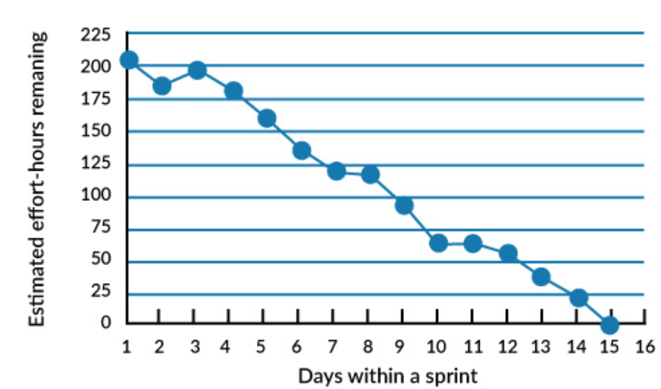
A sprint burndown chart
Sprint burndown is a graphical representation of the estimated effort-hours remaining for a given period of time during a Sprint

Slide 36
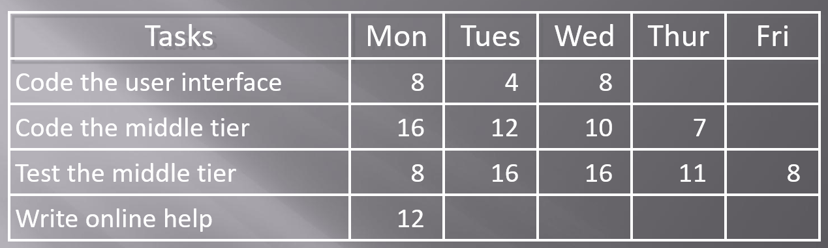
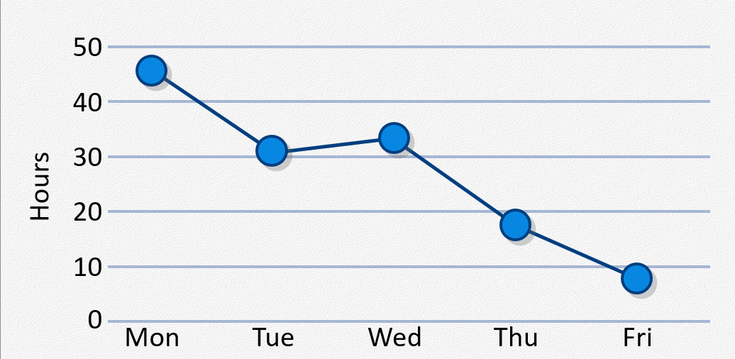

Slide 37
Scalability
Typical individual team is 7 ± 2 people
  Scalability comes from teams of teams
Factors in scaling
  Type of application
  Team size
  Team dispersion
  Project duration
Scrum has been used on multiple 500+ person projects

