Slide 1
SQLite

Slide 2
CASE Syntax
CASE WHEN condition1 THEN result1 WHEN condition2 THEN result2 WHEN conditionN THEN resultN ELSE result END;

Slide 3
Case Statement for SELECT
SELECT orders_id, amount,
CASE
WHEN amount > 24 THEN 'The amount is greater than 25'
WHEN amount = 22 THEN 'The amount is 22'
ELSE 'The amount is under 22'
END AS amountText
FROM ORDERS;

Slide 4
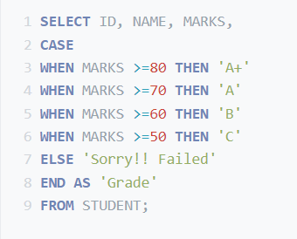
Example of Case Statement

Slide 5
Case Statement for Conditional Updates
Write the SQL statement by using case to
The company want to give 10% discount for all orders amount with value greater than 30 JD and 5 % on amount under 30 JD only on 2/12/2022
Check by yourself how to make the discount first

Slide 6
Example
Write the SQL statement show that
If employee earn over 5000 as salary then s\he is a boss
If employee earn less than 5000 and over 4000 as salary then s\he is a manager
If employee earn between 2000 and 1500 as salary then s\he is a worker
Else he is trainee

Slide 7
Table with Auto_Increment

Slide 8
Rename Table
To rename a table in SQLite, the following syntax is used.

Slide 9
Table with Auto_Increment (insert)

Slide 10
Data Types

Slide 11
Data Types

Slide 12
Example

Slide 13
Data Types (typeof)

Slide 14
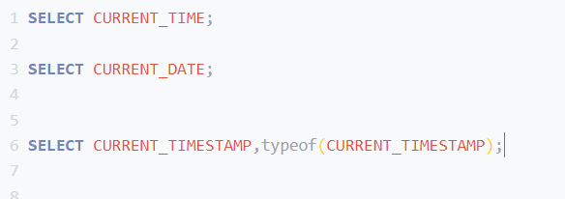
Date and Time Data Type
three special keywords that may be used as a default value: CURRENT_TIME, CURRENT_DATE, and CURRENT_TIMESTAMP.

