Slide 1
Pharmaceutics 1
Liquid dosage forms
Solutions
1

Slide 2
Solutions
In pharmaceutical terms, solutions are “liquid preparations that contain one or more chemical substances dissolved in a suitable solvent or mixture of mutually miscible solvents” ( aqueous or non –aqueous) .
It may be classified as oral, otic, ophthalmic, or topical.
Certain solutions prepared to be sterile and pyrogen free and intended for parenteral administration are classified as injections.

Slide 3
Solutions can be formulated for different routes of administration
Orally: Syrups, elixirs, drops
Parenterally : IV , IM , SC
In mouth and throat: Mouth washes, gargles,
throat sprays.
In body cavities: Douches, enemas, ear drops,
nasal sprays.
On body Surfaces: Collodions, lotions.
Notes:
3

Slide 4
Advantages of SoIutions
(1) Easier to swallow therefore easier for:
children - old age - unconscious people.
(2) More quickly effective than tablets and capsules.
(3) Homogenous, , the drug will be uniformly distributed throughout the preparation therefore give uniform dose compared to suspension or emulsion which need shaking.
(4) Some drugs can irritate the gastric mucosa if localized in one area. Irritation is reduced by administration of a solution of the drug
Notes:
4

Slide 5
Disadvantages of Solutions
Bulky therefore difficult to transport and store.
(2) Unpleasant taste or odours are difficult to mask.
(3) Needs an accurate spoon to measure the dose.
(4) Less stable than solid dosage forms.
major signs of instability:
colour change,
precipitation
microbial growth
chemical gas formation
Notes:
5

Slide 6
Classification of Solutions According to Vehicle
(a) Aqueous solutions
(b) Non-aqueous solutions
Notes:
6

Slide 7
Aqueous Solutions
Aqueous solutions are homogeneous mixtures that are
prepared by dissolving a solid, liquid or gas in an aqueous medium (vehicle).
Vehicle: This may be water, aromatic water or extracts.
None- Aqueous Solutions
alcoholic or hydroalcoholic solutions, e.g. elixirs
and spirits,
2. ethereal solutions, e.g. the Collodions
3. glycerin solutions, e.g. the glycerites,
4. oleaginous solutions e.g. the liniments, medicated oils, oleo- vitamins, sprays, and toothache drops.

Slide 8
Oral solutions
their absorption from the gastrointestinal tract into the systemic circulation may be expected to occur more rapidly than from suspension or solid dosage forms of the same medicinal agent.
Solutes other than the medicinal agent are usually present in orally administered solutions.
These additional agents are frequently included to provide color, flavor, sweetness, or stability.

Slide 9
In formulating or compounding a pharmaceutical solution, the pharmacist must use information on the solubility and stability of each solute with regard to the solvent or solvent system.
Combinations of medicinal or pharmaceutical agents that will result in chemical and/or physical interactions affecting the therapeutic quality or pharmaceutical stability of the product must be avoided.

Slide 10
For many medicinal agents, their solubility in the usual solvents are stated in the United States Pharmacopeia– National Formulary (USP–NF) as well as in other reference books.
A pharmacist can, in certain instances, dissolve greater quantities of a solute than would otherwise be possible by using Solubilizing agent or a different chemical salt form of the medicinal agent, alteration of the pH of a solution, or substitution in part or in whole of the solvent.
Example: iodine in water or an aqueous solution of potassium iodide or sodium iodide as the solvent , much larger amounts of iodine may be dissolved in the second solvent as the result of the formation of a water-soluble complex with the iodide salt.
This reaction is taken advantage of, for example, in Iodine Topical Solution, USP, prepared to contain about 2% iodine and 2.4% sodium iodide.

Slide 11
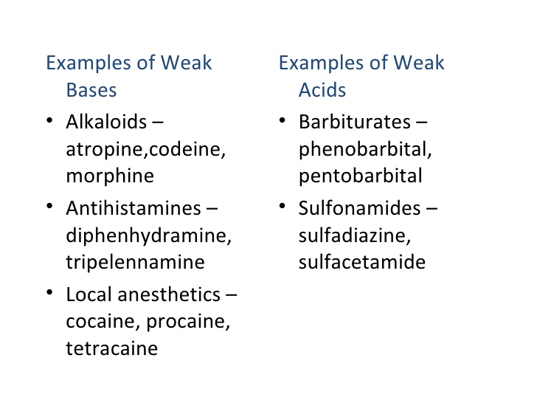
Many of the organic medicinal agents are either weak acids or weak bases, and their solubility depends to a large measure on the pH of the solvent. These drugs react either with strong acids or strong bases to form water soluble salts.

Slide 12
Pharmaceutical manufacturers have prepared many acid salts of these organic bases to enable the preparation of aqueous solutions , ex (diphenhydramine HCl) , Atropine sulfate
Many basic salts of weak acids have been prepared
Phenobarbital sodium
silver sulfadiazine

Slide 13
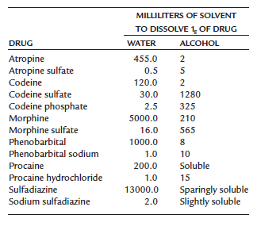
Water and alcohol solubility of weak acids and weak bases and their salts

Slide 14
The rate of solution, that is, the speed at which the substance dissolves, depends on:
the particle size of the substance: the finer the powder, the greater the surface area, which comes in contact with the solvent, and the more rapid the dissolving process.
the extent of agitation: the greater the agitation, the more unsaturated solvent passes over the drug and the faster the formation of the solution.

Slide 15
3. Temperature: heating a liquid also causes solution to take place more rapidly by increasing the frequency which solvent molecules collide with the surface of the dissolving mixture

Slide 16
Selection criteria for solvents
the selection of the proper solvent for a particular solute:
solubility, (like dissolves like)
clarity,
low toxicity,
viscosity,
Compatibility with other formulative ingredients,
Chemical inertness,
palatability,
odor, color,
economy.

Slide 17
SOLVENTS FOR LIQUID
PREPARATIONS
PURIFIED WATER, USP, H2O
Fixed oils
ALCOHOL, USP
DILUTED ALCOHOL, NF
RUBBING ALCOHOL
GLYCERIN, USP
PROPYLENE GLYCOL, USP

Slide 18
SOLVENTS FOR LIQUID
PREPARATIONS
water
In most instances, water is the preferred solvent because it comes closer to meeting these criteria than other solvents.
Advantages: Tasteless, odourless, lack of pharmacological activity, neutral and very cheap .
Disadvantages: favorable medium for some chemical reactions, and it supports the growth of microorganisms when contaminated.
When water is used as the primary solvent, commonly an auxiliary solvent ( Co-Solvents ) is also employed to augment the solvent action of water or to contribute to a product’s chemical or physical stability.
Alcohol, glycerin, and propylene glycol.

Slide 19
PURIFIED WATER, USP, H2O
Ordinary drinking water from the tap is not acceptable for the manufacture of most aqueous pharmaceutical preparations or for the extemporaneous compounding of prescriptions
because of the possible chemical incompatibilities between dissolved solids and the medicinal agents being added.

Slide 20
Purified Water, USP, is obtained by distillation, ion exchange treatment, reverse osmosis, or other suitable process.
has fewer solid impurities than ordinary drinking water.
When evaporated to dryness, it must not yield more than 0.001% of residue (1 mg of solids per 100 mL of water).

Slide 21
Purified Water, USP intended for use in the preparation of aqueous dosage forms except those intended for parenteral administration (injections).
Water for Injection, USP; Bacteriostatic Water for Injection, USP; or Sterile pyrogen free Water for Injection, USP, is used for injections.

Slide 22
SOLVENTS FOR LIQUID PREPARATIONS
Fixed oils
A number of fixed oils, such as corn oil, cottonseed oil, peanut oil, and sesame oil, are useful solvents, particularly in the preparation of oleaginous injections.
Intramuscular injection (IM(
Rapid absorption from aqueous solution.
Slow absorption from nonaqueous (oil) solutions.

Slide 23
ALCOHOL, USP: ETHYL ALCOHOL,
ETHANOL, C2H5OH
Next to water, alcohol is the most useful solvent in pharmacy.
It is used as a primary solvent for many organic compounds.
Together with water, it forms a hydroalcoholic mixture that dissolves both alcohol- soluble and water-soluble substances.
Alcohol, USP, is 94.9% to 96.0% C2H5OH by volume (i.e., v/v) when determined at 15.56°C.
Dehydrated Alcohol, USP, contains not less than 99.5% C2H5OH by volume and is used when an essentially water-free alcohol is desired.

Slide 24
ALCOHOL, USP
Certain drugs are insoluble in water and must be dissolved in an alternative vehicle.
Alcohol is often preferred because of:
its miscibility with water
its ability to dissolve many water-insoluble ingredients, including drug substances, flavorants, and antimicrobial preservatives.

Slide 25
ALCOHOL, USP
Alcohol is frequently used with other solvents, such as glycols and glycerin, to reduce the amount of alcohol required.
It is also used in liquid products as an antimicrobial preservative alone or with parabens, benzoates, sorbates.

Slide 26
ALCOHOL, USP
Undesired pharmacological action and potential toxic effects of alcohol when ingested in pharmaceutical products, particularly by children.
Thus, the U.S. Food and Drug Administration (FDA) has proposed that insofar as possible manufacturers of over-the-counter(OTC) oral drug products restrict the use of alcohol and include appropriate warnings in the labeling.

Slide 27
ALCOHOL, USP
For OTC oral products, the recommended alcohol content limit in product intended for:
children under 6 years of age, the recommended alcohol content limit is 0.5%;
children 6 to 12 years of age, the recommended limit is 5%;
children over 12 years of age and adults, the recommended limit is 10%.

Slide 28
DILUTED ALCOHOL, NF
is prepared by mixing equal volumes of Alcohol, USP, and Purified Water, USP.
The final volume of such mixtures is not the sum of the individual volumes of the two components because the liquids contract upon mixing; the final volume is generally about 3% less than what would otherwise be expected.
Diluted alcohol is a useful hydroalcoholic solvent in various pharmaceutical processes and preparations.

Slide 29
ETHYL ALCOHOL RUBBING ALCOHOL
contains about 70% ethyl alcohol by volume, the remainder consisting of water, denaturants with or without color additives and perfume oils, and stabilizers.
must contain sucrose octaacetate or denatonium benzoate, bitter substances that discourage accidental or abusive oral ingestion.
The product is volatile and flammable and should be stored in a tight container remote from fire.

Slide 30
RUBBING ALCOHOL
It is employed as:
a rubefacient externally and as a soothing rub for bedridden patients,
a germicide for instruments,
a skin cleanser prior to injection.
a vehicle for topical preparations.

Slide 31
ISOPROPYL RUBBING ALCOHOL
is about 70% by volume isopropyl alcohol, the remainder consisting of water with or without color additives, stabilizers, and perfume oils.
It is used externally as:
a rubefacient
soothing rub
as a vehicle for topical products.

Slide 32
GLYCERIN, USP (GLYCEROL),
CH2OH•CHOH•CH2OH
Glycerin is a clear syrupy liquid with a sweet taste.
It is miscible with both water and alcohol.
As a solvent, it is comparable with alcohol, but because of its viscosity, solutes are slowly soluble in it unless it is rendered less viscous by heating.
Glycerin has preservative qualities and is often used as a stabilizer and as an auxiliary solvent in conjunction with water or alcohol.
It is used in many internal preparations.

Slide 33
PROPYLENE GLYCOL, USP,
CH3CH(OH)CH2OH
a viscous liquid, miscible with water and alcohol.
It is a useful solvent with a wide range of applications and is frequently substituted for glycerin in modern pharmaceutical formulations.

Slide 34
PREPARATION OF SOLUTIONS

Slide 35
Methods of Preparation of Solutions
(a) Simple Solution
(b) Solution by Chemical Reaction
(c) Solution by Extraction
(a) Simple Solution
Solutions of this type are prepared by dissolving the solute in a suitable solvent (by stirring or heating).
The solvent may contain other ingredients which stabilize or solubilize the active ingredient e.g. solubility of Iodine is 1: 2950 in water however, it dissolves in presence of KI due the formation of more soluble polyiodides (KI.I₂ KI.2I₂ KI3.I₃ KI.4I₄) .[ Strong Iodine Solution USP (Lugol's SoIution)].
Notes:
35

Slide 36
(b) Solution by Chemical Reaction
These solutions are prepared by reacting two or more solutes with each other in a suitable solvent e.g. Calcium carbonate and lactic acid used to prepare Calcium lactate mixture. WHY?
(c) Solution by Extraction
Plant or animal products are prepared by suitable extraction process. Preparations of this type may be classified as solutions but more often, are classified as extractives.
Notes:
36

Slide 37
PREPARATION OF SOLUTIONS
Most pharmaceutical solutions are unsaturated with solute.
Thus, the amounts of solute to be dissolved are usually well below the capacity of the volume of solvent employed.
The strengths of pharmaceutical preparations are usually expressed in terms of percent strength.

Slide 38
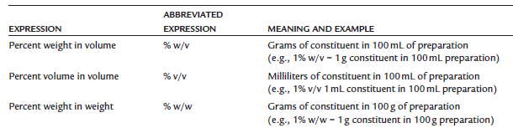

Slide 39
Some chemical agents in a given solvent require an extended time to dissolve. To fasten dissolution, a pharmacist may employ one of several techniques, such as:
Applying heat,
Reducing the particle size of the solute,
Using a solubilizing agent,
Subjecting the ingredients to vigorous agitation.

Slide 40
many medicinal agents are destroyed at elevated temperatures and the advantage of rapid solution may be completely offset by drug deterioration.
If volatile solutes are to be dissolved or if the solvent is volatile (as is alcohol), the heat would encourage the loss of these agents to the atmosphere and must therefore be avoided.
certain chemical agents, particularly calcium salts, undergo exothermic reactions as they dissolve and give off heat. For such materials, the use of heat would actually discourage the formation of a solution.
A pharmacist may choose to decrease the particle size of the solute by comminution (grinding a solid to a fine state of subdivision) with a mortar and pestle on a small scale or industrial micronizer on a larger scale.

Slide 41
Stability of solutions
Both physical and chemical stability of solutions in their containers is very important
A solution must retain its clarity, colour, odour, taste and viscosity over its shelf life.
The formulation pharmacist must be wary of chemical interactions between the various components of a solution that may alter the preparation’s stability and/or potency.
For instance, esters of p-hydroxybenzoic acid (methyl-, ethyl-, propyl-, and butylparabens), frequently used preservatives in oral preparations, have a tendency to partition into certain flavoring oils .
This partitioning effect could reduce the effective concentration of the preservatives in the aqueous medium of a pharmaceutical product below the level needed for preservative action.
Notes:
41

Slide 42
DRY MIXTURES FOR SOLUTION
A number of medicinal agents, particularly certain antibiotics, e.g., penicillin V, have insufficient stability in aqueous solution to meet extended shelf-life periods.
Thus, commercial manufacturers of these products provide them to the pharmacist in dry powder or granule form for reconstitution with a prescribed amount of purified water immediately before dispensing to the patient.
The dry powder mixture contains all of the formulative components, including drug, flavorant, colorant, buffers, and others, except for the solvent.

Slide 43
Once reconstituted by the pharmacist, the solution remains stable when stored in the refrigerator for the labeled period, usually 7 to 14 days
This is a sufficient period for the patient to complete the regimen usually prescribed.
in case the medication remains after the patient completes the course of therapy, the patient should be instructed to discard the remaining portion, which would be unfit for use at a later time.

Slide 44
ORAL REHYDRATION SOLUTIONS
Rapid fluid loss associated with diarrhea can lead to dehydration accompanied by depletion of sodium, potassium, and bicarbonate ions. (Na⁺, K⁺ & HCO3 ⁻.)
Replace the lost fluid & electrolytes with an oral rehydration solution to avoid dehydration.
These are OTC products effective in patients with mild volume depletion of 5 – 10% of body weight.

Slide 45
The active absorption of glucose in the smooth intestine ( even during diarrhea) promotes:
glucose absorption is coupled with Na⁺ absorption
Na⁺ promotes anion (X⁻) absorption,
NaX absorption promotes H₂O absorption.

Slide 46
To produce maximal absorption of sodium and water, studies have demonstrated that the optimal concentrations of glucose and sodium in an isotonic solution are
Glucose: 110 mM ≈ 2% w/v.
Na⁺: 60 mEq/L.
3. Bicarbonate and/or citrate ions are also included in these solutions to help correct the metabolic acidosis caused by diarrhea and dehydration.

Slide 47
A typical oral rehydration solution contains:
45 mEq Na⁺,
20 mEq K⁺,
35 mEq Cl⁻,
30 mEq citrate,
25 g of dextrose per liter.
These formulations are available in liquid or powder/ packet form for reconstitution.
It is important that the user add the specific amount of water needed to prepare the powder forms.
these products should not be mixed with or given with other electrolyte-containing liquids, such as milk or fruit juices. otherwise there is no method to calculate how much electrolyte the patient received.

Slide 48
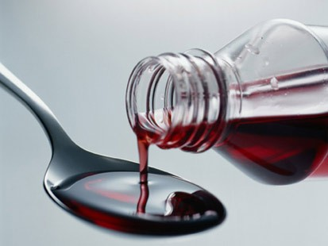
SYRUPS
Syrups are concentrated aqueous preparations of a sugar or sugar substitute with or without flavoring agents and medicinal substances.
Antihistamine Syrup
Acetaminophen Syrup
Cough and Cold Syrup

Slide 49
SYRUPS
Syrups containing flavoring agents but not medicinal substances are called flavored vehicles (non-medicated syrups) (simple syrup) .
These syrups are intended to serve as:
Pleasant tasting vehicles for medicinal substances to be added in the extemporaneous compounding of prescriptions or in the preparation of a standard formula for a medicated syrup, which is a syrup containing a therapeutic agent.

Slide 50
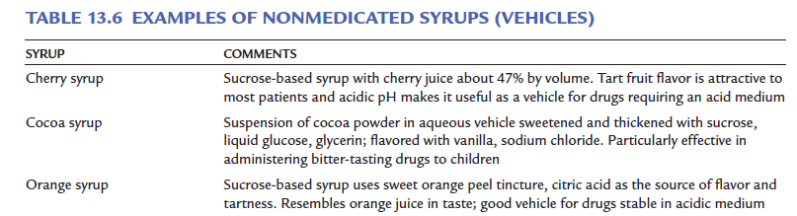

Slide 51
Syrups provide a pleasant means of administering a liquid form of a disagreeable-tasting drug.
They are particularly effective in the administration of drugs to youngsters, since their pleasant taste usually dissipates any reluctance on the part of the child to take the medicine.
the most frequently found types of medications administered as medicated syrups are antitussive agents and antihistamines.

Slide 52
COMPONENTS OF SYRUPS
Most syrups contain the following components in addition to the purified water and any medicinal agents present:
(a) the sugar, usually sucrose, or sugar substitute used to provide sweetness and viscosity;
(b) antimicrobial preservatives;
(c) flavorants;
(d) colorants.
Also, many types of syrups contain special solvents, solubilizing agents, thickeners, or stabilizers.

Slide 53
Sucrose- and Nonsucrose-based Syrups
Sucrose is the sugar most frequently employed in syrups, although in special circumstances, it may be replaced in whole or in part by other sugars or substances such as sorbitol, glycerin, and propylene glycol.
In some instances, all glycogenetic substances (materials converted to glucose in the body) including materials mentioned above, are replaced by nonglycogenetic substances, such as methylcellulose or hydroxyethylcellulose.

Slide 54
Methylcellulose or Hydroxyethylcellulose
Are not hydrolyzed and absorbed into the blood stream, and their use results in an excellent syrup-like vehicle for medications intended for use by diabetic patients and others whose diet must be controlled and restricted to nonglycogenetic substances.
The viscosity resulting from the use of these cellulose derivatives is much like that of a sucrose syrup.
The addition of one or more artificial sweeteners (aspartame, saccharin) usually produces an excellent facsimile of a true syrup.

Slide 55
The characteristic body that the sucrose and alternative agents seek to impart to the syrup is essentially the result of attaining the proper viscosity.
This quality, together with the sweetness and flavorants, results in a type of pharmaceutical preparation that masks the taste of added medicinal agents.

Slide 56
When the syrup is swallowed, only a portion of the dissolved drug actually makes contact with the taste buds, the remainder of the drug being carried past them and down the throat in the viscous syrup. This type of physical concealment of the taste is not possible for a solution of a drug in an unthickened, mobile aqueous preparation.

Slide 57
Most syrups contain a high proportion of sucrose, usually 60% to 80%, not only because of the desirable sweetness and viscosity of such solutions but also because of their inherent stability in contrast to the unstable character of dilute sucrose solutions.
The aqueous sugar medium of dilute sucrose solutions is an efficient nutrient medium for the growth of microorganisms, particularly yeasts and molds.
concentrated sugar solutions are quite resistant to microbial growth because of the unavailability of the water required for the growth of microorganisms.

Slide 58
simple syrup
Syrup, NF, also called simple syrup.
It is prepared by dissolving 85 g of sucrose in enough purified water to make 100 mL of syrup (46.3 mL of water )
The resulting preparation generally requires no additional preservation if it is to be used soon; in the official syrup, preservatives are added if the syrup is to be stored.

Slide 59
simple syrup
Simple syrup contains 85 g sucrose per 100 mL of solution, which weighs 131.3 g (specific gravity, 131.3 g/100ml ).
specific gravity (s.g. =1.313)
Specific gravity ₌ weight of substance weigh of equal volume water
1.313 ₌ w , thus, weight of 100 mL syrup is 131.3
100
131.3g - 85g = 46.3 g or mL of water in the syrup.

Slide 60
Thus, 46.3 g of water are mixed with 85 g of sucrose to give syrup 65.5% w/w or 85%w/v.
It takes 46.3 mL of water to prepare the solution (131.3 − 85 = 46.3), and the sucrose occupies a volume of (100 − 46.3 = 53.7) 53.7 mL.
The solubility of sucrose in water is 1 g in 0.5 mL of water; therefore, to dissolve 85 g of sucrose, about 42.5 mL of water would be required.

Slide 61
only a very slight excess of water (about 3.8 mL per 100 mL of syrup) is employed in the preparation of syrup.
The slight excess of water permits the syrup to remain physically stable in varying temperatures.
If the syrup were completely saturated with sucrose, in cool storage, some sucrose might crystallize from solution
As formulated, the official syrup is stable and resistant to crystallization and microbial growth.

Slide 62
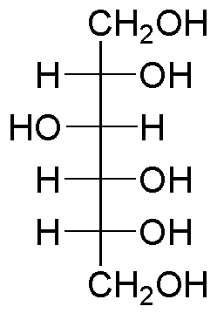
sucrose-based syrup may be substituted in whole or in part by other agents in the preparation of medicated syrups.
A solution of a polyol, such as sorbitol,
or a mixture of polyols, such as sorbitol
and glycerin, is commonly used.
The polyols, although less sweet than sucrose, have the advantage of providing favorable viscosity, reducing cap-locking (which occurs when sucrose crystallizes), and in some cases acting as cosolvents and preservatives.
sorbitol

Slide 63
Sorbitol Solution, USP, which contains 64% by weight of the polyhydric alcohol sorbitol, is employed as shown in the following example formulations for medicated syrups:
Antihistamine Syrup
RX
Chlorpheniramine maleate 0.4 g
Glycerin 25.0 mL
Syrup 83.0 mL
Sorbitol solution 282.0 mL
Sodium benzoate 1.0 g
Alcohol 60.0 mL
Color and flavor q.s.
Purified water, to make 1000.0 mL

Slide 64
Preserving Syrups
Syrup USP, having a specific gravity of 1.313 and a concentration of 85% w/v is a 65% w/w solution. This 65% by weight is the minimum amount of sucrose which will preserve neutral syrup.
If one wants to formulate a syrup containing less sucrose, the quantity of alcohol, or other preservatives, may be estimated.

Slide 65
free water is preserved by 18% alcohol
If other dissolved solids are present, their volume (often estimated) is subtracted from the free water volume.
If glycerin is present, its volume preserves an equal volume of free water.
If propylene glycol is present, it is considered equivalent to ethanol.

Slide 66
EXAMPLE
Rx
Active drug 5 mL volume occupied
Other drug solids3 ml volume occupied
Sucrose 25 g
Glycerin 15 mL
Ethanol 95% ??.
Purified water q.s. 100 mL
How much alcohol would be required to preserve this prescription?
Use the free-water method to calculate the quantity of alcohol required.

Slide 67
Syrup (85 %w/v) has s.g = 1.313, thus,
85 g sucrose are in 100 ml 131.3 g of solution.
131.3g – 85g = 46.3 g or 46.3 mL of water.
100mL - 46.3 mL = 53.7 mL is the v. of 85 g of sucrose.
Thus, 85 g of sucrose preserves 46.3 mL of water.
So, 85 g → 46.3 mL
25 g → X, thus, X = 13.62 mL of water preserved.
Volume of sucrose is:
85g → 53.7 mL
25g → x
Thus, X = 15.7 mL
v. of active drug + v. of other drugs occupies 5 + 3 = 8 mL
1 mL of glycerin preserves 1 mL of water & occupy 1 mL.
So, glycerin preserves: 15 mL + 15 mL = 30 mL total.
The volume taken care = 13.62 + 15.7 + 8 +30 = 67.3 mL.

Slide 68
100 ml – 67.3 mL of water preserved = 32.68 ml of water which need preservation.
Since it requires about 18% of alcohol to preserve water:
So, 18 → 100 mL
x → 32.68 mL, → x = 5.88 mL of alcohol 100%.
But the available alcohol 95%:
So, C₁ . V₁ = C₂ . V₂
100 . 5.9 = 95 . V₂ → V₂ = 6.2 ml of alcohol 95% is required.
So, add 6.2 ml of alcohol to the syrup and complete volume up to 100 mL with water.

Slide 69
Flavor
Most syrups are flavored with synthetic flavorants or with naturally occurring materials, such as volatile oils (e.g., orange oil), vanillin, and others, to render the syrup pleasant tasting. Because syrups are aqueous preparations, these flavorants must be water soluble.

Slide 70
Colour
To enhance the appeal of the syrup, a coloring
agent that correlates with the flavorant employed (i.e., green with mint, brown with chocolate,etc.) is used.
Generally, the colorant is water soluble, nonreactive with the other syrup components, and color stable at the pH range and under the intensity of light that the syrup is likely to encounter during its shelf life.

Slide 71
Antimicrobial Preservatives.
The amount of preservatives required in a syrup varies with the proportions of water available for microbial growth.
Among the preservatives:
1. Benzoic acid-0.1% to 0.2%
2. Sodium benzoate – 0.1 to 0.2%
3. Combination of methyl, propyl, butyl parabens totaling 0.1%

Slide 72
PREPARATION OF SYRUPS
methods are:
(a) solution of the ingredients with the aid of heat,
(b) solution of the ingredients by agitation without the use of heat, or the simple admixture of liquid components,
(c) addition of sucrose to a prepared medicated liquid or to a flavored liquid,
(d) percolation of either the source of the medicating substance or the sucrose.

Slide 73
Solution with the Aid of Heat
Syrups are prepared by this method when:
It is desired to prepare the syrup as quickly as possible
and when the syrup’s components are not damaged or volatilized by heat.
In this method:
The sugar is generally added to the purified water, and heat is applied until the sugar is dissolved.
Then, other heat-stable components are added to the hot syrup,
The mixture is allowed to cool, And its volume is adjusted to the proper level by the addition of purified water.

Slide 74
If heat-labile agents or volatile substances, such as volatile flavoring oils and alcohol, are to be added, they are generally added to the syrup after the sugar is dissolved by heat, and the solution is rapidly cooled to room temperature.

Slide 75
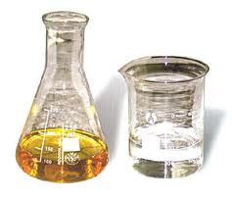
caution must be exercised against using excessive heat.
Sucrose, a disaccharide, may be hydrolyzed into monosaccharides, dextrose (glucose), and fructose (levulose).
This hydrolytic reaction is inversion,
and the combination of the two
monosaccharide products is
invert sugar.

Slide 76
When heat is applied in the preparation of a sucrose syrup, some inversion of the sucrose is almost certain.
The speed of inversion is greatly increased by the presence of acids, the hydrogen ion acting as a catalyst to the reaction.
Should inversion occur, the sweetness of the syrup is altered because invert sugar is sweeter than sucrose, and the normally colorless syrup darkens because of the effect of heat on the levulose portion of the invert suger.

Slide 77
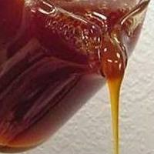
When the syrup is greatly overheated, it becomes amber colored as the sucrose caramelizes.
Syrups so decomposed are more susceptible to fermentation and to microbial growth than the stable, undecomposed syrups.

Slide 78
Solution by Agitation Without the Aid of Heat
To avoid heat-induced inversion of sucrose,
On a small scale, sucrose and other formulative agents may be dissolved in purified water by placing the ingredients in a vessel larger than the volume of syrup to be prepared, permitting thorough agitation of the mixture.
This process is more time consuming than the use of heat, but the product has maximum stability.

Slide 79
other liquids that are soluble in the syrup or miscible with it may be added and thoroughly mixed.
When solid agents are to be added to a syrup, it is best to dissolve them in minimal amount of purified water and incorporate the resulting solution into the syrup.
When solid substances are added directly to a syrup, they dissolve slowly because:
the viscous nature of the syrup does not permit the solid substance to distribute readily throughout the syrup to the available solvent
Also a limited amount of available water is present in the concentrated syrup .

Slide 80
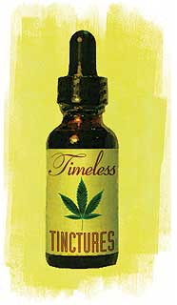
Addition of Sucrose to a Medicated
Liquid or to a Flavored Liquid
Occasionally a medicated liquid,
such as a tincture or fluidextract,
is employed as the source of medication.
tincture is an alcoholic extract of plant or animal material
The filtrate is the medicated liquid to which the sucrose is added in preparation of the syrup.
It is necessary to take care that medicated substance should not get precipitated in this process

Slide 81
Percolation
In this process, purified water or an aqueous solution is allowed to pass through a bed of crystalline sucrose.
A pledget of cotton is put in the neck of the percolator and purified water or aqueous solution is added in the percolator containing sucrose.
The flow rate is controlled by the stopcock
and maintained such that drops appear in rapid
sequence.
If required, a small portion of liquid is re-passed through the percolator to dissolve the sugar completely in the liquid or aqueous solvent.

Slide 82
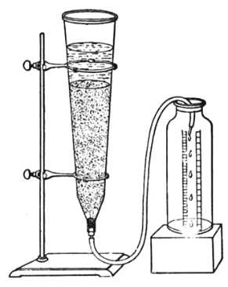
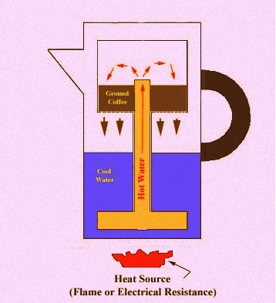
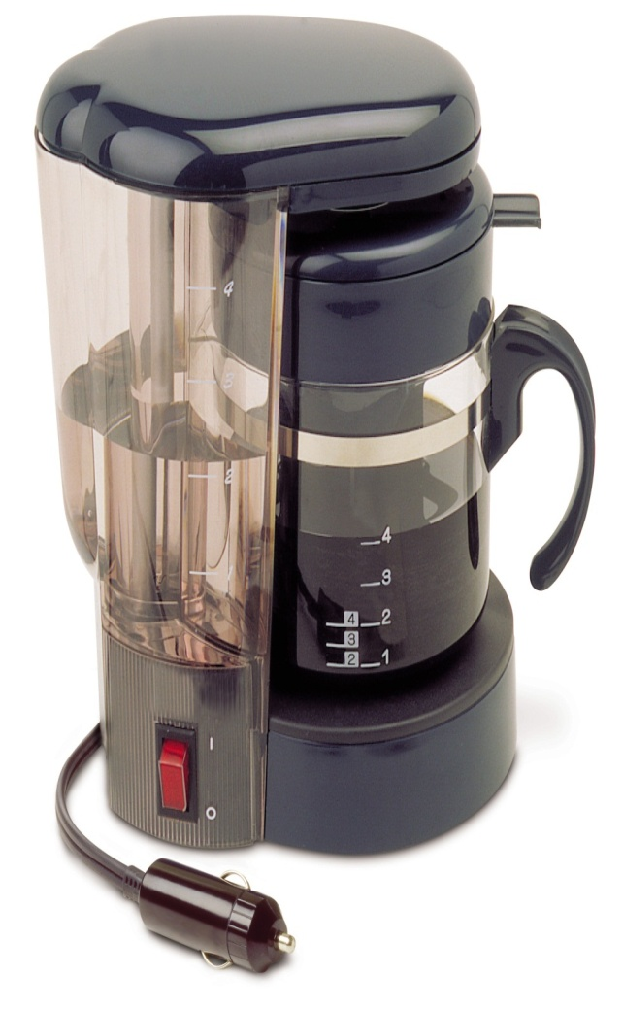
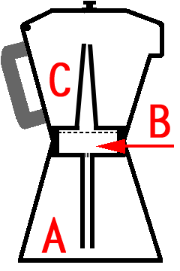
Percolator

Slide 83
either sucrose may be percolated to prepare the syrup or the source of the medicinal component may be percolated to form an extractive to which sucrose or syrup may be added.
An example of a syrup prepared by percolation is ipecac syrup, which is prepared by adding glycerin and syrup to an extractive of powdered ipecac obtained by percolation.

Slide 84
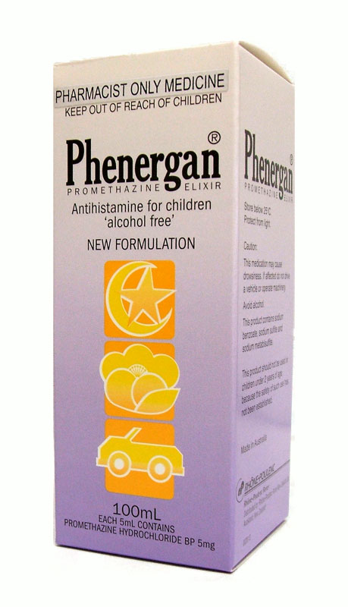
ELIXIRS
Elixirs are clear, sweetened hydroalcoholic
solutions intended for oral use and are usually
flavored to enhance their palatability.
Nonmedicated elixirs are employed as vehicles, and medicated elixirs are used for the therapeutic effect of the medicinal substances they contain.
In addition to alcohol and water, other solvents, such as glycerin and propylene glycol, are frequently employed in elixirs as adjunctive solvents.

Slide 85
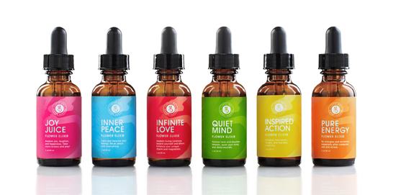
ELIXIRS
Phenobarbital Elixir
Theophylline Elixir
Medicated elixirs are formulated so that a patient receives the usual adult dose of the drug in a convenient measure of elixir. For most elixirs, one or two teaspoonfuls (5 or 10 mL) provide the usual adult dose of the drug.

Slide 86
Elixirs Compared with syrups:
Elixirs are usually less sweet and less viscous because they contain a lower proportion of sugar and consequently are less effective than syrups in masking the taste of medicinal substances.
because of their hydroalcoholic character, elixirs are better able than aqueous syrups to maintain both water soluble and alcohol-soluble components in solution.
Elixirs are more easily prepared ( by simple solution).

Slide 87
The proportion of alcohol in elixirs varies widely because the solubility of individual components of elixir varies widely..
Each elixir requires a specific blend of alcohol and water to maintain all of the components in solution.
for elixirs containing agents with poor water solubility, the proportion of alcohol required is greater than for elixirs prepared from components having good water solubility.

Slide 88
elixirs are sweetened with sucrose or with a sucrose syrup, some use sorbitol, glycerin, and/or artificial sweeteners.
Sucrose, which is only slightly soluble in alcohol usually substituted with an artificial sweetener, such as saccharin, for sweetening of Elixirs having a high alcoholic content .
All elixirs contain flavorings to increase their palatability, and most elixirs have coloring agents to enhance their appearance.
Elixirs containing more than 10% to 12% of alcohol are usually self-preserving and do not require the addition of an antimicrobial agent.

Slide 89
formulations for some medicated elixirs
Phenobarbital Elixir
Phenobarbital 4.0 g
Orange oil 0.25 mL
Propylene glycol 100.0 mL
Alcohol 200.0 mL
Sorbitol solution 600.0 mL
Color q.s.
Purified water, to make 1000.0 mL

Slide 90
Advantage / disadvantage of elixirs
One advantage of elixirs over their counterpart drugs in solid dosage forms is the flexibility and ease of dosage administration to patients who have difficulty swallowing solid forms.
A disadvantage of elixirs for children and for adults who choose to avoid alcohol is their alcoholic content.
Because of their usual content of volatile oils and alcohol, elixirs should be stored in tight, light-resistant containers and protected from excessive heat.

Slide 91
PREPARATION OF ELIXIRS
Elixirs are usually prepared by simple solution with agitation and/or by admixture of two or more liquid ingredients.
Alcohol-soluble and water-soluble components are generally dissolved separately in alcohol and in purified water, respectively.
Then the aqueous solution is added to the alcoholic solution, rather than the reverse, so that minimal separation of the alcohol-soluble components occurs.

Slide 92
When the two solutions are completely mixed, the mixture is made to the volume with the specified solvent or vehicle.
Frequently, the final mixture will be cloudy, principally because of separation of some of the flavoring oils by the reduced alcoholic concentration.
If this occurs, the elixir is usually permitted to stand for a prescribed number of hours to ensure saturation of the hydroalcoholic solvent and to permit the oil globules to coalesce so that they may be more easily removed by filtration.
Talc, a frequent filter aid in the preparation of elixirs, absorbs the excessive amounts of oils and therefore assists in their removal from the solution.

Slide 93
Nonmedicated elixirs
Nonmedicated elixirs may be useful to the pharmacist in the extemporaneous filling of prescriptions for example.
1) the addition of therapeutic agent to pleasant tasting vehicle
2) dilution of an existing medicated elixir
When a pharmacist is called on to dilute an existing medicated elixir, the nonmedicated elixir he or she selects as the diluent should have approximately the same alcoholic concentration as the elixir being diluted.
the flavor and color characteristics of the diluent should not be in conflict with those of the medicated elixir, and all components should be chemically and physically compatible.

Slide 94
MEDICATED ELIXIRS
Most official and commercial elixirs contain a single therapeutic agent.
The main advantage of having only a single therapeutic agent is that the dosage of that single drug may be increased or decreased by simply taking more or less of the elixir,

Slide 95
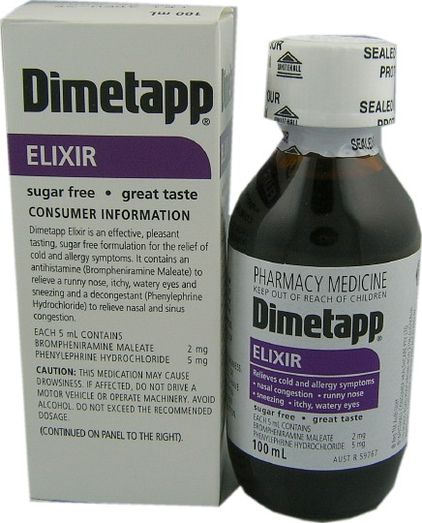
examples of medicated elixirs.
Antihistamine Elixirs
Barbiturate Sedative and Hypnotic Elixirs
Digoxin Elixir

Slide 96
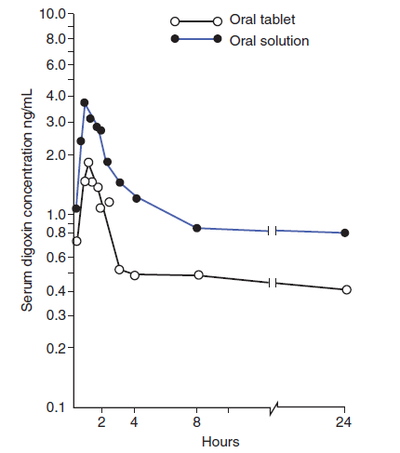
Serum digoxin concentrations following administration of digoxin 0.5 mg by oral tablet and elixir-like oral solution.

Slide 97
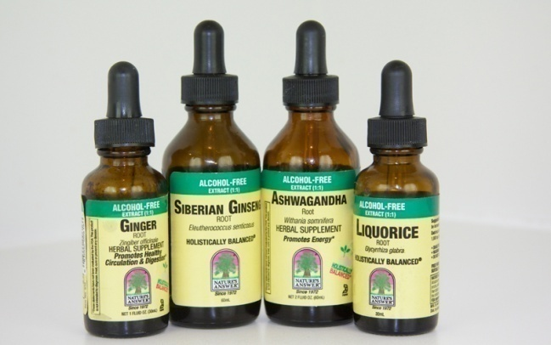
TINCTURES

Slide 98
TINCTURES
Tinctures are alcoholic or hydroalcoholic solutions prepared from vegetable materials or from chemical substances.
Tinctures contain alcohol in amounts ranging from approximately 15% to 80%.
They vary in method of preparation, strength of the active ingredient, alcoholic content, and intended use.
When they are prepared from chemical substances (e.g., iodine, thimerosal), tinctures are prepared by simple solution of the chemical agent in the solvent.

Slide 99
The alcohol content protects against microbial growth and keeps the alcohol-soluble extractives in solution.
In addition to alcohol, other solvents, such as glycerin, may be employed.

Slide 100
Tinctures …
Tinctures cannot be mixed successfully with liquids too diverse in solvent character because the solute may precipitate.
For example, compound benzoin tincture, prepared with alcohol, contains alcohol-soluble principles that are immediately precipitated from solution upon addition of water.

Slide 101
Because of the alcoholic content, tinctures must be tightly stoppered and not exposed to excessive temperatures.
Also, because many of the constituents found in tinctures undergo a photochemical change upon exposure to light, many tinctures must be stored in light-resistant containers and protected from sunlight.
Medicated tinctures taken orally are not preferred by physicians and patients due to their high alcoholic content.

Slide 102
TOPICAL SOLUTIONS
AND TINCTURES
The topical solutions employ an aqueous vehicle
The topical tinctures employ an alcoholic vehicle.
All medications intended for external use should be clearly labeled for external use
As required, cosolvents to enhance solubility or stability might be employed.

Slide 103
Most topical solutions and tinctures are prepared by simple solution (dissolving)
Some are prepared by chemical reaction.
Because of the nature of the active constituents or the solvents, many topical solutions and tinctures are self-preserved. Those that are not may contain suitable preservatives.
Topical solutions and tinctures should be packaged in containers that make them convenient to use.
Those that are used in small volume, such as the anti-infectives, are usually packaged in glass or plastic bottles with an applicator tip as a part of the cap assembly or in plastic squeeze bottles that deliver the medication in drops.

Slide 104
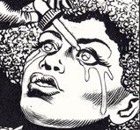
Douches
Douche is an aqueous solution, which is directed against a part or into a cavity of the body.
It functions as a cleansing or antiseptic agent.
Eye douches are used to remove foreign particles and discharges from the eyes. It is directed gently at an oblique angle and is allowed to run from the inner to the outer corner of the eye.
Pharyngeal douches are used to prepare the interior of the throat for an operation and to cleanse it in supportive conditions.
Similarly, there are nasal and vaginal douches.
Douches most frequently dispensed in the form of a powder with directions for dissolving in a specified quantity of water.
Notes:
104

Slide 105
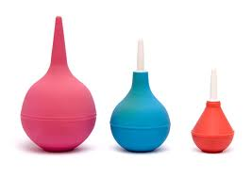
Enemas
These preparations are rectal injections employed to:
  evacuate the bowel (evacuation enemas ex. Starch enema ),
  influence the general system by absorption (retention enemas) e.g. nutritive, sedative or stimulating properties
  affect locally the site of disease (e.g. anthelmintic property)
  they may contain radiopaque substances for roentgenographic examination of the lower bowel.
Retention enemas are used in small quantities (about 30ml) and are thus called retention microenema.
Notes:
105

Slide 106
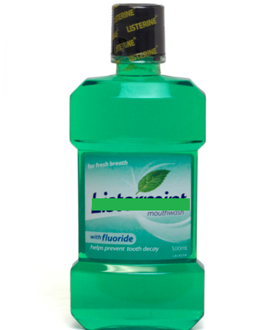
TOPICAL ORAL (DENTAL)
SOLUTIONS
Mouthwash/Gargle:
Mouthwashes can be used for therapeutic & cosmetic purposes
  Therapeutic mouthwashes can be formulated to reduce plaque, gingivitis, dental caries and stomatitis.
  Cosmetic mouthwashes may be formulated to reduce bad breath through the use of antimicrobial and/or flavoring agents.
  Many gargles must be diluted with water prior to use.

Slide 107
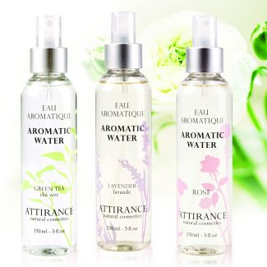
AROMATIC WATERS
Aromatic waters are clear, aqueous solutions saturated with volatile oils or other aromatic or volatile substances.
Aromatic waters are no longer in widespread use.
Aromatic waters were prepared from a number of volatile substances, including orange flower oil, peppermint oil, rose oil, anise oil, spearmint oil, wintergreen oil, camphor, and chloroform.

Slide 108
Most of the aromatic substances in the preparation of aromatic waters have very low solubility in water, and even though the water may be saturated, its concentration of aromatic material is still rather small.
Aromatic waters may be used for perfuming and/or flavoring.

Slide 109
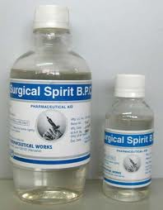
SPIRITS
Spirits are alcoholic or hydroalcoholic
solutions of volatile substances.
Generally, the alcoholic concentration of spirits is rather high, usually over 60%.
Because of the greater solubility of aromatic or volatile substances in alcohol than in water, spirits can contain a greater concentration of these materials than the corresponding aromatic waters.

Slide 110
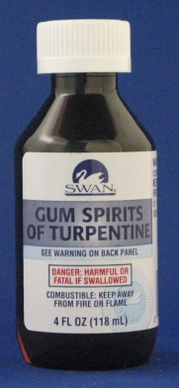
When mixed with water or with an aqueous preparation, the volatile substances present in spirits generally separate from the solution and form a milky preparation.
Spirits may be used pharmaceutically as flavoring agents and medicinally
for the therapeutic value of the
aromatic solute.

Slide 111
When taken orally, they are generally mixed with a portion of water to reduce the pungency of the spirit.
Depending on the materials, spirits may be prepared by simple solution, solution by maceration, or distillation.
The spirits most recently official in the USP–NF are aromatic ammonia spirit, camphor spirit, compound orange spirit, and peppermint spirit.

Slide 112
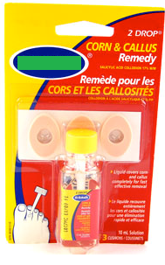
COLLODIONS
Collodions are liquid preparations composed
of pyroxylin dissolved in a solvent mixture
usually composed of alcohol and ether with or without added medicinal substances.
Pyroxylin (i.e., nitrocellulose,) consists chiefly of cellulose tetranitrate.
When applied to the skin with brush or glass applicator, the solvent rapidly evaporates, leaving a filmy residue of pyroxylin.

Slide 113
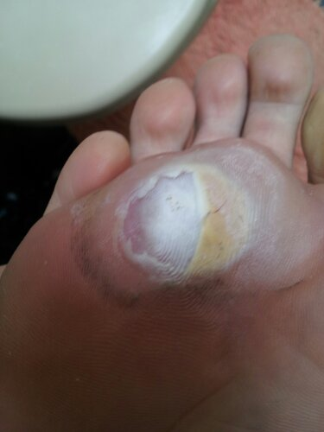
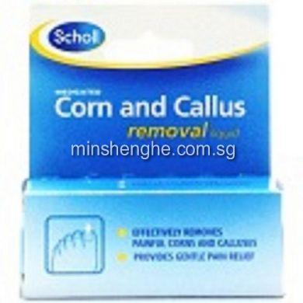
when the collodion is medicated, it leaves a thin layer of that medication firmly placed against the skin.
Collodions must be applied to dry tissues to adhere to the skin’s surface.
Collodions are intended for external use.
The products must be clearly labeled “for external use only”
collodions, are flammable and must be stored away from flame in well-closed containers, protected from light.

Slide 114

Salicylic Acid Collodion
10% solution of salicylic acid in flexible collodion.
It is used for its keratolytic effects, especially in the removal of corns from the toes.
Flexible collodion is prepared by adding 2% camphor and 3% castor oil to collodion. The castor oil renders the product flexible, permitting its comfortable use over skin areas that are normally moved, such as joints, fingers, and toes.
The camphor makes the product waterproof.

Slide 115
GLYCERITES:
Solutions of mixtures of medicinal or pharmaceutical substances in glycerin
Generally a minimum of 50% of glycerin is present in glycerites
Glycerites are generally quite viscous with some of them reaching a jelly like consistency
Glycerites are considered to be stable preparation and are not usually as prone to microbial contamination because it possesses preservative properties

Slide 116
Glycerin alone is used as an otic solution , aid in the removal of cerumen. Or as solvent for the preparation of Benzocaine Otic Solution USP.
Starch Glycerite
used as an emollient;
Starch 100g;
water 200mL;
Benzoic acid 2g;
Glycerin 700mL

