Slide 1
Pharmaceutics I
Route of Drug Administration

Slide 2
Route of administration
Is the path by which a drug, fluid, poison or other substance is brought into contact with the body

Slide 3
Routs of Drug administration
The possible routes of drug entry into the body may be divided into two classes:
  Enteral Route
  Parenteral Route
  Other Routes
Notes:
3
3

Slide 4
Parenteral Route of Drug Administration
Parenteral Routes:
An injection is an infusion method of putting liquid into the body, usually with a hollow needle and a syringe which is pierced through the skin to a sufficient depth for the material to be forced into the body.
There are several methods of injection, including:
Intravenous bolus (IV)
Intravenous infusion (IV inf)
Intramuscular injection (IM)
Subcutaneous injection (SC)

Slide 5
Parenteral Routes
  Intravascular (IV)- placing a drug directly into the blood stream; the only systemic route with no membrane to cross.
  Intramuscular (IM) - drug injected into skeletal muscle
  Subcutaneous - Absorption of drugs from the subcutaneous tissues
Notes:
5
5

Slide 6
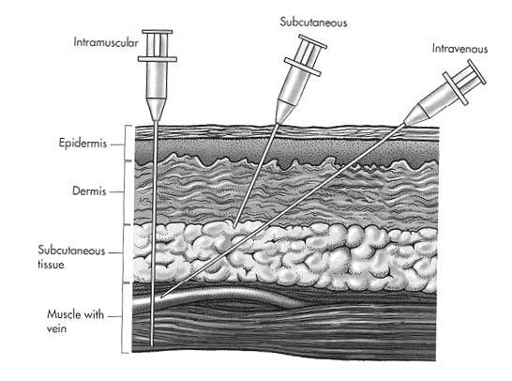

Slide 7
Enteral Routes
Enteral - drug placed directly in the GI tract:
  sublingual (SL)- placed under the tongue
  oral - swallowing (p.o.)
  rectum (PR) - Absorption through the rectum
Other Routes
Transdermal
Inhalation
Intranasal
Ophthalmic
Notes:
7
7

Slide 8
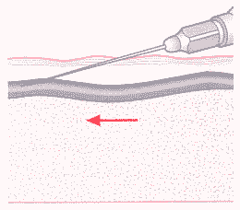
Intravenous bolus (IV(
Complete (100%) systemic drug absorption.
Rate of bioavailability considered instantaneous.
Drug is given for immediate effect.
Increased chance for adverse reaction .
Possible anaphylaxis

Slide 9
Intravenous infusion (IV inf)
Complete (100%) systemic drug absorption.
Rate of drug absorption controlled by infusion rate.
Plasma drug levels more precisely controlled.
May inject large fluid volumes.
Requires skill in insertion of infusion set.
Tissue damage at site of injection (infiltration, necrosis, or sterile abscess).

Slide 10
Intramuscular injection (IM(
Rapid absorption from aqueous solution.
Slow absorption from nonaqueous (oil) solutions.
Larger volumes may be used compared to subcutaneous solutions.
Easier to inject than intravenous injection.
Irritating drugs may be very painful.
Different rates of absorption depending on muscle group injected and blood flow.

Slide 11
Subcutaneous injection (SC(
Prompt absorption from aqueous solution.
Slow absorption from repository formulations.
Generally, used for insulin injection.
Rate of drug absorption depends on blood flow and injection volume.

Slide 12
Oral (PO(
Absorption may vary.
Generally, slower absorption rate compared to IV bolus or IM injection.
Advantages:
Safest and easiest route of drug administration.
Variety of dosage forms available and may use immediate-release and modified-release drug products
Convenient - portable, no pain, easy to take..

Slide 13
Oral (PO( Disadvantages
Drugs may have erratic absorption,
Drugs may be unstable in the gastrointestinal tract, it is destructed by gastric acid and digestive juices
Drug may be metabolized by liver prior to systemic absorption "first-pass" effects.
Sometimes inefficient - high dose or low solubility drugs may suffer poor availability, only part of the dose may be absorbed.
unable to use in unconscious patient.

Slide 14
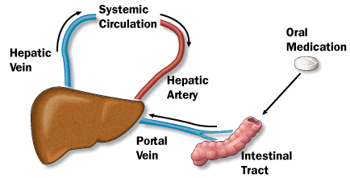
First-pass Effect
The first-pass effect Is the term used for the hepatic metabolism
of a pharmacological agent when it is absorbed from the gut and
delivered to the liver via the portal circulation.
The greater the first-pass effect, the less the agent will reach
the systemic circulation when the agent is administered orally
Notes:
14
14

Slide 15
After a drug is swallowed, it is absorbed by the digestive system and enters the hepatic portal system. It is carried through theportal vein into the liver before it reaches the rest of the body. The liver metabolizes many drugs, sometimes to such an extent that only a small amount of active drug emerges from the liver to the rest of the circulatory system. This first pass through the liver thus greatly reduces the bioavailability of the drug.

Slide 16
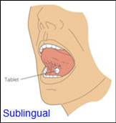
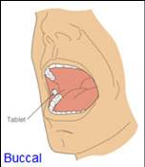
Buccal or sublingual (SL)
Sublingual administration is where the dosage form is placed under the tongue
Buccal administration is where the dosage form is placed between gums and inner lining of the cheek.

Slide 17
Rapid absorption from lipid-soluble drugs
No "first-pass" effects.
Some drugs may be swallowed.
Not for drugs with high doses.
Irritation of oral mucosa
Drug taste may need to be masked.

Slide 18
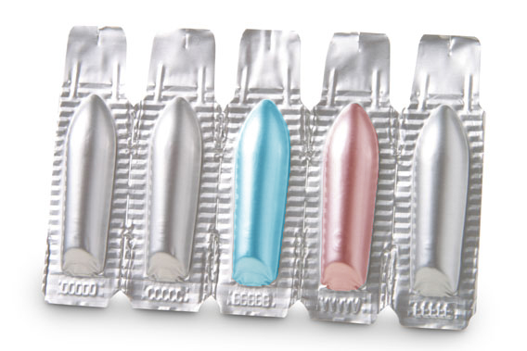
Rectal
Rectal (PR(
USED FOR :
1. unconscious patients and children
2. if patient is nauseous or vomiting
3. good for drugs affecting the bowel
such as laxatives
Notes:
18
18

Slide 19
Rectal (PR(
Absorption may vary from suppository.
More reliable absorption from enema solution.
Useful when patient cannot swallow medication
Used for local and systemic effects.
Absorption may be erratic.
Some patient discomfort.

Slide 20
Transdermal
Slow absorption, rate may vary.
An occlusive dressing may be used to improve absorption.
lower risk of side effects
Transdermal delivery system (patch) is easy to use.
It could achieve systemic or local effects.
Used for lipid-soluble drugs with low dose and low MW.

Slide 21
Transdermal Disadvantages
Skin irritation from the patch or drug.
Permeability of skin variable with condition, anatomic site, age, and gender.
Type of cream or ointment base affects drug release and absorption.

Slide 22
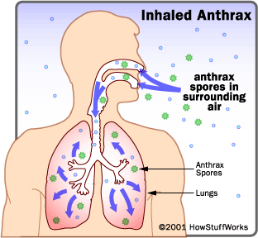
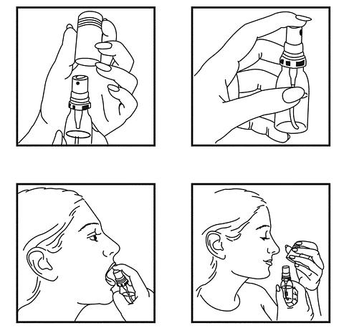
Inhalation and intranasal
Rapid absorption.
Total dose absorbed is variable.
May be used for local or systemic effects.
May stimulate cough reflex.
Some drug may be swallowed.

Slide 23
When a drug is administered by an extravascular route of administration (eg, oral, topical, intranasal, inhalation, rectal), the drug must first be absorbed into the systemic circulation and then diffuse or be transported to the site of action before eliciting biological and therapeutic activity.
The general principles and kinetics of absorption from these extravascular sites follow the same principles as oral dosing, although the physiology of the site of administration differs.

Slide 24
Many drugs are not administered orally because of drug instability in the gastrointestinal tract or drug degradation by the digestive enzymes in the intestine.
erythropoietin and human growth hormone are administered IM, and insulin is administered SC or IM, because of the potential for degradation of these drugs in the stomach or intestine.
Biotechnology products are too labile to be administered orally and are usually given parenterally.

Slide 25
Drug absorption after subcutaneous injection is slower than intravenous injection.
Pathophysiologic conditions such as burns will increase the permeability of drugs across the skin compared with normal intact skin.

Slide 26
The systemic absorption of a drug is dependent on:
(1) the physicochemical properties of the drug,
(2) the nature of the drug product,
(3) the anatomy and physiology of the drug
absorption site.

