Slide 1
Chapter 1

Slide 2
Objectives
Define the Internet
Describe how individuals, businesses, educational institutions, and organizations use the Internet
Discuss the developments of the Internet and the World Wide Web
Explain how individuals and businesses connect to the Internet

Slide 3
Defining the Internet
The Internet is a worldwide network of computers that allows individual and businesses around the world to share information and other resources and to conduct business transactions
The Internet is an interconnected network of networks where each host (a computer directly connected to the Internet) has a number of other computers connected to it
Users who connect to the Internet to access information and services are online

Slide 4
Defining the Internet

Slide 5
Defining the Internet
All computers and mobile devices use a common method of communicating known as a protocol, or standard
The Internet uses Transmission Control Protocol/Internet Protocol (TCP/IP)

Slide 6
Using the Internet
The Internet and web significantly have influenced the way the world communicates, educates, entertains, and conducts business. People use the Internet to:
Search for information and conduct business
Communicate and share information or media
Check weather, news, and sport statistics
Participate in online training
Shop and play games
Download books, music, or videos

Slide 7
Using the Internet

Slide 8
Using the Internet
Who Uses the Internet?
Students
Teachers
Businesspeople
Professionals
Homemakers
Children
Retirees

Slide 9
استخدامات الانترنت
يستخدم الافراد الانترنت للبحث عن المعلومات في اي موضوع، مثل التسلية و الرياضة و السياسة و العلوم و الفنون و التاريخ و غيرها.
بينما يستخدم العاملون في المجال الطبي الانترنت للابحاث عن ادوية جديدة، او علاجات حالية، او التواصل مع المرضى او ارسال سجلات المرضى الكترونيا لعاملين اخرين.
و تستخدم الاسر الانترنت لانشاء تقويم مشترك لتنسيق مواعيدها، و ارسال الرسائل و ايجاد وصفات الطعام و غيرها.
و يستخدم الساسة و المشاهير و غيرهم من الشخصيات العامة وسائل التواصل الاجتماعي لمشاركة متابعيهم باخبارهم و نشاطاتهم.
و يستخدم المواطنون الانترنت للتسوق و دفع الفواتير و ارسال الحوالات و تقديم بياناتهم الضريبية.

Slide 10
Using the Internet
People also use the Internet to publish blogs
Video sharing or video blogging or vlogging
Microblogging, e.g. Twitter

Slide 11
Using the Internet
Internet Activities
Browsing and searching for information
Communicating with others through email, text or video chat, social networking, instant messaging, mailing lists, blogs and microblogs, and other media
Downloading and uploading files
Accessing remote computers or servers
Conducting business activities
Online shopping and bill payment

Slide 12
Using the Internet
Internet Activities – The World Wide Web
Commonly called the web, it is a subset of the Internet
Webpages – can include text, pictures, sound, animation, or video
Website – collection of related webpages
College, university, corporate, retail, non-profit, personal

Slide 13
Using the Internet

Slide 14
Using the Internet
Internet Activities (continued)
Markup language – coding system that uses tags to control appearance of webpage
Hypertext Markup Language (HTML)
Cascading style sheets (CSS)
Web authoring software
Web server – computer on which webpages are stored

Slide 15
Using the Internet
Internet Activities (continued)
Web browser or browser – software used to access and view webpages
Hyperlink, or link, used to connect to other webpages
Browsing or surfing the web refers to moving from one webpage to another using links that connect them

Slide 16
Using the Internet

Slide 17
Using the Internet
Internet Activities (continued)
Search tools
Web-based resource to help find specific information on the web

Slide 18
Using the Internet
Internet Activities (continued)
Downloading and uploading files – using FTP (File Transfer Protocol) to send or retrieve electronic files from a server
Remote computing
Cloud computing
Virtual private network (VPN)
Web conferencing or video calling
Telnet

Slide 19
Using the Internet
Cloud: Google Docs

Slide 20
Using the Internet
Internet Activities (continued)
Conducting business activities
E-business:
Business-to-consumer (B2C)
Business-to-business (B2B)
Business-to-employee (B2E)
Consumer-to-consumer (C2C)
B2B transactions account for majority of e-business dollars spent

Slide 21
Using the Internet

Slide 22
Dark Side of the Internet
Illegitimate, biased, unfounded content
Spread of viruses
Anonymity & cyberstalking
Threatening or harassing other people
Health
Vision, neck, fingers
Addiction
Impact on personal relationships

Slide 23
Origins of the Internet
1958: Department of Defense founded Advanced Research Projects Agency (ARPA) to prevent computer systems from being vulnerable to a nuclear attack
1960s: Around 10,000 computers existed
1961: Leonard Kleinrock developed packet switching
1962: J.C.R. Licklider headed computer and information processing research efforts
1966: ARPANET – prototype network connecting ARPA and university research centers

Slide 24
Origins of the Internet
Growth and Development of ARPANET
1970: Thirteen research centers in ARPANET
Roughly doubled in size every year for next 15 years
1972: Robert Kahn and Vinton Cerf developed standard or protocol for communications over a network Transmission Control Protocol (TCP) and Internet Protocol (IP)
To the Public
1985: NSFnet replaced ARPANET
1992: Congress authorized commercial activity on the NSFnet
1995: NSFnet moved connections to commercial network providers

Slide 26
Origins of the Web
1991: Gopher at University of Minnesota
Directory-based system
Used directory links to make navigation easier

Slide 27
Origins of the Web
Tim Berners-Lee
1990: Hypertext Markup Language (HTML)
1990: Hypertext Transfer Protocol (HTTP)
1991: First browser; was called WorldWideWeb
Marc Andreessen and Eric Bina
1993: Mosaic browser
Marc Andreessen and Jim Clark
1994: Netscape Navigator browser (➔ Firefox)

Slide 28
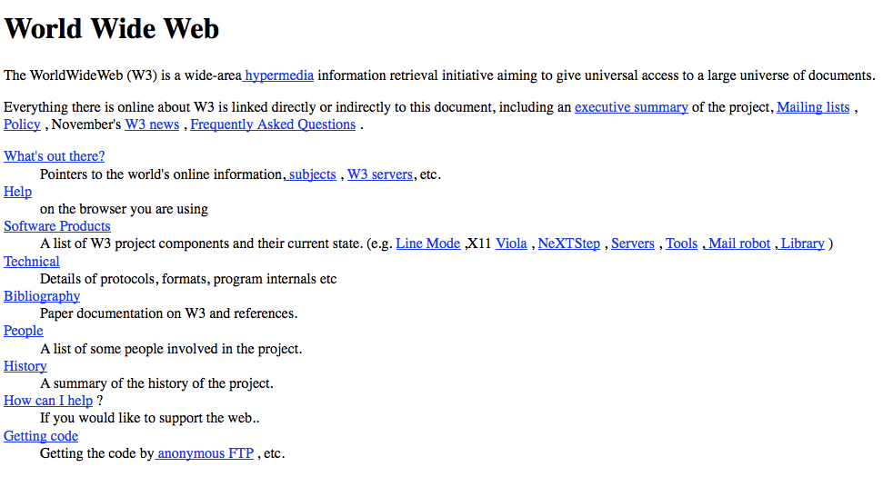
Origins of the Web
The first web page, 1992

Slide 29
Origins of the Web

Slide 30
Origins of the Web
1994: First banner ad, first spam email
1994: The web has approximately 10 million users
1995: Microsoft released Internet Explorer

Slide 31
Impact of the Internet

Slide 32
Connecting to the Internet
Internet Service Providers (ISPs)
Provide Internet access to individuals and companies
Mobile service provider, sometimes called a wireless data provider, offers wireless Internet access to computers and mobile devices
Local area network (LAN) connects computers using cables or wirelessly
Regional ISP provides Internet access in a specific geographic area
National ISP provides Internet access in major cities and towns nationwide

Slide 33
Connecting to the Internet
Internet Service Providers (ISPs) (continued)
Considerations for choosing an ISP
The speed or bandwidth of the connection
The availability of wireless or mobile data service
The type of connection and cost of service
Availability of customer service and technical support

Slide 34
Connecting to the Internet
Internet Service Providers (ISPs) (continued)
Transfer rate measures numbers of bits can be transmitted in one second (bits per second or Bps)
Kilobits per second (KBps) – thousands of bits per second
Megabites per second (MBps) – millions of bits per second
Gigabits per second (GBps) – billions of bits per second

Slide 35
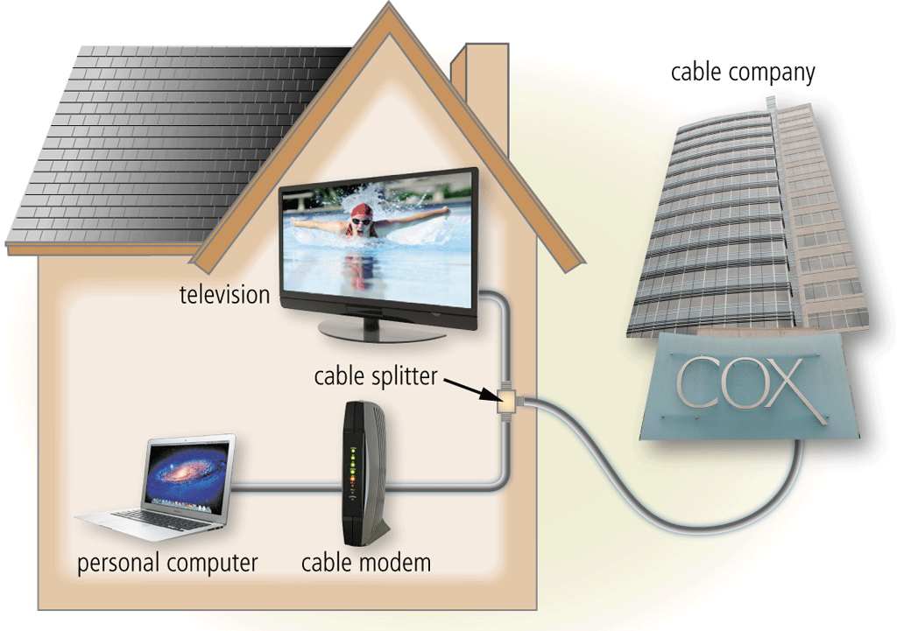
Connecting to the Internet
Connection Methods
Cable
Cable television (CATV) lines use same coaxial cable that delivers TV transmissions
Cable modem and
line splitter required

Slide 36
Connecting to the Internet
Connection Methods (continued)
Digital Dedicated Lines
A constant connection between two communications devices that uses a local phone network
Integrated Services Digital Network (ISDN)
Digital subscriber line (DSL)
Asymmetrical digital subscriber line (ADSL)
T-carrier line
Fractional T-1 line
T-3 line

Slide 37
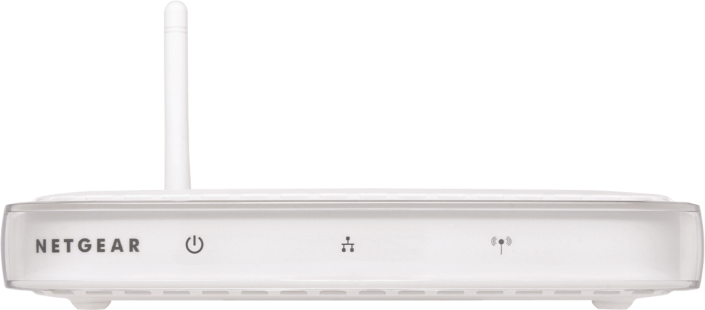
Connecting to the Internet
Connection Methods (continued)
Wireless Fidelity
Wireless fidelity (Wi-Fi) technologies to connect to networks
Hotspot – specific geographic location in which a wireless access point provides public Internet access
Wireless access point – hardware that connects wireless devices to a network

Slide 38
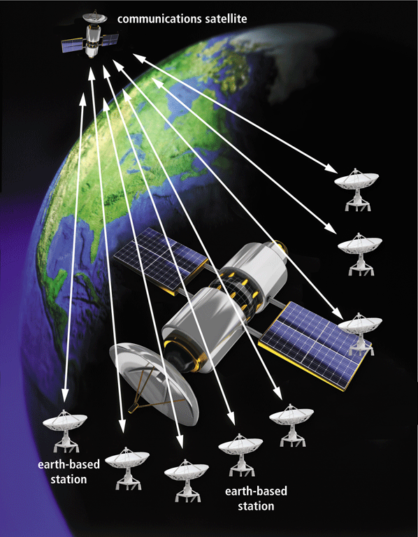
Connecting to the Internet
Connection Methods (continued)
Satellite Internet access: One-way or two-way satellite transmissions

Slide 39
Chapter Summary
Define the Internet
Describe how individuals, businesses, educational institutions, and organizations use the Internet
Discuss the developments of the Internet and the World Wide Web
Explain how individuals and businesses connect to the Internet

