Slide 2
Objectives
Describe the components of email systems and email messages
Discuss and apply email etiquette
Use email to send, receive, and organize email messages and contacts, and discuss email viruses
Describe various online social media and communication tools and discuss how they are used

Slide 3
Email Systems
Email is one of the most efficient and commonly used online communication tools
Indispensable for businesses, schools and other organizations
Used by people for nonbusiness communications
Volume of daily email exceeds the number of pieces of paper mail handled by major postal systems
Problems include spam (unsolicited junk email)

Slide 4
Email Issues
Users don’t “own” their email
Belongs to universities, work, or email service providers (e.g. Gmail, Yahoo, etc.) or internet service providers (e.g. work, coffee shop, Zain, Orange, etc.)
Many people have multiple accounts
Work, friends & family, online shopping, etc.

Slide 5
Email Systems
Email has several distinct benefits
Speed of delivery
Low cost
Accessibility
Convenience
Ease of management
Components of an email system
Addresses, clients, servers, protocols

Slide 6
Email Systems
Email Addresses
User name or user ID
Host name
TLD (top level domain)

Slide 7
Email Systems
Email Clients, Servers, and Protocols
Email Client
Program used to create, send, and receive email messages
Typically offers tools to:
Create and send outgoing email messages
Read, save, and print messages and attachments
Sort, archive, and delete messages
Create folders to organize messages

Slide 8
Email Systems
Email Clients, Servers, and Protocols
Email protocols include:
POP (Post Office Protocol)
SMTP (Simple Mail Transfer Protocol)
IMAP (Internet Message Access Protocol)
HTTP (Hypertext Transfer Protocol)

Slide 9
Email Systems

Slide 10
Email Systems
Anatomy of an Email Message
Most email clients provide the same basic message window features
To line
CC line (courtesy or carbon copy)
BCC line (blind CC)
Subject line
Attachment line
Message body
Signature file

Slide 11
Email Systems

Slide 12
Email Systems
Email Etiquette
Determine whether email is the proper communication method
Do not use all caps, which indicates SHOUTING
Do not respond with strong language or insults
Flaming
Use emoticons (e.g. :) ) and emoji (e.g. ☺) sparingly
Emoticons and emoji are rarely appropriate for business email

Slide 13
Creating a Web-Based Email Account
Start a browser and enter gmail.com in the Address bar, then tap or click the necessary button to open the Gmail home page
Tap or click the ‘Create an account’ button to open the Gmail registration page
Enter your name and user name in the Name text boxes
Enter and verify password in the ‘Create a password’ text box
Continue filling out the rest of the registration form

Slide 14
Creating a Web-Based Email Account

Slide 15
Creating a Web-Based Email Account

Slide 16
Passwords
Use passwords that are at least 8 characters long
Mix letters, numbers and special characters
Don’t use keyboard sequences
E.g. qwerty, asdf, zcxv, uiop, jkl, etc.
Use questions that only you the answers for
Use “complex” words
E.g. p@$$w0rd, 1imit, etc.

Slide 17
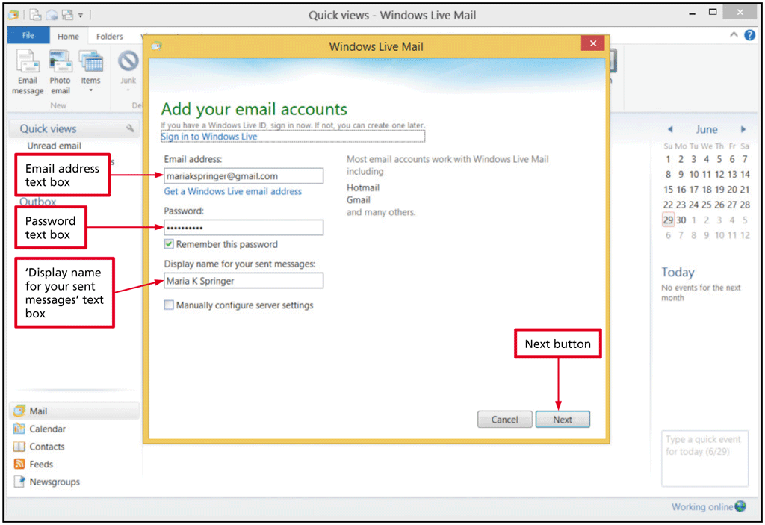
Syncing Web-Based Email with an Email Client
Open Windows Live Mail
Enter your Gmail address, password, and display name
Click the Next button to open your Windows Live inbox

Slide 18
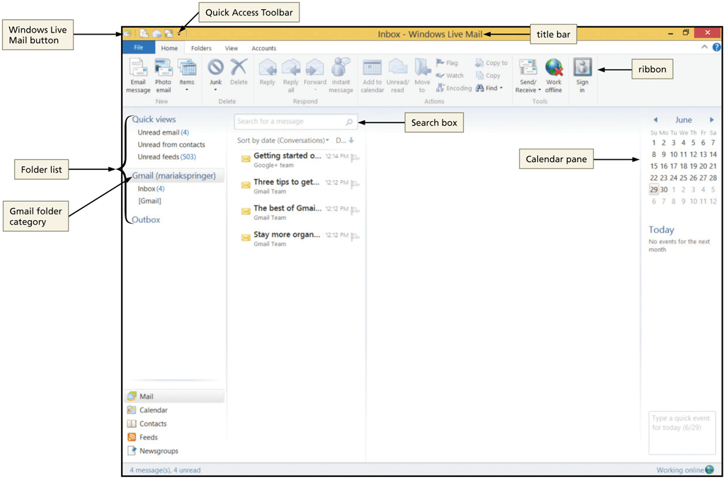
Using Email
Reviewing the Email Window

Slide 19
Using Email
Reviewing the Email Window (continued)
The Home tab

Slide 20
Using Email
Reviewing the Email Window (continued)
Inbox folder
Outbox folder
Sent Items folder or Sent Mail folder
Deleted Items folder or Trash folder
Drafts folder
Junk email folder or Spam folder
Message list

Slide 21
Checking for Incoming Mail
Tap or click the Send/Receive or Refresh button to download an incoming message and send any outgoing messages temporarily stored in the Outbox folder
Tap or click a message to select it and view its contents in the Preview pane

Slide 22
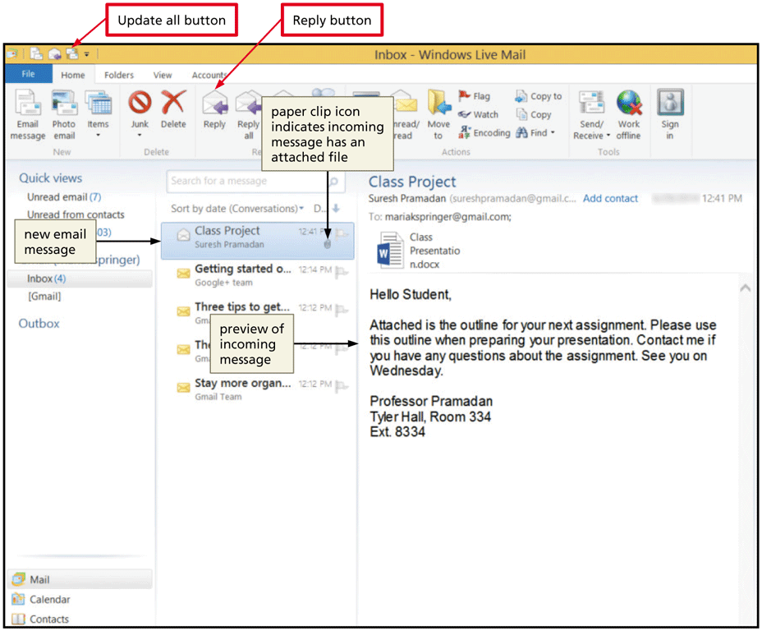
Checking for Incoming Mail

Slide 23
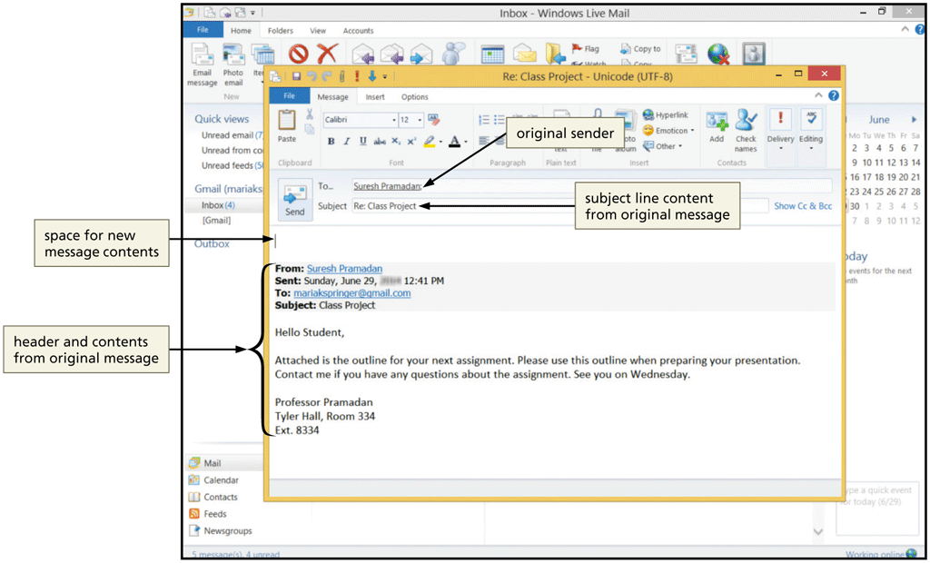
Replying to an Email Message
Tap or click the Reply button to open the Re: message window

Slide 24
Viewing and Saving an Attachment
Double-tap or double-click the message
Right-click or press and hold the attachment’s file name to display the shortcut menu
Tap or click the Open command to display the Mail Attachment dialog box
Tap or click the Open button to open the attachment
Tap or click the Close button on the title bar to close the document and return to Windows Live Mail
Display the message and then right-click or press and hold the attachment icon to open the shortcut menu

Slide 25
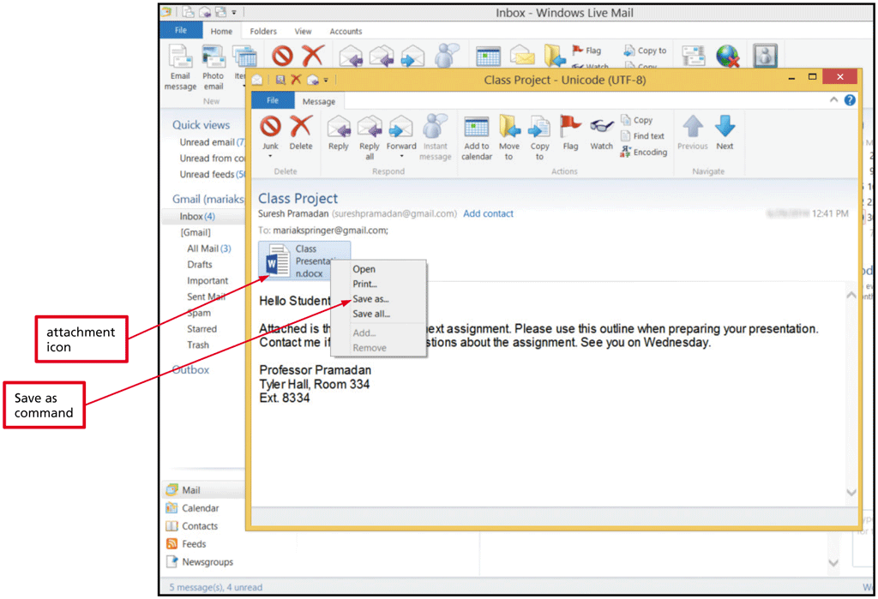
Viewing and Saving an Attachment
Tap or click the Save as command to open the Save Attachment As dialog box
Tap or click the Save button in Save Attachment As dialog box

Slide 26
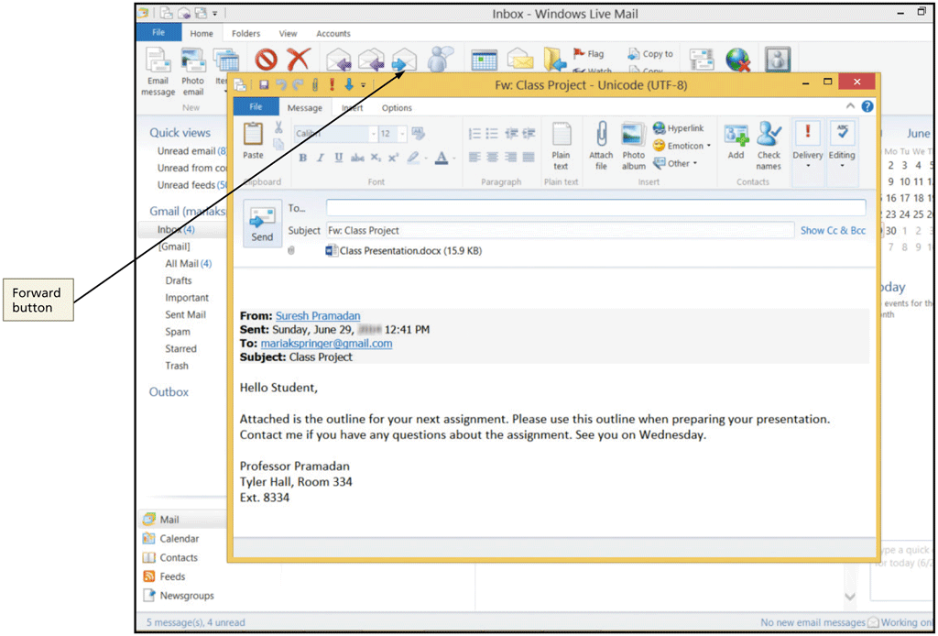
Using Email
Forwarding an Email Message
Tap or click the Forward button
Attachments also are forwarded
Printing an Email Message
Set print options, including number of copies

Slide 27
Using Email
Composing and Sending an Outgoing Email Message
Write a meaningful Subject line
Add a greeting
Write a brief, clear message
Instead of typing or retyping information, use hyperlinks to link to a website or network folder you are referencing in your email, or include an attachment file
When replying to an email, you should leave the message to which you are replying at the bottom of your message
Add a personalized closing and a signature file

Slide 28
Using Email
Creating a Signature File
A signature file includes standard information automatically inserted at the end of email messages
Basic contact information, such as name, company, phone number(s) website, Twitter handle, and email address
Can include a confidentiality agreement, logo, inspirational quotation, motto, or more

Slide 29
Composing and Sending a Message with an Attachment
Tap or click the Email message button and, if necessary, maximize the message window
Type the recipient’s email address, subject, greeting line, and message text
Tap or click the Attach file button in the Insert group to display the Open dialog box
Navigate to the location containing the attachment
Double-tap or double-click the file name and then click the Open button to attach the file to the message
Tap or click the Send button

Slide 30
Composing and Sending a Message with an Attachment

Slide 31
Creating a New Message Folder
Tap or click the Folders tab to display folder options
Tap or click the New folder button to display the Create Folder dialog box
Enter the desired folder name
Tap or click the OK button to create the folder

Slide 32
Creating a New Message Folder

Slide 33
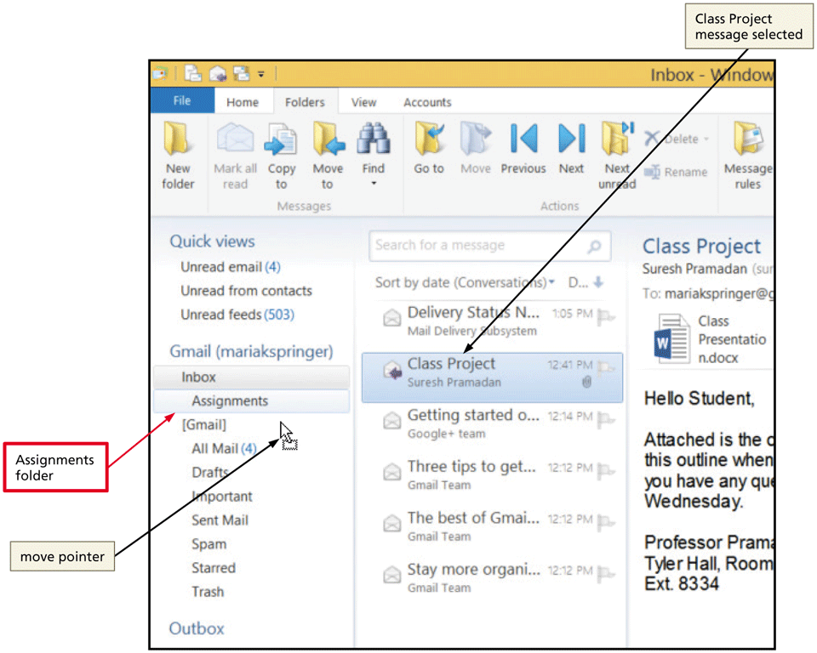
Moving a Message from the Inbox Folder into the Assignments Folder
Tap or click the message to move in the Message list
Drag the message to the desired folder

Slide 34
Using Email
Managing Your Inbox
You can set rules for incoming spam or junk messages in the Safety Options dialog box

Slide 35
Deleting a Message
Double-tap or double-click the message to delete
Tap or click the Delete button on the Message tab in the Delete group to move the message to the Deleted items folder

Slide 36
Using Email
Flag a message that requires further action
Prioritize messages
High, Normal, and Low priority
Add a read receipt
Sort messages
Click the Sort order button in the Arrangement group on the View tab

Slide 37
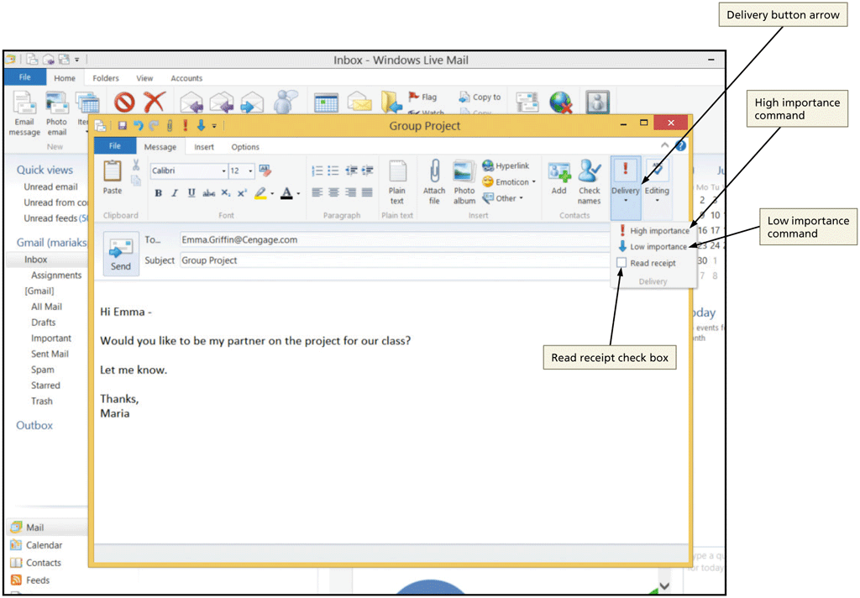
Using Email

Slide 38
Creating a Contact
Tap or click the Contacts folder button in the left pane to open the Contacts folder
Tap or click the Contact button in the New group on the Home tab and then type new contact information
Tap or click the Add contact button in the Add a Contact dialog box

Slide 39
Creating a Contact

Slide 40
Sending an Email Message to a Contact
Tap or click the Email message button in the New group on the Home tab
Tap or click the To button in the message header to open the Send an Email dialog box
Tap or click the contact to whom you want to send the email message
Tap or click the To button in the lower part of the dialog box
Tap or click the OK button
Tap or click the Send button

Slide 41
Sending an Email Message to a Contact

Slide 42
Using Email
Managing Contacts (continued)
Creating Contact Categories
A contact category is a list of contacts with a single name
In the Contacts folder, enter a name for the category and select the contacts to be included in the group
Deleting the category does not delete the individual contacts from your Contacts folder

Slide 43
Using Email
Managing Contacts (continued)
Editing and Deleting Contacts
To edit, tap or right-click the contact’s name in the Contacts folder and then tap or click Edit contact; or double-tab or double-click contact to open the Edit Contact dialog box
To delete, select the contact’s name in the Contacts folder and then press the DELETE key, or tap or right-click the contact’s name in the Contacts folder and tap or click Delete Contact command

Slide 44
Using Email
Email Viruses and Worms
Worm
Trojan horse
Use caution in opening email messages
Don’t download attachments from untrusted sources
Especially, .exe files
Install virus protection software on your computer and keep it up to date
Virus hoaxes

Slide 45
Using Email
Junk Email Options
Malicious spam types include:
Phishing: Collecting personal information
Stock-manipulation schemes: Encouraging buying
“Nigerian Sting” operations: Requests for money
Spam-filtering services allow you to filter out and either block or move messages to the Spam folder
You can set options to block junk email and set exceptions to the blocking process

Slide 46
Using Email

Slide 47
Social Media
Social media refers to online tools that allow people to communicate, collaborate, and share over the Internet
Social networking websites and apps, such as Facebook, LinkedIn, Google+, provide a medium in which friends, colleagues, and school alumni can share personal information or photographs, résumés and networking opportunities, or information about events

Slide 48
Social Media
Social Networking
Social networking sites typically offer a combination of online communication tools:
Email
Discussion groups
Blogs
Instant messaging
P2P networking
Real-time chat

Slide 49
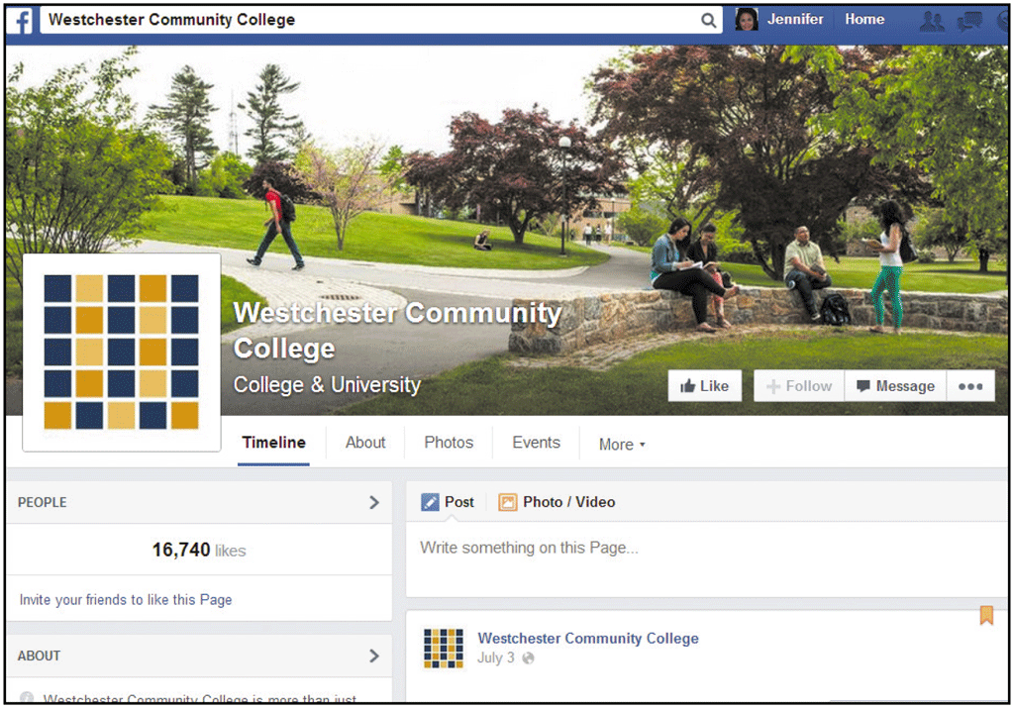
Social Media

Slide 50
Social Media
Blogging and Microblogging
Variety of blogs available is collectively called the blogosphere
Blogs are highly popular and powerful tools for sharing thoughts and ideas across a wide spectrum of interests and audiences
Microblogging, which resembles a combination of blogging and instant messaging, involves broadcasting brief (typically 140 characters or less) messages to a public website or sending email or text messages to subscribers

Slide 51
Blogging and Microblogging

Slide 52
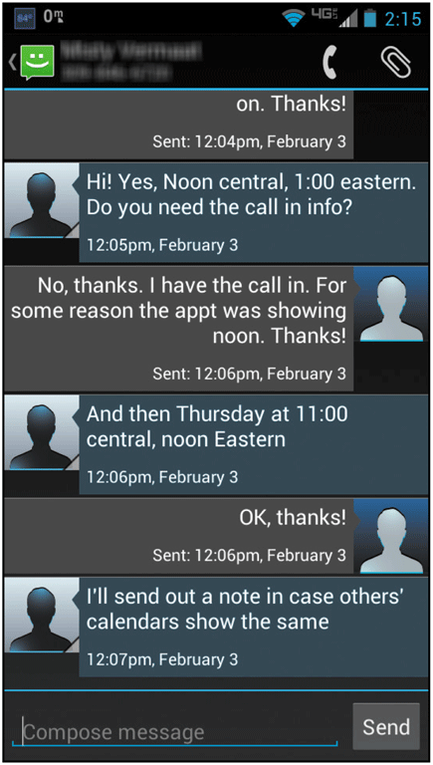
Social Media
Text Messaging
Text and multimedia messaging, also called Short Message Service (SMS) and Multimedia Messaging Service (MMS), respectively, allow users to send short messages containing text only or text, audio, and video to and from smartphones

Slide 53
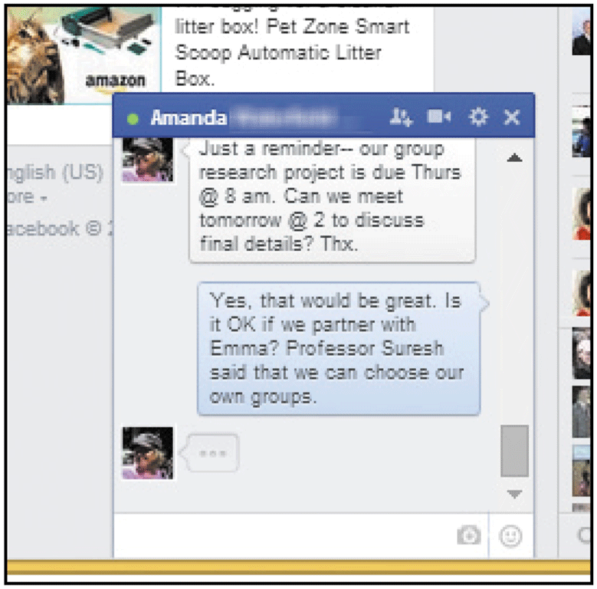
Social Media
Chat
A facility that allows two or more people to exchange text or multimedia messages in real-time using a special client, or mobile or web app
Web-based chat allows real-time communication using a web browser or web or mobile app

Slide 54
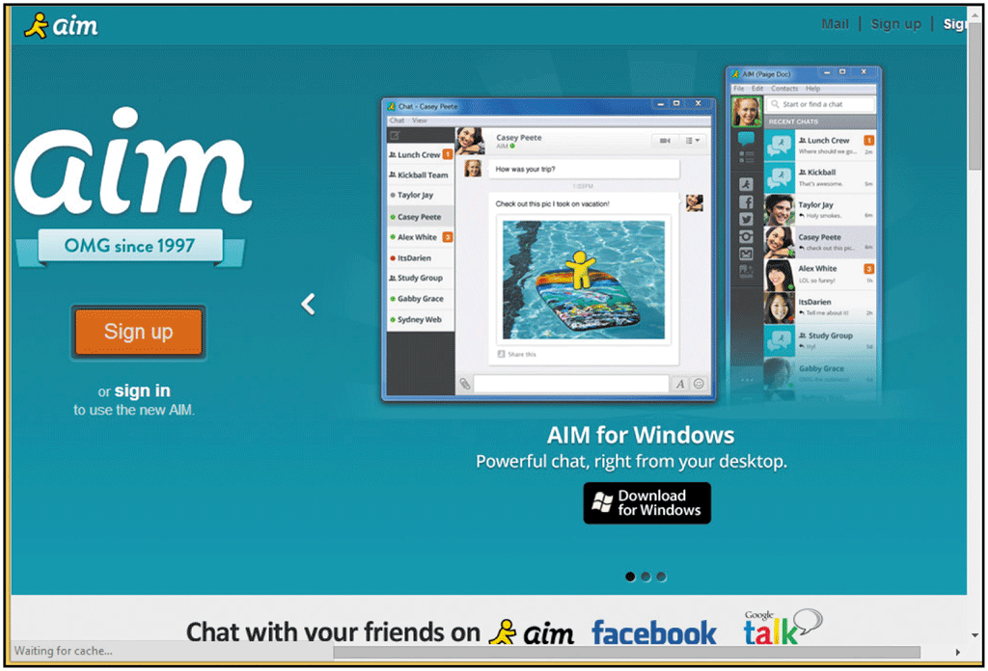
Social Media
Chat (continued)
Instant messaging (IM) is a private means of exchanging real-time messages with one or several people using the Internet

Slide 55
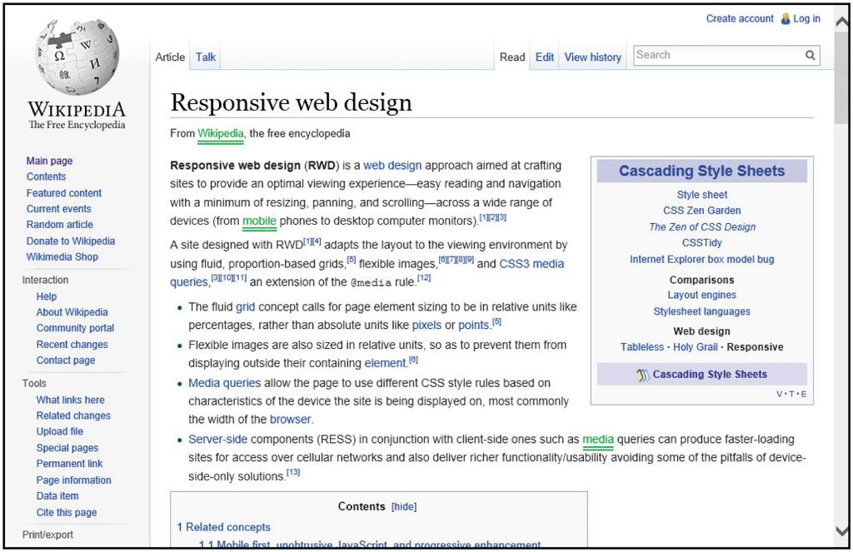
Social Media
Collaboration and Sharing
A wiki consists of webpages in which authorized users can make edits to content

Slide 56
Social Media
Collaboration and Sharing (continued)
Social bookmarking and content sharing websites, also called social tagging websites, allow users to post a webpage link or image bookmark to a public website, then tag the bookmark with keywords or hashtags
Tagging helps organize the bookmarks and makes it easy to search by topic

Slide 57
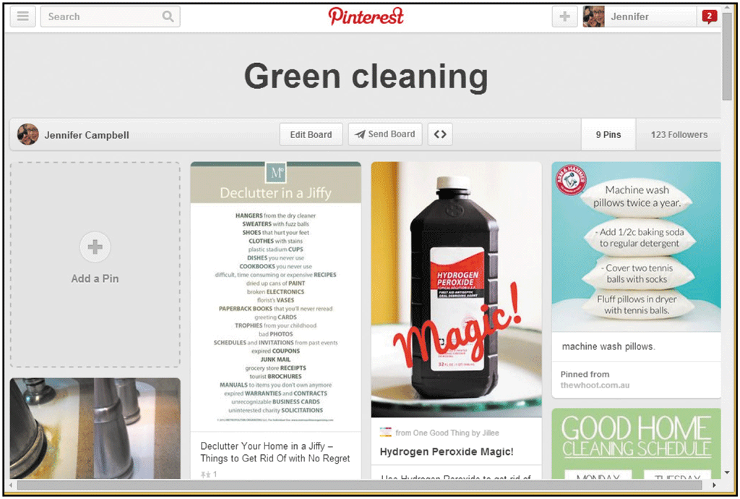
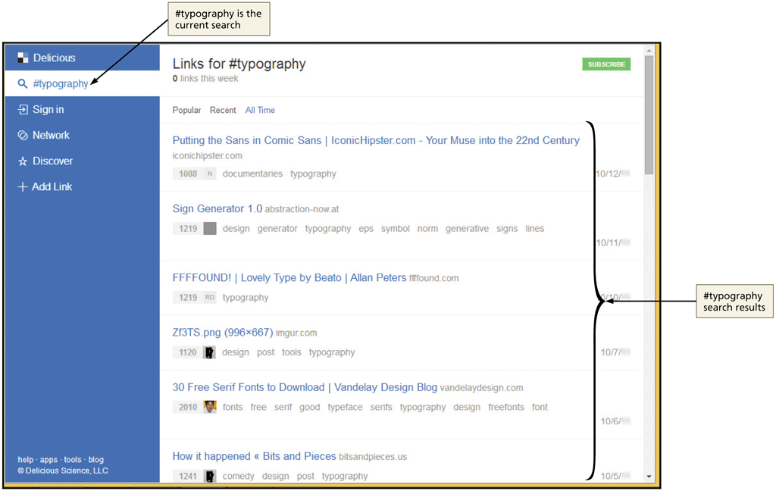
Social Media

Slide 58
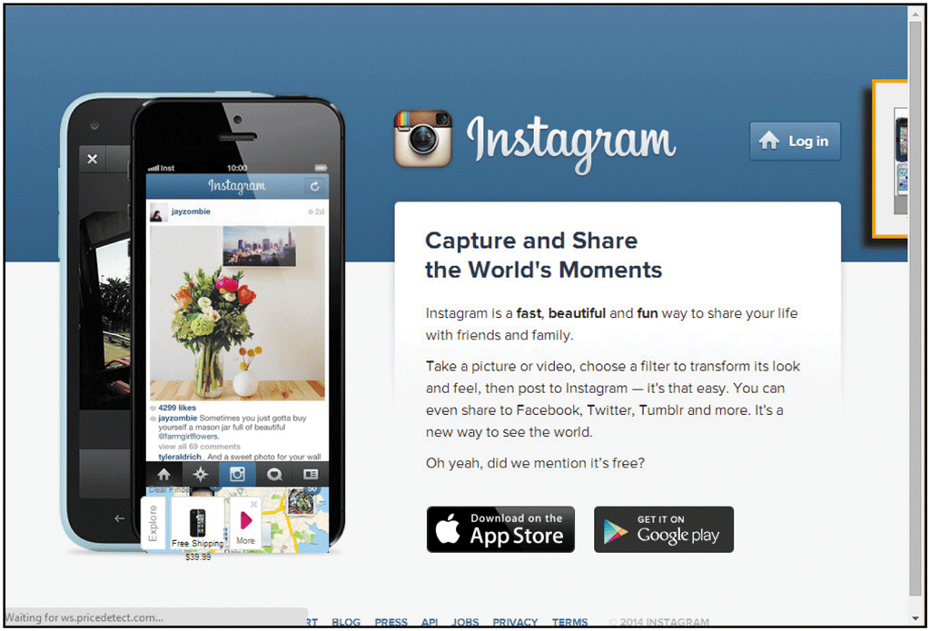
Social Media
Collaboration and Sharing (continued)
People use photo sharing websites or apps to manage their photo and/or video collections
Flickr
Shutterfly
Instagram
YouTube

Slide 59
Social Media
Collaboration and Sharing (continued)
Consumers visit social opinion websites to check out user reviews for products, movies, books, travel accommodations, local restaurants, appliances, and local service providers
Angie’s List
Yelp
Amazon.com and TripAdvisor integrate social opinion features

Slide 60
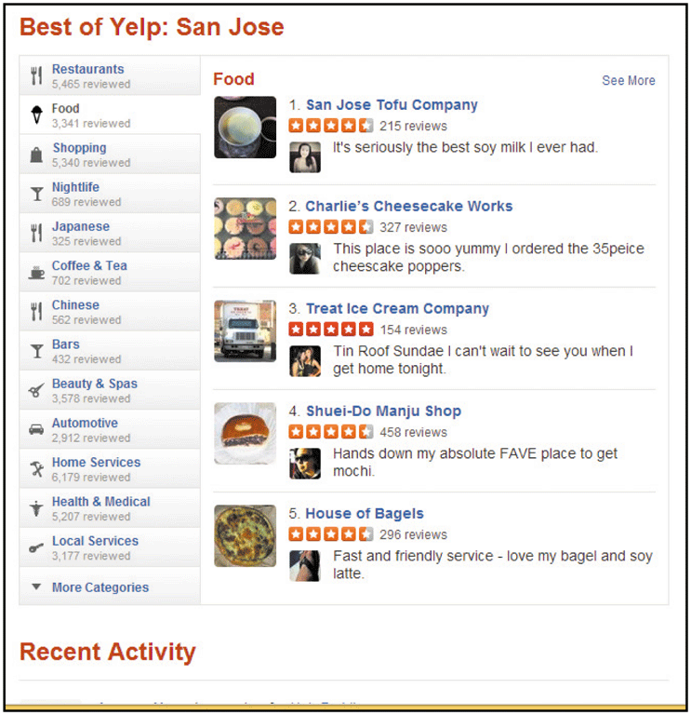
Social Media

Slide 61
Social Media
Email Marketing and Online Survey Technologies
Email marketing software helps organizations send email and track the success of a marketing campaign by keeping track of the number users who read the email, how many times the recipients tapped or clicked a link in the email, and how many times the recipients purchased a product or enrolled in a service
Online survey technology companies offer companies and organizations the ability to send an online survey using email

Slide 62
Social Media

Slide 63
Social Media
VoIP
VoIP (voice over Internet telephony) is technology used to make phone calls over the Internet
To use, you must have:
Broadband connection
Microphone
Speaker
Software or app (such as Skype)

Slide 64
Social Media
Newsgroups and Web-Based Discussion Groups
Web-based discussion groups are online discussion forums often hosted by a portal
Outgrowth of newsgroups, which are online bulletin boards first made available in the 1980s over the Usenet network
Usenet consists of a number of servers that use the Network News Transfer Protocol (NNTP) to send newsgroup messages over an IP network
Users access newsgroup content using a newsreader

Slide 65
Social Media

Slide 66
Social Media
Mailing Lists
Have diminished in popularity with the rise of social networking tools
Mailing list must have a moderator or list owner for administrative tasks
Subscribe
Open list vs. closed list
Unmoderated list vs. moderated list
Posting

Slide 67
Summary
Describe the components of email systems and email messages
Discuss and apply email etiquette
Use email to send, receive, and organize email messages and contacts, and discuss email viruses
Describe various online social media and communication tools and discuss how they are used

