Slide 2
Objectives
Describe the origins of electronic business transactions, including the electronic funds transfer (EFT) system, the electronic data interchange (EDI) standard, and value-added networks (VANs)
Discuss unique e-business factors and identify e-businesses that use them

Slide 3
Objectives
Define common e-business models and explain how each model generates revenue
Describe the e-retailing storefront software, merchant accounts, and payment-processing services needed to create and operate an online store

Slide 4
E-Business Origins
Electronic Funds Transfer (EFT)
  Allows the electronic exchange of money between banks – without the exchange of paper currency – via the Automated Clearing House (ACH) network
Electronic Data Interchange (EDI)
  Standard that specifies the layout or format a company uses to exchange electronic business data with its suppliers and customers
  Participants in EDI are called trading partners
  Before the Internet, used value-added networks (VANs)

Slide 5
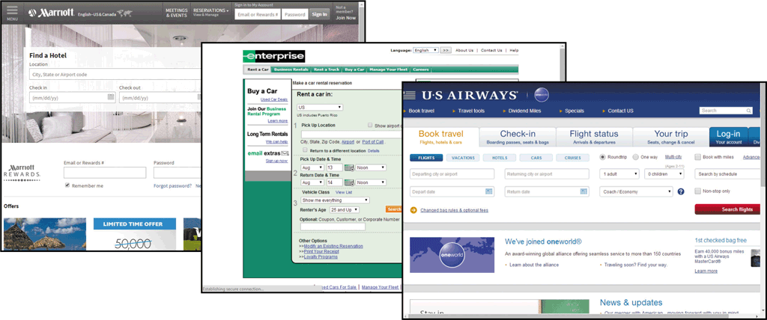
Unique E-Business Factors
Redefining Markets
  Disintermediation occurs when a market removes its traditional intermediaries
    Computer industry (Dell)
    Travel industry

Slide 6
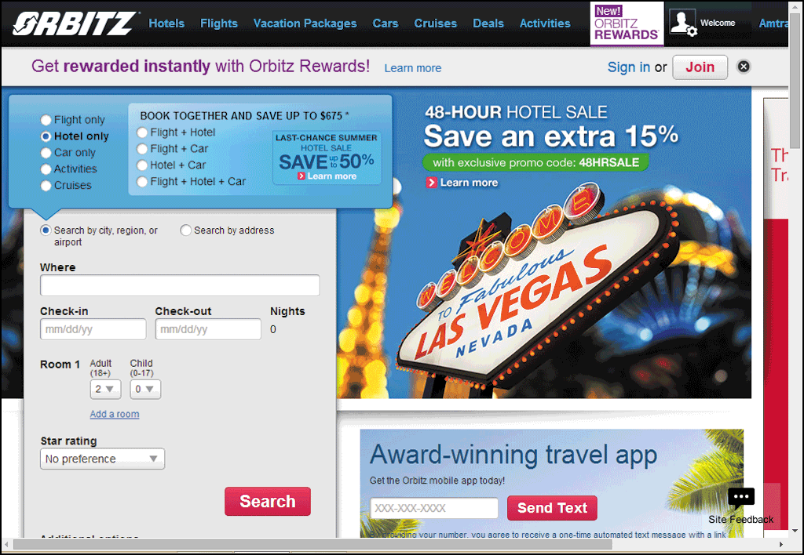
Unique E-Business Factors
Redefining Markets (continued)
  Reintermediation occurs when an e-business introduces a new type of intermediary into the marketspace
    Dell, Hewlett-Packard, and other online versions of stores
    Orbitz and Hotels.com in the travel industry

Slide 7
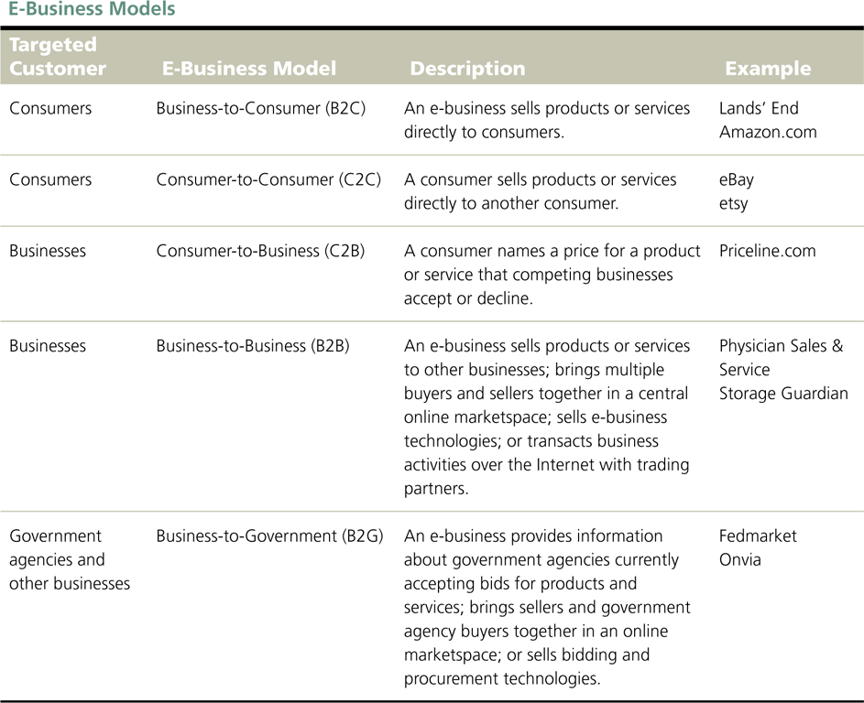
E-Business Models

Slide 8
Creating an Online Store
Thousands of men and women become
e-business entrepreneurs by starting and operating an online business
Famous and successful e-business entrepreneurs
  Evan Williams (Twitter)
  Jeff Bezos (Amazon.com)
  Michael Dell (Dell, Inc.)
  Reed Hastings (Netflix)

Slide 9
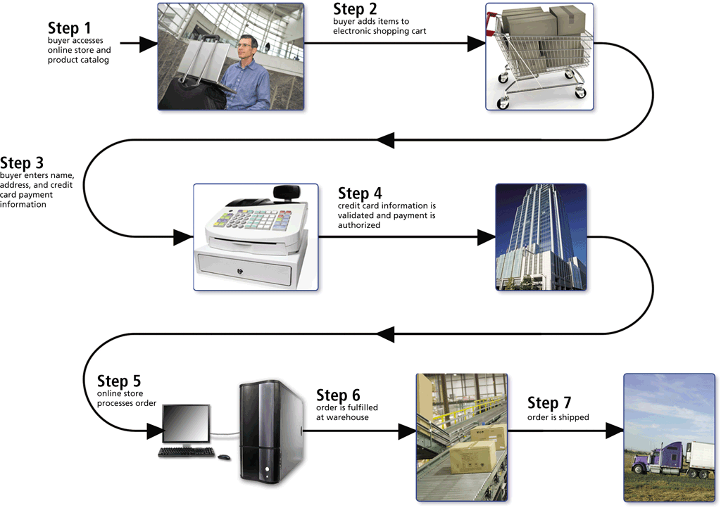
Creating an Online Store
Storefront Software
  A typical e-retail transaction consists of several steps

Slide 10
Creating an Online Store
Storefront Software (continued)
  Storefront software (also called e-commerce software) provides tools to build and maintain webpages and the underlying product databases
  Also contains shopping cart software that tracks items selected for purchase and handles the checkout process
    Summarizing the order
    Calculating shipping and taxes
    Calculating the total order
    Processing the payment

Slide 11
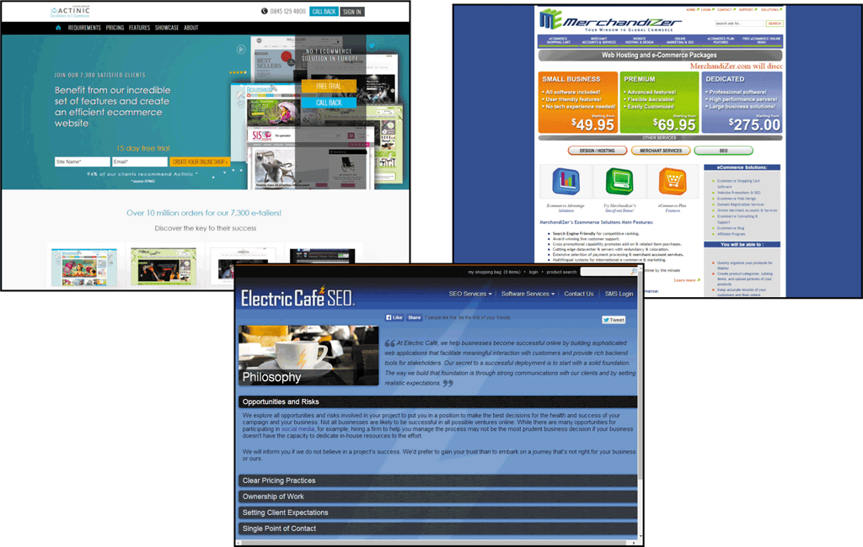
Creating an Online Store
Storefront Software (continued)
  Installed storefront software is customizable software that resides on an e-retailer’s web server

Slide 12

Creating an Online Store
Storefront Software (continued)
  Hosted storefront software uses webpage templates that allow you to create a store and add products to your online catalog
    May have fees
    Some vendors provide software demos or allow review of their software on a free trial basis

Slide 13
Creating an Online Store
Credit Card Authorization and Processing
  Many online purchases are paid for by credit card
  Third-party payment processors
    PayPal
    Google Wallet
  An e-retailer that accepts credit cards must have two things
    Account for credit card receipt deposits
    Service that authorizes and processes credit card transactions

Slide 14
Creating an Online Store
Credit Card Authorization and Processing (continued)
  Merchant account is an e-business account with a financial institution that stores money from credit card purchases
    Any business that accepts credit cards must have merchant account
    Can withdraw funds, but only can deposit credit card receipts

Slide 15
Creating an Online Store
Credit Card Authorization and Processing (continued)
  Fees might include
    Setup fees
    Monthly access fees
    Per-item transaction fees
    Discount rate, which is the percentage of each transaction that the financial institution will charge the e-business

Slide 16
Creating an Online Store
Credit Card Authorization and Processing (continued)
  Fees for merchant account depend on the financial institution’s perceived risk of doing business with the e-business
    Chargeback – return of funds to a credit card company resulting from a card holder’s refusal to pay a charge
    Card not present/card holder not present risk increases the risk of credit card fraud and potential chargebacks

Slide 17
Creating an Online Store
Credit Card Authorization and Processing (continued)
  An online store must be able to connect to a payment-processing service that can verify, authorize, and process secure credit card transactions
  Some vendors offer online payment-processing services, called payment gateways

Slide 18
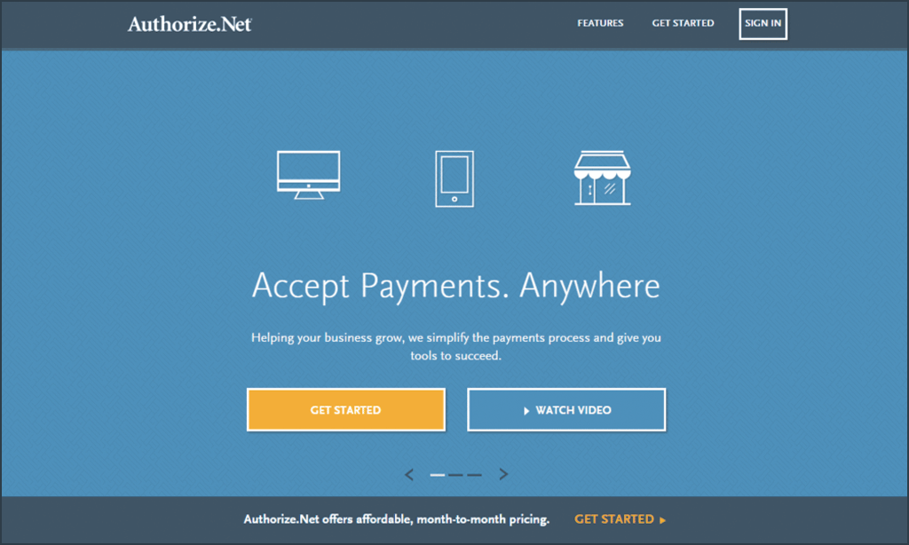
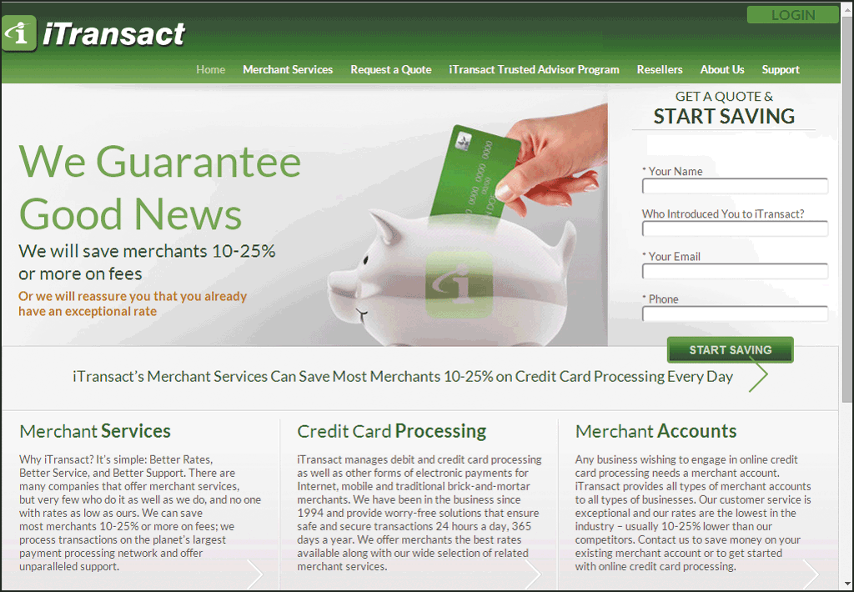
Creating an Online Store

Slide 19
Creating an Online Store
Credit Card Authorization and Processing (continued)
  When selecting storefront software, a payment gateway, and merchant account, be certain all three are compatible.
  Order fulfillment is the process e-retailers have for packaging and shipping products
    Many e-retailers save time and money by using third-party fulfillment or logistics companies

Slide 20
Summary
Describe the origins of electronic business transactions, including the electronic funds transfer (EFT) system, the electronic data interchange (EDI) standard, and value-added networks (VANs)
Discuss unique e-business factors and identify e-businesses that use them

Slide 21
Summary
Define common e-business models and explain how each model generates revenue
Describe the e-retailing storefront software, merchant accounts, and payment-processing services needed to create and operate an online store

