Slide 1
Networks Fundamentals
Mousa Al-Sahory

Slide 2
Chapter 1
Network Fundamentals
Introduction

Slide 3
Telecommunications
Telecommunications
The electronic transmission of signals for communications, including such means as:
Telephone
Radio
Television
Telecommunication medium
Anything that carries an electronic signal and interfaces between a sending device and a receiving device.

Slide 4
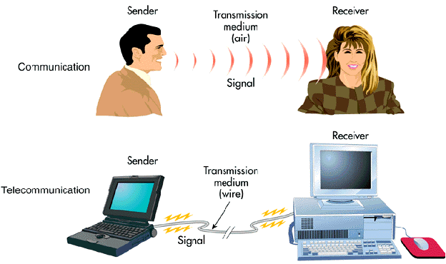
Communications and Telecommunications
In human speech, the sender transmits a signal through the transmission medium of the air.
In telecommunications, the sender transmits a signal through the transmission medium of a cable

Slide 5
Computer Network
Communication is almost as important to us as our reliance on air, water, food, and shelter. In today’s world, through the use of networks, we are connected like never before.
A computer network is two or more computers connected together so they can communicate with one another.
Two computers are interconnected if they can exchange information among them.
These interconnected computers are called Computer networks

Slide 6
Computer Network
Today, a single mainframe computer is not serving all the computation needs, but a large number of interconnected computers will do.
Computers networks vary in their size, communication media and speed of data transmission.
Uses of Computer Networks
Business Applications
Home Applications
Mobile Users

Slide 7
Benefits and uses of computer networks
Business applications: companies that have large number of computers can benefit from computer networks as follows:
Hardware sharing: like printers, hard drives and scanners.
Send files from one computer to another quite easily
Connectivity and Communication: Networks connect computers and the users within a building or work group can be connected into local area networks (LANs); users in distant locations can be interconnected into larger wide area networks (WANs).
Run programs that installed on central computers (servers) but are not installed on any other user's computer.
Internal e-mail services
E-commerce.

Slide 8
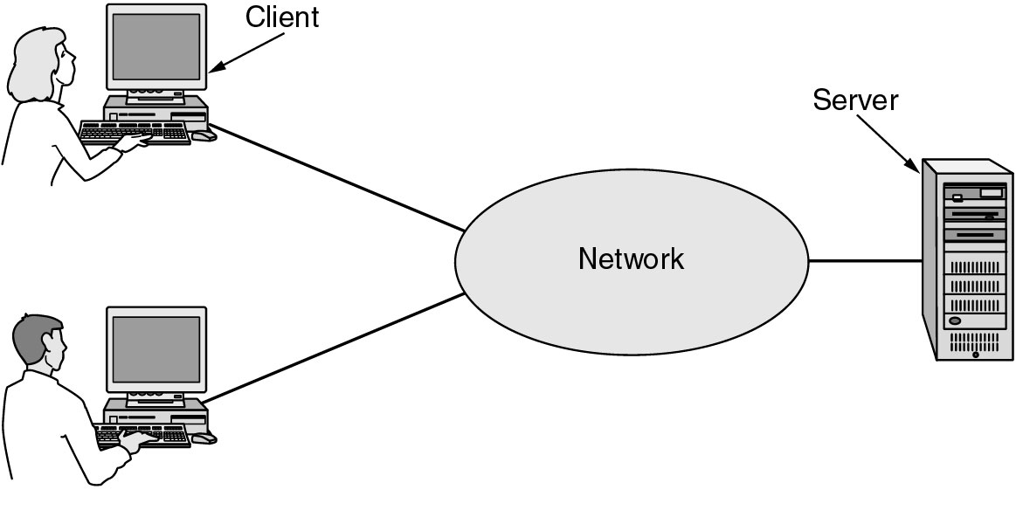
Business Applications of Networks
Business Applications of Networks
Clients
A computer provides a user with access to a network. End user personal computers or networked computers
Servers
A computer or system that provides resources, data, services, or programs to other computers, used to manage the networks
A network with two clients and one server.

Slide 9
Business Applications of Networks (2)
Business Applications of Networks
The client-server model involves requests and replies.

Slide 10
Benefits and uses of computer networks
Data Security and Management:
Computer networks allow the administrators to manage the company's critical data. Instead of having this data spread over a large number of small computers data can be centralized on shared servers.
This makes it easy for everyone to find the data, backup data on regular basis, and allows for the implementation of security measures to control who can read or change critical information.

Slide 11
Home Network Applications
Home Network Applications
Access to remote information
Person-to-person communication
Interactive entertainment
Electronic commerce

Slide 12
Home Network Applications
Home applications:
Sharing resources like printers, scanners
share a single Internet connection on all the home PCs.
Interactive entertainment : e.g. Video on demand on the internet.
Peer to peer communication to share music
Connecting home appliances together.

Slide 13
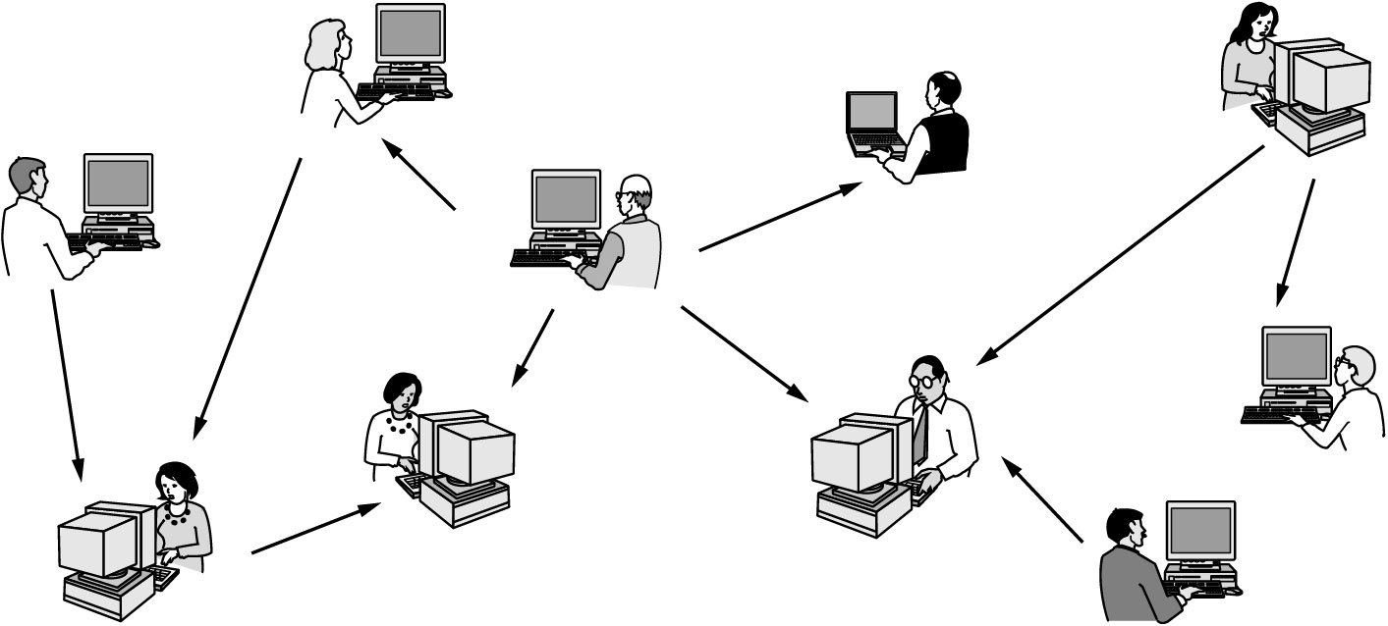
Home Network Applications (2)
Home Network Applications
In peer-to-peer system there are no fixed clients and servers.

Slide 14
Home Network Applications (3)
Home Network Applications
Some forms of e-commerce.

Slide 15
Transmission Technology
Computer networks differ by their size and transmission technology.
There are two types of transmission technology:
Broadcast links
Point-to-point links.
Broadcast links have a single transmission channel that is shared by all the computers on the network.

Slide 16
Transmission Technology
Broadcast links :
If the destination of the sent messages is all the existing computers on the network this known as a broadcasting.
If the destination of the sent messages is a specific computers this known as a multicasting.
Point-to-point link:
The messages are sent from one sending computer to one receiving computer.

Slide 17
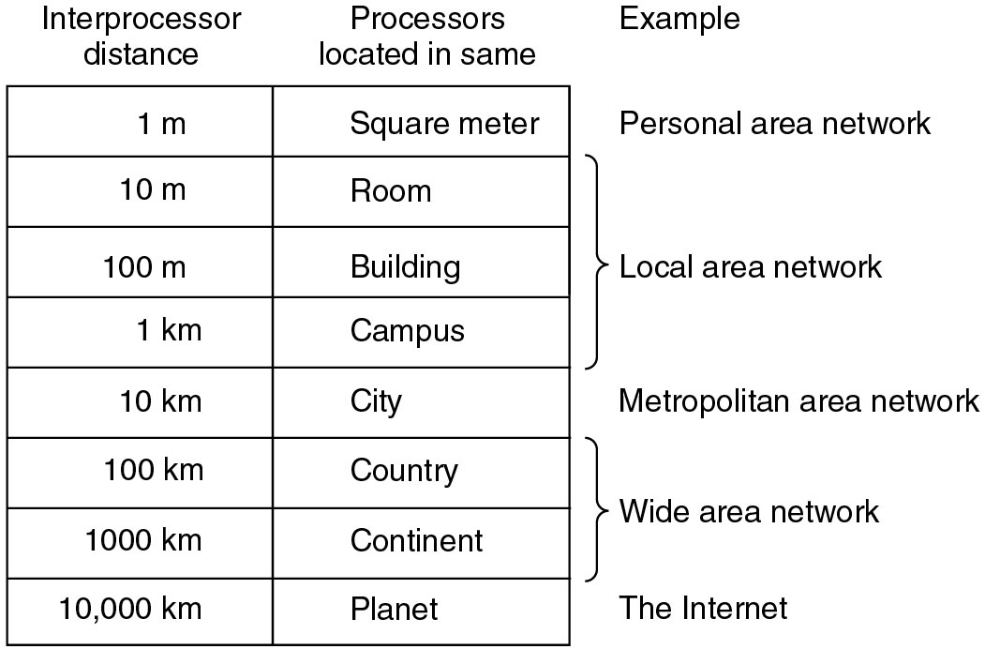
Broadcast Networks (2)
Broadcast Networks
Classification of interconnected processors by scale.

Slide 18
Transmission Modes
Transmission Modes:
Simplex
Sends information in one direction only.
Half Duplex:
Uses only one wire pair.
Collision might occur.
Full Duplex:
Uses two pairs of wire.
No collision.
Transmitted data is sent on a different wires than the received data.
Full duplex is faster than half duplex.

Slide 19
Data communication
Data communication is a telecommunication network to send and receive data between two or more computers over the same or different network.
There are two ways to establish a connection before sending data from one device to another:
Connection-Oriented
Connectionless Service.

Slide 20
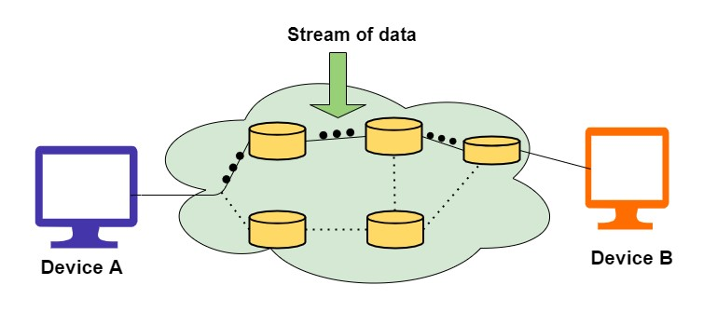
Connection-Oriented Services
Connection-oriented service involves the creation and termination of the connection for sending the data between two or more devices.
Used to create an end to end connection between the sender and the receiver before transmitting the data over the same or different networks.

Slide 21
Connection-Oriented Services
Advantages
Connection-Oriented Services are reliable.
There is no duplication of data packets.
There are no chances of Congestion.
These are Suitable for long connections.
Sequencing of data packets is guaranteed.
Disadvantages
This allocation of resources is mandatory before communication.
The speed of connection is slower.

Slide 22
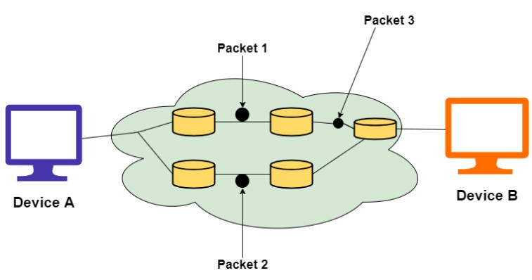
Connectionless Services
Connectionless service is used in the network system to transfer data from one end to another end without creating any connection.
So it does not require establishing a connection before sending the data from the sender to the receiver.
It is not a reliable network service because it does not guarantee the transfer of data packets to the receiver, and data packets can be received in any order to the receiver.

Slide 23
Connectionless Services
Advantages
There are usually low overheads.
Connection-Oriented services help to broadcast or multicast messages to multiple recipients.
Disadvantages
These are susceptible to congestion in the network.
It is not reliable as there is the possibility of a loss of data packets, wrong delivery of packets or duplication is high.

Slide 24
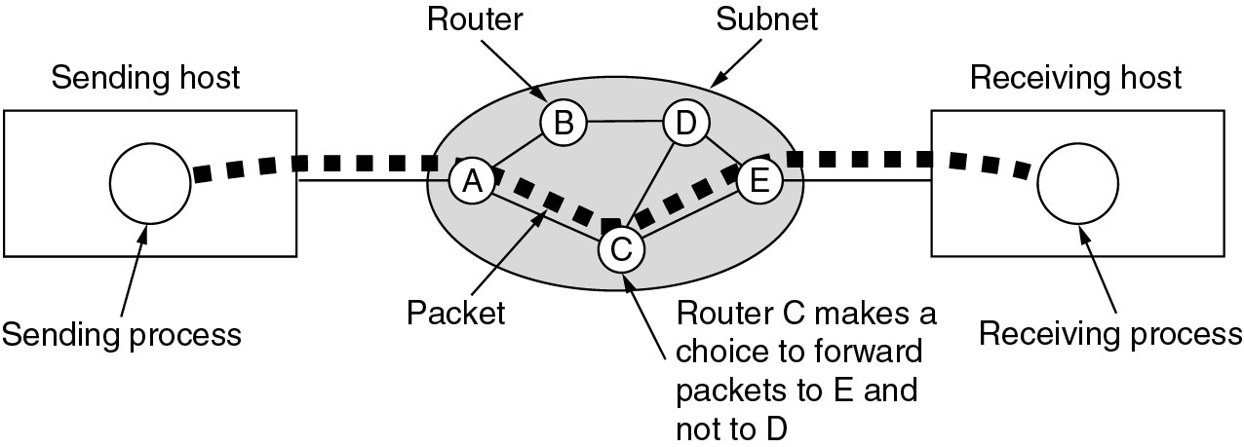
Data communication
A stream of packets from sender to receiver.

Slide 25
Service Primitives
Five service primitives for implementing a simple connection-oriented service.

Slide 26
Service Primitives
Packets sent in a simple client-server interaction on a connection-oriented network.

Slide 27
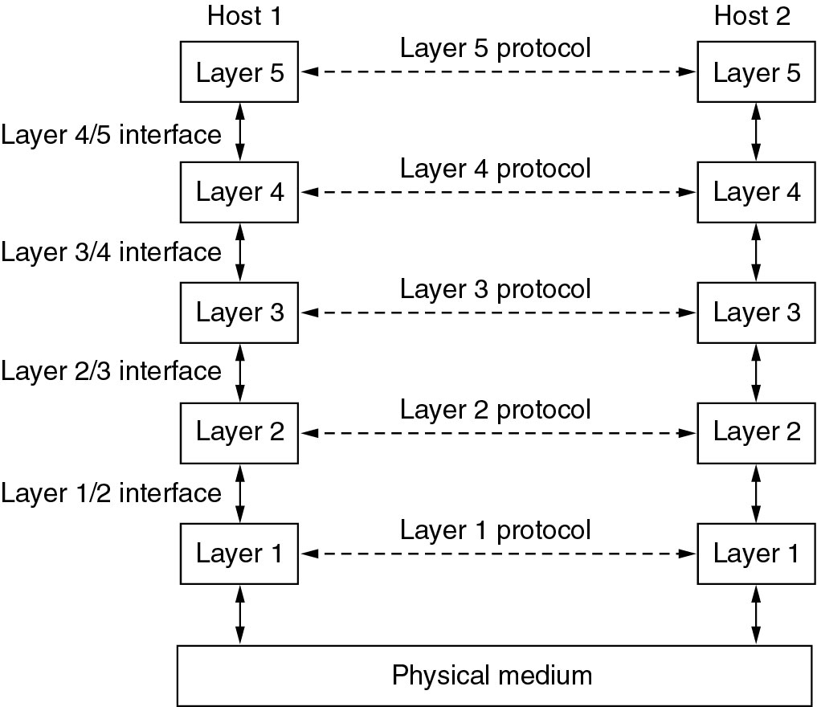
Network Hierarchies
Networks are designed into layers to reduce complexity.
Layers, protocols, and interfaces.

Slide 28
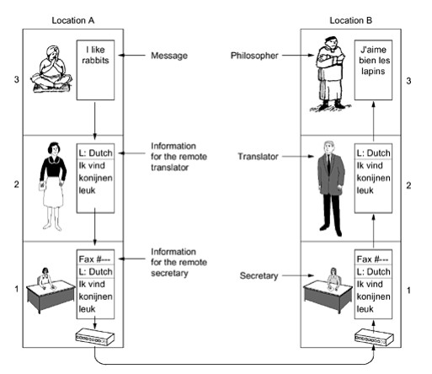
Protocol Hierarchies (2)
Network Hierarchies
The philosopher-translator-secretary architecture

Slide 29
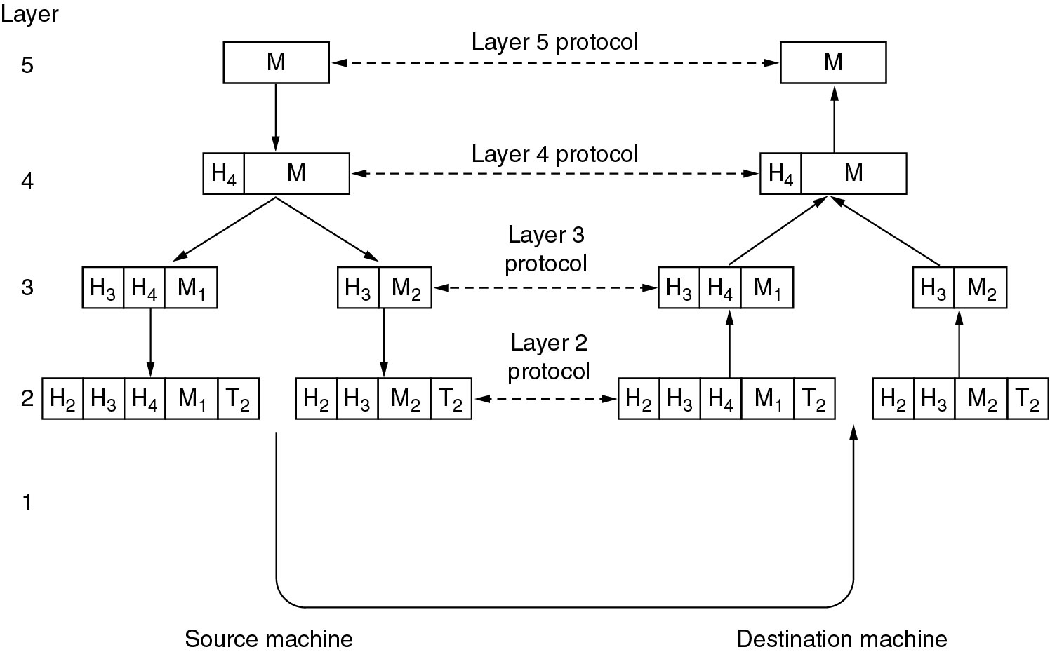
Protocol Hierarchies (3)
Network Hierarchies
Example information flow supporting virtual communication in layer 5.

Slide 30
Q&A

