Slide 1
E-commerce

Slide 2
What is E-commerce
E-Commerce refers to any form of business transaction conducted online.
The most popular example of e-commerce is online shopping, which is defined as buying and selling of goods via the internet on any device.
E-commerce can also entail other types of activities, such as online auctions, payment gateways, online ticketing, and internet banking.

Slide 3
E-commerce types
E-Commerce is classified into three types based on the type of participants involved in the transaction:
business to business (B2B),
business to consumer (B2C)
consumer to consumer (C2C).
Consumer-to-Business (C2B).
Business-to-Administration (B2A).
Consumer-to-Administration (C2A).

Slide 4
business to business (B2B)
his kind of eCommerce consists of all the electronic transactions and dealings related to the goods and services. These basically are conducted between companies and include conventional wholesalers and producers dealing with retailers.

Slide 5
business to consumer (B2C)
The Business-to-Consumer eCommerce is related to the transactions and relationship between businesses and the end customers. This is mainly to do with the retail eCommerce trade that takes place online. With the inception of the internet, B2C eCommerce has evolved to a great extent. Today, we find scores of electronic shopping sites and virtual stores on the web, that sell myriad products, ranging from computers, fashion items to even necessities.
In this case, the customer has more info about the products in the form of informative content and there is also a chance to buy products at cheaper rates. Most times, quick delivery of the order is also maintained.

Slide 6
consumer to consumer (C2C).
This consists of electronic transactions of products and services between two customers. These are mainly conducted through a third party that provides an online platform for these transactions. Sites, where old items are bought and sold, are examples of C2C eCommerce.

Slide 7
Consumer-to-Business (C2B)
In this, a complete reversal of the selling and buying process takes place. This is very relevant for crowdsourcing projects. In this case, individuals make their items or services and sell them to companies. Some examples are proposals for company site or logo, royalty free photographs, design elements and so on.

Slide 8
Business-to-Administration (B2A)
In this kind of eCommerce transaction, there are dealings between companies and public administration. It encompasses different services, such as social security, fiscal measures, legal documents, employment and so on.

Slide 9
Consumer-to-Administration (C2A).
In this eCommerce model, electronic transactions are carried between individuals and public administration. Some examples are distance learning, information sharing, electronic tax filing, and so on.

Slide 10
Benefits of e-Commerce
With the internet becoming an essential requirement of everyday life, businesses are learning to take advantage of the numerous benefits of e-Commerce:
Global market.
Around-the-clock availability
Reduced costs
Inventory management.
Targeted marketing.
Serving niche markets.
Working from anywhere.
https://www.oberlo.com/ecommerce-wiki/ecommerce

Slide 11
Limitations of E-Commerce Businesses
E-Commerce has become one of the most popular mediums of transactions in the recent years. While it does offer quite a lot of benefits to both buyers and sellers, it is not totally free from disadvantages. By having an idea of these limitations, we can address them and come up with a solution.
Here are the top disadvantages and limitations of e-Commerce businesses:
1. Security:
In most cases, people are hesitant to provide their personal and financial details in spite of advanced data encryption security systems in place.
There are some websites that do not have the capability and features installed to authenticate transactions.
As such, there are instances of fraudulent activities.
The fear of providing financial information like credit card details hinders the growth of e-Commerce.
2. Lack of Privacy:
To some extent, the privacy of a customer is compromised in e-Commerce.
You need to provide your personal details to the seller.
There are still lots of sites that do not have the advanced technology to protect sensitive information.
There are also sites that illegally collect consumer statistics without permission.

Slide 12
Limitations of E-Commerce Businesses
3. Tax Issue:
In case of different geographical locations, sales tax becomes an issue.
Many a time sellers have faced problems in the computation of sales tax.
Physical stores have a risk of losing business if online transactions are exempted from taxation.
4. Product Suitability:
It is not possible for people to physically examine the product in e-Commerce.
In many cases, the original product may not match with the picture or specifications in the e-Commerce site.
5. High Labour Cost:
In order to get the whole e-Commerce and delivery process right, companies have to shed a good amount of money and employ a talented pool of people.

Slide 13
Limitations of E-Commerce Businesses
6. Technical Limitations:
e-Commerce requires advanced technology platforms for better performance.
Lack of proper domain, network and software issues and so on can affect the seamless performance of an e-Commerce site.
7. Huge Technological Cost:
a lot of money needs to be invested to be built up the technical infrastructure needed to run an e-Commerce business.
They need to be upgraded based to keep abreast with the changing technology.

Slide 14
How to start an e-Commerce business
Choosing and sourcing a product.
Conducting research and planning ahead.
Getting your brand right.
Deciding how you will sell:
You can build an e-Commerce store from scratch
You can use an off-the-shelf e-Commerce solution like Shopify.

Slide 15
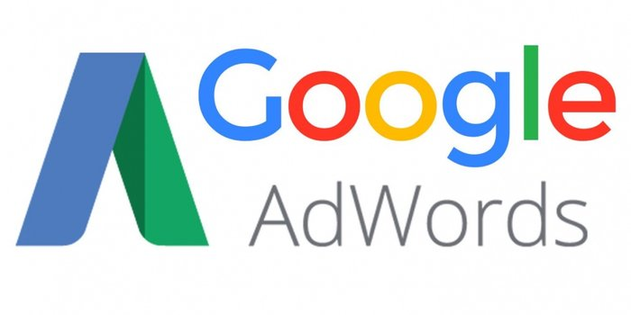

Slide 16
What is Google AdWords
Also known as Google Ads.
it is an online advertising service that allows businesses to have their ads run on Google’s search results page.
The ads look almost identical to the normal search results, with the only difference being the small word “Ad” in green. Google ads will show at the top and bottom of a search results page.

Slide 17
Why google ads
https://www.wordstream.com/blog/ws/2012/12/03/why-use-adwords

Slide 18
how does it work?

Slide 19
Before you start
you pick some keywords that a searcher might use on Google,
then create an advert that will appear on the search engine results page (SERP) based on those keywords.
You are not going to be the only company wanting to serve adverts to people who use those particular terms. Rival companies can bid for the same search term.
If you want your ad to appear at all, you have to bid against other marketers on how much you’re willing to pay Google AdWords every time a searcher clicks on your ad.
The more you pay-per-click (PPC) the more likely your ad will appear in the search results.
It’s not just the highest bid that is taken into account. Google also uses something called a ‘quality score’.
Quality score:
Google looks at how relevant and useful your ad is to the searcher and the search terms they’ve used. A
Also looks at how many clicks your ad has received previously.
The higher your quality score, the better.

Slide 20
How to Advertise on Google
Create AdWords account (for free) on the official Google AdWords page.
(or use your previous google account)
create your campaigns
Decide what your goals are
Create your buyer persona(s)
Research your keywords
Choose your budgets and bids
Build out your campaign structure
Write your ad copy
Design and publish landing pages
Set up conversion tracking
For more information:
https://youtu.be/Sy7Y7T5Dz4M
https://www.entrepreneur.com/article/237212

Slide 21
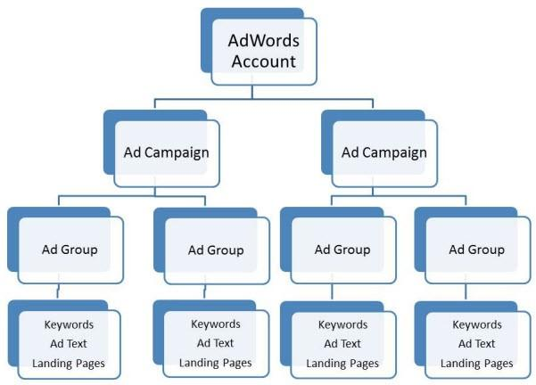

Slide 22
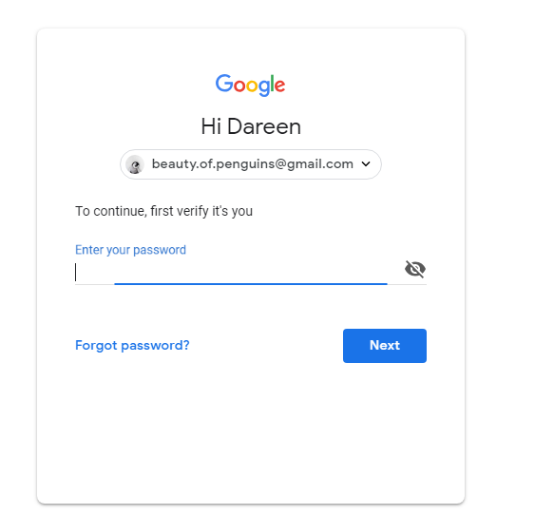

Slide 23
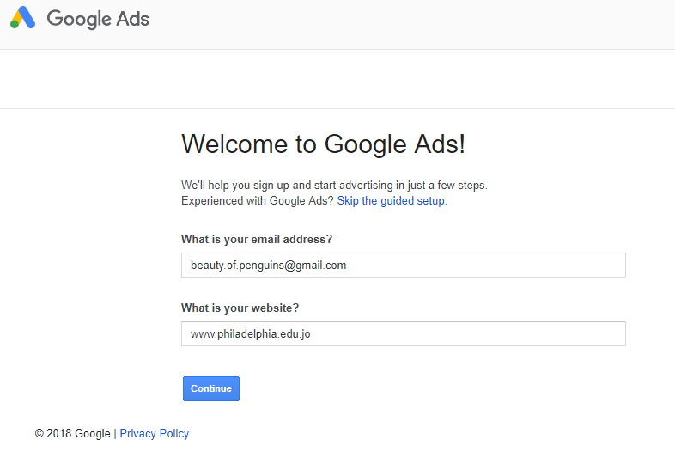

Slide 24
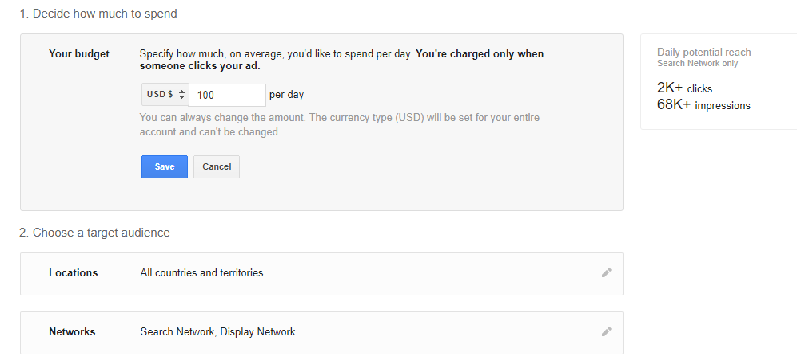
Next, you have to create your first campaign. A campaign focuses on a theme or a group of products. To create a campaign, you'll set a budget, choose your audience, and write your ad. Keep in mind, you won't be charged for selecting options, and you can always make changes later.

Slide 25
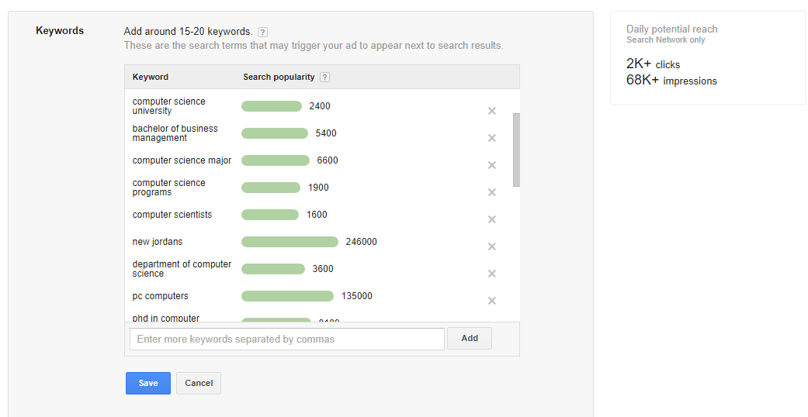

Slide 27
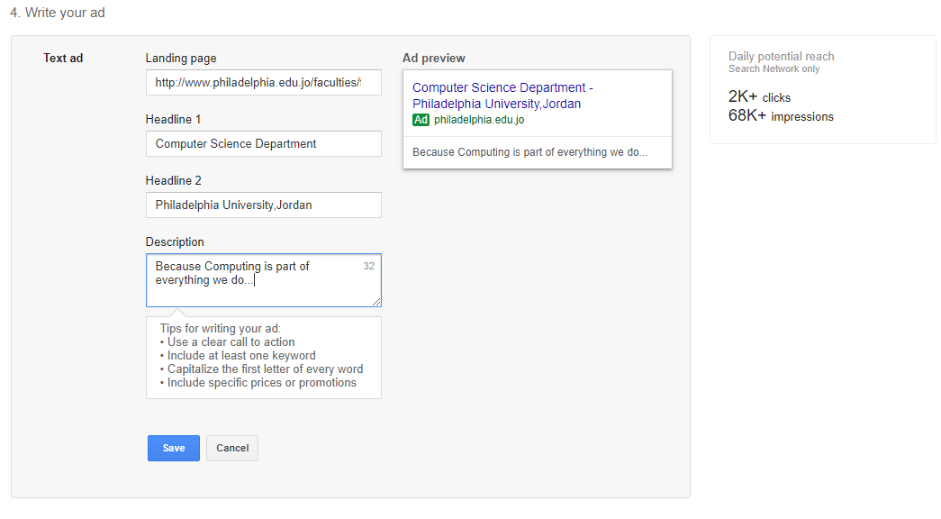

Slide 28
