Slide 2
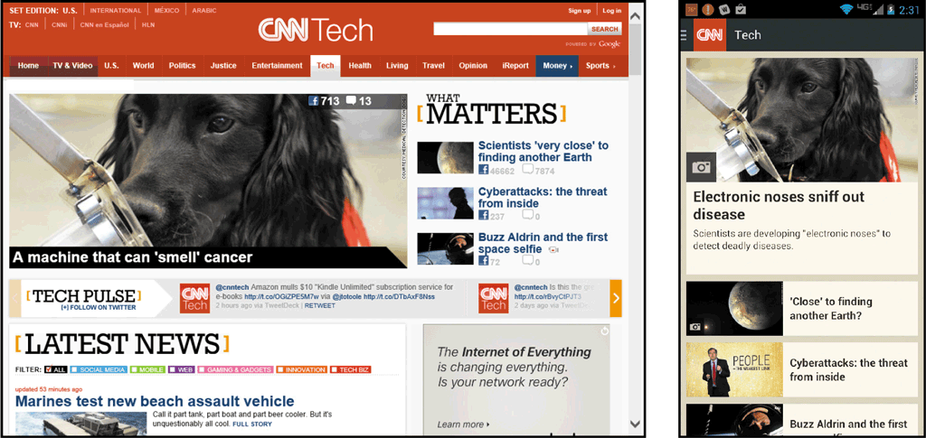
News, Sports, Weather, and Traffic Resources
Users supplement traditional print and broadcast news media sources with websites they access from computers and mobile devices

Slide 3
News, Sports, Weather, and Traffic Resources
Most major newspapers also publish online editions
Television and radio networks publish websites and provide apps
  National Public Radio (NPR)
  NBC
  CBC
  BBC
  CNN
  FOX News

Slide 4
News, Sports, Weather, and Traffic Resources
Sports
  Kooora
  ESPN
  FOX Sports
  Sports Illustrated
Weather
  Arabia Weather
  Weather Channel
  AccuWeather.com
Traffic reports
  Google Maps
  NAVTEQ

Slide 5
News, Sports, Weather, and Traffic Resources
Characteristics of News-Oriented Websites
  Availability – access from almost anywhere, at anytime
  Authority – legitimate news websites follow practices to ensure integrity
  Immediacy – breaking news, sports scores, or weather and traffic updates
  Interactivity – interact with editorial staff and react or respond to articles
  Customizability – each viewer can customize based on location and interests
  Connectivity –users can share news and articles by posting or sending links using social media, text, or email

Slide 6
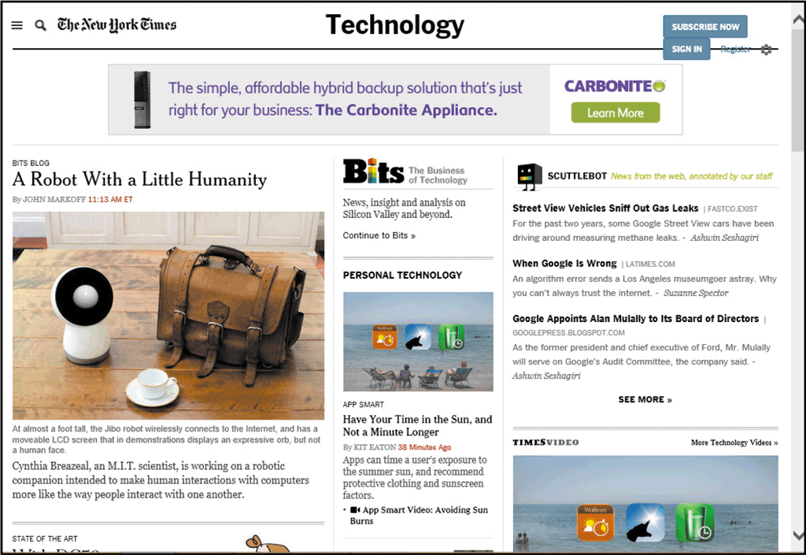
Exploring News and Traffic Websites
Start a browser and enter the web address in the Address bar.
Press the enter key or tap or click the necessary button to display the webpage.
Scroll the webpage to review its contents and links.

Slide 7

News, Sports, Weather, and Traffic Resources
Streaming Media
  Streaming media is audio and video that you can view in a browser without downloading
    Advantage of streaming media is that you do not use storage space to store the media
    Computer or device must have a sound card, speakers, and a media player

Slide 8
Research and Reference Tools
Numerous websites that provide access to specialized information collections
  Online encyclopedias
  Dictionaries
  Reference desks
  Trip planners

Slide 9
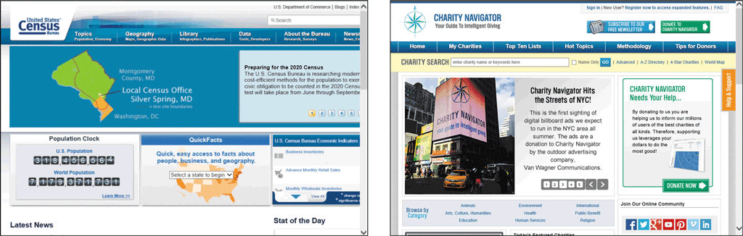
Research and Reference Tools

Slide 10
Exploring an Online Encyclopedia
Start a browser and enter the web address in the Address bar
Press the enter key or tap or click the necessary button to open the home page
Enter search text in the Search box and then tap or click Search button to find links
Scroll through search results to see suggested links

Slide 11
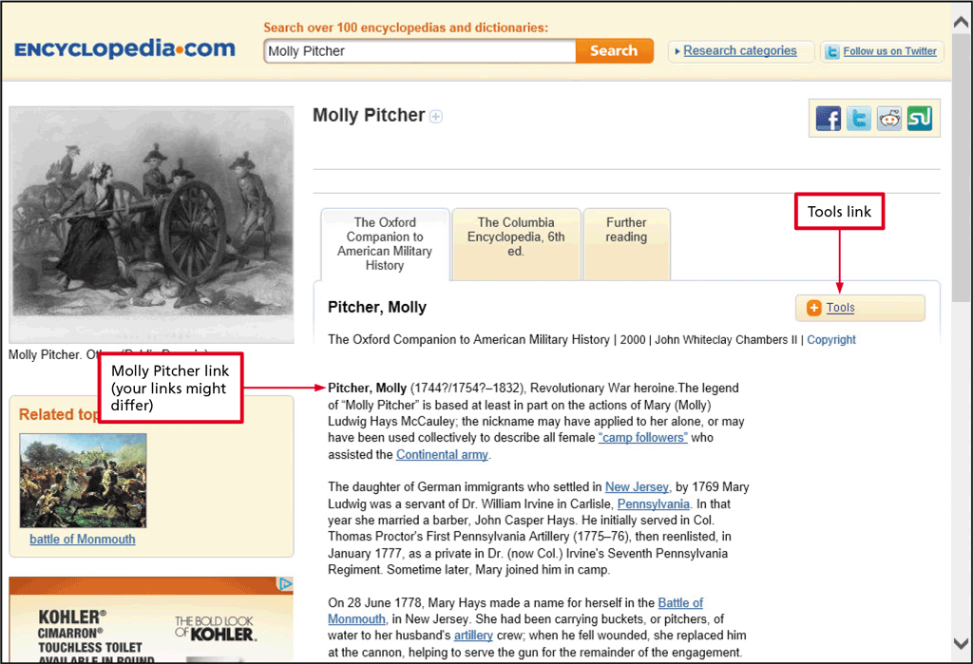
Research and Reference Tools

Slide 12
Research and Reference Tools
Online Dictionaries
  Merriam-Webster Online
  OneLook Dictionary Search
  Cambridge Dictionaries Online
  Thesaurus.com
  NetLingo
  Law.com

Slide 13
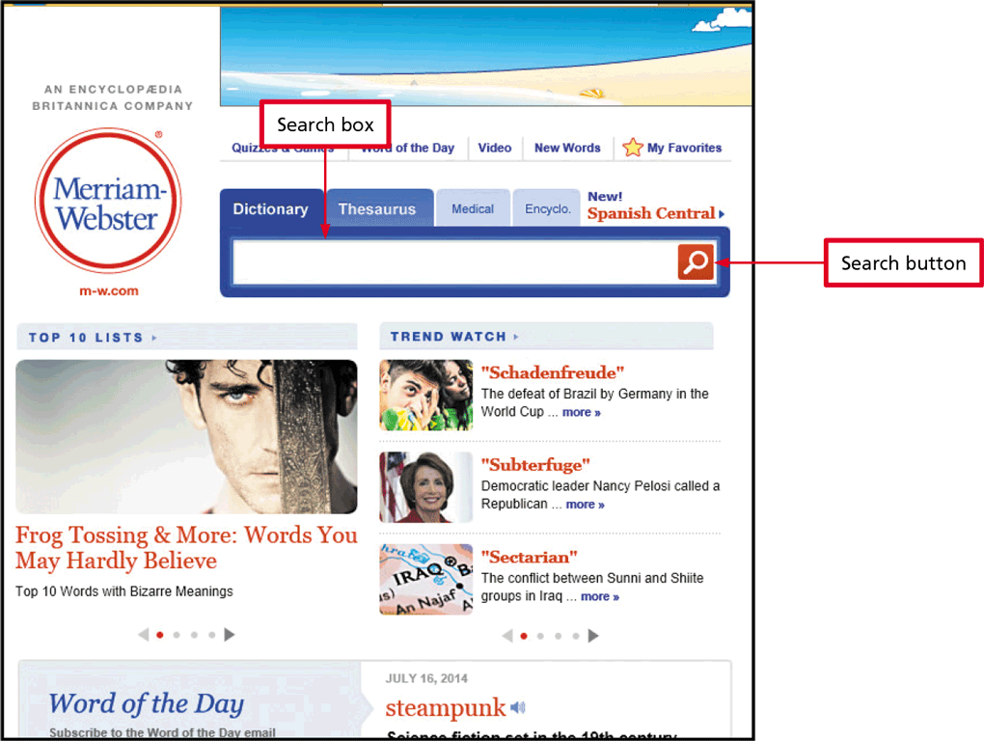
Research and Reference Tools

Slide 14
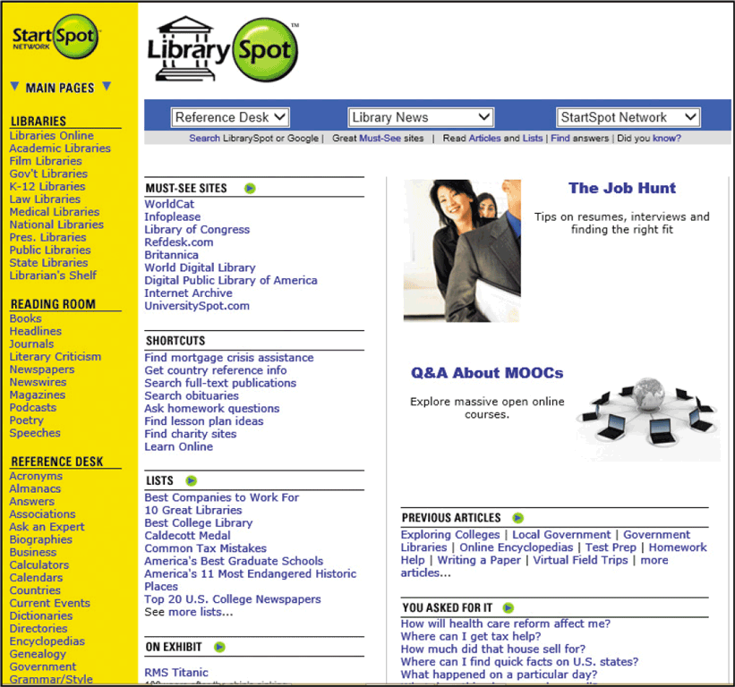
Research and Reference Tools
Online Reference Desks
  An online reference desk is a collection of links to online sources
    Internet Public Library
    refdesk.com
    LibrarySpot.com
    iTools

Slide 15
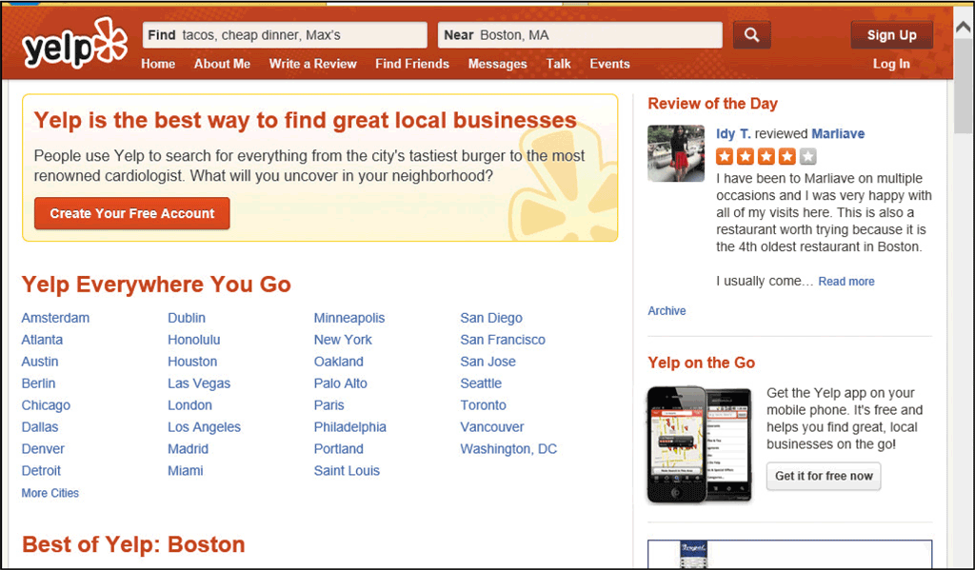
Research and Reference Tools
User-Generated Content
  User-generated research tools can use GPS or a user-entered ZIP code to access user reviews and ratings of restaurants and other services
    Yelp
    OpenTable
    Urbanspoon

Slide 16
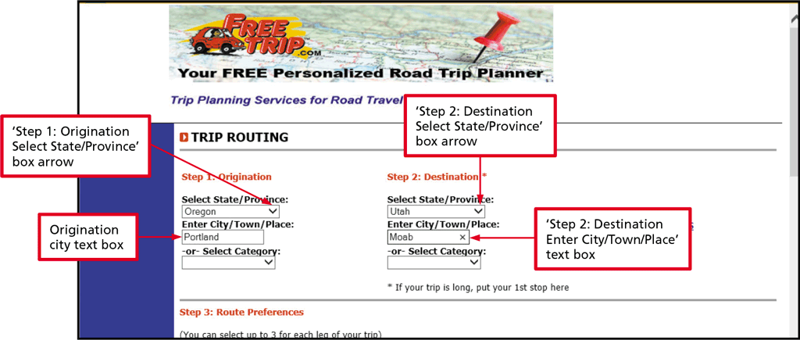
Research and Reference Tools
Online Route Planners
  FreeTrip
  MapQuest
  Google Maps
  Yahoo! Maps
  Expedia Maps

Slide 17
Personal Finance Resources
Banking, Bill Presentment, and Bill Payment Services
  Complete traditional paper-based banking activities online quickly and easily
    Check your bank balance or view paid items
  Brick-and-mortar businesses are physical locations
  Brick-and-click businesses allow customers to conduct business or complete transactions at a physical location as well as online

Slide 18
Personal Finance Resources
Banking, Bill Presentment, and Bill Payment Services (continued)
Online banking allows you to:
  View real-time account balances and recent transactions
  View a history of account activity
  Deposit checks
  Pay your bills
  Transfer funds between accounts
  Order checks
  Report a lost or stolen ATM card and request a replacement
  Change personal information, such as your address, telephone number, and e-mail address

Slide 19
Personal Finance Resources
Banking, Bill Presentment, and Bill Payment Services (continued)
  Some companies allow their customers to log on to the company’s website and pay their bills electronically
    Utilities
    Credit card companies
  Third-party payment service, such as PayPal

Slide 20
Special Interest Websites
Health, Diet, and Fitness Information
  Restricted-calorie meal plans
  Grocery shopping lists
  Exercise plans, complete with text and graphic instructions
  Daily food and exercise diaries
  Databases of food items with nutrition information used to select foods for daily food consumption diaries
  Support discussion groups

Slide 21
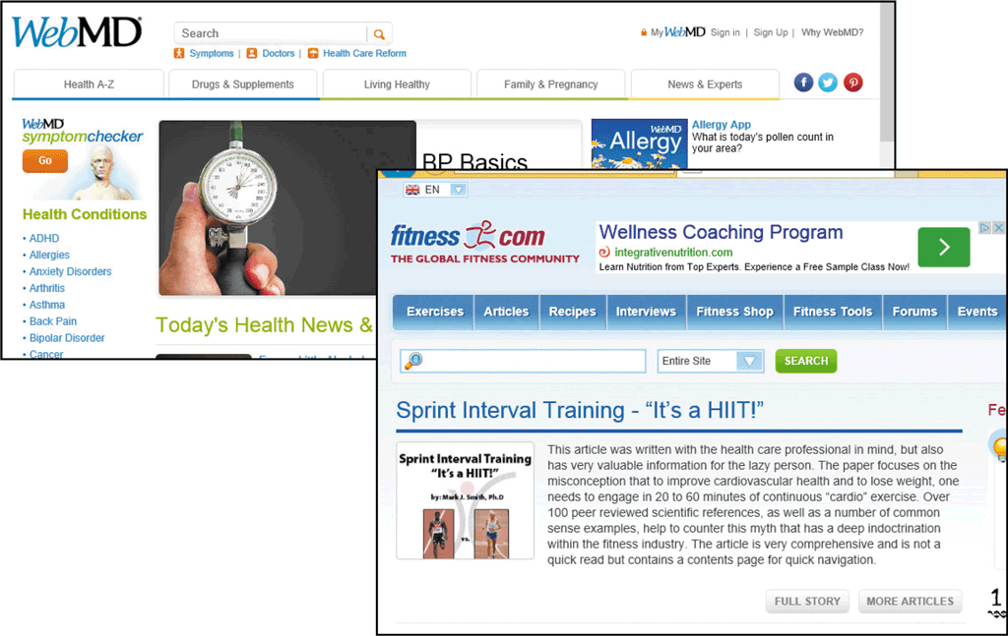
Special Interest Websites

Slide 22
Entertainment, Hobby, and Other Special-Interest Sites
Exchange family history with distant cousins at FamilySearch.org
Review résumé writing tips and post your résumé at Monster.com
Check out colleges, universities, graduate schools, and financial aid choices at Peterson’s
Enjoy movie reviews at Rotten Tomatoes
Discover the beauty of Native American art by touring online exhibits at the National Museum of the American Indian

Slide 23

Entertainment, Hobby, and Other Special-Interest Sites
Food and Cooking
  Emeril’s
  Epicurious
  Vegetarian Times

Slide 24
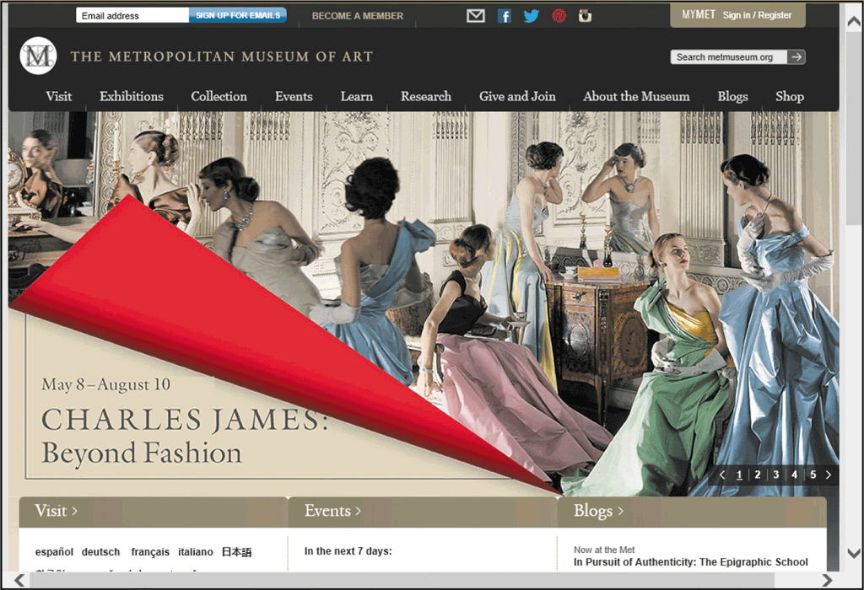
Entertainment, Hobby, and Other Special-Interest Sites
Museums
  American Museum of Natural History National Library of Australia
  Colonial Williamsburg Museum
  African American Museum

Slide 25
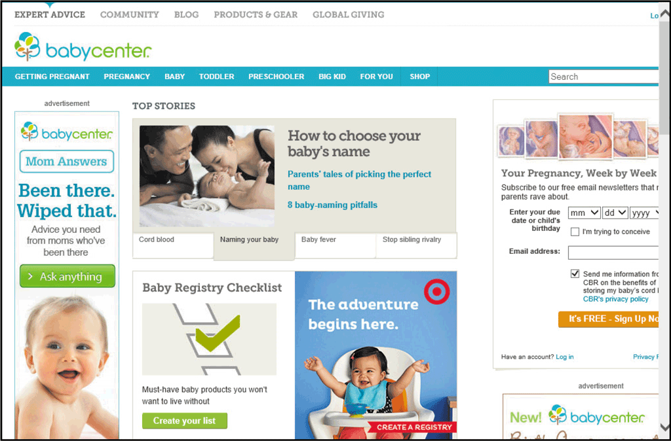
Entertainment, Hobby, and Other Special-Interest Sites
Parents and Families

Slide 26
Education Tools
Web-based learning (online learning or distance learning) is the delivery of educational material over the Internet to users
  K-12 schools
  Adult continuing education at colleges and universities
  Employee training
  Personal enrichment

Slide 27
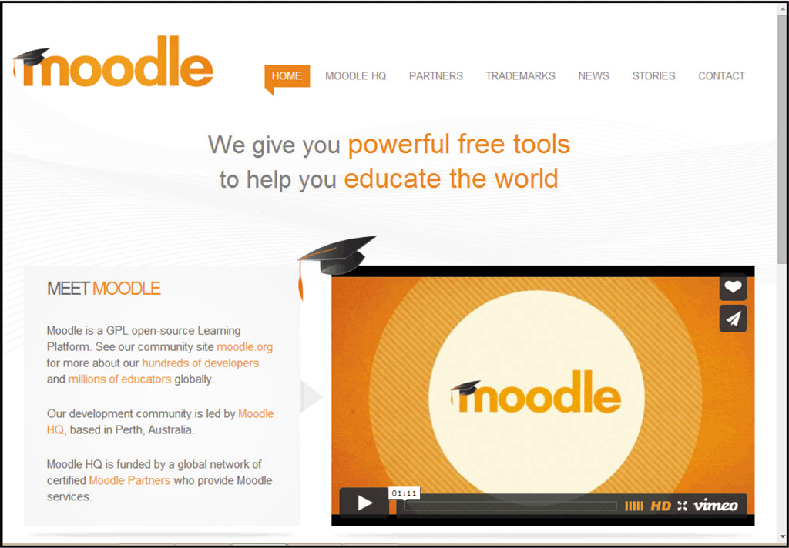
Education Tools
K-12 and University Students
  Enhances curriculum for rural schools
  Enables students to control timing, location, and learning pace
  Offers additional opportunities for working adults who cannot always attend traditional classes

Slide 28
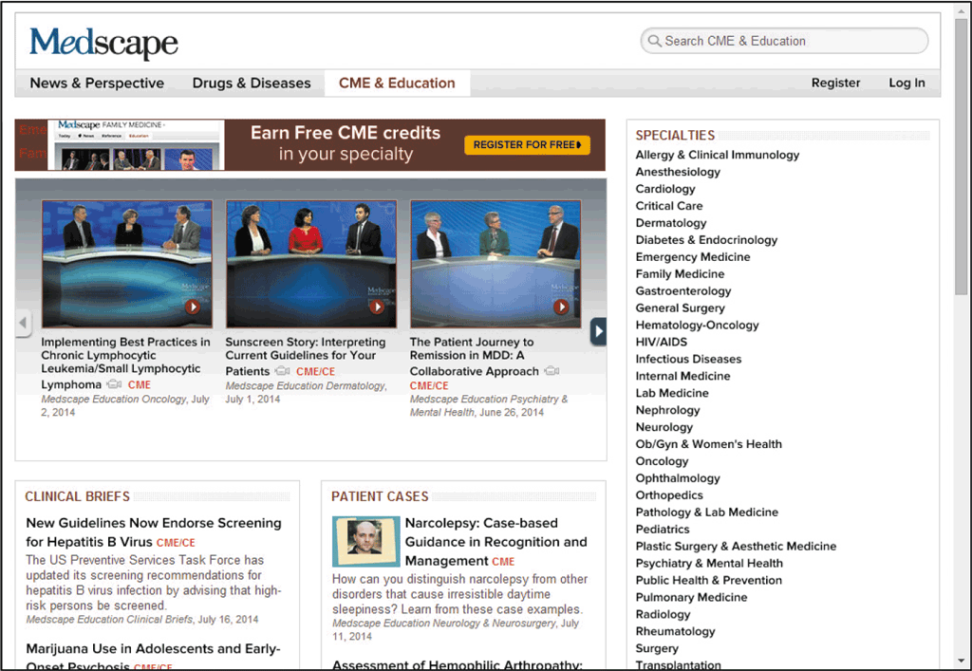
Education Tools
Online Employee Training and Professional Development
  Provides an economical way to train employees
  Allows busy professionals to fulfill their professional education requirements
  IT professionals can use online content to prepare for certifications

