Slide 1

Writing Professional Emails

Slide 2
Email
An Email: is a message distributed by electronic means from one computer user to one or more recipients via a network.
Emails could be used for personal purposes to communicate with friends and family, but their importance raises from using them in formal correspondence.

Slide 3
Formal Email
A Formal Email: is an email you write to person that you have a non-casual relationship with, such as:
  Your Professor
  Your Superior (Manager, Team Leader, …etc)
  Your Colleague
  Prospective Employer
  Or, someone you don’t know, …etc.

Slide 4
Main Parts of an Email
Any email, format or informal, contains the following parts:
  Sender
  Reciever(s)
  Subject
  Message Body
    Salutation
    Body Paragraphs
    Closing

Slide 5
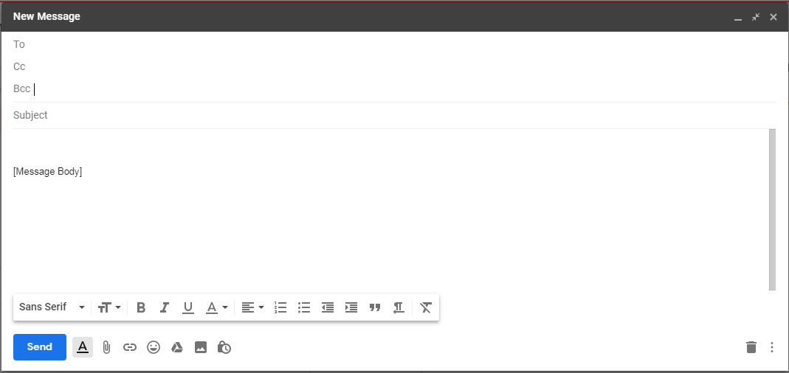
Main Parts of an Email

Slide 6
Sender and Receiver
Sender: The person who writes the email.
Receiver: The person(s) that receive(s) the email.
You can place the email of the receiver(s) in 3 boxes, labeled as:
  To: Here you place the email(s) of the main receiver(s), who is/are the main target of the email, and who is/are concerned of the email topic.
  CC: Here you place the email(s) of the receiver(s) that are interested in the topic of the email, but are not the direct target of it.
  For example: If you are a team leader, you send an email To a member to perform a certain task, but CC the other members for their information.
  BCC: A hidden copy of the email that you might need to interested to certain person(s) while hiding their email addresses.

Slide 7
Sender and Receiver
Important Note:
  Make sure that you write the right email addresses in the Receiver parts.
  An email sent to a the wrong email address may cost you your job.

Slide 8
The Subject
  The email subject is an essential part of your email. If you leave it empty, most email systems will give warning about it.
  Why Subject is important?
    The subject of an email, is the first thing a receiver reads in an email. And according to the subject, he/she decides to read the email now, later, or maybe never.

Slide 9
How to write an appealing Subject?
    The subject should relate to the email body and be something that would convince the receiver to open the email.
    Make it short, clear and stick to the point. (Keep your subject line 5 words or less.)
    It is OK to have “Re:” or “Fwd:” in the Subject line, to show that you are replying to the original sender, or forwarding a previously received email.
    It is ok to add numbers, to be more clear (e.g. 2-day vacation, 50Jds Payback, …etc.)
    Write the subject line using the “Title Case”, i.e. every word in the subject starts with capital letter.

Slide 10
Subject Line: Don’t…
Don’t use “Re:” or “Fwd:” if it is your first email to the receivers.
Don’t write the subject as a question.
Don’t use exclamation mark.
Don’t use greetings (i.e. Hi, Hey, Hello, …etc.)

Slide 11
Email Body
The Email body, is the letter you are concerned to send to receiver.
In formal emails, it is better to write briefly unless you need to outline details.
Email Body consists of three main parts:
  Salutation (greeting and addressing the receiver)
  Body Paragraphs
  Closing and signature

Slide 12
Email Body – Salutation (Greeting)
If you don’t know who you are writing the email to, you can start your email with:
  To Whom it May Concern
  Dear Sir/Ms.
  If you know the name of the person, start with:
    Dear Mr. Smith -- if he is a man
    Dear Ms. Smith – if she is woman
  Notes:
    Use the last name of the receiver, not the first (Regarding the countries that use the last name in corresponding)
    Don’t start the greetings with “Hi”, “Hello” or “Hey”

Slide 13
Email Body – Paragraphs
Try to make them short and concise.
Start with an opening statement, such as:
  I hope my email finds you will
  I hope all is well with you
  Thank you for your prompt respond
  Thank you for accepting my application, …etc

Slide 14
Email Body – Paragraphs
  Depending on the subject, you should have a maximum of four paragraphs and each paragraph should contain a single point.
  It is important to provide questions in order to prompt response.
  Again, make it clear and concise.

Slide 15
Email Body – Paragraphs
After the last paragraph close with a thank you line, or an action that you are expecting.
For example:
  Thank you for your cooperation
  Thank you for your assistance with…
  Thank you for your time and I look forward to hearing back from you.
  Please feel free to call or email me if you have any questions.
  Your prompt response is highly appreciated.
  I would appreciate it if this could be taken care of promptly.

Slide 16
Email Body – Closing
Close with:
  Thank you
  Best Regards
  Sincerely
  Yours
Add your signature (this can be added automatically)
  Then your full name
  It is useful sometimes to add your job position (if applicable), and phone number.

Slide 17

Tips for writing an email
Do not use contractions:
  For example: don’t, haven’t, I’m, isn’t.
  Instead use: do not, have not, I am, is not, …etc
Do not write in all capital letters.
  For example: Please reply SOON!
  But, you can use them for abbreviations, such as, KSA, JU, …etc.
Use formal vocabulary, do not use slang.
Proofread your email.
  Check that you do not have spelling or grammatical mistakes.
  Read your email at lease twice, and take second opinion if possible.
Use polite language, even if you are sending a complaint.

Slide 18
Writing a Cover Letter
A Cover letter: is a single-page letter that should be part of any job application.
If you are handing a hardcopy of the CV, this page will be the first one.
If you are handing a softcopy, usually a cover letter is written in the email body, where you are attaching your CV.
In this letter you give a quick presentation about yourself, to attract an employer to read your CV.

Slide 19
Writing a Cover Letter
Take into considerations:
  The cover letter is a formal letter, so all previous tips count.
  The purpose of this letter is to:
    Introduce you.
    Mention the job you are applying for.
    Match your skills and expertise with the ones requested for the job.
    Finish with a call of action (for example: requesting an interview, or asking to meet).

Slide 20

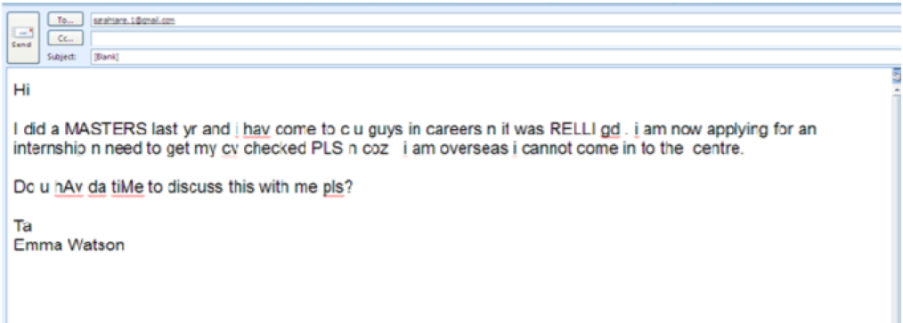
Example of a poor communication, Why?

Slide 21

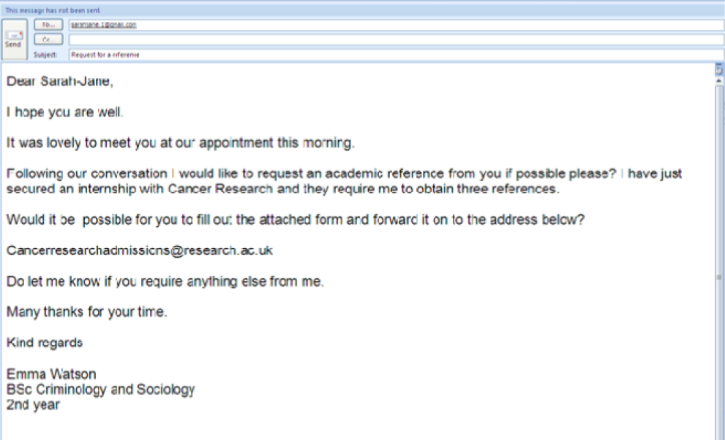
Example of a good communication

Slide 22

Exercise
Write a formal email:
  To your teacher saying that you have questions about the course and that you need to set an appointment with him/her to discuss this issue.
  To your boss, declaring that you have accomplished the task requested from you, and asking for his/her feedback.

Slide 23

Any Questions?

Slide 24
References
https://englishlive.ef.com/blog/career-english/write-perfect-professional-email-english-5-steps/
https://www.yesware.com/blog/how-to-write-a-professional-email/
https://www.city.ac.uk/__data/assets/pdf_file/0003/234354/Writing-Professional-Emails.pdf
https://www.menlo.edu/wp-content/uploads/2015/03/writing-a-formal-email.pdf
https://www.youthcentral.vic.gov.au/jobs-and-careers/applying-for-a-job/what-is-a-cover-letter/how-to-write-a-cover-letter

