Slide 1
Deanship of Development and Distance Learning
Training Course
Computer Skills - For Administrative Members
Sara Shaker Al-Aqra Montaser Mustafa Dana’a
First Level - ST 1801

Slide 2
Course Topics
Microsoft Word 2010 :
Tables.
Bookmark.
Hyperlinks.
Microsoft Excel 2010 :
Functions.
Logical Functions.
Microsoft Power Point 2010 :
Windows 7 :
Files or folders encryption.
Firewall.
Disable or Enable Network Adapter in Windows 7.
Search the files.
Network printer sharing.
E-Mail :

Slide 3
Microsoft Word 2010
Tables الجداول

Slide 4
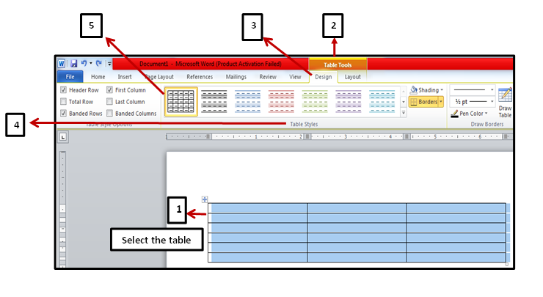
Tables الجداول
Table styles:أنماط الجدول
(1) Select the Table → (2) Table tools → (3) Design tab → (4) Table styles group → (5) Select the style you want to apply.

Slide 5
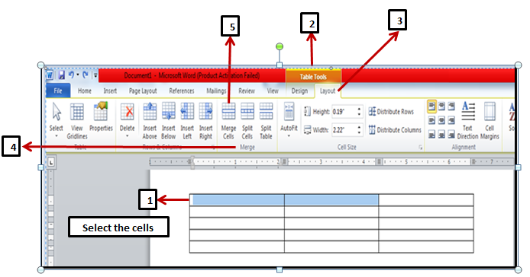
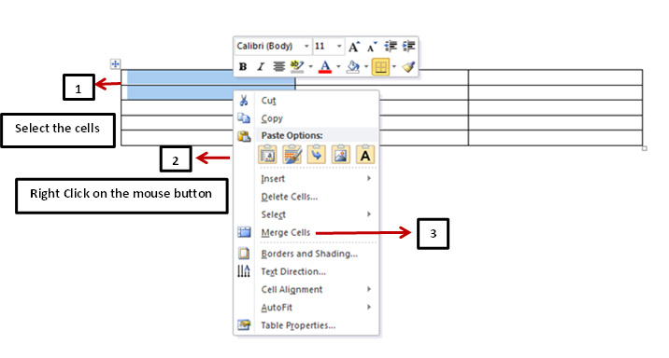
Merging cells within a table:دمج الخلايا داخل الجدول
(1) Select the cells you want to merge → (2) Table Tools → (3) Layout tab → (4) Merge group → (5) Merge Cells.
Or
(1) Select the cells you want to merge → (2) Click on the right button of the mouse→ (3) Merge Cells.
Or
Click on the right button of the mouse

Slide 6
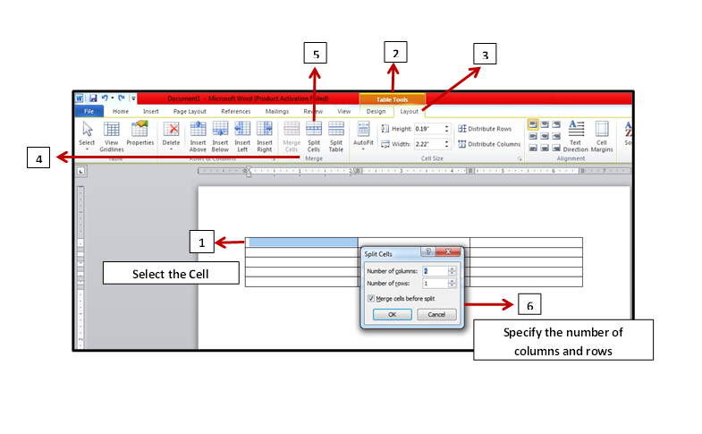
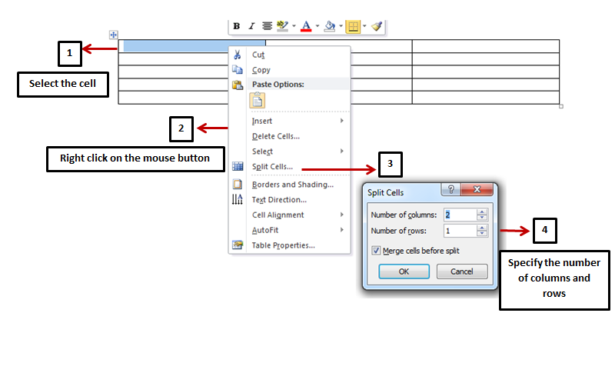
Splitting cells within a table:تقسيم الخلايا داخل الجدول
(1) Select the cell you want to split → (2) Table Tools → (3) Layout tab → (4) Merge group → (5) Split Cells → (6) Specify the number of columns and rows.
Or
(1) Select the cell you want to split → (2) Click on the right button of the mouse → (3) Split Cells → (4) Specify the number of columns and rows.
Click on the right button of the mouse
Or

Slide 7
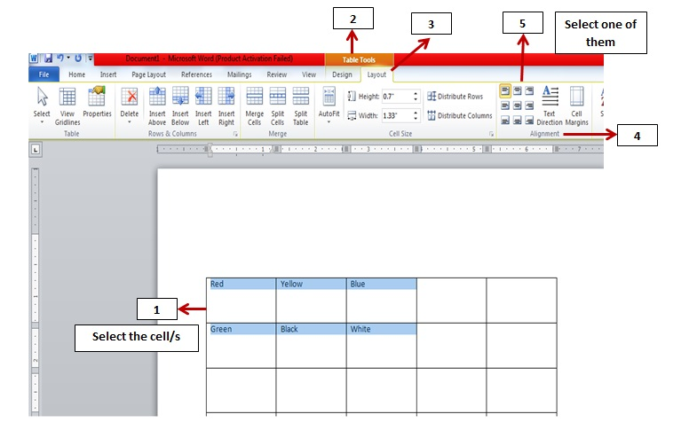
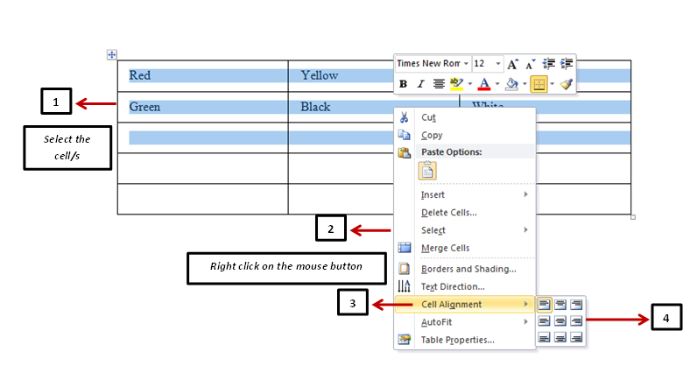
Modifying cell alignment:تعديل محاذاة الخلية
Select the cell/s you want to align → (2) Table Tools → (3) Layout tab → (4) Alignment group → (5) Select one of them.
Or
(1) Select the cell/s you want to align → (2) Click on the right button of the mouse → (3) Cell Alignment → (4) Select one of them.
Or
Click on the right button of the mouse

Slide 8
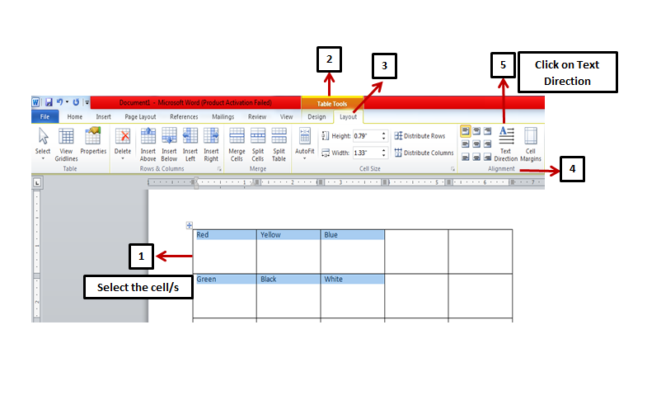
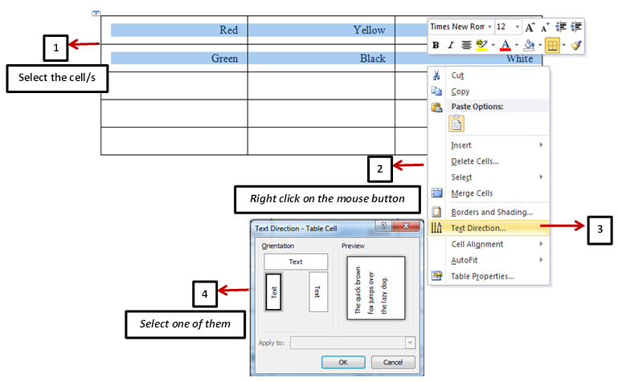
Changing cell text direction :تغيير إتجاه نص الخلية
Select the cell/s you want to change → (2) Table Tools → (3) Layout tab → (4) Alignment group → (5) Click on Text direction.
Or
(1) Select the cell/s you want to change→ (2) Click on the right button of the mouse → (3) Text Direction → (4) Select one of them.
Or
Click on the right button of the mouse

Slide 9
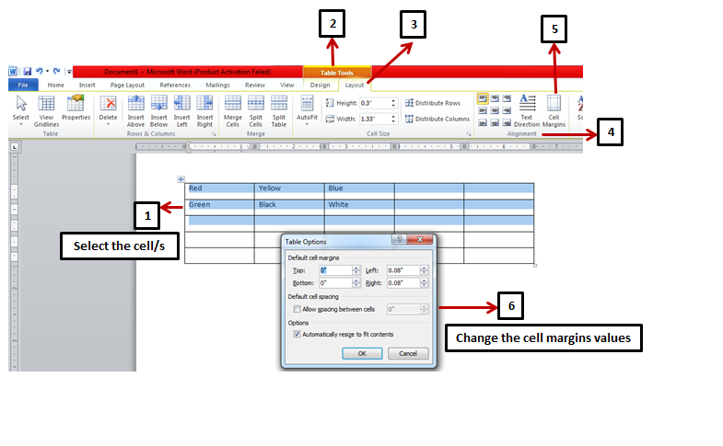
Modifying cell margins :تعديل هوامش الخلية
(1) Select the cell/s → (2) Table Tools → (3) Layout tab → (4) Alignment group → (5) Cell margins → (6) Change the cell margins values.

Slide 10
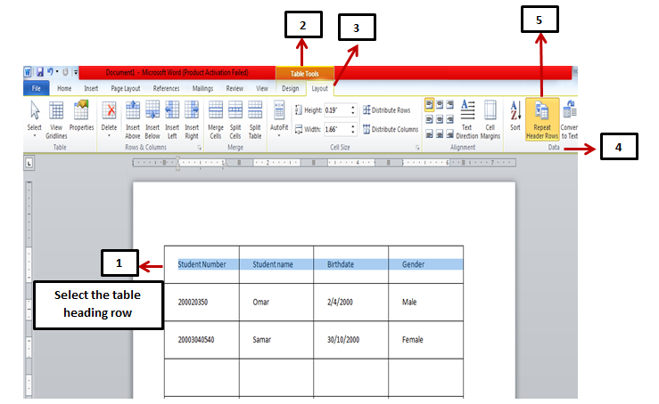
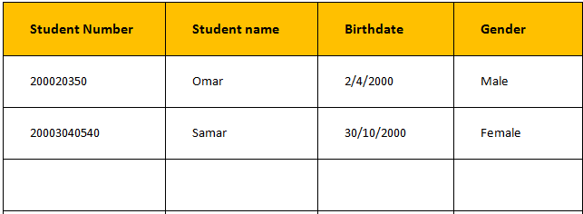
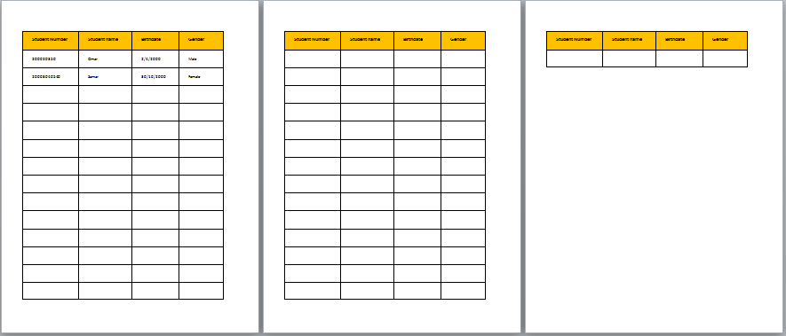
Repeating the table heading row for multi - page tables :تكرار رأس الجدول للجداول متعددة الصفحات
(1) Select the table heading row (the first row) → (2) Table Tools → (3) Layout tab → (4) Data group → (5) Repeat header rows.

Slide 11
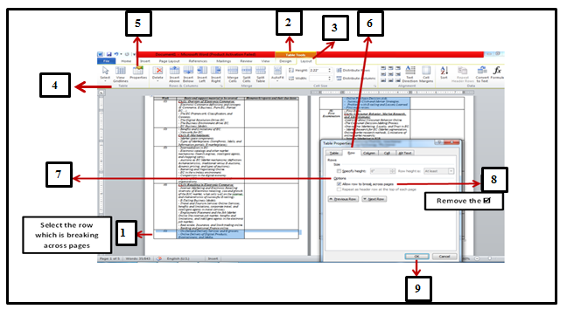
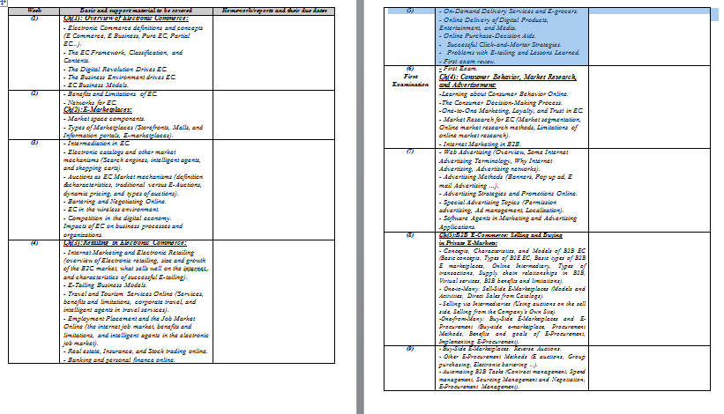
Controlling row breaking across pages :التحكم في تقسيم الصف عبر الصفحات
(1) Select the row which is breaking across pages →(2) Table Tools → (3) Layout tab → (4) Table group → (5) Properties → (6) Row tab → (7) Options → (8) Remove the sign from the check box (Allow row to break across pages) → (9) Ok.

Slide 12
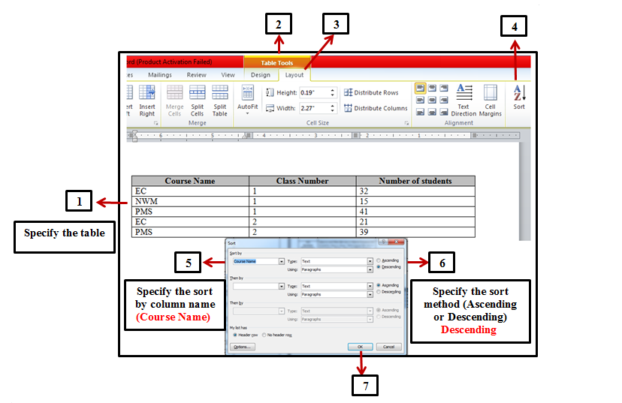
Performing a single column sort :فرز بيانات الجدول إعتمادًا على بيانات عامود واحد
(1) Specify the table which you want to sort → (2) Table Tools → (3) Layout tab → (4) Sort → (5) Specify the column name (ex. Course Name) in (Sort by) option → (6) Specify the sort method (Ascending or Descending) → (7) Ok.

Slide 13
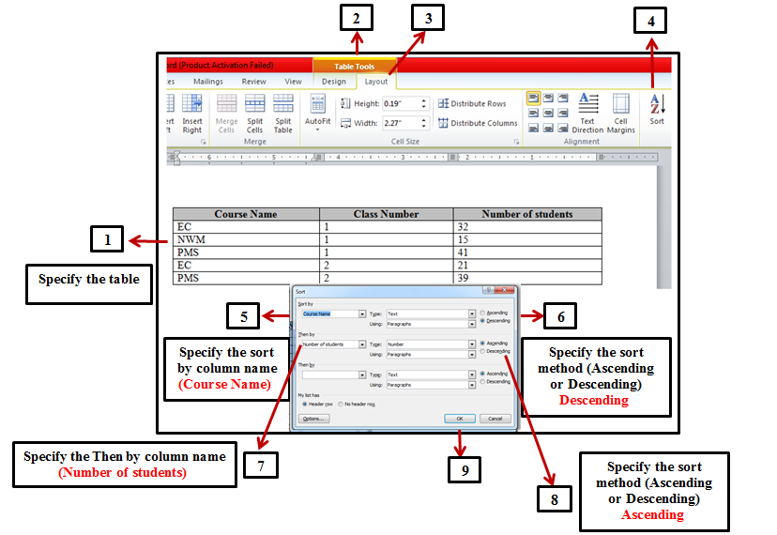
Multilevel sorting : فرز بيانات الجدول إعتمادًا على بيانات أعمدة متعددة (مختلفة)
(1) Specify the table which you want to sort → (2) Table Tools → (3) Layout tab → (4) Sort → (5) Specify the column name (ex. Course Name) in (Sort by) option → (6) Specify the sort method (Ascending or Descending) → (7) Specify the other column (ex. Number of students) in (Then by) option → (8) Specify the sort method (Ascending or Descending) → (9) Ok.

Slide 14
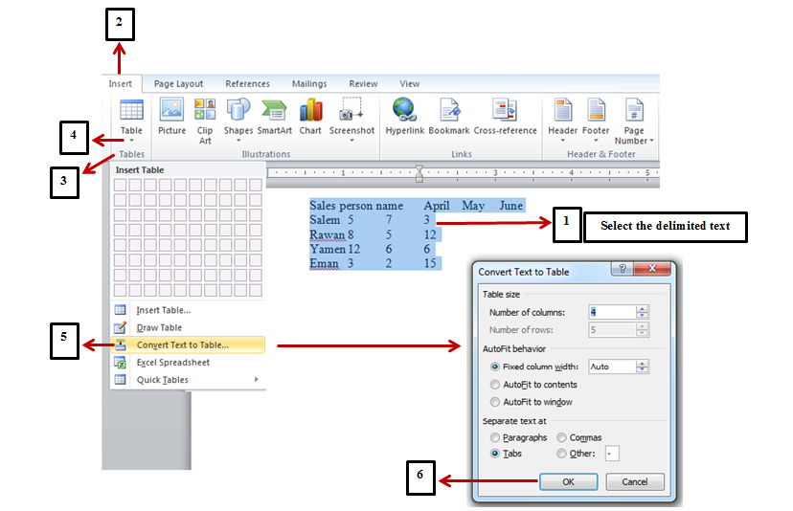
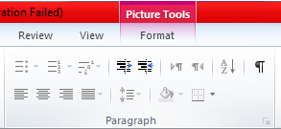
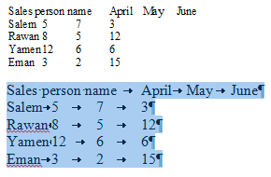
Converting delimited text to a table :تحويل نص محدد إلى جدول
(1) Specify the delimited text → (2) Insert tab → (3) Tables group → (4) Table→ (5) Convert text to table → (6) Ok.
Note:
Delimited Text

Slide 15
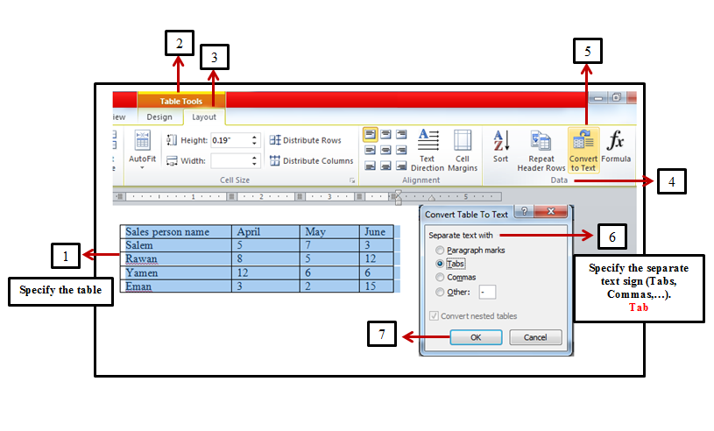
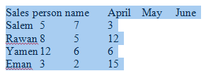
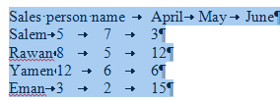
Converting a table to text :تحويل جدول إلى نص
(1) Specify the table → (2) Table Tools → (3) Layout tab → (4) Data group → (5) Convert to text →(6) Specify the separate text sign (Tabs, Commas, …) → (7) Ok.

Slide 16
Microsoft Word 2010
Hyperlinks الإرتباطات التشعبية

Slide 17
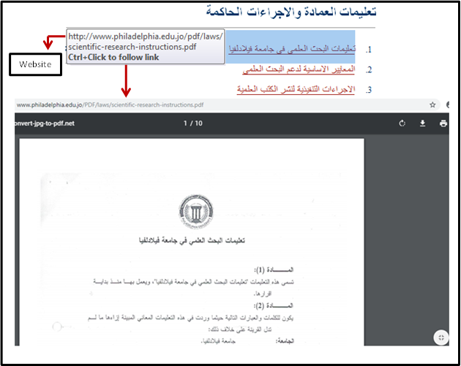
Hyperlinksالإرتباطات التشعبية
How to create a hyperlink: طريقة إنشاء إرتباط تشعبي
With a Bookmark: مع مرجعية توضيحية للنص
With a Website: مع موقع إلكتروني
A
B

Slide 18
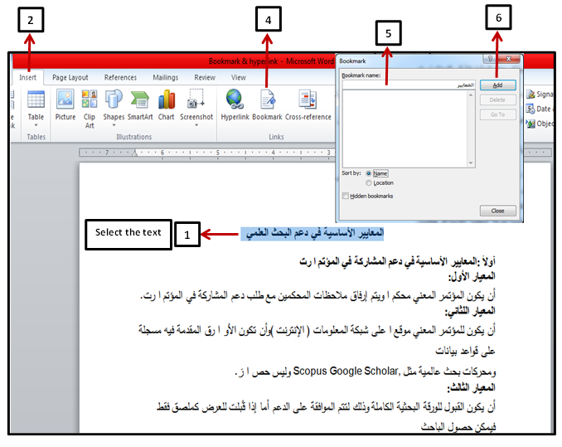
Bookmark مرجعية توضيحية للنص
How to create a Bookmark :طريقة بناء مرجعية توضيحية للنص
(1) Select the text that you want to use as a bookmark → (2) Insert tab → (3) Links group → (4) Bookmark → (5) Enter the Bookmark name (ex. المعايير ) → (6) Add.

Slide 19
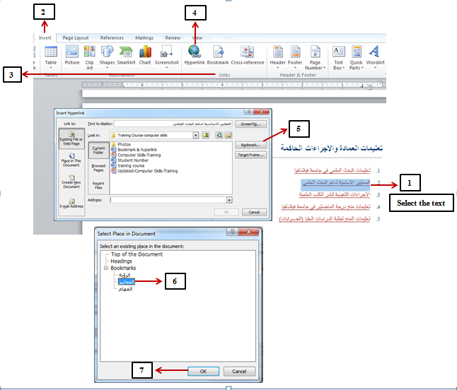
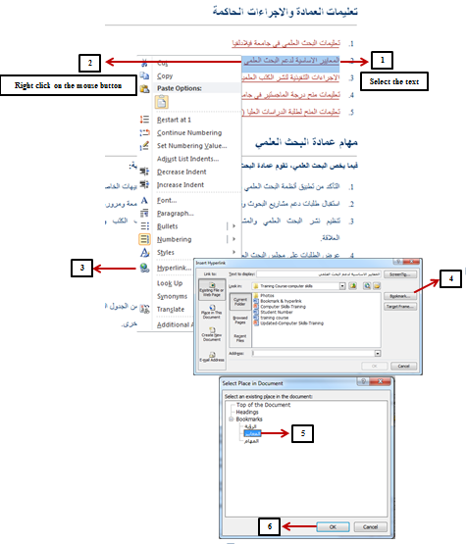
Link with a Bookmark :طريقة الربط مع مرجعية توضيحية للنص
Select the text that you want to link → (2) Insert tab → (3) Links group → (4) Hyperlink → (5) Bookmark → (6) Select the Bookmark (ex. المعايير ) → (7) Ok.
Or
(1) Select the text that you want to link → (2) Click on the right button of the mouse → (3) Hyperlink → (4) Bookmark → (5) Select the Bookmark (ex. المعايير ) → (6) Ok.
Click on the right button of the mouse
Or

Slide 20
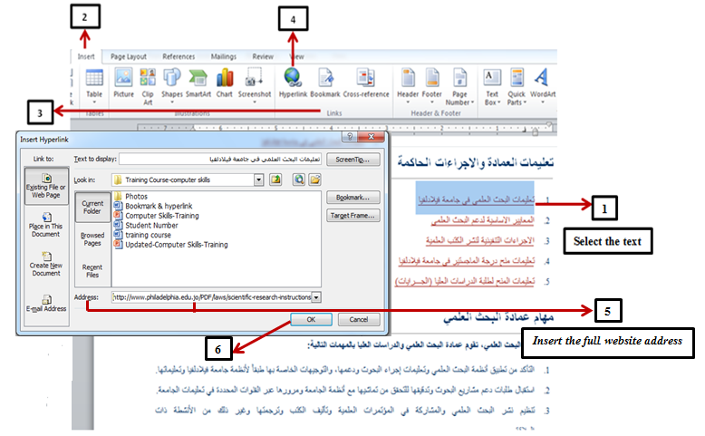
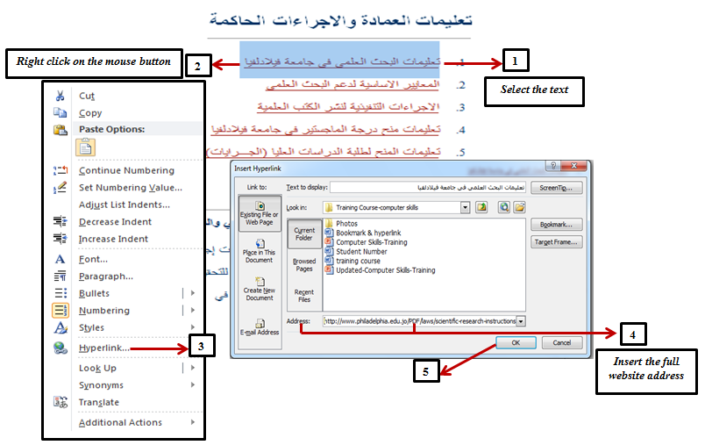
Link with a Website :طريقة الربط مع الموقع الإلكتروني
Select the text that you want to link → (2) Insert tab → (3) Links group → (4) Hyperlink → (5) Insert the Full website address(URL) in the address field→ (6) Ok.
Or
(1) Select the text that you want to link → (2) Click on the right button of the mouse → (3) Hyperlink → (4) Insert the website address(URL) in the address field→ (5) Ok.
Click on the right button of the mouse
Or

Slide 21
Microsoft Excel 2010
Functions الدوال

Slide 22
Functions الدوال
تعريف الدالة: عبارة عن صيغة مجهزة مسبقًا تستخدم في أداء مختلف العمليات الحسابية وذلك من خلال إستخدام قيم معينة يُطلق عليها معاملات (Arguments) يمكن أن تكون نصوصًا أو أرقامًا مرتبة بنظام معين.
Date and time functions: دوال الوقت والتاريخ
The Date function (TODAY).
The Date and time function (NOW).
The Day function (DAY).
The Month function (MONTH).
The Year function (YEAR).
Text functions: الدوال النصية
PROPER.
UPPER.
LOWER.
LEFT.
RIGHT.
MID.
TRIM.
Math and Trig functions: دوال الرياضيات والمثلثات
SUMIF.
ROUND.
ROUND UP & ROUND DOWN.
Lookup functions: دوال البحث
HLOOKUP.
VLOOKUP.
Statistical functions: الدوال الإحصائية
COUNT.
COUNTBLANK.
COUNTA.
COUNTIF.
RANK.
Variance (VAR).
Standard deviation (STDEV).
MEDIAN.
Database functions: دوال قواعد البيانات
DSUM.
DMIN.
DMAX.
DCOUNT.
Logical functions: الدوال المنطقية
IF.
AND.
OR.
Other functions: دوال أخرى

Slide 23
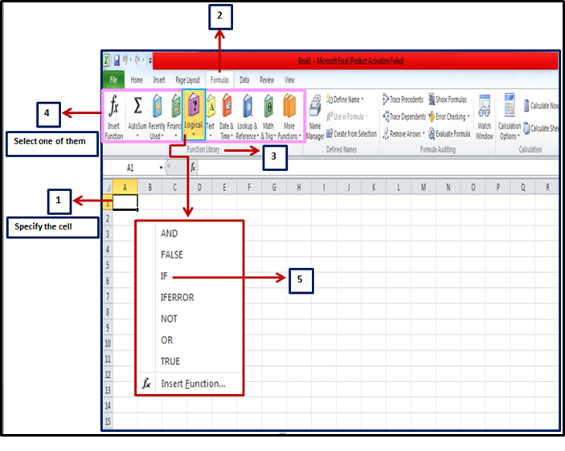
How to reach functions:طريقة الوصول للدوال
(1) Specify the cell that you want to appear the result in it → (2) Formulas tab → (3) Function library group → (4) select one of the function categories (ex. Logical) → (5) Select the function that you want to apply (ex. IF).

Slide 24
Logical functions:الدوال المنطقية (تُستخدم لإختبار شرط ما، حيث النتيجة صح أو خطأ)
IF Function:
IF function checks a condition that must be either true or false.
IF function conditions:
Condition name | Condition symbol
Equals يساوي | =
Less than أقل من | <
Greater than أكبر من | >
Not equal to لا يساوي | <>
Less than or equal toأقل من أو يساوي | <=
Greater than or equal toأكبر من أو يساوي | >=

Slide 25
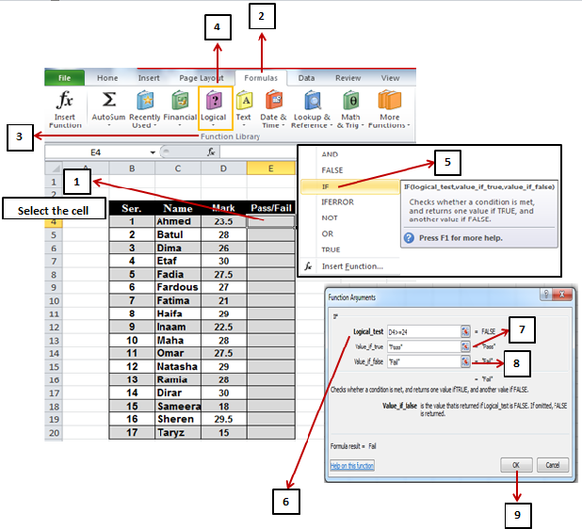
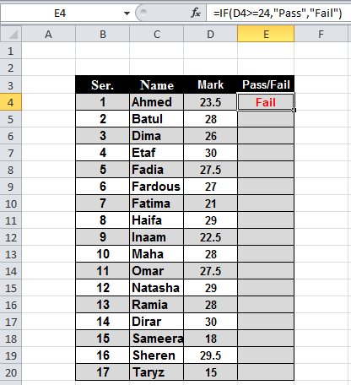
Example:
Use the IF function to type (Pass) for students who get the grade 24 or more, and to type (Fail) for students who got less than 24.
Solution :
(1) Select the cell that you want to appear the result in it → (2) Formulas tab → (3) Function library group → (4) select one of the function categories (Logical) → (5) Select the function that you want to apply (ex. IF) → (6) In the Logical_test field write the condition (ex. D4>=24) →(7) In the Value_if_true field write the result (ex. Pass) →(8) In the Value_if_false field write the result (ex. Fail) →(9) Ok .

Slide 26
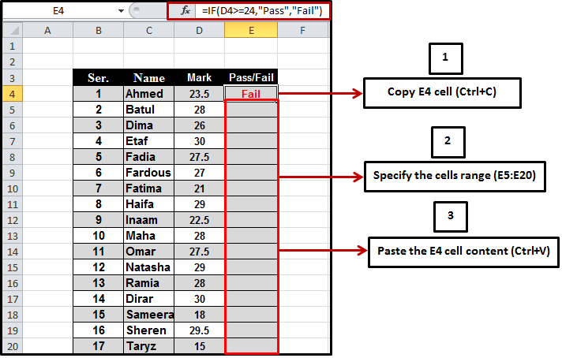
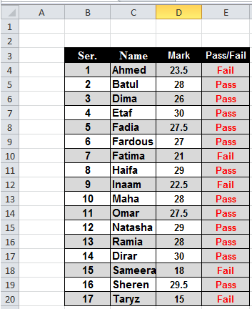
Note:ملاحظة هامة
You can copy the cell E4 content, and paste it in the cells range (E5:E20), to appear the results of all students (Pass or Fail).

Slide 27
AND Function:تستخدم هذه الدالة دائمًا داخل معادلة أخرى
AND function: yields TRUE when all the arguments are true. When one or more arguments are false, it yields FALSE.
True and True → True.
True and False → False.
False and False→ False.
Example:
Use the IF function to type (Passed) for students who got the grade 50 or more in the 1st exam and in the 2nd exam, otherwise type (Not passed).
Solution :
(1) Select the cell that you want to appear the result in it → (2) Formulas tab → (3) Function library group → (4) select one of the function categories (Logical) → (5) Select the function that you want to apply (ex. IF) → (6) In the Logical_test field write the condition (ex. AND(B5>=50,C5>=50)) →(7) In the Value_if_true field write the result (ex. Passed) →(8) In the Value_if_false field write the result (ex. Not passed) →(9) Ok .

Slide 28
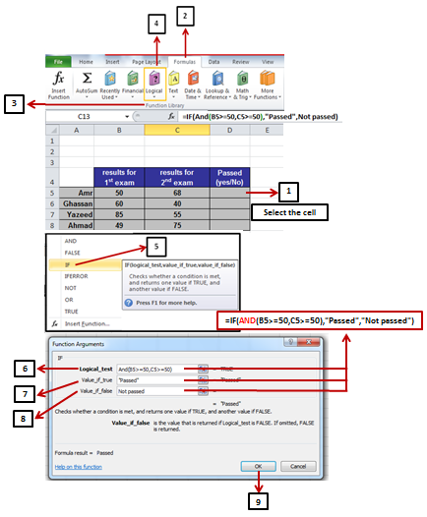
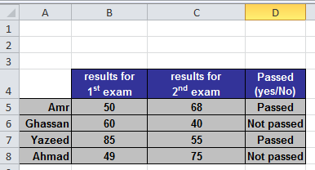

Slide 29
OR Function:تستخدم هذه الدالة دائمًا داخل معادلة أخرى
OR function: yields TRUE when any of the arguments is true. When all arguments are false, it yields FALSE.
True or True → True.
True or False → True.
False or False→ False.
Example:
Use the IF function to type (Passed) for students who got the grade 50 or more in the 1st exam or in the 2nd exam, otherwise type (Not passed).
Solution :
(1) Select the cell that you want to appear the result in it → (2) Formulas tab → (3) Function library group → (4) select one of the function categories (Logical) → (5) Select the function that you want to apply (ex. IF) → (6) In the Logical_test field write the condition (ex. OR (B3>=50,C3>=50)) →(7) In the Value_if_true field write the result (ex. Passed) →(8) In the Value_if_false field write the result (ex. Not passed) →(9) Ok .

Slide 30
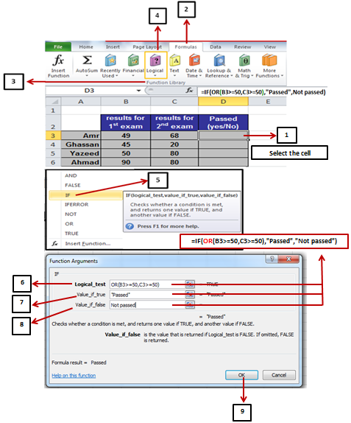

Slide 31
Microsoft PowerPoint 2010

Slide 32
Windows7
Files or folders encryption تشفير الملفات أو المجلدات

Slide 33
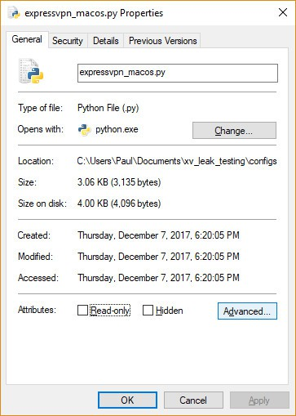
Files or folders encryption تشفير الملفات أو المجلدات
How to encrypt files or folders in Windows 10, 8, or 7:طريقة تشفير الملفات أوالمجلدات
In Windows Explorer, right-click on the file or folder you wish to encrypt.
From the context-menu, select Properties.
Click on the Advanced button at the bottom of the dialogue box.

Slide 34
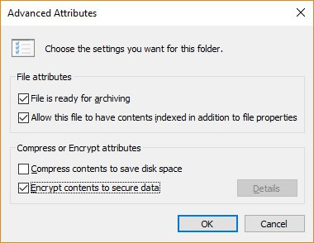
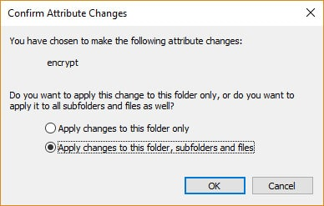
In the Advanced Attributes dialogue box, under Compress or Encrypt Attributes, check Encrypt contents to secure data.
Click OK.
Click Apply.
If you selected a folder to encrypt, a Confirm Attribute Change dialogue box will be displayed asking if you want to encrypt everything in the folder. Select Apply change to this folder only or Apply changes to this folder, subfolders and files, and click OK.

Slide 35
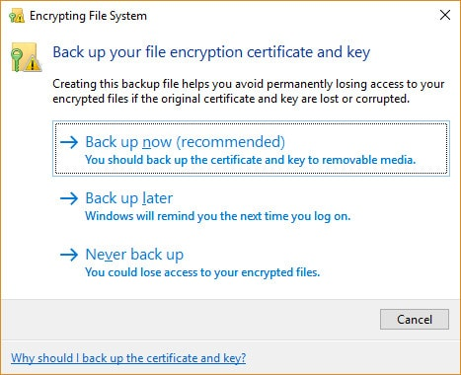
Click on the Back up your file encryption key pop-up message. If the message disappears before you can click it, you can find it in the Notification Area for your OS.
Ensure you have a USB flash drive plugged into your PC.
Click Back up now (recommended).
Click Next to continue.
Click Next to create your certificate.

Slide 36
Windows7
Firewall الجدار الناري

Slide 37
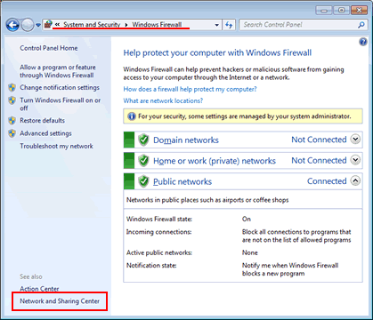
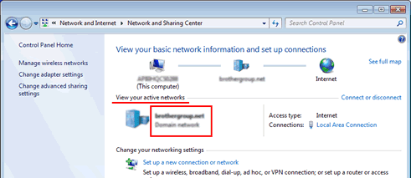
Firewall الجدار الناري
Windows Firewall:
Click the Start => Control Panel => System and Security => Windows Firewall => Network and Sharing Center.
Check your network location which is shown in the View your active networks section.

Slide 38
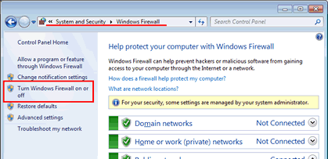
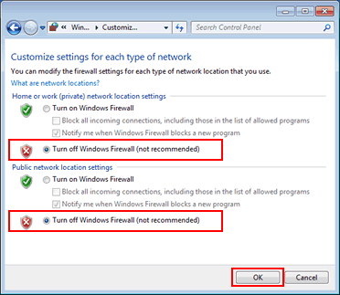
Disable the Firewall settings: تعطيل إعدادات الجدار الناري
Click the Start button => Control Panel => System and Security => Windows Firewall => Turn Windows Firewall on or off.
Choose Turn off Windows Firewall (not recommended) for your network location, and click OK.

Slide 39
Windows7
Disable or Enable Network Adapter in Windows 7
تعطيل أو تشغيل محول الشبكة في ويندوز 7

Slide 40
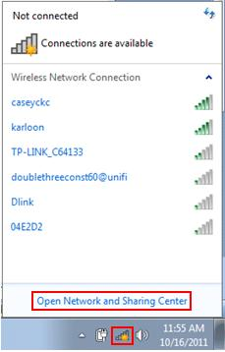
Disable or Enable Network Adapter in Windows 7
تعطيل أو تشغيل محول الشبكة في ويندوز7
How to Disable or Enable Network Adapter in Windows 7:
طريقة تعطيل أو تشغيل محول الشبكة في ويندوز7
- Disable and re-enable network adapter can be used to reconnect your computer to network sometimes if suddenly it fails connecting to network. This approach especially works on wireless adapter if it fails to detect any available wireless network initially.
- Enable the network adapter (wireless or wired) in order to connect that adapter to the network if it’s in disable mode.
- Disable unused network adapter if there are different network adapters (wireless or wired) installed on your computer or laptop.

Slide 41
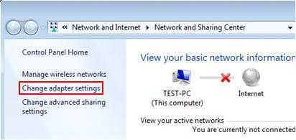
Let’s explore how to disable and enable network adapter here:
Locate the network icon which is located at lower right corner as shown below, click on it and proceed to click Open Network and Sharing Center.
Note: You can also open this Network and Sharing Center by clicking on Start -> Control Panel -> View network status and tasks.
Once Network and Sharing Center windows is opened, click on Change adapter settings.
Here you will be able to locate wired or wireless network adapters available on your computer, you can go ahead to right click the adapter icon to enable or disable it. That’s it and you're done!

Slide 42
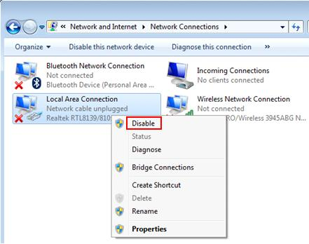
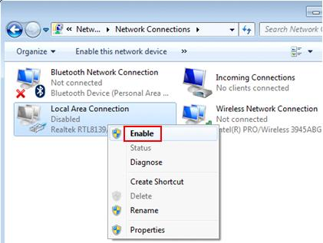
Example 1: Let say if you wish to connect your computer to wireless network only, and so you can right click your wired network adapter (Local Area Connection) and click on Disable to disable it since you are not going to use it.
Example 2: If you need to connect your computer to network with wired connection later, come back to this network adapter window, right click your wired network adapter (Local Area Connection) again and click on Enable to enable it. You might also notice that Disabled wording is tied to the adapter if it’s in disable mode.

Slide 43
Windows7
Search the files البحث عن الملفات

Slide 44
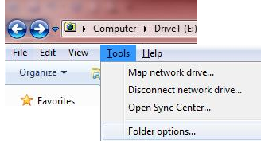
Search the files البحث عن الملفات
How to search the files in windows7: طريقة البحث عن الملفات في ويندوز7
Open Windows Explorer and click on the Alt key to display the Explorer menu tab.
Click on Tools and select Folder Options.
On the Folder Options Windows click on the Search tab.
Enable Search File Content by selecting Always search file names and contents (this might take several minutes).

Slide 45
Windows7
Network printer sharing مشاركة طابعة معرفة على الشبكة

Slide 46
Network printer sharing مشاركة طابعة معرفة على الشبكة
How to share a network printer: طريقة مشاركة طابعة معرفة على الشبكة
If you only have one printer and two Windows 7 computers, you’ll want to be able to share it. Here’s how to share a printer between two Windows 7 systems.
In this example, a Cannon MP495 series printer is connected to a PC running Windows 7 in a home office upstairs. The other machine is downstairs in another room.
First start with the computer the printer is connected to.
Make sure it’s installed correctly with the latest drivers.
Then click Start >> Devices and Printers.

Slide 47
Next, right-click on the printer you want to share and select Printer Properties.
Click the Sharing tab. Make sure Share this Printer is checked and give it an easy to remember share name.
Click OK.

Slide 48
The computer the printer is attached to will need to be powered on to find and print to it.
Now go to the other computer you want to print from.
Click Start >> Devices and Printers.
Click Add a Printer.

Slide 49
Next, click Add a Network, Wireless or Bluetooth Printer.
The system will search your network for the shared printer. When it finds the printer, highlight it and click Next.

Slide 50
When Success, click Next.
Back in Devices and Printers, you’ll find the printer listed. Send a test page to the printer to verify it’s working.

Slide 51
If Windows doesn’t automatically find the printer, click The Printer That I Want Isn’t Listed.
Check Select a Shared Printer by Name and type the path in directly.

Slide 52
Or click Browse to find the printer and select it.
After the shared printer has been added to your system, right-click on the icon and set it as the default printer.

Slide 53
Note:
Each printer is different and having the latest drivers is key. Especially when sharing between Windows 7 64 & 32-bit systems.
If you can’t get sharing to work, here’s troubleshooting steps to take:
Verify the computer the printer is connected to is powered on.
Verify the USB cable is connected properly. Reseat the cable and verify the printer is recognized by Windows.
Verify the printer is shared, with the correct share name.
Make sure both computers are hardwired into your network, if one is on WiFi – it can cause connection problems.
Make sure you have the latest drivers installed for the printer on each machine.
If you have any additional tips to share, leave a comment and let us know.

Slide 54
E-mail البريد الإلكتروني

